Slide 1
Foramen ovale
__________________________________: “oval door”
present in _
connects the ________________________ and allows blood entering the right heart to bypass the pulmonary circuit

Slide 2
Ductus arteriosus
____________________________________ between the _.
Shortly after birth, it closes, separating right and left sides of the heart.

Slide 3
Congenital Heart Defects
__________________________ductus arteriosus...in which the connection between the aorta and pulmonary trunk _
A patent ductus arteriosus allows _
children become cyanotic after physical exertion.

Slide 4
Heart Sounds
“lubb dubb” sounds are from the contraction and relaxation of heart tissues and the _

Slide 5
Heart Sounds
Lubb:
first sound
Ventricular contraction: _
________________________________________________due to the ventricular pressure
Dubb:
second sound.
ventricular relaxation: _
________________________________________________ valves closing.

Slide 6
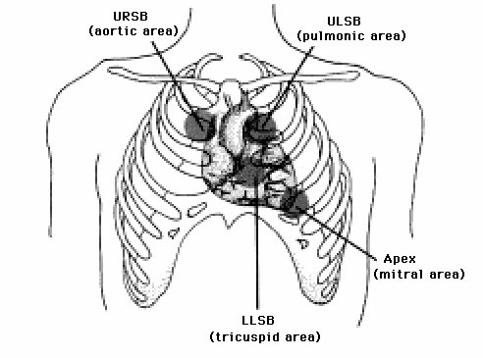
Heart Sounds
Auscultation:
2nd ICS at R sternal margin
Pulmonary Valve
2nd ICS at L sternal margin
5th ICS at R sternal margin
Mitral Valve
5th ICS, midclavicular line
PMI

Slide 7
Cardiac Fibers
_________________________________ = SA node.
specialized ___________________________________ beneath the epicardium.
Located in _
Fibers are continuous with those of the atrial syncytium.

Slide 8
Cardiac Fibers
SA node can reach threshold on their own,
membranes _
Need no outside stimulation.
initiates impulses that spread to the myocardium and stimulate the muscles to contract.

Slide 9
SA Node
SA node activity is _
Generates impulses 75 – 100 times a minute on its own.
Tempered by the _
Slows rate to 60 to 80 bpm
Called the Pacemaker.

Slide 10
SA node
From SA node into the __________________________________, the impulse goes from cell to cell via _
R and L atria contract almost simultaneously.

Slide 11
Cardiac Conduction
Before the impulses reach the ventricular syncytium, they are _________________________ by a group of tissues called the _
located in the __________________________________________________________________________ that separates that atria

Slide 12
Cardiac conduction
AV node provides the _____________________________________ between atrial and ventricular syncytia
Because of the AV node there is a time delay.
allows time for the atria to _____________________________________ before the coming ventricular contraction

Slide 13
Cardiac Conduction
The impulse reaches the far side of the AV node
it passes into a group of fibers called __________________________________________________________________________ and the impulse passes through them

Slide 14
Cardiac Conduction
Bundle of His divides into right and left branches .
gives rise to enlarged __________________________________ that carry the impulses ______________________ than the cell to cell contact could

Slide 15
Cardiac Conduction
Purkinje fibers
transmit the impulses _
allows the contraction to push the blood superiorly towards the aortic and pulmonary valves.
Allows the ventricular myocardium to contract __________________________________ rather than in a wave.

Slide 16
Intrinsic Cardiac Conduction
1.
2.
3. Atrioventricular bundle
Bundle of His
4. R/L bundle branches
5.

Slide 17
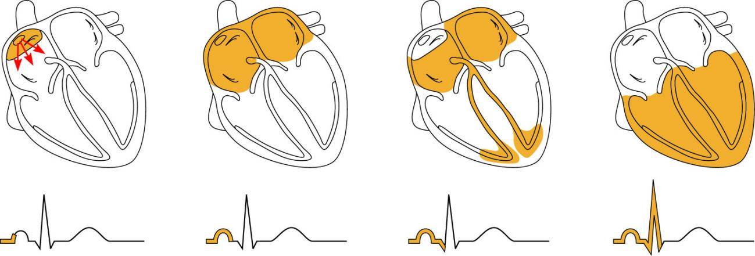
Heart Excitation Related to ECG
SA node generates impulse;
atrial excitation begins
Impulse delayed
at AV node
Impulse passes to
heart apex; ventricular
excitation begins
Ventricular excitation
complete
SA node
AV node
Bundle
branches
Purkinje
fibers
Figure 18.17

Slide 18
Conduction Defects
Uncoordinated atrial and ventricular contractions
Fibrillation
Rapid and _
SA node _
Defibrillation: electrical shock to the heart interrupts chaotic fibrillations and _

Slide 19
Cardiac Output
Stroke Volume
Volume of blood pumped out by _
Cardiac output (CO)
Amount of blood pumped out by each ventricle _
_________________________________________= Cardiac Output

Slide 20
EKG
____________________________________ occur in the myocardium during a cardiac cycle.
Body fluids _____________________________________ that can be detected on the surface of the body

Slide 21
EKG
Normal ECG has _
SA node triggers impulses, electrical change in atrium.
Produces a _
Corresponds to the __________________________________________________________________________ that will soon lead to the contraction of the atrium.

Slide 22
EKG
When the impulses reach the ventricular fibers, they _
Ventricle walls are thicker and the electrical charge is greater
Forms the _
Contains Q wave, R wave, and S wave.

Slide 23
EKG
ventricle muscles _

Slide 24
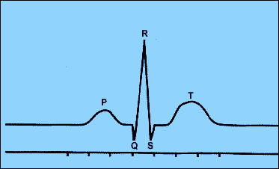
EKG
P:
QRS: repolarization of atria and overlapping depolarization of ventricles
T:

Slide 25
Regulation
Remember, the SA node on its own will cause the heart to beat at _
Tempered by Parasympathetic and Sympathetic systems

Slide 26
Extrinsic Regulation of the Cardiac Cycle
Parasympathetic fibers that innervate the heart arise from neurons in the medulla oblongata and make up parts of the _
These fibers branch into the SA and AV nodes. At nerve fiber endings, releases _

Slide 27
Regulation
Parasympathetic system can change heart rate in either direction.
_______________________________in the impulses →increases Acetylcholine →_
______________________________ in the impulse →decreases acetylcholine → _

Slide 28
Extrinsic Regulation
Resting heart rate is approximately 70 bpm due to the parasympathetic innervation from the _
The Vagus Nerve/Parasympathetic input slows the pacemaker cells

Slide 29
Extrinsic Regulation
Sympathetic System:
increases ____________________________________ of myocardial contractions.

Slide 30
Regulation
found _
Detects changes in blood pressure.

Slide 31
Regulation
Increase in pressure →stretches the receptors →signals the ___________________________________ →sends parasympathetic impulses to _______________________________the heart rate and force of contraction.
Helps to _____________________________________ towards normal

Slide 32
Regulation
Stretch receptors in _
when blood pressure increases →signals cardioaccelerators →
Sympathetic impulses → ________________________________________________________________________→
Venous pressure is reduced

Slide 33
Chemical Regulation
Hormones
From _
Short term, rapid increase in heart rate
Thyroxine
From _
Takes longer to act, but causes a _
Can lead to _______________________________________ heart in hyperthyroid conditions

Slide 34
Chemical regulation
Ion imbalances:
Depresses the heart
Increase heart irritability
Spastic heart contractions

Slide 35
Chemical regulation
Ion imbalances:
Feeble irregular heart beat
Interferes with depolarization
Can lead to cardiac arrest

Slide 36
Heart rate
Increased heart rate
Above _
Can be caused by
increased body temperatures
Heart disease

Slide 37
Heart Rate
Bradycardia
Decreased heart rate
Can be caused by
Drugs
Parasympathetic nervous system
Pathological if cardiac output falls
Indicative of brain edema following head trauma

Slide 38
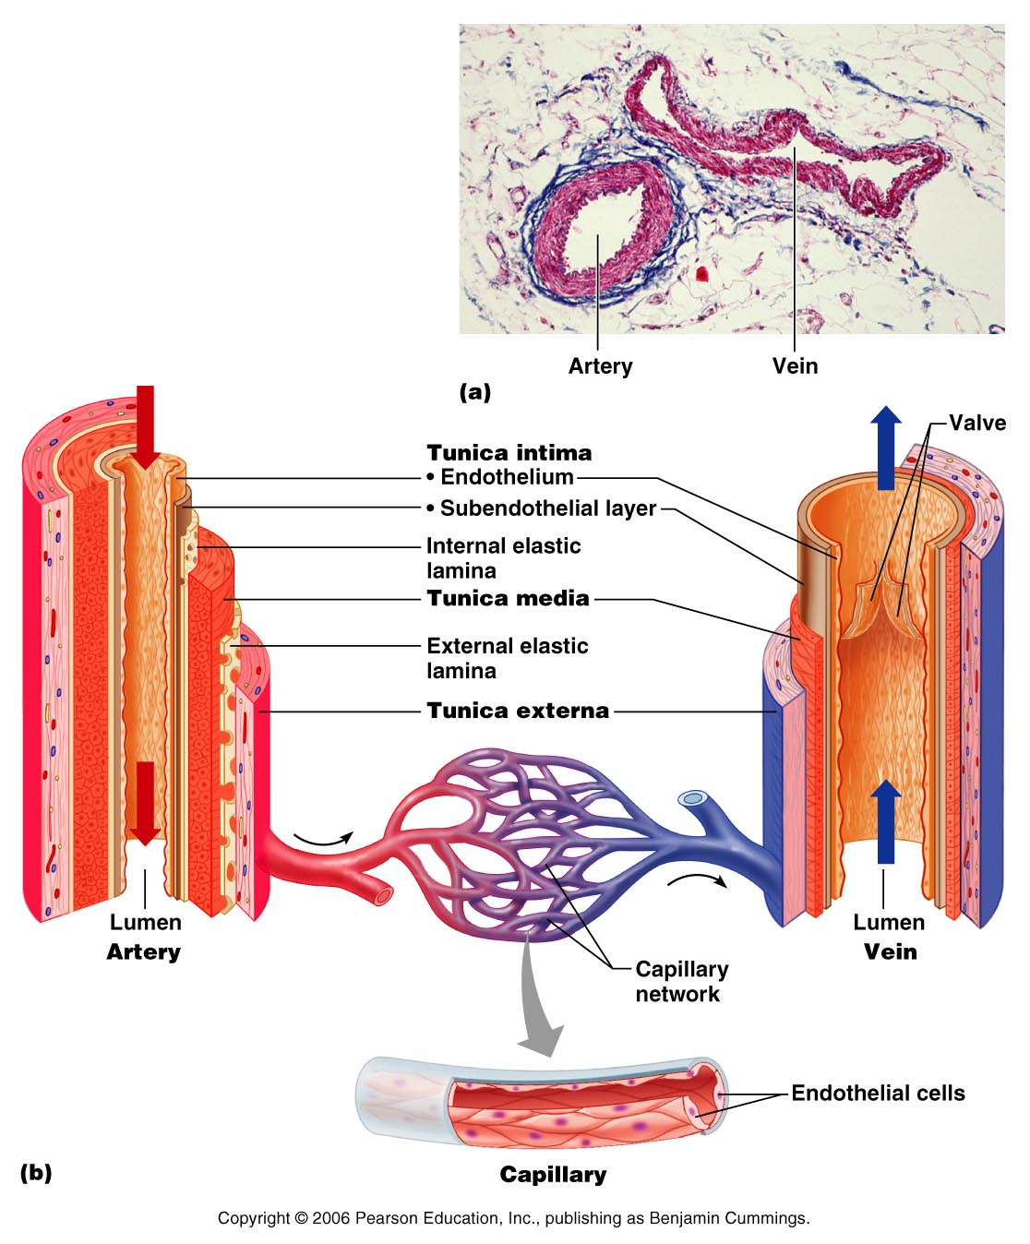
Blood Vessels

Slide 39
Arteries
strong _______________________________ vessels adapted to carry blood under _
Three layers or tunics
Tunica _
Tunica _
Tunica _

Slide 40
Arteries
Innermost: tunica interna/intima:
Separates the _
helps to _____________________________________ by secreting chemicals that inhibit platelet aggregation.
Provides a _

Slide 41
Arteries
Middle layer: _
bulk of arterial wall is _____________________________________ and thick layer of elastic connective tissue.
gives the vessels an _______________________________________ that helps it to stand up to the force of the blood pressure.

Slide 42
Arteries
Tunica Media
Activity of the smooth muscle is regulated by _
From _
Increased impulses allow vasoconstriction: _
Decreased impulses allow vasodilation: _

Slide 43
Arteries
Outer layer: tunica externa/adventitia:
thin connective tissue with _
_____________________________________ the artery to the surrounding tissues.

Slide 44
Types of Arteries
Elastic arteries
Arterioles

Slide 45
Elastic Arteries
Thick walled arteries _
A.k.a.
Contain a lot of _
Act as pressure reservoirs
Keeps blood flow continuous rather than stop/start

Slide 46
Muscular arteries
Also:
Tunica media contains ____________________________________ and less elastic tissue than elastic arteries
More active _

Slide 47
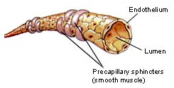
Arterioles
Larger arterioles have _
Small arterioles have _
These vessels will feed into the capillaries

Slide 48
Capillaries
Smallest blood vessels.
Connect the smallest arterioles and smallest venules.
Three types

Slide 49
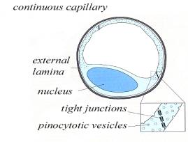
Capillaries
Continuous
Abundant in _
Endothelial cells provide a continuous lining joined together by tight junctions
Gaps in membranes called intercellular clefts
Allow passage of fluids and small solutes

Slide 50
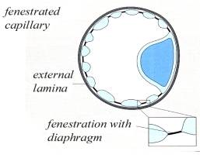
Capillaries
Fenestrated
Contains pores or openings _
More _
Located where _______________________________________ takes place
Small intestine
Kidneys
Endocrine glands like pituitary and thyroid

Slide 51
Capillaries
Sinusoid
Also called discontinuous capillaries
Found in
__________________________________________: associated with macrophages called Kupffer cells that destroy bacteria
Lymph tissue: Spleen
Some endocrine organs
Fenestrated with few tight junctions
Allows __________________________________________________________________________________ to get into the nearby tissue

Slide 52
Capillaries
Walls are _____________________________, single layer of squamous epithelial cells.
Form a _____________________________________through which the exchange of gasses and wastes take place

Slide 53
Capillaries
Exchange of gasses and nutrients occurs in the capillaries.
Biochemicals move through the walls by __
____________________________________ is the most important means of transfer.

Slide 54
Capillaries
High O₂ conc and nutrients, substances diffuse through the capillary walls and _
CO₂ concentration _____________________________________. Will diffuse into capillaries from tissues

Slide 55
Regulation of capillary
_____________________________________ that encircles the capillary entrances.
Precapillary sphincters: may close a capillary by contracting or open it by relaxing.
Sphincters _

