Slide 1
Veins and Venules
microscopic vessels that emerge from capillaries and _
Veins carry blood _

Slide 2
Veins and Venules
Walls of veins are similar to arteries. Middle layer of venous wall is _ Therefore, have thinner walls
Lumen has _
Veins have __________________________, which maintain the blood flow in one direction.

Slide 3
Veins
Veins function as _
useful in times of blood loss.
Hemorrhaging:
drop in arterial pressure → muscular walls of the veins stimulated by _

Slide 4
Veins
Venous constriction helps _____________________________________ by returning more blood to the heart.
Ensures a nearly normal blood flow even with a _

Slide 5
Veins
Blood flow through the venous system depends more on the ____________________________________ , breathing movements, and _____________________________________ of veins than on the direct result of the heart action.

Slide 6
Veins
Contracting muscles _____________________________________, squeezing the blood inside towards heart _
The presence of the valves _

Slide 7
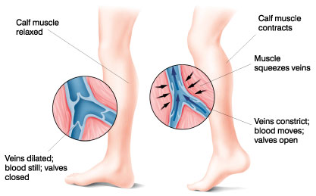
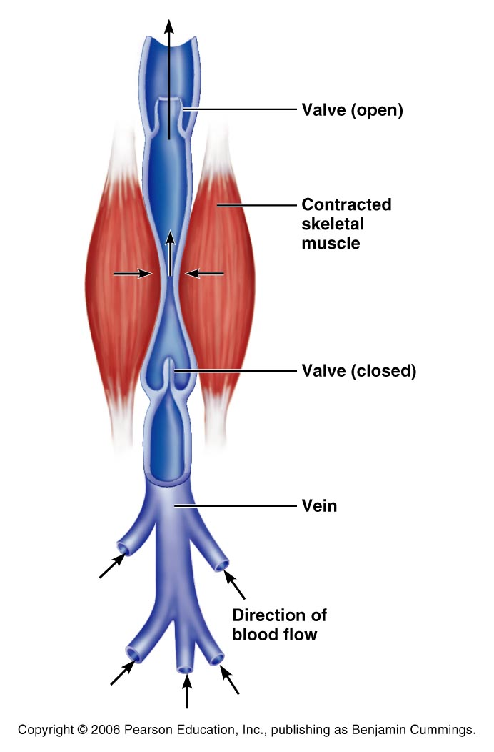

Slide 8
Veins
_________________________________ movements move venous blood.
___________________________in thoracic cavity is _____________________________ as the diaphragm contracts and the rib cage moves up and out.

Slide 9
Veins
The pressure in the ____________________________________ is __________________________________ as the diaphragm presses on the abdominal viscera….
the blood moves from area of _
from abdomen towards thoracics. (towards heart)

Slide 10
Terms for circulation
Blood flow
_________________________of blood flowing through a _
Relatively constant at rest
Varies with individual organs: _
Blood pressure
The force on the vessel wall based on the blood

Slide 11
Terms for circulation
Resistance
Friction, mostly occurring _
Causes of Peripheral resistance
__________________________________________________: Increased viscosity yeilds increased resistance
__________________________________________________: The longer the vessel the greater the resistance
__________________________________________________: the smaller the vessel, the greater the resistance

Slide 12
Viscosity
the _____________________________________ with which its molecules flow past one another.
The higher the viscosity, the more difficult the fluid is to move
_______________________________________ increase viscosity.
The greater the blood’s resistance to flowing, the _
BP rises as viscosity increases.

Slide 13
Viscosity
Anemia _______________________________ …. Lowers blood pressure.
_____________________________________ increase viscosity and blood pressure

Slide 14
Central Venous Pressure
All veins ____________________________________ drain into the R atrium…
the pressure within the right atrium is called the
Affects the pressure within the peripheral veins.

Slide 15
Central Venous Pressure
Heart beats weakly →the central venous pressure _
blood __________________________________________________________________________→raising its pressure.

Slide 16
Central Venous Pressure
if heart is beating ___________________________ , the CVP and the pressure within the venous network __________________________________.

Slide 17
Central Venous Pressure
Factors that increase the blood flow into RA…elevate the CVP:
Increase in _
Widespread _
Increased CVP can lead to ____________________________________ due to the hydrostatic pressure forcing fluid into tissues.

Slide 18
Blood Pressure
Is the force the blood exerts against the inner walls of the blood vessels.
Most commonly refers to _

Slide 19
Blood pressure
Arterial blood pressure: rises and falls in a pattern with the _
When ventricles contract: ventricular systole: walls squeeze blood into _____________________________________. Pressure in the arteries increases sharply.

Slide 20
Blood pressure
__________________________________ achieved during ventricular contraction is _

Slide 21
Blood pressure
When ventricles relax =
the arterial pressure drops, and the _____________________________________ that remains in the arteries before the next contraction is the _

Slide 22
Blood Pressure
BP read as _____________________________________ which translates into
ventricular contraction pressure/ventricular relaxation pressure.

Slide 23
Pulse
the __________________________________ of artery walls due to _____________________________________ from ventricular contraction.
Felt near surfaces.
______________________________________: near wrist: two finger widths below thumb. Equal to the rate at which the left ventricle contracts and can be used to determine heart rate.

Slide 24
Short term BP control
Short term controls of blood pressure
Nervous system
Chemicals
Hormones
Function to correct minor fluctuations in BP
By altering peripheral resistance
By altering cardiac output

Slide 25
Vasomotor Center
Short term control: neural
Two main goals
Maintaining adequate mean arterial pressure by altering blood vessel diameter
Distributing blood to those organs with a higher demand

Slide 26
Vasomotor center
Vasomotor center: neurons located in the medulla
With the cardiac center in the medulla, they form the cardiovascular center
Vasomotor center in medulla →sympathetic efferent fibers → smooth muscles of the arterioles
Arterioles under state of constant constriction called vasomotor tone

Slide 27
Vasomotor activity
Vasomotor control modified by
Baroreceptors
Chemoreceptors
Higher brain centers

Slide 28
Vasomotor: Baroreceptors
Increased arterial BP causes stretch in baroreceptors
Located in carotid sinuses
Carotid provides the major blood flow to the brain
Carotid sinus reflex protects the brain
Located in aortic arch and walls of large arteries
Aortic sinus reflex protects the systemic circuit

Slide 29
Vasomotor: baroreceptors
Increased BP →
stretches vessels →
triggers baroreceptors →
impulses sent to vasomotor center →
arterioles and veins vasodilate →
BP drops

Slide 30
Vasomotor: chemoreceptors
Sensitive to
Oxygen
pH
Carbon dioxide
Locations:
Carotid bodies located in Carotid artery
Aortic bodies located in Aorta
Main function:
regulating respiratory rate, but does have some blood pressure function

Slide 31
Vasomotor: chemoreceptors
Decreased oxygen → stimulates chemoreceptors →
signals sent to cardioacceleratory center → cardiac output increases
AND signals sent to vasomotor center → vasoconstriction → blood pressure rises → blood supply returns to heart (and lungs) quickly

Slide 32
Vasomotor: brain functions
Medulla is not the only brain area that controls blood pressure
Cerebral cortex
Hypothalamus
Both of these regions have input into medulla to indirectly control BP

Slide 33
Hormone effects on BP
Adrenal medulla
Epinephrine
increases CO
General vasoconstriction
Specific vasodilation: skeletal and cardiac muscles
Norepinephrine
vasoconstriction
Enhance sympathetic fight/flight response

Slide 34
Hormone effects on BP
Atrial natriuretic peptide: ANP
Increased blood pressure stimulates ANP release.
Results in decrease BP after ANP causes sodium to be excreted from kidneys
Where sodium goes, water goes

Slide 35
Hormone effects on BP
Antidiuretic Hormone ADH/ vasopressin
Results in the conservation of water in the body
If low BP or blood volume, ADH will prevent water from being lost as urine
Water restores blood volume/pressure
Also can cause vasoconstriction

Slide 36
Hormone effects on BP
Angiotensin II
stimulates vasoconstriction
Causes the release of ADH and Aldosterone
Causes long-term regulation by increasing blood volume

Slide 37
Hormone effects on BP
Angiotensin II
Low BP →
Kidneys release renin
Renin acts as an enzyme, breaking angiotensinogen into angiotensin I
Angiotensin I is changed into angiotensin II by ACE: Angiotensin Converting Enzyme

Slide 38
BP Control: Long term
Will change blood pressure based on changes in blood volume
Recall that short term controls dealt mostly with altering peripheral resistance to control blood pressure
Short term solutions like baroreceptors can
Respond quickly
Adapt to chronic conditions

Slide 39
BP control: long term
Kidneys
Directly regulate arterial pressure
Alters blood volume as a function of filtration pressure
High blood pressure forces blood to be filtered and processed quickly through the renal system. Larger amounts of water will be lost as urine causing the blood pressure to lower
Indirectly regulates arterial pressure
Renin-angiotensin mechanism:
stimulates aldosterone which reabsorbs sodium and in turn causes the reabsorption of water

