Slide 1
Veins and Venules
microscopic vessels that emerge from capillaries and _
Veins carry blood _

Slide 2
Veins and Venules
Walls of veins are similar to arteries. Middle layer of venous wall is _ Therefore, have thinner walls
Lumen has _
Veins have __________________________, which maintain the blood flow in one direction.

Slide 3
Veins
Veins function as _
useful in times of blood loss.
Hemorrhaging:
drop in arterial pressure → muscular walls of the veins stimulated by _

Slide 4
Veins
Venous constriction helps _____________________________________ by returning more blood to the heart.
Ensures a nearly normal blood flow even with a _

Slide 5
Veins
Blood flow through the venous system depends more on the ____________________________________ , breathing movements, and _____________________________________ of veins than on the direct result of the heart action.

Slide 6
Veins
Contracting muscles _____________________________________, squeezing the blood inside towards heart _
The presence of the valves _

Slide 7
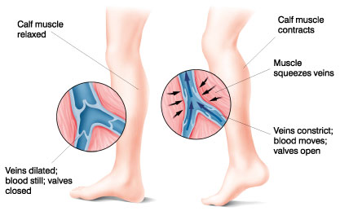
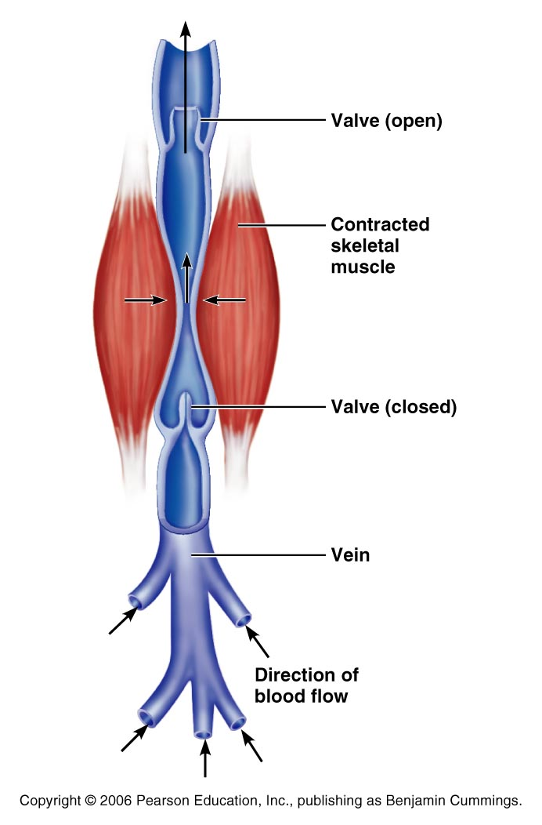

Slide 8
Veins
_________________________________ movements move venous blood.
___________________________in thoracic cavity is _____________________________ as the diaphragm contracts and the rib cage moves up and out.

Slide 9
Veins
The pressure in the ____________________________________ is __________________________________ as the diaphragm presses on the abdominal viscera….
the blood moves from area of _
from abdomen towards thoracics. (towards heart)

Slide 10
Terms for circulation
Blood flow
_________________________of blood flowing through a _
Relatively constant at rest
Varies with individual organs: _
Blood pressure
The force on the vessel wall based on the blood

Slide 11
Terms for circulation
Resistance
Friction, mostly occurring _
Causes of Peripheral resistance
__________________________________________________: Increased viscosity yields increased resistance
__________________________________________________: The longer the vessel the greater the resistance
__________________________________________________: the smaller the vessel, the greater the resistance

Slide 12
Viscosity
the _____________________________________ with which its molecules flow past one another.
The higher the viscosity, the more difficult the fluid is to move
_______________________________________ increase viscosity.
The greater the blood’s resistance to flowing, the _
BP rises as viscosity increases.

Slide 13
Viscosity
Anemia _______________________________ …. Lowers blood pressure.
_____________________________________ increase viscosity and blood pressure

Slide 14
Central Venous Pressure
All veins ____________________________________ drain into the R atrium…
the pressure within the right atrium is called the
Affects the pressure within the peripheral veins.

Slide 15
Central Venous Pressure
Heart beats weakly →the central venous pressure _
blood __________________________________________________________________________→raising its pressure.

Slide 16
Central Venous Pressure
if heart is beating ___________________________ , the CVP and the pressure within the venous network __________________________________.

Slide 17
Central Venous Pressure
Factors that increase the blood flow into RA…elevate the CVP:
Increase in _
Widespread _
Increased CVP can lead to ____________________________________ due to the hydrostatic pressure forcing fluid into tissues.

Slide 18
Blood Pressure
Is the force the blood exerts against the inner walls of the blood vessels.
Most commonly refers to _

Slide 19
Blood pressure
Arterial blood pressure: rises and falls in a pattern with the _
When ventricles contract: ventricular systole: walls squeeze blood into _____________________________________. Pressure in the arteries increases sharply.

Slide 20
Blood pressure
__________________________________ achieved during ventricular contraction is _

Slide 21
Blood pressure
When ventricles relax =
the arterial pressure drops, and the _____________________________________ that remains in the arteries before the next contraction is the _

Slide 22
Blood Pressure
BP read as _____________________________________ which translates into
ventricular contraction pressure/ventricular relaxation pressure.

Slide 23
Pulse
the ______________________________ of artery walls due to increased pressure from ventricular contraction.
Felt near surfaces.
________________________________: near wrist: two finger widths below thumb. Equal to the rate at which the left ventricle contracts and can be used to determine heart rate.

Slide 24
Short term BP control
Short term controls of blood pressure
Function to correct __________________________ fluctuations in BP
By altering peripheral resistance
By altering cardiac output

Slide 25
Vasomotor Center
Short term control: neural
Two main goals
Maintaining adequate mean arterial pressure _
Distributing blood to those organs with a _

Slide 26
Vasomotor center
Vasomotor center: neurons located in the _
With the cardiac center in the medulla, they form the cardiovascular center
Vasomotor center in medulla →___________________________________ → smooth muscles of the _
Arterioles under state of constant constriction called vasomotor tone

Slide 27
Vasomotor activity
Vasomotor control modified by
Higher brain centers

Slide 28
Vasomotor: Baroreceptors
Increased arterial BP causes ___________________ in baroreceptors
Located in carotid sinuses
Carotid provides the major blood flow to the brain
Located in aortic arch and walls of large arteries
Aortic sinus reflex protects the _

Slide 29
Vasomotor: baroreceptors
Increased BP →
stretches vessels →
triggers ______________________________ →
impulses sent to ___________________________→
arterioles and veins ________________________ →
BP _

Slide 30
Vasomotor: chemoreceptors
Sensitive to
Carbon dioxide
Locations:
Carotid bodies located in _
Aortic bodies located in Aorta
Main function:
regulating ______________________________________, but does have some blood pressure function

Slide 31
Vasomotor: chemoreceptors
Decreased oxygen → ___________________________________ →
signals sent to cardioacceleratory center → cardiac output _
AND signals sent to vasomotor center → vasoconstriction → blood pressure rises → blood supply returns to heart (and lungs) quickly

Slide 32
Vasomotor: brain functions
Medulla is not the only brain area that controls blood pressure
Hypothalamus
Both of these regions have input into medulla to _

Slide 33
Hormone effects on BP
Adrenal medulla
increases _
General vasoconstriction
____________________________________________: skeletal and cardiac muscles
Norepinephrine
Enhance sympathetic fight/flight response

Slide 34
Hormone effects on BP
Atrial natriuretic peptide: ANP
___________________________ blood pressure ____________________________ ANP release.
Results in decrease BP after ANP causes sodium to be excreted from kidneys

Slide 35
Hormone effects on BP
Antidiuretic Hormone ADH/ vasopressin
Results in the _
If low BP or blood volume, ADH will prevent water from being lost as urine
Water restores blood volume/pressure
Also can cause _

Slide 36
Hormone effects on BP
Angiotensin II
Causes the release of _
Causes long-term regulation by _

Slide 37
Hormone effects on BP
Angiotensin II
Low BP →
Kidneys release _
Renin acts as an ________________________, breaking angiotensinogen into _
Angiotensin I is changed into ________________________________________ by ACE: Angiotensin Converting Enzyme

Slide 38
BP Control: Long term
Will change blood pressure based on changes in blood volume
Recall that short term controls dealt mostly with altering peripheral resistance to control blood pressure
Short term solutions like baroreceptors can
__________________________ to chronic conditions

Slide 39
BP control: long term
Kidneys
________________________ regulate arterial pressure
Alters ____________________________________ as a function of filtration pressure
High blood pressure forces blood to be filtered and processed quickly through the renal system. Larger amounts of water will be lost as urine causing the blood pressure to lower
___________________________________ regulates arterial pressure
Renin-angiotensin mechanism:
stimulates __________________________________________ which reabsorbs sodium and in turn causes the reabsorption of water

Slide 40
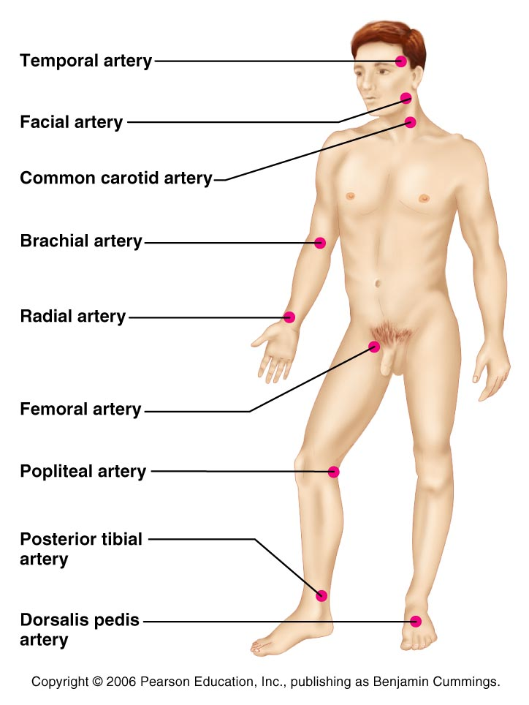
Pulse
the ___________________________ of artery walls due to increased pressure from ventricular contraction.
Felt _

Slide 41
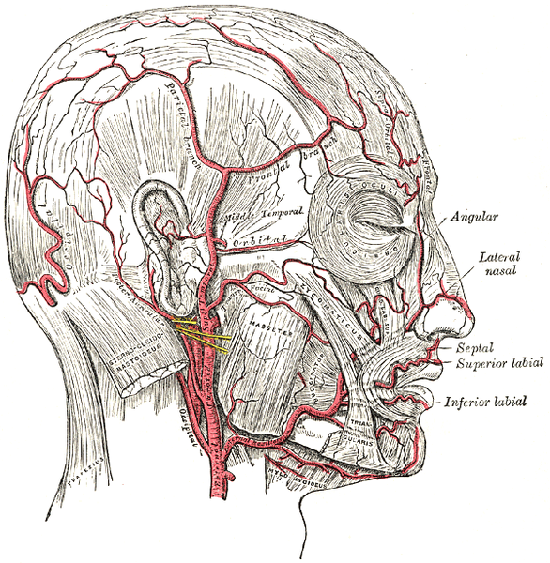
Head and neck pulses
Temporal artery
Branches off of _
Pulse is palpable superior to the zygomatic arch, anterior and superior to the tragus

Slide 42
Head and neck pulses
Common carotid artery
The ___________________________________ artery is one of three arteries that originate along the aortic arch
The _______________________ common carotid artery arises from the _
Pulse: palpated in the neck at _
Baroreceptors in carotids are sensitive to bilateral palpation, may cause bradycardia or fainting

Slide 43
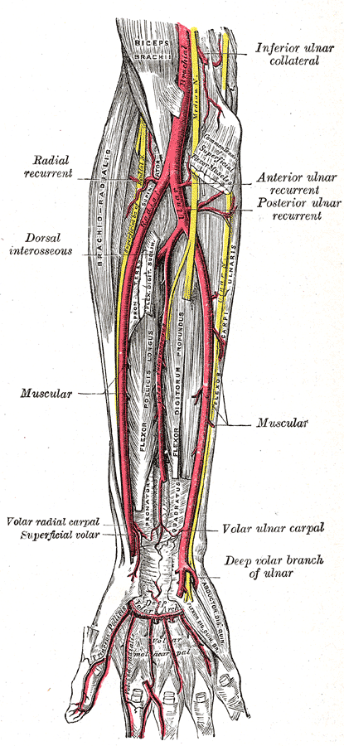
Upper limb pulses
Brachial artery
Origin:
Palpation: at the antecubital fossa
Is the artery used to determine _

Slide 44
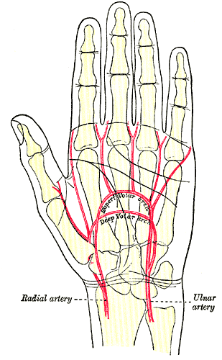
Upper limb pulses
Radial Artery
Origin: Subclavian a → axillary a → brachial a → _
Palpation: at the anterior wrist: three finger-widths proximal to the _

Slide 45
Lower Limb Pulses
four arterial pulses are routinely felt in the lower limb.
popliteal
Dorsalis pedis (dorsum of foot)

Slide 46
Femoral pulse
Most of the blood supply to the lower limb is carried in the external iliac artery.
Aorta →
descending aorta →
_____________________________________ →
external iliac artery →
becomes the ____________________________→
_

Slide 47
Finding the Femoral Pulse
Locate the superior border of the pubis in the mid line of the body;
Feel the anterior iliac crest. The femoral pulse can be found ___________________between these two bony points
(the mid-inguinal point)

Slide 48
Popliteal
The femoral artery enters the ___________________by passing through the adductor magnus muscle.
The name of the vessel then changes to the popliteal artery.

Slide 49
Palpating popliteal artery
bend the knee so that it is flexed to about 90 degrees.
press the tips of your fingers into the +
The popliteal pulse is deep and diffuse
Can be _

Slide 50
Posterior Tibial
The Popliteal artery branches into _

Slide 51
Palpating Posterior tibial artery
Locate the _
inferior and posterior to the medial malleolus you should find the _

Slide 52
Dorsalis Pedis
Below the knee, the popliteal artery divides into the anterior and posterior tibial arteries.
The anterior branch enters the anterior compartment of the leg by passing between the tibia and fibula above the _
It continues on to the _______________________as the dorsalis pedis artery

Slide 53
Palpating dorsalis pedis pulse
Place your fingers half way down the dorsum of the foot in the line between the first and second toes.
The bones you can feel are the dorsal aspect of the navicular and the intermediate cuneiform bones.
The pulse is palpated where the artery passes over this area.

Slide 54
Alterations in Blood pressure
Hypotension
Systolic below _______________mm Hg
_________________________ hypotension
________________________________________ low blood pressure
Getting up quickly

Slide 55
Alterations in blood pressure
Chronic hypotension
May be related to ________________________________________ proteins causing low blood viscosity
May be symptomatic of
Addison’s disease
Hypothyroidism
Tissue wasting
Acute hypotension

Slide 56
Alterations in blood pressure
Hypertension
__________________________________ changes seen during
Physical exertion
__________________________________changes are related to
Increased peripheral resistance due to
Diet
Diabetes mellitus

Slide 57
Circulatory shock
Any condition in which blood vessels are _____________________________________ and blood can not circulate normally
Can result in _

Slide 58
Hypovolemic shock
Hypovolemic shock
Due to _
Blood volume drops rapidly
heart rate _
Intense _
Blood pressure stabilizes until further blood loss

Slide 59
Vascular shock
Vascular shock
Blood volume _
Circulation poor due to extreme _
Causes a drop in _
Blood pressure falls
Common causes
Loss _
___________________________________________→ histamines → autonomic nervous system fails to maintain vasomotor tone
Septicemia

Slide 60
Cardiogenic shock
Cardiogenic shock results from _
Weak pump due to _

