Slide 1
The Heart
Structure: hollow, cone shaped _
Found in the middle _

Slide 2
The Heart
Size varies with person.
Length runs from second _
About the size of a _
Weighs less than a pound
Heart borders:
Laterally:
Posteriorly:
Anteriorly:

Slide 3
The Heart
attached to large blood vessels, lies beneath second rib
Distal end:
Apex:
area of apical heartbeat.
Referred to as PMI: point of maximum intensity

Slide 4
Pericardium
encloses the heart and the _
Consists of an _
fibrous pericardium surrounds visceral pericardium (epicardium) which covers the heart.

Slide 5
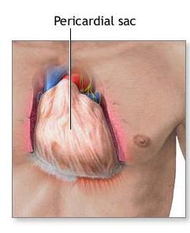
Pericardium
At the base of the heart, the lining turns back and _
This in turn forms the inner lining of the fibrous pericardium.

Slide 6
Pericardium
Three layers of pericardium:
1. fibrous outer layer:
Two inner layers (serous):
2. ___________________________________: adheres to heart. Epicardium
3__________________________________: adherent to fibrous pericardium

Slide 7
Pericardial Cavity
________________________________: Space between parietal and visceral layers
contains small amount of ___________________________________ that is secreted by the pericardial membrane.

Slide 8
Pericardial Cavity
Functions to _____________________________________ between the membranes as the heart moves.
Allows the heart to work in a relatively friction free environment.

Slide 9
Pericarditis
due to viral or bacterial infection
results in _________________________________ that attach the layers of the pericardium.

Slide 10
Pericardititis
____________________________________ of serous fluid,
_________________________________ and interferes with heart movements.
Beating heart rubs against pericardial sac causes a _____________________________________ that can be heard with a stethoscope…
Pericardial friction rub

Slide 11
Walls of the Heart
Three Layers

Slide 12
Epicardium
corresponds to _
Protective outer layer_

Slide 13
Myocardium
Middle layer
Consists largely of the _
Fibers are arranged in planes, separated by _

Slide 14
Endocardium
inner layer…
Contains _
Purkinje fibers.
Protective inner lining of the chambers and valves.
_____________________________________ with the endothelial linings of the blood vessels leaving and entering the heart.

Slide 15
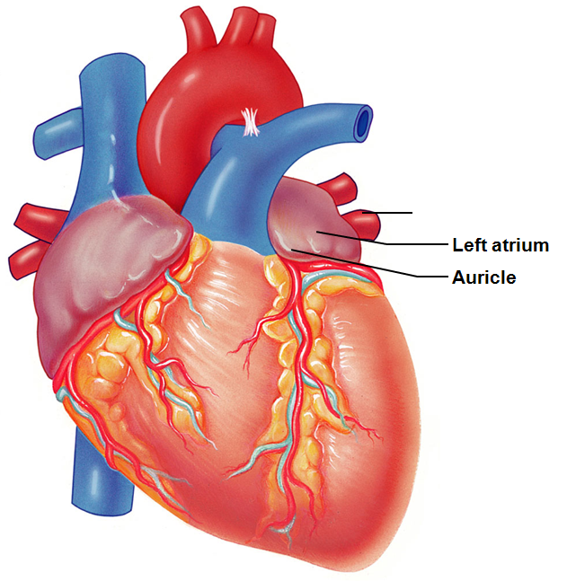
Chambers of the Heart
Atria:
Have thin walls. ___________________ returning to heart.
__________________: small ear-like projections extend anteriorly.

Slide 16
Chambers of the Heart
Atria
Pectinate muscles
Present in the anterior right atrium
Also found in both _
Anterior and posterior atria are separated by crista terminalis _

Slide 17
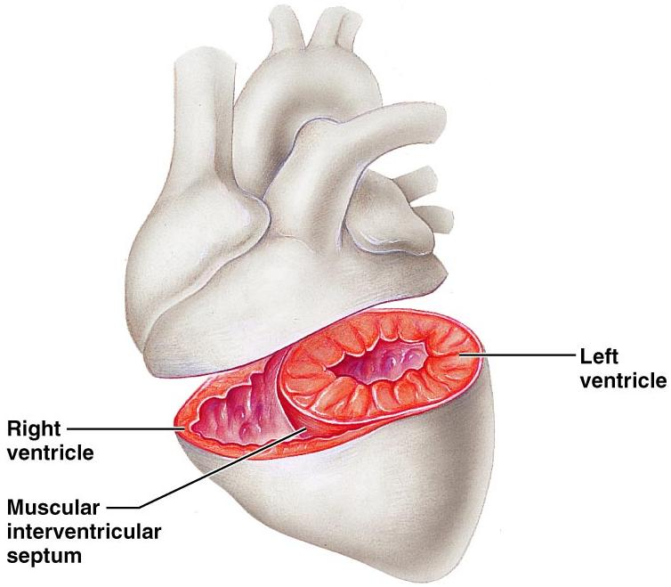
Chambers of the Heart
Ventricles_
Force the blood out of heart _

Slide 18
Septums
_____________________________________: separates right from left atrium.
____________________________________: shallow depression that was once an opening in the fetal heart
_____________________________________: separates right from left ventricle.

Slide 19
Right side of Heart
Right side =
Right atrium:
Receives blood from

Slide 20
Right side of heart
guards the AV _
Composed of three leaflets or cusps.
Permits blood to move from _
Close passively due to pressure

Slide 21
Right side of heart
_____________________________________: strong fibrous strings attach to cusps and ventricles.
Originate from ____________________________________. Papillary muscles contract and pull on the chordae tendinae and _

Slide 22
Right side of the heart
Right ventricle is _
Right pumps to _
Left pumps to entire body and has a greater resistance to overcome.

Slide 23
Tricuspid Valve
Right vent contracts and the pressure rises.
Tricuspid valve _
Exit is through the ____________________________________…turns into pulmonary arteries.
Must pass through _

Slide 24
Pulmonary Valve
Opens as right ventricle contracts. When there is ventricular relaxation: blood begins to back up into pulmonary trunk _

Slide 25
Left side of heart
Left side of heart is the ____________________________________ pump.
Left atrium:
receives blood from lungs through _

Slide 26
Left side of the heart
Blood goes from atrium through
into the left ventricle.
____________________________________ prevent valve from flapping up into atrium

Slide 27
Left side of heart
Ventricle contracts,
mitral valve closes passively
blood is _
Which has _____________________________ valves. When ventricle relaxes, valve closes.

Slide 28
Mitral valve prolapse
cusps of the mitral valve __________________________________________________________________________ during the ventricular contraction.
Blood ______________________________ into the left atrium.

Slide 29
Mitral valve prolapse
Symptoms:
chest pain, ______________________________,
fatigue, and anxiety.
Can be damaged by Streptococcus. May lead to __________________________________: an inflammation of the endocardium due to infection.

Slide 30
Heart Skeleton
Rings of dense _
provide _______________________________ for the heart valves and muscle fibers and
prevents ______________________________ during contraction.
Helps heart keep its shape. Otherwise, the heart would balloon outward with the increased pressure.

Slide 31
Pathway of Blood
Enters _______________________________ from Superior Vena Cava, Inferior Vena Cava, and Coronary Sinus
Blood ________________________________. High in CO₂. Low in O₂

Slide 32
Pathway
Pressure in R. Atrium forces open
Blood passes into _

Slide 33
Pathway
From the Right Ventricle, contractions force blood
through _____________________________________ (pressure closes the Tricuspid Valve)
Blood travels to Lungs

Slide 34
Pathway
Blood returns from lungs freshly _
Enters _
Passes through Bicuspid Valve (also called Mitral Valve)
Into _

Slide 35
Pathway
L. Ventricle contracts.
Bicuspid/Mitral valve closes due to pressure
Blood passes through _
Into Aorta

Slide 36
Heart’s blood supply
Aorta…branches off.
First two branches are called _
They supply blood to the

Slide 37
Heart’s Blood supply
From the Left coronary artery….
__________________________________ follows AV sulcus on left.
Supplies blood to walls of the _
anterior interventricular artery or LAD Left Anterior Descending…
travels in the anterior Interventricular sulcus and branches supply walls _

Slide 38
Heart’s Blood Supply
From the Right Coronary Artery
Two major branches:
supplies the walls of both ventricles.
Supplies right atrium and right ventricles.

Slide 39
Heart’s blood supply
Cardiac veins _
Veins join the coronary sinus at the _
Coronary sinus empties into _

Slide 40
Heart Activity
Atrial walls contract while the ventricular walls relax;
ventricular walls contract while the atrial walls relax.
There is a moment of relaxation. _

Slide 41
Foramen ovale
__________________________________: “oval door”
present in _
connects the ________________________ and allows blood entering the right heart to bypass the pulmonary circuit

Slide 42
Ductus arteriosus
____________________________________ between the _.
Shortly after birth, it closes, separating right and left sides of the heart.

Slide 43
Congenital Heart Defects
__________________________ductus arteriosus...in which the connection between the aorta and pulmonary trunk _
A patent ductus arteriosus allows _
children become cyanotic after physical exertion.

Slide 44
Heart Sounds
“lubb dubb” sounds are from the contraction and relaxation of heart tissues and the _

Slide 45
Heart Sounds
Lubb:
first sound
Ventricular contraction: _
________________________________________________due to the ventricular pressure
Dubb:
second sound.
ventricular relaxation: _
________________________________________________ valves closing.

Slide 46
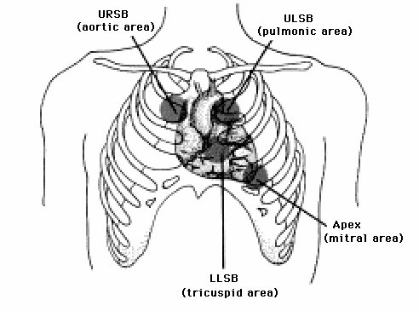
Heart Sounds
Auscultation:
2nd ICS at R sternal margin
Pulmonary Valve
2nd ICS at L sternal margin
5th ICS at R sternal margin
Mitral Valve
5th ICS, midclavicular line
PMI

Slide 47
Cardiac Fibers
_________________________________ = SA node.
specialized ___________________________________ beneath the epicardium.
Located in _
Fibers are continuous with those of the atrial syncytium.

Slide 48
Cardiac Fibers
SA node can reach threshold on their own,
membranes _
Need no outside stimulation.
initiates impulses that spread to the myocardium and stimulate the muscles to contract.

Slide 49
SA Node
SA node activity is _
Generates impulses 75 – 100 times a minute on its own.
Tempered by the _
Slows rate to 60 to 80 bpm
Called the Pacemaker.

Slide 50
SA node
From SA node into the __________________________________, the impulse goes from cell to cell via _
R and L atria contract almost simultaneously.

Slide 51
Cardiac Conduction
Before the impulses reach the ventricular syncytium, they are _________________________ by a group of tissues called the _
located in the __________________________________________________________________________ that separates that atria

Slide 52
Cardiac conduction
AV node provides the _____________________________________ between atrial and ventricular syncytia
Because of the AV node there is a time delay.
allows time for the atria to _____________________________________ before the coming ventricular contraction

Slide 53
Cardiac Conduction
The impulse reaches the far side of the AV node
it passes into a group of fibers called __________________________________________________________________________ and the impulse passes through them

Slide 54
Cardiac Conduction
Bundle of His divides into right and left branches .
gives rise to enlarged __________________________________ that carry the impulses ______________________ than the cell to cell contact could

Slide 55
Cardiac Conduction
Purkinje fibers
transmit the impulses _
allows the contraction to push the blood superiorly towards the aortic and pulmonary valves.
Allows the ventricular myocardium to contract __________________________________ rather than in a wave.

Slide 56
Intrinsic Cardiac Conduction
1.
2.
3. Atrioventricular bundle
Bundle of His
4. R/L bundle branches
5.

Slide 57
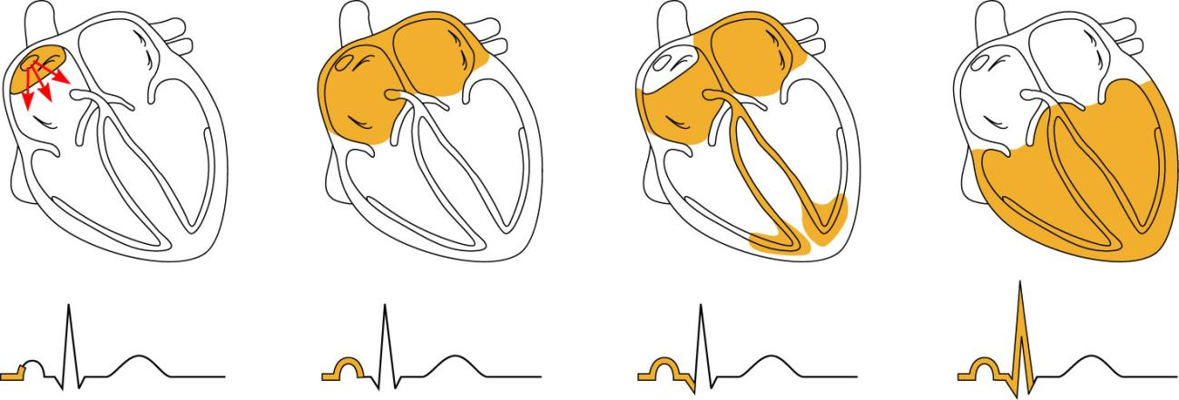
Heart Excitation Related to ECG
SA node generates impulse;
atrial excitation begins
Impulse delayed
at AV node
Impulse passes to
heart apex; ventricular
excitation begins
Ventricular excitation
complete
SA node
AV node
Bundle
branches
Purkinje
fibers
Figure 18.17

Slide 58
Conduction Defects
Uncoordinated atrial and ventricular contractions
Fibrillation
Rapid and _
SA node _
Defibrillation: electrical shock to the heart interrupts chaotic fibrillations and _

Slide 59
Cardiac Output
Stroke Volume
Volume of blood pumped out by _
Cardiac output (CO)
Amount of blood pumped out by each ventricle _
_________________________________________= Cardiac Output

Slide 60
EKG
____________________________________ occur in the myocardium during a cardiac cycle.
Body fluids _____________________________________ that can be detected on the surface of the body

Slide 61
EKG
Normal ECG has _
SA node triggers impulses, electrical change in atrium.
Produces a _
Corresponds to the __________________________________________________________________________ that will soon lead to the contraction of the atrium.

Slide 62
EKG
When the impulses reach the ventricular fibers, they _
Ventricle walls are thicker and the electrical charge is greater
Forms the _
Contains Q wave, R wave, and S wave.

Slide 63
EKG
ventricle muscles _

Slide 64
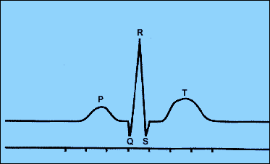
EKG
P:
QRS: repolarization of atria and overlapping depolarization of ventricles
T:

Slide 65
Regulation
Remember, the SA node on its own will cause the heart to beat at _
Tempered by Parasympathetic and Sympathetic systems

Slide 66
Extrinsic Regulation of the Cardiac Cycle
Parasympathetic fibers that innervate the heart arise from neurons in the medulla oblongata and make up parts of the _
These fibers branch into the SA and AV nodes. At nerve fiber endings, releases _

Slide 67
Regulation
Parasympathetic system can change heart rate in either direction.
_______________________________in the impulses →increases Acetylcholine →_
______________________________ in the impulse →decreases acetylcholine → _

Slide 68
Extrinsic Regulation
Resting heart rate is approximately 70 bpm due to the parasympathetic innervation from the _
The Vagus Nerve/Parasympathetic input slows the pacemaker cells

Slide 69
Extrinsic Regulation
Sympathetic System:
increases ____________________________________ of myocardial contractions.

Slide 70
Regulation
found _
Detects changes in blood pressure.

Slide 71
Regulation
Increase in pressure →stretches the receptors →signals the ___________________________________ →sends parasympathetic impulses to _______________________________the heart rate and force of contraction.
Helps to _____________________________________ towards normal

Slide 72
Regulation
Stretch receptors in _
when blood pressure increases →signals cardioaccelerators →
Sympathetic impulses → ________________________________________________________________________→
Venous pressure is reduced

Slide 73
Chemical Regulation
Hormones
From _
Short term, rapid increase in heart rate
Thyroxine
From _
Takes longer to act, but causes a _
Can lead to _______________________________________ heart in hyperthyroid conditions

Slide 74
Chemical regulation
Ion imbalances:
Depresses the heart
Increase heart irritability
Spastic heart contractions

Slide 75
Chemical regulation
Ion imbalances:
Feeble irregular heart beat
Interferes with depolarization
Can lead to cardiac arrest

Slide 76
Heart rate
Increased heart rate
Above _
Can be caused by
increased body temperatures
Heart disease

Slide 77
Heart Rate
Bradycardia
Decreased heart rate
Can be caused by
Drugs
Parasympathetic nervous system
Pathological if cardiac output falls
Indicative of brain edema following head trauma

Slide 78
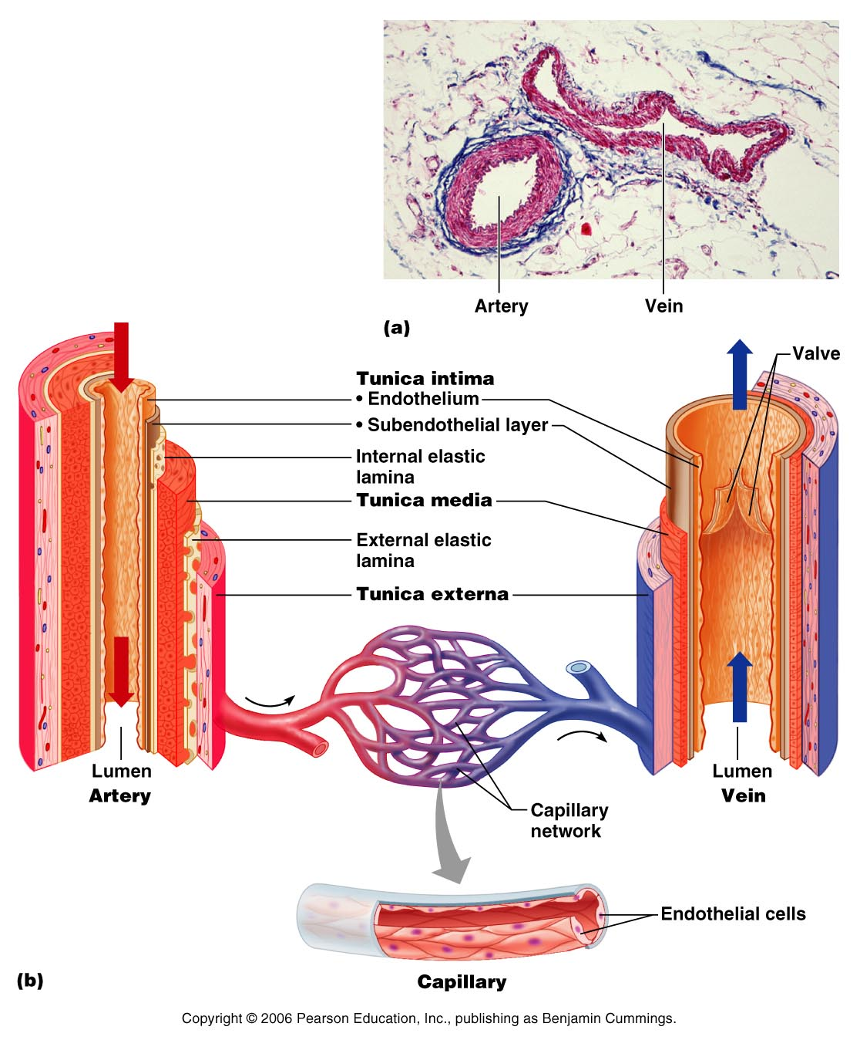
Blood Vessels

Slide 79
Arteries
strong _______________________________ vessels adapted to carry blood under _
Three layers or tunics
Tunica _
Tunica _
Tunica _

Slide 80
Arteries
Innermost: tunica interna/intima:
Separates the _
helps to _____________________________________ by secreting chemicals that inhibit platelet aggregation.
Provides a _

Slide 81
Arteries
Middle layer: _
bulk of arterial wall is _____________________________________ and thick layer of elastic connective tissue.
gives the vessels an _______________________________________ that helps it to stand up to the force of the blood pressure.

Slide 82
Arteries
Tunica Media
Activity of the smooth muscle is regulated by _
From _
Increased impulses allow vasoconstriction: _
Decreased impulses allow vasodilation: _

Slide 83
Arteries
Outer layer: tunica externa/adventitia:
thin connective tissue with _
_____________________________________ the artery to the surrounding tissues.

Slide 84
Types of Arteries
Elastic arteries
Arterioles

Slide 85
Elastic Arteries
Thick walled arteries _
A.k.a.
Contain a lot of _
Act as pressure reservoirs
Keeps blood flow continuous rather than stop/start

Slide 86
Muscular arteries
Also:
Tunica media contains ____________________________________ and less elastic tissue than elastic arteries
More active _

Slide 87
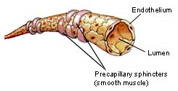
Arterioles
Larger arterioles have _
Small arterioles have _
These vessels will feed into the capillaries

Slide 88
Capillaries
Smallest blood vessels.
Connect the smallest arterioles and smallest venules.
Three types

Slide 89
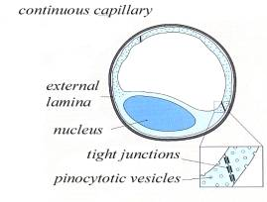
Capillaries
Continuous
Abundant in _
Endothelial cells provide a continuous lining joined together by tight junctions
Gaps in membranes called intercellular clefts
Allow passage of fluids and small solutes

Slide 90
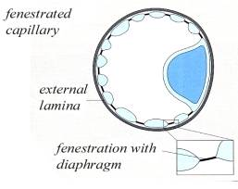
Capillaries
Fenestrated
Contains pores or openings _
More _
Located where _______________________________________ takes place
Small intestine
Kidneys
Endocrine glands like pituitary and thyroid

Slide 91
Capillaries
Sinusoid
Also called discontinuous capillaries
Found in
__________________________________________: associated with macrophages called Kupffer cells that destroy bacteria
Lymph tissue: Spleen
Some endocrine organs
Fenestrated with few tight junctions
Allows __________________________________________________________________________________ to get into the nearby tissue

Slide 92
Capillaries
Walls are _____________________________, single layer of squamous epithelial cells.
Form a _____________________________________through which the exchange of gasses and wastes take place

Slide 93
Capillaries
Exchange of gasses and nutrients occurs in the capillaries.
Biochemicals move through the walls by __
____________________________________ is the most important means of transfer.

Slide 94
Capillaries
High O₂ conc and nutrients, substances diffuse through the capillary walls and _
CO₂ concentration _____________________________________. Will diffuse into capillaries from tissues

Slide 95
Regulation of capillary
_____________________________________ that encircles the capillary entrances.
Precapillary sphincters: may close a capillary by contracting or open it by relaxing.
Sphincters _

Slide 96
Veins and Venules
microscopic vessels that emerge from capillaries and _
Veins carry blood _

Slide 97
Veins and Venules
Walls of veins are similar to arteries. Middle layer of venous wall is _ Therefore, have thinner walls
Lumen has _
Veins have __________________________, which maintain the blood flow in one direction.

Slide 98
Veins
Veins function as _
useful in times of blood loss.
Hemorrhaging:
drop in arterial pressure → muscular walls of the veins stimulated by _

Slide 99
Veins
Venous constriction helps _____________________________________ by returning more blood to the heart.
Ensures a nearly normal blood flow even with a _

Slide 100
Veins
Blood flow through the venous system depends more on the ____________________________________ , breathing movements, and _____________________________________ of veins than on the direct result of the heart action.

Slide 101
Veins
Contracting muscles _____________________________________, squeezing the blood inside towards heart _
The presence of the valves _

Slide 102
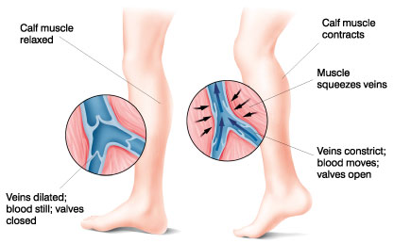
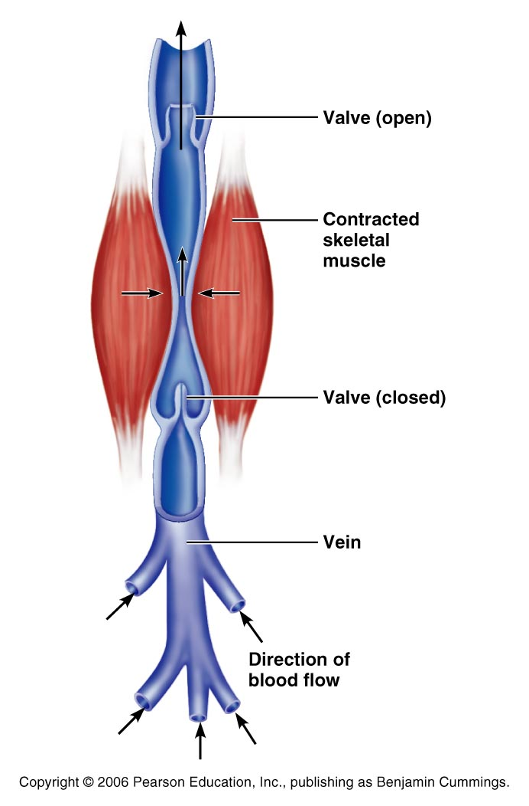

Slide 103
Veins
_________________________________ movements move venous blood.
___________________________in thoracic cavity is _____________________________ as the diaphragm contracts and the rib cage moves up and out.

Slide 104
Veins
The pressure in the ____________________________________ is __________________________________ as the diaphragm presses on the abdominal viscera….
the blood moves from area of _
from abdomen towards thoracics. (towards heart)

Slide 105
Terms for circulation
Blood flow
_________________________of blood flowing through a _
Relatively constant at rest
Varies with individual organs: _
Blood pressure
The force on the vessel wall based on the blood

Slide 106
Terms for circulation
Resistance
Friction, mostly occurring _
Causes of Peripheral resistance
__________________________________________________: Increased viscosity yeilds increased resistance
__________________________________________________: The longer the vessel the greater the resistance
__________________________________________________: the smaller the vessel, the greater the resistance

Slide 107
Viscosity
the _____________________________________ with which its molecules flow past one another.
The higher the viscosity, the more difficult the fluid is to move
_______________________________________ increase viscosity.
The greater the blood’s resistance to flowing, the _
BP rises as viscosity increases.

Slide 108
Viscosity
Anemia _______________________________ …. Lowers blood pressure.
_____________________________________ increase viscosity and blood pressure

Slide 109
Central Venous Pressure
All veins ____________________________________ drain into the R atrium…
the pressure within the right atrium is called the
Affects the pressure within the peripheral veins.

Slide 110
Central Venous Pressure
Heart beats weakly →the central venous pressure _
blood __________________________________________________________________________→raising its pressure.

Slide 111
Central Venous Pressure
if heart is beating ___________________________ , the CVP and the pressure within the venous network __________________________________.

Slide 112
Central Venous Pressure
Factors that increase the blood flow into RA…elevate the CVP:
Increase in _
Widespread _
Increased CVP can lead to ____________________________________ due to the hydrostatic pressure forcing fluid into tissues.

Slide 113
Blood Pressure
Is the force the blood exerts against the inner walls of the blood vessels.
Most commonly refers to _

Slide 114
Blood pressure
Arterial blood pressure: rises and falls in a pattern with the _
When ventricles contract: ventricular systole: walls squeeze blood into _____________________________________. Pressure in the arteries increases sharply.

Slide 115
Blood pressure
__________________________________ achieved during ventricular contraction is _

Slide 116
Blood pressure
When ventricles relax =
the arterial pressure drops, and the _____________________________________ that remains in the arteries before the next contraction is the _

Slide 117
Blood Pressure
BP read as _____________________________________ which translates into
ventricular contraction pressure/ventricular relaxation pressure.

Slide 118
Pulse
the expansion/recoil of artery walls due to increased pressure from ventricular contraction.
Felt near surfaces.
Radial artery: near wrist: two finger widths below thumb. Equal to the rate at which the left ventricle contracts and can be used to determine heart rate.

Slide 119
Short term BP control
Short term controls of blood pressure
Nervous system
Chemicals
Hormones
Function to correct minor fluctuations in BP
By altering peripheral resistance
By altering cardiac output

Slide 120
Vasomotor Center
Short term control: neural
Two main goals
Maintaining adequate mean arterial pressure by altering blood vessel diameter
Distributing blood to those organs with a higher demand

Slide 121
Vasomotor center
Vasomotor center: neurons located in the medulla
With the cardiac center in the medulla, they form the cardiovascular center
Vasomotor center in medulla →sympathetic efferent fibers → smooth muscles of the arterioles
Arterioles under state of constant constriction called vasomotor tone

Slide 122
Vasomotor activity
Vasomotor control modified by
Baroreceptors
Chemoreceptors
Higher brain centers

Slide 123
Vasomotor: Baroreceptors
Increased arterial BP causes stretch in baroreceptors
Located in carotid sinuses
Carotid provides the major blood flow to the brain
Carotid sinus reflex protects the brain
Located in aortic arch and walls of large arteries
Aortic sinus reflex protects the systemic circuit

Slide 124
Vasomotor: baroreceptors
Increased BP →
stretches vessels →
triggers baroreceptors →
impulses sent to vasomotor center →
arterioles and veins vasodilate →
BP drops

Slide 125
Vasomotor: chemoreceptors
Sensitive to
Oxygen
pH
Carbon dioxide
Locations:
Carotid bodies located in Carotid artery
Aortic bodies located in Aorta
Main function:
regulating respiratory rate, but does have some blood pressure function

Slide 126
Vasomotor: chemoreceptors
Decreased oxygen → stimulates chemoreceptors →
signals sent to cardioacceleratory center → cardiac output increases
AND signals sent to vasomotor center → vasoconstriction → blood pressure rises → blood supply returns to heart (and lungs) quickly

Slide 127
Vasomotor: brain functions
Medulla is not the only brain area that controls blood pressure
Cerebral cortex
Hypothalamus
Both of these regions have input into medulla to indirectly control BP

Slide 128
Hormone effects on BP
Adrenal medulla
Epinephrine
increases CO
General vasoconstriction
Specific vasodilation: skeletal and cardiac muscles
Norepinephrine
vasoconstriction
Enhance sympathetic fight/flight response

Slide 129
Hormone effects on BP
Atrial natriuretic peptide: ANP
Increased blood pressure stimulates ANP release.
Results in decrease BP after ANP causes sodium to be excreted from kidneys
Where sodium goes, water goes

Slide 130
Hormone effects on BP
Antidiuretic Hormone ADH/ vasopressin
Results in the conservation of water in the body
If low BP or blood volume, ADH will prevent water from being lost as urine
Water restores blood volume/pressure
Also can cause vasoconstriction

Slide 131
Hormone effects on BP
Angiotensin II
stimulates vasoconstriction
Causes the release of ADH and Aldosterone
Causes long-term regulation by increasing blood volume

Slide 132
Hormone effects on BP
Angiotensin II
Low BP →
Kidneys release renin
Renin acts as an enzyme, breaking angiotensinogen into angiotensin I
Angiotensin I is changed into angiotensin II by ACE: Angiotensin Converting Enzyme

Slide 133
BP Control: Long term
Will change blood pressure based on changes in blood volume
Recall that short term controls dealt mostly with altering peripheral resistance to control blood pressure
Short term solutions like baroreceptors can
Respond quickly
Adapt to chronic conditions

Slide 134
BP control: long term
Kidneys
Directly regulate arterial pressure
Alters blood volume as a function of filtration pressure
High blood pressure forces blood to be filtered and processed quickly through the renal system. Larger amounts of water will be lost as urine causing the blood pressure to lower
Indirectly regulates arterial pressure
Renin-angiotensin mechanism:
stimulates aldosterone which reabsorbs sodium and in turn causes the reabsorption of water

Slide 135
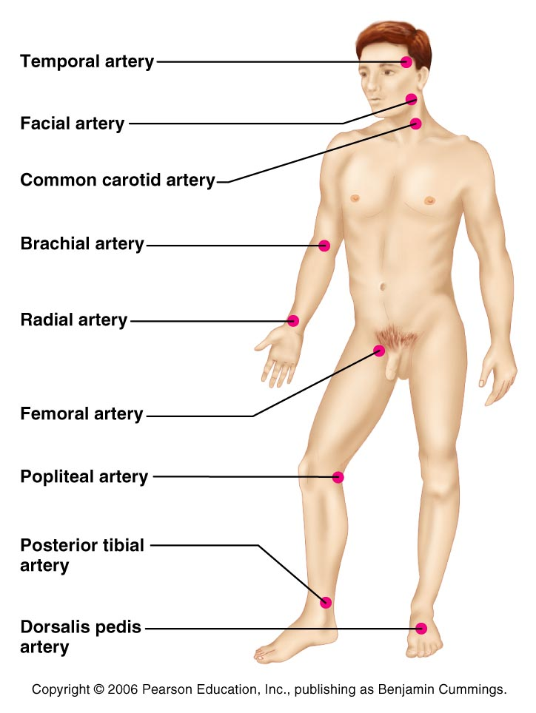
Pulse
the expansion/recoil of artery walls due to increased pressure from ventricular contraction.
Felt near surfaces.

Slide 136
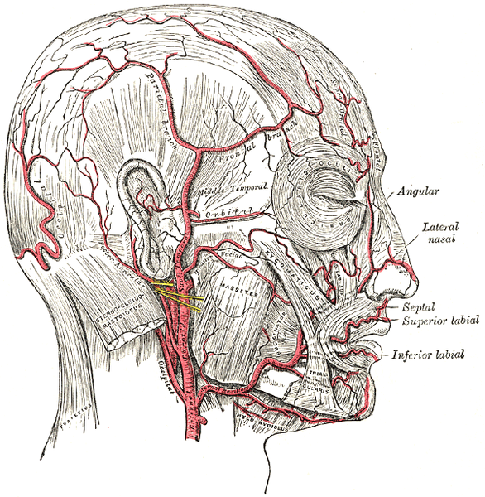
Head and neck pulses
Temporal artery
Branches off of external carotid artery
Pulse is palpable superior to the zygomatic arch, anterior and superior to the tragus

Slide 137
Head and neck pulses
Common carotid artery
The left common carotid artery is one of three arteries that originate along the aortic arch
The right common carotid artery arises from the brachiocephalic artery
Pulse: palpated in the neck at lateral aspects of trachea
Baroreceptors in carotids are sensitive to bilateral palpation, may cause bradycardia or fainting

Slide 138
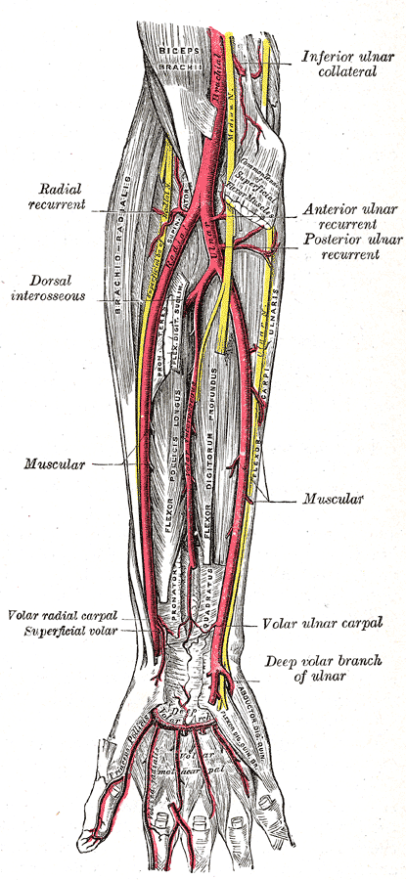
Upper limb pulses
Brachial artery
Origin: subclavian artery → axillary artery → to brachial artery
Palpation: at the antecubital fossa
Is the artery used to determine arterial blood pressure

Slide 139
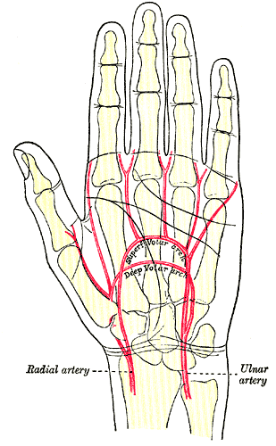
Upper limb pulses
Radial Artery
Origin: Subclavian a → axillary a → brachial a → splits into radial a and ulnar a
Palpation: at the anterior wrist: three finger-widths proximal to the thenar eminence

Slide 140
Lower Limb Pulses
four arterial pulses are routinely felt in the lower limb.
femoral
popliteal
Posterior tibial
Dorsalis pedis (dorsum of foot)

Slide 141
Femoral pulse
Most of the blood supply to the lower limb is carried in the external iliac artery.
Aorta →
descending aorta →
common iliac artery →
external iliac artery →
becomes the femoral artery →
deep femoral

Slide 142
Finding the Femoral Pulse
Locate the superior border of the pubis in the mid line of the body;
Feel the anterior iliac crest. The femoral pulse can be found midway between these two bony points
(the mid-inguinal point)

Slide 143
Popliteal
The femoral artery leaves enters the popliteal fossa by passing through the adductor magnus muscle.
The name of the vessel then changes to the popliteal artery.

Slide 144
Palpating popliteal artery
bend the knee so that it is flexed to about 90 degrees.
press the tips of your fingers into the popliteal fossa.
The popliteal pulse is deep and diffuse
Can be difficult to palpate

Slide 145
Posterior Tibial
The Popliteal artery branches into anterior tibial and posterior tibial arteries.

Slide 146
Palpating Posterior tibial artery
Locate the medial malleolus
inferior and posterior to the medial malleolus you should find the posterior tibial pulse.

Slide 147
Dorsalis Pedis
Below the knee, the popliteal artery divides into the anterior and posterior tibial arteries.
The anterior branch enters the anterior compartment of the leg by passing between the tibia and fibula above the interosseous membrane.
It continues on to the dorsum of the foot as the dorsalis pedis artery

Slide 148
Palpating dorsalis pedis pulse
Place your fingers half way down the dorsum of the foot in the line between the first and second toes.
The bones you can feel are the dorsal aspect of the navicular and the intermediate cuneiform bones.
The pulse is palpated where the artery passes over this area.

Slide 149
Alterations in Blood pressure
Hypotension
Low blood pressure
Systolic below 100 mm Hg
Orthostatic hypotension
Temporary positional low blood pressure
Getting up quickly

Slide 150
Alterations in blood pressure
Chronic hypotension
May be related to anemia or deficient blood proteins causing low blood viscosity
May be symptomatic of
Addison’s disease
Hypothyroidism
Tissue wasting
Acute hypotension
Circulatory shock

Slide 151
Alterations in blood pressure
Hypertension
Transient changes seen during
Fevers
Physical exertion
Emotional stress
Persistent changes are related to
Increased peripheral resistance due to
Obesity
Diet
Diabetes mellitus
Hereditary
Smoking

Slide 152
Circulatory shock
Any condition in which blood vessels are inadequately filled and blood can not circulate normally
Can result in cell death

Slide 153
Hypovolemic shock
Hypovolemic shock
Most common form
Due to low blood volume
Blood volume drops rapidly
heart rate increases
Intense vasoconstriction
Blood pressure stabilizes until further blood loss

Slide 154
Vascular shock
Vascular shock
Blood volume normal
Circulation poor due to extreme vasodilation
Causes a drop in peripheral resistance
Blood pressure falls
Common causes
Loss of vasomotor tone
Anaphylaxis → histamines → autonomic nervous system fails to maintain vasomotor tone
Septicemia

Slide 155
Cardiogenic shock
Cardiogenic shock results from failure at the heart
Weak pump due to myocardial damage

