Slide 1
The Respiratory System
Major function-respiration
Supply body with _
____________________________________________, a waste product of cellular respiration
Also functions in olfaction and speech

Slide 2
Processes of Respiration
Pulmonary ventilation
movement of air into and out of lungs
External respiration-
O₂ and CO₂ exchange between _
Transport
O₂ and CO₂ in blood
Internal respiration
O₂ and CO₂ exchange between _

Slide 3
Respiratory System: Functional Anatomy
Major organs
Nose, nasal cavity, and paranasal sinuses
Larynx
Bronchi and their branches
Lungs and alveoli

Slide 4
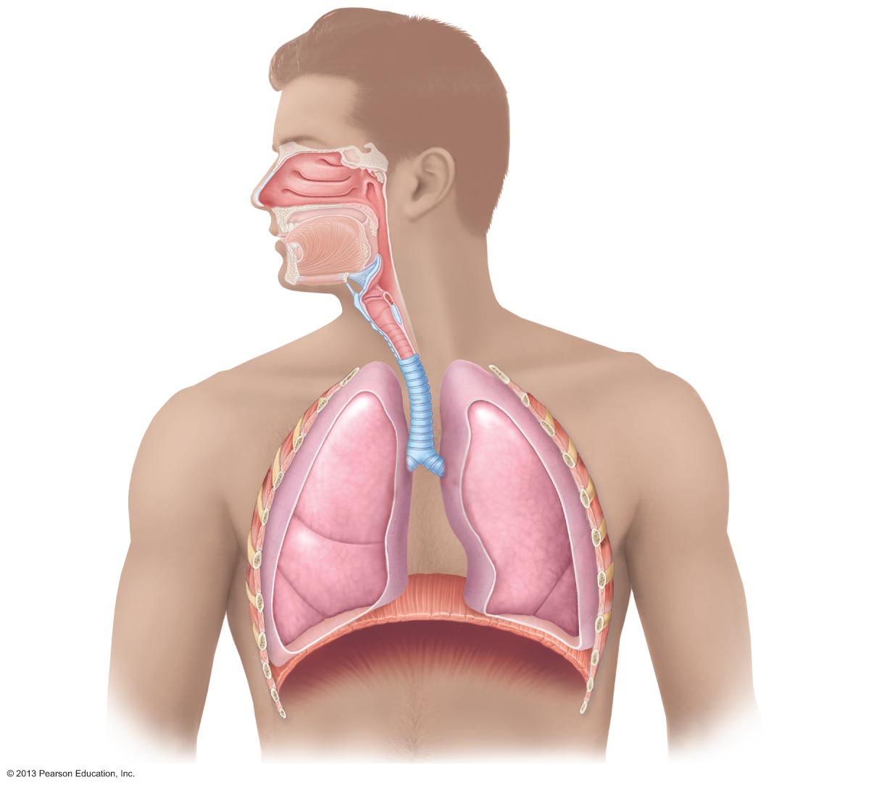
Figure 22.1 The major respiratory organs in relation to surrounding structures.
Nasal cavity
Oral cavity
Nostril
Pharynx
Larynx
Trachea
Carina of
trachea
Left primary
bronchus
Right primary
bronchus
Left lung
Right
lung
Diaphragm

Slide 5
Functional Anatomy
Respiratory zone
Microscopic structures
respiratory bronchioles
alveolar ducts
alveoli
Conducting zone
Includes all other respiratory structures
Diaphragm and other respiratory muscles promote ventilation

Slide 6
The Nose
Functions
Provides an _
Moistens and warms entering air
Serves as resonating chamber for speech
Houses _

Slide 7
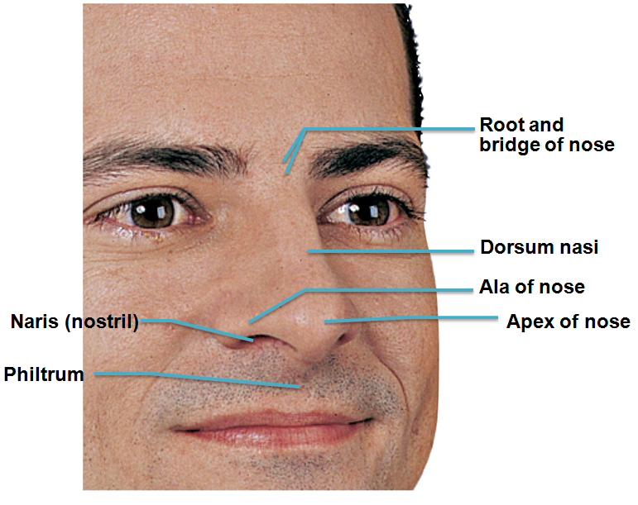
The Nose
Two regions
external nose
External nose
root, bridge, dorsum nasi, and apex
shallow vertical groove inferior to apex
Nostrils (nares)
bounded laterally by alae

Slide 8
The Nose
Nasal cavity
within and posterior to external nose
Divided by _
Posterior nasal apertures (________________________) open into nasal pharynx
Roof
ethmoid and sphenoid bones
Floor
hard (bone) and soft palates (muscle)

Slide 9
Nasal Cavity
Nasal vestibule
nasal cavity _
Vibrissae (________________________) filter coarse particles from inspired air
Rest of nasal cavity lined with mucous membranes
Olfactory mucosa
Respiratory mucosa

Slide 10
Nasal Cavity
Olfactory mucosa contains _
Responsible for _
Respiratory mucosa
Mucous and serous secretions contain lysozyme and defensins
Cilia move contaminated mucus posteriorly to throat
Inspired air warmed by capillaries and veins
Sensory nerve endings trigger sneezing

Slide 11
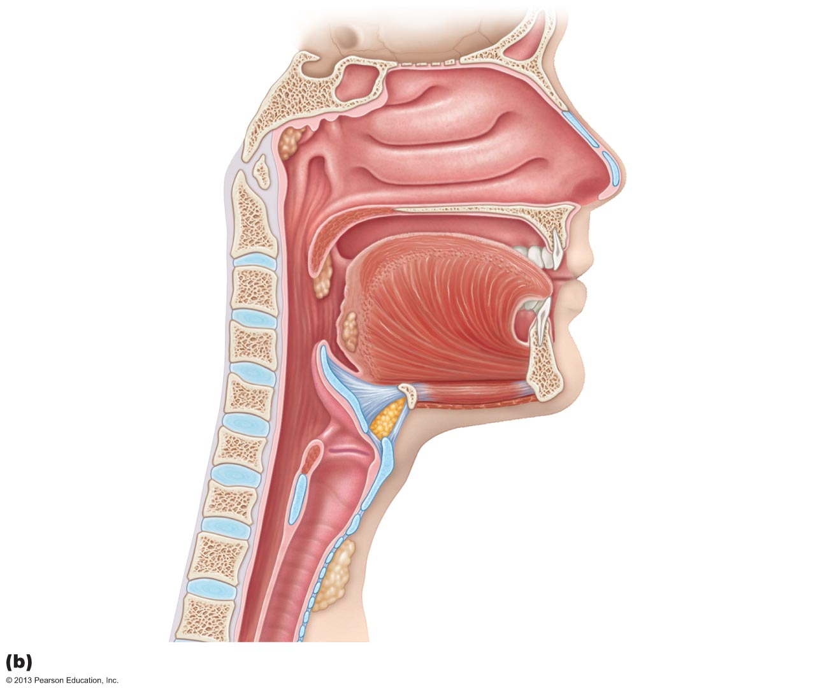
Figure 22.3b The upper respiratory tract.
Cribriform plate
of ethmoid bone
Sphenoid sinus
Frontal sinus
Posterior nasal
aperture
Nasal cavity
Nasal conchae
(superior, middle
and inferior)
Nasopharynx
Pharyngeal tonsil
Nasal meatuses
(superior, middle,
and inferior)
Opening of
pharyngotympanic tube
Nasal vestibule
Uvula
Nostril
Oropharynx
Hard palate
Palatine tonsil
Soft palate
Isthmus of the
fauces
Tongue
Lingual tonsil
Laryngopharynx
Hyoid bone
Larynx
Epiglottis
Vestibular fold
Thyroid cartilage
Esophagus
Vocal fold
Cricoid cartilage
Trachea
Thyroid gland
Illustration

Slide 12
Nasal Cavity
Nasal conchae
superior, middle, and inferior
Protrude medially from lateral walls
Nasal meatus
Groove inferior to each concha

Slide 13
Functions of the Nasal Mucosa and Conchae
During inhalation, conchae and nasal mucosa
During ____________________________________ these structures
Reclaim heat and moisture

Slide 14
Paranasal Sinuses
In frontal, sphenoid, ethmoid, and maxillary bones
Help to warm air
Moisten air

Slide 15
Homeostatic Imbalance
Inflammation of nasal mucosa
Nasal mucosa continuous with mucosa of respiratory tract → spreads from nose → throat → chest
Spreads to tear ducts and ________________________________________ causing
Blocked sinus passageways → air absorbed → vacuum → sinus headache

Slide 16
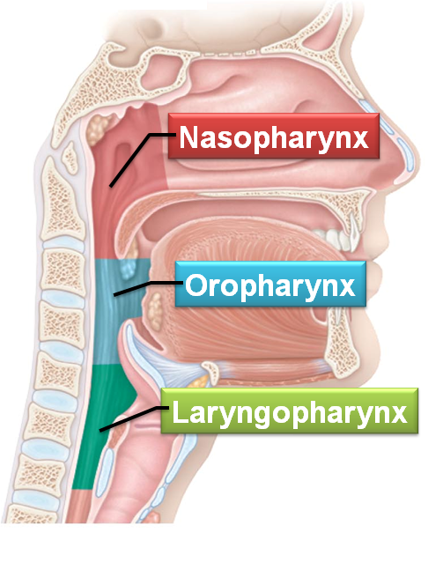
Pharynx
Muscular tube from _
Connects nasal cavity and mouth to larynx and esophagus
Composed of _
Three regions
Nasopharynx
Oropharynx
Laryngopharynx

Slide 17
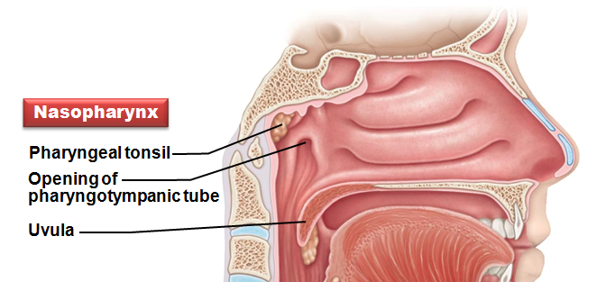
Nasopharynx
Air passageway _
Lining
pseudostratified columnar epithelium
Soft palate and ______________________________ close nasopharynx during swallowing
Pharyngeal tonsil
Pharyngotympanic
(auditory) tubes drain and equalize pressure in middle ear; open into lateral walls

Slide 18
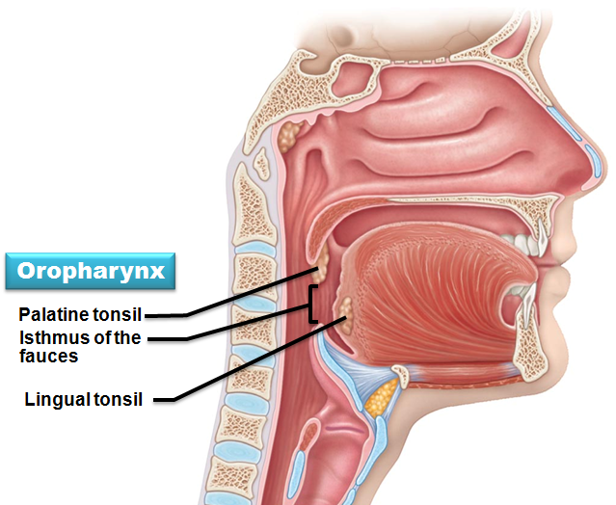
Oropharynx
Passageway for ____________________________ from level of soft palate to epiglottis
Lining of stratified squamous epithelium
opening to oral cavity
Palatine tonsils
Lingual tonsil
on posterior surface of _

Slide 19
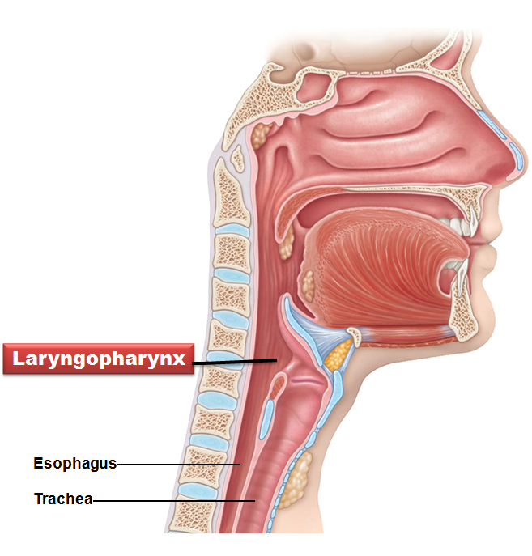
Laryngopharynx
Passageway for _
Posterior to upright epiglottis
Extends to larynx, where continuous with esophagus
Lined with _

Slide 20
Larynx
Attaches to _
opens into laryngopharynx
continuous with trachea
Functions
Provides open airway
Voice production
Houses vocal folds

Slide 21
Larynx
Nine cartilages of larynx
All hyaline cartilage _
Thyroid cartilage with _
Ring-shaped cricoid cartilage
Epiglottis
covers laryngeal inlet during swallowing
covered in taste bud-containing mucosa
_____________________________________ Cartilage
Arytenoid
Cuneiform
Corniculate

Slide 22
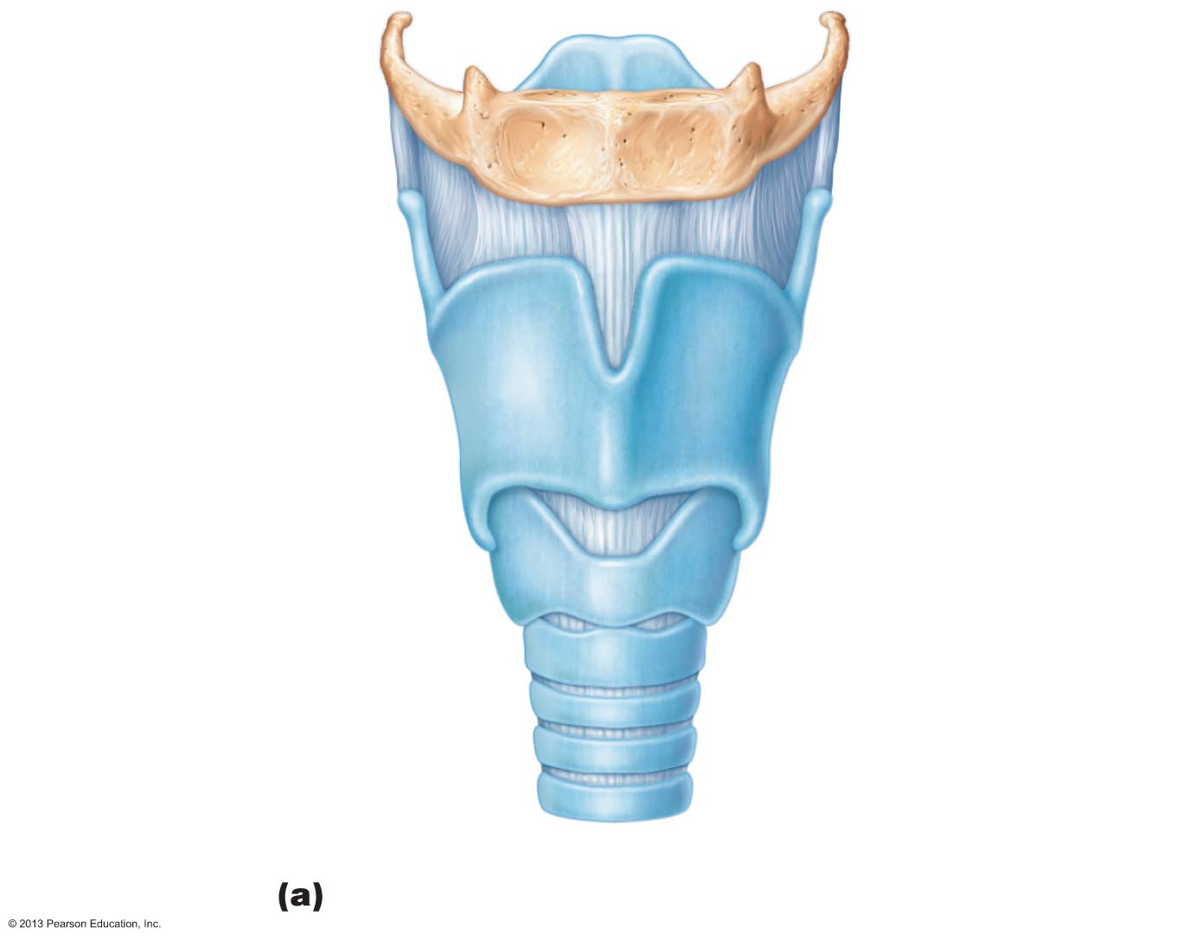
Figure 22.4a The larynx.
Epiglottis
Body of hyoid bone
Thyrohyoid
membrane
Thyroid cartilage
Laryngeal prominence
(Adam’s apple)
Cricothyroid ligament
Cricoid cartilage
Cricotracheal ligament
Tracheal cartilages
Anterior superficial view

Slide 23
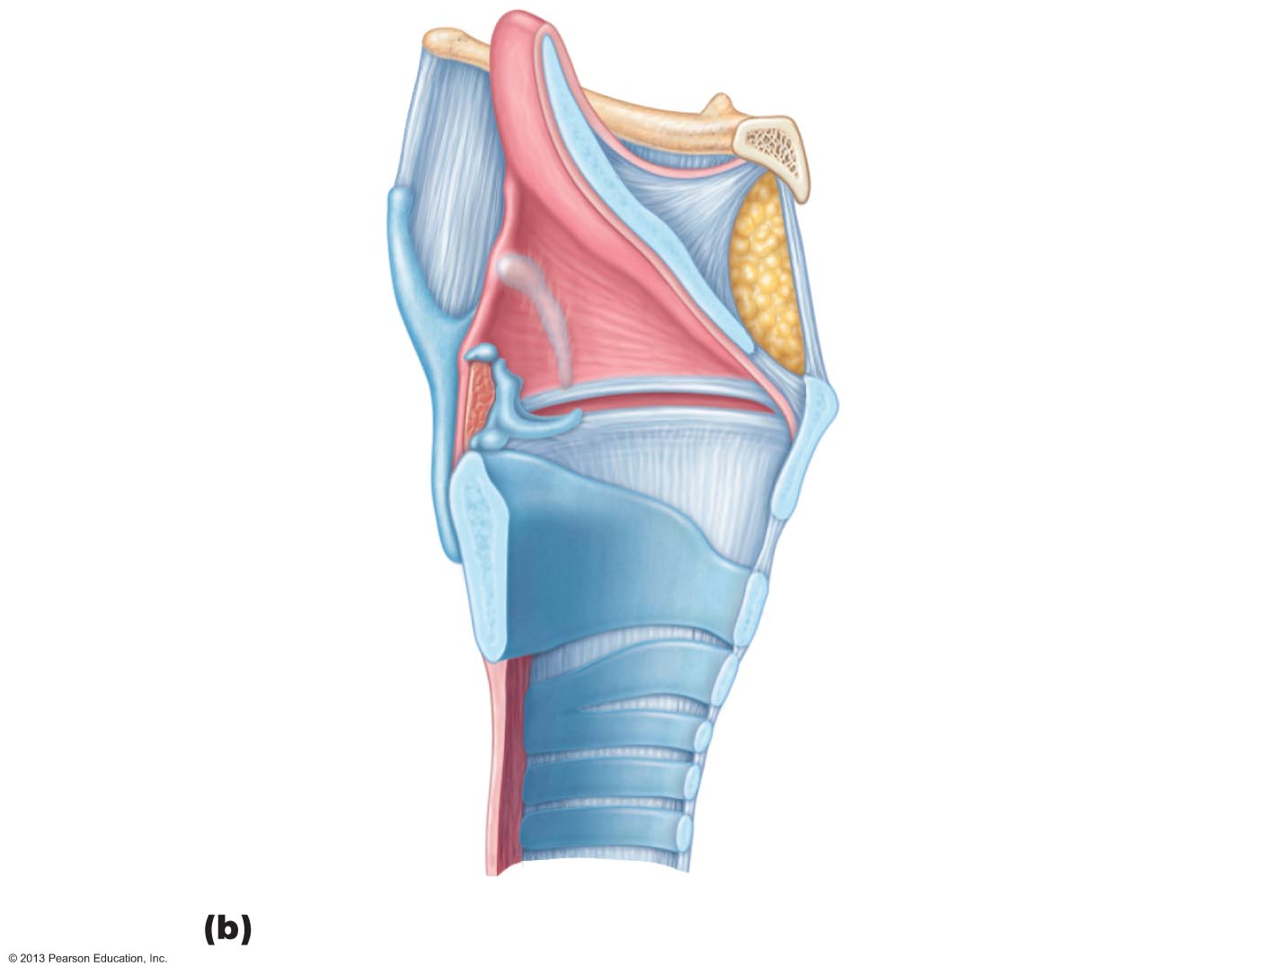
Epiglottis
Body of hyoid bone
Cuneiform cartilage
Corniculate cartilage
Vestibular fold
(false vocal cord)
Arytenoid cartilage
Thyroid cartilage
Vocal fold
(true vocal cord)
Cricoid cartilage
Tracheal cartilages

Slide 24
Larynx
Vocal ligaments
deep to laryngeal mucosa
Attach arytenoid cartilages to thyroid cartilage
Contain elastic fibers
Form core of _
opening between vocal folds
Folds __________________________________________________ to produce sound as air rushes up from lungs

Slide 25
Larynx
Vestibular folds (____________________________)
Superior to vocal folds
No part in sound production
Help to _______________________________________ during swallowing

Slide 26
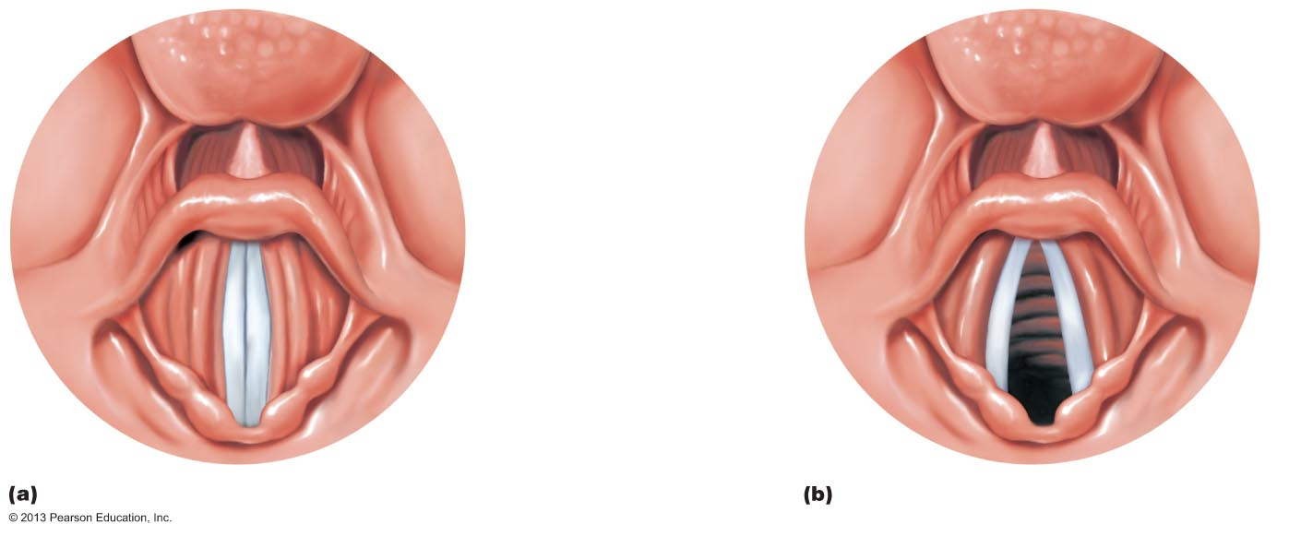
Figure 22.5 Movements of the vocal folds.
Base of tongue
Epiglottis
Vestibular fold (false vocal cord)
Vocal fold (true vocal cord)
Glottis
Inner lining of trachea
Cuneiform cartilage
Corniculate cartilage
Vocal folds in closed position; closed glottis
Vocal folds in open position; open glottis

Slide 27
Voice Production
intermittent release of expired air while opening and closing glottis
Pitch
determined by length and tension of vocal cords
depends upon force of air
__________________________________________________ amplify and enhance sound quality
Pharynx
Oral cavity
Nasal cavity
Sinus cavities
Sound is "shaped" into language by muscles of pharynx, tongue, soft palate, and lips

Slide 28
Larynx
Vocal folds may ______________________________ to prevent air passage
Example
Abdominal muscles contract
Intra-abdominal pressure rises
Helps to empty rectum or stabilizes trunk during heavy lifting
Closes to initiate a “grunt”

Slide 29
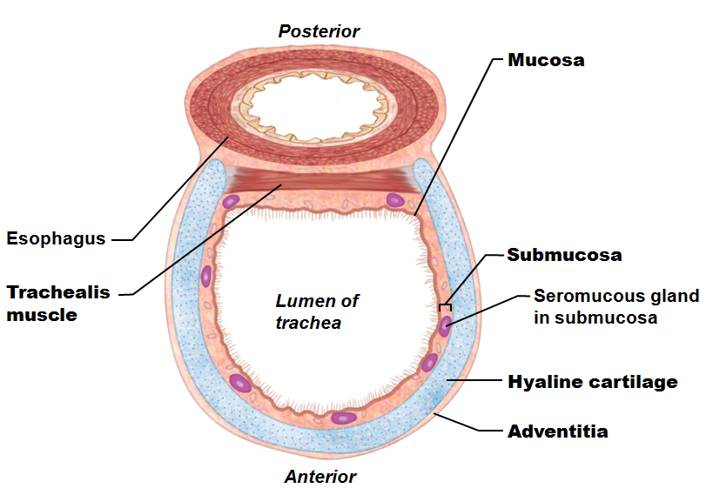
Trachea
Windpipe
from larynx into mediastinum
Wall composed of three layers
ciliated pseudostratified epithelium with goblet cells
connective tissue with seromucous glands
outermost layer made of connective tissue
encases C-shaped rings of hyaline cartilage

Slide 30
Trachea
Trachealis muscle
Connects posterior parts of cartilage rings
Point where trachea branches into two main bronchi

Slide 31
Bronchi and Subdivisions
Air passages undergo _____________________ of branching → bronchial (respiratory) tree
From tips of bronchial tree
→ conducting zone structures
→

Slide 32
Conducting Zone Structures
right and left main (primary) bronchi
Each main bronchus enters hilum of one lung
Each main bronchus branches into lobar (secondary) bronchi (three on right, two on left)
Each lobar bronchus supplies one lobe

Slide 33
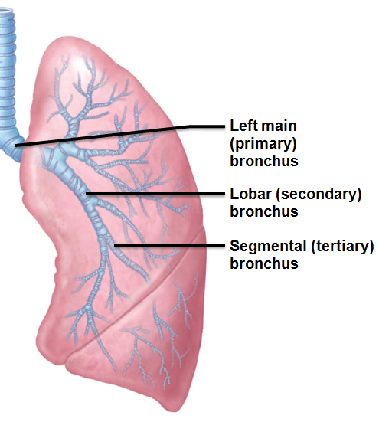
Conducting Zone Structures
Each lobar bronchus branches into segmental (tertiary) bronchi
Segmental bronchi divide repeatedly
Branches become smaller and smaller →
less than 1 mm in diameter

Slide 34
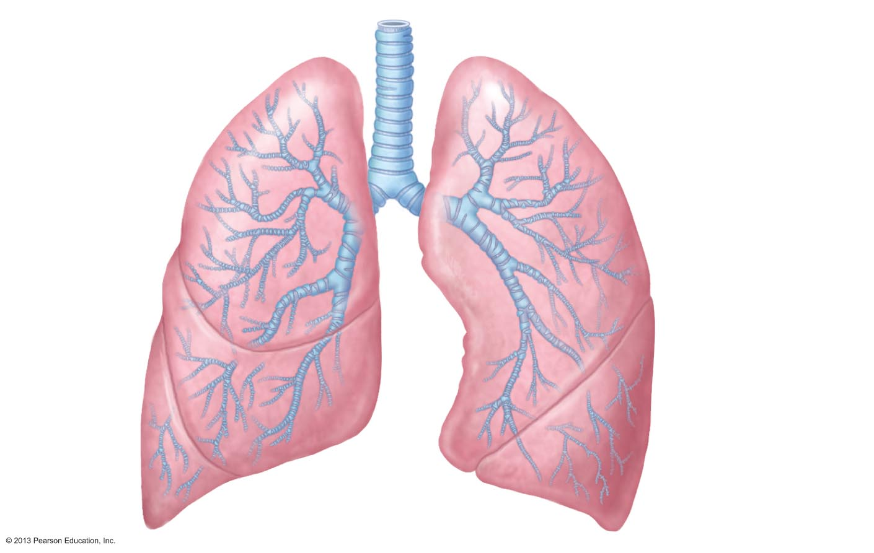
Figure 22.7 Conducting zone passages.
Trachea
Superior lobe
of left lung
Left main
(primary)
bronchus
Superior lobe
of right lung
Lobar (secondary)
bronchus
Segmental (tertiary)
bronchus
Middle lobe
of right lung
Inferior lobe
of right lung
Inferior lobe
of left lung

Slide 35
Conducting Zone Structures
From bronchi through bronchioles, structural changes occur
Cartilage rings _
in bronchioles elastic fibers replace cartilage
Epithelium changes from pseudostratified columnar _
cilia and _
Relative amount of smooth muscle _
Allows constriction

Slide 36
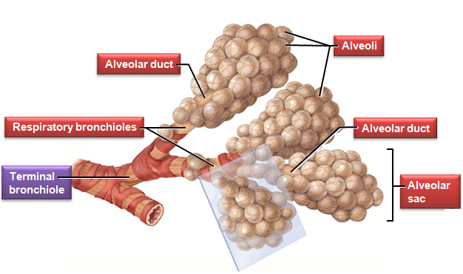
Respiratory Zone
Begins as terminal bronchioles
→
→ alveolar ducts
→ alveolar sacs
Alveolar sacs contain clusters of _
Sites of gas exchange

Slide 37
Respiratory Membrane
Alveolar and capillary walls and their fused basement membranes
~0.5-μ m-thick; gas exchange across membrane _
Alveolar walls
Single layer of squamous epithelium (_______________________________________)
Scattered cuboidal type II alveolar cells secrete _________________________________ and antimicrobial proteins

Slide 38
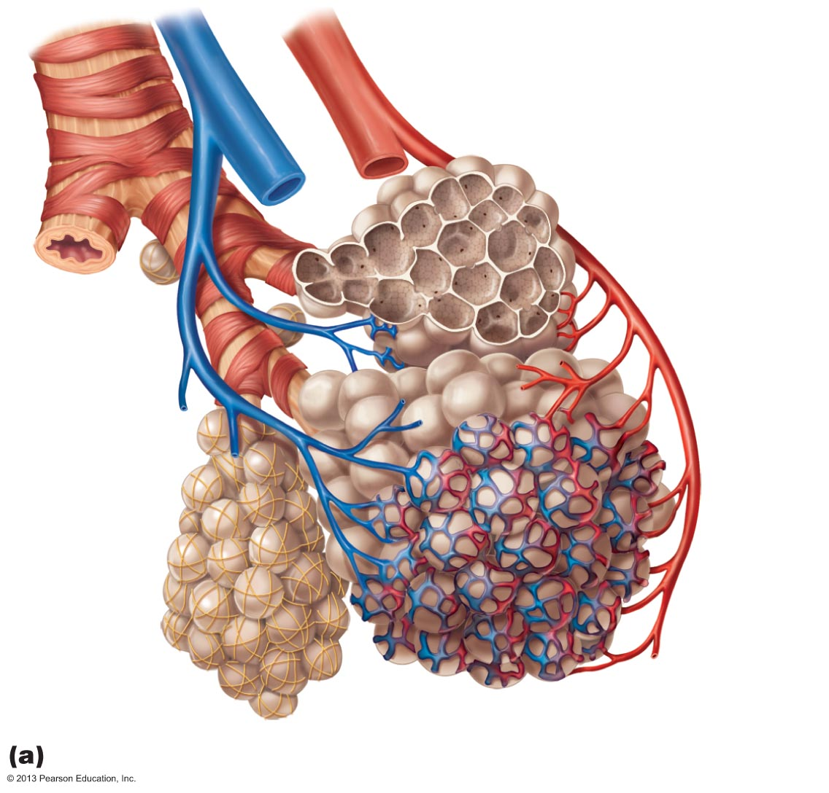
Figure 22.9a Alveoli and the respiratory membrane.
Terminal bronchiole
Respiratory bronchiole
Smooth
muscle
Elastic
fibers
Alveolus
Capillaries
Diagrammatic view of capillary-alveoli relationships

Slide 39
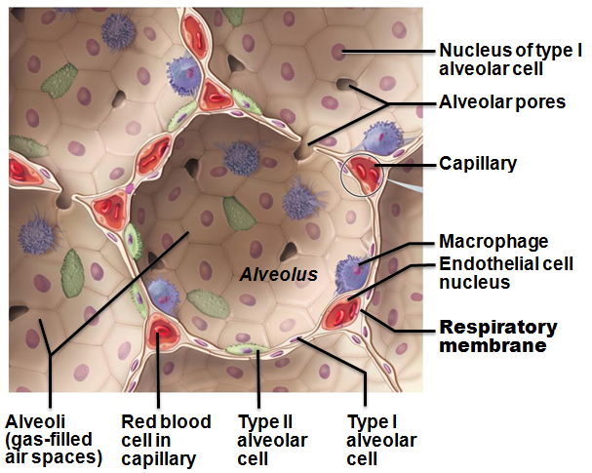
Alveoli
Surrounded by fine _______________________ and pulmonary capillaries
Alveolar _________________________ connect adjacent alveoli
Alveolar macrophages keep alveolar surfaces sterile
2 million dead macrophages/hour carried by cilia → throat → swallowed

Slide 40
Lungs
Occupy all thoracic cavity except mediastinum
Root
site of vascular and bronchial attachment _
anterior, lateral, and posterior surfaces
Composed primarily of alveoli

Slide 41
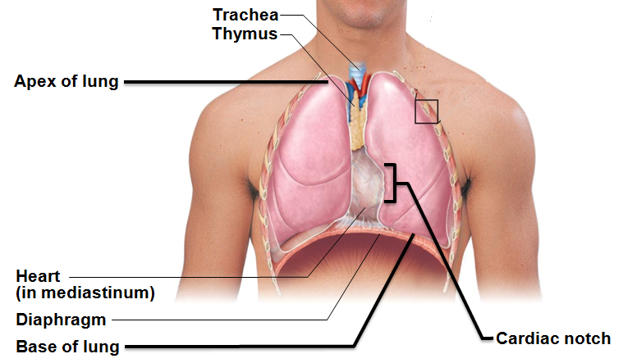
Lungs
superior tip; deep to clavicle
inferior surface; rests on diaphragm
Hilum
on mediastinal surface; site for entry/exit of blood vessels, bronchi, lymphatic vessels, and nerves
_________________________ lung smaller than _
___________________________________________________ -concavity for heart
Separated into superior and inferior lobes by _

Slide 42
Lungs
Right lung
Superior, middle, inferior lobes separated by _
Bronchopulmonary segments (10 right, 8–10 left)
separated by connective tissue septa
If diseased can be individually removed
smallest subdivisions visible to naked eye; served by bronchioles and their branches

Slide 43
Blood Supply
Pulmonary circulation (low pressure, high volume)
deliver systemic ___________________________________ blood to lungs for oxygenation
Branch profusely; feed into pulmonary capillary networks
Pulmonary _
carry _______________________________________________ blood from respiratory zones to heart

Slide 44
Blood Supply
Bronchial arteries provide _____________________________ blood to lung tissue
Arise from ______________________________ and enter lungs at hilum
Part of systemic circulation (high pressure, low volume)
Supply all lung tissue _

Slide 45
Pleurae
Thin, double-layered serosa
thoracic wall
superior face of diaphragm
around heart
between lungs
external lung surface
Pleural fluid fills slitlike pleural cavity
Provides ____________________________________________→ assists in expansion and recoil

Slide 46
Mechanics of Breathing
Pulmonary ventilation consists of two phases
Inspiration
gases exit lungs

Slide 47
Pressure Relationships in the Thoracic Cavity
Atmospheric pressure (P_{atm})
Respiratory pressures described relative to P_{atm}
____________________________________ respiratory pressure
less than atmospheric
____________________________________ respiratory pressure
greater than atmospheric
Zero respiratory pressure
Equal to atmospheric

Slide 48
Intrapulmonary Pressure
Intrapulmonary (intra-alveolar) pressure (P_{pul})
Always eventually equalizes with atmospheric

Slide 49
Intrapleural Pressure
Intrapleural pressure (P_{ip})
Pressure in _
Always a __________________________________________ pressure
less than atmospheric
Less than intrapulmonary pressure
Fluid level must be minimal
Pumped out by lymphatics
If accumulates
→ positive intrapleural pressure
→ lung collapse

Slide 50
Intrapleural Pressure
Negative Intrapleural pressure is caused by opposing forces
Two inward forces promote lung collapse
_________________________________________ of lungs decreases lung size
_________________________________________ of alveolar fluid reduces alveolar size
One outward force tends to _
Elasticity of chest wall pulls thorax outward

Slide 51
Homeostatic Imbalance
Atelectasis (________________________________) due to
Plugged bronchioles
→
Pneumothorax
From either wound in parietal or rupture of visceral pleura
Treated by removing air with chest tubes
Pleural membranes heal
→ lung re-inflates

Slide 52
Pulmonary Ventilation
Inspiration and expiration
Mechanical processes that depend on __________________________________ in thoracic cavity
Volume changes
→
Pressure changes
→ gases flow to equalize pressure

Slide 53
Inspiration
Active process
Inspiratory muscles
Thoracic volume increases
→ intrapulmonary pressure drops below atmospheric
Lungs stretched and intrapulmonary volume increases

Slide 54
Forced Inspiration
Vigorous exercise
COPD
accessory muscles _____________________________ in thoracic cage size
Sternocleidomastoid
Pectoralis minor

Slide 55
Expiration
Quiet expiration normally __________________________ process
Inspiratory muscles relax
Thoracic cavity volume decreases
Elastic _______________________________________ and intrapulmonary volume decreases
→ pressure increases above atmospheric pressure
Air flows out of lungs down its pressure gradient
Note:
uses abdominal and internal intercostal muscles

Slide 56
Physical Factors Influencing Pulmonary Ventilation
Three factors hinder air passage and pulmonary ventilation; require energy to overcome
Airway resistance

Slide 57
Airway Resistance
Resistance usually _
Large airway diameters in first part of conducting zone
Progressive branching of airways as get smaller, increasing total cross-sectional area
Resistance greatest in medium-sized bronchi
Resistance disappears at ______________________________________ where diffusion drives gas movement

Slide 58
Homeostatic Imbalance
As airway resistance rises, breathing movements become more strenuous
Severe constriction or obstruction of bronchioles
Can _
Can occur during ____________________________________; stops ventilation
____________________________________ dilates bronchioles, reduces air resistance

Slide 59
Alveolar Surface Tension
Attracts liquid molecules to one another at gas-liquid interface
Resists any force that tends to increase surface area of liquid
Water–high surface tension; coats alveolar walls →

Slide 60
Alveolar Surface Tension
Detergent-like lipid and protein complex
produced by _
Reduces surface tension of alveolar fluid and discourages alveolar collapse
Insufficient quantity in premature infants causes infant respiratory distress syndrome
→

Slide 61
Lung Compliance
Measure of change in lung volume that occurs with given change in transpulmonary pressure
Higher lung compliance →
Normally high due to
Alveolar surface tension

Slide 62
Lung Compliance
Diminished by
Nonelastic scar tissue replacing lung tissue (_________________________)
__________________________________ production of surfactant
_______________________________________ of thoracic cage

Slide 63
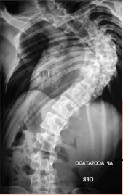
Lung Compliance
Homeostatic imbalances that reduce compliance
Ossification of costal cartilage
Paralysis of intercostal muscles

Slide 64
Respiratory Volumes
Used to assess a person’s respiratory status
Inspiratory reserve volume (IRV)
Expiratory reserve volume (ERV)

Slide 65
Respiratory Volumes
Tidal volume (TV)
air that moves _
(approximately 500 ml)
Inspiratory reserve volume (IRV)
air that can be _
(2100–3200 ml)

Slide 66
Respiratory Volumes
Expiratory reserve volume (ERV)
air that can be _
(1000–1200 ml)
Residual volume (RV)
air left in the lungs after _
(1200 ml)

Slide 67
Respiratory Capacities
Inspiratory capacity (IC)
Functional residual capacity (FRC)
Vital capacity (VC)
Total lung capacity (TLC)

Slide 68
Respiratory Capacities
Inspiratory capacity (IC)
total amount of air that can be _
(IRV + TV)
Functional residual capacity (FRC)
amount of air remaining in the lungs after a _
(RV + ERV)

Slide 69
Respiratory Capacities
Vital capacity (VC)
the _
(TV + IRV + ERV)
Total lung capacity (TLC)
___________________ of all lung volumes
(approximately 6000 ml in males)

Slide 70
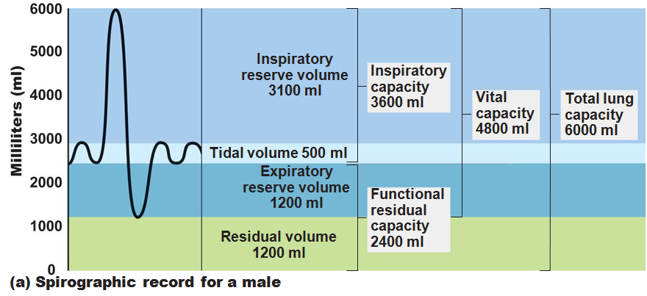

Slide 71
Dead Space
Anatomical dead space
No contribution to _
Air remaining in passageways
Alveolar dead space
__________________________________________ due to collapse or obstruction
sum of anatomical and alveolar dead space

Slide 72
Pulmonary Function Tests
instrument for measuring respiratory volumes and capacities
Spirometry can distinguish between
increased airway resistance (e.g., bronchitis)
TLC, FRC, RV may increase
reduced TLC due to disease or fibrosis
VC, TLC, FRC, RV decline

Slide 73
Pulmonary Function Tests
To measure rate of gas movement
Forced vital capacity (_____________)
gas forcibly expelled after taking deep breath
Forced expiratory volume (____________)
amount of gas expelled during specific time intervals of FVC

Slide 74
Nonrespiratory Air Movements
May modify normal respiratory rhythm
Most result from reflex action; some voluntary
Sneeze
Laughing
Yawns

Slide 75
Gas Exchanges Between Blood, Lungs, and Tissues
External respiration
diffusion of gases in _
Internal respiration
diffusion of gases at _
Both involve
Physical properties of gases
Composition of alveolar gas

Slide 76
Composition of Alveolar Gas
Alveoli contain more CO₂ and water vapor than atmospheric air
Mixing of alveolar gas with each breath

Slide 77
External Respiration
Exchange of O₂ and CO₂ across respiratory membrane
Influenced by
_______________________________ and surface area of respiratory membrane
Partial pressure gradients and _
Ventilation-perfusion coupling

Slide 78
Thickness and Surface Area of the Respiratory Membrane
Respiratory membranes
0.5 to 1 μ m thick
Large total surface area for gas exchange
40 times that of skin
Thicken if lungs become _
→ gas exchange inadequate
Reduced surface area in ______________________, tumors, inflammation, mucus

Slide 79
Partial Pressure Gradients and Gas Solubilities
__________________________ partial pressure gradient for O₂ in lungs
Drives oxygen flow to blood
Equilibrium reached across respiratory membrane in ~0.25 seconds, about 1/3 time a red blood cell in pulmonary capillary →
Adequate oxygenation even if blood flow increases

Slide 80
Partial Pressure Gradients and Gas Solubilities
Partial pressure gradient for CO₂ in lungs _
Though gradient not as steep, CO₂ diffuses in equal amounts with oxygen
________________________________________________ in plasma than oxygen

Slide 81
Ventilation-Perfusion Coupling
blood flow reaching alveoli
amount of gas reaching alveoli
Ventilation and perfusion ______________________ for efficient gas exchange

Slide 82
Ventilation-Perfusion Coupling
Perfusion
Changes in Po₂ in alveoli cause changes in diameters of arterioles
Where alveolar O₂ is high, _______________________________ dilate
Where alveolar O₂ is low, arterioles constrict
Directs most blood where alveolar oxygen high

Slide 83
Ventilation-Perfusion Coupling
Changes in Pco₂ in alveoli cause changes in diameters of _
Where alveolar CO₂ is high, _______________________ dilate
Where alveolar CO₂ is low, bronchioles constrict
Allows __________________________________________ more rapidly

Slide 84
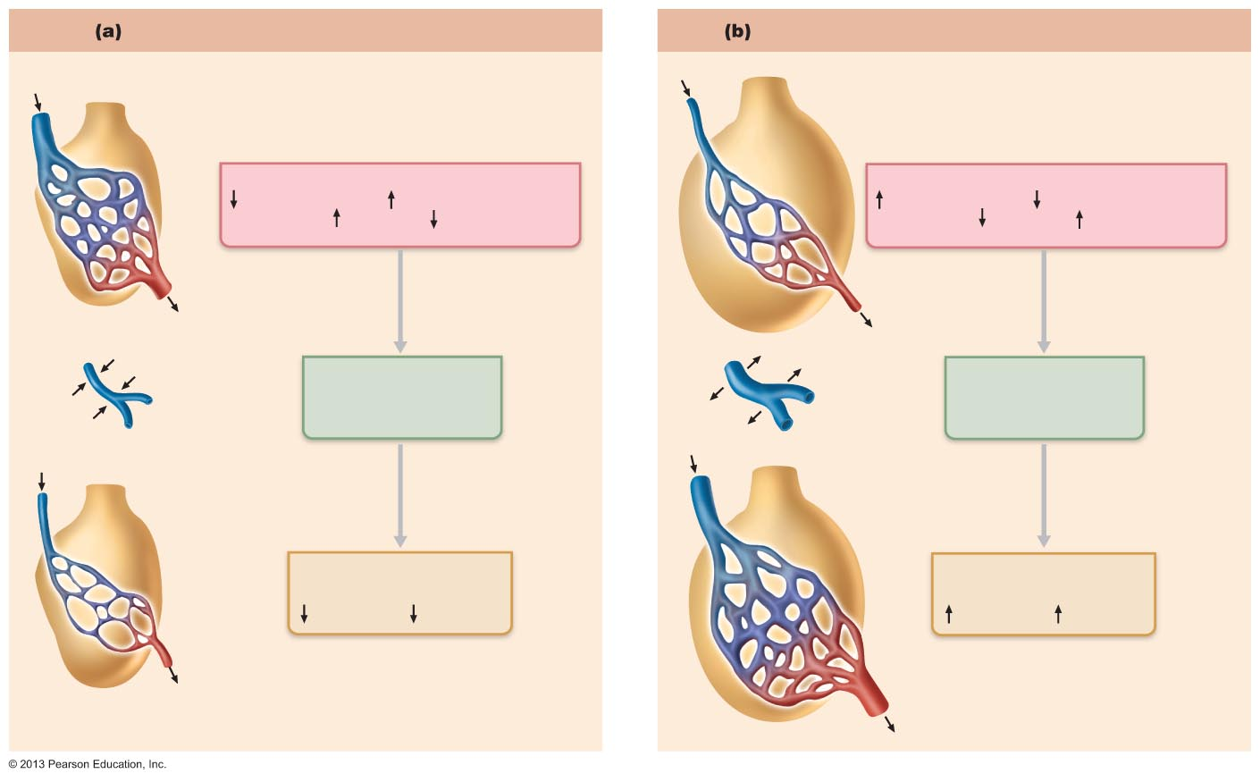
Figure 22.19 Ventilation-perfusion coupling.
Ventilation less than perfusion
Ventilation greater than perfusion
Mismatch of ventilation and perfusion
ventilation and/or perfusion of alveoli
causes local P and P
Mismatch of ventilation and perfusion
ventilation and/or perfusion of alveoli
causes local P and P
CO₂
O₂
CO₂
O₂
O₂ autoregulates
arteriolar diameter
O₂ autoregulates
arteriolar diameter
Pulmonary arterioles
serving these alveoli
constricts
Pulmonary arterioles
serving these alveoli
dilate
Match of ventilation
and perfusion
ventilation, perfusion
Match of ventilation
and perfusion
ventilation, perfusion

Slide 85
Internal Respiration
Capillary gas exchange in _
Partial pressures and diffusion gradients _________________________________________ compared to external respiration

Slide 86
Transport of Respiratory Gases by Blood
Oxygen (O₂) transport
1.5%
98.5%
4 O₂ per Hb
Carbon dioxide (CO₂) transport

Slide 87
O₂ and Hemoglobin
Loading and unloading of O₂ facilitated by _
As O₂ binds, Hb affinity for _
As O₂ is released, Hb affinity for _
Fully saturated (100%) if all four heme groups carry O₂
Partially saturated when one to three hemes carry O₂

Slide 88
O₂ and Hemoglobin
Rate of loading and unloading of O₂ regulated to ensure adequate oxygen delivery to cells
Blood pH
Pco₂
Concentration of _
produced by RBCs during glycolysis
levels rise when oxygen levels chronically low

Slide 89
Influence of Po₂ on Hemoglobin Saturation
In venous blood
Po₂ = 40 mm Hg
Contains 15 vol % oxygen
Venous reserve
Oxygen remaining in venous blood

Slide 90
Other Factors Influencing Hemoglobin Saturation
Increases in temperature, H⁺, Pco₂, and BPG
Modify structure of hemoglobin; _
Occur in _
Enhance O₂ unloading from blood
Shift O₂-hemoglobin dissociation curve to right
Decreases in these factors shift curve to left
Decreases oxygen unloading from blood

Slide 91
Factors that Increase Release of O₂ by Hemoglobin
As cells metabolize glucose and use O₂
Pco₂ and H⁺ increase in capillary blood →
Declining blood pH and increasing Pco₂ →
Bohr effect - Hb-O₂ bond weakens → _
Heat production increases → directly and indirectly decreases Hb affinity for O₂ → _

Slide 92
Homeostatic Imbalance
Hypoxia
Inadequate O₂ delivery to tissues → cyanosis
too few RBCs; abnormal or too little Hb
impaired/blocked circulation
Histotoxic hypoxia
cells unable to use O₂, as in metabolic poisons
Hypoxemic hypoxia
abnormal ventilation; pulmonary disease
200X greater affinity for Hb than oxygen

Slide 93
CO₂ Transport
CO₂ transported in blood in three forms
7 to 10% _
20% bound to globin of _(carbaminohemoglobin)
70% transported as _

Slide 94
Transport and Exchange of CO₂
CO₂ combines with water to form _____________________________ (H₂CO₃), which quickly dissociates
Occurs primarily ______________________ , where carbonic anhydrase reversibly and rapidly catalyzes reaction

Slide 95
Transport and Exchange of CO₂
In systemic capillaries
HCO₃– quickly diffuses from RBCs into plasma
Outrush of HCO₃– from RBCs balanced as Cl– moves into RBCs from plasma

Slide 96
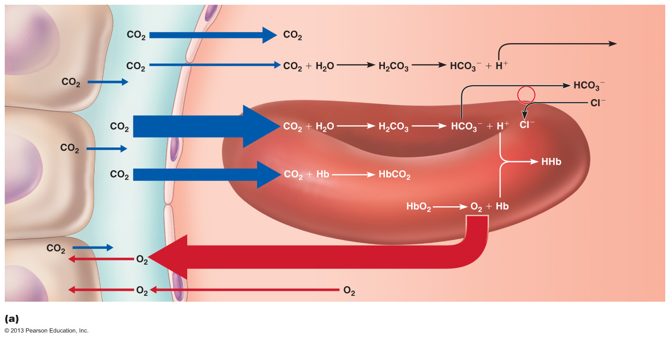
Figure 22.22a Transport and exchange of CO₂ and O₂.
Tissue cell
Interstitial fluid
(dissolved in plasma)
Binds to
plasma
proteins
Slow
Chloride
shift
(in) via
transport
protein
Fast
Carbonic
anhydrase
(Carbamino-
hemoglobin)
Red blood cell
(dissolved in plasma)
Blood plasma
Oxygen release and carbon dioxide pickup at the tissues

Slide 97
Transport and Exchange of CO₂
In pulmonary capillaries
HCO₃– moves into RBCs (while Cl⁻ move out); binds with H⁺ to form H₂CO₃
H₂CO₃ split by ___________________________________ into CO₂ and water
CO₂ diffuses into _

Slide 98
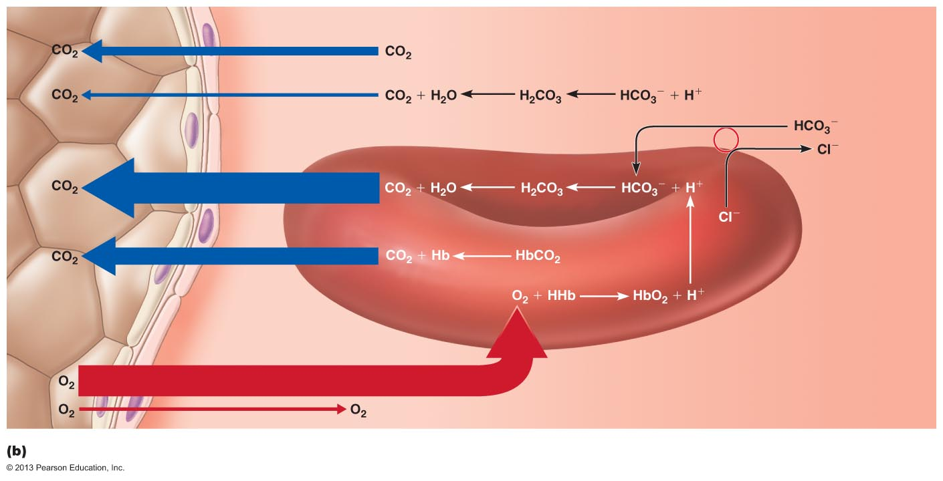
Figure 22.22b Transport and exchange of CO₂ and O₂.
Alveolus
Fused basement membranes
(dissolved in plasma)
Slow
Chloride
shift
(out) via
transport
protein
Fast
Carbonic
anhydrase
(Carbamino-
hemoglobin)
Red blood cell
(dissolved in plasma)
Blood plasma
Oxygen pickup and carbon dioxide release in the lungs

Slide 99
Influence of CO₂ on Blood pH
Carbonic acid–bicarbonate buffer system– _
If H⁺ concentration in blood rises, excess H⁺ is removed by combining with HCO₃– to create H₂CO₃
If H⁺ concentration begins to drop, H₂CO₃ dissociates_
HCO₃– is alkaline reserve of carbonic acid-bicarbonate buffer system

Slide 100
Influence of CO₂ on Blood pH
Changes in respiratory rate and depth affect blood pH
Slow, shallow breathing → increased CO₂ in blood
→
Lower pH means more acidic
Rapid, deep breathing → decreased CO₂ in blood
→
Rise in pH means more alkaline, less acidic
Changes in ventilation can adjust pH when disturbed by metabolic factors

Slide 101
Depth and Rate of Breathing
increased depth and rate of breathing that exceeds body's need to remove CO₂
→ decreased blood CO₂ levels (_______________________)
→ cerebral vasoconstriction and cerebral ischemia → dizziness, fainting
breathing cessation from abnormally low Pco₂

Slide 102
Summary of Chemical Factors
__________________________ levels most powerful respiratory stimulant
Normally blood Po₂ affects breathing only indirectly by influencing _________________________________ sensitivity to changes in Pco₂

Slide 103
Summary of Chemical Factors
When arterial __________ falls below 60 mm Hg, it becomes _
via ____________________________chemoreceptors
Changes in arterial pH resulting from CO₂ retention or metabolic factors act indirectly through peripheral chemoreceptors

Slide 104
Influence of Higher Brain Centers
Hypothalamic controls act through ______________________________ to modify rate and depth of respiration
Example-breath holding that occurs in _
Rise in body temperature increases respiratory rate
Cortical controls
direct signals from _
Example- _
Brain stem reinstates breathing when blood CO₂ critical

Slide 105
Inflation Reflex
Hering-Breuer Reflex (inflation reflex)
______________________________________ in pleurae and airways stimulated by lung inflation
Inhibitory signals to medullary respiratory centers end inhalation and _
Acts as protective response more than normal regulatory mechanism

Slide 106
Homeostatic Imbalances
Chronic obstructive pulmonary disease (COPD)
Exemplified by
Irreversible decrease in ability to force air out of lungs
Other common features
History of smoking in 80% of patients
labored breathing "air hunger"
Coughing and frequent pulmonary infections
Most develop respiratory failure (____________________________) accompanied by respiratory acidosis, hypoxemia

Slide 107
Homeostatic Imbalance
Emphysema
Permanent _
destruction of _
_______________________________________ lung elasticity →
Accessory muscles necessary for breathing
→
Hyperinflation → flattened diaphragm → reduced ventilation efficiency
Damaged pulmonary capillaries → enlarged right ventricle

Slide 108
Homeostatic Imbalance
Chronic bronchitis
Inhaled irritants → _______________________________→
Inflamed and fibrosed lower respiratory passageways →
Obstructed airways →
Impaired lung ventilation and gas exchange →

Slide 109
Homeostatic Imbalance
COPD symptoms and treatment
Strength of innate respiratory drive → different symptoms in patients
“______________________________________“
thin; near-normal blood gases
Primary pathology: emphysema
Body compensates with hyperventilation: puffing
“______________________________________“
stocky, hypoxic
Primary pathology: chronic bronchitis
Decreased ventilation/increased cardiac output
Increased ____________________________________________ causes “bloated” appearance
Treated with bronchodilators, corticosteroids, oxygen, sometimes surgery

Slide 110
Homeostatic Imbalances
Asthma
Characterized by coughing, ______________________________, wheezing, and chest tightness
Active _______________________________ of airways precedes bronchospasms
Airway inflammation is immune response caused by release of interleukins, production of IgE, and recruitment of inflammatory cells
Airways ___________________________________ with inflammatory exudate magnify effect of bronchospasms

Slide 111
Homeostatic Imbalances
Tuberculosis (TB)
Infectious disease caused by bacterium Mycobacterium tuberculosis
Symptoms
______________________________________, weight loss, racking cough, coughing up blood
Treatment- 12-month course of antibiotics
Are antibiotic resistant strains

Slide 112
Homeostatic Imbalances
Lung cancer
Leading cause of cancer deaths in North America
90% of all cases _
Three most common types
Adenocarcinoma (~40% of cases)
originates in _
bronchial glands, alveolar cells
Squamous cell carcinoma (20–40% of cases)
in _
Small cell carcinoma (~20% of cases)
contains lymphocyte-like cells that originate in ______________________________________________________ and subsequently metastasize

Slide 113
Homeostatic Imbalance
Lung cancer
Early detection key to survival
If no metastasis →
If metastasis →

