Slide 1
Respiratory Capacities
____________________________________ capacity (IC)
____________________________________ capacity (FRC)
____________________________________ capacity (VC)
Total lung capacity (TLC)

Slide 2
Respiratory Capacities
Inspiratory capacity (IC)
total amount of air that can be _
Functional residual capacity (FRC)
amount of air remaining in the lungs after a _

Slide 3
Respiratory Capacities
Vital capacity (VC)
the total amount of ______________________________________________ (TV + IRV + ERV)
Total lung capacity (TLC)
sum of all lung volumes (approximately 6000 ml in males)

Slide 4
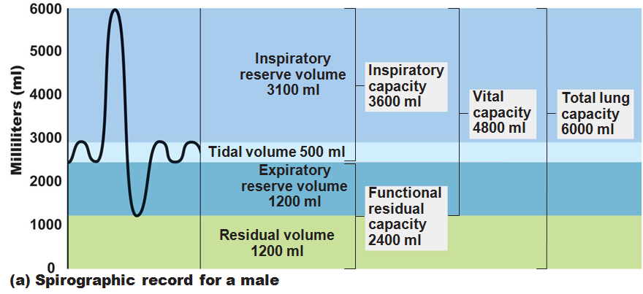

Slide 5
Dead Space
Some inspired air _
volume of the _________________________________ zone conduits (~150 ml)
Alveolar dead space:
alveoli that ___________________________________ in gas exchange due to _
Total dead space:
sum of above non-useful volumes

Slide 6
Pulmonary Function Tests
instrument used to measure respiratory volumes and capacities
Spirometry can distinguish between
increased airway resistance (e.g., bronchitis)
reduction in total lung capacity due to structural or functional lung changes (e.g., fibrosis or TB)

Slide 7
Pulmonary Function Tests
total amount of gas flow into or out of the respiratory tract in one minute
Forced vital capacity (FVC):
gas forcibly _
Forced expiratory volume (FEV):
the amount of gas expelled ______________________________________________ of the FVC

Slide 8
Pulmonary Function Tests
____________________________________ in TLC, FRC, and RV may occur as a result of _
____________________________________ in VC, TLC, FRC, and RV result from _

Slide 9
Alveolar Ventilation
Alveolar ventilation rate (AVR): flow of gases into and out of the alveoli during a particular time
Dead space is _
Rapid, shallow breathing _
AVR | = | frequency | X | (TV – dead space)
(ml/min) |  | (breaths/min) |  | (ml/breath)

Slide 10
Nonrespiratory Air Movements
Most result from reflex action
Examples include:
Sneeze
Laughing

Slide 11
Gas Exchanges Between Blood, Lungs, and Tissues
To understand the above processes, first consider
Physical properties of gases
Composition of alveolar gas

Slide 12
Composition of Alveolar Gas
Alveoli contain more CO₂ and water vapor than atmospheric air, due to
Gas exchanges in the lungs
______________________________________ of alveolar gas that occurs with each breath

Slide 13
External Respiration
Exchange of O₂ and CO₂ across the respiratory membrane
Influenced by
___________________________________________ gradients and gas solubilities
Structural characteristics of the respiratory membrane

Slide 14
Partial Pressure Gradients and Gas Solubilities
Partial pressure ____________________________ for O₂ in the lungs is steep
Venous blood Po₂ = 40 mm Hg
Alveolar Po₂ = 104 mm Hg
O₂ partial pressures reach equilibrium of 104 mm Hg in ~0.25 seconds, _

Slide 15
Partial Pressure Gradients and Gas Solubilities
Partial pressure gradient for CO₂ in the lungs is __________________________________________:
Venous blood Pco₂ = 45 mm Hg
Alveolar Pco₂ = 40 mm Hg
CO₂ is _______________________________________ in plasma than oxygen
CO₂ diffuses in equal amounts with oxygen

Slide 16
Ventilation-Perfusion Coupling
amount of gas reaching the _
_______________________________________ reaching the alveoli
Ventilation and perfusion must be ____________________________________ (coupled) for efficient gas exchange

Slide 17
Ventilation-Perfusion Coupling
Changes in Po₂ in the alveoli cause changes _
Where alveolar O₂ is high, _
Where alveolar O₂ is low, _

Slide 18
Ventilation-Perfusion Coupling
Changes in Pco₂ in the alveoli cause changes in the diameters of the bronchioles
Where alveolar CO₂ is high, _
Where alveolar CO₂ is low, _

Slide 19
Thickness and Surface Area of the Respiratory Membrane
Respiratory membranes
0.5 to 1 μm thick
Large total surface area
__________________________________ if lungs become waterlogged and edematous, and gas exchange becomes inadequate
Reduction in surface area with ____________________________________ , when walls of _

Slide 20
Internal Respiration
Partial pressures and diffusion gradients are reversed compared to external respiration

Slide 21
Transport of Respiratory Gases by Blood
Oxygen (O₂) transport
Carbon dioxide (CO₂) transport

Slide 22
O₂ Transport
Molecular O₂ is carried in the blood
1.5% dissolved in _
98.5% loosely bound to _
4 O₂ per Hb

Slide 23
O₂ and Hemoglobin
______________________________________- (HbO₂):
hemoglobin-O₂ combination
Reduced hemoglobin (HHb):
hemoglobin that has _

Slide 24
O₂ and Hemoglobin
Loading and unloading of O₂ is facilitated by change in _
As O₂ binds, Hb ________________________________ for O₂ increases
As O₂ is released, Hb affinity for _
Fully (100%) saturated
if _________________________________ heme groups carry O₂
Partially saturated
when one to three hemes carry O₂

Slide 25
O₂ and Hemoglobin
Rate of loading and unloading of O₂ is regulated by
Po₂
Blood pH
Pco₂

Slide 26
Hemoglobin Saturation Curve
Hemoglobin is almost completely saturated at a P_{O2} _
Further increases in P_{O2} produce only _____________________________________ in oxygen binding
Oxygen loading and delivery to tissue is adequate when P_{O2} is _

Slide 27
Hemoglobin Saturation Curve
Only ________________________________ of bound oxygen is unloaded during _
If oxygen levels in tissues drop:
________________________________________ from hemoglobin and is used by cells
Respiratory rate or cardiac output _

Slide 28
Factors Influencing Hemoglobin Saturation
_______________________________ of these factors:
Po₂
Temperature
Blood pH
Pco₂
Concentration of BPG
Increase of the above factors _
Enhances oxygen _
Decreases act in the opposite manner
These parameters are all high in _________________________________________________ capillaries where oxygen unloading is the goal

Slide 29
Factors that Increase Release of O₂ by Hemoglobin
As cells metabolize _
Pco₂ and H⁺ increase in concentration in capillary blood
________________________________________________ weakens the hemoglobin-O₂ bond
Heat production increases
_____________________________________________________ directly and indirectly decreases Hb affinity for O₂

