Slide 1
Intrapulmonary Pressure
Intrapulmonary (intra-alveolar) pressure (P_{pul})
Pressure in the alveoli
Fluctuates with breathing
Always eventually equalizes with P_{atm}

Slide 2
Intrapleural Pressure
Intrapleural pressure (P_{ip}):
Pressure _
_____________________________________ with breathing
Always a _______________________________________ pressure (<P_{atm} and <P_{pul})

Slide 3
Intrapleural Pressure
Negative P_{ip} is caused by _
Two inward forces _
Elastic ___________________________________ of lungs decreases lung size
_______________________________________________ of alveolar fluid reduces alveolar size
One outward force tends to _
___________________________________________ of the chest wall pulls the thorax outward

Slide 4
Pressure Relationships
If P_{ip} = P_{pul} the _
(P_{pul} – P_{ip}) = transpulmonary pressure
Keeps the airways open
The greater the transpulmonary pressure, _

Slide 5
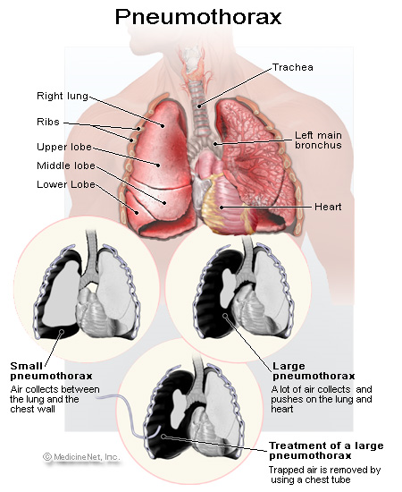
Homeostatic Imbalance
_______________________ (lung collapse) is due to
Plugged bronchioles → _
Wound that admits air into pleural cavity

Slide 6
Pulmonary Ventilation
Inspiration and expiration
________________________________ processes that depend on _____________________________ changes in the thoracic cavity
Volume changes yield _
Pressure changes cause gases flow to equalize pressure

Slide 7
Inspiration
An active process
_________________________________ muscles contract
Thoracic _
Lungs are stretched and intrapulmonary _
Intrapulmonary _
Air flows into the lungs, down its pressure gradient until intrapulmonary pressure is the same as atmospheric pressure

Slide 8
Expiration
Quiet expiration is normally a _________________________ process
Inspiratory muscles relax
Thoracic cavity _
Elastic lungs _____________________________ and intrapulmonary _
Intrapulmonary __________________________________________ than atmospheric pressure
Air flows out of the lungs down its pressure gradient
Note: ___________________________expiration is an ___________________________________ process: it uses abdominal and internal intercostal muscles

Slide 9
Physical Factors Influencing Pulmonary Ventilation
Inspiratory muscles consume energy to overcome three factors that hinder air passage and pulmonary ventilation
Alveolar _
Lung compliance

Slide 10
Airway Resistance
_________________________________ is the major nonelastic source of resistance to gas flow
Gas flow changes inversely with resistance

Slide 11
Airway Resistance
Resistance is usually insignificant because of
____________________________________________ in the first part of the conducting zone
Progressive branching of airways as they get smaller, increasing the total cross-sectional area
Resistance disappears at the terminal bronchioles where _

Slide 12
Airway Resistance
As airway resistance rises, _
Severely constricting or obstruction of bronchioles
Can __________________________________ life-sustaining ventilation
Can occur during _____________________________________________ and stop ventilation
_________________________________________ dilates bronchioles and reduces air resistance

Slide 13
Alveolar Surface Tension
Attracts liquid molecules to one another at a gas-liquid interface
________________________________________ that tends to increase the surface area of the liquid

Slide 14
Alveolar Surface Tension
Detergent-like lipid and protein complex produced by _
_____________________________________________ of alveolar fluid and discourages alveolar collapse
Insufficient quantity in premature infants causes infant respiratory distress syndrome

Slide 15
Lung Compliance
A measure of the change in lung volume that occurs with a given change in transpulmonary pressure
Normally _____________________________ due to
Alveolar surface tension

Slide 16
Lung Compliance
Diminished by
Nonelastic scar tissue _
Reduced production of _
_________________________________________________ of the thoracic cage

Slide 17
Lung Compliance
Homeostatic imbalances that reduce compliance
Deformities of _
_________________________________________ of the costal cartilage
Paralysis of _

Slide 18
Respiratory Volumes
Used to assess a person’s respiratory status
___________________________________volume (TV)
___________________________________ reserve volume (IRV)
___________________________________ reserve volume (ERV)
____________________________________volume (RV)

Slide 19
Respiratory Volumes
Tidal volume (TV)
air that moves into and out of the lungs _
Inspiratory reserve volume (IRV)
air that can be _

Slide 20
Respiratory Volumes
Expiratory reserve volume (ERV)
air that can be ____________________________ from the lungs after a __________________________ expiration (1000–1200 ml)
Residual volume (RV)
air left in the lungs after _

Slide 21
Respiratory Capacities
____________________________________ capacity (IC)
____________________________________ capacity (FRC)
____________________________________ capacity (VC)
Total lung capacity (TLC)

Slide 22
Respiratory Capacities
Inspiratory capacity (IC)
total amount of air that can be _
Functional residual capacity (FRC)
amount of air remaining in the lungs after a _

Slide 23
Respiratory Capacities
Vital capacity (VC)
the total amount of ______________________________________________ (TV + IRV + ERV)
Total lung capacity (TLC)
sum of all lung volumes (approximately 6000 ml in males)

Slide 24
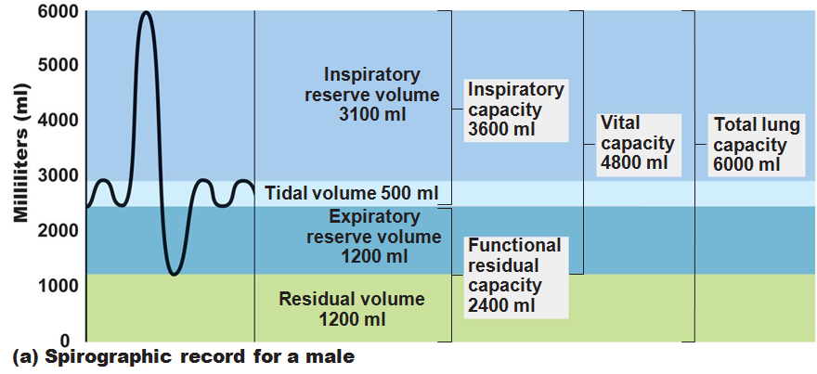

Slide 25
Dead Space
Some inspired air _
volume of the _________________________________ zone conduits (~150 ml)
Alveolar dead space:
alveoli that ___________________________________ in gas exchange due to _
Total dead space:
sum of above non-useful volumes

Slide 26
Pulmonary Function Tests
instrument used to measure respiratory volumes and capacities
Spirometry can distinguish between
increased airway resistance (e.g., bronchitis)
reduction in total lung capacity due to structural or functional lung changes (e.g., fibrosis or TB)

Slide 27
Pulmonary Function Tests
total amount of gas flow into or out of the respiratory tract in one minute
Forced vital capacity (FVC):
gas forcibly _
Forced expiratory volume (FEV):
the amount of gas expelled ______________________________________________ of the FVC

Slide 28
Pulmonary Function Tests
____________________________________ in TLC, FRC, and RV may occur as a result of _
____________________________________ in VC, TLC, FRC, and RV result from _

Slide 29
Alveolar Ventilation
Alveolar ventilation rate (AVR): flow of gases into and out of the alveoli during a particular time
Dead space is _
Rapid, shallow breathing _
AVR | = | frequency | X | (TV – dead space)
(ml/min) |  | (breaths/min) |  | (ml/breath)

Slide 30
Nonrespiratory Air Movements
Most result from reflex action
Examples include:
Sneeze
Laughing

Slide 31
Gas Exchanges Between Blood, Lungs, and Tissues
To understand the above processes, first consider
Physical properties of gases
Composition of alveolar gas

Slide 32
Composition of Alveolar Gas
Alveoli contain more CO₂ and water vapor than atmospheric air, due to
Gas exchanges in the lungs
______________________________________ of alveolar gas that occurs with each breath

Slide 33
External Respiration
Exchange of O₂ and CO₂ across the respiratory membrane
Influenced by
___________________________________________ gradients and gas solubilities
Structural characteristics of the respiratory membrane

Slide 34
Partial Pressure Gradients and Gas Solubilities
Partial pressure ____________________________ for O₂ in the lungs is steep
Venous blood Po₂ = 40 mm Hg
Alveolar Po₂ = 104 mm Hg
O₂ partial pressures reach equilibrium of 104 mm Hg in ~0.25 seconds, _

Slide 35
Partial Pressure Gradients and Gas Solubilities
Partial pressure gradient for CO₂ in the lungs is __________________________________________:
Venous blood Pco₂ = 45 mm Hg
Alveolar Pco₂ = 40 mm Hg
CO₂ is _______________________________________ in plasma than oxygen
CO₂ diffuses in equal amounts with oxygen

Slide 36
Ventilation-Perfusion Coupling
amount of gas reaching the _
_______________________________________ reaching the alveoli
Ventilation and perfusion must be ____________________________________ (coupled) for efficient gas exchange

Slide 37
Ventilation-Perfusion Coupling
Changes in Po₂ in the alveoli cause changes _
Where alveolar O₂ is high, _
Where alveolar O₂ is low, _

Slide 38
Ventilation-Perfusion Coupling
Changes in Pco₂ in the alveoli cause changes in the diameters of the bronchioles
Where alveolar CO₂ is high, _
Where alveolar CO₂ is low, _

Slide 39
Thickness and Surface Area of the Respiratory Membrane
Respiratory membranes
0.5 to 1 μm thick
Large total surface area
__________________________________ if lungs become waterlogged and edematous, and gas exchange becomes inadequate
Reduction in surface area with ____________________________________ , when walls of _

Slide 40
Internal Respiration
Partial pressures and diffusion gradients are reversed compared to external respiration

Slide 41
Transport of Respiratory Gases by Blood
Oxygen (O₂) transport
Carbon dioxide (CO₂) transport

Slide 42
O₂ Transport
Molecular O₂ is carried in the blood
1.5% dissolved in _
98.5% loosely bound to _
4 O₂ per Hb

Slide 43
O₂ and Hemoglobin
______________________________________- (HbO₂):
hemoglobin-O₂ combination
Reduced hemoglobin (HHb):
hemoglobin that has _

Slide 44
O₂ and Hemoglobin
Loading and unloading of O₂ is facilitated by change in _
As O₂ binds, Hb ________________________________ for O₂ increases
As O₂ is released, Hb affinity for _
Fully (100%) saturated
if _________________________________ heme groups carry O₂
Partially saturated
when one to three hemes carry O₂

Slide 45
O₂ and Hemoglobin
Rate of loading and unloading of O₂ is regulated by
Po₂
Blood pH
Pco₂

Slide 46
Hemoglobin Saturation Curve
Hemoglobin is almost completely saturated at a P_{O2} _
Further increases in P_{O2} produce only __________________________________________ in oxygen binding
Oxygen loading and delivery to tissue is adequate when P_{O2} is _

Slide 47
Hemoglobin Saturation Curve
Only ________________________________ of bound oxygen is unloaded during _
If oxygen levels in tissues drop:
________________________________________ from hemoglobin and is used by cells
Respiratory rate or cardiac output _

