Slide 1
Function of the respiratory system
Goal:
to supply the _
To dispose of _
Method: Respiration: Includes the following
Transport of _

Slide 2
Pulmonary Ventilation
Movement of _

Slide 3
External Respiration
Movement of
oxygen
Carbon dioxide

Slide 4
Transport of gasses
Oxygen is carried to the cells of the body via the _
Carbon dioxide is carried from the body to the lungs _

Slide 5
Internal respiration
Moving oxygen from _
Moving carbon dioxide from _

Slide 6
Cells’ use for oxygen
Why transport oxygen?
We deliver oxygen to the cells
Within the cell, oxygen is used by ___________________________________ in a process called _
Production of ATP

Slide 7
Respiratory Anatomy
Respiratory system includes
Nose
Pharynx
Trachea
Lungs
Alveoli

Slide 8
Respiratory system
Can be divided up into two functional zones
1.
Actual location where _
Respiratory bronchioles
Alveoli
Microscopic structures

Slide 9
Respiratory system
2.
The passageways that _____________________________________, but do not participate in exchange
Rigid conduits
Also function to

Slide 10
Function of the Nose
The only __________________________ part of the respiratory system
Provides an airway for respiration
__________________________________ the entering air
__________________________________ inspired air and cleans it of foreign matter

Slide 11
Structure of the Nose
Nose is divided into two regions:
External nose, including the _
Internal _
_____________________________ – a shallow vertical groove inferior to the apex
The external ______________ (nostrils) are bounded laterally by the ____________

Slide 12
Nasal Cavity
Lies in and posterior to the external nose
Is divided by a _
Opens posteriorly into the nasal pharynx via internal nares
The _____________________________ bones form the roof
The floor is formed by the _

Slide 13
Nasal Cavity
Vestibule –
_____________________________ – hairs that filter coarse particles from inspired air
Olfactory mucosa
Lines the _
Contains smell receptors

Slide 14
Nasal Cavity
____________________________ mucosa
Lines the nasal cavity
Except for the olfactory portion
Glands secrete mucus containing ______________________ and ______________________ to help destroy bacteria

Slide 15
Nasal Cavity
Inspired air is:
______________________________ by the high water content in the nasal cavity
______________________________ by rich plexuses of capillaries
Remember:
Ciliated mucosal cells remove contaminated mucus

Slide 16
Nasal Cavity
Superior, medial, and inferior conchae:
Protrude medially from the lateral walls
Enhance air turbulence and _
Sensitive mucosa triggers sneezing when stimulated by _

Slide 17
Functions of the Nasal Mucosa and Conchae
During inhalation the conchae and nasal mucosa:
Filter, heat, and moisten air
During _________________________ these structures:
_________________________ heat and moisture
__________________________ heat and moisture loss

Slide 18
Paranasal Sinuses
Sinuses ______________________ that surround the nasal cavity
Sinuses ____________________________ and help to warm and moisten the air

Slide 19
Pharynx
The _
Funnel-shaped tube of skeletal muscle that connects to the:
__________________________________ superiorly
__________________________________ inferiorly
Extends from the base of the skull to the level of the sixth cervical vertebra

Slide 20
Pharynx
It is divided into three regions
Oropharynx

Slide 21
Nasopharynx
Lies ___________________ to the nasal cavity,
inferior to the sphenoid,
superior to the level of the soft palate
Strictly an _
Lined with pseudostratified columnar epithelium

Slide 22
Nasopharynx
___________________ during swallowing to _
The _____________________________ lies high on the posterior wall
Pharyngotympanic (auditory) tubes open into the lateral walls

Slide 23
Oropharynx
Extends inferiorly from the level of the soft palate to the epiglottis
Serves as a _

Slide 24
Oropharynx
The epithelial lining is protective stratified squamous epithelium
Palatine tonsils lie in the lateral walls
__________________________ covers the base of the _

Slide 25
Laryngopharynx
Serves as a _
Lies posterior to the upright epiglottis
Extends to the larynx, where the respiratory and digestive pathways diverge

Slide 26
Larynx (Voice Box)
Attaches to the _
Continuous with the _
functions
To provide an _
To direct food and air into the proper pathways
To function in _

Slide 27
Framework of the Larynx
Cartilages (____________________) of the larynx
_______________________ cartilage: Shield-shaped
with a midline prominence _
____________________________ cartilage
Three pairs of small
arytenoid,
cuneiform,
corniculate
___________________________ – ________________________________ that covers the laryngeal inlet during swallowing

Slide 28
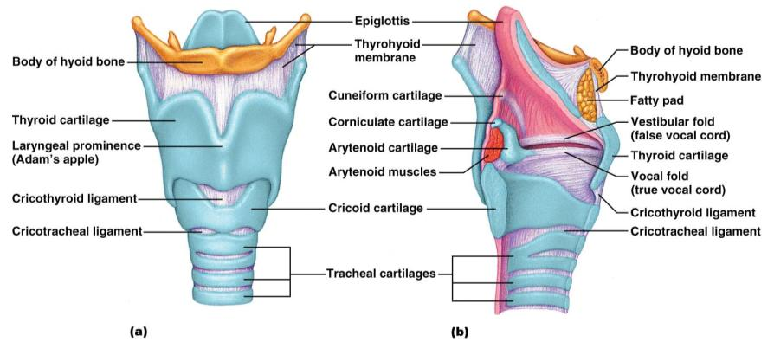
Framework of the Larynx
Figure 22.4a, b

Slide 29
Vocal Ligaments
Attach the _______________________ cartilages to the _____________________ cartilage
Composed of _______________________ that form mucosal folds called _
The medial ____________________ between them is the _
They vibrate to produce sound as air rushes up from the lungs

Slide 30
Vocal Production
Speech
intermittent release of _
determined by the length and ___________________________ of the vocal cords
Loudness
depends upon the ________________ at which the air rushes across the vocal cords

Slide 31
Vocal production
The pharynx
Sound is shaped into language by action of the pharynx, tongue, soft palate, and lips

Slide 32
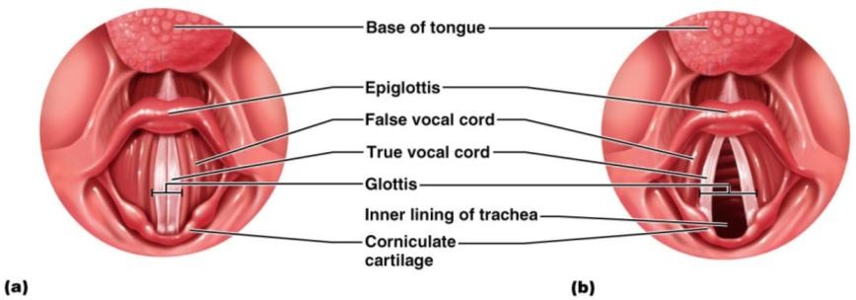
Movements of Vocal Cords
Figure 22.5

Slide 33
Trachea
Flexible and mobile tube extending from the _
Composed of three layers
made up of _____________________________ and ciliated epithelium
Submucosa
______________________________________ deep to the mucosa
Adventitia
outermost layer made of _

Slide 34
Conducting Zone: Bronchi
last tracheal _
marks the _
Air reaching the bronchi is
Warm and cleansed of impurities

Slide 35
Conducting Zone: Bronchial Tree
Bronchi subdivide into __________________, each supplying a lobe of the lungs
Air passages undergo 23 orders of branching
As conducting tubes become smaller, structural changes occur
_________________________________ support structures change
_________________________________________ change
Amount of _____________________________________ increases

Slide 36
Conducting Zone: Bronchial Tree
Bronchioles
Consist of _
Have a complete layer of _
____________________ cartilage support and mucus-producing cells

Slide 37
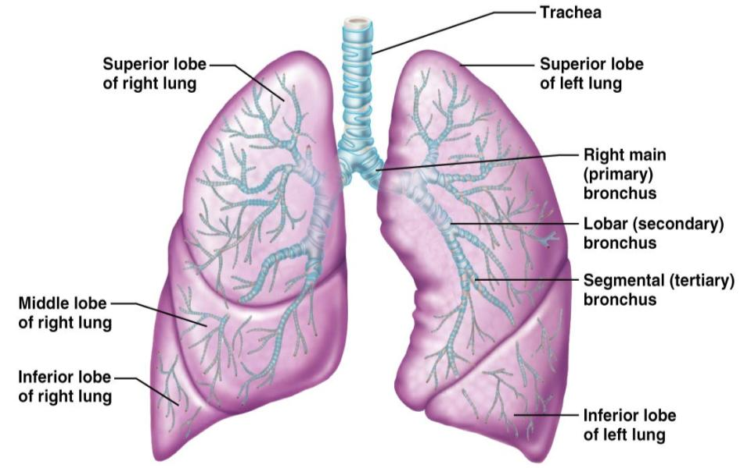
Conducting Zones
Figure 22.7

Slide 38
Respiratory Zone
Defined by
presence of _
begins as terminal bronchioles feed into _
Respiratory bronchioles → _____________________________ → alveolar sacs composed of alveoli
Approximately 300 million alveoli:
Accounts for _
tremendous _________________ for gas exchange

Slide 39
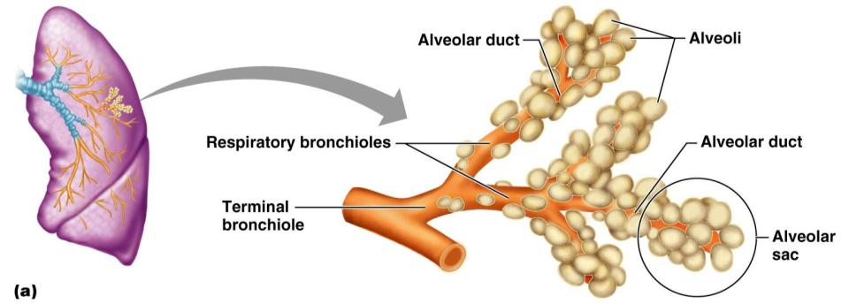
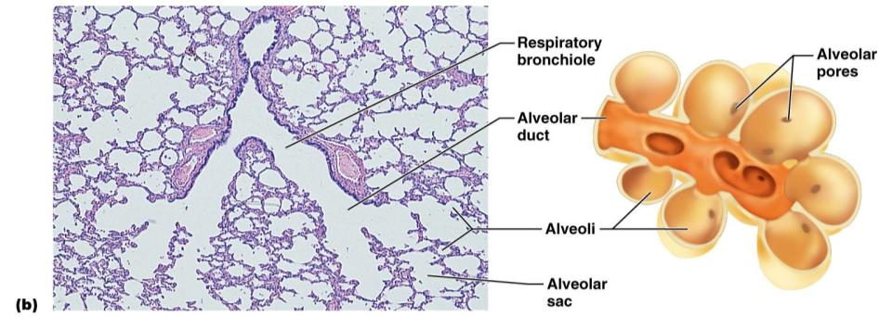
Figure 22.8a

Slide 40
Respiratory Membrane
Alveolar walls:
single layer of ____________________________ epithelial cells
Permit gas exchange by _
Secrete _
Type ___ cells secrete _

Slide 41
Alveoli
Surrounded by fine elastic fibers
Contain _
Connect adjacent alveoli
Allow __________________________ throughout the lung to be _
House ___________________________ that keep alveolar surfaces sterile

