Slide 1
Gross Anatomy of the Lungs
Lungs occupy all of the thoracic cavity except the mediastinum
Root
site of _
Costal surface
anterior, lateral, and posterior surfaces in _
Apex
narrow _
Base
inferior surface that _
Hilus
______________________________________ that contains pulmonary and systemic blood vessels

Slide 2
Lungs
______________________ notch (impression)
cavity that _
Left lung
separated into upper and lower lobes by _
Right lung
separated into ______________________ by the oblique and horizontal fissures
There are 10 bronchopulmonary segments in each lung

Slide 3
Blood Supply to Lungs
Lungs are _____________________ by two circulations: _
Pulmonary arteries
supply _______________________________ blood to be _
Branch profusely, along with bronchi
Ultimately _____________________________________________ surrounding the alveoli
Pulmonary veins
carry _____________________________ blood from _

Slide 4
Blood Supply to Lungs
provide ___________________________ to the lung tissue
Arise from ____________________________ and enter the lungs at the hilus
Supply all lung tissue except the alveoli
Bronchial veins ____________________________ with pulmonary veins
Pulmonary veins carry most venous blood back to the heart

Slide 5
Pleurae
Covers the _____________________________ and superior face of the diaphragm
Continues around heart and between lungs

Slide 6
Pleurae
also pulmonary pleura
Covers the

Slide 7
Breathing
Breathing, or __________________________, consists of two phases
air flows into the lungs
gas exits the lungs

Slide 8
Pressure Relationships in the Thoracic Cavity
Respiratory pressure is always described relative to _
Atmospheric pressure (P_{atm})
Pressure exerted by the _
__________________________ respiratory pressure is less than atmospheric
__________________________ respiratory pressure is greater than atmospheric

Slide 9
Pressure Relationships in the Thoracic Cavity
_____________________________ pressure (P_{pul})
pressure _
______________________________ pressure (P_{ip})
pressure within _

Slide 10
Pressure Relationships
Intrapulmonary pressure and intrapleural pressure ___________________ with the phases of breathing
Intrapulmonary pressure always eventually equalizes itself with atmospheric pressure
Intrapleural pressure is ________________________________ intrapulmonary pressure and atmospheric pressure

Slide 11
Pressure Relationships
_____________________ act to pull the lungs away from the thoracic wall, promoting lung collapse
_____________________________ of lungs causes them to assume smallest possible size
_____________________________ of alveolar fluid draws alveoli to their smallest possible size
Opposing force – elasticity of the chest wall _

Slide 12
Lung Collapse
Caused by ___________________________ of the intrapleural pressure with the intrapulmonary pressure
____________________________________ keeps the airways open
Transpulmonary pressure – difference between the intrapulmonary and intrapleural pressures (P_{pul} – P_{ip})

Slide 13
Pulmonary Ventilation
A mechanical process that depends on volume changes in the thoracic cavity
_______________________________ lead to _________________________________, which lead to the ____________________ to equalize pressure

Slide 14
Inspiration
The diaphragm ______________________________ towards the abdomen
external intercostal muscles contract _
The lungs are _
intrapulmonary _
Intrapulmonary _____________________________ below atmospheric pressure (−1 mm Hg)
__________________________________________, down its pressure gradient to equilibrium

Slide 15
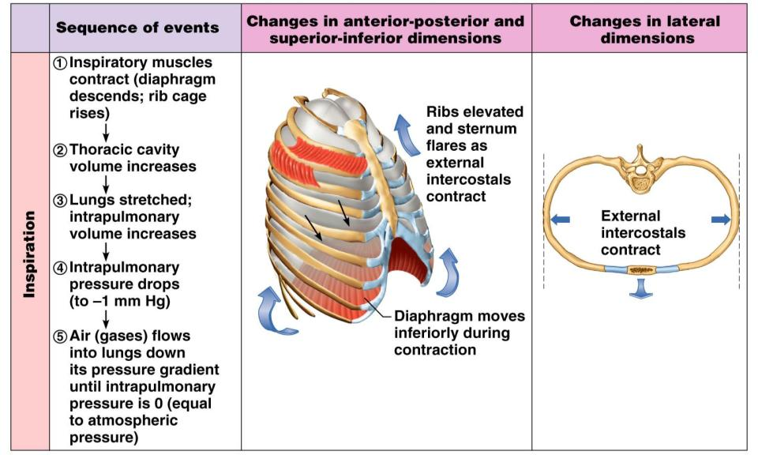
Inspiration
Figure 22.13.1

Slide 16
Expiration
Inspiratory _
rib cage ______________________due to gravity
Thoracic cavity _
Elastic lungs _
intrapulmonary _
Intrapulmonary ________________________ above atmospheric pressure
Gases ______________________________ down the pressure gradient

Slide 17
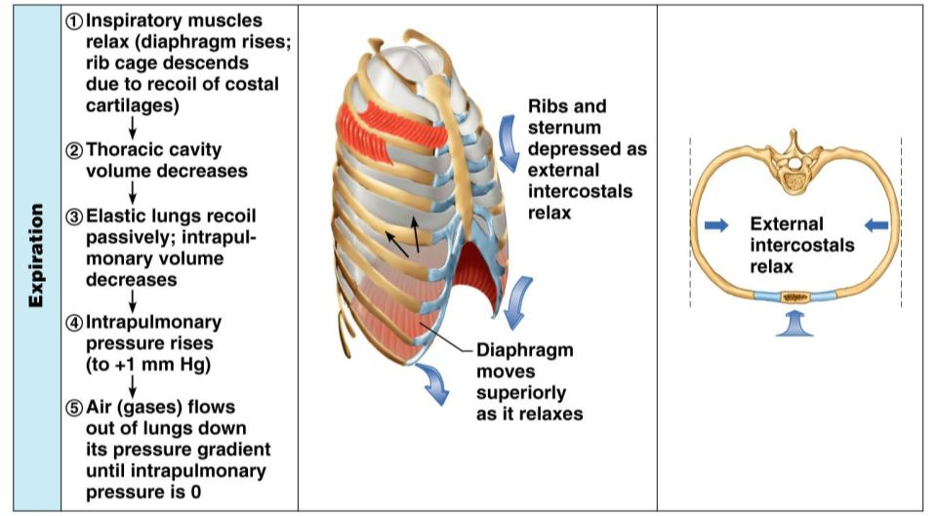
Expiration
Figure 22.13.2

Slide 18
Airway Resistance
As airway _________________________ rises
breathing movements become _
Severely _____________________________ bronchioles:
Can prevent life-sustaining ventilation
Can occur during _________________________ which stops ventilation
__________________________________ release
from the sympathetic nervous system
________________________________ bronchioles
________________________________ air resistance

Slide 19
Alveolar Surface Tension
Surface tension
the ______________________________________ at a liquid-gas interface
The liquid coating the alveolar surface is always acting to _
Surfactant, a detergent-like complex, _________________________________________ and helps keep the alveoli _

Slide 20
Lung Compliance
The _________________________ with which lungs can be expanded
Determined by two main factors
_____________________________________ of the lung tissue and surrounding thoracic cage
_______________________________________ of the alveoli

Slide 21
Factors That Diminish Lung Compliance
Scar tissue or _
reduces the _____________________of the lungs
Seen in tuberculosis
________________________ of the smaller respiratory passages with _
Reduced production of _
Decreased _____________________________________ or its decreased ability to expand

Slide 22
Factors That Diminish Lung Compliance
Examples include:
Deformities of _
__________________________________ of the costal cartilage
____________________________________ of intercostal muscles

Slide 23
Respiratory Volumes
Tidal volume
air that moves _
(approximately 500 ml)
Inspiratory reserve volume
air that can be _____________________________________ (2100–3200 ml)

Slide 24
Respiratory Volumes
Expiratory reserve volume
air that can be ____________________________________ (1000–1200 ml)
Residual volume
air left in the lungs after _
(1200 ml)

Slide 25
Respiratory Capacities
Inspiratory capacity
____________________________________
____________________________________ (IRV + TV)
_________________________________ amount of air remaining in the lungs after a tidal expiration (RV + ERV)

Slide 26
Respiratory Capacities
the total amount of exchangeable air (TV + IRV + ERV)
Total lung capacity (TLC)
____________________________________ (approximately 6000 ml in males)

Slide 27
Dead Space
Anatomical dead space
volume of the __________________________________________ (150 ml)
___________________________ dead space
alveoli that _
Total dead space
sum of ___________________________________ dead spaces

Slide 28
Pulmonary Function Tests
Spirometer
an instrument consisting of a hollow bell inverted over water, used to _
Spirometry can distinguish between:
Obstructive pulmonary disease – _
Restrictive disorders – ____________________________________ from structural or functional lung changes

Slide 29
Pulmonary Function Tests
Total _
total amount of gas flow into or out of the respiratory tract in one minute
Forced _
gas forcibly expelled after taking a deep breath
Forced expiratory volume (FEV)
the amount of gas expelled during _

Slide 30
Pulmonary Function Tests
Increases in _________________________ may occur as a result of _
Reduction in VC, TLC, FRC, and RV result from _

Slide 31
Alveolar Ventilation
Alveolar ventilation rate (AVR)
measures the _
Slow, deep breathing _
AVR | = | frequency | X | (TV – dead space)
(ml/min) |  | (breaths/min) |  | (ml/breath)

Slide 32
Nonrespiratory Air Movements
Most result from _
Examples include
Coughing
Hiccupping

Slide 33
Composition of Alveolar Gas
The atmosphere is mostly _
alveoli contain more _
These differences result from:
____________________________________ – oxygen diffuses from the alveoli and carbon dioxide diffuses into the alveoli
________________________________ of air by conducting passages
The mixing of alveolar gas that occurs with each breath

Slide 34
External Respiration: Pulmonary Gas Exchange
Factors influencing the _
Partial pressure _________________________ and gas _
Matching of ________________________ and pulmonary _
Structural characteristics of the respiratory membrane

Slide 35
Partial Pressure Gradients and Gas Solubilities
The partial pressure oxygen (PO₂) of venous blood is 40 mm Hg; the partial pressure in the alveoli is 104 mm Hg
This ____________________________ allows oxygen partial pressures to ___________________________________ (in 0.25 seconds), and thus blood can move three times as quickly (0.75 seconds) through the pulmonary capillary and _

Slide 36
Partial Pressure Gradients and Gas Solubilities
Although carbon dioxide has a _
It is ________________________________ in plasma than oxygen
It diffuses in equal amounts with oxygen

Slide 37
Ventilation-Perfusion Coupling
Ventilation
the amount of _
Perfusion
the ______________________________ reaching the alveoli
Ventilation and perfusion must be _

Slide 38
Ventilation-Perfusion Coupling
Changes in ________________________ cause changes in the diameters of the bronchioles
Passageways servicing areas where _
Those serving areas where alveolar _

Slide 39
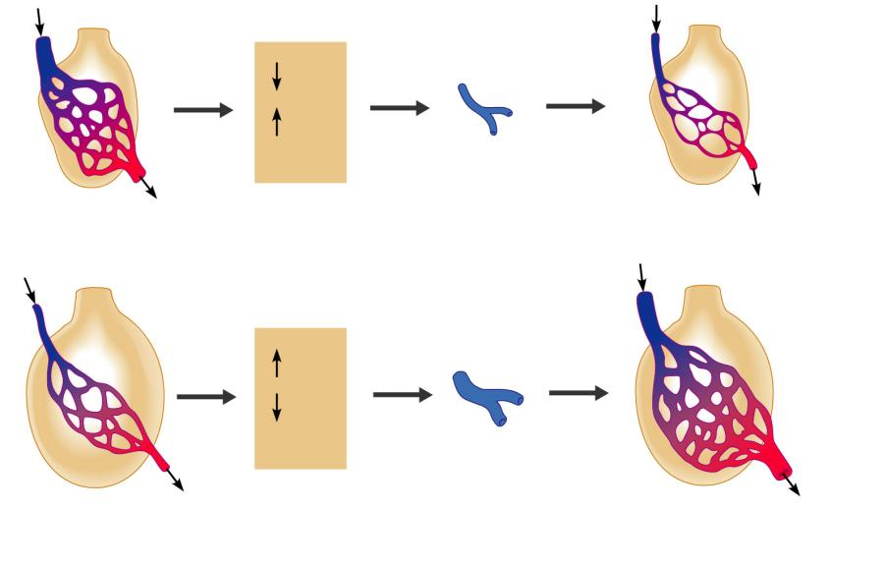
P_{O2}
P_{CO2}
in alveoli
Reduced alveolar ventilation;
excessive perfusion
Pulmonary arterioles
serving these alveoli
constrict
Reduced alveolar ventilation;
reduced perfusion
P_{O2}
P_{CO2}
in alveoli
Enhanced alveolar ventilation;
inadequate perfusion
Pulmonary arterioles
serving these alveoli
dilate
Enhanced alveolar ventilation;
enhanced perfusion
Figure 22.19

Slide 40
Surface Area and Thickness of the Respiratory Membrane
Respiratory membranes:
Are thin, allowing for efficient gas exchange
Have a total surface area (in males) of about 60 m² (________________ that of one’s skin)
______________________ if lungs become waterlogged and edematous,
gas exchange is _
Decrease in surface area with emphysema, when walls of adjacent _

Slide 41
Internal Respiration
The factors promoting _____________________________ are the same as those for _
The partial pressures and diffusion gradients are _
P_{O2} in ____________ is _______________ lower than in systemic arterial blood
P_{O2} of venous blood draining tissues is 40 mm Hg and P_{CO2} is 45 mm Hg

Slide 42
Oxygen Transport
______________________________ is carried in the blood:
Bound to __________________________ within red blood cells

