Slide 1
Oxygen Transport: Role of Hemoglobin
Each Hb molecule binds ___________________ atoms in a _
The hemoglobin-oxygen combination is called _
Hemoglobin that has released oxygen is called _
Lungs
HHb + O₂
HbO₂ + H⁺
Tissues

Slide 2
Hemoglobin (Hb)
Saturated hemoglobin
when ____________________________ of the molecule are bound to oxygen
_________________________ saturated hemoglobin
when _______________________ hemes are bound to oxygen

Slide 3
Hemoglobin Saturation Curve
Hemoglobin is almost completely saturated at a P_{O2} of 70 mm Hg
Further _________________________ in P_{O2} produce ___________________________ in oxygen binding
Oxygen loading and delivery to tissue is adequate when P_{O2} is below normal levels

Slide 4
Hemoglobin Saturation Curve
Only __________________________________ during one systemic circulation
If oxygen levels in _
More oxygen ________________________ from hemoglobin and is used by cells
Respiratory rate or cardiac output _

Slide 5
Factors Influencing Hemoglobin Saturation
BPG:
bisphosphoglycerate (produced by RBCs during glycolysis and can bind with Hb)
alters hemoglobin’s affinity for oxygen

Slide 6
Factors Influencing Hemoglobin Saturation
Increases of these factors:
____________________________ hemoglobin’s affinity for oxygen
_____________________________________________ from the blood
Decreases act in the opposite manner
These parameters are all ___________________________________________ where oxygen unloading is the goal

Slide 7
Factors That Increase Release of Oxygen by Hemoglobin
As cells _____________________________, carbon dioxide is released into the blood causing:
Increases in
Carbon dioxide pressure
__________________________________ in capillary blood
Declining ____________________________ which weakens the hemoglobin-oxygen bond (Bohr effect)

Slide 8
Factors That Increase Release of Oxygen by Hemoglobin
Metabolizing cells have ___________________ as a byproduct and the rise in temperature _
All these factors ________________________________________ in the vicinity of working tissue cells

Slide 9
Carbon Dioxide Transport
Carbon dioxide is transported in the blood in _
Chemically _________________________________ – 20% is carried in RBCs as carbaminohemoglobin
___________________________________ in plasma – 70% is transported as bicarbonate (HCO₃–)

Slide 10
Transport and Exchange of Carbon Dioxide
Carbon dioxide diffuses ____________________ and combines ___________________________ to form ____________________________________ , which quickly dissociates into hydrogen ions and bicarbonate ions
In RBCs, the enzyme _________________________________________ converts carbon dioxide and water to carbonic acid
CO₂ | + | H₂O | ↔ | H₂CO₃ | ↔ | H⁺ | + | HCO₃–
Carbon dioxide |  | Water |  | Carbonic acid |  | Hydrogen ion |  | Bicarbonate ion

Slide 11
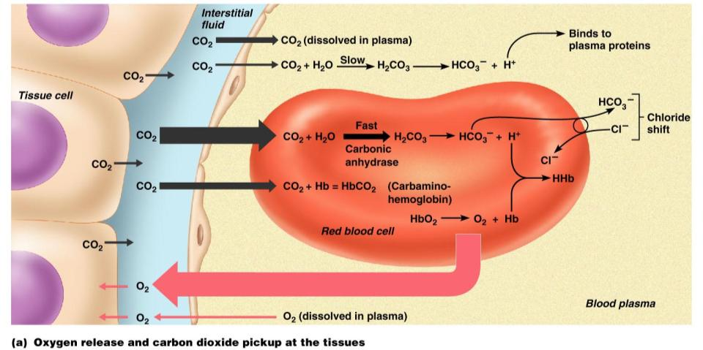
Transport and Exchange of Carbon Dioxide
Figure 22.22a

Slide 12
Transport and Exchange of Carbon Dioxide
At the tissues:
Bicarbonate _________________________ diffuses _
The _
counterbalance the outrush of ______________________ (bicarbonate) from the RBCs
chloride ions (Cl–) move _

Slide 13
Transport and Exchange of Carbon Dioxide
At the lungs, these processes are reversed
Bicarbonate ions move _______________________ and bind with hydrogen ions to form _
Carbonic acid is then split by carbonic anhydrase to _
Carbon dioxide then diffuses from the _

Slide 14
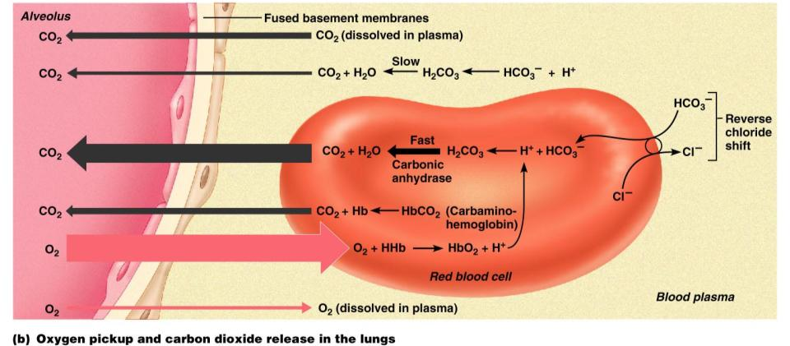
Transport and Exchange of Carbon Dioxide
Figure 22.22b

Slide 15
Haldane Effect
The amount of carbon dioxide transported is markedly affected by the P_{O2}
Haldane effect
the _________________________________________, the _____________________ carbon dioxide can be carried in the blood

Slide 16
Haldane Effect
At the tissues, as more carbon dioxide enters the blood:
More oxygen dissociates from hemoglobin
____________________________________ allows oxygen to break away and diffuse into the tissues
More _____________________________________, and more bicarbonate ions are formed
This situation is _________________________ in pulmonary circulation

Slide 17
Influence of Carbon Dioxide on Blood pH
The carbonic acid–bicarbonate ______________________ resists blood pH changes
If hydrogen ion concentrations in blood ______________, excess H⁺ is _
If hydrogen ion concentrations ______________________, carbonic acid dissociates, _
CO₂ | + | H₂O | ↔ | H₂CO₃ | ↔ | H⁺ | + | HCO₃–
Carbon dioxide |  | Water |  | Carbonic acid |  | Hydrogen ion |  | Bicarb ion

Slide 18
Influence of Carbon Dioxide on Blood pH
Changes in respiratory rate can also:
Provide a fast-acting system to _______________________________ when it is disturbed by metabolic factors

Slide 19
Control of Respiration: Medullary Respiratory Centers
The ______________________________________ (DRG)
or inspiratory center:
Location:
Function:
Excites the inspiratory muscles
sets eupnea (12-15 breaths/minute)
Eu:
Pnea:
Becomes ________________________ during expiration

Slide 20
Medullary respiratory centers
The _____________________________ respiratory group (VRG)
involved in _

Slide 21
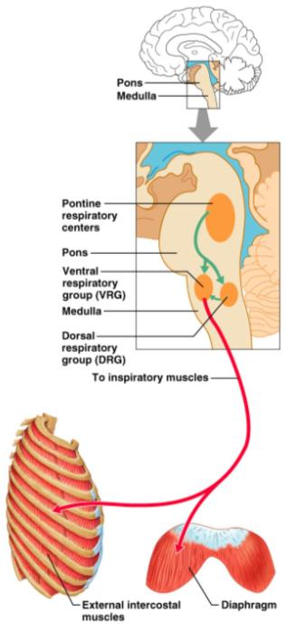
Control of Respiration: Pons Respiratory Centers
Pons centers:
Influences medullary centers
Smooth out ________________ (inspiration/expiration)
The pontine respiratory group (PRG) – continuously inhibits the inspiration center

Slide 22
Respiratory Rhythm
A result of relationship between medullary and pons centers
Other theories include
___________________________________________ and are both automatic and rhythmic
____________________________________ in the lungs establish respiratory rhythm

Slide 23
Depth and Rate of Breathing
Inspiratory ____________________ is determined by how actively the respiratory center stimulates the respiratory muscles
__________________________ of respiration is determined by ___________________________ the inspiratory center is active
Respiratory centers in the pons and medulla are sensitive to both excitatory and inhibitory stimuli

Slide 24
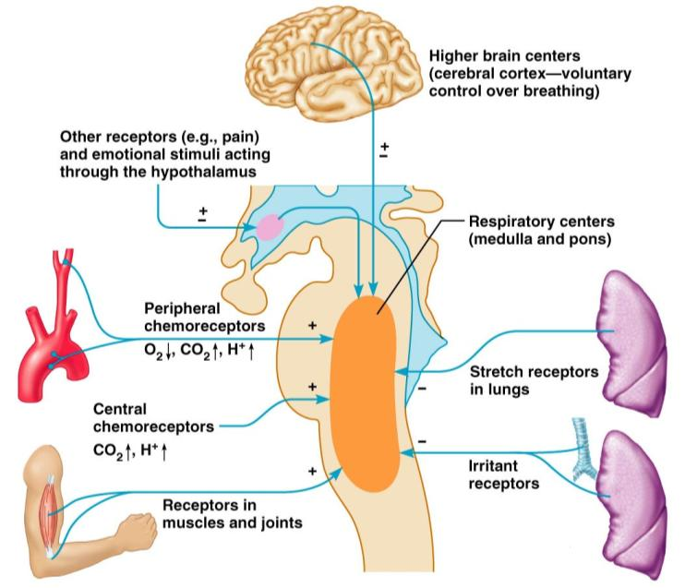
Medullary Respiratory Centers
Figure 22.25

Slide 25
Depth and Rate of Breathing: Reflexes
Pulmonary irritant reflexes
irritants ___________________________________ of air passages
Inflation reflex (Hering-Breuer)
________________________________________ in the lungs are stimulated by lung inflation
Prevents _
The body gives feedback based on stretch.

Slide 26
Depth and Rate of Breathing: Higher Brain Centers
Hypothalamic controls act with the _____________________________________ to modify rate and depth of respiration
Example: breath holding that occurs in anger
A ___________________________________ acts to increase respiratory rate
Cortical controls are direct signals from the cerebral motor cortex that _
Examples: voluntary breath holding, taking a deep breath

Slide 27
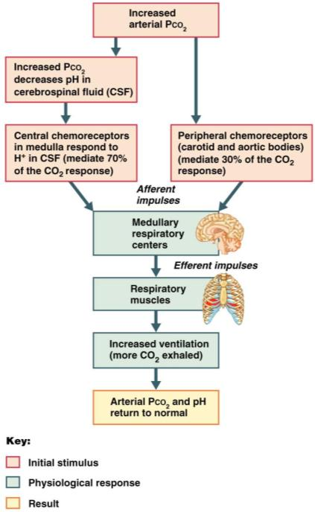
Depth and Rate of Breathing: P_{CO2}
levels are monitored by _
Carbon dioxide in the blood diffuses into _
Resulting carbonic acid dissociates, releasing hydrogen ions
Carbon dioxide levels rise
resulting in _

Slide 28
Depth and Rate of Breathing: P_{CO2}
Hyperventilation – ________________________________________:
Quickly ___________________________________ from the blood
Occurs in response to hypercapnia
Elevated Carbon dioxide levels
Though a rise CO₂ acts as the _____________________________, control of breathing at rest is regulated by the _

Slide 29
Depth and Rate of Breathing: P_{CO2}
______________________________________ breathing due to abnormally low P_{CO2} levels
_________________________ (breathing cessation) may occur _

Slide 30
Depth and Rate of Breathing: P_{CO2}
Oxygen levels are ___________ a stimulus for ventilation unless the levels drop significantly
If carbon dioxide is not removed, chemoreceptors become _
Then oxygen levels become the principal respiratory stimulus (________________________)

Slide 31
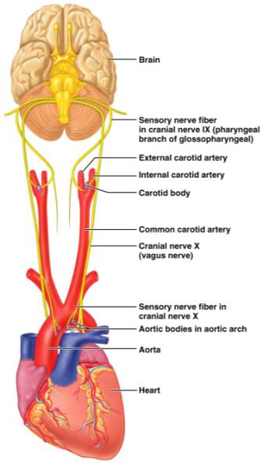
Depth and Rate of Breathing: Arterial pH
Changes in ______________________ can modify respiratory rate even if carbon dioxide and oxygen levels _
Increased ventilation in response to falling pH is mediated by _

Slide 32
Depth and Rate of Breathing: Arterial pH
Acidosis may reflect:
Carbon dioxide retention
Accumulation of _
Excess _____________________________ in patients with diabetes mellitus
Respiratory system controls will attempt to ___________________________ by increasing respiratory _

Slide 33
Respiratory Adjustments: Exercise
Respiratory adjustments are geared to both the _________________________________ of exercise
During vigorous exercise:
Ventilation can increase 20 fold
Breathing becomes ______________________________, but respiratory rate may not be significantly changed (hyperpnea)
Exercise-enhanced breathing is not prompted by an increase in P_{CO2} or a decrease in P_{O2} or pH
These levels remain surprisingly constant during exercise

Slide 34
Respiratory Adjustments: Exercise
As exercise begins:
Ventilation _________________________________, rises slowly, and reaches a steady state
When exercise stops:
Ventilation _______________________________, then gradually decreases to normal

Slide 35
Respiratory Adjustments: Exercise
Neural factors bring about the above changes, including:
______________________________ of exercise
Cortical motor activation
Both _
Excitatory impulses from _

Slide 36
Chronic Obstructive Pulmonary Disease (COPD)
Includes chronic bronchitis and obstructive emphysema
Patients have a history of:
________________________________, where labored breathing occurs and gets progressively worse
frequent pulmonary infections
COPD victims develop __________________________________________, carbon dioxide retention, and respiratory acidosis

Slide 37
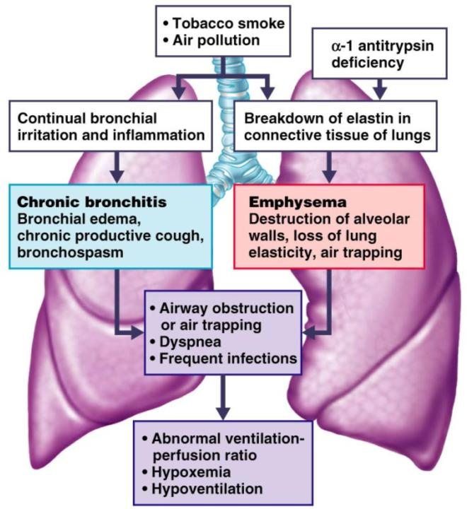
COPD
Figure 22.28

Slide 38
Asthma
Characterized by
Active inflammation of the airways precedes bronchospasms

Slide 39
Asthma
Airway inflammation is an _
caused by release of IL-4 and IL-5
stimulate _
recruit _
Airways fill with _________________ as a result of the inflammation. This magnifies the effect of _

Slide 40
Tuberculosis
Infectious disease caused by the bacterium Mycobacterium tuberculosis
Symptoms include
weight loss,
racking cough
splitting headache
Treatment entails a 12-month course of antibiotics

Slide 41
Lung Cancer
Accounts for 1/3 of all cancer deaths in the U.S.
90% of all patients with lung cancer were _
The three most common types are:
_________________________________ (20-40% of cases)
arises in _
Adenocarcinoma (25-35% of cases)
originates in _
_____________________________________ carcinoma (20-25% of cases)
contains lymphocyte-like cells that originate in the ______________________________ and subsequently _

