Slide 1
Respiration
Involves both the respiratory _
Four processes that supply the body with O₂ and _

Slide 2
Respiration
_________________________________(breathing): movement of air into and out of the lungs
O₂ and CO₂ exchange between the lungs and the blood
Transport:
O₂ and CO₂ in the blood
O₂ and CO₂ exchange between systemic blood vessels and tissues

Slide 3
Respiratory System: Functional Anatomy
Major organs
Nose, nasal cavity, and paranasal sinuses
Larynx
Bronchi and their branches

Slide 4
Functional Anatomy
Respiratory zone:
site of _
Microscopic structures:
respiratory bronchioles, alveolar ducts, and alveoli
conduits to gas exchange sites
Includes all other respiratory structures
Respiratory muscles:
________________________________________ and other muscles that promote ventilation

Slide 5
The Nose
Functions
Provides an _
_________________________________________ and warms the entering air
_____________________________________ and cleans inspired air
Serves as a resonating chamber for speech
Houses _

Slide 6
The Nose
Two regions: external nose and nasal cavity
External nose: root, bridge, dorsum nasi, and apex
___________________________________________________: a shallow vertical groove inferior to the apex
Nostrils (___________________________________): bounded laterally by the alae

Slide 7
The Nose
Nasal cavity: in and __________________________________ to the external nose
Divided by a midline _
Posterior _________________________________________ (choanae) open into the nasal pharynx
____________________________________________: ethmoid and sphenoid bones
____________________________________________: hard and soft palates

Slide 8
Nasal Cavity
Vestibule:
nasal cavity _
Vibrissae
___________________________________________ coarse particles from inspired air
Olfactory mucosa
Lines the _
Contains _____________________________ receptors

Slide 9
Nasal Cavity
Respiratory mucosa
Mucous and serous secretions contain lysozyme and defensins
_______________________________________ move contaminated mucus posteriorly to throat
Inspired air is warmed by _
Sensory nerve endings triggers sneezing

Slide 10
Nasal Cavity
Superior, middle, and inferior nasal conchae
Protrude from _
Increase mucosal area
Enhance _

Slide 11
Functions of the Nasal Mucosa and Conchae
During inhalation, the conchae and nasal mucosa
During exhalation these structures
________________________________________ heat and moisture

Slide 12
Paranasal Sinuses
In frontal, sphenoid, ethmoid, and maxillary bones
_____________________________________ the skull and help to warm and moisten the air

Slide 13
Pharynx
Muscular tube that connects to the
_____________________________________________ superiorly
Larynx and esophagus inferiorly
From the ____________________________________ to the level of the sixth cervical vertebra

Slide 14
Nasopharynx
Air passageway posterior to the nasal cavity
Lining
pseudostratified columnar epithelium
close nasopharynx during swallowing

Slide 15
Nasopharynx
Pharyngeal tonsil
also called _
Located on _
Pharyngotympanic tubes
Also called _
open into the _

Slide 16
Oropharynx
Passageway for food and air from the level of the soft palate to the epiglottis
Lining is ______________________________________________ epithelium
_________ _______________________________ tonsils in the lateral walls
_________________________________________ tonsil on the posterior surface of the tongue

Slide 17
Laryngopharynx
Passageway for food and air
Posterior to the _
Extends to the larynx, where it is also continuous with the _

Slide 18
Larynx
Attaches to the ___________________________ and opens into the laryngopharynx
Continuous with the _
Functions
Provides an _
Routes air and food into proper channels

Slide 19
Larynx
Cartilages of the larynx
____________________________________ cartilage except for the epiglottis
___________________________________________ with laryngeal prominence (Adam’s apple)
Ring-shaped _
Paired arytenoid, cuneiform, and corniculate cartilages
:
________________________________________ cartilage; covers the laryngeal inlet during swallowing

Slide 20
Larynx
Vocal ligaments
Contain _
Form the core of ________________________________ (true vocal cords)
Opening between them is the _
Folds vibrate to produce sound as air rushes up from the lungs

Slide 21
Larynx
Vestibular _
Superior to the vocal folds
Help to close the glottis during swallowing

Slide 22
Voice Production
intermittent release of expired air while opening and closing the glottis
determined by the length and tension of the vocal cords
depends upon the force of air
Chambers of pharynx, oral, nasal, and sinus cavities ___________________________________________ sound quality
Sound is “shaped” into language by muscles of the pharynx, tongue, soft palate, and lips

Slide 23
Larynx
Vocal folds may act as a __________________________________ to prevent air passage
Example:
_________________________________________ closes to prevent exhalation
_________________________________________ muscles contract
Intra-abdominal pressure rises
Helps to _________________________________________ or stabilizes the trunk during heavy lifting

Slide 24
Trachea
Windpipe:
from the larynx into the mediastinum
Wall composed of three layers
ciliated pseudostratified epithelium with _
:
connective tissue with seromucous glands
Adventitia:
outermost layer made of ______________________________________________ that encases the C-shaped rings of hyaline cartilage

Slide 25
Trachea
Trachealis muscle
Connects posterior parts of cartilage rings
Carina
Last _
Point where trachea branches into _

Slide 26
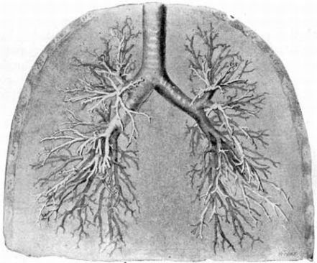
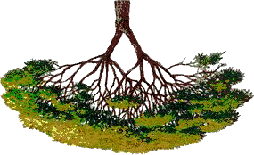
Bronchi and Subdivisions
Air passages undergo 23 orders of branching
Branching pattern called the _

Slide 27
Conducting Zone Structures
Trachea → right and left _
Each main bronchus enters the _________________________ of one lung
______________________________ main bronchus is wider, shorter, and more vertical than the left
Each main bronchus branches into lobar (secondary) bronchi (three right, two left)
Each lobar bronchus supplies _

Slide 28
Conducting Zone Structures
Each lobar bronchus branches into __________________________________ (tertiary) bronchi
Segmental bronchi divide repeatedly
Bronchioles are less than 1 mm in diameter
Terminal bronchioles are the ________________________________ , less than 0.5 mm diameter

Slide 29
Conducting Zone Structures
From bronchi through bronchioles, structural changes occur
Cartilage rings give way to _
cartilage is _
Epithelium changes from pseudostratified columnar to _
________________________________________________________ become infrequent
Relative amount of smooth muscle _

Slide 30
Respiratory Zone
Respiratory bronchioles, _________________________________ , alveolar sacs (clusters of alveoli)
~300 million alveoli account for most of the lungs’ volume and are the _

Slide 31
Respiratory Membrane
Alveolar and capillary walls and _
Alveolar walls
Single layer of ___________________________________________ (type I cells)
Scattered type II _____________________________ secrete _____________________________________ and antimicrobial proteins

Slide 32
Alveoli
Surrounded by _
Contain open _________________________ that
Connect adjacent alveoli
Allow ______________________________________ throughout the lung to be equalized
House alveolar _____________________________ that keep alveolar surfaces sterile

Slide 33
Lungs
Occupy ______________________________________ except the mediastinum
site of vascular and bronchial attachments
anterior, lateral, and posterior surfaces

Slide 34
Lungs
Apex:
Base:
inferior surface that rests on _
on mediastinal surface; site for attachment of blood vessels, bronchi, lymphatic vessels, and nerves
Cardiac notch of left lung:
concavity that _

Slide 35
Lungs
Left lung is smaller, separated into two lobes by an _
Right lung has ___________________________ separated by _
Bronchopulmonary segments (10 right, 8–9 left)
Lobules are the smallest subdivisions; served by bronchioles and their branches

Slide 36
Blood Supply
Pulmonary circulation
Pulmonary _______________________________ deliver systemic _
Branch profusely, along with bronchi
Feed into the _
Pulmonary ______________________ carry ______________________________________________ from respiratory zones to the heart

Slide 37
Blood Supply
Systemic circulation
Bronchial arteries _
Arise from _____________________________ and enter the lungs at the hilum
Supply all lung tissue except the alveoli
Bronchial veins anastomose with pulmonary veins
Pulmonary _

Slide 38
Pleurae
Thin, double-layered serosa
__________________________________________ on thoracic wall and superior face of diaphragm
__________________________________________ on external lung surface
Pleural fluid fills the slitlike pleural cavity
Provides _

Slide 39
Mechanics of Breathing
Pulmonary ventilation consists of two phases
Inspiration:
___________________________________________: gases exit the lungs

Slide 40
Pressure Relationships in the Thoracic Cavity
Atmospheric pressure (P_{atm})
Pressure exerted by the air surrounding the body
760 mm Hg at sea level
Respiratory pressures are described _
_______________________________________ respiratory pressure is less than P_{atm}
_______________________________________ respiratory pressure is greater than P_{atm}
Zero respiratory pressure = P_{atm}

Slide 41
Intrapulmonary Pressure
Intrapulmonary (intra-alveolar) pressure (P_{pul})
Pressure in the alveoli
Fluctuates with breathing
Always eventually equalizes with P_{atm}

Slide 42
Intrapleural Pressure
Intrapleural pressure (P_{ip}):
Pressure _
_____________________________________ with breathing
Always a _______________________________________ pressure (<P_{atm} and <P_{pul})

Slide 43
Intrapleural Pressure
Negative P_{ip} is caused by _
Two inward forces _
Elastic ___________________________________ of lungs decreases lung size
_______________________________________________ of alveolar fluid reduces alveolar size
One outward force tends to _
___________________________________________ of the chest wall pulls the thorax outward

Slide 44
Pressure Relationships
If P_{ip} = P_{pul} the _
(P_{pul} – P_{ip}) = transpulmonary pressure
Keeps the airways open
The greater the transpulmonary pressure, _

Slide 45
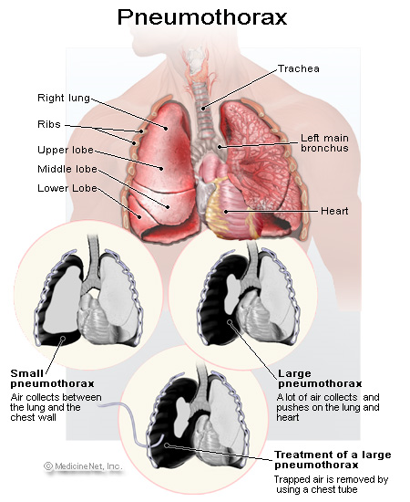
Homeostatic Imbalance
_______________________ (lung collapse) is due to
Plugged bronchioles → _
Wound that admits air into pleural cavity

Slide 46
Pulmonary Ventilation
Inspiration and expiration
________________________________ processes that depend on _____________________________ changes in the thoracic cavity
Volume changes yield _
Pressure changes cause gases flow to equalize pressure

Slide 47
Inspiration
An active process
_________________________________ muscles contract
Thoracic _
Lungs are stretched and intrapulmonary _
Intrapulmonary _
Air flows into the lungs, down its pressure gradient until intrapulmonary pressure is the same as atmospheric pressure

Slide 48
Expiration
Quiet expiration is normally a _________________________ process
Inspiratory muscles relax
Thoracic cavity _
Elastic lungs _____________________________ and intrapulmonary _
Intrapulmonary __________________________________________ than atmospheric pressure
Air flows out of the lungs down its pressure gradient
Note: ___________________________expiration is an ___________________________________ process: it uses abdominal and internal intercostal muscles

Slide 49
Physical Factors Influencing Pulmonary Ventilation
Inspiratory muscles consume energy to overcome three factors that hinder air passage and pulmonary ventilation
Alveolar _
Lung compliance

Slide 50
Airway Resistance
_________________________________ is the major nonelastic source of resistance to gas flow
Gas flow changes inversely with resistance

Slide 51
Airway Resistance
Resistance is usually insignificant because of
____________________________________________ in the first part of the conducting zone
Progressive branching of airways as they get smaller, increasing the total cross-sectional area
Resistance disappears at the terminal bronchioles where _

Slide 52
Airway Resistance
As airway resistance rises, _
Severely constricting or obstruction of bronchioles
Can __________________________________ life-sustaining ventilation
Can occur during _____________________________________________ and stop ventilation
_________________________________________ dilates bronchioles and reduces air resistance

Slide 53
Alveolar Surface Tension
Attracts liquid molecules to one another at a gas-liquid interface
________________________________________ that tends to increase the surface area of the liquid

Slide 54
Alveolar Surface Tension
Detergent-like lipid and protein complex produced by _
_____________________________________________ of alveolar fluid and discourages alveolar collapse
Insufficient quantity in premature infants causes infant respiratory distress syndrome

Slide 55
Lung Compliance
A measure of the change in lung volume that occurs with a given change in transpulmonary pressure
Normally _____________________________ due to
Alveolar surface tension

Slide 56
Lung Compliance
Diminished by
Nonelastic scar tissue _
Reduced production of _
_________________________________________________ of the thoracic cage

Slide 57
Lung Compliance
Homeostatic imbalances that reduce compliance
Deformities of _
_________________________________________ of the costal cartilage
Paralysis of _

Slide 58
Respiratory Volumes
Used to assess a person’s respiratory status
___________________________________volume (TV)
___________________________________ reserve volume (IRV)
___________________________________ reserve volume (ERV)
____________________________________volume (RV)

Slide 59
Respiratory Volumes
Tidal volume (TV)
air that moves into and out of the lungs _
Inspiratory reserve volume (IRV)
air that can be _

Slide 60
Respiratory Volumes
Expiratory reserve volume (ERV)
air that can be ____________________________ from the lungs after a __________________________ expiration (1000–1200 ml)
Residual volume (RV)
air left in the lungs after _

Slide 61
Respiratory Capacities
____________________________________ capacity (IC)
____________________________________ capacity (FRC)
____________________________________ capacity (VC)
Total lung capacity (TLC)

Slide 62
Respiratory Capacities
Inspiratory capacity (IC)
total amount of air that can be _
Functional residual capacity (FRC)
amount of air remaining in the lungs after a _

Slide 63
Respiratory Capacities
Vital capacity (VC)
the total amount of ______________________________________________ (TV + IRV + ERV)
Total lung capacity (TLC)
sum of all lung volumes (approximately 6000 ml in males)

Slide 64
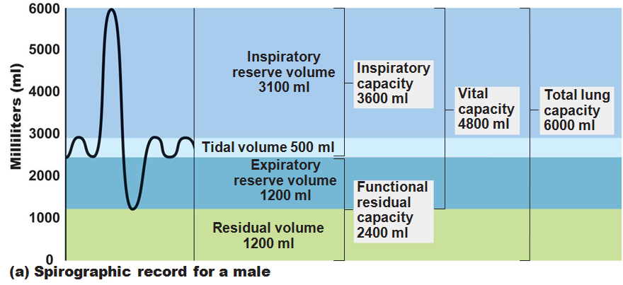

Slide 65
Dead Space
Some inspired air _
volume of the _________________________________ zone conduits (~150 ml)
Alveolar dead space:
alveoli that ___________________________________ in gas exchange due to _
Total dead space:
sum of above non-useful volumes

Slide 66
Pulmonary Function Tests
instrument used to measure respiratory volumes and capacities
Spirometry can distinguish between
increased airway resistance (e.g., bronchitis)
reduction in total lung capacity due to structural or functional lung changes (e.g., fibrosis or TB)

Slide 67
Pulmonary Function Tests
total amount of gas flow into or out of the respiratory tract in one minute
Forced vital capacity (FVC):
gas forcibly _
Forced expiratory volume (FEV):
the amount of gas expelled ______________________________________________ of the FVC

Slide 68
Pulmonary Function Tests
____________________________________ in TLC, FRC, and RV may occur as a result of _
____________________________________ in VC, TLC, FRC, and RV result from _

Slide 69
Alveolar Ventilation
Alveolar ventilation rate (AVR): flow of gases into and out of the alveoli during a particular time
Dead space is _
Rapid, shallow breathing _
AVR | = | frequency | X | (TV – dead space)
(ml/min) |  | (breaths/min) |  | (ml/breath)

Slide 70
Nonrespiratory Air Movements
Most result from reflex action
Examples include:
Sneeze
Laughing

Slide 71
Gas Exchanges Between Blood, Lungs, and Tissues
To understand the above processes, first consider
Physical properties of gases
Composition of alveolar gas

Slide 72
Composition of Alveolar Gas
Alveoli contain more CO₂ and water vapor than atmospheric air, due to
Gas exchanges in the lungs
______________________________________ of alveolar gas that occurs with each breath

Slide 73
External Respiration
Exchange of O₂ and CO₂ across the respiratory membrane
Influenced by
___________________________________________ gradients and gas solubilities
Structural characteristics of the respiratory membrane

Slide 74
Partial Pressure Gradients and Gas Solubilities
Partial pressure ____________________________ for O₂ in the lungs is steep
Venous blood Po₂ = 40 mm Hg
Alveolar Po₂ = 104 mm Hg
O₂ partial pressures reach equilibrium of 104 mm Hg in ~0.25 seconds, _

Slide 75
Partial Pressure Gradients and Gas Solubilities
Partial pressure gradient for CO₂ in the lungs is __________________________________________:
Venous blood Pco₂ = 45 mm Hg
Alveolar Pco₂ = 40 mm Hg
CO₂ is _______________________________________ in plasma than oxygen
CO₂ diffuses in equal amounts with oxygen

Slide 76
Ventilation-Perfusion Coupling
amount of gas reaching the _
_______________________________________ reaching the alveoli
Ventilation and perfusion must be ____________________________________ (coupled) for efficient gas exchange

Slide 77
Ventilation-Perfusion Coupling
Changes in Po₂ in the alveoli cause changes _
Where alveolar O₂ is high, _
Where alveolar O₂ is low, _

Slide 78
Ventilation-Perfusion Coupling
Changes in Pco₂ in the alveoli cause changes in the diameters of the bronchioles
Where alveolar CO₂ is high, _
Where alveolar CO₂ is low, _

Slide 79
Thickness and Surface Area of the Respiratory Membrane
Respiratory membranes
0.5 to 1 μm thick
Large total surface area
__________________________________ if lungs become waterlogged and edematous, and gas exchange becomes inadequate
Reduction in surface area with ____________________________________ , when walls of _

Slide 80
Internal Respiration
Partial pressures and diffusion gradients are reversed compared to external respiration

Slide 81
Transport of Respiratory Gases by Blood
Oxygen (O₂) transport
Carbon dioxide (CO₂) transport

Slide 82
O₂ Transport
Molecular O₂ is carried in the blood
1.5% dissolved in _
98.5% loosely bound to _
4 O₂ per Hb

Slide 83
O₂ and Hemoglobin
______________________________________- (HbO₂):
hemoglobin-O₂ combination
Reduced hemoglobin (HHb):
hemoglobin that has _

Slide 84
O₂ and Hemoglobin
Loading and unloading of O₂ is facilitated by change in _
As O₂ binds, Hb ________________________________ for O₂ increases
As O₂ is released, Hb affinity for _
Fully (100%) saturated
if _________________________________ heme groups carry O₂
Partially saturated
when one to three hemes carry O₂

Slide 85
O₂ and Hemoglobin
Rate of loading and unloading of O₂ is regulated by
Po₂
Blood pH
Pco₂

Slide 86
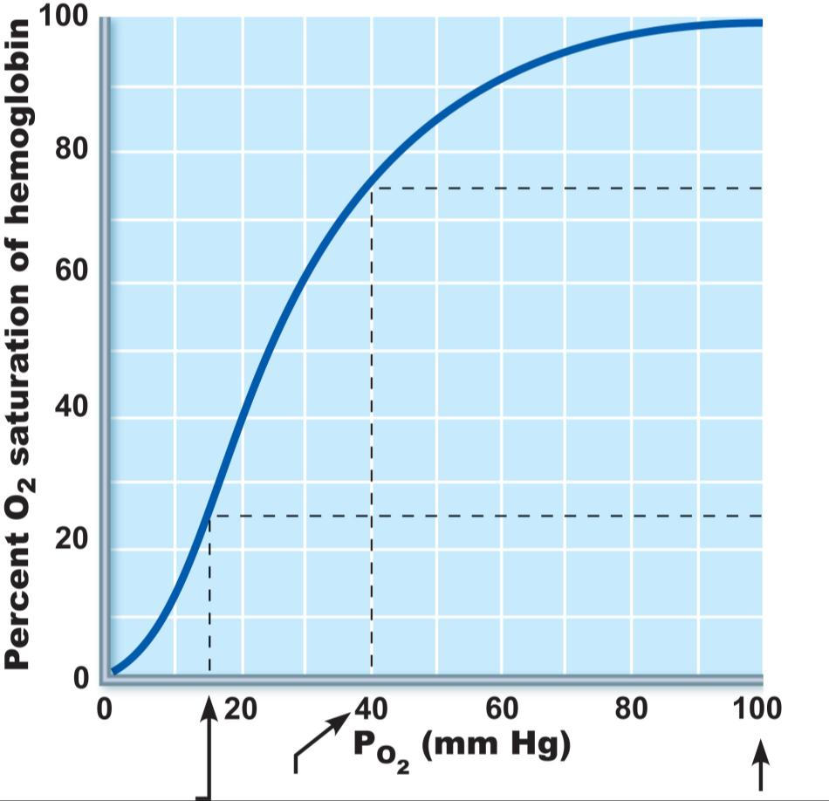
O₂ unloaded
to resting
tissues
Additional
O₂ unloaded
to exercising
tissues
Exercising
tissues
Resting
tissues
Lungs
Figure 22.20

Slide 87
Hemoglobin Saturation Curve
Hemoglobin is almost completely saturated at a P_{O2} _
Further increases in P_{O2} produce only __________________________________________ in oxygen binding
Oxygen loading and delivery to tissue is adequate when P_{O2} is _

Slide 88
Hemoglobin Saturation Curve
Only ________________________________ of bound oxygen is unloaded during _
If oxygen levels in tissues drop:
_________________________________________________ from hemoglobin and is used by cells
Respiratory rate or cardiac output _

Slide 89
Factors Influencing Hemoglobin Saturation
_______________________________ of these factors:
Po₂
Temperature
Blood pH
Pco₂
Concentration of BPG
Increase of the above factors _
Enhances oxygen _
Decreases act in the opposite manner
These parameters are all high in _________________________________________________ capillaries where oxygen unloading is the goal

Slide 90
Factors that Increase Release of O₂ by Hemoglobin
As cells metabolize _
Pco₂ and H⁺ increase in concentration in capillary blood
________________________________________________ weakens the hemoglobin-O₂ bond
Heat production increases
_____________________________________________________ directly and indirectly decreases Hb affinity for O₂

Slide 91
Homeostatic Imbalance
Inadequate O₂ delivery to tissues
Due to a variety of causes
Too few _
Abnormal or _
Blocked circulation
Pulmonary _
Carbon monoxide

Slide 92
CO₂ Transport
CO₂ is transported in the blood in three forms
7 to 10% _
20% bound to _ (carbaminohemoglobin)
70% transported as _____________________________________________ in plasma

Slide 93
Transport and Exchange of CO₂
CO₂ combines with water to form ______________________________________ (H₂CO₃), which quickly dissociates:
Most of the above occurs in __________________, where ______________________________________ reversibly and ___________________________catalyzes the reaction
CO₂ | + | H₂O | ↔ | H₂CO₃ | ↔ | H⁺ | + | HCO₃–
Carbon dioxide |  | Water |  | Carbonic acid |  | Hydrogen ion |  | Bicarbonate ion

Slide 94
Transport and Exchange of CO₂
In systemic capillaries
HCO₃– ______________________________________from RBCs into the plasma
The chloride shift occurs:
outrush of HCO₃– from the RBCs _

Slide 95
Transport and Exchange of CO₂
In pulmonary capillaries
HCO₃– moves into the RBCs and binds _
H₂CO₃ is split by _______________________________________________ into CO₂ and water
CO₂ diffuses into the alveoli

Slide 96
Haldane Effect
The amount of _________________________________ is affected by the _
The lower the Po₂ and hemoglobin saturation with O₂, the _

Slide 97
Haldane Effect
At the tissues, as more carbon dioxide enters the blood
More oxygen _
As HbO₂ releases O₂, it ________________________________________________ with CO₂ to form carbaminohemoglobin

Slide 98
Influence of CO₂ on Blood pH
HCO₃– in plasma is ___________________________________ of the carbonic acid–bicarbonate buffer system
If H⁺ concentration in blood rises, excess H⁺ is removed _
If H⁺ concentration begins to drop, _
CO₂ | + | H₂O | ↔ | H₂CO₃ | ↔ | H⁺ | + | HCO₃–
Carbon dioxide |  | Water |  | Carbonic acid |  | Hydrogen ion |  | Bicarbonate ion

Slide 99
Influence of CO₂ on Blood pH
Changes in __________________________________ can also alter blood pH
For example, _________________________________ breathing ______________________________________ in the blood, causing pH to drop
Changes in ventilation can be used to adjust pH when it is disturbed by metabolic factors

Slide 100
Control of Respiration
Involves neurons in the __________________________________________ of the medulla and pons

Slide 101
Medullary Respiratory Centers
Dorsal respiratory group (DRG)
Near the root of _
Integrates input from peripheral stretch and _

Slide 102
Medullary Respiratory Centers
2. Ventral respiratory group (VRG)
Rhythm-generating and integrative center
Sets ________________________________ (12–15 breaths/minute)
Inspiratory neurons excite the inspiratory muscles via the _
Expiratory neurons ____________________________ the inspiratory neurons

Slide 103
Pontine Respiratory Centers
Influence and modify activity of the _
Smooth out _______________________________ between inspiration and expiration and vice versa

Slide 104
Genesis of the Respiratory Rhythm
Not well understood
Most widely accepted hypothesis
__________________________________________ of two sets of interconnected neuronal networks in the medulla sets the rhythm

Slide 105
Depth and Rate of Breathing
___________________________________- is determined by how actively the respiratory center stimulates the _
_____________________________is determined by ______________________________-the inspiratory center is active
Both are __________________________________ in response to changing body demands

Slide 106
Chemical Factors
Influence of Pco₂:
If Pco₂ levels rise (____________________________), CO₂ accumulates in the brain
CO₂ is hydrated;
resulting ____________________________________________ dissociates, releasing H⁺
H⁺ stimulates the _________________________________________________ of the brain stem
Chemoreceptors synapse with the respiratory regulatory centers, increasing the depth and rate of breathing

Slide 107
Depth and Rate of Breathing: P_{CO2}
__________________________________________ – increased depth and rate of breathing that:
Quickly ________________________________________ from the blood
Occurs in response to _
Elevated Carbon dioxide levels
Though a rise CO₂ acts as the original stimulus, control of breathing at rest is regulated _

Slide 108
Depth and Rate of Breathing: P_{CO2}
___________________________________________- breathing due to abnormally _________________ levels
__________________________________ (breathing cessation) may occur until P_{CO2} levels rise

Slide 109
Chemical Factors
Influence of Po₂
Peripheral chemoreceptors in the _
When excited, they cause the respiratory centers _
Substantial drops in ________________________ (to 60 mm Hg) must occur in order to stimulate increased ventilation

Slide 110
Chemical Factors
Influence of arterial pH
Can modify respiratory _________________________________________ even if CO₂ and O₂ levels are normal
Decreased pH may reflect
Accumulation of _
Excess _______________________________________ in patients with diabetes mellitus
Respiratory system controls will attempt to raise the pH by _

Slide 111
Summary of Chemical Factors
Normally blood Po₂ affects breathing only indirectly by influencing peripheral chemoreceptor sensitivity to changes in Pco₂

Slide 112
Summary of Chemical Factors
When arterial Po₂ falls below 60 mm Hg, it becomes the major stimulus for respiration (via the peripheral chemoreceptors)
Changes in arterial pH resulting from CO₂ retention or metabolic factors act indirectly through the peripheral chemoreceptors

Slide 113
Influence of Higher Brain Centers
____________________________________ controls act through the _________________________________ to modify rate and depth of respiration
Example: breath holding that occurs in anger or gasping with pain
A rise in _______________________________________ acts to increase respiratory rate
______________________________________________ are direct signals from the cerebral motor cortex that bypass medullary controls
Example: __________________________________ breath holding

Slide 114
Pulmonary Irritant Reflexes
Receptors in the bronchioles _
Promote _____________________________________ of air passages
Receptors in the larger airways mediate the _

Slide 115
Inflation Reflex
Hering-Breuer Reflex
______________________________________________ in the pleurae and airways are stimulated by lung inflation
Inhibitory signals to the medullary respiratory centers end inhalation and _
Acts more as a _______________________________________ response than a normal regulatory mechanism

Slide 116
Respiratory Adjustments: Exercise
Adjustments are geared to both the _
Increase in ventilation (10 to 20 fold) in response to metabolic needs
Pco₂, Po₂, and pH remain surprisingly ________________________________________ during exercise

Slide 117
Respiratory Adjustments: Exercise
Three neural factors cause increase in ventilation as exercise begins
Psychological stimuli
_________________________________of exercise
Simultaneous _______________________________________________ of skeletal muscles and respiratory centers
Exictatory impulses reaching respiratory centers

Slide 118
Respiratory Adjustments: Exercise
As exercise ends
________________________________________________ suddenly as the three neural factors shut off

Slide 119
Respiratory Adjustments: High Altitude
Quick travel to altitudes above 8000 feet may produce symptoms of _
Headaches, shortness of breath, nausea, and dizziness
In severe cases, _

Slide 120
Acclimatization to High Altitude
Acclimatization: respiratory and hematopoietic adjustments to altitude
Chemoreceptors become ___________________________________________ to Pco₂ when Po₂ declines
Substantial decline in Po₂ directly stimulates peripheral chemoreceptors
Result:
minute ventilation increases and ______________________________________________________ to 2–3 L/min higher than at sea level

Slide 121
Acclimatization to High Altitude
Decline in blood O₂ stimulates the _______________________________________ to accelerate production of _
_____________________________________________ to provide long-term compensation

Slide 122
Homeostatic Imbalances
Chronic obstructive pulmonary disease (COPD)
Exemplified by _
_________________________________________decrease in the ability to _
Other common features
History of _______________________________-in 80% of patients
labored breathing (“air hunger”)
Coughing and frequent _
Most victims develop respiratory failure (hypoventilation) accompanied by _

Slide 123
Homeostatic Imbalances
Asthma
Characterized by coughing, _______________________________ , wheezing, and _
__________________________________________ of the airways precedes bronchospasms
Airway inflammation is an ___________________________________________ caused by release of ____________________________________, production of IgE, and recruitment of inflammatory cells
Airways thickened with __________________________________________________ magnify the effect of bronchospasms

Slide 124
Homeostatic Imbalances
Infectious disease caused by the bacterium Mycobacterium tuberculosis
Symptoms include
weight loss
racking cough
Treatment entails a 12-month course of antibiotics

Slide 125
Homeostatic Imbalances
Lung cancer
Leading cause of cancer deaths in North America
_______________of all cases are the result of smoking
The three most common types
_________________________________________ (~20–40% of cases) in bronchial epithelium
________________________________________ (~40% of cases) originates in peripheral lung areas
________________________________________ (~20% of cases) contains lymphocyte-like cells that originate in the primary bronchi and subsequently metastasize

