Slide 1
Function of the respiratory system
Goal:
to supply the _
To dispose of _
Method: Respiration: Includes the following
Transport of _

Slide 2
Pulmonary Ventilation
Movement of _

Slide 3
External Respiration
Movement of
oxygen
Carbon dioxide

Slide 4
Transport of gasses
Oxygen is carried to the cells of the body via the _
Carbon dioxide is carried from the body to the lungs _

Slide 5
Internal respiration
Moving oxygen from _
Moving carbon dioxide from _

Slide 6
Cells’ use for oxygen
Why transport oxygen?
We deliver oxygen to the cells
Within the cell, oxygen is used by ___________________________________ in a process called _
Production of ATP

Slide 7
Respiratory Anatomy
Respiratory system includes
Nose
Pharynx
Trachea
Lungs
Alveoli

Slide 8
Respiratory system
Can be divided up into two functional zones
1.
Actual location where _
Respiratory bronchioles
Alveoli
Microscopic structures

Slide 9
Respiratory system
2.
The passageways that _____________________________________, but do not participate in exchange
Rigid conduits
Also function to

Slide 10
Function of the Nose
The only __________________________ part of the respiratory system
Provides an airway for respiration
__________________________________ the entering air
__________________________________ inspired air and cleans it of foreign matter

Slide 11
Structure of the Nose
Nose is divided into two regions:
External nose, including the _
Internal _
_____________________________ – a shallow vertical groove inferior to the apex
The external ______________ (nostrils) are bounded laterally by the ____________

Slide 12
Nasal Cavity
Lies in and posterior to the external nose
Is divided by a _
Opens posteriorly into the nasal pharynx via internal nares
The _____________________________ bones form the roof
The floor is formed by the _

Slide 13
Nasal Cavity
Vestibule –
_____________________________ – hairs that filter coarse particles from inspired air
Olfactory mucosa
Lines the _
Contains smell receptors

Slide 14
Nasal Cavity
____________________________ mucosa
Lines the nasal cavity
Except for the olfactory portion
Glands secrete mucus containing ______________________ and ______________________ to help destroy bacteria

Slide 15
Nasal Cavity
Inspired air is:
______________________________ by the high water content in the nasal cavity
______________________________ by rich plexuses of capillaries
Remember:
Ciliated mucosal cells remove contaminated mucus

Slide 16
Nasal Cavity
Superior, medial, and inferior conchae:
Protrude medially from the lateral walls
Enhance air turbulence and _
Sensitive mucosa triggers sneezing when stimulated by _

Slide 17
Functions of the Nasal Mucosa and Conchae
During inhalation the conchae and nasal mucosa:
Filter, heat, and moisten air
During _________________________ these structures:
_________________________ heat and moisture
__________________________ heat and moisture loss

Slide 18
Paranasal Sinuses
Sinuses ______________________ that surround the nasal cavity
Sinuses ____________________________ and help to warm and moisten the air

Slide 19
Pharynx
The _
Funnel-shaped tube of skeletal muscle that connects to the:
__________________________________ superiorly
__________________________________ inferiorly
Extends from the base of the skull to the level of the sixth cervical vertebra

Slide 20
Pharynx
It is divided into three regions
Oropharynx

Slide 21
Nasopharynx
Lies ___________________ to the nasal cavity,
inferior to the sphenoid,
superior to the level of the soft palate
Strictly an _
Lined with pseudostratified columnar epithelium

Slide 22
Nasopharynx
___________________ during swallowing to _
The _____________________________ lies high on the posterior wall
Pharyngotympanic (auditory) tubes open into the lateral walls

Slide 23
Oropharynx
Extends inferiorly from the level of the soft palate to the epiglottis
Serves as a _

Slide 24
Oropharynx
The epithelial lining is protective stratified squamous epithelium
Palatine tonsils lie in the lateral walls
__________________________ covers the base of the _

Slide 25
Laryngopharynx
Serves as a _
Lies posterior to the upright epiglottis
Extends to the larynx, where the respiratory and digestive pathways diverge

Slide 26
Larynx (Voice Box)
Attaches to the _
Continuous with the _
functions
To provide an _
To direct food and air into the proper pathways
To function in _

Slide 27
Framework of the Larynx
Cartilages (____________________) of the larynx
_______________________ cartilage: Shield-shaped
with a midline prominence _
____________________________ cartilage
Three pairs of small
arytenoid,
cuneiform,
corniculate
___________________________ – ________________________________ that covers the laryngeal inlet during swallowing

Slide 28
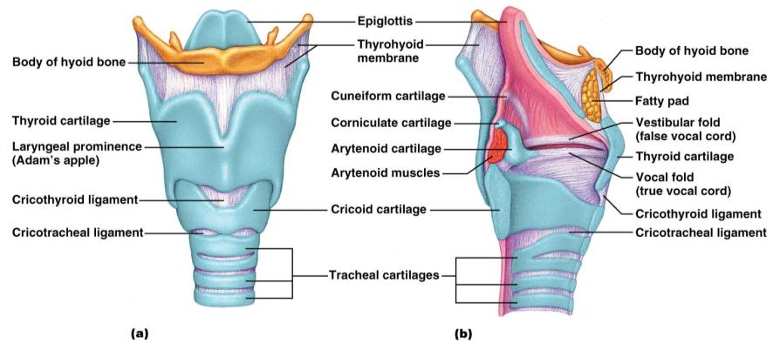
Framework of the Larynx
Figure 22.4a, b

Slide 29
Vocal Ligaments
Attach the _______________________ cartilages to the _____________________ cartilage
Composed of _______________________ that form mucosal folds called _
The medial ____________________ between them is the _
They vibrate to produce sound as air rushes up from the lungs

Slide 30
Vocal Production
Speech
intermittent release of _
determined by the length and ___________________________ of the vocal cords
Loudness
depends upon the ________________ at which the air rushes across the vocal cords

Slide 31
Vocal production
The pharynx
Sound is shaped into language by action of the pharynx, tongue, soft palate, and lips

Slide 32
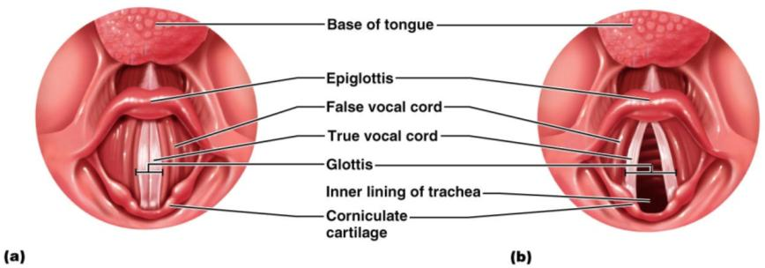
Movements of Vocal Cords
Figure 22.5

Slide 33
Trachea
Flexible and mobile tube extending from the _
Composed of three layers
made up of _____________________________ and ciliated epithelium
Submucosa
______________________________________ deep to the mucosa
Adventitia
outermost layer made of _

Slide 34
Conducting Zone: Bronchi
last tracheal _
marks the _
Air reaching the bronchi is
Warm and cleansed of impurities

Slide 35
Conducting Zone: Bronchial Tree
Bronchi subdivide into __________________, each supplying a lobe of the lungs
Air passages undergo 23 orders of branching
As conducting tubes become smaller, structural changes occur
_________________________________ support structures change
_________________________________________ change
Amount of _____________________________________ increases

Slide 36
Conducting Zone: Bronchial Tree
Bronchioles
Consist of _
Have a complete layer of _
____________________ cartilage support and mucus-producing cells

Slide 37
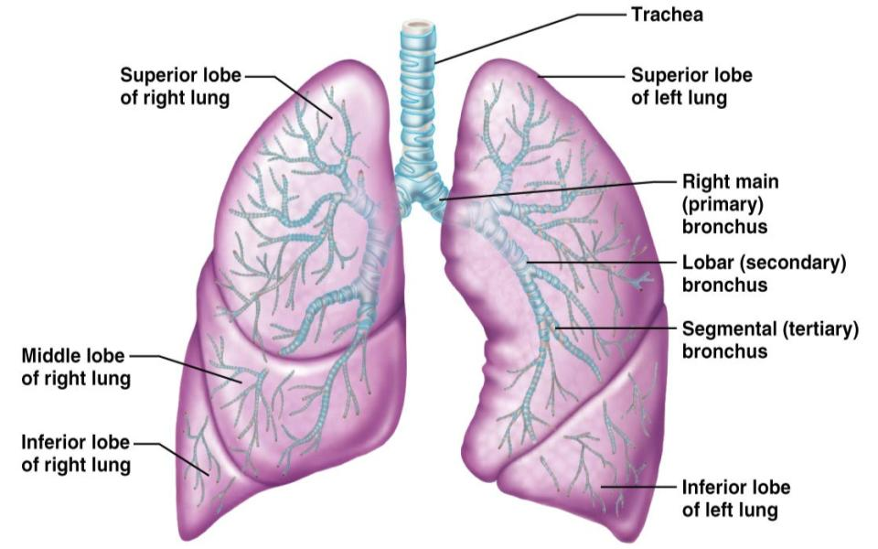
Conducting Zones
Figure 22.7

Slide 38
Respiratory Zone
Defined by
presence of _
begins as terminal bronchioles feed into _
Respiratory bronchioles → _____________________________ → alveolar sacs composed of alveoli
Approximately 300 million alveoli:
Accounts for _
tremendous _________________ for gas exchange

Slide 39
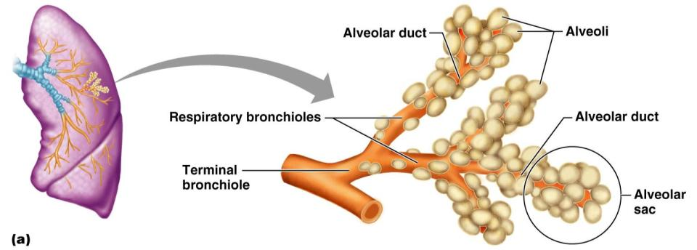
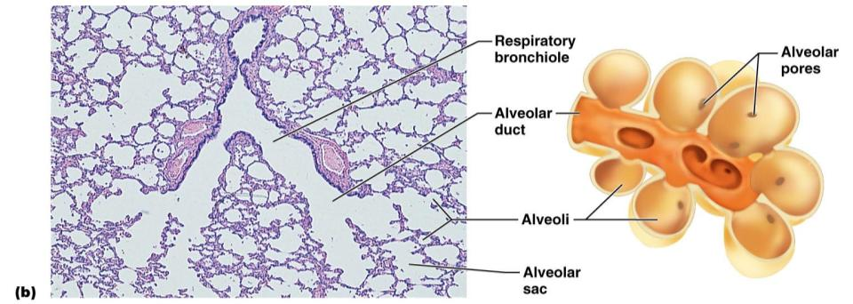
Figure 22.8a

Slide 40
Respiratory Membrane
Alveolar walls:
single layer of ____________________________ epithelial cells
Permit gas exchange by _
Secrete _
Type ___ cells secrete _

Slide 41
Alveoli
Surrounded by fine elastic fibers
Contain _
Connect adjacent alveoli
Allow __________________________ throughout the lung to be _
House ___________________________ that keep alveolar surfaces sterile

Slide 42
Gross Anatomy of the Lungs
Lungs occupy all of the thoracic cavity except the mediastinum
Root
site of _
Costal surface
anterior, lateral, and posterior surfaces in _
Apex
narrow _
Base
inferior surface that _
Hilus
______________________________________ that contains pulmonary and systemic blood vessels

Slide 43
Lungs
______________________ notch (impression)
cavity that _
Left lung
separated into upper and lower lobes by _
Right lung
separated into ______________________ by the oblique and horizontal fissures
There are 10 bronchopulmonary segments in each lung

Slide 44
Blood Supply to Lungs
Lungs are _____________________ by two circulations: _
Pulmonary arteries
supply _______________________________ blood to be _
Branch profusely, along with bronchi
Ultimately _____________________________________________ surrounding the alveoli
Pulmonary veins
carry _____________________________ blood from _

Slide 45
Blood Supply to Lungs
provide ___________________________ to the lung tissue
Arise from ____________________________ and enter the lungs at the hilus
Supply all lung tissue except the alveoli
Bronchial veins ____________________________ with pulmonary veins
Pulmonary veins carry most venous blood back to the heart

Slide 46
Pleurae
Covers the _____________________________ and superior face of the diaphragm
Continues around heart and between lungs

Slide 47
Pleurae
also pulmonary pleura
Covers the

Slide 48
Breathing
Breathing, or __________________________, consists of two phases
air flows into the lungs
gas exits the lungs

Slide 49
Pressure Relationships in the Thoracic Cavity
Respiratory pressure is always described relative to _
Atmospheric pressure (P_{atm})
Pressure exerted by the _
__________________________ respiratory pressure is less than atmospheric
__________________________ respiratory pressure is greater than atmospheric

Slide 50
Pressure Relationships in the Thoracic Cavity
_____________________________ pressure (P_{pul})
pressure _
______________________________ pressure (P_{ip})
pressure within _

Slide 51
Pressure Relationships
Intrapulmonary pressure and intrapleural pressure ___________________ with the phases of breathing
Intrapulmonary pressure always eventually equalizes itself with atmospheric pressure
Intrapleural pressure is ________________________________ intrapulmonary pressure and atmospheric pressure

Slide 52
Pressure Relationships
_____________________ act to pull the lungs away from the thoracic wall, promoting lung collapse
_____________________________ of lungs causes them to assume smallest possible size
_____________________________ of alveolar fluid draws alveoli to their smallest possible size
Opposing force – elasticity of the chest wall _

Slide 53
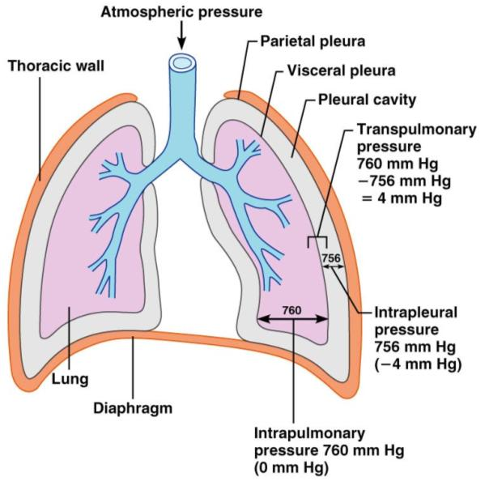
Pressure Relationships
Figure 22.12

Slide 54
Lung Collapse
Caused by ___________________________ of the intrapleural pressure with the intrapulmonary pressure
____________________________________ keeps the airways open
Transpulmonary pressure – difference between the intrapulmonary and intrapleural pressures (P_{pul} – P_{ip})

Slide 55
Pulmonary Ventilation
A mechanical process that depends on volume changes in the thoracic cavity
_______________________________ lead to _________________________________, which lead to the ____________________ to equalize pressure

Slide 56
Inspiration
The diaphragm ______________________________ towards the abdomen
external intercostal muscles contract _
The lungs are _
intrapulmonary _
Intrapulmonary _____________________________ below atmospheric pressure (−1 mm Hg)
__________________________________________, down its pressure gradient to equilibrium

Slide 57
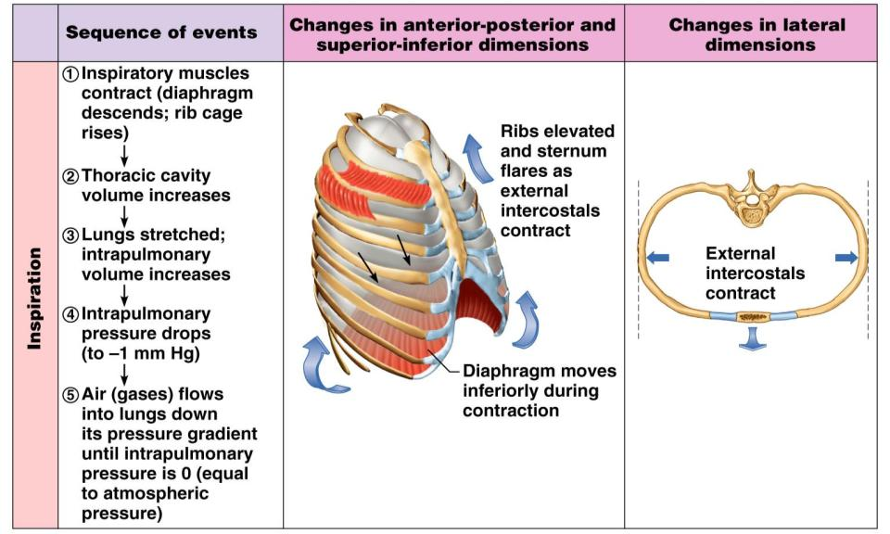
Inspiration
Figure 22.13.1

Slide 58
Expiration
Inspiratory _
rib cage ______________________due to gravity
Thoracic cavity _
Elastic lungs _
intrapulmonary _
Intrapulmonary ________________________ above atmospheric pressure
Gases ______________________________ down the pressure gradient

Slide 59
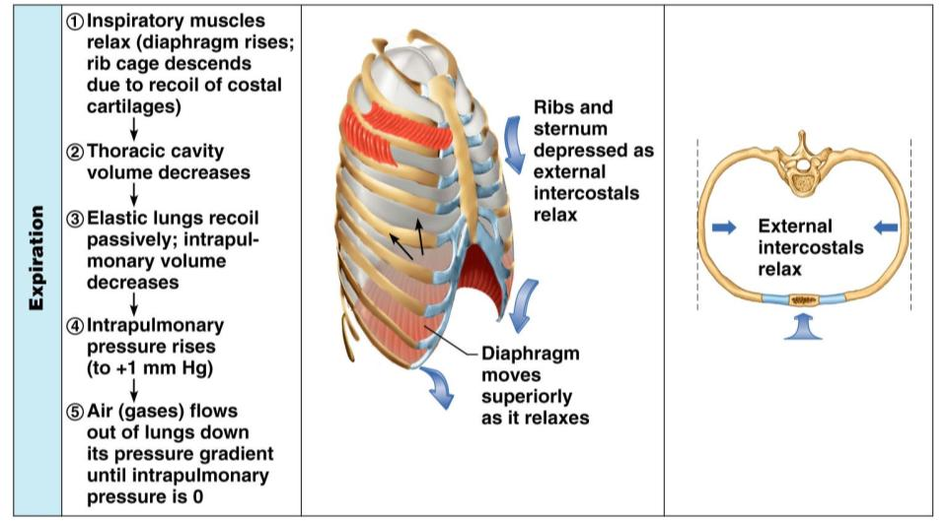
Expiration
Figure 22.13.2

Slide 60
Airway Resistance
As airway _________________________ rises
breathing movements become _
Severely _____________________________ bronchioles:
Can prevent life-sustaining ventilation
Can occur during _________________________ which stops ventilation
__________________________________ release
from the sympathetic nervous system
________________________________ bronchioles
________________________________ air resistance

Slide 61
Alveolar Surface Tension
Surface tension
the ______________________________________ at a liquid-gas interface
The liquid coating the alveolar surface is always acting to _
Surfactant, a detergent-like complex, _________________________________________ and helps keep the alveoli _

Slide 62
Lung Compliance
The _________________________ with which lungs can be expanded
Determined by two main factors
_____________________________________ of the lung tissue and surrounding thoracic cage
_______________________________________ of the alveoli

Slide 63
Factors That Diminish Lung Compliance
Scar tissue or _
reduces the _____________________of the lungs
Seen in tuberculosis
________________________ of the smaller respiratory passages with _
Reduced production of _
Decreased _____________________________________ or its decreased ability to expand

Slide 64
Factors That Diminish Lung Compliance
Examples include:
Deformities of _
__________________________________ of the costal cartilage
____________________________________ of intercostal muscles

Slide 65
Respiratory Volumes
Tidal volume
air that moves _
(approximately 500 ml)
Inspiratory reserve volume
air that can be _____________________________________ (2100–3200 ml)

Slide 66
Respiratory Volumes
Expiratory reserve volume
air that can be ____________________________________ (1000–1200 ml)
Residual volume
air left in the lungs after _
(1200 ml)

Slide 67
Respiratory Capacities
Inspiratory capacity
____________________________________
____________________________________ (IRV + TV)
_________________________________ amount of air remaining in the lungs after a tidal expiration (RV + ERV)

Slide 68
Respiratory Capacities
the total amount of exchangeable air (TV + IRV + ERV)
Total lung capacity (TLC)
____________________________________ (approximately 6000 ml in males)

Slide 69
Dead Space
Anatomical dead space
volume of the __________________________________________ (150 ml)
___________________________ dead space
alveoli that _
Total dead space
sum of ___________________________________ dead spaces

Slide 70
Pulmonary Function Tests
Spirometer
an instrument consisting of a hollow bell inverted over water, used to _
Spirometry can distinguish between:
Obstructive pulmonary disease – _
Restrictive disorders – ____________________________________ from structural or functional lung changes

Slide 71
Pulmonary Function Tests
Total _
total amount of gas flow into or out of the respiratory tract in one minute
Forced _
gas forcibly expelled after taking a deep breath
Forced expiratory volume (FEV)
the amount of gas expelled during _

Slide 72
Pulmonary Function Tests
Increases in _________________________ may occur as a result of _
Reduction in VC, TLC, FRC, and RV result from _

Slide 73
Alveolar Ventilation
Alveolar ventilation rate (AVR)
measures the _
Slow, deep breathing _
AVR | = | frequency | X | (TV – dead space)
(ml/min) |  | (breaths/min) |  | (ml/breath)

Slide 74
Nonrespiratory Air Movements
Most result from _
Examples include
Coughing
Hiccupping

Slide 75
Composition of Alveolar Gas
The atmosphere is mostly _
alveoli contain more _
These differences result from:
____________________________________ – oxygen diffuses from the alveoli and carbon dioxide diffuses into the alveoli
________________________________ of air by conducting passages
The mixing of alveolar gas that occurs with each breath

Slide 76
External Respiration: Pulmonary Gas Exchange
Factors influencing the _
Partial pressure _________________________ and gas _
Matching of ________________________ and pulmonary _
Structural characteristics of the respiratory membrane

Slide 77
Partial Pressure Gradients and Gas Solubilities
The partial pressure oxygen (PO₂) of venous blood is 40 mm Hg; the partial pressure in the alveoli is 104 mm Hg
This ____________________________ allows oxygen partial pressures to ___________________________________ (in 0.25 seconds), and thus blood can move three times as quickly (0.75 seconds) through the pulmonary capillary and _

Slide 78
Partial Pressure Gradients and Gas Solubilities
Although carbon dioxide has a _
It is ________________________________ in plasma than oxygen
It diffuses in equal amounts with oxygen

Slide 79
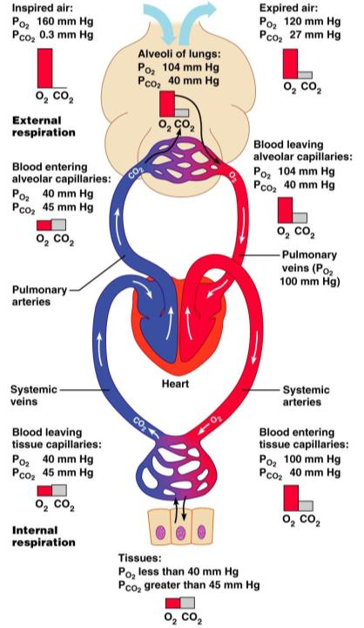
Figure 22.17

Slide 80
Ventilation-Perfusion Coupling
Ventilation
the amount of _
Perfusion
the ______________________________ reaching the alveoli
Ventilation and perfusion must be _

Slide 81
Ventilation-Perfusion Coupling
Changes in ________________________ cause changes in the diameters of the bronchioles
Passageways servicing areas where _
Those serving areas where alveolar _

Slide 82
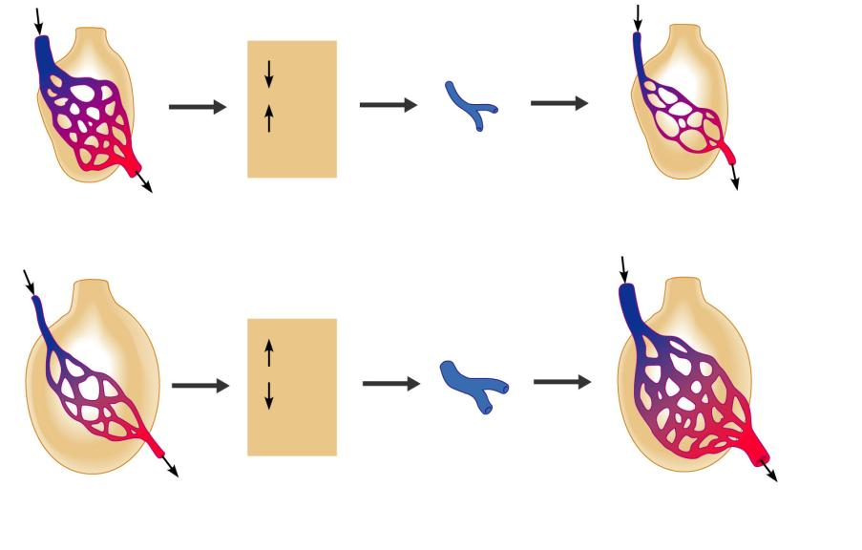
P_{O2}
P_{CO2}
in alveoli
Reduced alveolar ventilation;
excessive perfusion
Pulmonary arterioles
serving these alveoli
constrict
Reduced alveolar ventilation;
reduced perfusion
P_{O2}
P_{CO2}
in alveoli
Enhanced alveolar ventilation;
inadequate perfusion
Pulmonary arterioles
serving these alveoli
dilate
Enhanced alveolar ventilation;
enhanced perfusion
Figure 22.19

Slide 83
Surface Area and Thickness of the Respiratory Membrane
Respiratory membranes:
Are thin, allowing for efficient gas exchange
Have a total surface area (in males) of about 60 m² (________________ that of one’s skin)
______________________ if lungs become waterlogged and edematous,
gas exchange is _
Decrease in surface area with emphysema, when walls of adjacent _

Slide 84
Internal Respiration
The factors promoting _____________________________ are the same as those for _
The partial pressures and diffusion gradients are _
P_{O2} in ____________ is _______________ lower than in systemic arterial blood
P_{O2} of venous blood draining tissues is 40 mm Hg and P_{CO2} is 45 mm Hg

Slide 85
Oxygen Transport
______________________________ is carried in the blood:
Bound to __________________________ within red blood cells

Slide 86
Oxygen Transport: Role of Hemoglobin
Each Hb molecule binds ___________________ atoms in a _
The hemoglobin-oxygen combination is called _
Hemoglobin that has released oxygen is called _
Lungs
HHb + O₂
HbO₂ + H⁺
Tissues

Slide 87
Hemoglobin (Hb)
Saturated hemoglobin
when ____________________________ of the molecule are bound to oxygen
_________________________ saturated hemoglobin
when _______________________ hemes are bound to oxygen

Slide 88
Hemoglobin Saturation Curve
Hemoglobin is almost completely saturated at a P_{O2} of 70 mm Hg
Further _________________________ in P_{O2} produce ___________________________ in oxygen binding
Oxygen loading and delivery to tissue is adequate when P_{O2} is below normal levels

Slide 89
Hemoglobin Saturation Curve
Only __________________________________ during one systemic circulation
If oxygen levels in _
More oxygen ________________________ from hemoglobin and is used by cells
Respiratory rate or cardiac output _

Slide 90
Factors Influencing Hemoglobin Saturation
BPG:
bisphosphoglycerate (produced by RBCs during glycolysis and can bind with Hb)
alters hemoglobin’s affinity for oxygen

Slide 91
Factors Influencing Hemoglobin Saturation
Increases of these factors:
____________________________ hemoglobin’s affinity for oxygen
_____________________________________________ from the blood
Decreases act in the opposite manner
These parameters are all ___________________________________________ where oxygen unloading is the goal

Slide 92
Factors That Increase Release of Oxygen by Hemoglobin
As cells _____________________________, carbon dioxide is released into the blood causing:
Increases in
Carbon dioxide pressure
__________________________________ in capillary blood
Declining ____________________________ which weakens the hemoglobin-oxygen bond (Bohr effect)

Slide 93
Factors That Increase Release of Oxygen by Hemoglobin
Metabolizing cells have ___________________ as a byproduct and the rise in temperature _
All these factors ________________________________________ in the vicinity of working tissue cells

Slide 94
Carbon Dioxide Transport
Carbon dioxide is transported in the blood in _
Chemically _________________________________ – 20% is carried in RBCs as carbaminohemoglobin
___________________________________ in plasma – 70% is transported as bicarbonate (HCO₃–)

Slide 95
Transport and Exchange of Carbon Dioxide
Carbon dioxide diffuses ____________________ and combines ___________________________ to form ____________________________________ , which quickly dissociates into hydrogen ions and bicarbonate ions
In RBCs, the enzyme _________________________________________ converts carbon dioxide and water to carbonic acid
CO₂ | + | H₂O | ↔ | H₂CO₃ | ↔ | H⁺ | + | HCO₃–
Carbon dioxide |  | Water |  | Carbonic acid |  | Hydrogen ion |  | Bicarbonate ion

Slide 96
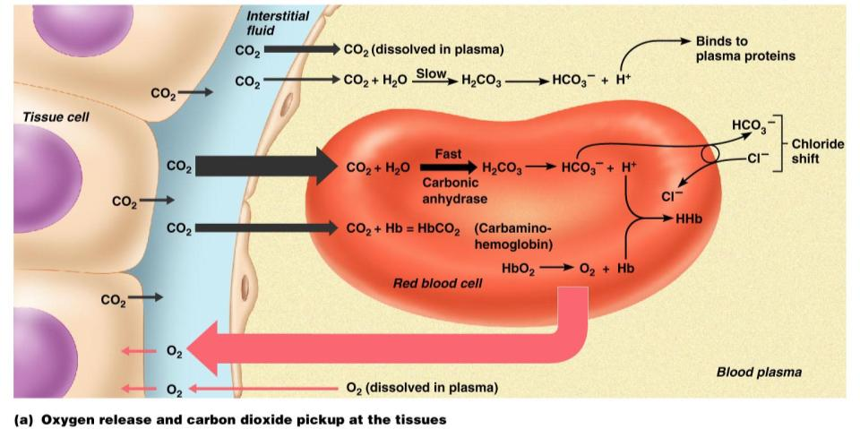
Transport and Exchange of Carbon Dioxide
Figure 22.22a

Slide 97
Transport and Exchange of Carbon Dioxide
At the tissues:
Bicarbonate _________________________ diffuses _
The _
counterbalance the outrush of ______________________ (bicarbonate) from the RBCs
chloride ions (Cl–) move _

Slide 98
Transport and Exchange of Carbon Dioxide
At the lungs, these processes are reversed
Bicarbonate ions move _______________________ and bind with hydrogen ions to form _
Carbonic acid is then split by carbonic anhydrase to _
Carbon dioxide then diffuses from the _

Slide 99
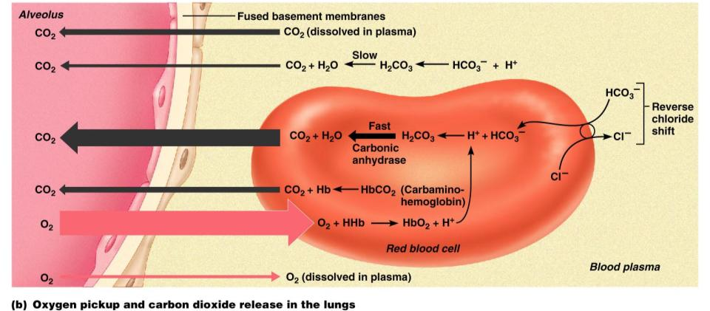
Transport and Exchange of Carbon Dioxide
Figure 22.22b

Slide 100
Haldane Effect
The amount of carbon dioxide transported is markedly affected by the P_{O2}
Haldane effect
the _________________________________________, the _____________________ carbon dioxide can be carried in the blood

Slide 101
Haldane Effect
At the tissues, as more carbon dioxide enters the blood:
More oxygen dissociates from hemoglobin
____________________________________ allows oxygen to break away and diffuse into the tissues
More _____________________________________, and more bicarbonate ions are formed
This situation is _________________________ in pulmonary circulation

Slide 102
Influence of Carbon Dioxide on Blood pH
The carbonic acid–bicarbonate ______________________ resists blood pH changes
If hydrogen ion concentrations in blood ______________, excess H⁺ is _
If hydrogen ion concentrations ______________________, carbonic acid dissociates, _
CO₂ | + | H₂O | ↔ | H₂CO₃ | ↔ | H⁺ | + | HCO₃–
Carbon dioxide |  | Water |  | Carbonic acid |  | Hydrogen ion |  | Bicarb ion

Slide 103
Influence of Carbon Dioxide on Blood pH
Changes in respiratory rate can also:
Provide a fast-acting system to _______________________________ when it is disturbed by metabolic factors

Slide 104
Control of Respiration: Medullary Respiratory Centers
The ______________________________________ (DRG)
or inspiratory center:
Location:
Function:
Excites the inspiratory muscles
sets eupnea (12-15 breaths/minute)
Eu:
Pnea:
Becomes ________________________ during expiration

Slide 105
Medullary respiratory centers
The _____________________________ respiratory group (VRG)
involved in _

Slide 106
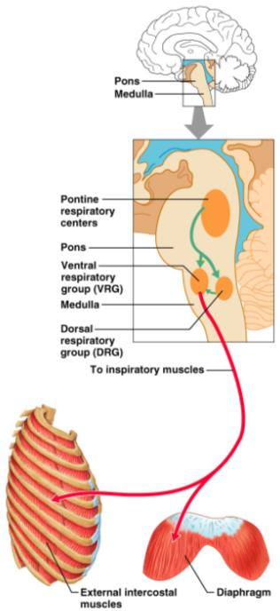
Control of Respiration: Pons Respiratory Centers
Pons centers:
Influences medullary centers
Smooth out ________________ (inspiration/expiration)
The pontine respiratory group (PRG) – continuously inhibits the inspiration center

Slide 107
Respiratory Rhythm
A result of relationship between medullary and pons centers
Other theories include
___________________________________________ and are both automatic and rhythmic
____________________________________ in the lungs establish respiratory rhythm

Slide 108
Depth and Rate of Breathing
Inspiratory ____________________ is determined by how actively the respiratory center stimulates the respiratory muscles
__________________________ of respiration is determined by ___________________________ the inspiratory center is active
Respiratory centers in the pons and medulla are sensitive to both excitatory and inhibitory stimuli

Slide 109
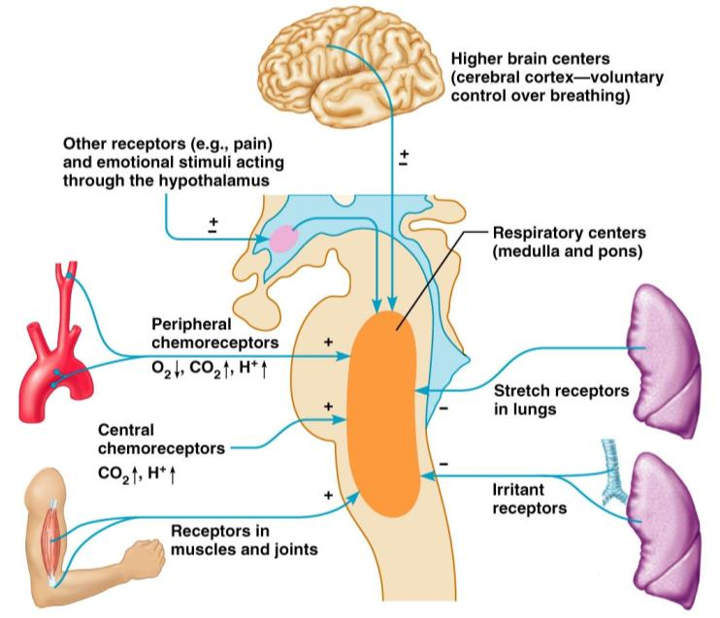
Medullary Respiratory Centers
Figure 22.25

Slide 110
Depth and Rate of Breathing: Reflexes
Pulmonary irritant reflexes
irritants ___________________________________ of air passages
Inflation reflex (Hering-Breuer)
________________________________________ in the lungs are stimulated by lung inflation
Prevents _
The body gives feedback based on stretch.

Slide 111
Depth and Rate of Breathing: Higher Brain Centers
Hypothalamic controls act with the _____________________________________ to modify rate and depth of respiration
Example: breath holding that occurs in anger
A ___________________________________ acts to increase respiratory rate
Cortical controls are direct signals from the cerebral motor cortex that _
Examples: voluntary breath holding, taking a deep breath

Slide 112
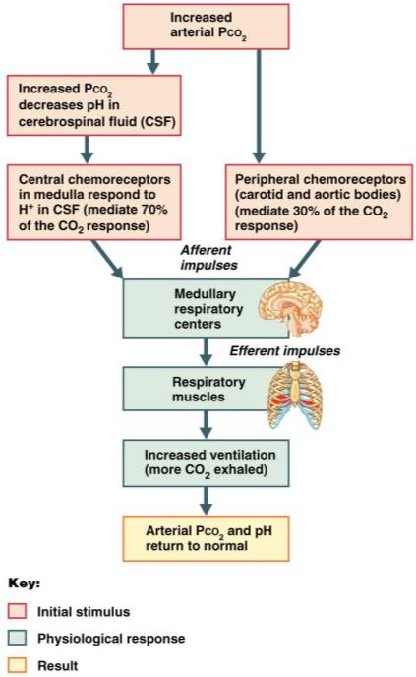
Depth and Rate of Breathing: P_{CO2}
levels are monitored by _
Carbon dioxide in the blood diffuses into _
Resulting carbonic acid dissociates, releasing hydrogen ions
Carbon dioxide levels rise
resulting in _

Slide 113
Depth and Rate of Breathing: P_{CO2}
Hyperventilation – ________________________________________:
Quickly ___________________________________ from the blood
Occurs in response to hypercapnia
Elevated Carbon dioxide levels
Though a rise CO₂ acts as the _____________________________, control of breathing at rest is regulated by the _

Slide 114
Depth and Rate of Breathing: P_{CO2}
______________________________________ breathing due to abnormally low P_{CO2} levels
_________________________ (breathing cessation) may occur _

Slide 115
Depth and Rate of Breathing: P_{CO2}
Oxygen levels are ___________ a stimulus for ventilation unless the levels drop significantly
If carbon dioxide is not removed, chemoreceptors become _
Then oxygen levels become the principal respiratory stimulus (________________________)

Slide 116
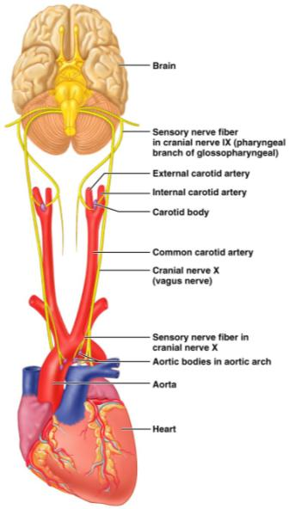
Depth and Rate of Breathing: Arterial pH
Changes in ______________________ can modify respiratory rate even if carbon dioxide and oxygen levels _
Increased ventilation in response to falling pH is mediated by _

Slide 117
Depth and Rate of Breathing: Arterial pH
Acidosis may reflect:
Carbon dioxide retention
Accumulation of _
Excess _____________________________ in patients with diabetes mellitus
Respiratory system controls will attempt to ___________________________ by increasing respiratory _

Slide 118
Respiratory Adjustments: Exercise
Respiratory adjustments are geared to both the _________________________________ of exercise
During vigorous exercise:
Ventilation can increase 20 fold
Breathing becomes ______________________________, but respiratory rate may not be significantly changed (hyperpnea)
Exercise-enhanced breathing is not prompted by an increase in P_{CO2} or a decrease in P_{O2} or pH
These levels remain surprisingly constant during exercise

Slide 119
Respiratory Adjustments: Exercise
As exercise begins:
Ventilation _________________________________, rises slowly, and reaches a steady state
When exercise stops:
Ventilation _______________________________, then gradually decreases to normal

Slide 120
Respiratory Adjustments: Exercise
Neural factors bring about the above changes, including:
______________________________ of exercise
Cortical motor activation
Both _
Excitatory impulses from _

Slide 121
Chronic Obstructive Pulmonary Disease (COPD)
Includes chronic bronchitis and obstructive emphysema
Patients have a history of:
________________________________, where labored breathing occurs and gets progressively worse
frequent pulmonary infections
COPD victims develop __________________________________________, carbon dioxide retention, and respiratory acidosis

Slide 122
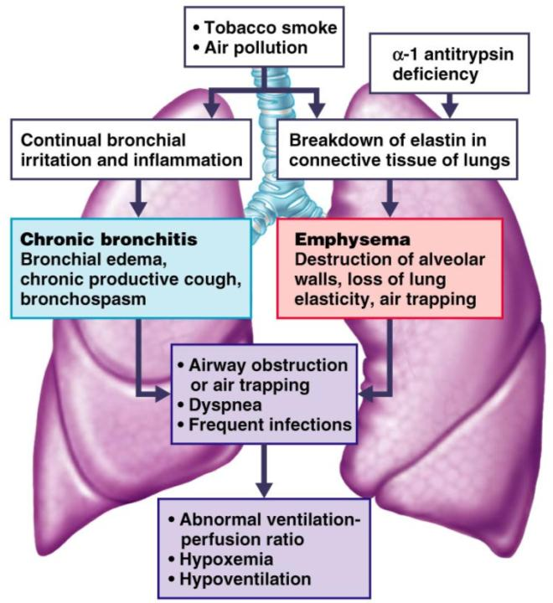
COPD
Figure 22.28

Slide 123
Asthma
Characterized by
Active inflammation of the airways precedes bronchospasms

Slide 124
Asthma
Airway inflammation is an _
caused by release of IL-4 and IL-5
stimulate _
recruit _
Airways fill with _________________ as a result of the inflammation. This magnifies the effect of _

Slide 125
Tuberculosis
Infectious disease caused by the bacterium Mycobacterium tuberculosis
Symptoms include
weight loss,
racking cough
splitting headache
Treatment entails a 12-month course of antibiotics

Slide 126
Lung Cancer
Accounts for 1/3 of all cancer deaths in the U.S.
90% of all patients with lung cancer were _
The three most common types are:
_________________________________ (20-40% of cases)
arises in _
Adenocarcinoma (25-35% of cases)
originates in _
_____________________________________ carcinoma (20-25% of cases)
contains lymphocyte-like cells that originate in the ______________________________ and subsequently _

