Slide 1
Digestive System
Two groups of organs
gastrointestinal or GI tract
Extends from _
____________________________________ and _________________________________________
Mouth, pharynx, esophagus, stomach, small intestine, and large intestine

Slide 2
Digestive System
2. Accessory digestive organs
Digestive glands

Slide 3
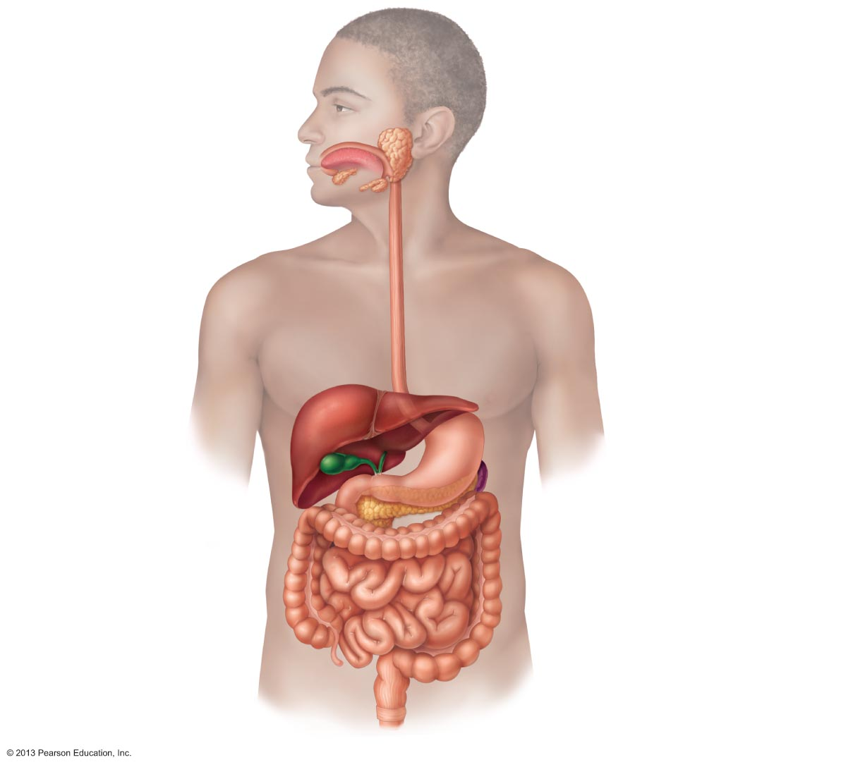
Figure 23.1 Alimentary canal and related accessory digestive organs.
Mouth (oral cavity)
Salivary
glands*
Tongue*
Esophagus
Pharynx
Stomach
Liver*
Pancreas*
Gallbladder*
Small
intestine
Large
intestine
Anus
Anal canal

Slide 4
Digestive Processes
Six essential activities
Propulsion
Digestion

Slide 5
GI Tract Regulatory Mechanisms
Mechanoreceptors and chemoreceptors
Respond to
changes in osmolarity
pH
end products of digestion
Initiate reflexes that
Activate or inhibit digestive glands
Stimulate ______________________________________ to mix and move lumen contents

Slide 6
GI Tract Regulatory Mechanisms
Intrinsic and extrinsic controls
enteric nerve plexuses (_______________________) respond to stimuli in GI tract
Long reflexes
respond to stimuli inside or outside GI tract
involve ________________________________ and autonomic nerves

Slide 7
Peritoneum and Peritoneal Cavity
serous membrane of abdominal cavity
external surface of most digestive organs
Parietal peritoneum
lines _
Peritoneal cavity
Between two peritoneums
Fluid ____________________________________ mobile organs

Slide 8
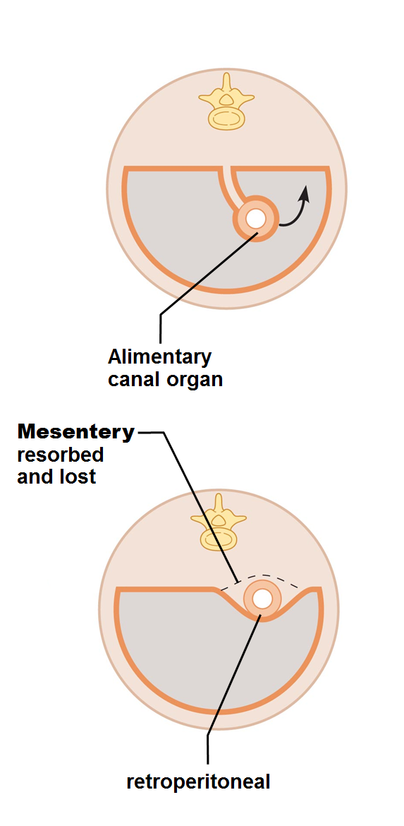
Peritoneum and Peritoneal Cavity
Routes for blood vessels, lymphatics, and nerves
Holds organs in place; _
Intraperitoneal (peritoneal) organs surrounded by peritoneum
Retroperitoneal organs _

Slide 9
Homeostatic Imbalance
Inflammation of peritoneum
Caused by
ruptured appendix
Peritoneal coverings _
Dangerous and lethal if widespread
Treated with debris removal and antibiotics

Slide 10
Histology of the Alimentary Canal
Four basic layers (tunics)
Muscularis externa
Serosa

Slide 11
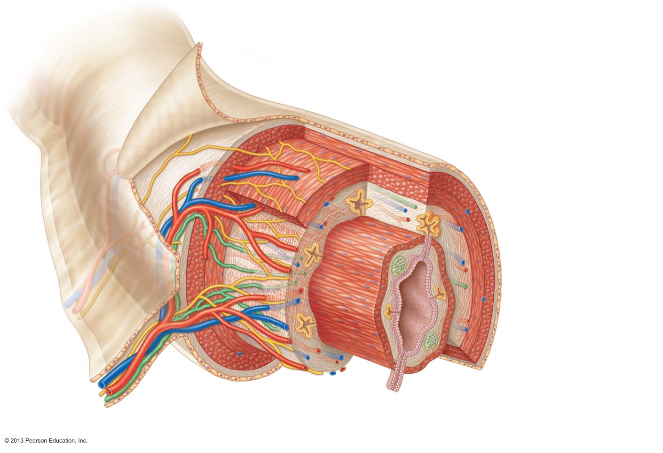
Figure 23.6 Basic structure of the alimentary canal.
Glands in
submucosa
Mucosa
Epithelium
Lamina propria
Muscularis
mucosae
Submucosa
Muscularis externa
Longitudinal muscle
Circular muscle
Serosa
Gland in mucosa
Lumen
Mucosa-associated
lymphoid tissue
Mesentery

Slide 12
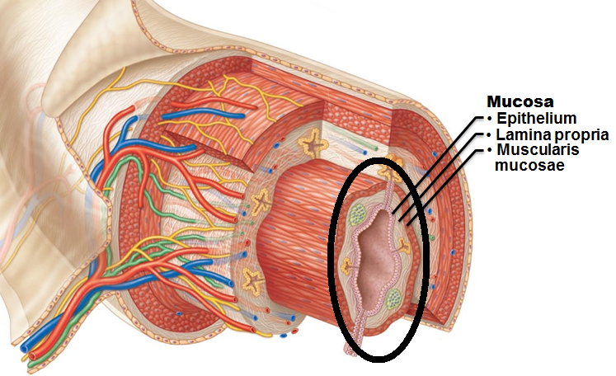
Mucosa
Lines _
Functions
Secretes
digestive enzymes
H
Protects against infectious disease
Three sublayers:
muscularis mucosae

Slide 13
Mucosa
Epithelium
Simple columnar epithelium and mucus-secreting cells (most of tract)
Protects digestive organs from enzymes
May secrete enzymes and hormones
in stomach and small intestine

Slide 14
Mucosa
Loose areolar connective tissue
Capillaries for nourishment and absorption
Defend against microorganisms
_______________________________________: smooth muscle → local movements of mucosa

Slide 15
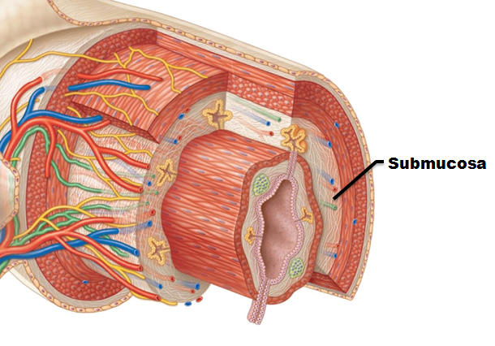
Submucosa
Submucosa
Areolar connective tissue
Blood and ______________________________________, and submucosal nerve plexus

Slide 16
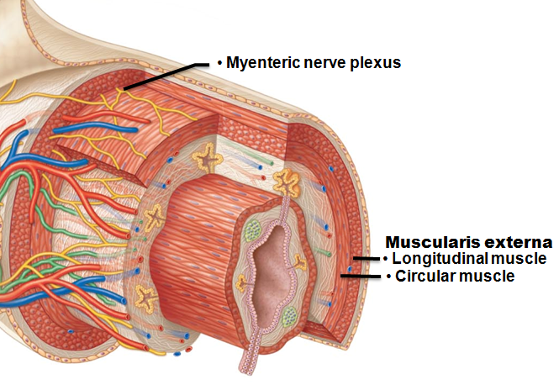
Muscularis Externa
Muscularis externa
Responsible for _
Inner circular and outer longitudinal layers
Circular layer thickens in some areas →
Myenteric nerve plexus _

Slide 17
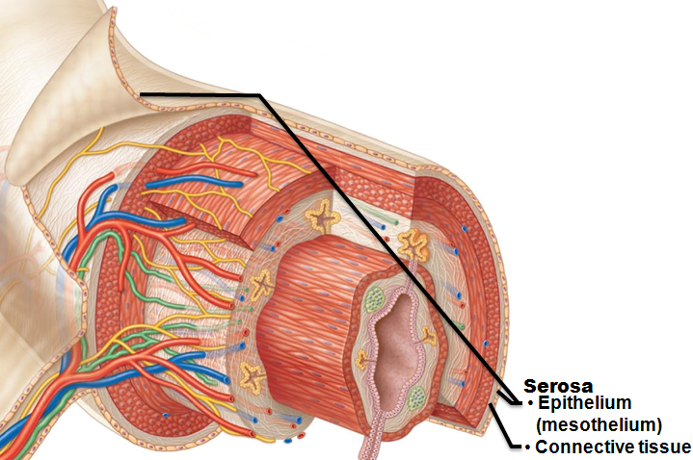
Serosa
Areolar connective tissue covered with mesothelium in most organs
Replaced by __________________________ in esophagus
Retroperitoneal organs have both an adventitia and serosa

Slide 18
Enteric Nervous System
Intrinsic nerve supply of alimentary canal
Major nerve supply to GI tract wall; control motility
Regulates _____________________________________________ in the mucosa
_______________________________________ nerve plexus
Controls GI tract motility

Slide 19
Enteric Nervous System
Linked to ________________________ via afferent visceral fibers
Long ANS fibers synapse with enteric plexuses
Sympathetic impulses ________________________ digestive activities
Parasympathetic impulses _________________________ digestive activities

Slide 20
Functional Anatomy: Mouth
Oral (buccal) cavity
Bounded by
Cheeks
Tongue
Oral orifice _
Lined with stratified squamous epithelium

Slide 21
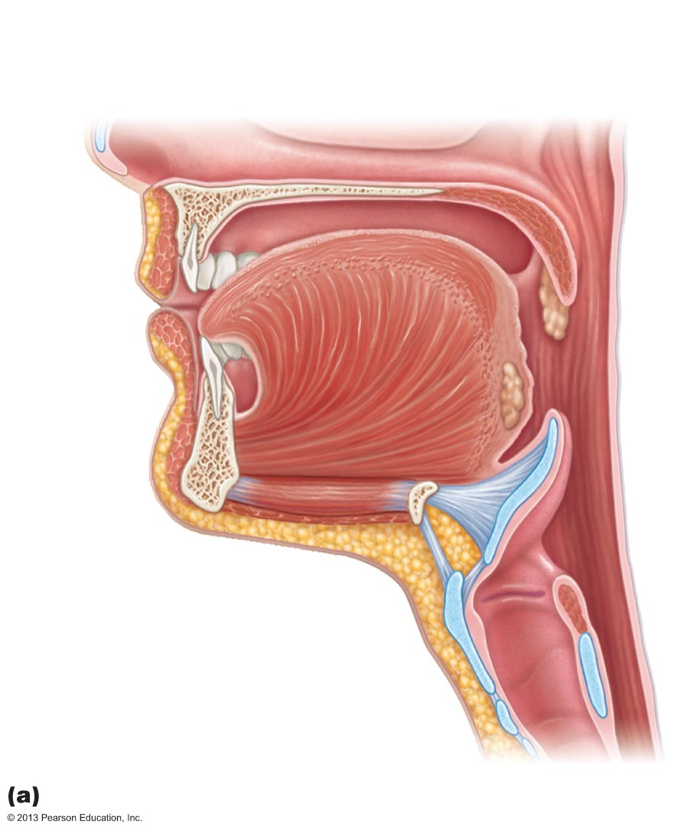
Figure 23.7a Anatomy of the oral cavity (mouth).
Soft
palate
Uvula
Hard
palate
Oral cavity
Palatine
tonsil
Tongue
Oropharynx
Lingual tonsil
Epiglottis
Hyoid bone
Laryngopharynx
Esophagus
Trachea
Sagittal section of the oral cavity and pharynx

Slide 22
Lips and Cheeks
Contain ___________________________________ and buccinator muscles
recess internal to lips (labia) and cheeks, external to teeth and gums
Oral cavity proper
lies within teeth and gums
median attachment of each lip to gum

Slide 23
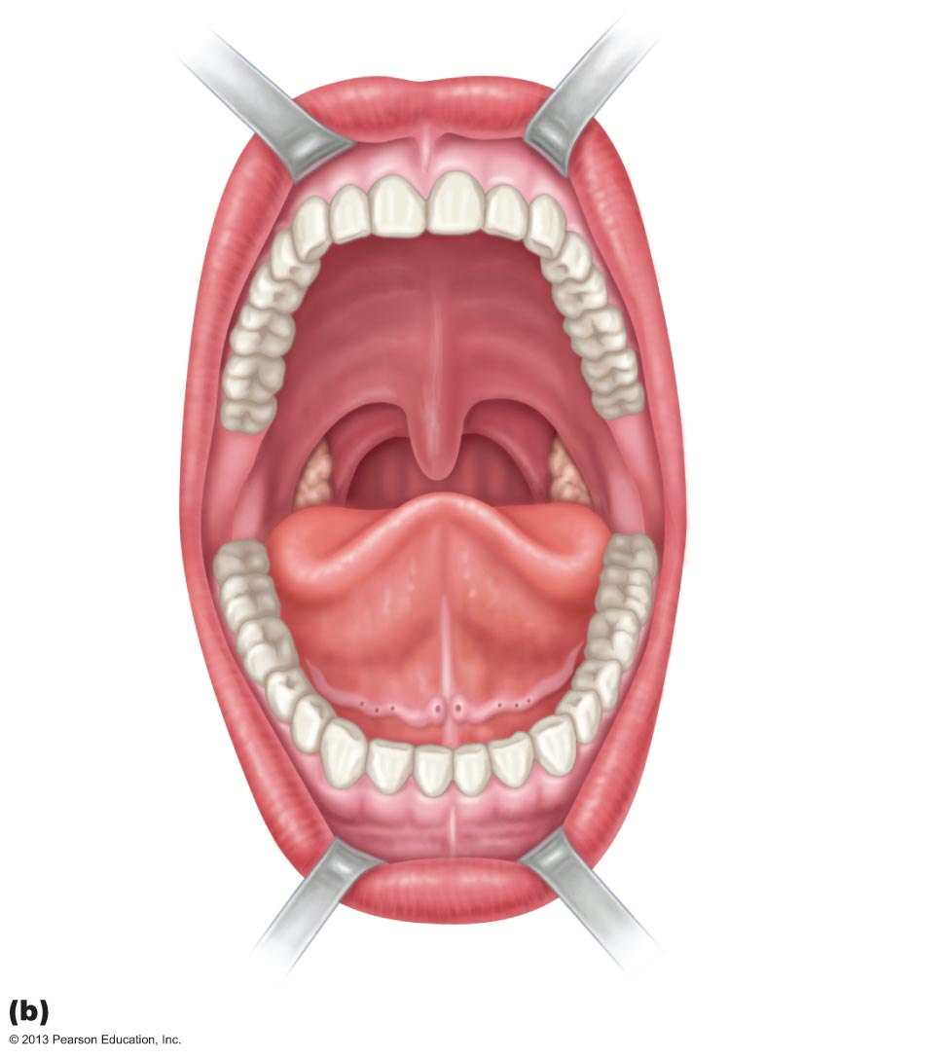
Figure 23.7b Anatomy of the oral cavity (mouth).
Upper lip
Gingivae
(gums)
Superior
labial
frenulum
Palatine
raphe
Palatoglossal
arch
Hard
palate
Soft
palate
Palatopharyngeal
arch
Uvula
Posterior wall
of oropharynx
Palatine
tonsil
Tongue
Lingual frenulum
Opening of
Submandibular
duct
Gingivae (gums)
Oral vestibule
Lower lip
Inferior labial
frenulum
Anterior view

Slide 24
Palate
Hard palate
palatine bones and palatine processes of maxillae
Soft palate
fold formed mostly of skeletal muscle
________________________________ projects downward from its free edge

Slide 25
Tongue
Skeletal muscle
Functions include
Repositioning and mixing food during chewing
Initiation of swallowing, speech, and taste
Intrinsic muscles
alter tongue's position
attachment to floor of mouth

Slide 26
Tongue
Surface bears papillae
whitish, give the tongue roughness and provide friction
do not contain taste buds
reddish, scattered over tongue
contain taste buds
Circumvallate (vallate)
V-shaped row in back of tongue
contain taste buds
Foliate
on lateral aspects of posterior tongue; contain taste buds that function primarily in infants and children

Slide 27
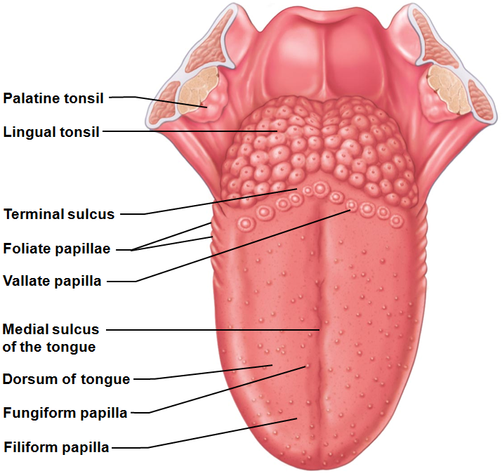
Tongue
Secreted by serous cells beneath foliate and vallate papillae secrete
Fat-digesting enzyme _
_______________________ marks division between
Body
anterior 2/3 residing in oral cavity
Root
posterior third residing in oropharynx
Just posterior to vallate papillae

Slide 28
Salivary Glands
Function of saliva
Dissolves food chemicals for taste
Moistens food; _
Begins breakdown of _

Slide 29
Salivary Glands
_____________________________ salivary glands
Produce most saliva;
Parotid
Submandibular
Sublingual
Intrinsic salivary glands
Scattered _____________________________________; augment slightly
continuously keep mouth _

Slide 30
Salivary Glands
Parotid gland
External to masseter muscle
___________________________________ opens into vestibule next to _
Mumps is inflammation of parotid glands
Submandibular gland
Medial to body of mandible
Duct opens at base of _

Slide 31
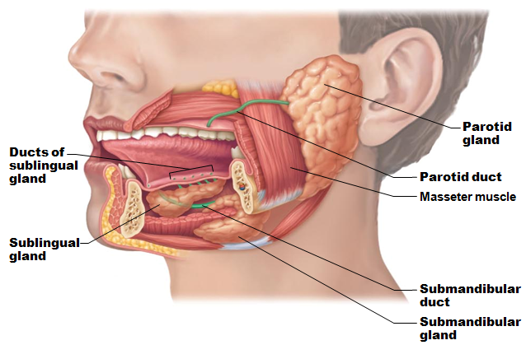
Salivary Glands
Anterior to submandibular gland under tongue
Opens via 10–12 ducts into floor of mouth

Slide 32
Salivary Glands
Two types of secretory cells
Watery, enzymes, ions, bit of mucin
Mucus
Parotid gland, submandibular glands are mostly serous
Sublingual gland is mostly mucous

Slide 33
Composition of Saliva
97–99.5% water, slightly acidic
Electrolytes
Na⁺, K⁺, Cl–, PO₄ ^{2–}, HCO₃–
Mucin
Metabolic _
urea and uric acid
Lysozyme, IgA, defensins, and a cyanide compound protect against microorganismsa

Slide 34
Control of Salivation
Extrinsic salivary glands activated by _________________________________ nervous system when
Ingested ____________________ stimulates chemoreceptors and mechanoreceptors in mouth →
Salivatory nuclei in brain stem send impulses along parasympathetic fibers in cranial nerves VII and IX
Strong ________________________________ stimulation inhibits salivation and results in dry mouth

Slide 35
Teeth
Tear and grind food for digestion
Primary and permanent dentitions formed by age 21
20 ___________________________________ teeth erupt (6–24 months of age)
teeth fall out (6–12 years of age) as permanent teeth develop
32 permanent teeth
All but __________________________________ in by end of adolescence
Third molars at 17–25, or may not erupt

Slide 36
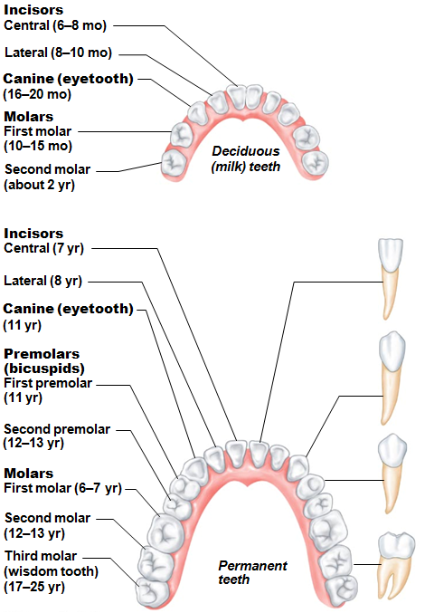
Classes of Teeth
Chisel shaped for cutting
Canines
Fanglike teeth that tear or pierce
Broad crowns, rounded cusps
grind/crush
Molars
Broad crowns, rounded cusps – _

Slide 37
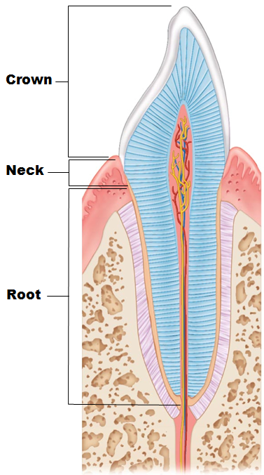
Tooth Structure
Crown
exposed part _
Covered by _
hardest substance in body
Enamel-producing cells degenerate when tooth erupts → no healing if decay or crack
portion embedded in jawbone
Connected to crown _

Slide 38
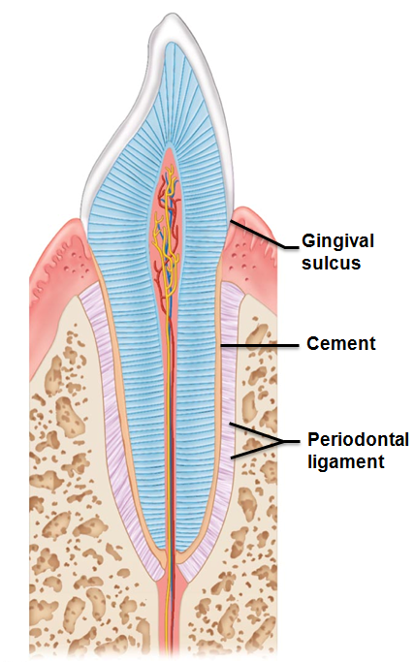
Tooth Structure
Covers root
Attaches it to periodontal ligament
Periodontal ligament
Anchors tooth in bony socket
groove where gingiva borders tooth

Slide 39
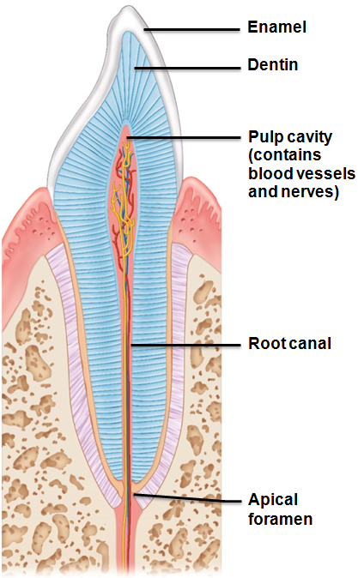
Tooth Structure
bonelike material under enamel
Maintained by odontoblasts of pulp cavity
Pulp cavity
surrounded by dentin
Pulp - connective tissue, blood vessels, and nerves
as pulp cavity extends to root
Apical foramen at proximal end of root
Entry for blood vessels, nerves, etc.

Slide 40
Tooth and Gum Disease
______________________________________ (cavities)
demineralization of enamel and dentin from bacterial action
______________________________________ (film of sugar, bacteria, and debris) adheres to teeth
Proteolytic enzymes digest organic matter
Prevention: daily flossing and brushing

Slide 41
Tooth and Gum Disease
Plaque calcifies to form _
Calculus ____________________________________ between gingivae and teeth
Anaerobic bacteria infect gums
Infection reversible if calculus removed

Slide 42
Tooth and Gum Disease
Periodontitis (from neglected gingivitis)
__________________________________________ attack intruders and body tissues
Destroy periodontal ligament
Activate osteoclasts →
Possible tooth loss
may promote
atherosclerosis
clot formation in _
Risk factors - smoking, diabetes mellitus, oral piercing

Slide 43
Pharynx
Food passes from mouth → oropharynx → laryngopharynx
Allows passage of _
Stratified squamous epithelium lining; mucus-producing glands
__________________________________ muscle layers: inner longitudinal, outer pharyngeal constrictors

Slide 44
Esophagus
Flat muscular tube from laryngopharynx to stomach
Pierces diaphragm at _
Joins stomach at _
Gastroesophageal (cardiac) _
Surrounds cardial orifice

Slide 45
Homeostatic Imbalance
Stomach acid regurgitates into esophagus
Likely with excess food/drink, extreme obesity, pregnancy, running
Also with _
structural abnormality

Slide 46
Esophagus
Esophageal mucosa contains stratified squamous epithelium
Changes to _____________________________________ at stomach
Esophageal glands in submucosa __________________________________________ to aid in bolus movement
Muscularis externa
skeletal superiorly; mixed in middle; _
Adventitia instead of serosa

Slide 47
Digestive Processes: Mouth
Ingestion
Mechanical digestion
Propulsion
swallowing
Chemical digestion
salivary amylase
lingual lipase
Almost _____________________________________ takes place

Slide 48
Mastication
Cheeks and closed lips hold food between teeth
Tongue mixes food with saliva; _
Teeth _
Partly _
Partly reflexive
Stretch reflexes; pressure receptors in cheeks, gums, tongue

Slide 49
Deglutition
Involves tongue, soft palate, pharynx, esophagus
________________________________________ contraction of tongue
Pharyngeal-esophageal phase
primarily __________________________________ nerve
Control center in the medulla and lower pons

Slide 50
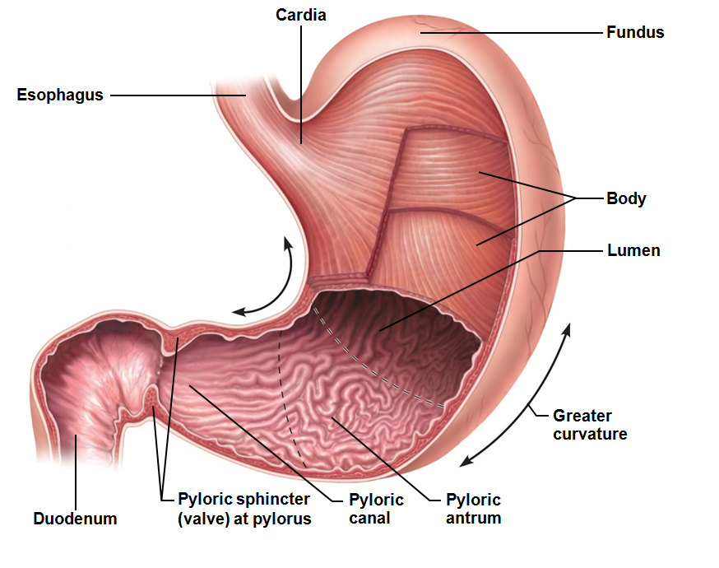
Stomach: Gross Anatomy
In upper left quadrant; temporary storage; chemical digestion of _
Cardial part (cardia)
Surrounds cardial orifice
Dome-shaped region beneath diaphragm
Midportion
Pyloric part
____________________________ (superior portion) → pyloric canal → pylorus
Pylorus continuous with duodenum through pyloric valve (sphincter controlling stomach emptying)

Slide 51
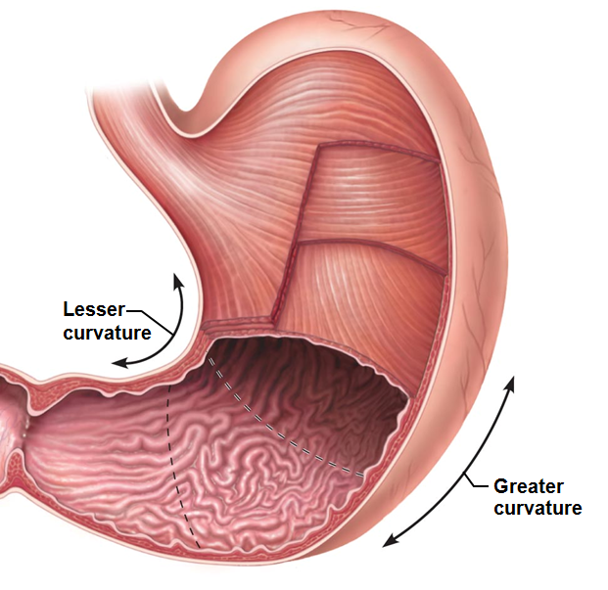
Stomach: Gross Anatomy
convex lateral surface
concave medial surface
Mesenteries tether stomach
Lesser omentum
From liver to lesser curvature
_____________________________– contains fat deposits & lymph nodes
Greater curvature → over small intestine → spleen & transverse colon

Slide 52
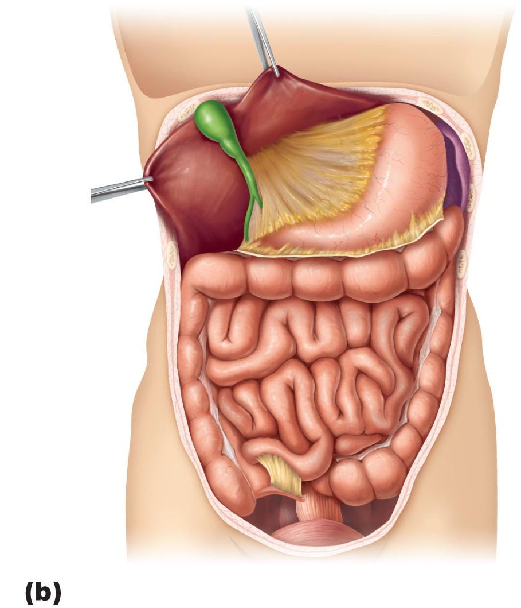
Figure 23.30b Mesenteries of the abdominal digestive organs.
Liver
Gallbladder
Lesser omentum
Stomach
Duodenum
Transverse colon
Small intestine
Cecum
Urinary bladder

Slide 53
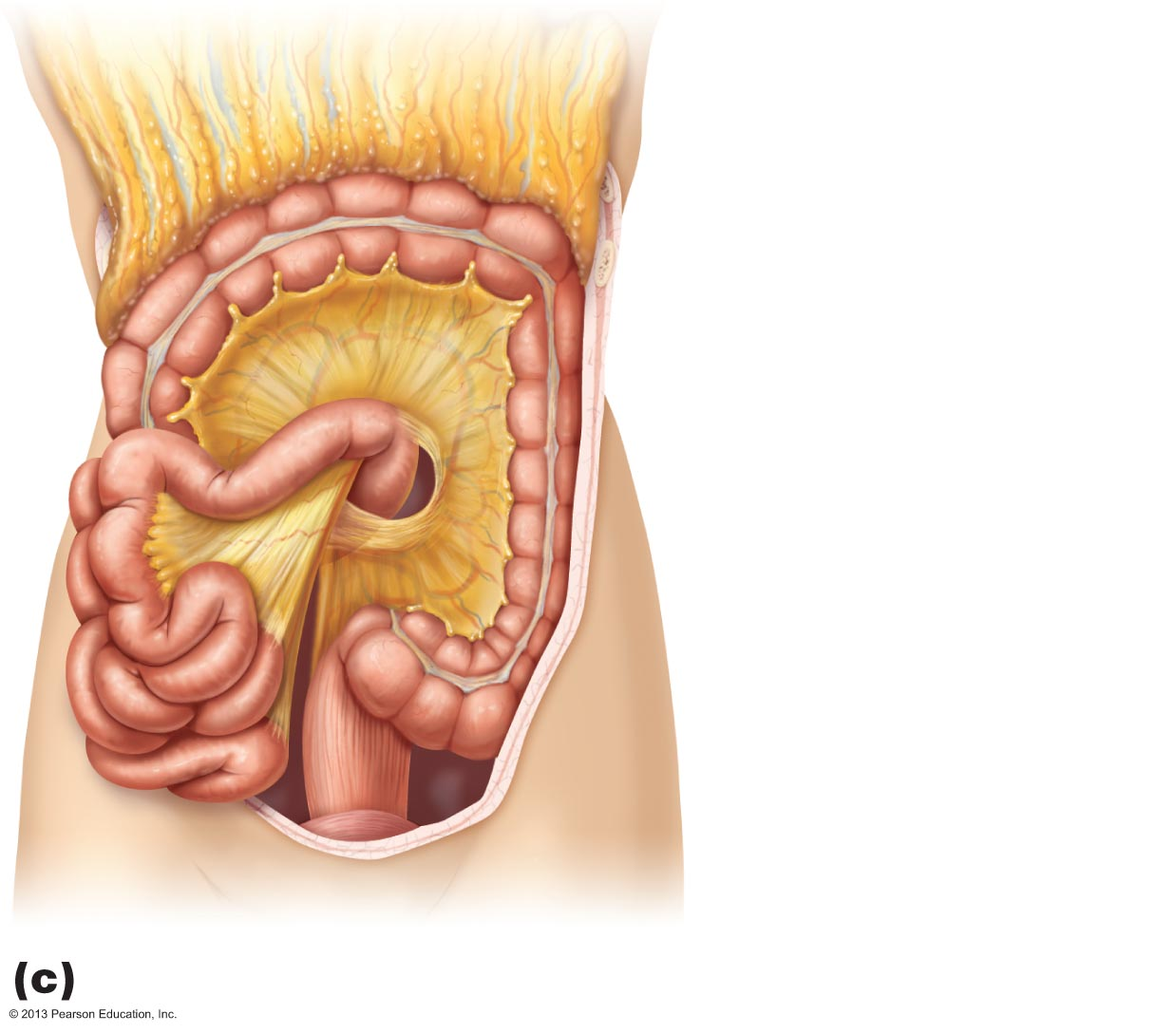
Figure 23.30c Mesenteries of the abdominal digestive organs.
Greater omentum
Transverse colon
Transverse
mesocolon
Descending colon
Jejunum
Mesentery
Sigmoid
mesocolon
Sigmoid colon
Ileum

Slide 54
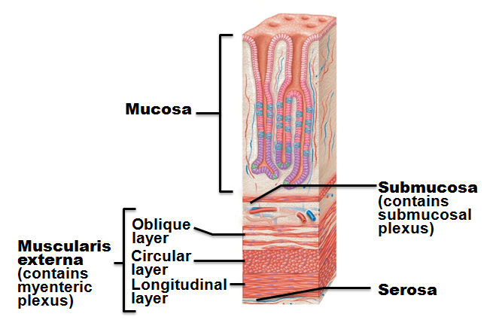
Stomach: Microscopic Anatomy
Muscularis and mucosa modified
Muscularis _
Three layers of smooth muscle
Inner oblique layer allows stomach to churn, mix, move, and physically break down food

Slide 55
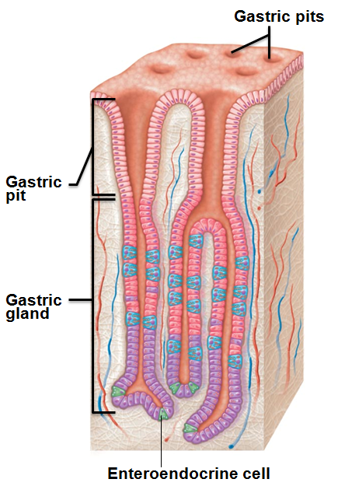
Stomach: Microscopic Anatomy
Mucosa
Simple columnar epithelium composed of mucous cells
Secrete _
Surface layer traps bicarbonate-rich fluid beneath it
Dotted with _______________________ → gastric glands
Gastric glands produce gastric juice

Slide 56
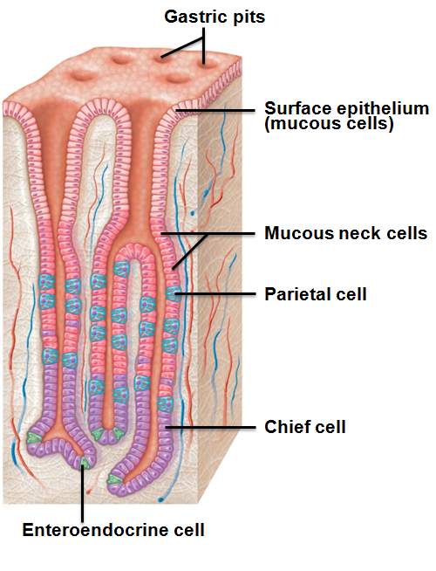
Gastric Glands
Cell types
______________________ (secrete thin, acidic mucus of unknown function)
Enteroendocrine cells

Slide 57
Gastric Gland Secretions
Glands in fundus and body produce most gastric juice
→ pH 1.5–3.5
denatures protein
activates pepsin
breaks down plant cell walls
kills many bacteria
Glycoprotein required for absorption of vitamin B₁₂ in small intestine

Slide 58
Gastric Gland Secretions
__________________________________ cell secretions
Activated to pepsin by HCl and by pepsin itself
a positive feedback mechanism
Lipases
Digest ~15% of lipids

Slide 59
Gastric Gland Secretions
Enteroendocrine cells
Secrete chemical messengers into lamina propria
Act as _
Serotonin and histamine
Somatostatin (also acts as paracrine) and gastrin

Slide 60
Mucosal Barrier
Harsh digestive conditions in stomach
Has __________________________________ to protect
Thick layer of _
_______________________________________ between epithelial cells
Prevent juice seeping underneath tissue
Damaged epithelial cells quickly replaced by division of stem cells
Surface cells replaced every 3–6 days

Slide 61
Homeostatic Imbalance
Inflammation caused by anything that breaches mucosal barrier
Peptic or _
Erosions of stomach wall
Can perforate → peritonitis; hemorrhage
Most caused by Helicobacter pylori bacteria
Some by _

Slide 62
Digestive Processes in the Stomach
Denaturation of _
Enzymatic digestion of proteins by _
Lingual lipase digests some _
Delivers chyme to small intestine

Slide 63
Digestive Processes in the Stomach
Lipid-soluble __________________________ and __________________________________ into blood
Only stomach function _
Secretes intrinsic factor for vitamin B₁₂ absorption
Lack of intrinsic factor leads to Pernicious Anemia
Treated with B₁₂ injections

Slide 64
Regulation of Gastric Secretion
Neural and hormonal mechanisms
Gastric mucosa produces up to 3 L gastric juice/day
Vagus nerve stimulation
Sympathetic stimulation
Decreases gastric activity
Hormonal control largely _
→ ↑Enzyme and HCl secretion
Most small intestine secretions - gastrin antagonists

Slide 65
Regulation of Gastric Secretion
Three phases of gastric secretion
conditioned reflex triggered by aroma, taste, sight, thought
lasts 3–4 hours
Stimulated by ____________________________________, peptides, low acidity, gastrin (major stimulus)
Caffeine, peptides, rising pH (becoming more alkaline)
stimulates enteroendocrine cells to release gastrin: results in increased enzyme release and more HCL released

Slide 66
Stimuli of Gastric Phase
Gastrin →
Low pH inhibits gastrin secretion (as between meals)
Buffering action of ingested proteins → ________________________→ gastrin secretion

Slide 67
Regulation of Gastric Secretion
Intestinal phase
Stimulatory component
Partially digested food enters small intestine → brief _
Inhibitory effects (enterogastric reflex and enterogastrones)
_________________________________________ fats, peptides, irritating substances → inhibition

Slide 68
Enterogastric Reflex
Three reflexes act to
Inhibit vagal nuclei in medulla
Activate ___________________________________→ tightening of pyloric sphincter → no more food entry to small intestine
→ ________________________________________→ protects small intestine from excessive acidity

Slide 69
Intestinal Phase
___________________________________ released
Secretin, cholecystokinin (CCK), vasoactive intestinal peptide (VIP)
All inhibit gastric secretion
If small intestine pushed to accept more chyme → dumping syndrome
Common in gastric reduction for weight loss

Slide 70
Gastric Contractile Activity
Peristaltic waves move toward pylorus at rate of 3 per minute
Basic electrical rhythm set by _
(formerly interstitial cells of Cajal)
Pacemaker cells linked by gap junctions → _
Distension and gastrin increase force of contraction

Slide 71
Gastric Contractile Activity
Most vigorous near _
Chyme is either
Delivered in to duodenum

Slide 72
Regulation of Gastric Emptying
As chyme enters duodenum
Receptors respond to __________________________ and ____________________________________signals
Enterogastric reflex and enterogastrones inhibit gastric secretion and duodenal filling
Carbohydrate-rich chyme moves _______________________________ through duodenum
Fatty chyme remains in duodenum _

Slide 73
Homeostatic Imbalance
Vomiting (____________________________) caused by
Intestinal irritants
bacterial toxins
certain drugs
Chemicals/sensory impulses
→ emetic center of _
Excessive vomiting →
_____________________________________, electrolyte and acid-base imbalances (______________________________)

Slide 74
Small Intestine: Gross Anatomy
Major organ of digestion and absorption
2-4 m long; from _
Subdivisions
Retroperitoneal
Ileum

Slide 75
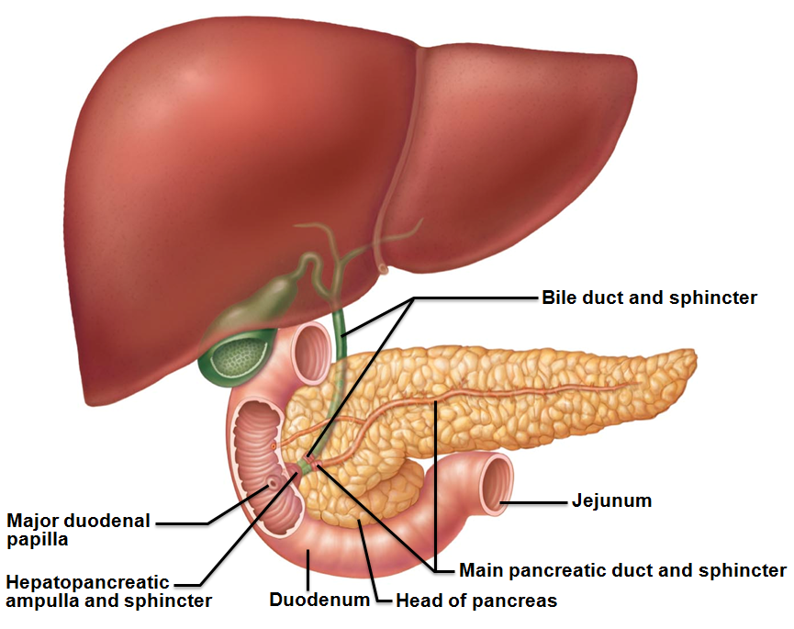
Duodenum
Curves around head of pancreas
Bile duct (__________________) and main pancreatic duct (from pancreas)
Join at hepatopancreatic _
Enter duodenum at major duodenal _
Entry controlled by hepatopancreatic sphincter

Slide 76
Jejunum and Ileum
Jejunum
Extends from duodenum to ileum
Ileum
Joins large intestine at _

Slide 77
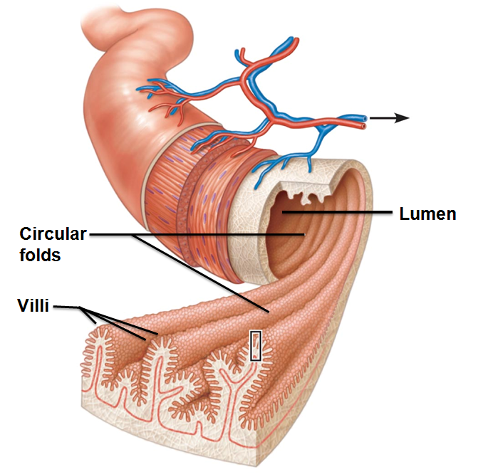
Structural Modifications
Increase ____________________ of proximal part for nutrient absorption
Circular folds (______________________)
Permanent folds
More nutrient absorption
Villi
Extensions of mucosa

Slide 78
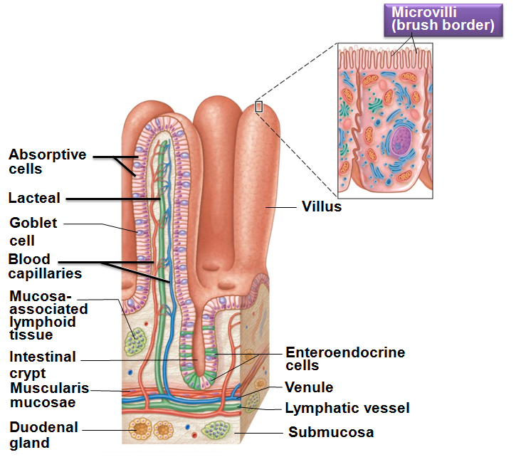
Structural Modifications
Microvilli (_____________________)
contain enzymes for _

Slide 79
Intestinal Crypts
Intestinal crypt
epithelium renewed every 2-4 days
Most
Enteroendocrine cells → enterogastrones

Slide 80
Mucosa
Peyer's patches protect especially ________________________________ against bacteria
May protrude into submucosa
__________________________________ leave intestine, enter blood, protect intestinal lamina propria _
Duodenal (Brunner's) glands of the duodenum secrete ______________________________ to neutralize acidic chyme

Slide 81
Intestinal Juice
1-2 L secreted daily
in response to _________________________________________ of mucosa
Slightly alkaline; isotonic with blood plasma
Largely water
enzymes of small intestine only in brush border
contains mucus
Facilitates ________________________________ and absorption of nutrients

Slide 82
The Liver and Gallbladder
Accessory organs
Many functions
only digestive function →
Bile –
Gallbladder
Chief function →
Notes:
Starting point for part II

Slide 83
Liver
Four lobes—right, left, caudate, and quadrate

Slide 84
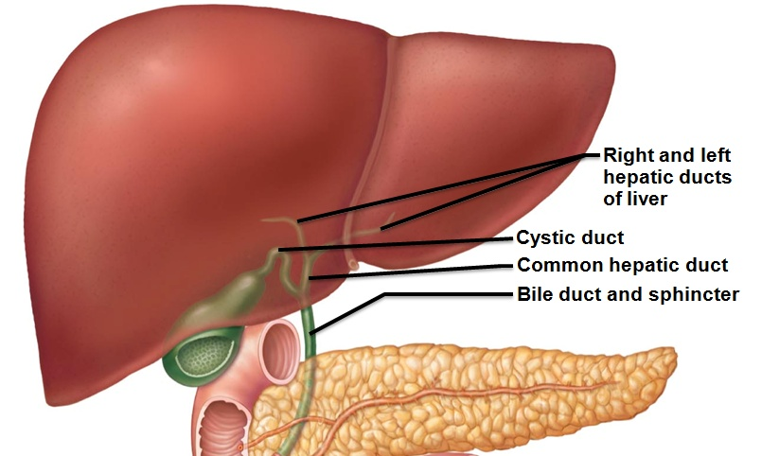
Liver: Associated Structures
________________________________________ anchors liver to stomach
Bile ducts
Common hepatic duct leaves liver
________________________________________________ connects to gallbladder
Bile duct formed by union of common hepatic and cystic ducts

Slide 85
Bile
Yellow-green, _
cholesterol derivatives
function in fat emulsification and absorption
pigment formed from heme
Cholesterol, neutral fats, phospholipids, and electrolytes

Slide 86
The Gallbladder
Thin-walled _________________________________ on ventral surface of liver
Stores bile
___________________________________________ by absorbing water and ions
Muscular contractions _
via cystic duct
flows into bile duct

Slide 87
The Gallbladder
High cholesterol and too few bile salts →
Obstruct flow of bile from gallbladder
May cause
Gallbladder contracts against sharp crystals → _
Treated with drugs, ultrasound vibrations (lithotripsy), laser vaporization, surgery

Slide 88
Regulation of Bile Secretion
Bile secretion stimulated by
___________________________________ from intestinal cells exposed to HCl and fatty chyme
Hepatopancreatic sphincter ____________________ unless digestion active
Released to small intestine only with contraction

Slide 89
Regulation of Bile Secretion
_______________________________ contraction stimulated by
Cholecystokinin (_____________) from intestinal cells exposed to acidic, fatty chyme
Vagal stimulation (minor stimulus)
CCK also causes
Hepatopancreatic sphincter to _

Slide 90
Pancreas
Location
Mostly ___________________________________ , deep to greater curvature of stomach
Head encircled by duodenum
Tail points back towards the spleen

Slide 91
Pancreas
Pancreatic islets secrete insulin and glucagon
Exocrine function
secrete _
To duodenum via main pancreatic duct

Slide 92
Pancreatic Juice
Watery ________________________ solution (pH 8) neutralizes chyme
Electrolytes (primarily HCO₃–)
Enzymes
_________________________, lipases, _______________________________ secreted in active form but require ions or bile for optimal activity
Proteases secreted in _

Slide 93
Regulation of Pancreatic Secretion
CCK induces secretion of _______________________________________ pancreatic juice
Secretin causes secretion of _______________________________________ pancreatic juice by duct cells
Vagal stimulation also causes release of pancreatic juice (minor stimulus)

Slide 94
Digestion in the Small Intestine
Chyme from stomach contains
Partially digested _
3–6 hours in small intestine
almost all nutrients absorbed
Small intestine, like stomach, _

Slide 95
Motility of the Small Intestine
Most common motion of _
____________________________________________ contents toward ileocecal valve
Wanes in late intestinal (fasting) phase

Slide 96
Motility of the Small Intestine
Peristalsis
Initiated by rise in hormone ___________________________ in late intestinal phase; every 90–120 minutes
Each wave starts _
Migrating motor complex
Meal remnants, bacteria, and debris _
From duodenum → ileum
about 2 hours

Slide 97
Motility of the Small Intestine
______________________________________ relaxes, admits chyme into large intestine when
________________________________________ enhances force of segmentation in ileum
Gastrin increases motility of ileum
Ileocecal valve flaps close when chyme exerts backward pressure

Slide 98
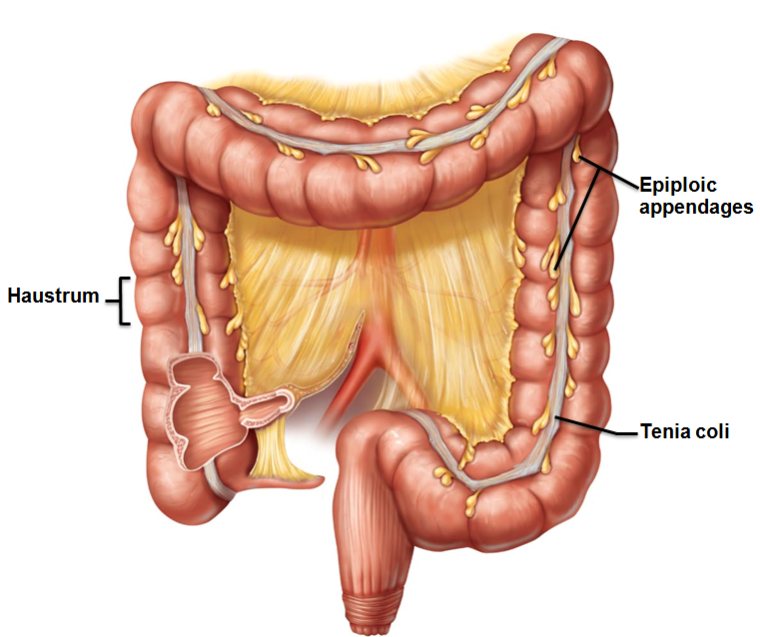
Large Intestine
Unique features
Three bands of longitudinal ______________________ in muscularis
Pocketlike sacs caused by tone of teniae coli
Epiploic appendages
______________________ pouches of visceral peritoneum

Slide 99
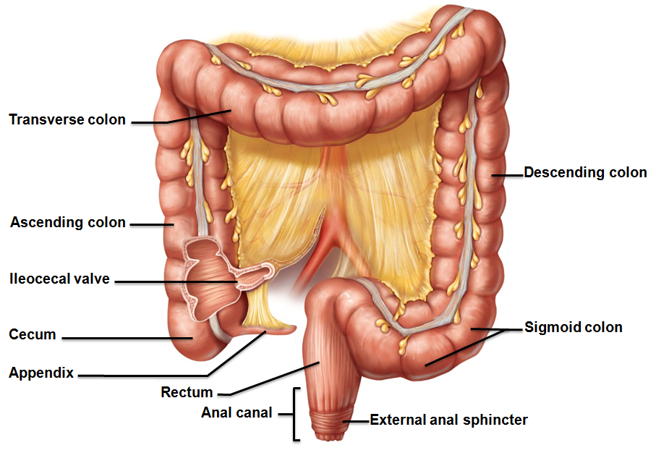
Large Intestine
Regions
Appendix
Anal canal

Slide 100
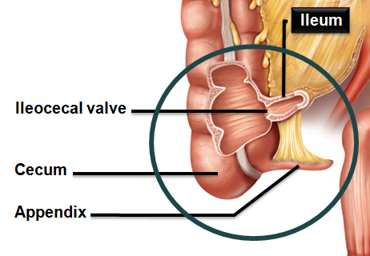
Subdivisions of the Large Intestine
Cecum
Appendix
masses of _
Part of _______________________ of immune system
Bacterial storehouse →
recolonizes gut when necessary

Slide 101
Colon
Retroperitoneal except for transverse and sigmoid regions
Ascending colon
right colic (_____________________________) flexure
Transverse colon
left colic (_______________________________) flexure
Descending colon
→ rectum

Slide 102
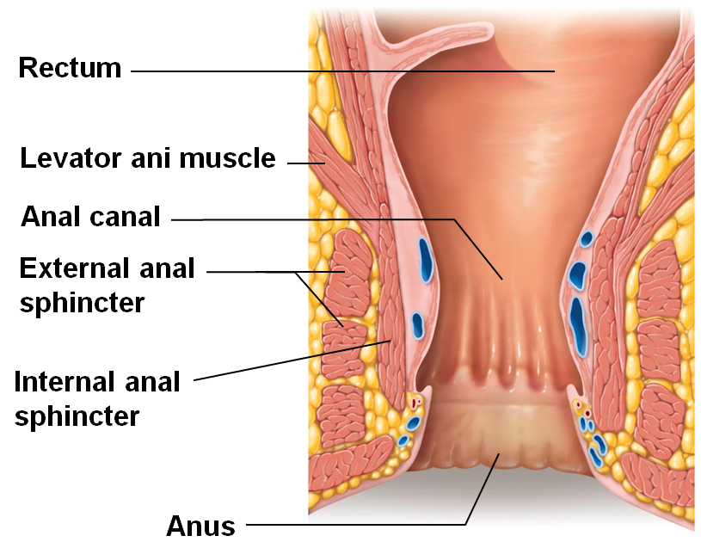
Rectum and Anus
Rectum
Three rectal valves _
Last segment of large intestine
Opens to body exterior at anus
Sphincters
Internal anal sphincter _______________________
External anal sphincter _______________________

Slide 103
Large Intestine: Microscopic Anatomy
Thicker mucosa of _
___________________________________________ which is stratified squamous to withstand abrasion
No circular folds, villi, digestive secretions
Abundant _
Superficial ________________________________ of anal canal form _______________________________ if inflamed

Slide 104
Bacterial Flora
Enter from small intestine or anus
Synthesize ______________________________________ and vitamin K
Ferment _
Release irritating acids and gases (~500 ml/day)

Slide 105
Intestinal Flora
Bacteria prevented from breaching _
Epithelial cells recruit dendritic cells to mucosa → sample microbial antigens → present to T cells of MALT → IgA antibody-mediated response → restricts microbes

Slide 106
Digestive Processes in the Large Intestine
Residue remains in large intestine 12–24 hours
No _____________________________________ except by enteric bacteria
Vitamins (made by bacterial flora), water, and electrolytes (especially Na⁺ and Cl–) reclaimed
Major functions
Colon not essential for life

Slide 107
Motility of the Large Intestine
Most contractions of colon
Slow segmenting movements
Haustra sequentially contract _

Slide 108
Motility of the Large Intestine
Gastrocolic reflex
Initiated by presence of _
Activates three to four slow powerful peristaltic waves per day in colon (______________________________________)

Slide 109
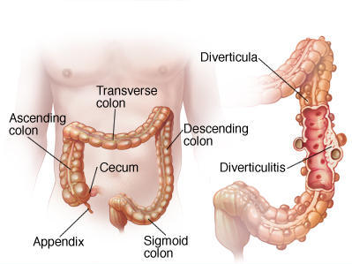
Homeostatic Imbalance
Low fiber diet → _
(herniations of mucosa)
Diverticulosis commonly in sigmoid colon
Affects ½ people > 70 years
Inflamed diverticula
may rupture and leak into peritoneal cavity

Slide 110
Homeostatic Imbalance
Irritable bowel syndrome
Functional GI disorder
Recurring abdominal pain, ____________________________, bloating, flatulence, nausea, depression
________________________ common precipitating factor
Stress management important in treatment

Slide 111
Defecation
Mass movements ___________________________ toward rectum
Distension initiates spinal _
Parasympathetic signals
Stimulate ________________________________________ and rectum
__________________________ internal anal sphincter
Conscious control allows relaxation of external anal sphincter

Slide 112
Defecation
Muscles of rectum contract to expel feces
Assisted by _
Closing of ____________________________ , contraction of diaphragm and abdominal wall muscles →
Levator ani muscle contracts → anal canal lifted superiorly → feces leave body

Slide 113
Digestion of Carbohydrates
Only monosaccharides can be absorbed
Monosaccharides absorbed as ingested
Digestive enzymes
pancreatic amylase
brush border enzymes
dextrinase, glucoamylase, lactase, maltase, and sucrase
Break down disaccharides sucrose, lactose, maltose; polysaccharides glycogen and starch

Slide 114
Digestion of Proteins
digested to _______________________________ monomers
Begins with ______________________________ in stomach at pH 1.5 – 2.5
Inactive in high pH of duodenum
Pancreatic proteases
Trypsin, chymotrypsin, and carboxypeptidase
Brush border enzymes
Aminopeptidases, carboxypeptidases, and dipeptidases

Slide 115
Digestion of Lipids
Pre-treatment:
Does ___________ break bonds
Enzymes
pancreatic lipases
→ Fatty acids and monoglycerides
Absorption of glycerol and short chain fatty acids
Absorbed into the _
Transported via the hepatic portal vein

Slide 116
Digestion of Nucleic Acids
Enzymes
________________________________ ribonuclease and deoxyribonuclease → nucleotide monomers
Brush border enzyme nucleosidases and phosphatases → free bases, pentose sugars, phosphate ions

Slide 117
Absorption
Absorbed into the small intestine before reaching the ileum
80% electrolytes
most water
ileum
Most absorbed by ________________________________ into the blood
Exception

Slide 118
Absorption of Protein
Amino acids transported by several types of carriers
Dipeptides and tripeptides
digested to amino acids within epithelial cells
Enter capillary blood by _

Slide 119
Homeostatic Imbalance
________________________ proteins not usually absorbed
Can be taken up by endocytosis/exocytosis
Most common in newborns → food allergies
Usually disappear with_
Allows IgA antibodies in _______________________________ to reach infant's bloodstream → _

Slide 120
Absorption of Lipids
Absorption of monoglycerides and fatty acids
Cluster with bile salts and lecithin to _
Released by micelles
diffuse into epithelial cells
Combined with lecithin, phospholipids, cholesterol, & coated with proteins
form _
Enter _
transported to systemic circulation
Hydrolyzed to free fatty acids and glycerol by lipoprotein lipase of capillary endothelium
Cells can use for _
Absorption of short chain fatty acids
Diffuse into portal blood for distribution

Slide 121
Absorption of Nucleic Acids
Absorption
Active transport across epithelium →

Slide 122
Absorption of Vitamins
In small intestine
Fat-soluble vitamins (____________________________) carried by micelles; diffuse into absorptive cells
Water-soluble vitamins (vitamin C and B vitamins) absorbed by diffusion or by passive or active transporters.
Vitamin B₁₂ (___________________, charged molecule)
binds with _
absorbed by endocytosis

Slide 123
Absorption of Vitamins
In large intestine
Vitamin _________________________ vitamins from ___________________________________________ are absorbed

Slide 124
Absorption of Water
9L water, most from GI tract secretions, enter small intestine
95% absorbed in the small intestine by osmosis
Most of rest _
Water uptake coupled with _

Slide 125
Malabsorption of Nutrients
Causes
Anything that interferes with _
Damaged _
bacterial infection
some antibiotics

Slide 126
Malabsorption of Nutrients
Gluten-sensitive enteropathy (_______________________________________)
________________________________________ to gluten
Gluten causes immune cell damage to intestinal villi and brush border
Treated by eliminating gluten from diet
all grains but rice and corn
Oats have no gluten, but _

Slide 127
Cancer
Stomach and colon cancers rarely _
Metastasized colon cancers frequently cause _
Prevention
Regular ____________________________ and medical examination

Slide 128
Kidney Functions
Regulating total _______________________________ and total solute concentration in water
Regulating Extracellular Fluid ion concentrations
Ensuring _
Removal of metabolic wastes, toxins, drugs

Slide 129
Kidney Functions
Endocrine functions
regulation of blood pressure
Erythropoietin
regulation of _
Activation of _
Gluconeogenesis during prolonged fasting

Slide 130
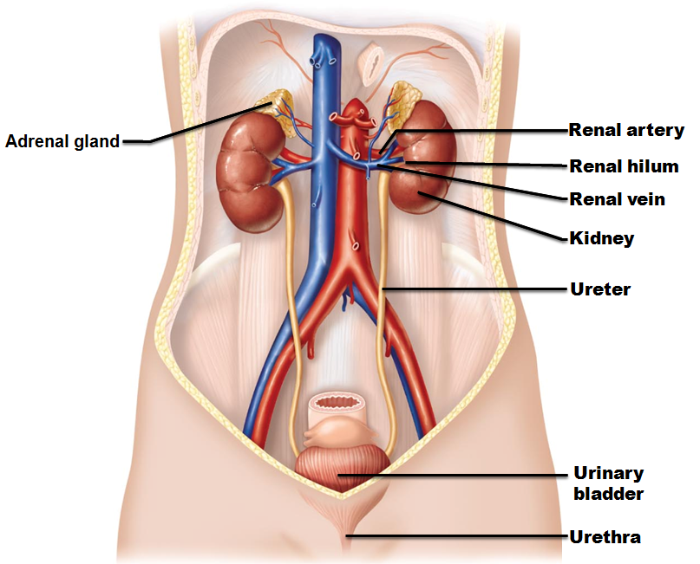
Urinary System Organs
Kidneys
transport urine from kidneys to urinary bladder
Urinary bladder
temporary storage reservoir for urine
______________________ transports urine out of body

Slide 131
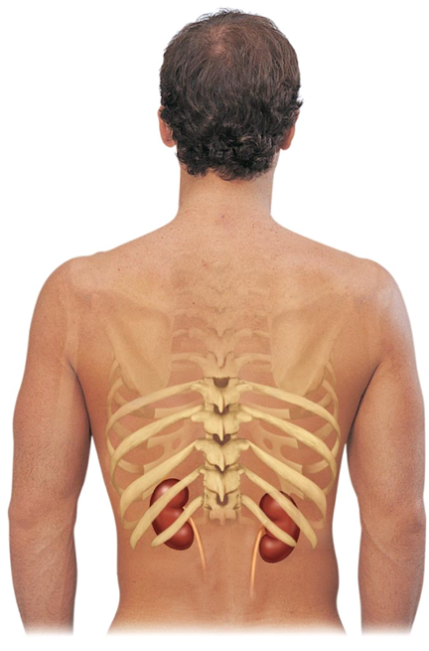
Kidney Anatomy
in the superior lumbar region;
T₁₂ to L₅
Right kidney crowded by liver
Adrenal (__________________________) gland atop each kidney
Convex lateral surface, concave medial surface; vertical renal hilum leads to _
Ureters, renal blood vessels, lymphatics, and nerves enter and exit at hilum

Slide 132
Kidney Anatomy
Layers of surrounding supportive tissue
Anchoring outer layer of dense fibrous connective tissue
Perirenal fat capsule
Fatty cushion
Prevents spread of infection to kidney

Slide 133
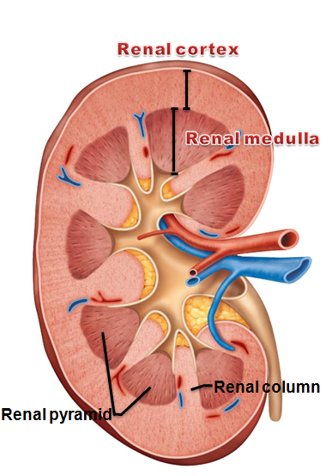
Internal Anatomy
Granular-appearing superficial region
Renal medulla
Composed of _
Pyramids separated by _
Inward extensions of cortical tissue

Slide 134
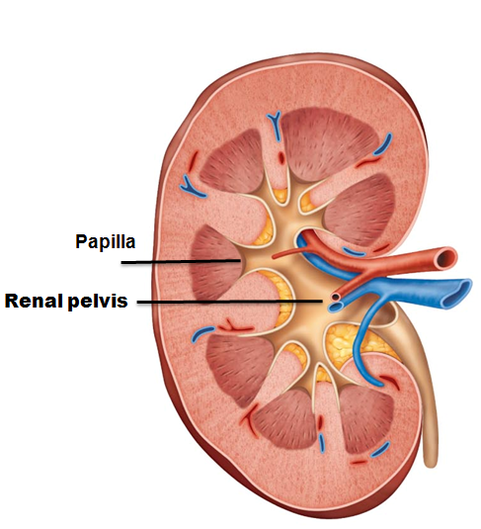
Internal Anatomy
Tip of pyramid; releases urine into minor calyx
Medullary pyramid and its surrounding cortical tissue; ~ 8/kidney
Renal pelvis

Slide 135
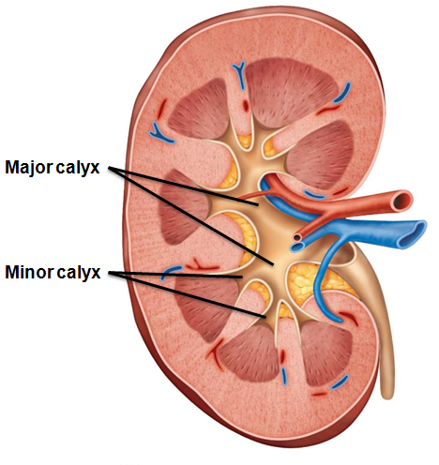
Internal Anatomy
Minor calyces
Collect urine from minor calyces
Empty urine into renal pelvis
Urine flow

Slide 136
Homeostatic Imbalance
Infection of renal pelvis and calyces
Pyelonephritis
Infection/inflammation of _
Normally - successfully treated with _

Slide 137
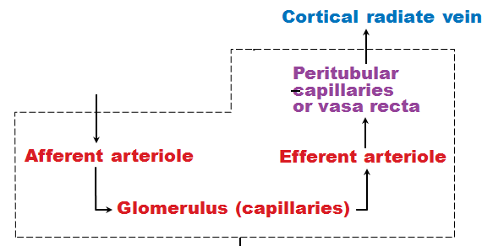
Blood and Nerve Supply
Kidneys
adjust its composition
Needs a rich blood supply
Nerve supply via ___________________________ fibers from renal plexus

Slide 138
Nephrons
Structural and functional units that form urine
1 million per kidney
Two main parts

Slide 139
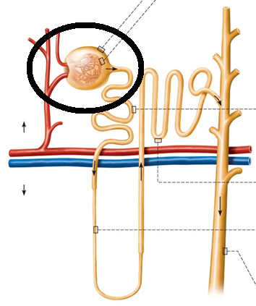
Renal Corpuscle
Two parts of renal corpuscle
Capillaries
highly porous
allows filtrate formation
_________________________ (Bowman's capsule)
Cup-shaped, hollow structure surrounding glomerulus

Slide 140
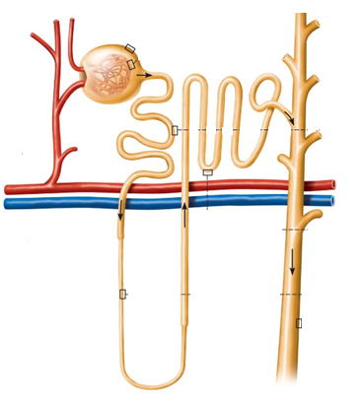
Renal Tubule
Three parts
Proximal → closest to renal corpuscle
Distal → farthest from renal corpuscle

Slide 141
Renal Tubule
Proximal convoluted tubule (PCT)
Cuboidal cells with dense microvilli
Functions in ______________________ and secretion
Confined to _

Slide 142
Renal Tubule
Proximal descending limb continuous with proximal tubule
Distal descending limb
descending thin limb
simple squamous epithelium
Thick ascending limb
Cuboidal to columnar cells

Slide 143
Renal Tubule
Distal convoluted tubule (DCT)
Cuboidal cells with very few microvilli
Function more in _
Confined to _

Slide 144
Collecting Ducts
Receive filtrate _
Run through _______________________ → striped appearance
Fuse together to deliver urine through _

Slide 145
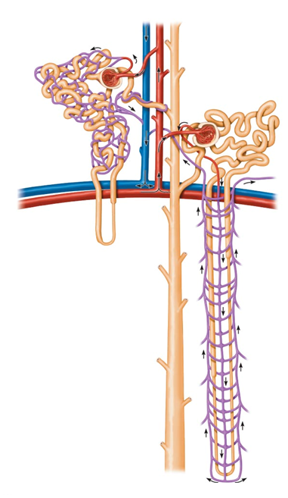
Classes of Nephrons
85% of nephrons; almost entirely in cortex
Juxtamedullary nephrons
Long nephron loops _
Ascending limbs have thick and thin segments
Important in production _

Slide 146
Nephron Capillary Beds
Renal tubule associated with two capillary beds
Juxtamedullary nephron associated with

Slide 147
Nephron Capillary Beds
Glomerulus
Different from other capillary beds
Afferent arteriole → __________________________→ efferent arteriole
Blood pressure in glomerulus high because
Arterioles are high-resistance vessels

Slide 148
Nephron Capillary Beds
_________________________________________ capillaries
Low-pressure, porous capillaries adapted for absorption of water and solutes
Arise from _
Cling to adjacent renal tubules in cortex

Slide 149
Nephron Capillary Beds
Long, thin-walled vessels parallel to ___________________________________________ of juxtamedullary nephrons
Arise from efferent arterioles serving juxtamedullary nephrons
Instead of peritubular capillaries
Function in _

Slide 150
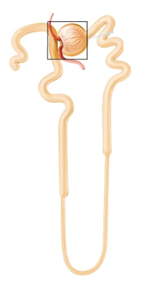
Juxtaglomerular Complex (JGC)
Involves modified portions of
Distal portion of ascending limb of nephron loop
Important in regulation of ___________________________ and blood pressure

Slide 151
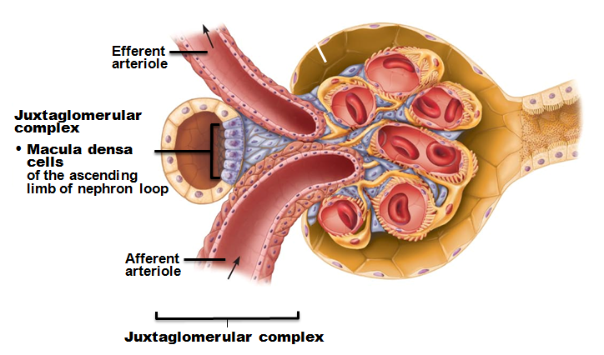
Juxtaglomerular Complex (JGC)
Three cell populations
extraglomerular mesangial cells
Macula densa
Tall, closely packed cells of ascending limb
_________________________; sense NaCl content of filtrate

Slide 152
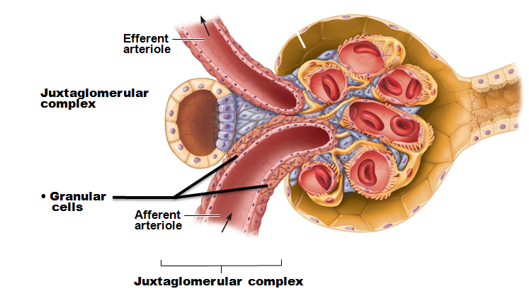
Juxtaglomerular Complex (JGC)
_____________________ (juxtaglomerular, or JG cells)
Enlarged, _
Secretory granules contain enzyme renin
Mechanoreceptors
sense _______________________ in afferent arteriole

Slide 153
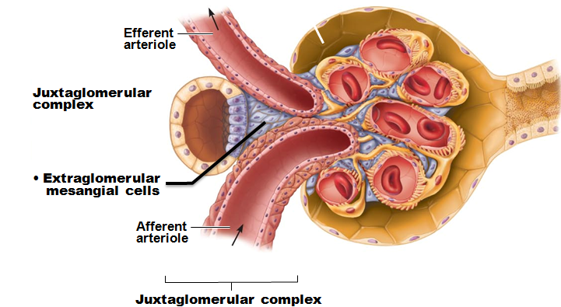
Juxtaglomerular Complex (JGC)
Extraglomerular mesangial cells
Between _
Interconnected with _
May pass signals between macula densa and granular cells

Slide 154
Kidney Physiology: Mechanisms of Urine Formation
Three processes in urine formation and adjustment of blood composition

Slide 155
Kidney Physiology: Mechanisms of Urine Formation
Glomerular filtration
produces ____________________________ and protein-free filtrate
Tubular reabsorption
Selectively __________________________________________________ in renal tubules and collecting ducts
Tubular secretion
Selectively moves substances from blood to filtrate in renal tubules and collecting ducts

Slide 156
Kidney Physiology: Mechanisms of Urine Formation
Kidneys filter body's entire plasma volume 60 times each day
consume 20-25% oxygen used by body at rest
produce _
Filtrate (produced by glomerular filtration)
Urine
<1% of original filtrate
Contains metabolic wastes and unneeded substances

Slide 157
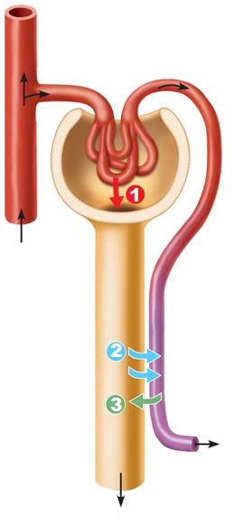
Glomerular Filtration
No metabolic energy required
__________________________ pressure forces fluids and solutes through filtration membrane
No reabsorption into capillaries of glomerulus

Slide 158
The Filtration Membrane
_________________________________membrane between blood and interior of glomerular capsule
Water, solutes smaller than plasma proteins pass; _
Three layers
Fenestrated endothelium of glomerular capillaries
Basement membrane (fused basal laminae of two other layers)
Foot processes of _________________________________ with filtration slits

Slide 159
Pressures That Affect Filtration
Outward pressures promote filtrate formation
___________________________________________ pressure in glomerular capillaries
Glomerular blood pressure
Chief force pushing water, solutes out of blood
Quite high – 55 mm Hg
Because ___________________________________________________________ with diameter smaller than afferent arteriole

Slide 160
Pressures That Affect Filtration
Inward forces inhibiting filtrate formation
Hydrostatic pressure in _
Pressure of filtrate in capsule – 15 mm Hg
Colloid osmotic pressure in _
"Pull" of proteins in blood – 30 mm Hg
Sum of forces → _
55 mm Hg forcing out; 45 mm Hg opposing = net outward force of 10 mm Hg

Slide 161
Net Filtration Pressure (NFP)
Pressure responsible for filtrate formation (10 mm Hg)
_______________________________________ determining glomerular filtration rate (GFR)

Slide 162
Glomerular Filtration Rate (GFR)
Volume of filtrate formed per minute by both kidneys (normal = 120–125 ml/min)
GFR directly proportional to
primary pressure is hydrostatic pressure in glomerulus
Total ___________________________________________ available for filtration
glomerular mesangial cells control by contracting
Filtration membrane _
much more permeable than other capillaries

Slide 163
Regulation of Glomerular Filtration
_______________________________ GFR allows kidneys to make filtrate and maintain extracellular homeostasis
Goal of _
maintain GFR in kidney
GFR affects systemic blood pressure
increased GFR → ________________________________→ ______________________blood pressure, and vice versa
Goal of extrinsic controls
maintain _

Slide 164
Regulation of Glomerular Filtration
Intrinsic controls
renal _
Act locally within kidney to maintain GFR
Extrinsic controls
_______________________________________________ mechanisms that maintain blood pressure; can negatively affect kidney function
Take precedence over intrinsic controls if systemic BP < 80 or > 180 mm Hg

Slide 165
Regulation of Glomerular Filtration
Controlled via glomerular hydrostatic pressure
If rises → __________________________ → GFR rises

Slide 166
Intrinsic Controls
Maintains nearly constant GFR when arterial blood pressure is in range of 80–180 mm Hg
Autoregulation _

Slide 167
Intrinsic Controls: Myogenic Mechanism
Smooth muscle contracts when stretched
↑ BP → __________________________________→ constriction of afferent arterioles → _____________________________________________
Protects glomeruli from _
↓ BP → dilation of afferent arterioles
Both help maintain normal GFR despite normal fluctuations in blood pressure

Slide 168
Extrinsic Controls: Sympathetic Nervous System
Under normal conditions at _
Renal _
Renal autoregulation mechanisms prevail

Slide 169
Extrinsic Controls: Sympathetic Nervous System
If extracellular fluid _________________________ (blood pressure low)
Norepinephrine released by sympathetic nervous system; epinephrine released by adrenal medulla →
Systemic ___________________________________→ increased blood pressure
Constriction of afferent arterioles → _________________ → increased blood volume and pressure

Slide 170
Extrinsic Controls: Renin-Angiotensin- Aldosterone Mechanism
Three pathways to renin release by granular cells
__________________________stimulation of granular cells by sympathetic nervous system
Stimulation by activated _____________________________________ when filtrate NaCl concentration low
Reduced stretch of granular cells

Slide 171
Extrinsic Controls: Other Factors Affecting GFR
Kidneys release chemicals; some act as ________________________________ that affect renal arterioles
Prostaglandin E₂
Intrinsic angiotensin II
reinforces effects of hormonal angiotensin II

Slide 172
Tubular Reabsorption
Most of tubular contents _
Selective transepithelial process
Water and ion reabsorption hormonally regulated and adjusted
Includes active and passive tubular reabsorption
Two routes

Slide 173
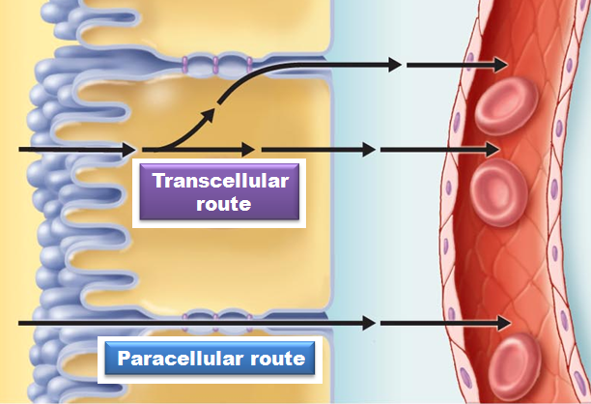
Tubular Reabsorption
Transcellular route
Passes __________ cells from lumen
Passes __________ the cytoplasm
Passes __________ cell and into blood
Paracellular route

Slide 174
Tubular Reabsorption of Sodium
__________ - most abundant ____________________ in filtrate

Slide 175
Passive Tubular Reabsorption of Water
Movement of Na⁺ and other solutes creates osmotic gradient for water
Water reabsorbed by osmosis, aided by water-filled pores called _
Aquaporins always present in PCT
___________________________________________ water reabsorption
Aquaporins inserted in collecting ducts _
___________________________________________ water reabsorption

Slide 176
Passive Tubular Reabsorption of Solutes
Solute concentration in filtrate increases as water reabsorbed → concentration gradients for solutes →
_______________________________________, some ions and urea, follow water into _________________________________________ down concentration gradients
→ Lipid-soluble drugs, environmental pollutants difficult to excrete

Slide 177
Transport Maximum
Transcellular transport systems
limited
Transport maximum for almost every reabsorbed substance;
reflects _____________________________________________ in renal tubules available
When carriers saturated, excess excreted in urine
hyperglycemia → high blood glucose levels exceed transport maximum →

Slide 178
Reabsorptive Capabilities of Renal Tubules and Collecting Ducts
Proximal Convoluted Tubules
Site of most reabsorption
____________________________________________ , e.g., glucose and amino acids
65% of Na⁺ and water
Many ions
~ All uric acid; ½ urea (_________________________________________________)

Slide 179
Reabsorptive Capabilities of Renal Tubules and Collecting Ducts
Descending limb
H₂O can leave;
Ascending limb
________________________ cannot leave; solutes can

Slide 180
Reabsorptive Capabilities of Renal Tubules and Collecting Ducts
Distal Collecting Tubule and collecting duct
Antidiuretic hormone (____________)
Aldosterone
Atrial natriuretic peptide (ANP)
PTH
Ca²⁺

Slide 181
Reabsorptive Capabilities of Renal Tubules and Collecting Ducts
Antidiuretic hormone (ADH)
Released by _
Causes principal cells of collecting ducts to insert aquaporins in apical membranes →
As ADH levels increase

Slide 182
Reabsorptive Capabilities of Renal Tubules and Collecting Ducts
Targets _
Promotes synthesis of Na⁺ and K⁺ channels
Na⁺ reabsorption and K⁺ secretion
water follows Na⁺
Functions
increase blood pressure; decrease K⁺ levels

Slide 183
Reabsorptive Capabilities of Renal Tubules and Collecting Ducts
Atrial natriuretic peptide
⁺
→ decreased blood volume and blood pressure
Released by _______________________________________ if blood volume or pressure elevated
Parathyroid hormone acts on DCT

Slide 184
Tubular Secretion
___________________________; almost all in _
Selected substances
K⁺, H⁺, NH₄⁺, creatinine, organic acids and bases move from peritubular capillaries through tubule cells into filtrate
Substances synthesized in tubule cells also secreted – e.g., HCO₃⁻

Slide 185
Tubular Secretion
Disposes of substances (e.g., drugs) _
Eliminates undesirable substances passively reabsorbed (e.g., urea and uric acid)
Rids body of ____________________________ (aldosterone effect)
Controls blood pH by altering amounts of ____________ or ____________ in urine

Slide 186
Countercurrent Mechanism
Role of countercurrent mechanisms
Establish and maintain ____________________________________________ from renal cortex through medulla
Allow kidneys to _

Slide 187
Formation of Dilute or Concentrated Urine
Osmotic gradient used to _
Overhydration →
Dehydration →
ADH released
Severe dehydration
99% water reabsorbed

Slide 188
Diuretics
Chemicals that enhance urinary output
ADH inhibitors
_________________________________________ inhibitors
caffeine, drugs for hypertension or edema
Loop diuretics inhibit medullary gradient formation
Osmotic diuretics
high glucose of diabetic patient

Slide 189
Clinical Evaluation of Kidney Function
Urine examined for signs of disease
Assessing _______________________________ requires both ____________________________ and ________________________ examination

Slide 190
Renal Clearance
Volume of plasma kidneys clear of particular substance in given time
________________________________________ used to determine GFR
To detect _
To follow _

Slide 191
Renal Clearance
Inulin (a ___________________________________________) is standard used
Freely filtered
neither reabsorbed nor secreted by kidneys
its renal clearance = GFR = 125 ml/min
Means that in one minute, the kidney has cleared all of the inulin present in 125 ml of plasma
If clearance value is _
substance _
If clearance value is _
substance completely reabsorbed
Or not filtered
If clearance value is the same as inulin
no net reabsorption or secretion
If clearance is _
substance secreted
Allows for adjustment of drug dosages. If the drugs break down and are eliminated in the urine, a larger or more frequent dosage may be needed.

Slide 192
Homeostatic Imbalance
GFR is less than 60 ml/min for 3 months
Filtrate formation _______________________________________ and wastes build up in the blood
diabetes mellitus; hypertension
Renal failure
GFR less than 15 ml/min
Causes ___________________________________ syndrome
Wastes not removed
Symptoms:
fatigue, anorexia, nausea, mental changes, muscle cramps
Treated with hemodialysis or transplant

Slide 193
Physical Characteristics of Urine
Color and transparency
Cloudy may indicate _
Pale to deep yellow from _
Pigment from hemoglobin breakdown; more concentrated urine → deeper color
Abnormal color (pink, brown, smoky)
Food ingestion, bile pigments, blood, drugs

Slide 194
Physical Characteristics of Urine
Odor
Slightly aromatic when fresh
Develops _________________________________ upon standing
As bacteria metabolize solutes
May be altered by some drugs and vegetables or diseases
Smells ____________________________ with uncontrolled diabetes mellitis

Slide 195
Physical Characteristics of Urine
Slightly acidic (~_________________, with range of 4.5 to 8.0)
Acidic diet (protein, whole wheat) → _
Alkaline diet (vegetarian), prolonged vomiting, or urinary tract infections → _
Specific gravity
1.001 to 1.035; dependent on solute concentration
Is a comparison of the mass of the urine to an _

Slide 196
Chemical Composition of Urine
95% water and 5% solutes
Nitrogenous wastes
from amino acid breakdown
largest solute component
from nucleic acid metabolism
metabolite of creatine phosphate

Slide 197
Chemical Composition of Urine
Other normal solutes
Na⁺, K⁺, PO₄^{3–}, and SO₄^{2–}, Ca²⁺, Mg²⁺ and HCO₃–
Abnormally high concentrations or abnormal components may _
blood proteins

Slide 198
Urine transport, Storage, and Elimination: Ureters
Convey urine from _
Begin at L₂ as continuation of renal pelvis
Enter base of bladder through posterior wall
As bladder pressure increases, distal ends of ureters close, preventing backflow of urine

Slide 199
Ureters
Three layers of ureter wall from inside out
Mucosa
Muscularis
smooth muscle _
Contracts in response to _
Propels urine into bladder
Adventitia
outer fibrous connective tissue

Slide 200
Homeostatic Imbalance
Renal calculi
kidney _______________________________in _
Crystallized calcium, magnesium, or uric acid salts
Large stones block ureter → pressure & pain
May be due to
chronic bacterial infection
urine retention
↑pH of urine
Treatment - ________________________________ lithotripsy
noninvasive; shock waves shatter stones

Slide 201
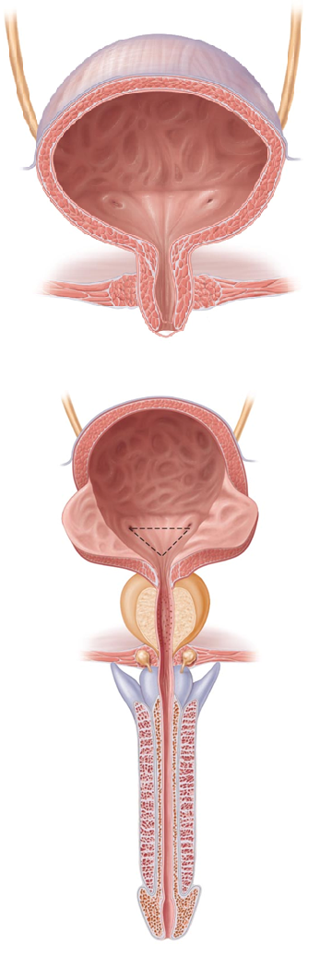
Urinary Bladder
Muscular sac for _
Retroperitoneal, on pelvic floor posterior to pubic symphysis
Males
Females
anterior to _

Slide 202
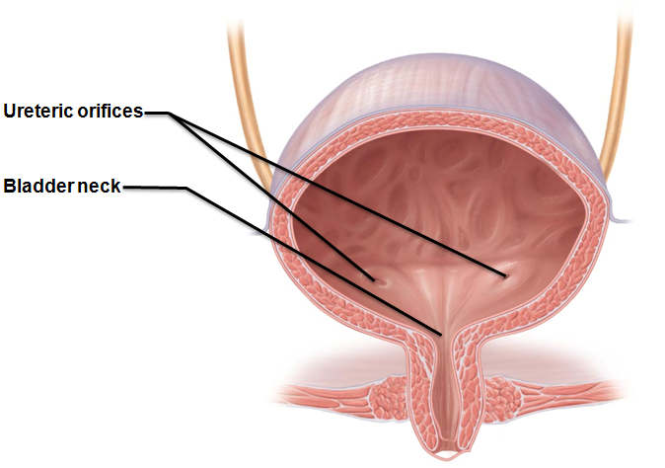
Urinary Bladder
Openings for _
Smooth triangular area outlined by openings for ureters and urethra
________________________________________ tend to persist in this region

Slide 203
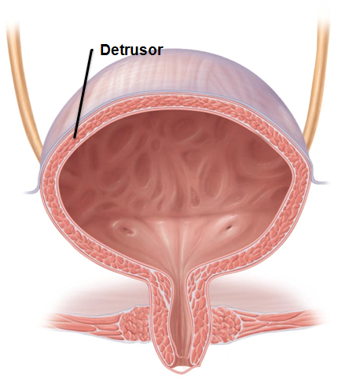
Urinary Bladder
Layers of bladder wall
transitional epithelial mucosa
Thick ___________________________ muscle
three layers of smooth muscle
Fibrous adventitia

Slide 204
Urinary Bladder
Collapses when empty; _
Expands and rises superiorly during filling without significant rise in internal pressure
Full bladder 12 cm long; holds about 500 ml
Can ________________________________ if overdistended

Slide 205
Urethra
_____________________________________ draining urinary bladder
Lining epithelium
Mostly pseudostratified columnar epithelium, except
Transitional epithelium near bladder

Slide 206
Urethra
Sphincters
Involuntary (smooth muscle) at bladder-urethra junction
Voluntary (skeletal) muscle surrounding urethra as it passes through pelvic floor

Slide 207
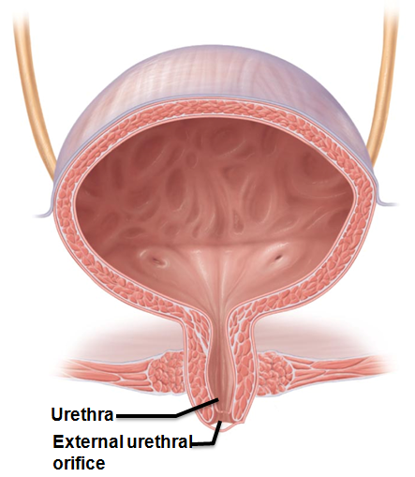
Urethra
Female urethra (3–4 cm)
Tightly bound to _
Anterior to vaginal opening; posterior to clitoris

Slide 208
Urethra
Male urethra carries semen and urine
Three named regions
within prostate gland
Intermediate part of the urethra (membranous urethra)
passes through urogenital diaphragm from prostate to beginning of penis
passes through penis; opens via external urethral orifice

Slide 209
Micturition
Urination or voiding
Three simultaneous events must occur
_______________________________________________ muscle by Autonomic Nervous System
Opening of __________________________________________ by Autonomic Nervous System
Opening of _________________________________________ by somatic nervous system

Slide 210
Micturition
Reflexive urination (________________________________)
Distension of bladder activates _
Excitation of parasympathetic neurons in reflex center in sacral region of spinal cord
Contraction of _
Contraction (opening) of _
Inhibition of somatic pathways to external sphincter, allowing its relaxation (opening)

Slide 211
Micturition
Pontine control centers mature between ages 2 and 3
Pontine _________________________________ inhibits micturition
Inhibits parasympathetic pathways
Excites sympathetic and somatic efferent pathways
Pontine micturition center _
Excites parasympathetic pathways
Inhibits sympathetic and somatic efferent pathways

Slide 212
Homeostatic Imbalance
______________________________________ usually from weakened pelvic muscles
Stress incontinence
Increased ________________________________________________ forces urine through external sphincter
Overflow incontinence
Urine dribbles when _

Slide 213
Homeostatic Imbalance
Urinary retention
Bladder _
Common after _
Treatment
catheterization

Slide 214
Homeostatic Imbalance
Three common congenital abnormalities
Two kidneys fuse across midline → single U-shaped kidney; usually _
Hypospadias
Corrected surgically at ~ 12 months

Slide 215
Homeostatic Imbalance
Polycystic kidney disease
Many __________________________ interfere with function
Autosomal dominant form
Autosomal recessive
more severe
Cause unknown but involves defect in signaling proteins

Slide 216
Developmental Aspects
Most elderly people have abnormal kidneys histologically
nephrons _
tubule cells less efficient
GFR ½ that of young adult by age 80
atherosclerosis of _
Bladder shrinks; loss of bladder tone
Needing to get up during night/sleep to urinate
incontinence

