Slide 1
Begin Exam Five material: Digestive System

Slide 2
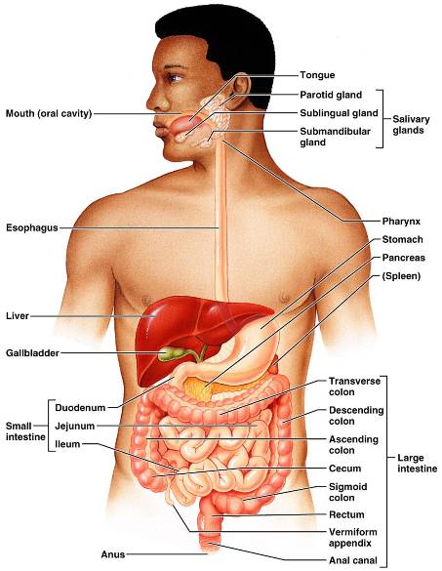
Digestive System: Overview
mouth, pharynx, esophagus, stomach, small intestine, and large intestine
teeth, tongue, gallbladder, salivary glands, liver, and pancreas

Slide 3
Digestive Process
The GI tract is a _____________________________________ line
Nutrients become more available to the body in each step
There are six essential activities:
Ingestion
mechanical digestion
defecation

Slide 4
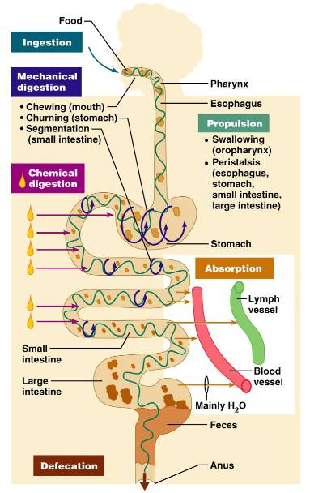
G.I. Tract Activities
Ingestion –
Propulsion – swallowing and peristalsis
Peristalsis – ______________________ of muscles in the organ walls
Mechanical digestion –

Slide 5
Gastrointestinal Tract Activities
Chemical digestion
catabolic _
movement of nutrients _
Defecation
elimination of _

Slide 6
GI Tract
___________________________________ for the digestive process
Regulation of digestion involves:
Mechanical and chemical stimuli – _________________________________, osmolarity, and presence of substrate in the lumen
Extrinsic control by _
Intrinsic control by _

Slide 7
Receptors of the GI Tract
Mechano- and chemoreceptors respond to:
Stretch, osmolarity, and pH
Presence of substrate, and end products of digestion
They initiate reflexes that:

Slide 8
Nervous Control of the GI Tract
Intrinsic controls
______________________________________ initiate short reflexes
Short reflexes are mediated by local enteric plexuses (gut brain)
Extrinsic controls
Long reflexes arising within or outside the GI tract
____________________________ and extrinsic _

Slide 9
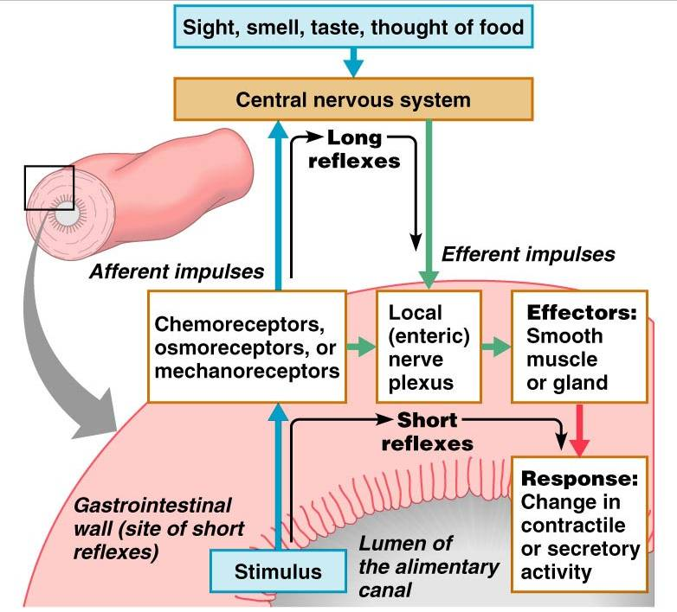

Slide 10
Peritoneum and Peritoneal Cavity
Peritoneum
______________________________________ of the abdominal cavity
covers external surface of most _
lines the _
Peritoneal cavity
________________________________ digestive organs
Allows them to slide across one another

Slide 11
Peritoneum and Peritoneal Cavity
Mesentery :
supplies _____________________________ to the viscera
Holds digestive organs in place and _

Slide 12
Histology of the Alimentary Canal
From esophagus to the anal canal the walls of the GI tract have the _
From the lumen outward they are the _________________________, _________________________, muscularis externa, and ___________________________
Each tunic has a predominant tissue type and a specific digestive function

Slide 13
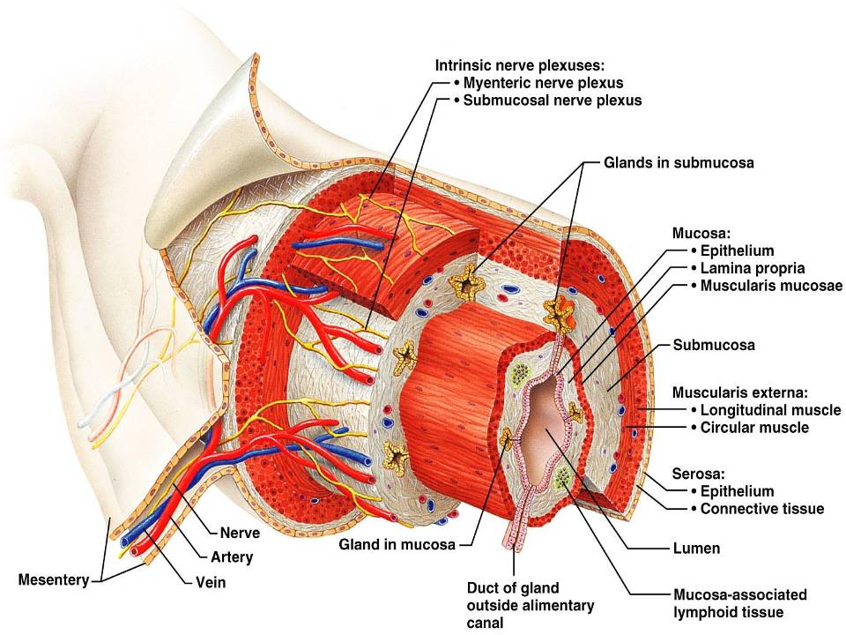
Figure 23.6

Slide 14
Mucosa
Moist epithelial layer that _____________________________ of the alimentary canal
Three major functions:
_______________________________ against infectious disease
Consists of three layers: a lining epithelium, lamina propria, and muscularis mucosae

Slide 15
Mucosa: Epithelial Lining
________________________________ and mucus-secreting goblet cells
Mucus secretions:
_______________________________________ from digesting themselves
Ease food along the tract
Stomach and small intestine mucosa contain:
__________________________________ -secreting cells (making them endocrine and digestive organs)

Slide 16
Mucosa: Lamina Propria and Muscularis Mucosae
Nourishes the epithelium and absorbs nutrients
Contains lymph nodes _____________________________ important in defense against bacteria
Muscularis mucosae
__________________________________ that produce local movements of mucosa

Slide 17
Mucosa: Other Sublayers
dense connective tissue containing elastic fibers, blood and lymphatic vessels, lymph nodes, and nerves
Muscularis externa
responsible for _
Serosa
the _
Replaced by the fibrous adventitia in the esophagus
Retroperitoneal organs have both an adventitia and serosa

Slide 18
Enteric Nervous System
two major intrinsic nerve plexuses:
regulates glands and smooth muscle in the mucosa
_____________________________ – Major nerve supply that controls GI tract mobility

Slide 19
Enteric Nervous System
Segmentation and peristalsis are largely ______________________________ involving local reflex arcs
Linked to the CNS via long _____________________________ reflex arc

Slide 20
Mouth
Oral or _____________________ cavity:
Is bounded by lips, cheeks, palate, and tongue
oral orifice
continuous with the oropharynx posteriorly

Slide 21
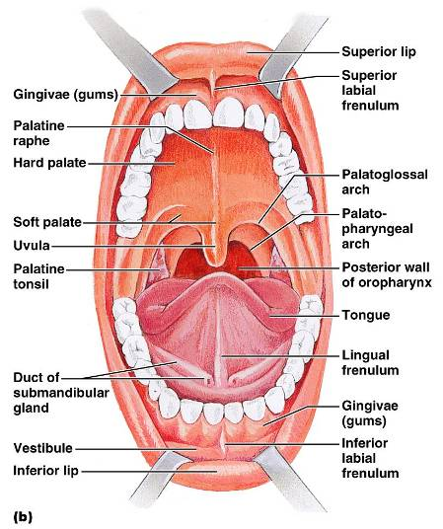
Mouth
To withstand _
The mouth is lined with _
The gums, hard palate, and dorsum of the tongue are _

Slide 22
Lips and Cheeks
Have a core of skeletal muscles
Lips:
Cheeks:
bounded by the lips and cheeks externally, and teeth and gums internally

Slide 23
Lips and Cheeks
Oral cavity proper
area that lies _
median fold that joins the internal aspect of each lip to the gum

Slide 24
Palate
Hard palate
palatine bones and palatine processes of the maxillae
Slightly _________________________ on either side of the raphe (midline ridge)

Slide 25
Palate
Soft palate – mobile fold _
Closes off the nasopharynx during swallowing

Slide 26
Tongue
Occupies the _
fills the oral cavity when mouth is closed
Functions include:
____________________________________ food during chewing
_____________________________________ and forming the bolus
Initiation of _

Slide 27
Tongue
______________________________ muscles change the _
_______________________________ muscles alter the tongue’s _
___________________________________ secures the tongue to the floor of the mouth

Slide 28
Tongue
three types of papillae
give the tongue roughness and provide friction
scattered widely over the tongue and give it a reddish hue
V-shaped row in back of tongue

Slide 29
Tongue
groove that separates the tongue into two areas:
Anterior 2/3 residing in the _
Posterior third residing in the _

Slide 30
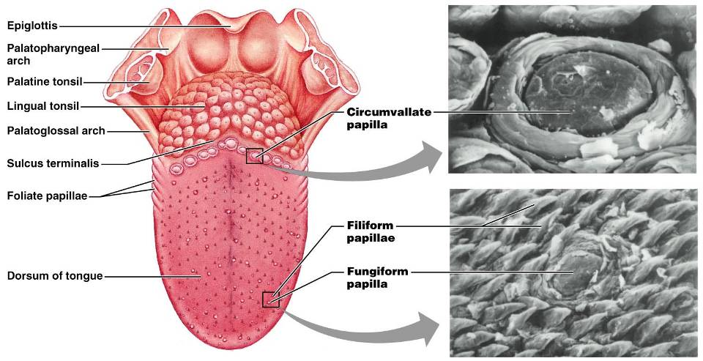
Tongue
Figure 23.8

Slide 31
Salivary Glands
Produce and secrete saliva that:
Moistens and dissolves food chemicals
Aids in bolus formation
Contains _

Slide 32
Salivary Glands
Three pairs of ____________________ glands
Intrinsic salivary glands (_______________________ glands) – scattered throughout the oral mucosa

Slide 33
Salivary Glands
Parotid
lies _______________________________ between the masseter muscle and skin
_________________________________ opens into the vestibule next to second upper molar
Submandibular
lies along the medial aspect of the mandibular body
ducts open at the _

Slide 34
Salivary Glands
Sublingual
lies anterior to the submandibular gland _
It opens via 10-12 ducts into the _

Slide 35
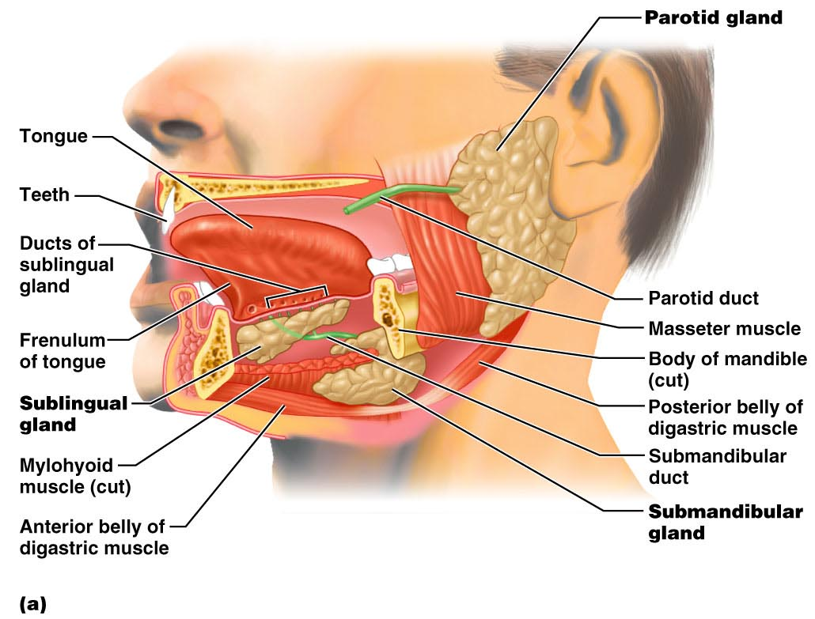
Salivary Glands
Figure 23.9a

Slide 36
Saliva: Source and Composition
Secreted from ________________________ cells of salivary glands
contains
_______________________________ – Na⁺, K⁺, Cl–, PO₄^{2–}, HCO₃–
Digestive enzyme –
Proteins – mucin, lysozyme, defensins, and IgA
____________________________________ – urea and uric acid

Slide 37
Control of Salivation
Intrinsic glands keep the mouth _
Extrinsic salivary glands secrete serous, enzyme-rich saliva in response to:
Ingested food which stimulates chemoreceptors and pressoreceptors
The thought of food
Strong ________________________________ inhibits salivation and results in dry mouth

Slide 38
Teeth
Primary
__________________________________ that erupt at intervals between 6 and 24 months
Permanent
enlarge and develop causing the root of deciduous teeth to be resorbed
fall out between the ages of _
All but the third molars have erupted by the end of adolescence
Usually _

Slide 39
Classification of Teeth
Based on shape and function
chisel-shaped teeth for cutting or nipping
Canines
fanglike teeth that _
Premolars (bicuspids) and molars
have _______________________________; best suited for grinding or crushing

Slide 40
Tooth Structure
Two main regions –
Crown
______________________________ above the gingiva
Enamel
acellular, brittle material composed of calcium salts and hydroxyapatite crystals;
Root
portion of the tooth _

Slide 41
Tooth Structure
Neck
constriction _
Cementum
Attaches it to the periodontal ligament

Slide 42
Tooth Structure
Periodontal ligament
________________________________ in the alveolus of the jaw
Forms the _
Gingival sulcus
depression where the gingiva borders the tooth

Slide 43
Tooth Structure
Dentin
bonelike material ________________________________ that forms the bulk of the tooth
cavity surrounded by dentin that contains pulp
Pulp
connective tissue, _

Slide 44
Tooth Structure
Root canal
portion of the pulp cavity that extends into the root
Odontoblasts
secrete and maintain dentin throughout life

Slide 45
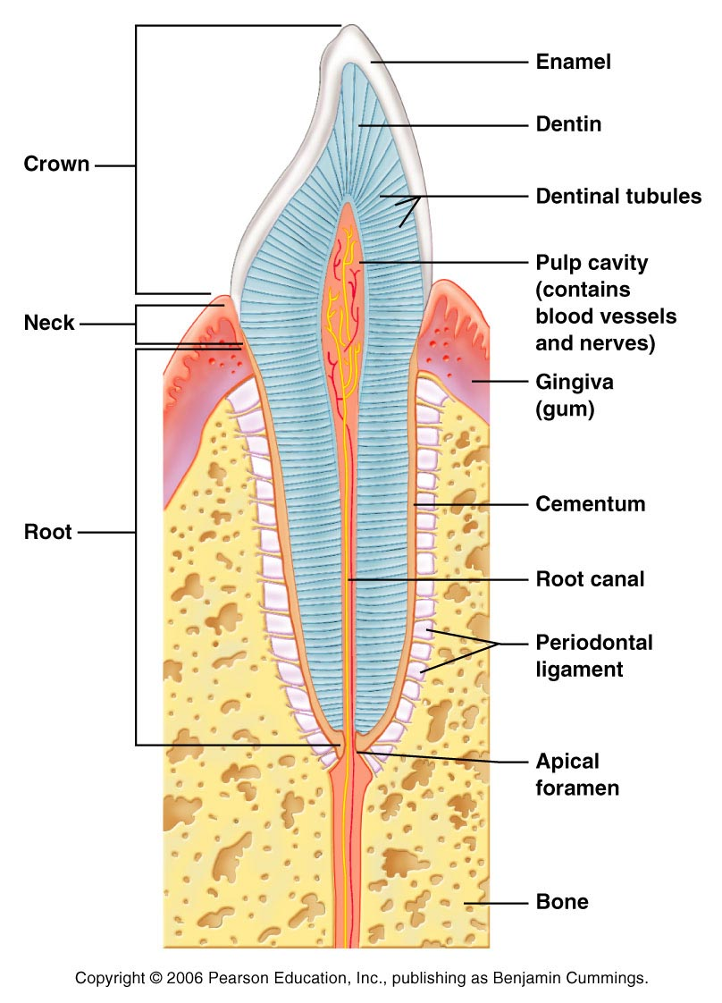

Slide 46
Tooth and Gum Disease
Dental _
gradual ___________________________ of enamel and dentin by bacterial action
Dental plaque adheres to teeth
a film of _
Acid from the bacteria dissolves calcium salts
Without calcium salts, organic matter is digested by _
Daily flossing and brushing help prevent caries by removing forming plaque

Slide 47
Tooth and Gum Disease: Periodontitis
Gingivitis
as plaque accumulates, it _
Accumulation of calculus:
________________________________ between the gingivae and the teeth
Puts the gums at risk for infection

Slide 48
Tooth and Gum Disease: Periodontitis
Periodontitis – serious gum disease resulting from an _
Immune system attacks intruders as well as body tissues, _

Slide 49
Pharynx
From the mouth, the oro- and laryngopharynx allow passage of:
Food and fluids to the _
________________________ to the trachea
Lined with _________________________ epithelium and _

Slide 50
Esophagus
_____________________________ going from the laryngopharynx to the stomach
Travels through the _
Joins the stomach at the cardiac orifice

Slide 51
Esophageal Characteristics
Esophageal mucosa
nonkeratinized stratified squamous epithelium
Glands secrete mucus as a____________ moves through the esophagus
Muscle changes from ______________________ (superiorly) to ______________________ (inferiorly)

Slide 52
Digestive Processes in the Mouth
Food is ingested
________________________ digestion begins (chewing)
_____________________________ is initiated by swallowing
_________________________________ begins chemical breakdown of starch

Slide 53
Deglutition (Swallowing)
Coordinated activity of the tongue, soft palate, pharynx, esophagus, and 22 separate muscle groups
bolus is forced into the _

Slide 54
Deglutition (Swallowing)
controlled by the _
All routes except into the digestive tract are sealed off
Peristalsis moves food through the pharynx to the esophagus

Slide 55
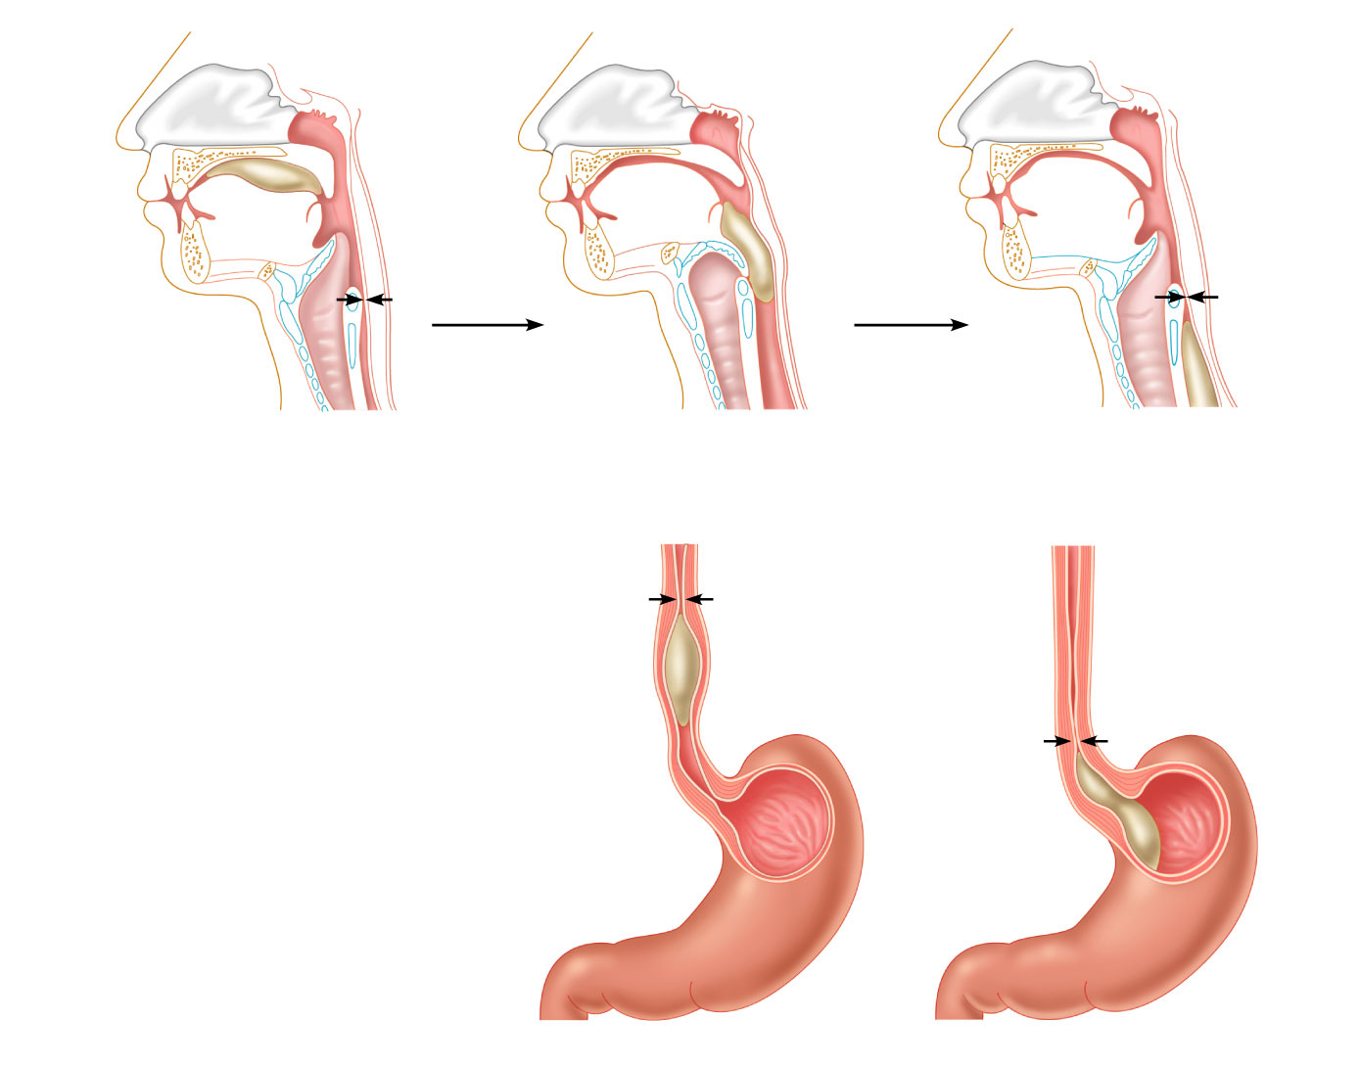
Bolus of food
Tongue
Uvula
Pharynx
Bolus
Epiglottis
Epiglottis
Glottis
Trachea
Esophagus
Bolus
(a)
Upper esophageal
sphincter contracted
(b)
Upper esophageal
sphincter relaxed
(c)
Upper esophageal
sphincter contracted
Relaxed
muscles
Relaxed
muscles
Circular muscles
contract,
constricting
passageway
and pushing
bolus down
Bolus of
food
Gastroesophageal
sphincter open
Longitudinal
muscles
contract,
shortening
passageway
ahead of bolus
Gastroesophageal
sphincter closed
Stomach
(d)
(e)
Figure 23.13

Slide 56
Stomach
Chemical breakdown of ___________________ and food is _
surrounds the cardiac orifice
dome-shaped region beneath the diaphragm
midportion of the stomach
made up of the antrum and canal which terminates at the pylorus
The pylorus is __________________________________________ through the pyloric sphincter

Slide 57
Stomach
Greater curvature
entire extent of the _
Lesser curvature
concave _
Lesser omentum
runs from the _
Greater omentum
drapes inferiorly from the _

Slide 58
Stomach
sympathetic and parasympathetic fibers of the autonomic nervous system
Blood supply
_______________________________, and corresponding veins (part of the hepatic portal system)

Slide 59
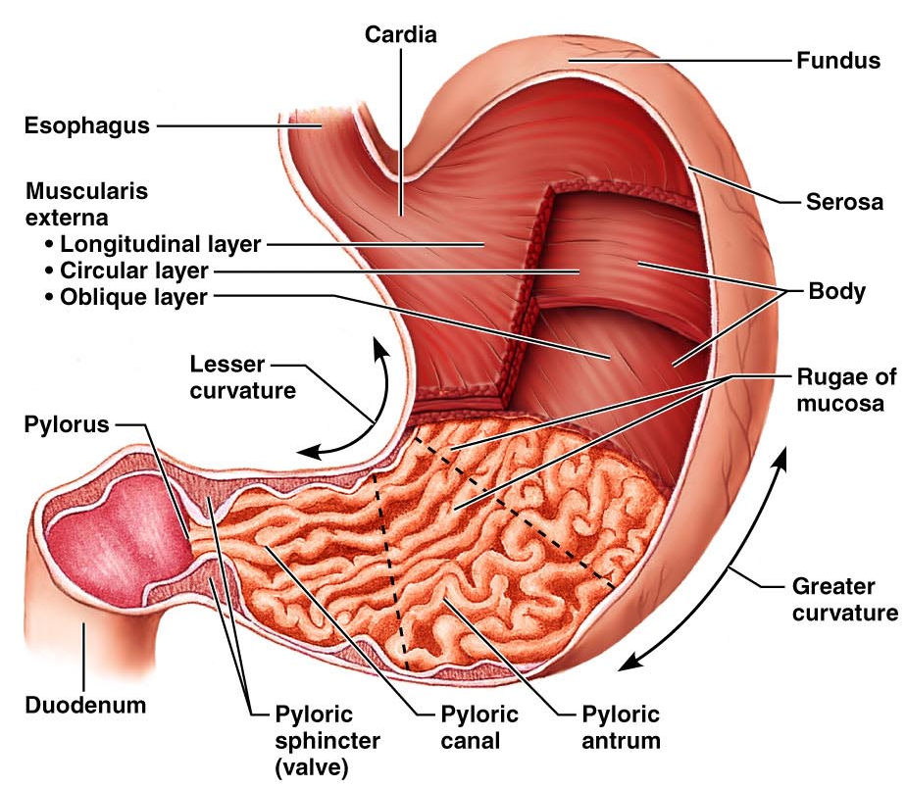
Figure 23.14a

Slide 60
Microscopic Anatomy of the Stomach
Epithelial lining is composed of:
____________________________ that produce a coat of alkaline mucus
The mucous surface layer traps a bicarbonate-rich fluid beneath it
________________________ contain gastric glands that secrete _

Slide 61
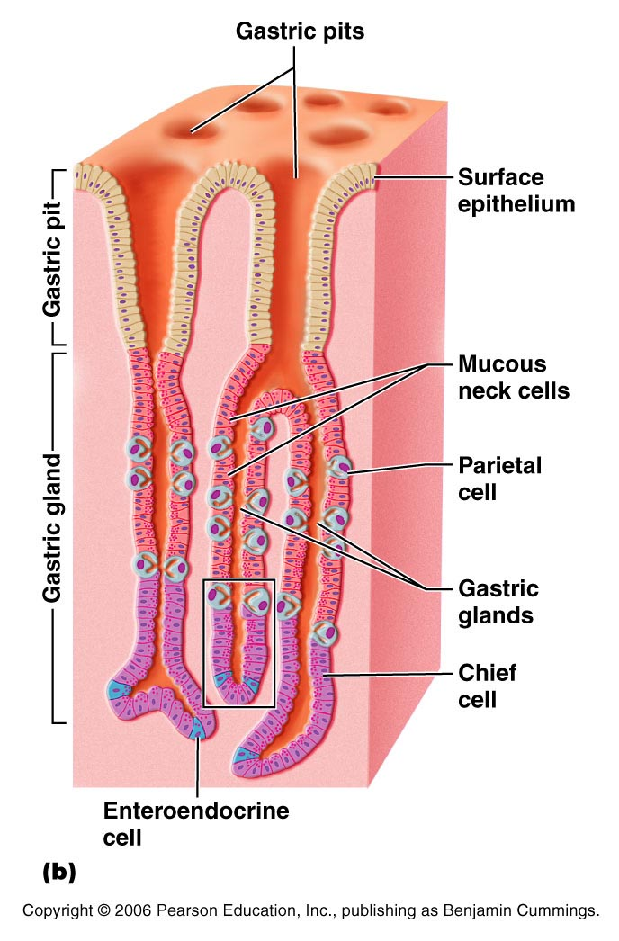
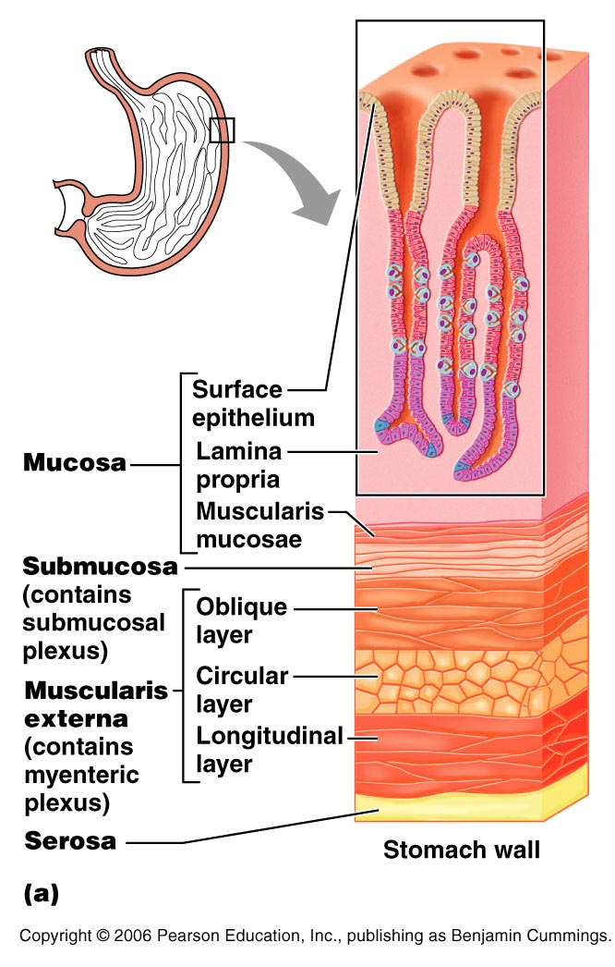
Anatomy of the Stomach
Figure 23.15a

Slide 62
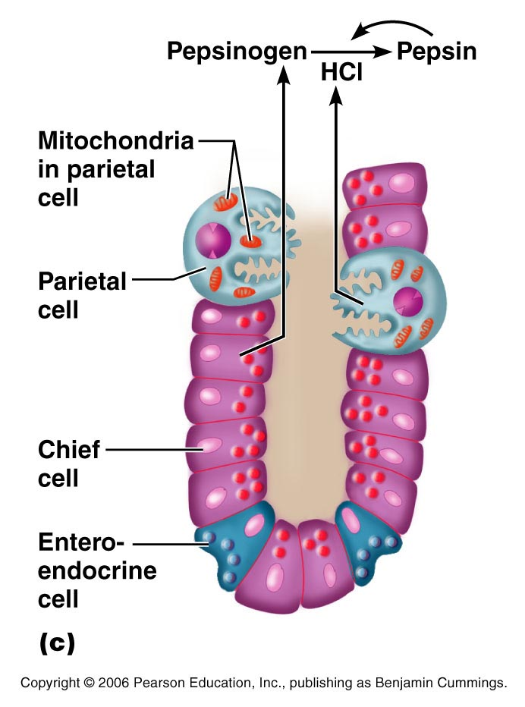
Microscopic Anatomy of the Stomach
Figure 23.15c

Slide 63
Glands of the Stomach Fundus and Body
Gastric glands of the fundus and body have a variety of secretory cells
secrete _
Parietal cells

Slide 64
Glands of the Stomach Fundus and Body
Chief cells
produce _
Pepsinogen is activated to pepsin by:
__________________________________ itself via a positive feedback mechanism
Enteroendocrine cells
secrete gastrin, histamine, endorphins, serotonin, cholecystokinin (CCK), and somatostatin into the lamina propria

Slide 65
Digestion in the Stomach
The stomach:
______________ ingested food
Degrades this food both physically and chemically
____________________________ to the small intestine
Enzymatically _
Secretes ______________________________ required for absorption of vitamin B₁₂

Slide 66
Regulation of Gastric Secretion
release of gastric juices
_________________________ (reflex) phase:
prior to food entry
_________________________ phase:
once food enters the stomach
__________________________ phase:
as partially digested food enters the duodenum

Slide 67
Cephalic Phase
Excitatory events include:
Stimulation of taste or smell receptors
Inhibitory events include:
Loss of appetite or _
____________________________ in stimulation of the _

Slide 68
Gastric Phase
Excitatory events include:
Activation of stretch receptors
Activation of ____________________________ by peptides, caffeine, and rising pH
Release of ____________________________ to the blood

Slide 69
Gastric Phase
Inhibitory events include:
A pH _
____________________________________ that overrides the parasympathetic division

Slide 70
Intestinal Phase
Excitatory phase
low pH; partially digested food enters the duodenum and _
Inhibitory phase
distension of duodenum, __________________________________, acidic, or hypertonic chyme, and/or irritants in the duodenum
Closes the _
Releases hormones that _

Slide 71
Regulation and Mechanism of HCl Secretion
HCl secretion is stimulated by
_______________________________ through second-messenger systems
Antihistamines block H₂ receptors and _

Slide 72
Response of the Stomach to Filling
Reflex-mediated events include:
as food travels in the esophagus, stomach muscles relax
the stomach dilates in response to gastric filling
Plasticity
the ability to be _

Slide 73
Gastric Contractile Activity
Most vigorous peristalsis and mixing occurs near the pylorus
Chyme is either:
Delivered in _ or
Forced ________________________________ for further mixing

Slide 74
Regulation of Gastric Emptying
Gastric emptying is regulated by:
The neural _
Hormonal (enterogastrone) mechanisms
These mechanisms _______________________________ and duodenal filling

Slide 75
Regulation of Gastric Emptying
______________________-rich chyme
____________________________ moves through the duodenum
_________________-laden chyme
digested ___________________________ causing food to remain in the stomach longer

Slide 76
Small Intestine: Gross Anatomy
Runs from pyloric sphincter to the ileocecal valve
Has three subdivisions:

Slide 77
Small Intestine: Gross Anatomy
The _
Join the duodenum at the hepatopancreatic ampulla
Are controlled by the _
The jejunum extends from the duodenum to the ileum
The ileum joins the large intestine at the __

Slide 78
Small Intestine: Microscopic Anatomy
Structural modifications of the small intestine wall increase surface area
Plicae circulares: deep __________________________ of the mucosa and submucosa
Villi
fingerlike _
tiny projections of absorptive mucosal cells’ plasma membranes

Slide 79
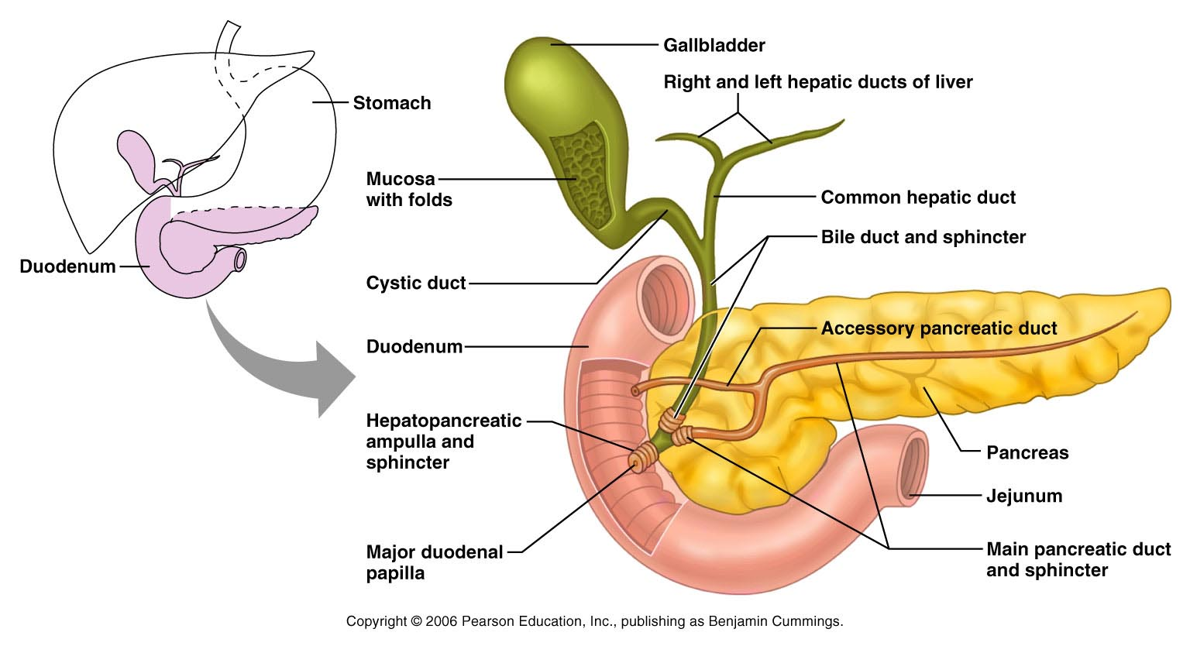
Duodenum and Related Organs
Figure 23.20

Slide 80
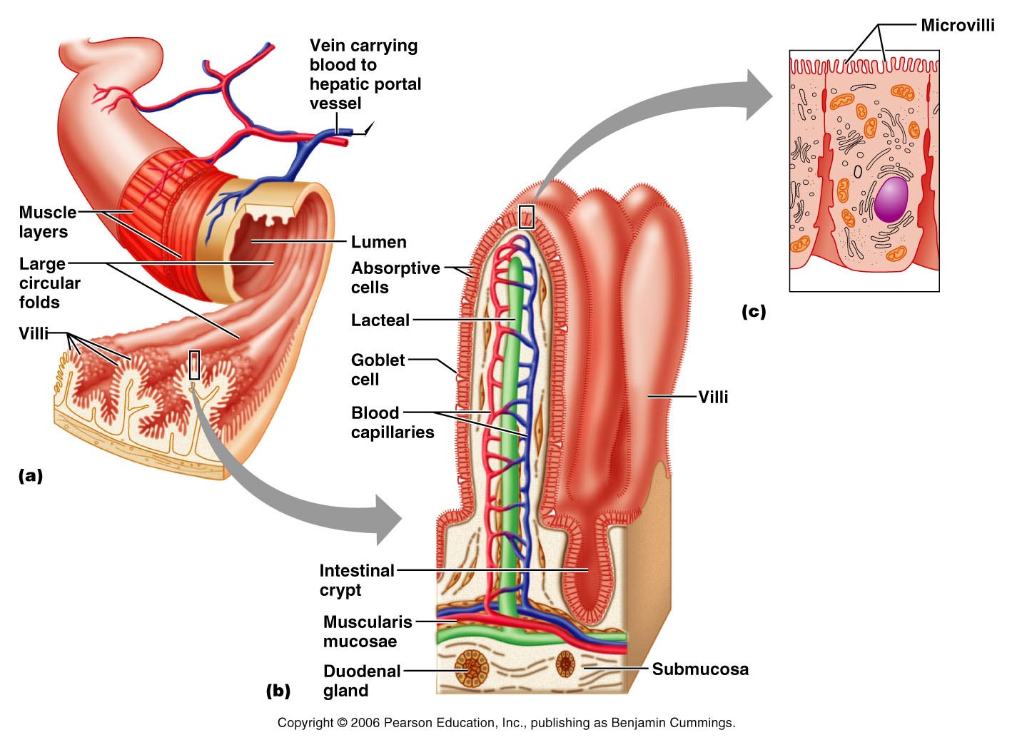
Figure 23.21

Slide 81
Small Intestine: Histology of the Wall
Cells of ___________________________ secrete intestinal juice
_______________________________ are found in the submucosa
Brunner’s glands in the duodenum secrete _

Slide 82
Intestinal Juice
Secreted by intestinal glands _
Slightly alkaline
Largely water,
enzyme-poor, but _

Slide 83
Liver
The _________________________ in the body
Superficially has _
right, left, caudate, and quadrate
The _
Is a remnant of the fetal _

Slide 84
Liver: Associated Structures
The lesser omentum _
The ______________________________ rests in a recess on the inferior surface of the right lobe

Slide 85
Liver: Associated Structures
Bile leaves the liver via:
Bile ducts,
which fuse into the common hepatic duct
The common hepatic duct,
which fuses with the cystic duct
___________________________________ form the bile duct

Slide 86
Composition of Bile
A yellow-green, alkaline solution containing
neutral fats,
phospholipids,
electrolytes
Bile salts are cholesterol derivatives that:
Facilitate fat and cholesterol absorption
Help solubilize cholesterol

Slide 87
Bile
Enterohepatic circulation _
The chief bile ______________________ is bilirubin
waste product of _

Slide 88
The Gallbladder
Thin-walled, green ___________________________ on the ventral surface of the liver
via the cystic duct
flows into the bile duct

Slide 89
Regulation of Bile Release
Acidic, _________________________ causes the duodenum to release:
Cholecystokinin (CCK)
into the _

Slide 90
Regulation of Bile Release
Cholecystokinin causes:
The _
The hepatopancreatic _
As a result, bile _

Slide 91
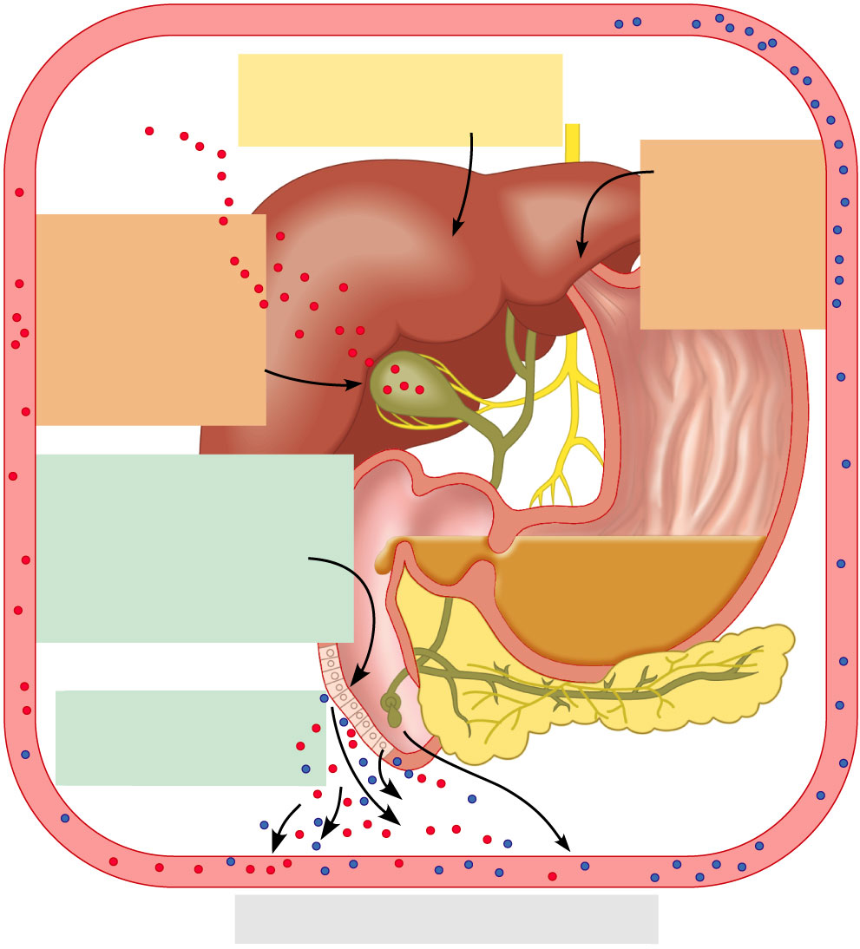
4
Vagal stimulation causes
weak contractions of
gallbladder
3
Bile salts
and secretin
transported via
bloodstream
stimulate liver
to produce bile
more rapidly
5
Cholecystokinin
(via bloodstream)
causes gallbladder
to contract and
hepatopancreatic
sphincter to relax;
bile enters
duodenum
Acidic, fatty chyme
entering duodenum causes
release of cholecystokinin
and secretin from
duodenal wall
enteroendocrine cells
1
Cholecystokinin
and secretin enter the
bloodstream
2
6
Bile salts reabsorbed into blood
Figure 23.25

Slide 92
Pancreas
Location
Lies deep to the greater curvature of the stomach
The _______________________________________ and the tail is near _

Slide 93
Pancreas
Exocrine function
Acini (clusters of secretory cells) contain _________________________________ with digestive enzymes
The pancreas also has an _
release of _

Slide 94
Composition and Function of Pancreatic Juice
Water solution of _ (primarily HCO₃–)
___________________________ acid chyme
Provides _______________________________ for pancreatic enzymes
Enzymes are released in _______________________________ and activated in the duodenum

Slide 95
Composition and Function of Pancreatic Juice
Examples include
__________________________ is activated to trypsin
Procarboxypeptidase is activated to _
Active enzymes secreted
Amylase, lipases, and nucleases
These enzymes require ___________________ for optimal activity

Slide 96
Regulation of Pancreatic Secretion
CCK and secretin enter the bloodstream when fatty or acidic chyme enters the duodenum
Upon reaching the _
CCK causes secretion
Secretin causes secretion
Vagal stimulation also causes release of pancreatic juice

Slide 97
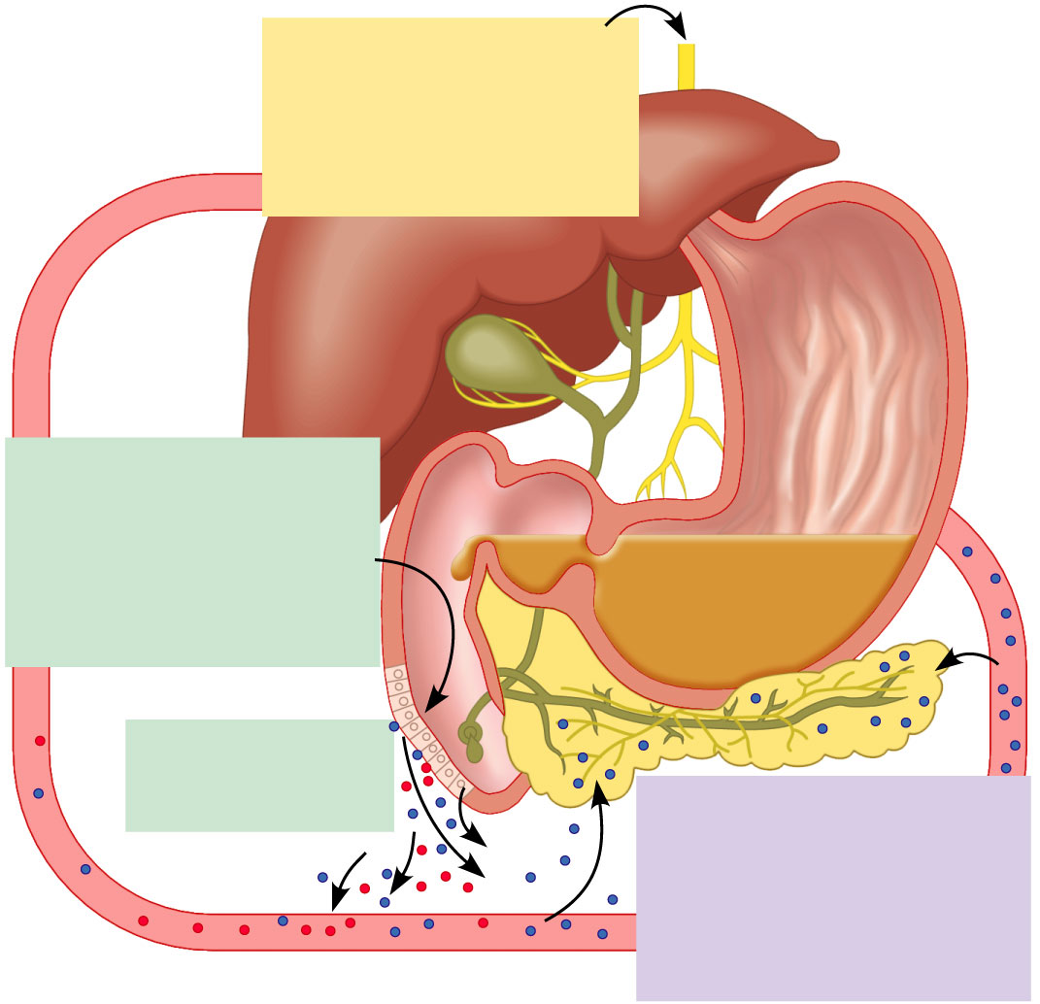
Regulation of Pancreatic Secretion
During cephalic and gastric
phases, stimulation by
vagal nerve fibers causes
release of pancreatic juice
and weak contractions of
the gallbladder.
1
Acidic chyme entering
duodenum causes the
enteroendocrine cells of
the duodenal wall to release
secretin, whereas fatty,
protein-rich chyme induces
release of cholecystokinin.
Cholecystokinin
and secretin enter
bloodstream.
2
3
Upon reaching the
pancreas, cholecystokinin
induces the secretion of
enzyme-rich pancreatic juice;
secretin causes copious
secretion of bicarbonate-rich
pancreatic juice.
Figure 23.28

Slide 98
Digestion in the Small Intestine
As chyme enters the duodenum:
Carbohydrates and proteins are only partially digested

Slide 99
Digestion in the Small Intestine
Digestion continues in the small intestine
Chyme is ____________________________ into the duodenum
Because it is hypertonic and has low pH, _
Virtually ____________________________________ takes place in the small intestine

Slide 100
Motility in the Small Intestine
The most common motion of the small intestine is _
It is initiated by _ (Cajal cells)
Moves contents steadily toward the _

Slide 101
Motility in the Small Intestine
After nutrients have been absorbed:
Peristalsis begins with each wave starting distal to the previous
Meal remnants, bacteria, mucosal cells, and debris are _

Slide 102
Control of Motility
Local enteric neurons of the GI tract coordinate intestinal motility
_________________________________ cause:
Contraction and shortening of the _
Shortening of _
Distension of the intestine

Slide 103
Control of Motility
Other impulses relax the circular muscle
The
Relax the _
Allow chyme to pass into the large intestine

Slide 104
Large Intestine
Has three unique features:
three bands of longitudinal smooth muscle in its muscularis
pocketlike sacs caused by the tone of the teniae coli
Epiploic appendages

Slide 105
Large Intestine
Is subdivided into the
The saclike cecum:
Lies below the ileocecal valve in the right iliac fossa
Contains a wormlike vermiform appendix

Slide 106
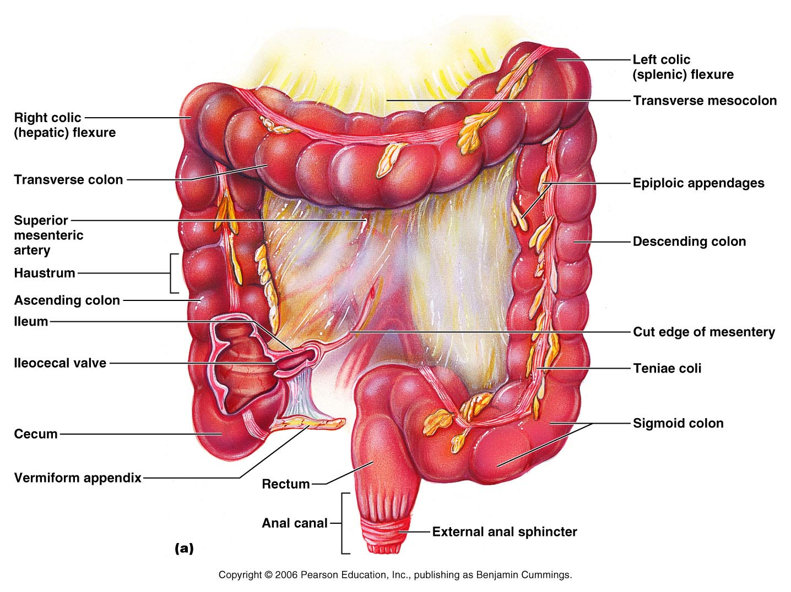
Figure 23.29a

Slide 107
Colon
Has distinct regions: ascending colon, hepatic flexure, transverse colon, splenic flexure, descending colon, and sigmoid colon
The _________________________ joins the _
The _____________________________ opens to the exterior _

Slide 108
Sphincters of the Anus
The anus has ____________ sphincters:
__________________ anal sphincter
composed of _________________________ muscle
__________________ anal sphincter
composed of _________________________ muscle
These sphincters are closed _

Slide 109
Large Intestine: Microscopic Anatomy
Colon mucosa is _____________________________ epithelium except in the anal canal
Has numerous deep ________________ lined with _

Slide 110
Large Intestine: Microscopic Anatomy
Anal canal mucosa is _
Anal sinuses _
Superficial venous plexuses are associated with the anal canal
Inflammation of these veins results in itchy varicosities called _

Slide 111
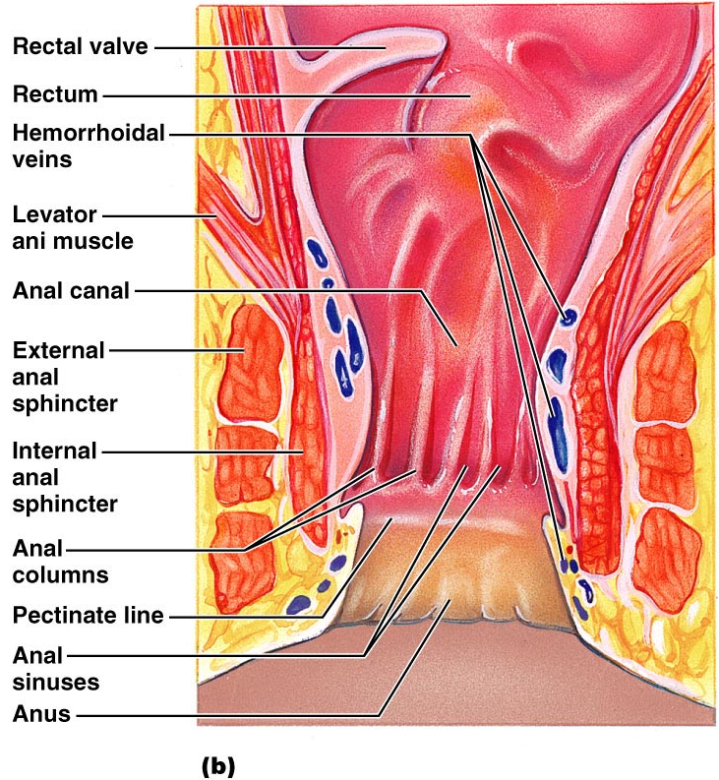
Structure of the Anal Canal
Figure 23.29b

Slide 112
Bacterial Flora
The _______________________ of the large intestine consist of:
Bacteria surviving the small intestine that enter the cecum and
Those entering via the anus
These bacteria:
Release irritating acids and _
Synthesize ___________________________ and vitamin K

Slide 113
Functions of the Large Intestine
Other than digestion of enteric bacteria, _
Vitamins, water, and electrolytes _
Its major function is _________________________________ toward the anus
Though essential for comfort, the colon is _

Slide 114
Motility of the Large Intestine
Slow segmenting movements that move the contents of the colon
contract as they are _
Presence of _
Activates the _
Initiates peristalsis that _

Slide 115
Defecation
_____________________ of rectal walls caused by feces:
_____________________________ of the rectal walls
Relaxes the ________________ anal sphincter
Voluntary signals stimulate relaxation of the external anal sphincter and defecation occurs

Slide 116
Chemical Digestion: Carbohydrates
Absorption:
Enter the _
Transported to the ____________via the _______________________________
Enzymes used:
_______________________ amylase,
_______________________ amylase,

Slide 117
Chemical Digestion: Proteins
Absorption: similar to carbohydrates
Enzymes in the stomach
Enzymes in the _
_______________________________ – trypsin, chymotrypsin, and carboxypeptidase
_______________________________ – aminopeptidases, carboxypeptidases, and dipeptidases

Slide 118
Chemical Digestion: Fats
Absorption: Diffusion into intestinal cells where they:
Enter __________________________ and are transported to systemic circulation _

Slide 119
Chemical Digestion: Fats
Glycerol and short chain fatty acids are:
Absorbed into the _
Transported via the _
Enzymes/chemicals used:
bile salts

Slide 120
Chemical Digestion: Nucleic Acids
Absorption: ______________________ via membrane carriers
Absorbed in villi
transported to liver via hepatic portal vein
Enzymes used:
pancreatic ribonucleases and deoxyribonuclease in the small intestines

Slide 121
Malabsorption of Nutrients
Results from anything that
interferes with _
______________________________ the intestinal mucosa (e.g., bacterial infection)

Slide 122
Malabsorption of Nutrients
Gluten enteropathy _
_________________________ damages the intestinal villi
reduces the _
Treated by eliminating gluten from the diet (all grains but rice and corn)

Slide 123
Cancer
Stomach and colon cancers _________________________________ or symptoms
Metastasized _____________________ frequently cause _
Prevention is by regular dental and medical examinations

Slide 124
Cancer
_____________________________ is the 2nd largest cause of cancer deaths in males
(__________________________ is 1st)
Forms from benign mucosal tumors
formation increases with age
Regular colon examination should be done for _

Slide 125
Kidney Functions
Filter 200 liters ________________ daily, allowing toxins, metabolic wastes, and excess ions to leave the body in urine
_____________________________ and chemical makeup of the blood
Maintain the _____________________ between water and salts, and acids and bases

Slide 126
Other Renal Functions
____________________________ during prolonged fasting
Production of __________________ to help ____________________________ and ______________________________ to stimulate _______________ production
Activation of vitamin D

Slide 127
Other Urinary System Organs
provides a temporary storage reservoir for urine
Paired ureters
transport urine from _
Urethra
transports urine from the _

Slide 128
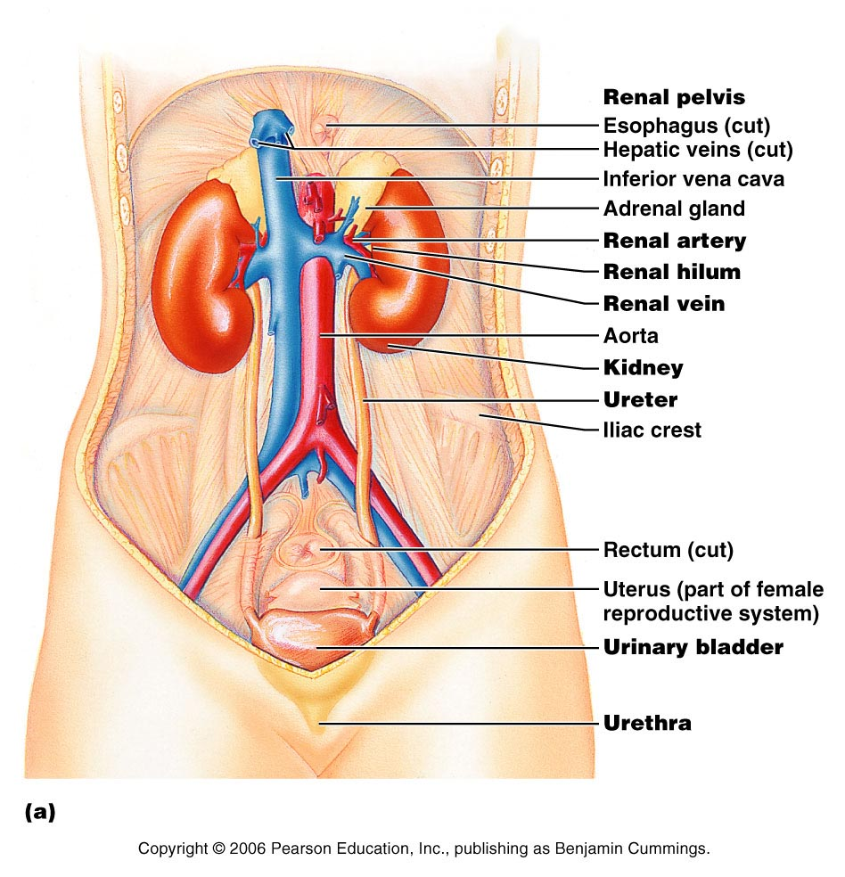
Figure 25.1a

Slide 129
Layers of Tissue Supporting the Kidney
fibrous capsule that prevents kidney infection
Adipose capsule
_______________________ that cushions the kidney and helps _________________ to the body wall
Renal fascia
outer layer of ________________________________ that anchors the kidney

Slide 130
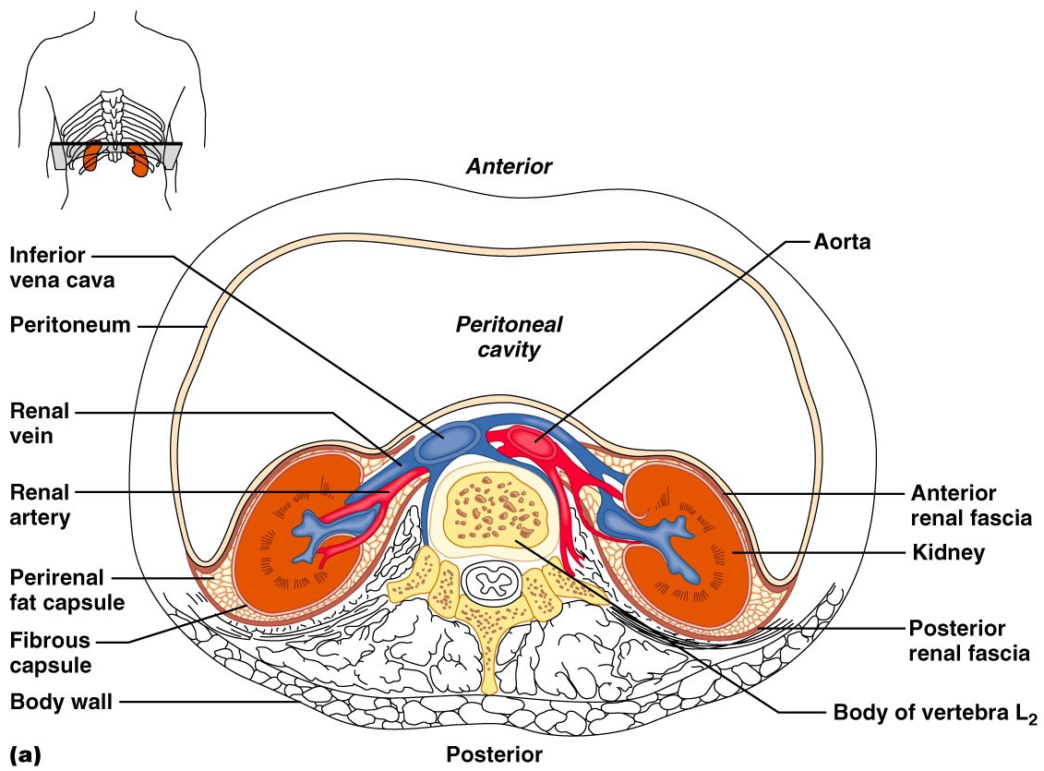
Kidney Location and External Anatomy
Figure 25.2a

Slide 131
Internal Anatomy (Frontal Section)
the light colored, __________________________ superficial region
Medulla
exhibits cone-shaped _________________________ separated by columns
The medullary pyramid and its surrounding capsule constitute a lobe
flat funnel shaped tube lateral to the hilus within the renal sinus

Slide 132
Internal Anatomy
Major calyces
large ______________________________ of the renal pelvis
_____________________________ draining from papillae
Empty urine into the pelvis
Urine flows through the _

Slide 133
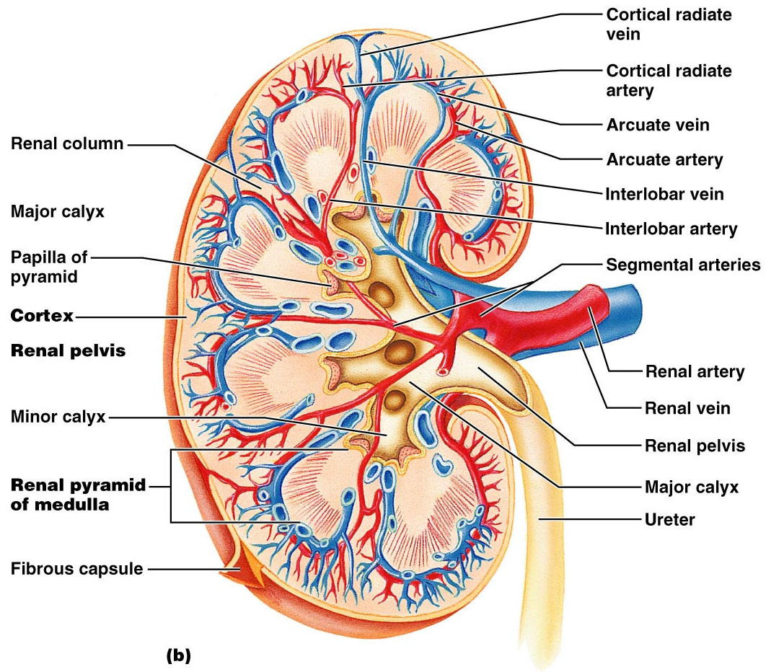
Figure 25.3b

Slide 134
Renal Vascular Pathway
Figure 25.3c

Slide 135
The Nephron
________________________ are the structural and functional units that form urine, consisting of:
Glomerulus
a tuft of ________________________________ associated with a _
Glomerular (Bowman’s) capsule
blind, ___________________________________ that completely surrounds the glomerulus

Slide 136
The Nephron
Renal _
the glomerulus and its Bowman’s capsule
______________________ epithelium that allows solute-rich, _________________________________ to pass from the blood into the glomerular capsule

Slide 137
Renal Tubule
Proximal convoluted tubule (PCT) –
composed of cuboidal cells with numerous _
____________________________ and solutes from filtrate and secretes substances into it

Slide 138
Renal Tubule
a hairpin-shaped loop of the renal tubule
Distal convoluted tubule (DCT)
cuboidal cells without microvilli that _

Slide 139
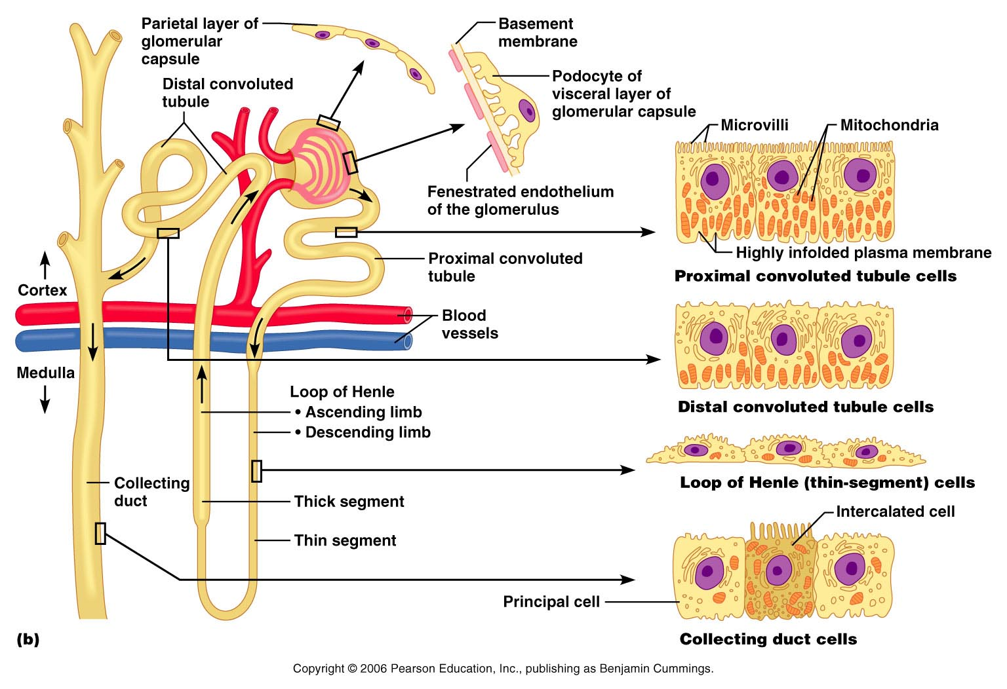
Figure 25.4b

Slide 140
Nephrons
85% of nephrons; located in the cortex
Juxtamedullary nephrons:
Are located at the cortex-medulla junction
Have loops of Henle that _
Are involved in the production of _

Slide 141
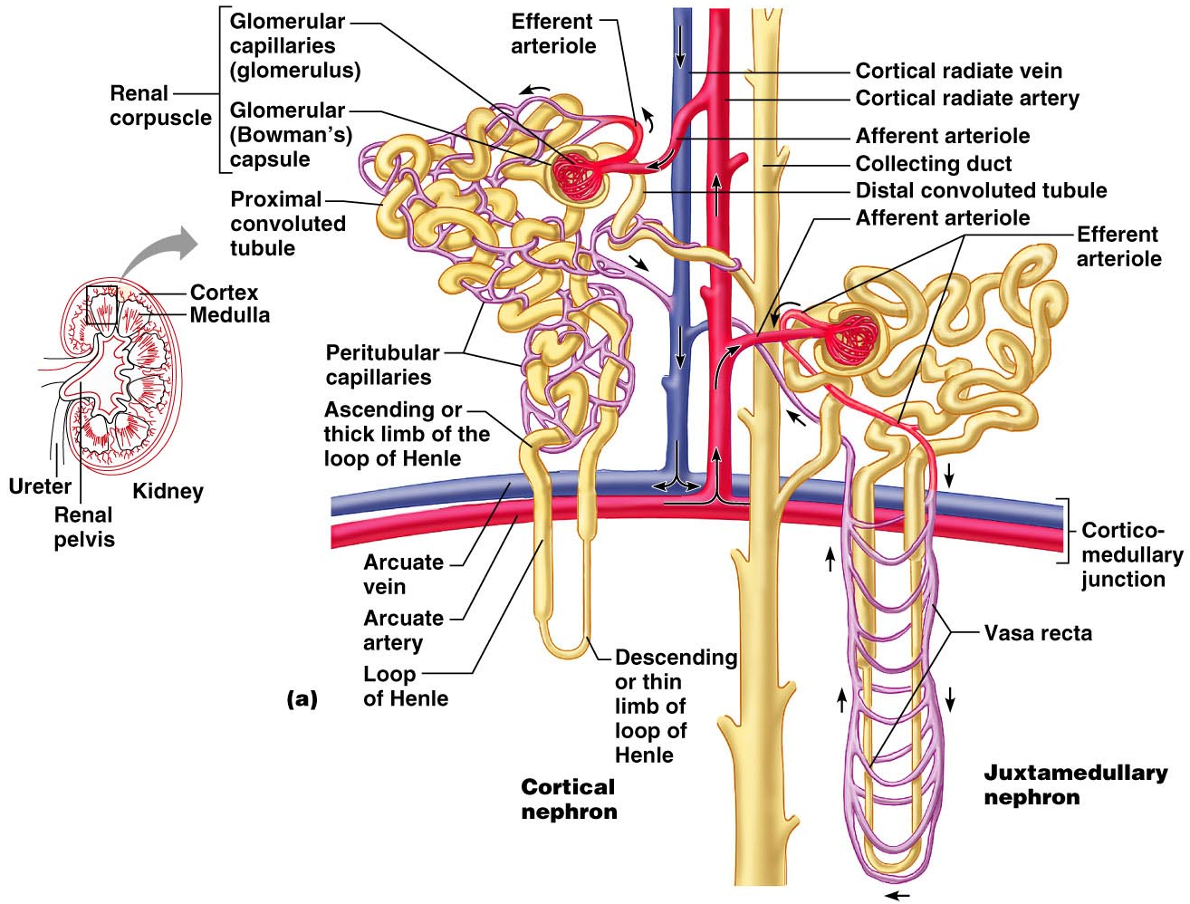
Figure 25.5a

Slide 142
Capillary Beds of the Nephron
Every nephron has _________ capillary beds
Each glomerulus is:
Fed by an _
Drained by an _

Slide 143
Capillary Beds of the Nephron
Blood pressure in the glomerulus is high because:
Arterioles are high-resistance vessels
Afferent arterioles _____________________ than efferent arterioles
Fluids and solutes are forced out of the blood throughout the entire length of the glomerulus

Slide 144
Capillary Beds
Peritubular beds are _____________________, porous capillaries ____________________ that:
Arise from efferent arterioles
Cling to adjacent renal tubules
Empty into the renal venous system
Vasa recta
long, straight _

Slide 145
Juxtaglomerular Apparatus (JGA)
Where the distal tubule lies against the afferent (sometimes efferent) arteriole
Arteriole walls have juxtaglomerular (JG) cells
Enlarged, _
Have _
Act as _

Slide 146
Juxtaglomerular Apparatus (JGA)
Tall, closely packed distal tubule cells
Lie adjacent to _
Function as chemoreceptors or osmoreceptors
Mesanglial cells:
Have ______________________________ properties
Influence capillary _

Slide 147
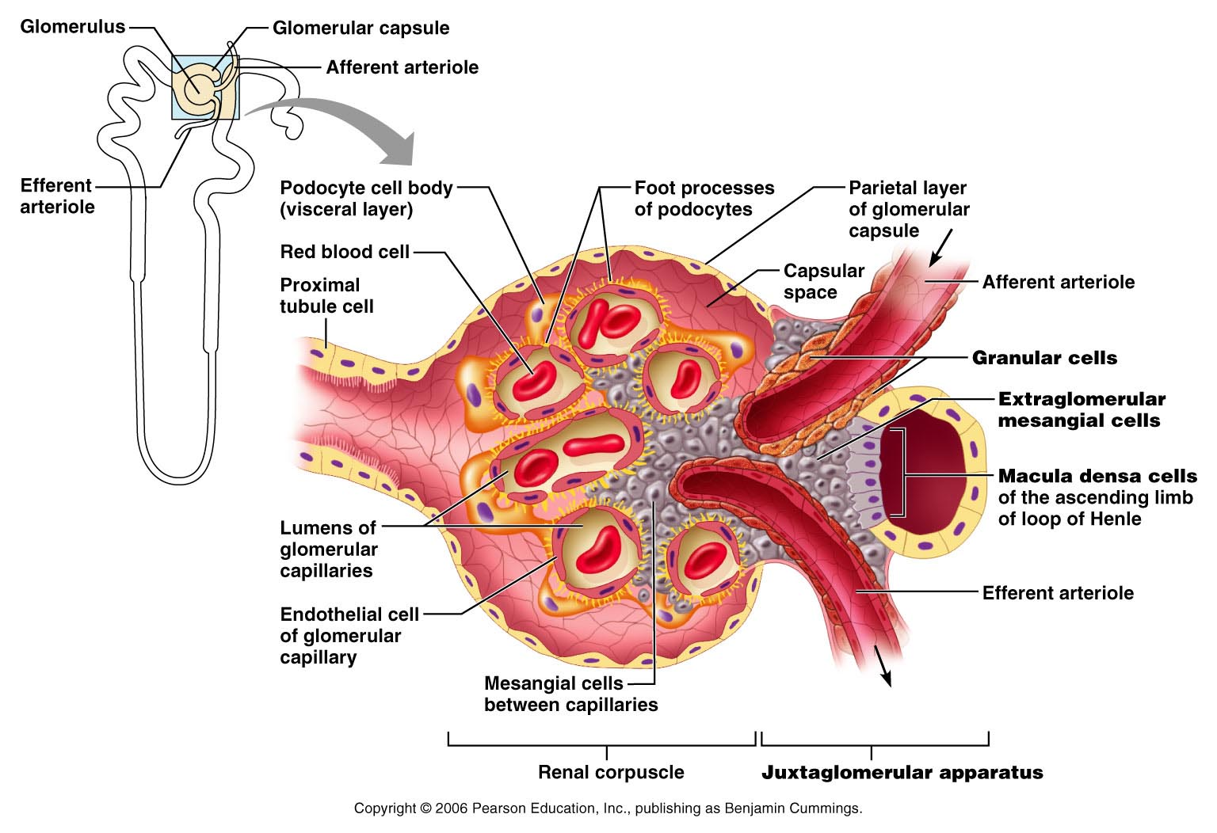
Juxtaglomerular Apparatus (JGA)
Figure 25.6

Slide 148
Mechanisms of Urine Formation
The kidneys filter the body’s _
The filtrate:
Contains all plasma components _
Loses water, nutrients, and essential ions to become urine
The urine contains _

Slide 149
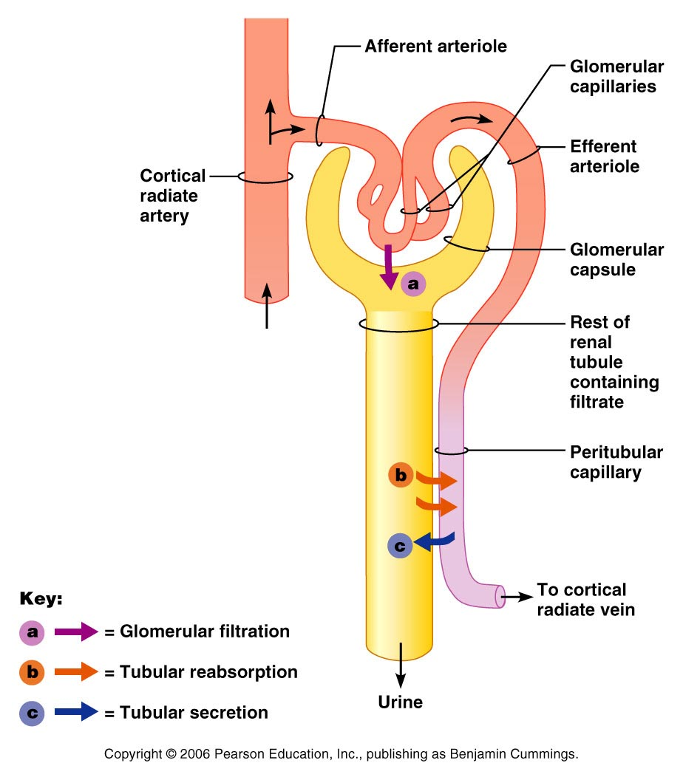
Mechanisms of Urine Formation
Urine formation and adjustment of blood composition involves three major processes
Figure 25.8

Slide 150
Glomerular Filtration
The _________________________ is more efficient than other capillary beds because:
Its filtration membrane is _
Glomerular _
It has a higher _

Slide 151
Glomerular Filtration Rate (GFR)
The total amount of filtrate formed per minute by the kidneys
Factors governing filtration rate at the capillary bed are:
Total _________________________ available for filtration
Filtration membrane _

Slide 152
Glomerular Filtration Rate (GFR)
GFR is ___________________________ to the NFP
Changes in GFR normally result from changes in _

Slide 153
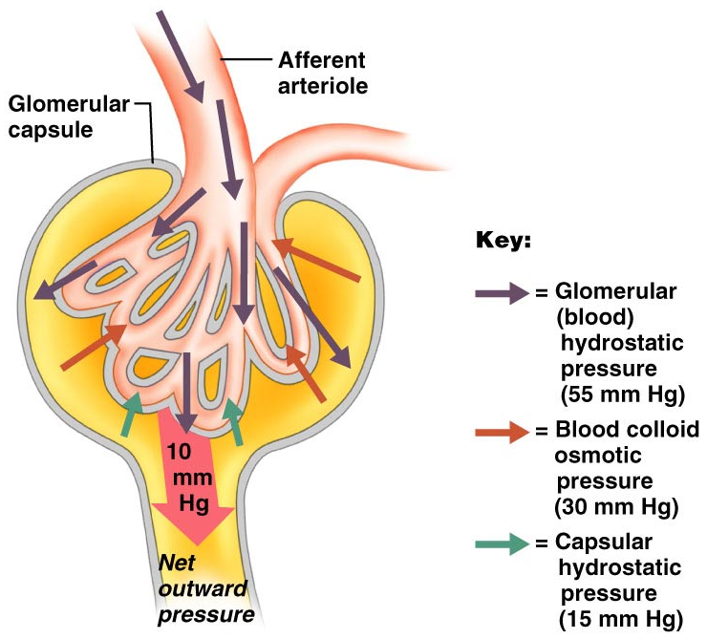
Glomerular Filtration Rate (GFR)
Figure 25.9

Slide 154
Regulation of Glomerular Filtration
If the GFR is too high:
Needed substances _
If the GFR is too low:
____________________________________, including wastes that are normally disposed of

Slide 155
Regulation of Glomerular Filtration
Three mechanisms control the GFR
Renal autoregulation _
Neural controls
Hormonal mechanism (the __________________________________ system)

Slide 156
Intrinsic Controls
Under normal conditions, renal autoregulation maintains a _____________________________ glomerular filtration rate

Slide 157
Extrinsic Controls
When the _________________________ nervous system is at ________________:
Renal blood vessels are _
Autoregulation mechanisms prevail

Slide 158
Extrinsic Controls
Under stress:
_______________________ is released by the sympathetic nervous system
_______________________ is released by the _
___________________________________ and filtration is inhibited
The sympathetic nervous system also stimulates the renin-angiotensin mechanism

Slide 159
Renin-Angiotensin Mechanism
Is triggered when the JG cells release renin
Renin acts on ___________________________ to release _
Angiotensin I is converted to angiotensin_
Angiotensin II:
Causes mean _
Stimulates the adrenal cortex to release _
As a result, both systemic and glomerular hydrostatic pressure rise

Slide 160
Renin Release
Renin release is triggered by:
___________________________ of the granular JG cells
Stimulation of the JG cells by _
Direct stimulation of the JG cells by _
Angiotensin _

Slide 161
Tubular Reabsorption
All ______________________________ are reabsorbed
Water and ion reabsorption is _________________________ controlled
Reabsorption may be an active (requiring ATP) or passive process

Slide 162
Nonreabsorbed Substances
A ___________________________ (T_{m}):
Reflects the number of _______________ in the renal tubules available
Exists for nearly every substance _
When the carriers are ______________________, excess of that substance _

Slide 163
Nonreabsorbed Substances
Substances are not reabsorbed if they:
Are _
Are too large to pass through membrane pores
Urea, creatinine, and uric acid are the most important nonreabsorbed substances

Slide 164
Atrial Natriuretic Peptide Activity
ANP _
_________________________ blood volume
Lowers blood pressure
ANP lowers blood Na⁺ by:
Acting directly on medullary ducts to _
Counteracting the effects of _
Indirectly stimulating an increase in GFR reducing water reabsorption

Slide 165
Tubular Secretion
Essentially reabsorption in reverse,
substances move from peritubular capillaries or tubule cells _
Tubular secretion is important for:
Disposing of substances not already in the filtrate
Eliminating undesirable substances such as _
Ridding the body of excess _
Controlling blood _

Slide 166
Formation of Dilute Urine
Filtrate is diluted in the ascending loop of Henle
Dilute urine is created by allowing this filtrate to continue into the renal pelvis
This will happen as long as _

Slide 167
Formation of Dilute Urine
Collecting ducts remain _
no further water reabsorption occurs
Sodium and selected ions can be removed by active and passive mechanisms

Slide 168
Formation of Concentrated Urine
Antidiuretic hormone (ADH) _
This equalizes the osmolality of the filtrate and the interstitial fluid
In the presence of ADH, _

Slide 169
Formation of Concentrated Urine
ADH-dependent water reabsorption is called _
ADH is the signal to produce _
The kidneys’ ability to respond depends upon the high medullary osmotic gradient

Slide 170
Diuretics
Chemicals that enhance the urinary output include:
Any substance _
Substances that exceed the ability of the renal tubules to reabsorb it
Substances that _

Slide 171
Diuretics
Osmotic diuretics include:
High _
carries water out with the glucose
Alcohol
Caffeine and most diuretic drugs
_______________________ and Diuril
inhibit Na⁺-associated symporters

Slide 172
Ureters
Slender tubes that _
Ureters enter the _
This closes their distal ends as bladder pressure increases and prevents backflow of urine into the ureters

Slide 173
Ureters
Ureters have a _
Transitional epithelial mucosa
Smooth muscle muscularis
Fibrous connective tissue adventitia
Ureters ___________________________ via response to smooth muscle stretch

Slide 174
Urinary Bladder
Smooth, collapsible, muscular sac that stores urine
It lies retroperitoneally on the pelvic floor _
Males
Females
triangular area outlined by the openings for the ureters and the urethra
Clinically important because _

Slide 175
Urinary Bladder
The bladder wall has three layers
A _
A _
The bladder is distensible and collapses when empty
As urine accumulates, the bladder expands without significant rise in internal pressure

Slide 176
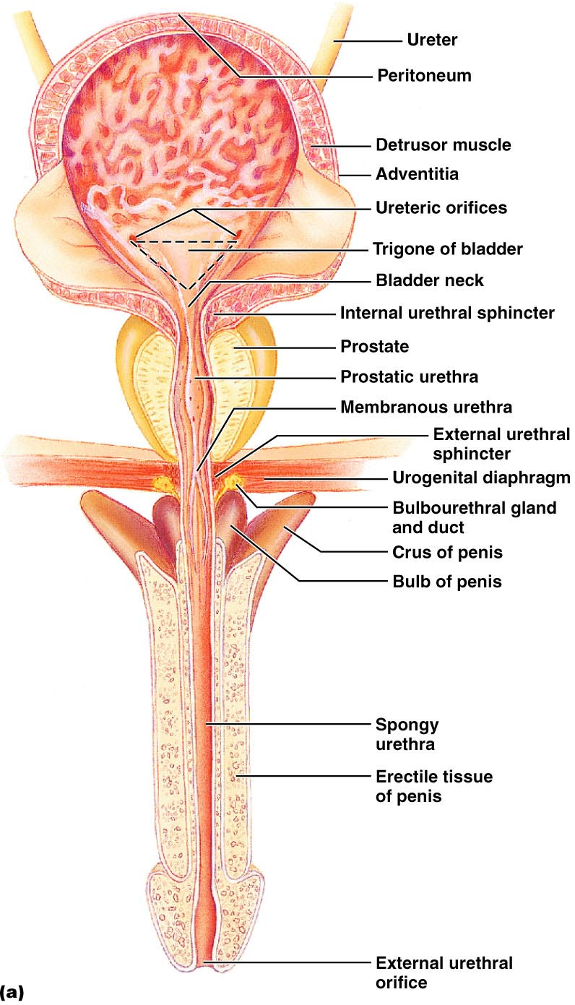
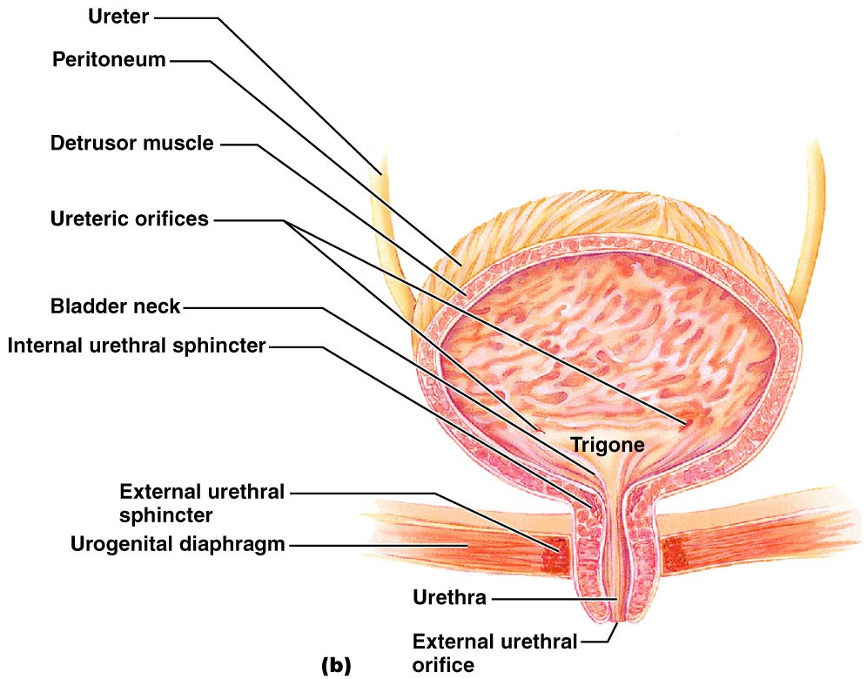
Urinary Bladder

Slide 177
Urethra
Muscular tube that:
Drains _
Conveys it out of the body

Slide 178
Urethra
Sphincters keep the urethra closed when urine is not being passed
____________________ urethral sphincter
__________________________ sphincter at the bladder-urethra junction
____________________ urethral sphincter
__________________________ sphincter surrounding the urethra as it passes through the urogenital diaphragm
Levator ani muscle

Slide 179
Urethra
The female urethra is _
Its external opening lies _
The male urethra has three named regions
Prostatic urethra
Membranous urethra
runs through _
passes through the penis and opens via the _

Slide 180
Micturition (Voiding or Urination)
The act of emptying the bladder
Distension of bladder walls initiates spinal reflexes that:
Stimulate contraction of the _
Inhibit the ____________________________ and internal sphincter (temporarily)
Voiding reflexes:
Stimulate the _
Inhibit the _

