Slide 1
Saliva: Source and Composition
Secreted from ________________________ cells of salivary glands
contains
_______________________________ – Na⁺, K⁺, Cl–, PO₄^{2–}, HCO₃–
Digestive enzyme –
Proteins – mucin, lysozyme, defensins, and IgA
____________________________________ – urea and uric acid

Slide 2
Control of Salivation
Intrinsic glands keep the mouth _
Extrinsic salivary glands secrete serous, enzyme-rich saliva in response to:
Ingested food which stimulates chemoreceptors and pressoreceptors
The thought of food
Strong ________________________________ inhibits salivation and results in dry mouth

Slide 3
Teeth
Primary
__________________________________ that erupt at intervals between 6 and 24 months
Permanent
enlarge and develop causing the root of deciduous teeth to be resorbed
fall out between the ages of _
All but the third molars have erupted by the end of adolescence
Usually _

Slide 4
Classification of Teeth
Based on shape and function
chisel-shaped teeth for cutting or nipping
Canines
fanglike teeth that _
Premolars (bicuspids) and molars
have _______________________________; best suited for grinding or crushing

Slide 5
Tooth Structure
Two main regions –
Crown
______________________________ above the gingiva
Enamel
acellular, brittle material composed of calcium salts and hydroxyapatite crystals;
Root
portion of the tooth _

Slide 6
Tooth Structure
Neck
constriction _
Cementum
Attaches it to the periodontal ligament

Slide 7
Tooth Structure
Periodontal ligament
________________________________ in the alveolus of the jaw
Forms the _
Gingival sulcus
depression where the gingiva borders the tooth

Slide 8
Tooth Structure
Dentin
bonelike material ________________________________ that forms the bulk of the tooth
cavity surrounded by dentin that contains pulp
Pulp
connective tissue, _

Slide 9
Tooth Structure
Root canal
portion of the pulp cavity that extends into the root
Odontoblasts
secrete and maintain dentin throughout life

Slide 10
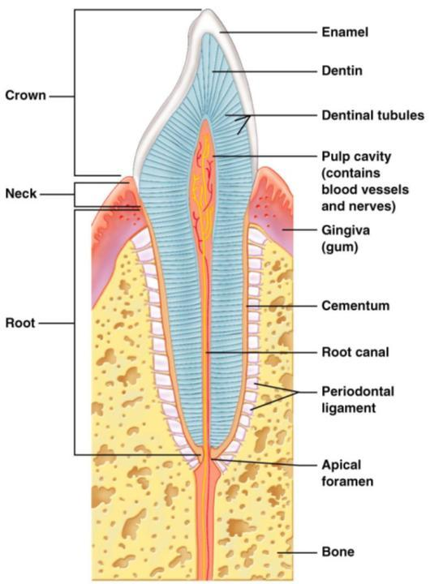

Slide 11
Tooth and Gum Disease
Dental _
gradual ___________________________ of enamel and dentin by bacterial action
Dental plaque adheres to teeth
a film of _
Acid from the bacteria dissolves calcium salts
Without calcium salts, organic matter is digested by _
Daily flossing and brushing help prevent caries by removing forming plaque

Slide 12
Tooth and Gum Disease: Periodontitis
Gingivitis
as plaque accumulates, it _
Accumulation of calculus:
________________________________ between the gingivae and the teeth
Puts the gums at risk for infection

Slide 13
Tooth and Gum Disease: Periodontitis
Periodontitis – serious gum disease resulting from an _
Immune system attacks intruders as well as body tissues, _

Slide 14
Pharynx
From the mouth, the oro- and laryngopharynx allow passage of:
Food and fluids to the _
________________________ to the trachea
Lined with _________________________ epithelium and _

Slide 15
Esophagus
_____________________________ going from the laryngopharynx to the stomach
Travels through the _
Joins the stomach at the cardiac orifice

Slide 16
Esophageal Characteristics
Esophageal mucosa
nonkeratinized stratified squamous epithelium
Glands secrete mucus as a____________ moves through the esophagus
Muscle changes from ______________________ (superiorly) to ______________________ (inferiorly)

Slide 17
Digestive Processes in the Mouth
Food is ingested
________________________ digestion begins (chewing)
_____________________________ is initiated by swallowing
_________________________________ begins chemical breakdown of starch

Slide 18
Deglutition (Swallowing)
Coordinated activity of the tongue, soft palate, pharynx, esophagus, and 22 separate muscle groups
bolus is forced into the _

Slide 19
Deglutition (Swallowing)
controlled by the _
All routes except into the digestive tract are sealed off
Peristalsis moves food through the pharynx to the esophagus

Slide 20
Stomach
Chemical breakdown of ___________________ and food is _
surrounds the cardiac orifice
dome-shaped region beneath the diaphragm
midportion of the stomach
made up of the antrum and canal which terminates at the pylorus
The pylorus is __________________________________________ through the pyloric sphincter

Slide 21
Stomach
Greater curvature
entire extent of the _
Lesser curvature
concave _
Lesser omentum
runs from the _
Greater omentum
drapes inferiorly from the _

Slide 22
Stomach
sympathetic and parasympathetic fibers of the autonomic nervous system
Blood supply
_______________________________, and corresponding veins (part of the hepatic portal system)

Slide 23
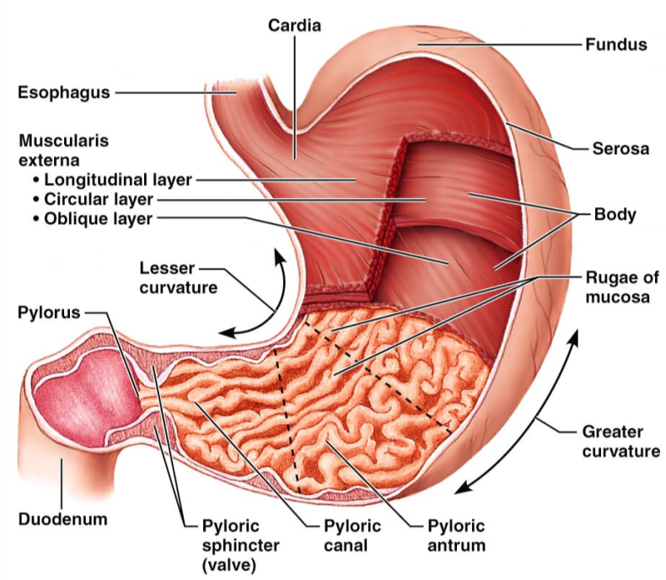
Figure 23.14a

Slide 24
Microscopic Anatomy of the Stomach
Epithelial lining is composed of:
____________________________ that produce a coat of alkaline mucus
The mucous surface layer traps a bicarbonate-rich fluid beneath it
________________________ contain gastric glands that secrete _

Slide 25
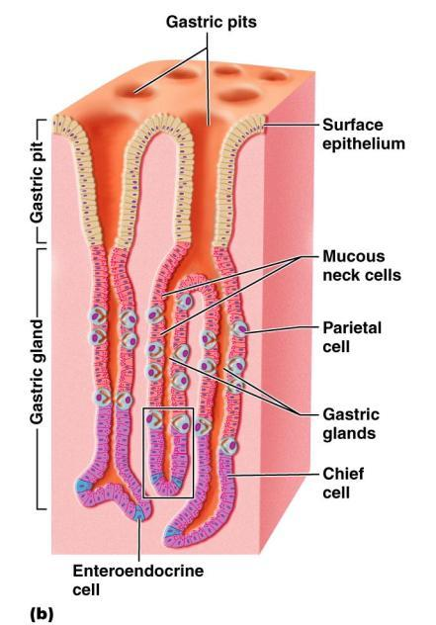
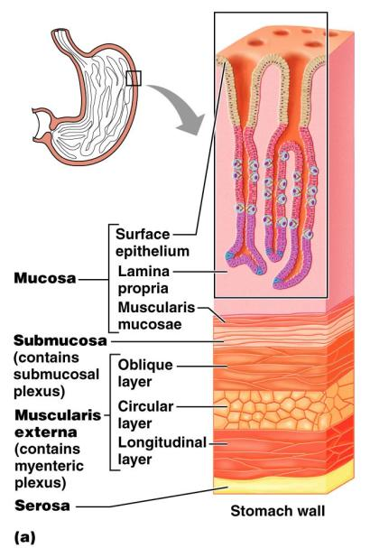
Anatomy of the Stomach
Figure 23.15a

Slide 26
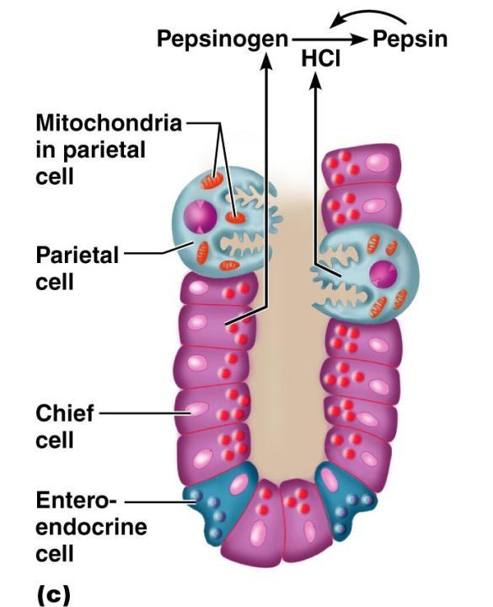
Microscopic Anatomy of the Stomach
Figure 23.15c

Slide 27
Glands of the Stomach Fundus and Body
Gastric glands of the fundus and body have a variety of secretory cells
secrete _
Parietal cells

Slide 28
Glands of the Stomach Fundus and Body
Chief cells
produce _
Pepsinogen is activated to pepsin by:
__________________________________ itself via a positive feedback mechanism
Enteroendocrine cells
secrete gastrin, histamine, endorphins, serotonin, cholecystokinin (CCK), and somatostatin into the lamina propria

