Slide 1
Digestion in the Stomach
The stomach:
______________ ingested food
Degrades this food both physically and chemically
____________________________ to the small intestine
Enzymatically _
Secretes ______________________________ required for absorption of vitamin B₁₂

Slide 2
Regulation of Gastric Secretion
release of gastric juices
_________________________ (reflex) phase:
prior to food entry
_________________________ phase:
once food enters the stomach
__________________________ phase:
as partially digested food enters the duodenum

Slide 3
Cephalic Phase
Excitatory events include:
Stimulation of taste or smell receptors
Inhibitory events include:
Loss of appetite or _
____________________________ in stimulation of the _

Slide 4
Gastric Phase
Excitatory events include:
Activation of stretch receptors
Activation of ____________________________ by peptides, caffeine, and rising pH
Release of ____________________________ to the blood

Slide 5
Gastric Phase
Inhibitory events include:
A pH _
____________________________________ that overrides the parasympathetic division

Slide 6
Intestinal Phase
Excitatory phase
low pH; partially digested food enters the duodenum and _
Inhibitory phase
distension of duodenum, __________________________________, acidic, or hypertonic chyme, and/or irritants in the duodenum
Closes the _
Releases hormones that _

Slide 7
Regulation and Mechanism of HCl Secretion
HCl secretion is stimulated by
_______________________________ through second-messenger systems
Antihistamines block H₂ receptors and _

Slide 8
Response of the Stomach to Filling
Reflex-mediated events include:
as food travels in the esophagus, stomach muscles relax
the stomach dilates in response to gastric filling
Plasticity
the ability to be _

Slide 9
Gastric Contractile Activity
Most vigorous peristalsis and mixing occurs near the pylorus
Chyme is either:
Delivered in _ or
Forced ________________________________ for further mixing

Slide 10
Regulation of Gastric Emptying
Gastric emptying is regulated by:
The neural _
Hormonal (enterogastrone) mechanisms
These mechanisms _______________________________ and duodenal filling

Slide 11
Regulation of Gastric Emptying
______________________-rich chyme
____________________________ moves through the duodenum
_________________-laden chyme
digested ___________________________ causing food to remain in the stomach longer

Slide 12
Small Intestine: Gross Anatomy
Runs from pyloric sphincter to the ileocecal valve
Has three subdivisions:

Slide 13
Small Intestine: Gross Anatomy
The _
Join the duodenum at the hepatopancreatic ampulla
Are controlled by the _
The jejunum extends from the duodenum to the ileum
The ileum joins the large intestine at the __

Slide 14
Small Intestine: Microscopic Anatomy
Structural modifications of the small intestine wall increase surface area
Plicae circulares: deep __________________________ of the mucosa and submucosa
Villi
fingerlike _
tiny projections of absorptive mucosal cells’ plasma membranes

Slide 15
Small Intestine: Histology of the Wall
Cells of ___________________________ secrete intestinal juice
_______________________________ are found in the submucosa
Brunner’s glands in the duodenum secrete _

Slide 16
Intestinal Juice
Secreted by intestinal glands _
Slightly alkaline
Largely water,
enzyme-poor, but _

Slide 17
Liver
The _________________________ in the body
Superficially has _
right, left, caudate, and quadrate
The _
Is a remnant of the fetal _

Slide 18
Liver: Associated Structures
The lesser omentum _
The ______________________________ rests in a recess on the inferior surface of the right lobe

Slide 19
Liver: Associated Structures
Bile leaves the liver via:
Bile ducts,
which fuse into the common hepatic duct
The common hepatic duct,
which fuses with the cystic duct
___________________________________ form the bile duct

Slide 20
Composition of Bile
A yellow-green, alkaline solution containing
neutral fats,
phospholipids,
electrolytes
Bile salts are cholesterol derivatives that:
Facilitate fat and cholesterol absorption
Help solubilize cholesterol

Slide 21
Bile
Enterohepatic circulation _
The chief bile ______________________ is bilirubin
waste product of _

Slide 22
The Gallbladder
Thin-walled, green ___________________________ on the ventral surface of the liver
via the cystic duct
flows into the bile duct

Slide 23
Regulation of Bile Release
Acidic, _________________________ causes the duodenum to release:
Cholecystokinin (CCK)
into the _

Slide 24
Regulation of Bile Release
Cholecystokinin causes:
The _
The hepatopancreatic _
As a result, bile _

Slide 25
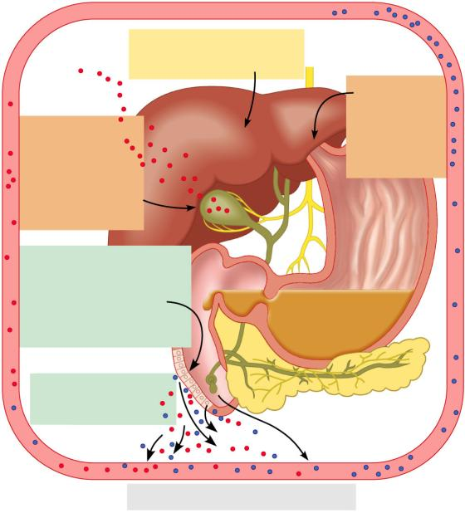
4
Vagal stimulation causes
weak contractions of
gallbladder
3
Bile salts
and secretin
transported via
bloodstream
stimulate liver
to produce bile
more rapidly
5
Cholecystokinin
(via bloodstream)
causes gallbladder
to contract and
hepatopancreatic
sphincter to relax;
bile enters
duodenum
Acidic, fatty chyme
entering duodenum causes
release of cholecystokinin
and secretin from
duodenal wall
enteroendocrine cells
1
Cholecystokinin
and secretin enter the
bloodstream
2
6
Bile salts reabsorbed into blood
Figure 23.25

Slide 26
Pancreas
Location
Lies deep to the greater curvature of the stomach
The _______________________________________ and the tail is near _

Slide 27
Pancreas
Exocrine function
Acini (clusters of secretory cells) contain _________________________________ with digestive enzymes
The pancreas also has an _
release of _

Slide 28
Composition and Function of Pancreatic Juice
Water solution of _ (primarily HCO₃–)
___________________________ acid chyme
Provides _______________________________ for pancreatic enzymes
Enzymes are released in _______________________________ and activated in the duodenum

Slide 29
Composition and Function of Pancreatic Juice
Examples include
__________________________ is activated to trypsin
Procarboxypeptidase is activated to _
Active enzymes secreted
Amylase, lipases, and nucleases
These enzymes require ___________________ for optimal activity

Slide 30
Regulation of Pancreatic Secretion
CCK and secretin enter the bloodstream when fatty or acidic chyme enters the duodenum
Upon reaching the _
CCK causes secretion
Secretin causes secretion
Vagal stimulation also causes release of pancreatic juice

Slide 31
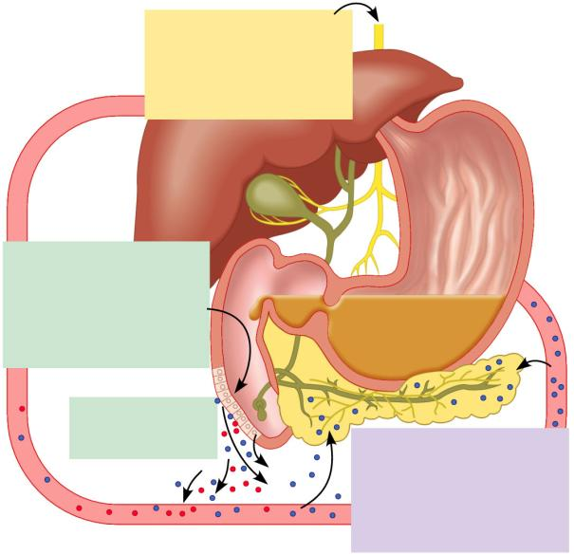
Regulation of Pancreatic Secretion
During cephalic and gastric
phases, stimulation by
vagal nerve fibers causes
release of pancreatic juice
and weak contractions of
the gallbladder.
1
Acidic chyme entering
duodenum causes the
enteroendocrine cells of
the duodenal wall to release
secretin, whereas fatty,
protein-rich chyme induces
release of cholecystokinin.
Cholecystokinin
and secretin enter
bloodstream.
2
3
Upon reaching the
pancreas, cholecystokinin
induces the secretion of
enzyme-rich pancreatic juice;
secretin causes copious
secretion of bicarbonate-rich
pancreatic juice.
Figure 23.28

Slide 32
Digestion in the Small Intestine
As chyme enters the duodenum:
Carbohydrates and proteins are only partially digested

Slide 33
Digestion in the Small Intestine
Digestion continues in the small intestine
Chyme is ____________________________ into the duodenum
Because it is hypertonic and has low pH, _
Virtually ____________________________________ takes place in the small intestine

