Slide 1
Motility in the Small Intestine
The most common motion of the small intestine is _
It is initiated by _ (Cajal cells)
Moves contents steadily toward the _

Slide 2
Motility in the Small Intestine
After nutrients have been absorbed:
Peristalsis begins with each wave starting distal to the previous
Meal remnants, bacteria, mucosal cells, and debris are _

Slide 3
Control of Motility
Local enteric neurons of the GI tract coordinate intestinal motility
_________________________________ cause:
Contraction and shortening of the _
Shortening of _
Distension of the intestine

Slide 4
Control of Motility
Other impulses relax the circular muscle
The
Relax the _
Allow chyme to pass into the large intestine

Slide 5
Large Intestine
Has three unique features:
three bands of longitudinal smooth muscle in its muscularis
pocketlike sacs caused by the tone of the teniae coli
Epiploic appendages

Slide 6
Large Intestine
Is subdivided into the
The saclike cecum:
Lies below the ileocecal valve in the right iliac fossa
Contains a wormlike vermiform appendix

Slide 7
Colon
Has distinct regions: ascending colon, hepatic flexure, transverse colon, splenic flexure, descending colon, and sigmoid colon
The _________________________ joins the _
The _____________________________ opens to the exterior _

Slide 8
Sphincters of the Anus
The anus has ____________ sphincters:
__________________ anal sphincter
composed of _________________________ muscle
__________________ anal sphincter
composed of _________________________ muscle
These sphincters are closed _

Slide 9
Large Intestine: Microscopic Anatomy
Colon mucosa is _____________________________ epithelium except in the anal canal
Has numerous deep ________________ lined with _

Slide 10
Large Intestine: Microscopic Anatomy
Anal canal mucosa is _
Anal sinuses _
Superficial venous plexuses are associated with the anal canal
Inflammation of these veins results in itchy varicosities called _

Slide 11
Bacterial Flora
The _______________________ of the large intestine consist of:
Bacteria surviving the small intestine that enter the cecum and
Those entering via the anus
These bacteria:
Release irritating acids and _
Synthesize ___________________________ and vitamin K

Slide 12
Functions of the Large Intestine
Other than digestion of enteric bacteria, _
Vitamins, water, and electrolytes _
Its major function is _________________________________ toward the anus
Though essential for comfort, the colon is _

Slide 13
Motility of the Large Intestine
Slow segmenting movements that move the contents of the colon
contract as they are _
Presence of _
Activates the _
Initiates peristalsis that _

Slide 14
Defecation
_____________________ of rectal walls caused by feces:
_____________________________ of the rectal walls
Relaxes the ________________ anal sphincter
Voluntary signals stimulate relaxation of the external anal sphincter and defecation occurs

Slide 15
Chemical Digestion: Carbohydrates
Absorption:
Enter the _
Transported to the ____________via the _______________________________
Enzymes used:
_______________________ amylase,
_______________________ amylase,

Slide 16
Chemical Digestion: Proteins
Absorption: similar to carbohydrates
Enzymes in the stomach
Enzymes in the _
_______________________________ – trypsin, chymotrypsin, and carboxypeptidase
_______________________________ – aminopeptidases, carboxypeptidases, and dipeptidases

Slide 17
Chemical Digestion: Fats
Absorption: Diffusion into intestinal cells where they:
Enter __________________________ and are transported to systemic circulation _

Slide 18
Chemical Digestion: Fats
Glycerol and short chain fatty acids are:
Absorbed into the _
Transported via the _
Enzymes/chemicals used:
bile salts

Slide 19
Chemical Digestion: Nucleic Acids
Absorption: ______________________ via membrane carriers
Absorbed in villi
transported to liver via hepatic portal vein
Enzymes used:
pancreatic ribonucleases and deoxyribonuclease in the small intestines

Slide 20
Malabsorption of Nutrients
Results from anything that
interferes with _
______________________________ the intestinal mucosa (e.g., bacterial infection)

Slide 21
Malabsorption of Nutrients
Gluten enteropathy _
_________________________ damages the intestinal villi
reduces the _
Treated by eliminating gluten from the diet (all grains but rice and corn)

Slide 22
Cancer
Stomach and colon cancers _________________________________ or symptoms
Metastasized _____________________ frequently cause _
Prevention is by regular dental and medical examinations

Slide 23
Cancer
_____________________________ is the 2nd largest cause of cancer deaths in males
(__________________________ is 1st)
Forms from benign mucosal tumors
formation increases with age
Regular colon examination should be done for _

Slide 24
Kidney Functions
Filter 200 liters ________________ daily, allowing toxins, metabolic wastes, and excess ions to leave the body in urine
_____________________________ and chemical makeup of the blood
Maintain the _____________________ between water and salts, and acids and bases

Slide 25
Other Renal Functions
____________________________ during prolonged fasting
Production of __________________ to help ____________________________ and ______________________________ to stimulate _______________ production
Activation of vitamin D

Slide 26
Other Urinary System Organs
provides a temporary storage reservoir for urine
Paired ureters
transport urine from _
Urethra
transports urine from the _

Slide 27
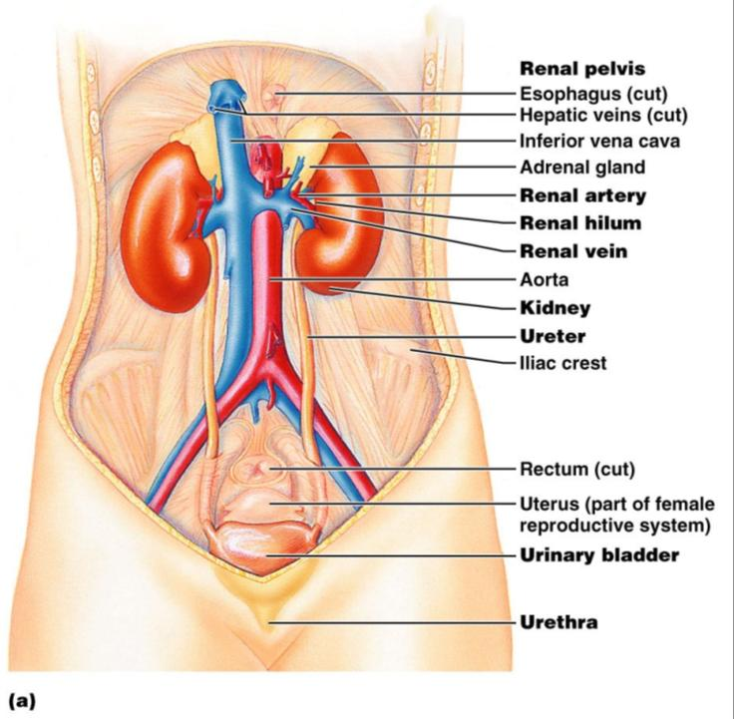
Figure 25.1a

Slide 28
Layers of Tissue Supporting the Kidney
fibrous capsule that prevents kidney infection
Adipose capsule
_______________________ that cushions the kidney and helps _________________ to the body wall
Renal fascia
outer layer of ________________________________ that anchors the kidney

Slide 29
Internal Anatomy (Frontal Section)
the light colored, __________________________ superficial region
Medulla
exhibits cone-shaped _________________________ separated by columns
The medullary pyramid and its surrounding capsule constitute a lobe
flat funnel shaped tube lateral to the hilus within the renal sinus

Slide 30
Internal Anatomy
Major calyces
large ______________________________ of the renal pelvis
_____________________________ draining from papillae
Empty urine into the pelvis
Urine flows through the _

