Slide 1
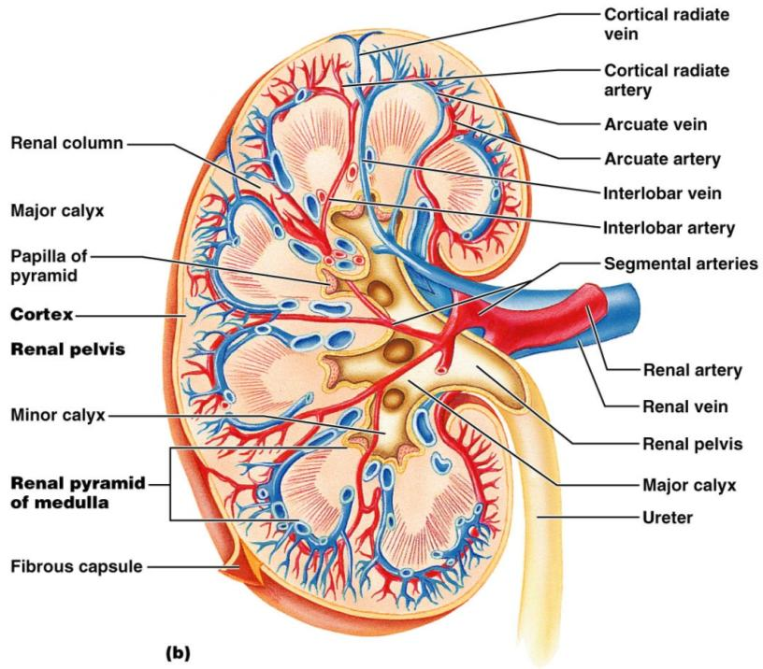
Figure 25.3b

Slide 2
Renal Vascular Pathway
Figure 25.3c

Slide 3
The Nephron
________________________ are the structural and functional units that form urine, consisting of:
Glomerulus
a tuft of ________________________________ associated with a _
Glomerular (Bowman’s) capsule
blind, ___________________________________ that completely surrounds the glomerulus

Slide 4
The Nephron
Renal _
the glomerulus and its Bowman’s capsule
______________________ epithelium that allows solute-rich, _________________________________ to pass from the blood into the glomerular capsule

Slide 5
Renal Tubule
Proximal convoluted tubule (PCT) –
composed of cuboidal cells with numerous _
____________________________ and solutes from filtrate and secretes substances into it

Slide 6
Renal Tubule
a hairpin-shaped loop of the renal tubule
Distal convoluted tubule (DCT)
cuboidal cells without microvilli that _

Slide 7
Nephrons
85% of nephrons; located in the cortex
Juxtamedullary nephrons:
Are located at the cortex-medulla junction
Have loops of Henle that _
Are involved in the production of _

Slide 8
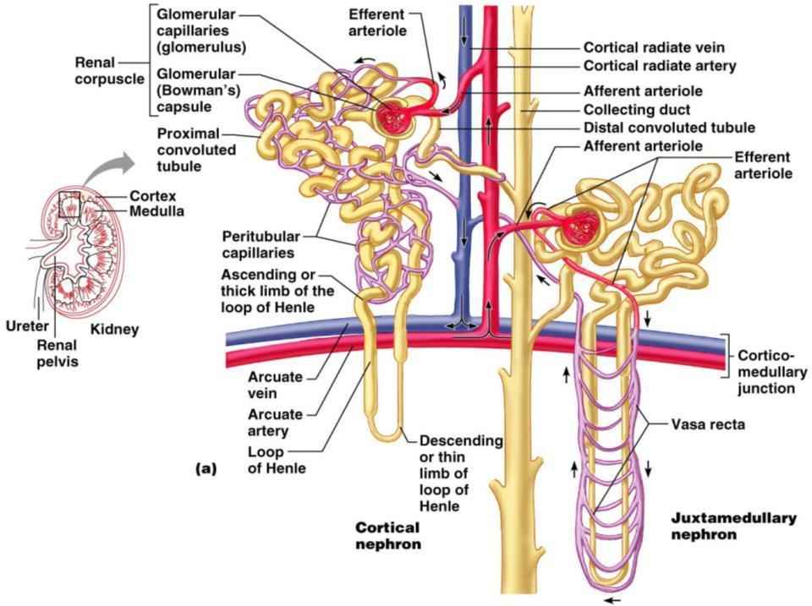
Figure 25.5a

Slide 9
Capillary Beds of the Nephron
Every nephron has _________ capillary beds
Each glomerulus is:
Fed by an _
Drained by an _

Slide 10
Capillary Beds of the Nephron
Blood pressure in the glomerulus is high because:
Arterioles are high-resistance vessels
Afferent arterioles _____________________ than efferent arterioles
Fluids and solutes are forced out of the blood throughout the entire length of the glomerulus

Slide 11
Capillary Beds
Peritubular beds are _____________________, porous capillaries ____________________ that:
Arise from efferent arterioles
Cling to adjacent renal tubules
Empty into the renal venous system
Vasa recta
long, straight _

Slide 12
Juxtaglomerular Apparatus (JGA)
Where the distal tubule lies against the afferent (sometimes efferent) arteriole
Arteriole walls have juxtaglomerular (JG) cells
Enlarged, _
Have _
Act as _

Slide 13
Juxtaglomerular Apparatus (JGA)
Tall, closely packed distal tubule cells
Lie adjacent to _
Function as chemoreceptors or osmoreceptors
Mesanglial cells:
Have ______________________________ properties
Influence capillary _

Slide 14
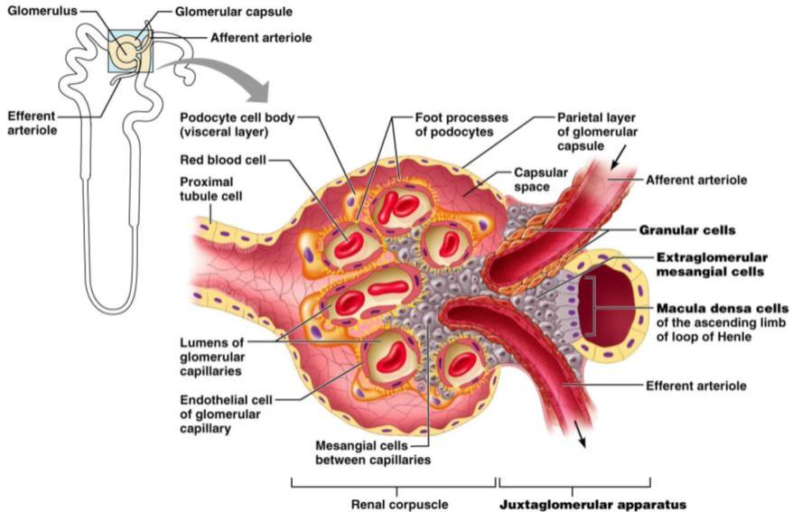
Juxtaglomerular Apparatus (JGA)
Figure 25.6

Slide 15
Mechanisms of Urine Formation
The kidneys filter the body’s _
The filtrate:
Contains all plasma components _
Loses water, nutrients, and essential ions to become urine
The urine contains _

Slide 16
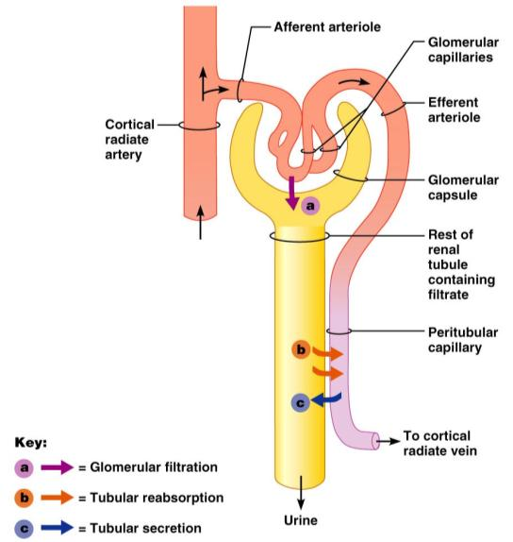
Mechanisms of Urine Formation
Urine formation and adjustment of blood composition involves three major processes
Figure 25.8

Slide 17
Glomerular Filtration
The _________________________ is more efficient than other capillary beds because:
Its filtration membrane is _
Glomerular _
It has a higher _

Slide 18
Glomerular Filtration Rate (GFR)
The total amount of filtrate formed per minute by the kidneys
Factors governing filtration rate at the capillary bed are:
Total _________________________ available for filtration
Filtration membrane _

Slide 19
Glomerular Filtration Rate (GFR)
GFR is ___________________________ to the NFP
Changes in GFR normally result from changes in _

Slide 20
Regulation of Glomerular Filtration
If the GFR is too high:
Needed substances _
If the GFR is too low:
____________________________________, including wastes that are normally disposed of

Slide 21
Regulation of Glomerular Filtration
Three mechanisms control the GFR
Renal autoregulation _
Neural controls
Hormonal mechanism (the __________________________________ system)

Slide 22
Intrinsic Controls
Under normal conditions, renal autoregulation maintains a _____________________________ glomerular filtration rate

Slide 23
Extrinsic Controls
When the _________________________ nervous system is at ________________:
Renal blood vessels are _
Autoregulation mechanisms prevail

Slide 24
Extrinsic Controls
Under stress:
_______________________ is released by the sympathetic nervous system
_______________________ is released by the _
___________________________________ and filtration is inhibited
The sympathetic nervous system also stimulates the renin-angiotensin mechanism

Slide 25
Renin-Angiotensin Mechanism
Is triggered when the JG cells release renin
Renin acts on ___________________________ to release _
Angiotensin I is converted to angiotensin_
Angiotensin II:
Causes mean _
Stimulates the adrenal cortex to release _
As a result, both systemic and glomerular hydrostatic pressure rise

Slide 26
Renin Release
Renin release is triggered by:
___________________________ of the granular JG cells
Stimulation of the JG cells by _
Direct stimulation of the JG cells by _
Angiotensin _

