Slide 1
Tubular Reabsorption
All ______________________________ are reabsorbed
Water and ion reabsorption is _________________________ controlled
Reabsorption may be an active (requiring ATP) or passive process

Slide 2
Nonreabsorbed Substances
A ___________________________ (T_{m}):
Reflects the number of _______________ in the renal tubules available
Exists for nearly every substance _
When the carriers are ______________________, excess of that substance _

Slide 3
Nonreabsorbed Substances
Substances are not reabsorbed if they:
Are _
Are too large to pass through membrane pores
Urea, creatinine, and uric acid are the most important nonreabsorbed substances

Slide 4
Atrial Natriuretic Peptide Activity
ANP _
_________________________ blood volume
Lowers blood pressure
ANP lowers blood Na⁺ by:
Acting directly on medullary ducts to _
Counteracting the effects of _
Indirectly stimulating an increase in GFR reducing water reabsorption

Slide 5
Tubular Secretion
Essentially reabsorption in reverse,
substances move from peritubular capillaries or tubule cells _
Tubular secretion is important for:
Disposing of substances not already in the filtrate
Eliminating undesirable substances such as _
Ridding the body of excess _
Controlling blood _

Slide 6
Formation of Dilute Urine
Filtrate is diluted in the ascending loop of Henle
Dilute urine is created by allowing this filtrate to continue into the renal pelvis
This will happen as long as _

Slide 7
Formation of Dilute Urine
Collecting ducts remain _
no further water reabsorption occurs
Sodium and selected ions can be removed by active and passive mechanisms

Slide 8
Formation of Concentrated Urine
Antidiuretic hormone (ADH) _
This equalizes the osmolality of the filtrate and the interstitial fluid
In the presence of ADH, _

Slide 9
Formation of Concentrated Urine
ADH-dependent water reabsorption is called _
ADH is the signal to produce _
The kidneys’ ability to respond depends upon the high medullary osmotic gradient

Slide 10
Diuretics
Chemicals that enhance the urinary output include:
Any substance _
Substances that exceed the ability of the renal tubules to reabsorb it
Substances that _

Slide 11
Diuretics
Osmotic diuretics include:
High _
carries water out with the glucose
Alcohol
Caffeine and most diuretic drugs
_______________________ and Diuril
inhibit Na⁺-associated symporters

Slide 12
Ureters
Slender tubes that _
Ureters enter the _
This closes their distal ends as bladder pressure increases and prevents backflow of urine into the ureters

Slide 13
Ureters
Ureters have a _
Transitional epithelial mucosa
Smooth muscle muscularis
Fibrous connective tissue adventitia
Ureters ___________________________ via response to smooth muscle stretch

Slide 14
Urinary Bladder
Smooth, collapsible, muscular sac that stores urine
It lies retroperitoneally on the pelvic floor _
Males
Females
triangular area outlined by the openings for the ureters and the urethra
Clinically important because _

Slide 15
Urinary Bladder
The bladder wall has three layers
A _
A _
The bladder is distensible and collapses when empty
As urine accumulates, the bladder expands without significant rise in internal pressure

Slide 16
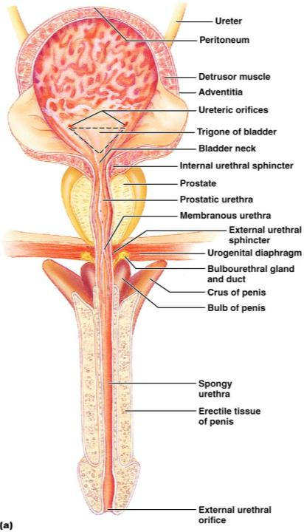
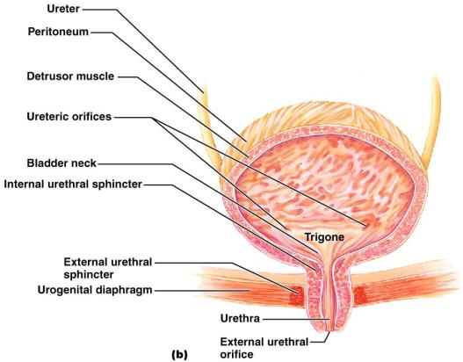
Urinary Bladder

Slide 17
Urethra
Muscular tube that:
Drains _
Conveys it out of the body

Slide 18
Urethra
Sphincters keep the urethra closed when urine is not being passed
____________________ urethral sphincter
__________________________ sphincter at the bladder-urethra junction
____________________ urethral sphincter
__________________________ sphincter surrounding the urethra as it passes through the urogenital diaphragm
Levator ani muscle

Slide 19
Urethra
The female urethra is _
Its external opening lies _
The male urethra has three named regions
Prostatic urethra
Membranous urethra
runs through _
passes through the penis and opens via the _

Slide 20
Micturition (Voiding or Urination)
The act of emptying the bladder
Distension of bladder walls initiates spinal reflexes that:
Stimulate contraction of the _
Inhibit the ____________________________ and internal sphincter (temporarily)
Voiding reflexes:
Stimulate the _
Inhibit the _

