Slide 1
Tooth and Gum Disease: Periodontitis
Gingivitis
as plaque accumulates, it _
Accumulation of calculus:
________________________________ between the gingivae and the teeth
Puts the gums at risk for infection

Slide 2
Tooth and Gum Disease: Periodontitis
Periodontitis – serious gum disease resulting from an _
Immune system attacks intruders as well as body tissues, _

Slide 3
Pharynx
From the mouth, the oro- and laryngopharynx allow passage of:
Food and fluids to the _
________________________ to the trachea
Lined with _________________________ epithelium and _

Slide 4
Esophagus
_____________________________ going from the laryngopharynx to the stomach
Travels through the _
Joins the stomach at the cardiac orifice

Slide 5
Esophageal Characteristics
Esophageal mucosa
nonkeratinized stratified squamous epithelium
Glands secrete mucus as a____________ moves through the esophagus
Muscle changes from ______________________ (superiorly) to ______________________ (inferiorly)

Slide 6
Digestive Processes in the Mouth
Food is ingested
________________________ digestion begins (chewing)
_____________________________ is initiated by swallowing
_________________________________ begins chemical breakdown of starch

Slide 7
Deglutition (Swallowing)
Coordinated activity of the tongue, soft palate, pharynx, esophagus, and 22 separate muscle groups
bolus is forced into the _

Slide 8
Deglutition (Swallowing)
controlled by the _
All routes except into the digestive tract are sealed off
Peristalsis moves food through the pharynx to the esophagus

Slide 9
Stomach
Chemical breakdown of ___________________ and food is _
surrounds the cardiac orifice
dome-shaped region beneath the diaphragm
midportion of the stomach
made up of the antrum and canal which terminates at the pylorus
The pylorus is __________________________________________ through the pyloric sphincter

Slide 10
Stomach
Greater curvature
entire extent of the _
Lesser curvature
concave _
Lesser omentum
runs from the _
Greater omentum
drapes inferiorly from the _

Slide 11
Stomach
sympathetic and parasympathetic fibers of the autonomic nervous system
Blood supply
_______________________________, and corresponding veins (part of the hepatic portal system)

Slide 12
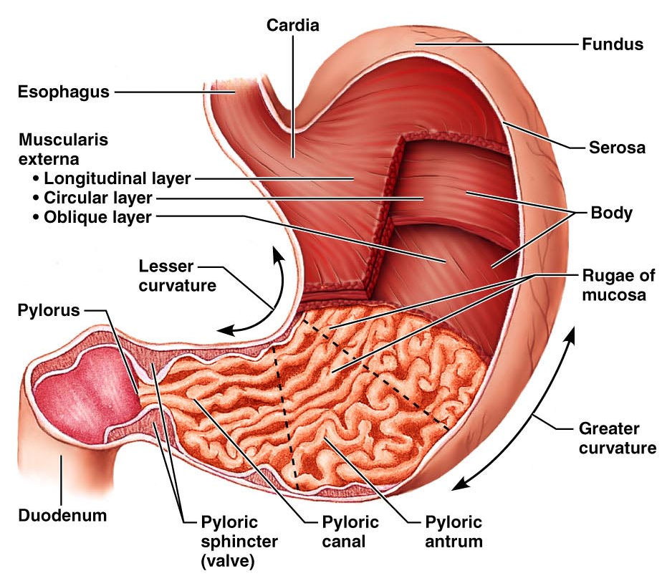
Figure 23.14a

Slide 13
Microscopic Anatomy of the Stomach
Epithelial lining is composed of:
____________________________ that produce a coat of alkaline mucus
The mucous surface layer traps a bicarbonate-rich fluid beneath it
________________________ contain gastric glands that secrete _

Slide 14
Glands of the Stomach Fundus and Body
Gastric glands of the fundus and body have a variety of secretory cells
secrete _
Parietal cells

Slide 15
Glands of the Stomach Fundus and Body
Chief cells
produce _
Pepsinogen is activated to pepsin by:
__________________________________ itself via a positive feedback mechanism
Enteroendocrine cells
secrete gastrin, histamine, endorphins, serotonin, cholecystokinin (CCK), and somatostatin into the lamina propria

Slide 16
Digestion in the Stomach
The stomach:
______________ ingested food
Degrades this food both physically and chemically
____________________________ to the small intestine
Enzymatically _
Secretes ______________________________ required for absorption of vitamin B₁₂

Slide 17
Regulation of Gastric Secretion
release of gastric juices
_________________________ (reflex) phase:
prior to food entry
_________________________ phase:
once food enters the stomach
__________________________ phase:
as partially digested food enters the duodenum

Slide 18
Cephalic Phase
Excitatory events include:
Stimulation of taste or smell receptors
Inhibitory events include:
Loss of appetite or _
____________________________ in stimulation of the _

Slide 19
Gastric Phase
Excitatory events include:
Activation of stretch receptors
Activation of ____________________________ by peptides, caffeine, and rising pH
Release of ____________________________ to the blood

Slide 20
Gastric Phase
Inhibitory events include:
A pH _
____________________________________ that overrides the parasympathetic division

Slide 21
Intestinal Phase
Excitatory phase
low pH; partially digested food enters the duodenum and _
Inhibitory phase
distension of duodenum, __________________________________, acidic, or hypertonic chyme, and/or irritants in the duodenum
Closes the _
Releases hormones that _

Slide 22
Regulation and Mechanism of HCl Secretion
HCl secretion is stimulated by
_______________________________ through second-messenger systems
Antihistamines block H₂ receptors and _

Slide 23
Response of the Stomach to Filling
Reflex-mediated events include:
as food travels in the esophagus, stomach muscles relax
the stomach dilates in response to gastric filling
Plasticity
the ability to be _

Slide 24
Gastric Contractile Activity
Most vigorous peristalsis and mixing occurs near the pylorus
Chyme is either:
Delivered in _ or
Forced ________________________________ for further mixing

Slide 25
Regulation of Gastric Emptying
Gastric emptying is regulated by:
The neural _
Hormonal (enterogastrone) mechanisms
These mechanisms _______________________________ and duodenal filling

Slide 26
Regulation of Gastric Emptying
______________________-rich chyme
____________________________ moves through the duodenum
_________________-laden chyme
digested ___________________________ causing food to remain in the stomach longer

Slide 27
Small Intestine: Gross Anatomy
Runs from pyloric sphincter to the ileocecal valve
Has three subdivisions:

Slide 28
Small Intestine: Gross Anatomy
The _
Join the duodenum at the hepatopancreatic ampulla
Are controlled by the _
The jejunum extends from the duodenum to the ileum
The ileum joins the large intestine at the __

Slide 29
Small Intestine: Microscopic Anatomy
Structural modifications of the small intestine wall increase surface area
Plicae circulares: deep __________________________ of the mucosa and submucosa
Villi
fingerlike _
tiny projections of absorptive mucosal cells’ plasma membranes

Slide 30
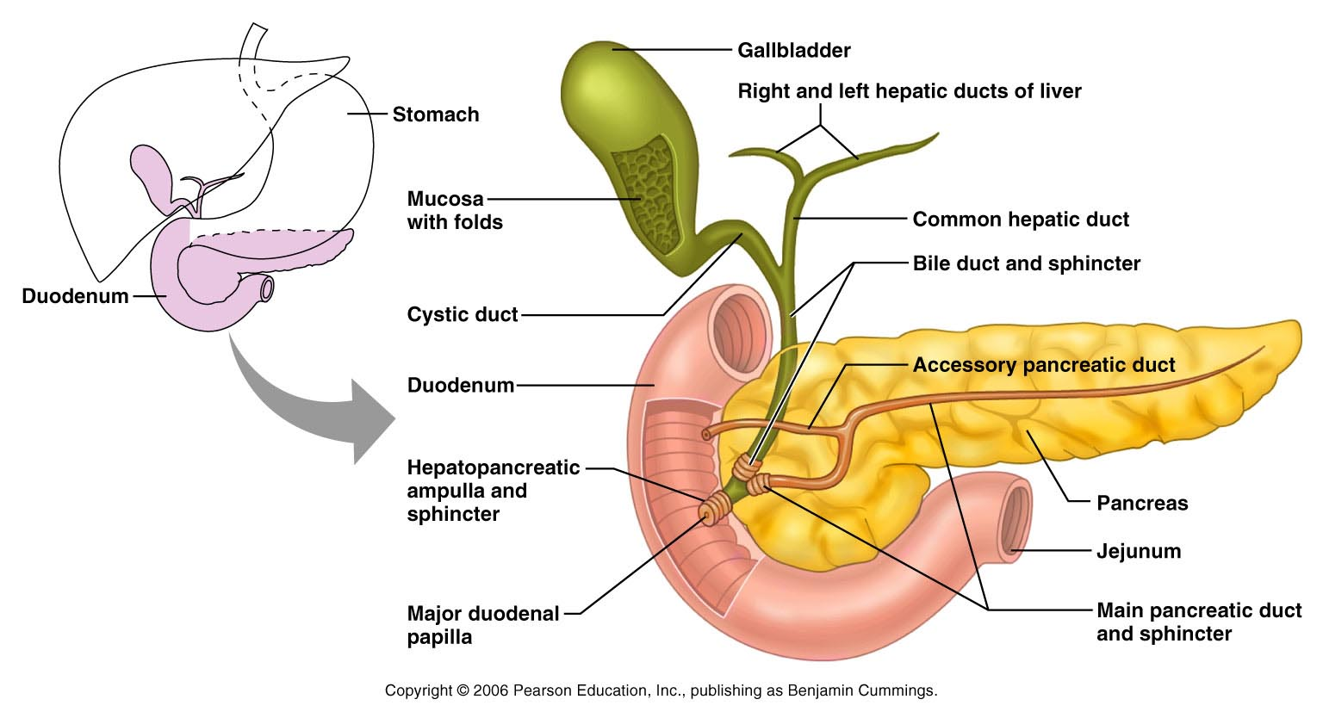
Duodenum and Related Organs
Figure 23.20

Slide 31
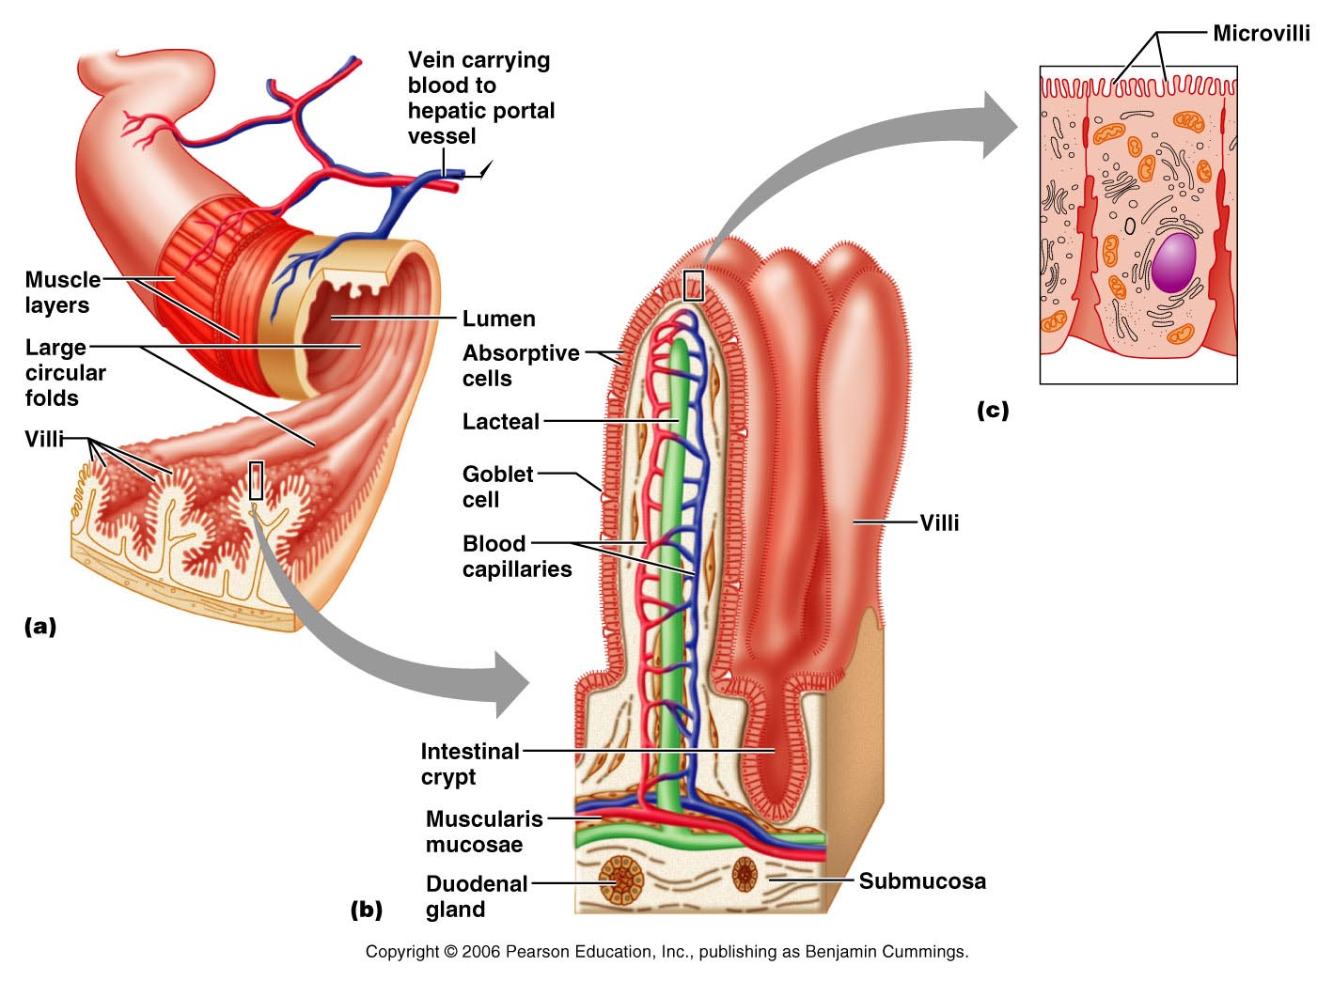
Figure 23.21

Slide 32
Small Intestine: Histology of the Wall
Cells of ___________________________ secrete intestinal juice
_______________________________ are found in the submucosa
Brunner’s glands in the duodenum secrete _

Slide 33
Intestinal Juice
Secreted by intestinal glands _
Slightly alkaline
Largely water,
enzyme-poor, but _

Slide 34
Liver
The _________________________ in the body
Superficially has _
right, left, caudate, and quadrate
The _
Is a remnant of the fetal _

Slide 35
Liver: Associated Structures
The lesser omentum _
The ______________________________ rests in a recess on the inferior surface of the right lobe

Slide 36
Liver: Associated Structures
Bile leaves the liver via:
Bile ducts,
which fuse into the common hepatic duct
The common hepatic duct,
which fuses with the cystic duct
___________________________________ form the bile duct

Slide 37
Composition of Bile
A yellow-green, alkaline solution containing
neutral fats,
phospholipids,
electrolytes
Bile salts are cholesterol derivatives that:
Facilitate fat and cholesterol absorption
Help solubilize cholesterol

Slide 38
Bile
Enterohepatic circulation _
The chief bile ______________________ is bilirubin
waste product of _

Slide 39
The Gallbladder
Thin-walled, green ___________________________ on the ventral surface of the liver
via the cystic duct
flows into the bile duct

Slide 40
Regulation of Bile Release
Acidic, _________________________ causes the duodenum to release:
Cholecystokinin (CCK)
into the _

Slide 41
Regulation of Bile Release
Cholecystokinin causes:
The _
The hepatopancreatic _
As a result, bile _

Slide 42
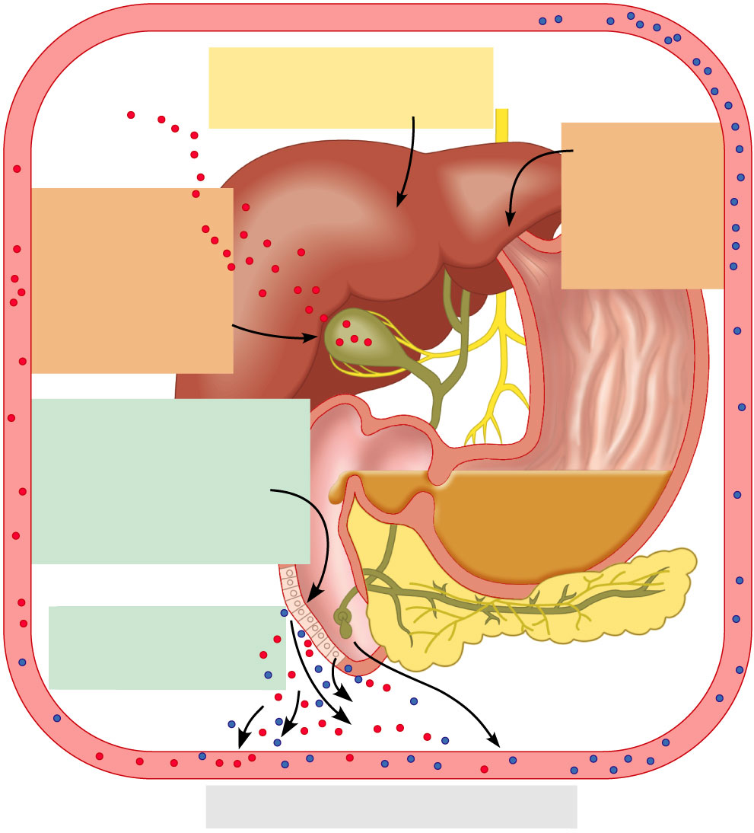
4
Vagal stimulation causes
weak contractions of
gallbladder
3
Bile salts
and secretin
transported via
bloodstream
stimulate liver
to produce bile
more rapidly
5
Cholecystokinin
(via bloodstream)
causes gallbladder
to contract and
hepatopancreatic
sphincter to relax;
bile enters
duodenum
Acidic, fatty chyme
entering duodenum causes
release of cholecystokinin
and secretin from
duodenal wall
enteroendocrine cells
1
Cholecystokinin
and secretin enter the
bloodstream
2
6
Bile salts reabsorbed into blood
Figure 23.25

Slide 43
Pancreas
Location
Lies deep to the greater curvature of the stomach
The _______________________________________ and the tail is near _

