Slide 1
Pancreas
Exocrine function
Acini (clusters of secretory cells) contain _________________________________ with digestive enzymes
The pancreas also has an _
release of _

Slide 2
Composition and Function of Pancreatic Juice
Water solution of _ (primarily HCO₃–)
___________________________ acid chyme
Provides _______________________________ for pancreatic enzymes
Enzymes are released in _______________________________ and activated in the duodenum

Slide 3
Composition and Function of Pancreatic Juice
Examples include
__________________________ is activated to trypsin
Procarboxypeptidase is activated to _
Active enzymes secreted
Amylase, lipases, and nucleases
These enzymes require ___________________ for optimal activity

Slide 4
Regulation of Pancreatic Secretion
CCK and secretin enter the bloodstream when fatty or acidic chyme enters the duodenum
Upon reaching the _
CCK causes secretion
Secretin causes secretion
Vagal stimulation also causes release of pancreatic juice

Slide 5
Digestion in the Small Intestine
As chyme enters the duodenum:
Carbohydrates and proteins are only partially digested

Slide 6
Digestion in the Small Intestine
Digestion continues in the small intestine
Chyme is ____________________________ into the duodenum
Because it is hypertonic and has low pH, _
Virtually ____________________________________ takes place in the small intestine

Slide 7
Motility in the Small Intestine
The most common motion of the small intestine is _
It is initiated by _ (Cajal cells)
Moves contents steadily toward the _

Slide 8
Motility in the Small Intestine
After nutrients have been absorbed:
Peristalsis begins with each wave starting distal to the previous
Meal remnants, bacteria, mucosal cells, and debris are _

Slide 9
Control of Motility
Local enteric neurons of the GI tract coordinate intestinal motility
_________________________________ cause:
Contraction and shortening of the _
Shortening of _
Distension of the intestine

Slide 10
Control of Motility
Other impulses relax the circular muscle
The
Relax the _
Allow chyme to pass into the large intestine

Slide 11
Large Intestine
Has three unique features:
three bands of longitudinal smooth muscle in its muscularis
pocketlike sacs caused by the tone of the teniae coli
Epiploic appendages

Slide 12
Large Intestine
Is subdivided into the
The saclike cecum:
Lies below the ileocecal valve in the right iliac fossa
Contains a wormlike vermiform appendix

Slide 13
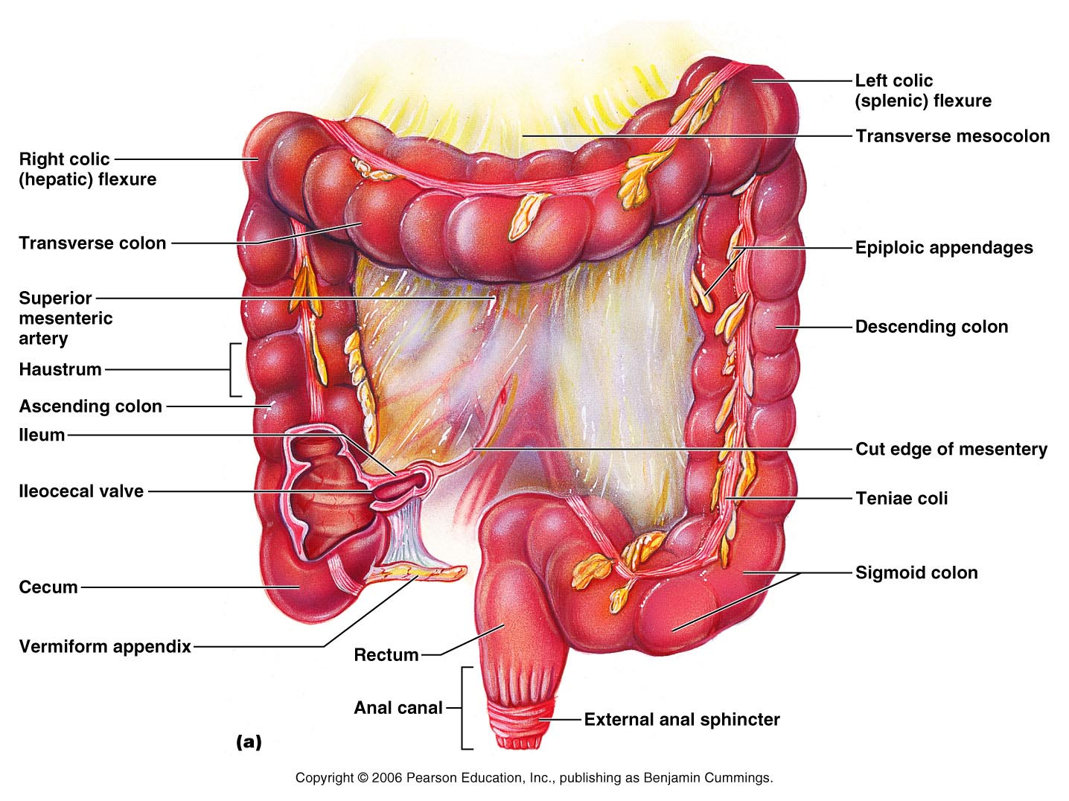
Figure 23.29a

Slide 14
Colon
Has distinct regions: ascending colon, hepatic flexure, transverse colon, splenic flexure, descending colon, and sigmoid colon
The _________________________ joins the _
The _____________________________ opens to the exterior _

Slide 15
Sphincters of the Anus
The anus has ____________ sphincters:
__________________ anal sphincter
composed of _________________________ muscle
__________________ anal sphincter
composed of _________________________ muscle
These sphincters are closed _

Slide 16
Large Intestine: Microscopic Anatomy
Colon mucosa is _____________________________ epithelium except in the anal canal
Has numerous deep ________________ lined with _

Slide 17
Large Intestine: Microscopic Anatomy
Anal canal mucosa is _
Anal sinuses _
Superficial venous plexuses are associated with the anal canal
Inflammation of these veins results in itchy varicosities called _

Slide 18
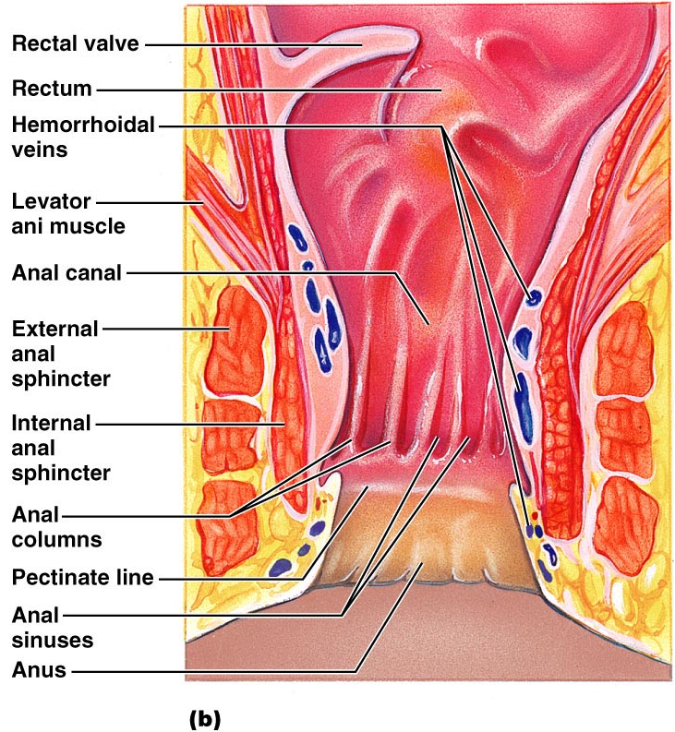
Structure of the Anal Canal
Figure 23.29b

Slide 19
Bacterial Flora
The _______________________ of the large intestine consist of:
Bacteria surviving the small intestine that enter the cecum and
Those entering via the anus
These bacteria:
Release irritating acids and _
Synthesize ___________________________ and vitamin K

Slide 20
Functions of the Large Intestine
Other than digestion of enteric bacteria, _
Vitamins, water, and electrolytes _
Its major function is _________________________________ toward the anus
Though essential for comfort, the colon is _

Slide 21
Motility of the Large Intestine
Slow segmenting movements that move the contents of the colon
contract as they are _
Presence of _
Activates the _
Initiates peristalsis that _

Slide 22
Defecation
_____________________ of rectal walls caused by feces:
_____________________________ of the rectal walls
Relaxes the ________________ anal sphincter
Voluntary signals stimulate relaxation of the external anal sphincter and defecation occurs

Slide 23
Chemical Digestion: Carbohydrates
Absorption:
Enter the _
Transported to the ____________via the _______________________________
Enzymes used:
_______________________ amylase,
_______________________ amylase,

Slide 24
Chemical Digestion: Proteins
Absorption: similar to carbohydrates
Enzymes in the stomach
Enzymes in the _
_______________________________ – trypsin, chymotrypsin, and carboxypeptidase
_______________________________ – aminopeptidases, carboxypeptidases, and dipeptidases

Slide 25
Chemical Digestion: Fats
Absorption: Diffusion into intestinal cells where they:
Enter __________________________ and are transported to systemic circulation _

Slide 26
Chemical Digestion: Fats
Glycerol and short chain fatty acids are:
Absorbed into the _
Transported via the _
Enzymes/chemicals used:
bile salts

Slide 27
Chemical Digestion: Nucleic Acids
Absorption: ______________________ via membrane carriers
Absorbed in villi
transported to liver via hepatic portal vein
Enzymes used:
pancreatic ribonucleases and deoxyribonuclease in the small intestines

Slide 28
Malabsorption of Nutrients
Results from anything that
interferes with _
______________________________ the intestinal mucosa (e.g., bacterial infection)

Slide 29
Malabsorption of Nutrients
Gluten enteropathy _
_________________________ damages the intestinal villi
reduces the _
Treated by eliminating gluten from the diet (all grains but rice and corn)

Slide 30
Cancer
Stomach and colon cancers _________________________________ or symptoms
Metastasized _____________________ frequently cause _
Prevention is by regular dental and medical examinations

Slide 31
Cancer
_____________________________ is the 2nd largest cause of cancer deaths in males
(__________________________ is 1st)
Forms from benign mucosal tumors
formation increases with age
Regular colon examination should be done for _

Slide 32
Kidney Functions
Filter 200 liters ________________ daily, allowing toxins, metabolic wastes, and excess ions to leave the body in urine
_____________________________ and chemical makeup of the blood
Maintain the _____________________ between water and salts, and acids and bases

Slide 33
Other Renal Functions
____________________________ during prolonged fasting
Production of __________________ to help ____________________________ and ______________________________ to stimulate _______________ production
Activation of vitamin D

Slide 34
Other Urinary System Organs
provides a temporary storage reservoir for urine
Paired ureters
transport urine from _
Urethra
transports urine from the _

Slide 35
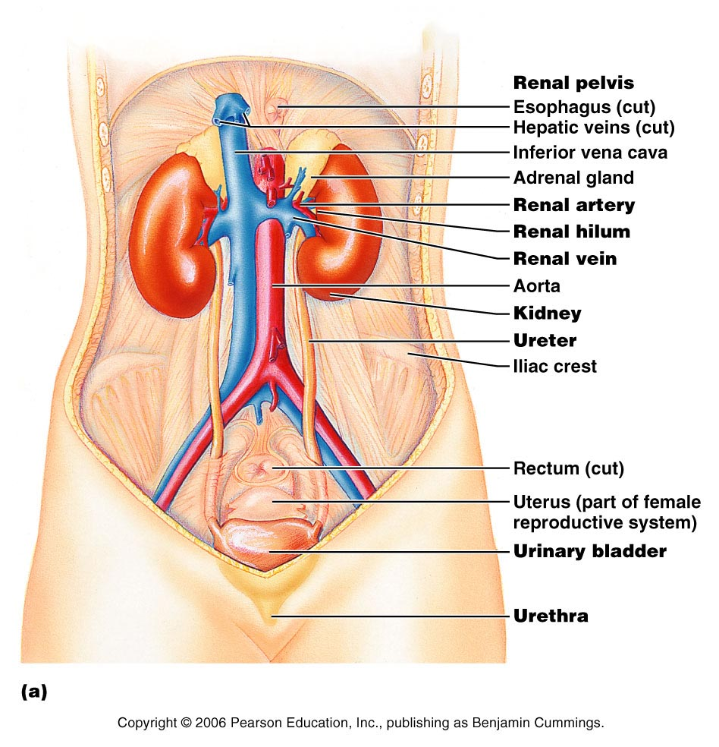
Figure 25.1a

Slide 36
Layers of Tissue Supporting the Kidney
fibrous capsule that prevents kidney infection
Adipose capsule
_______________________ that cushions the kidney and helps _________________ to the body wall
Renal fascia
outer layer of ________________________________ that anchors the kidney

Slide 37
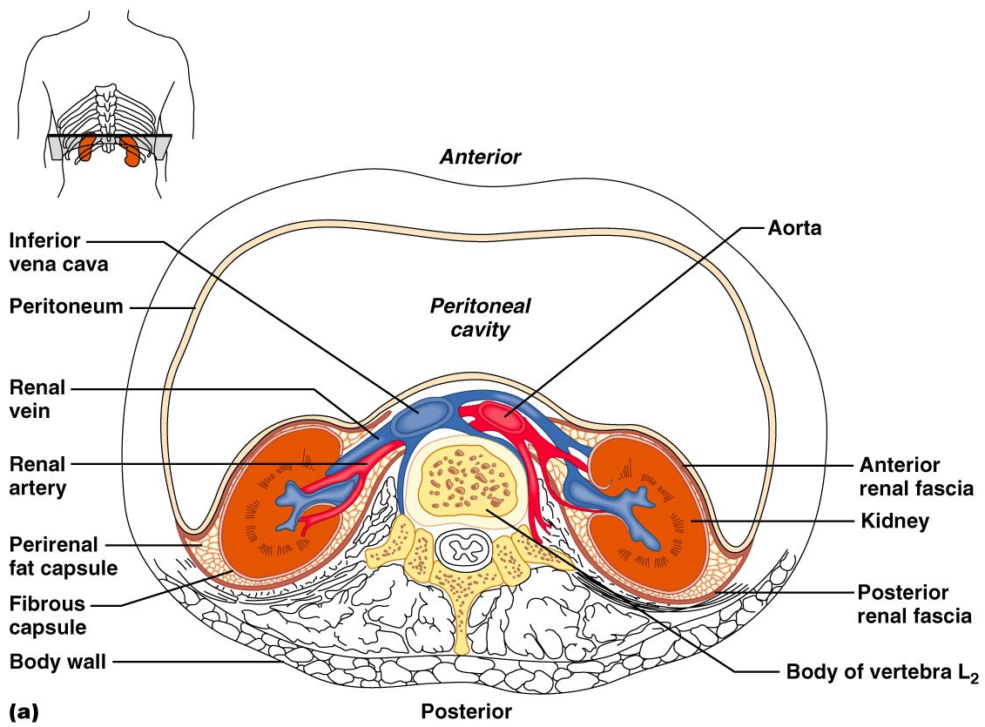
Kidney Location and External Anatomy
Figure 25.2a

Slide 38
Internal Anatomy (Frontal Section)
the light colored, __________________________ superficial region
Medulla
exhibits cone-shaped _________________________ separated by columns
The medullary pyramid and its surrounding capsule constitute a lobe
flat funnel shaped tube lateral to the hilus within the renal sinus

Slide 39
Internal Anatomy
Major calyces
large ______________________________ of the renal pelvis
_____________________________ draining from papillae
Empty urine into the pelvis
Urine flows through the _

Slide 40
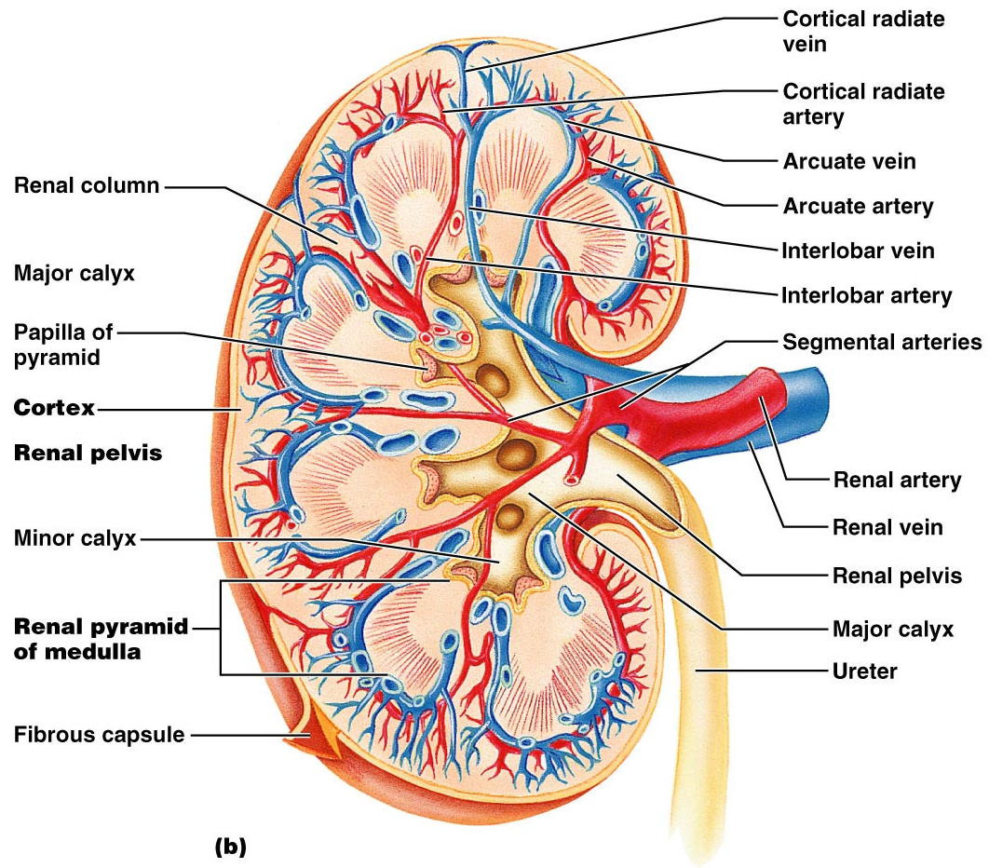
Figure 25.3b

Slide 41
Renal Vascular Pathway
Figure 25.3c

Slide 42
The Nephron
________________________ are the structural and functional units that form urine, consisting of:
Glomerulus
a tuft of ________________________________ associated with a _
Glomerular (Bowman’s) capsule
blind, ___________________________________ that completely surrounds the glomerulus

Slide 43
The Nephron
Renal _
the glomerulus and its Bowman’s capsule
______________________ epithelium that allows solute-rich, _________________________________ to pass from the blood into the glomerular capsule

Slide 44
Renal Tubule
Proximal convoluted tubule (PCT) –
composed of cuboidal cells with numerous _
____________________________ and solutes from filtrate and secretes substances into it

Slide 45
Renal Tubule
a hairpin-shaped loop of the renal tubule
Distal convoluted tubule (DCT)
cuboidal cells without microvilli that _

Slide 46
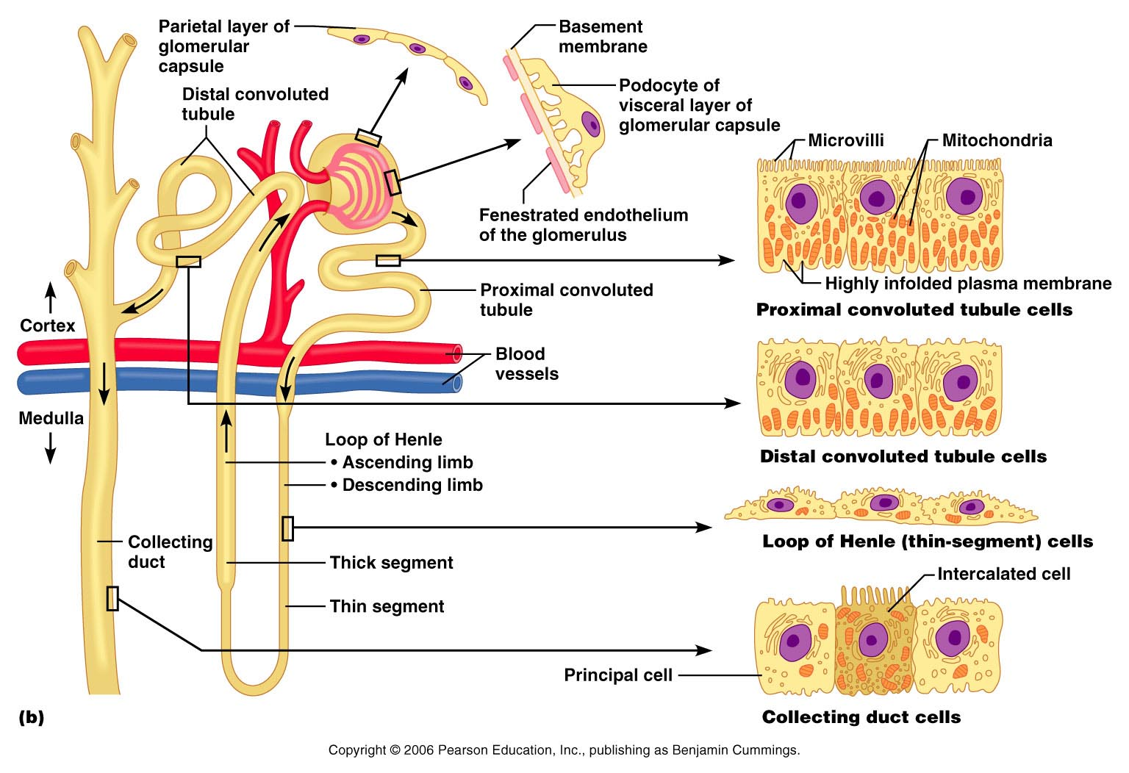
Figure 25.4b

Slide 47
Nephrons
85% of nephrons; located in the cortex
Juxtamedullary nephrons:
Are located at the cortex-medulla junction
Have loops of Henle that _
Are involved in the production of _

