Slide 1
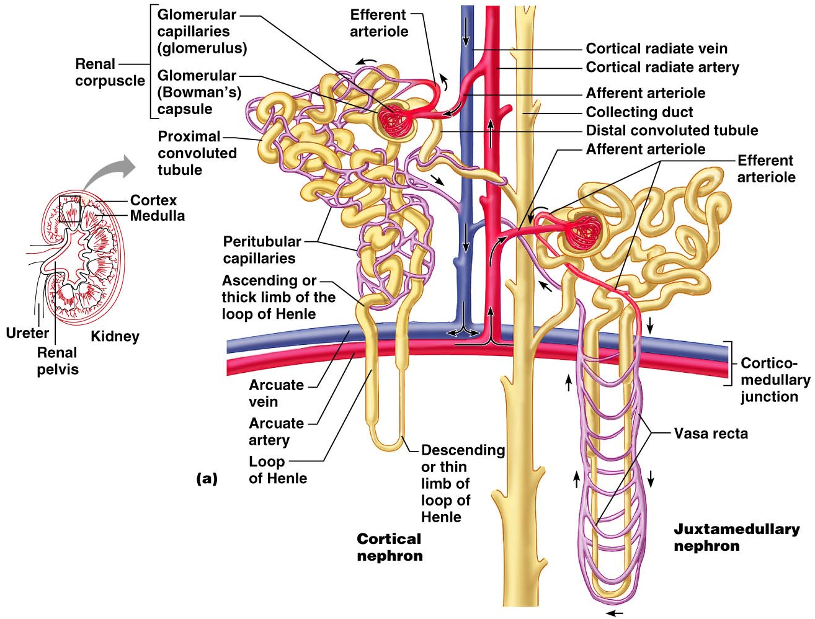
Figure 25.5a

Slide 2
Capillary Beds of the Nephron
Every nephron has _________ capillary beds
Each glomerulus is:
Fed by an _
Drained by an _

Slide 3
Capillary Beds of the Nephron
Blood pressure in the glomerulus is high because:
Arterioles are high-resistance vessels
Afferent arterioles _____________________ than efferent arterioles
Fluids and solutes are forced out of the blood throughout the entire length of the glomerulus

Slide 4
Capillary Beds
Peritubular beds are _____________________, porous capillaries ____________________ that:
Arise from efferent arterioles
Cling to adjacent renal tubules
Empty into the renal venous system
Vasa recta
long, straight _

Slide 5
Juxtaglomerular Apparatus (JGA)
Where the distal tubule lies against the afferent (sometimes efferent) arteriole
Arteriole walls have juxtaglomerular (JG) cells
Enlarged, _
Have _
Act as _

Slide 6
Juxtaglomerular Apparatus (JGA)
Tall, closely packed distal tubule cells
Lie adjacent to _
Function as chemoreceptors or osmoreceptors
Mesanglial cells:
Have ______________________________ properties
Influence capillary _

Slide 7
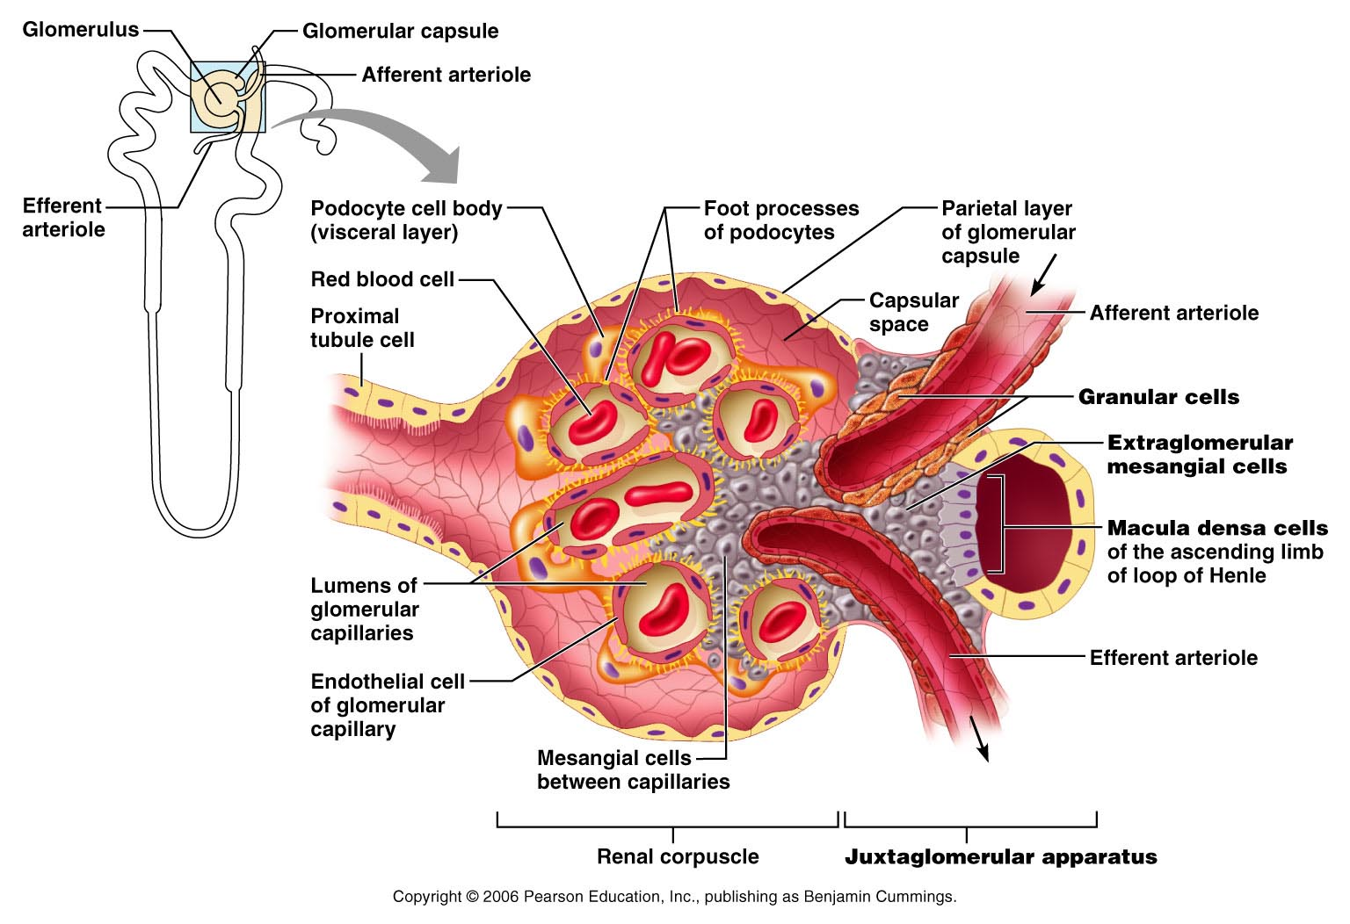
Juxtaglomerular Apparatus (JGA)
Figure 25.6

Slide 8
Mechanisms of Urine Formation
The kidneys filter the body’s _
The filtrate:
Contains all plasma components _
Loses water, nutrients, and essential ions to become urine
The urine contains _

Slide 9
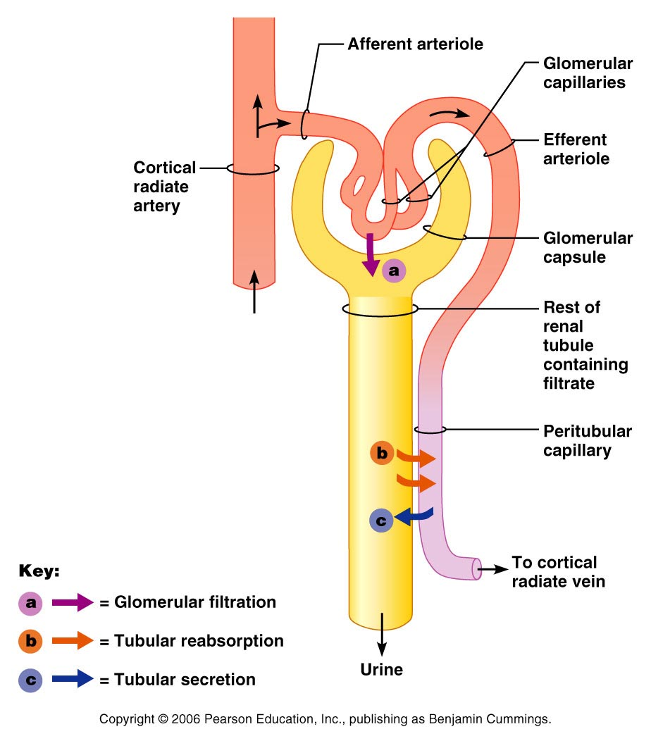
Mechanisms of Urine Formation
Urine formation and adjustment of blood composition involves three major processes
Figure 25.8

Slide 10
Glomerular Filtration
The _________________________ is more efficient than other capillary beds because:
Its filtration membrane is _
Glomerular _
It has a higher _

Slide 11
Glomerular Filtration Rate (GFR)
The total amount of filtrate formed per minute by the kidneys
Factors governing filtration rate at the capillary bed are:
Total _________________________ available for filtration
Filtration membrane _

Slide 12
Glomerular Filtration Rate (GFR)
GFR is ___________________________ to the NFP
Changes in GFR normally result from changes in _

Slide 13
Regulation of Glomerular Filtration
If the GFR is too high:
Needed substances _
If the GFR is too low:
____________________________________, including wastes that are normally disposed of

Slide 14
Regulation of Glomerular Filtration
Three mechanisms control the GFR
Renal autoregulation _
Neural controls
Hormonal mechanism (the __________________________________ system)

Slide 15
Intrinsic Controls
Under normal conditions, renal autoregulation maintains a _____________________________ glomerular filtration rate

Slide 16
Extrinsic Controls
When the _________________________ nervous system is at ________________:
Renal blood vessels are _
Autoregulation mechanisms prevail

Slide 17
Extrinsic Controls
Under stress:
_______________________ is released by the sympathetic nervous system
_______________________ is released by the _
___________________________________ and filtration is inhibited
The sympathetic nervous system also stimulates the renin-angiotensin mechanism

Slide 18
Renin-Angiotensin Mechanism
Is triggered when the JG cells release renin
Renin acts on ___________________________ to release _
Angiotensin I is converted to angiotensin_
Angiotensin II:
Causes mean _
Stimulates the adrenal cortex to release _
As a result, both systemic and glomerular hydrostatic pressure rise

Slide 19
Renin Release
Renin release is triggered by:
___________________________ of the granular JG cells
Stimulation of the JG cells by _
Direct stimulation of the JG cells by _
Angiotensin _

Slide 20
Tubular Reabsorption
All ______________________________ are reabsorbed
Water and ion reabsorption is _________________________ controlled
Reabsorption may be an active (requiring ATP) or passive process

Slide 21
Nonreabsorbed Substances
A ___________________________ (T_{m}):
Reflects the number of _______________ in the renal tubules available
Exists for nearly every substance _
When the carriers are ______________________, excess of that substance _

Slide 22
Nonreabsorbed Substances
Substances are not reabsorbed if they:
Are _
Are too large to pass through membrane pores
Urea, creatinine, and uric acid are the most important nonreabsorbed substances

Slide 23
Atrial Natriuretic Peptide Activity
ANP _
_________________________ blood volume
Lowers blood pressure
ANP lowers blood Na⁺ by:
Acting directly on medullary ducts to _
Counteracting the effects of _
Indirectly stimulating an increase in GFR reducing water reabsorption

Slide 24
Tubular Secretion
Essentially reabsorption in reverse,
substances move from peritubular capillaries or tubule cells _
Tubular secretion is important for:
Disposing of substances not already in the filtrate
Eliminating undesirable substances such as _
Ridding the body of excess _
Controlling blood _

Slide 25
Formation of Dilute Urine
Filtrate is diluted in the ascending loop of Henle
Dilute urine is created by allowing this filtrate to continue into the renal pelvis
This will happen as long as _

Slide 26
Formation of Dilute Urine
Collecting ducts remain _
no further water reabsorption occurs
Sodium and selected ions can be removed by active and passive mechanisms

Slide 27
Formation of Concentrated Urine
Antidiuretic hormone (ADH) _
This equalizes the osmolality of the filtrate and the interstitial fluid
In the presence of ADH, _

Slide 28
Formation of Concentrated Urine
ADH-dependent water reabsorption is called _
ADH is the signal to produce _
The kidneys’ ability to respond depends upon the high medullary osmotic gradient

Slide 29
Diuretics
Chemicals that enhance the urinary output include:
Any substance _
Substances that exceed the ability of the renal tubules to reabsorb it
Substances that _

Slide 30
Diuretics
Osmotic diuretics include:
High _
carries water out with the glucose
Alcohol
Caffeine and most diuretic drugs
_______________________ and Diuril
inhibit Na⁺-associated symporters

Slide 31
Ureters
Slender tubes that _
Ureters enter the _
This closes their distal ends as bladder pressure increases and prevents backflow of urine into the ureters

Slide 32
Ureters
Ureters have a _
Transitional epithelial mucosa
Smooth muscle muscularis
Fibrous connective tissue adventitia
Ureters ___________________________ via response to smooth muscle stretch

Slide 33
Urinary Bladder
Smooth, collapsible, muscular sac that stores urine
It lies retroperitoneally on the pelvic floor _
Males
Females
triangular area outlined by the openings for the ureters and the urethra
Clinically important because _

Slide 34
Urinary Bladder
The bladder wall has three layers
A _
A _
The bladder is distensible and collapses when empty
As urine accumulates, the bladder expands without significant rise in internal pressure

Slide 35
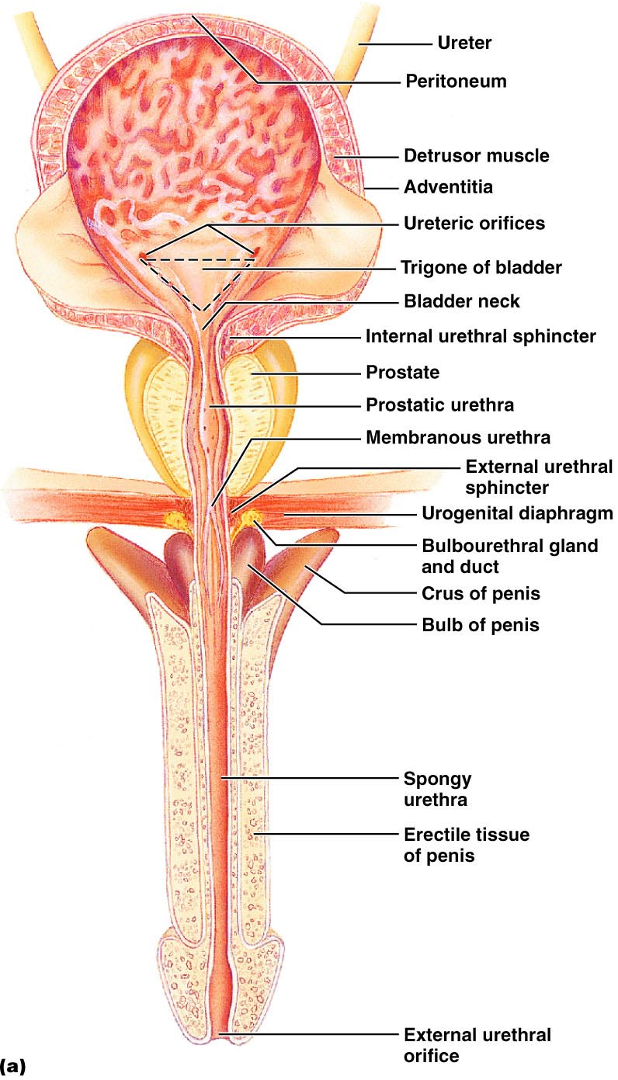
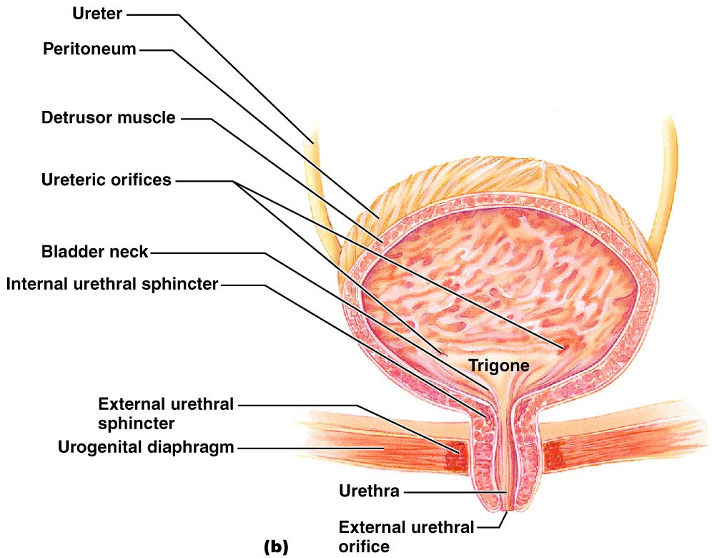
Urinary Bladder

Slide 36
Urethra
Muscular tube that:
Drains _
Conveys it out of the body

Slide 37
Urethra
Sphincters keep the urethra closed when urine is not being passed
____________________ urethral sphincter
__________________________ sphincter at the bladder-urethra junction
____________________ urethral sphincter
__________________________ sphincter surrounding the urethra as it passes through the urogenital diaphragm
Levator ani muscle

Slide 38
Urethra
The female urethra is _
Its external opening lies _
The male urethra has three named regions
Prostatic urethra
Membranous urethra
runs through _
passes through the penis and opens via the _

Slide 39
Micturition (Voiding or Urination)
The act of emptying the bladder
Distension of bladder walls initiates spinal reflexes that:
Stimulate contraction of the _
Inhibit the ____________________________ and internal sphincter (temporarily)
Voiding reflexes:
Stimulate the _
Inhibit the _

