Slide 1
Reproductive System
Primary sex organs: gonads
Produce __________________________________: sex cells
Sperm
ova
Secrete steroid sex hormones
Androgens (males)
Estrogens and progesterone (females)
Accessory reproductive organs
ducts, glands, and external genitalia

Slide 2
Reproductive System
Sex hormones play roles in
Sexual _
Growth and development of organs and tissues

Slide 3
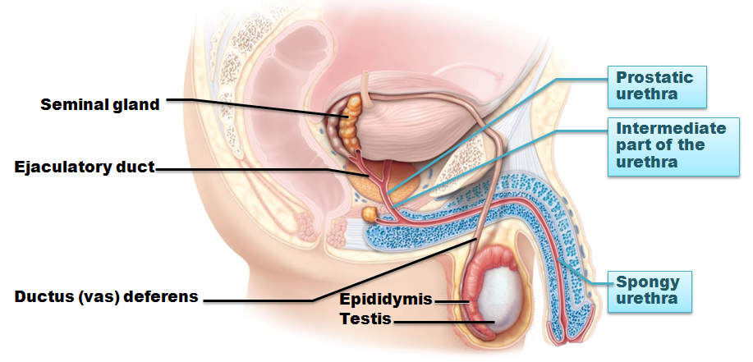
Male Reproductive System
within scrotum
Sperm delivered to exterior through system _
Epididymis → ductus deferens → ejaculatory duct → urethra

Slide 4
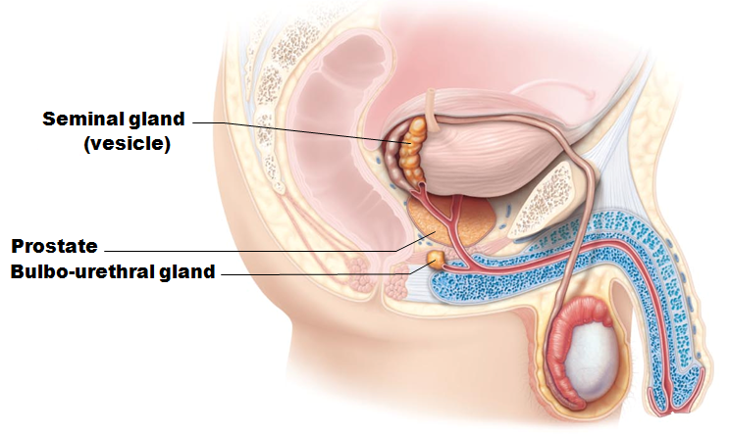
Male Reproductive System
Accessory sex glands
Bulbourethral glands
Empty secretions into ducts _

Slide 5
The Scrotum
Sac of skin and superficial fascia
Hangs _________________________ abdominopelvic cavity
Contains _
3°C ___________________________________ than core body temperature
Lower temperature _

Slide 6
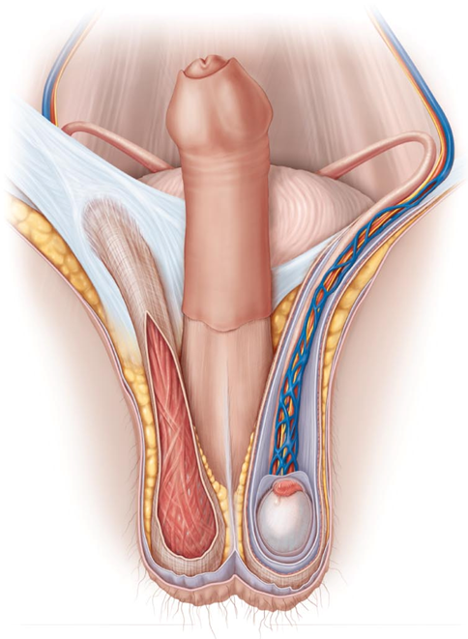
The Scrotum
Temperature kept constant by two sets of muscles
bands of skeletal muscle that elevate testes
smooth muscle
pulls scrotum close to body

Slide 7
The Testes
Each surrounded by two tunics
outer layer derived from peritoneum
inner layer
fibrous capsule
______________________ divide testis into ~250 lobules
each containing 1–4 seminiferous tubules
site of sperm production

Slide 8
Seminiferous Tubules
Thick, stratified epithelium surrounding central fluid-containing lumen
Epithelium
spermatogenic cells embedded in Sustentacular cells (___________________________________)
____________________________ cells surround each tubule
May squeeze sperm, testicular fluids out of testes
Tubules of each lobule form _

Slide 9
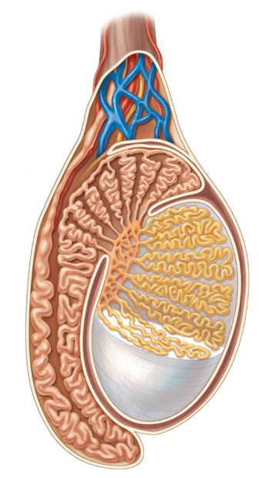
The Testes
Sperm conveyed from
Seminiferous tubules
Rete testis
Epididymis

Slide 10
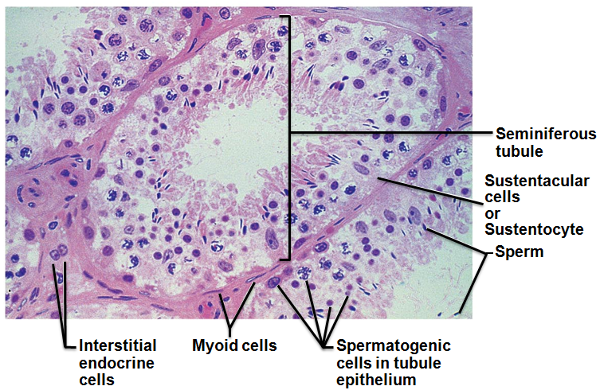
Seminiferous Tubules
________________________________ endocrine cells in soft tissue surrounding seminiferous tubules
Produce _
Secrete it into interstitial fluid

Slide 11
The Testes
Blood supply
Testicular arteries arise from abdominal aorta
Testicular veins arise from __________________________ surrounding each testicular artery
Cooler
absorb heat from testicular arteries
encloses nerve fibers, blood vessels, and lymphatics that supply testes

Slide 12
Homeostatic Imbalance
Testicular cancer
Rare
most common cancer in men _
_________________________________________ is risk factor
Sign
__________________________________________, solid mass in testis
90% cured by surgical removal of testis and often radiation or chemotherapy

Slide 13
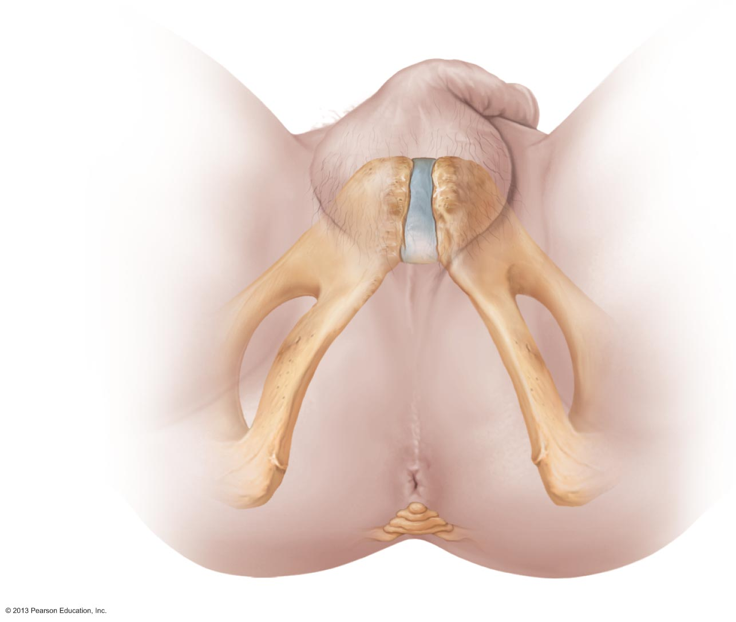
The Male Perineum
Diamond-shaped region between
Suspends scrotum
contains root of penis and anus

Slide 14
The Penis
External genitalia
Penis

Slide 15
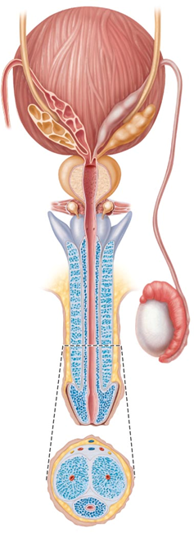
The Penis
Penis consists of
Proximal ends of corpora cavernosa surrounded by ischiocavernosus muscle
anchors penis to pubic arch
Root and shaft that ends in _
Prepuce
cuff of loose skin covering glans

Slide 16
Circumcision
60% newborn boys in US circumcised
15% in other parts of world
Some claim medically unnecessary
Studies show
Reduced risk for other reproductive system infections

Slide 17
The Penis: Internally
Spongy urethra and three cylindrical bodies of erectile tissue
spongy network of connective tissue and smooth muscle with vascular spaces
surrounds urethra and expands to form glans and bulb
paired dorsal erectile bodies
Erection
erectile tissue fills with blood, causing penis to _

Slide 18
The Male Duct System
Ejaculatory duct
Ducts carry sperm from testes to body exterior
Epididymis
Urethra
urethra
Ductus deferens
Vas deferens
epididymis

Slide 19
Epididymis
contains efferent ductules
superior aspect of testis
body and tail on posterolateral area of testis
Duct of the epididymis
___________________________________ (stereocilia)
absorb testicular fluid
Nonmotile sperm enter
pass slowly through (~ 20 days)
become motile
During ejaculation epididymis contracts, expelling sperm into ductus deferens
head
body
tail

Slide 20
Ductus Deferens and Ejaculatory Duct
Ductus deferens (__________________)
Passes through _
Expands to form _
joins duct of seminal vesicle to form ejaculatory duct
Smooth muscle in walls propels sperm from epididymis to urethra
cutting and ligating ductus deferens; nearly 100% effective form of birth control
ampulla
Seminal vesicle
Vas deferens

Slide 21
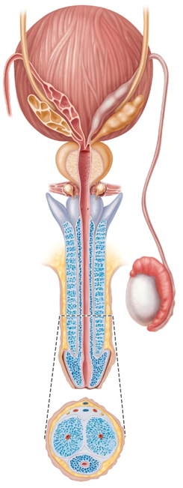
Urethra
Conveys both urine and semen (at different times)
Has three regions
surrounded by prostate
Intermediate part of the urethra (_________________________)
in urogenital diaphragm
runs through penis
opens at external urethral orifice
Prostatic
urethra
Membranous
urethra
Spongy
Urethra

Slide 22
The Male Accessory Glands
Paired seminal glands (____________________)
Paired bulbo-urethral glands
Produce bulk _
Remainder is sperm from testes
Seminal
vesicles
Prostate gland
Bulbourethral
glands

Slide 23
Accessory Glands: Seminal Glands
On _
smooth muscle contracts during ejaculation
Produces _____________________________ seminal fluid
____________________________, citric acid, coagulating enzyme (vesiculase), and prostaglandins
Yellow pigment fluoresces with UV light
70% volume of semen
Duct of seminal vesicle joins ductus deferens to _
Seminal
vesicles

Slide 24
Accessory Glands: Prostate
Encircles urethra inferior to bladder;
smooth muscle contracts during ejaculation
Secretes milky,_
Contains citrate, enzymes, and prostate-specific antigen (PSA)
Enters prostatic urethra during ejaculation
33% semen volume
Prostate gland

Slide 25
Prostate Disorders
inflammatory disorder
Bacterial infection
acute
Chronic
treated with antibiotics
May be age-related
treated with surgery, microwaves, drugs, balloon compression, radio-frequency radiation

Slide 26
Prostate Disorders
Second most common cause of cancer death in males
Digital exam screening, PSA levels
Biopsy if abnormal
Treated with ____________________________ and sometimes radiation; castration; drugs
In clinical trials
cryosurgery, chemotherapy, ultrasound, proton beam therapy

Slide 27
Accessory Glands: Bulbourethral Glands
Produce thick, clear _____________________ during sexual arousal
__________________________ traces of acidic urine in urethra
Bulbourethral
glands

Slide 28
Semen
Milky-white mixture of sperm and accessory gland secretions
Contains _
protects and activates sperm
facilitates sperm movement
Alkaline secretion
neutralizes acidity of _
neutralizes acidity of _
enhanced motility

Slide 29
Semen Functions
decrease viscosity of _
stimulate _
Contains _____________________ for energy
Suppresses female _
Antibacterial action
Clotting factors coagulate semen initially to prevent draining out;
then liquefied by fibrinolysin
sperm begin journey

Slide 30
Male Sexual Response
Erection
Arterioles are normally constricted
Sexual excitement causes activation of _
__________________________________________ (NO) release
local vascular smooth muscle relaxation
corpora cavernosa _
Slows _
engorgement of erectile tissues with blood
enlargement and stiffening of penis

Slide 31
Erection
Initiated by sexual stimuli
Touch; mechanical stimulation of penis; erotic sights, sounds, and smells
Can be __________________________ or ___________________________ by emotions or higher mental activity
Corpus ___________________________ keeps urethra open

Slide 32
Male Sexual Response
Ejaculation
Propulsion of semen from male duct system
Sympathetic spinal reflex
Ducts and accessory glands contract and empty their contents
Bulbospongiosus ___________________________ undergo rapid series of contractions
expulsion of semen at around 11 mph
Ejaculatory event
climax (orgasm)

Slide 33
Homeostatic Imbalance
Erectile dysfunction
Parasympathetic nerves of penis release _____________________________ Nitric Oxide
Causes
Hormones
blood vessel or nervous system problems
incompetent venous valves fail to retain blood in penis
New drugs (Viagra, Cialis) enhance existing Nitric Oxide effects

Slide 34
Spermatogenesis
Sperm (__________________________________) production in _
Most body cells have 46 chromosomes
diploid chromosomal number (2n)
Two sets (23 pairs) of chromosomes
One maternal, one paternal
Called _
Gametes have __________ chromosomes
haploid chromosomal number (n)
Only one member of homologous pair

Slide 35
Meiosis
Gamete formation involves _
Differs from mitosis
Two consecutive cell divisions
only one round of DNA replication
Produces _
Functions of meiosis
Number of chromosomes halved (from 2n to n)
Introduces _

Slide 36
Meiosis
_____________________________________ of homologous pairs in meiosis I
variability of gametes
variability of gametes
No two gametes exactly alike
All different from original parent cells

Slide 37
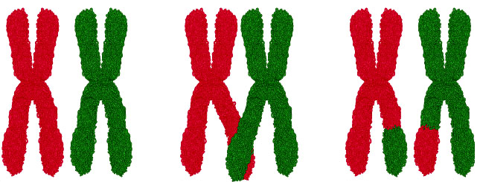
Meiosis I
Reduction division of meiosis
reduces chromosome number from 2n → n
Events found only during _________________________of Meiosis
homologous chromosomes pair forming tetrads of four chromatids
exchange of genetic material between male and female chromatid
unique chromosomes
Synapsis
Crossing over

Slide 38
Meiosis I
End of meiosis I each daughter cell
Two copies of one member of each homologous pair (either maternal or paternal); none of the other
__________________ chromosomal number
still-united sister chromatids one chromosome (_______________________________________________________)
Sister
chromatid

Slide 39
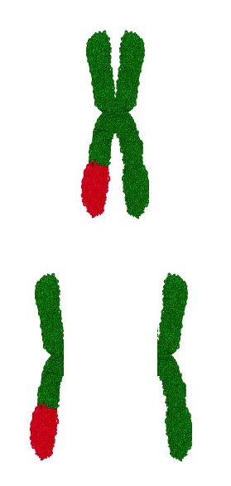
Meiosis II
Equational division of meiosis
Sister chromatids from meiosis I _
Like mitosis except no chromosome replication before begins
Sister chromatids split
into two
daughter chromosomes

Slide 40
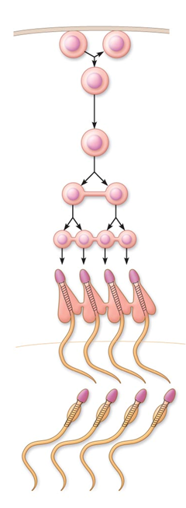
Spermatogenesis
spermatagonia
Spermatogenic cells give rise to sperm
___________________of spermatogonia forms _
Meiosis
Spermatocytes → secondary spermatocytes → _
Spermiogenesis
Daughter cells
from mitosis
Primary
spermatocytes
Secondary
spermatocytes
Spermatids

Slide 41
Mitosis of Spermatogonia
Type B
Type A
Spermatogenesis begins at puberty
________________________ in contact with epithelial basal lamina
Each mitotic division → one type A daughter cell and one type B daughter cell

Slide 42
Mitosis of Spermatogonia
Type B
Type A
Type A cells maintain _________________________ at basal lamina
Type B cells move toward lumen and _
becomes
primary spermatocyte
used
later

Slide 43
Meiosis: Spermatocytes to Spermatids
Meiosis I
Primary spermatocyte (46)
two secondary spermatocytes (23)
Meiosis II
Each secondary spermatocyte (23)
Spermatid
small, _____________________________ close to lumen of tubule
Meiosis I
Meiosis II

Slide 44
Spermiogenesis: Spermatids to Sperm
Correct chromosome number (n =23)
Nonmotile
Spermiogenesis
lose excess cytoplasm
Become spermatozoon (_____________________________)

Slide 45
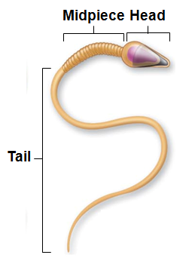
Sperm
Major regions
genetic region
nucleus and helmetlike ________________________________ containing hydrolytic enzymes
Midpiece
metabolic region
mitochondria → ATP to move tail
Tail
locomotor region

Slide 46
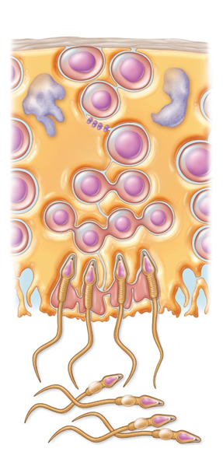
Role of Sustentocytes
Large supporting cells (Sertoli cells)
Provide ___________________________ and signals to dividing cells
Move cells along to lumen
Secrete testicular fluid into lumen for sperm transport
______________________________ and excess cytoplasm
Produce chemical mediators to regulate spermatogenesis
Sertoli Cells

Slide 47
Role of Sustentacular Cells
Tight junctions form _
Prevents sperm _____________________________ from escaping into blood
activation of immune system
Important
sperm _
_____________________________________________ during immune system development
would not be recognized as "self"

Slide 48
Homeostatic Imbalance
Infertility
Gradual decline in male fertility past 50 years
___________________________________________ (alien molecules) may be cause
Environmental toxins, PVCs, phthalates, pesticides, herbicides, compounds with estrogenic effects, antibiotics, radiation, lead, marijuana
Also, lack of selenium, ______________________________, lack of specific Ca²⁺ channel, anatomical obstructions, hormonal imbalances, oxidative stress, fevers, _

Slide 49
Hormonal Regulation of Male Reproductive Function
Sequence of hormonal regulatory events involving hypothalamus, anterior pituitary gland, and testes
Regulates production of gametes and sex hormones through 3 interacting sets of hormones
GnRH indirectly stimulates testes via FSH & LH
Testosterone & inhibin – negative feedback on hypothalamus and anterior pituitary

Slide 50
HPG Axis
Sequence of regulatory events
Hypothalamus releases gonadotropin-releasing hormone (_______________________) →
anterior pituitary to secrete FSH and LH
FSH causes sustentocytes to release _____________________________________________→
high concentration of testosterone near spermatogenic cells →
spermatogenesis
LH prods interstitial endocrine cells →
________________________________________________ →

Slide 51
HPG Axis
Testosterone →
development/maintenance secondary sex characteristics,
libido
Rising testosterone levels →
feedback to __________________________________ gonadotropin release
Inhibin (released when sperm count high)
inhibits GnRH and FSH release

Slide 52
HPG Axis
Three years to achieve balance, then testosterone and sperm production fairly stable throughout life
Without GnRH and gonadotropins → _______________________________________ ; sperm and testosterone production cease

Slide 53
Mechanism and Effects of Testosterone Activity
Testosterone
Synthesized from _
Transformed to exert its effects on some target cells
Dihydrotestosterone (DHT) in _
Estradiol in some neurons in _

Slide 54
Mechanism and Effects of Testosterone Activity
Prompts _
Targets all accessory organs
Has multiple anabolic effects throughout body
Deficiency leads to atrophy; ___________________________________________; erection and ejaculation impaired
Treated with testosterone replacement

Slide 55
Male Secondary Sex Characteristics
Features induced in nonreproductive organs by male sex hormones (mainly testosterone)
Appearance of _
Enhanced growth of chest hair; deepening of voice
Skin thickens and becomes oily
Bones grow, _
Skeletal muscles increase in size and mass
Boosts basal metabolic rate

Slide 56
Male Secondary Sex Characteristics
Testosterone
Masculinizes embryonic brain
Continues to exert effect well into adulthood
Adrenal glands ______________________________________ in small amounts –
insufficient to maintain normal testosterone-mediated functions

Slide 57
Female Reproductive Anatomy
Ovaries
Produce female gametes (___________________)
Secrete female sex hormones
________________________________________________ (estradiol, estrone, estriol)
progesterone
Accessory ducts include
Uterine tubes
Uterus
Vagina

Slide 58
Female Reproductive Anatomy
Internal genitalia – in pelvic cavity
Uterine tubes
External genitalia
External sex organs

Slide 59
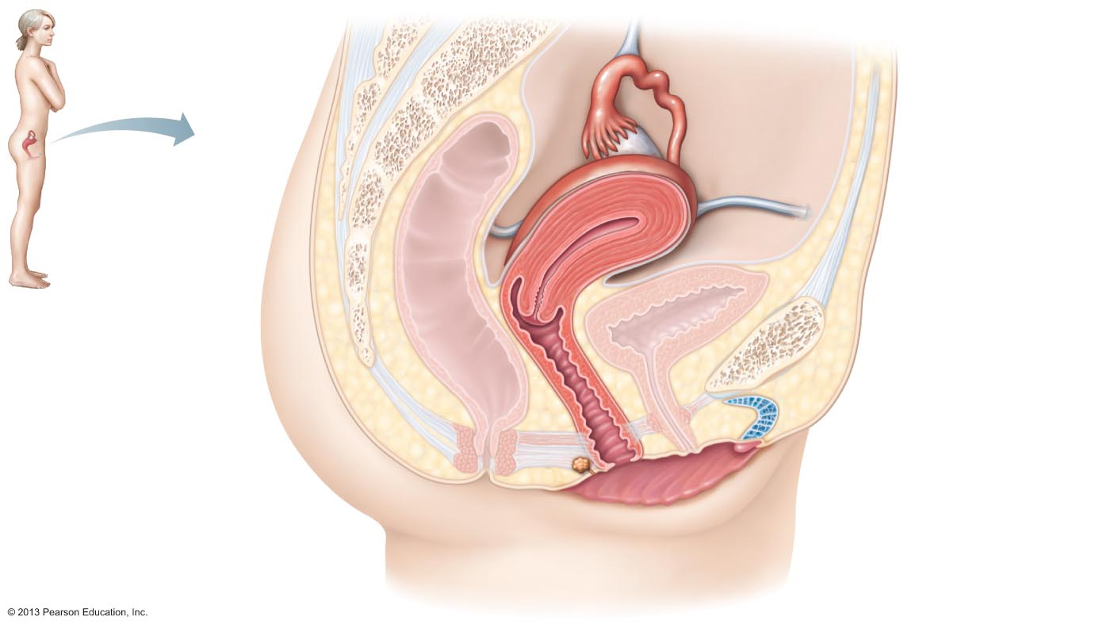
Figure 27.12 Internal organs of the female reproductive system, midsagittal section.
Suspensory ligament
of ovary
Infundibulum
Uterine tube
Ovary
Fimbriae
Uterus
Round ligament
Perimetrium
Urinary bladder
Rectum
Pubic symphysis
Posterior fornix
Mons pubis
Cervix
Urethra
Anterior fornix
Clitoris
Vagina
External urethral
orifice
Anus
Urogenital diaphragm
Hymen
Greater vestibular
gland
Labium minus
Labium majus

Slide 60
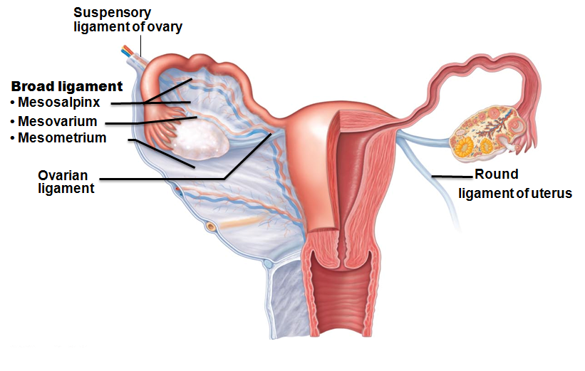
Ovaries
Held in place by several ligaments
anchors ovary medially to uterus
Suspensory ligament
anchors ovary laterally to pelvic wall
Mesovarium
suspends ovary
Suspensory ligament and mesovarium part ________________________
supports uterine tubes, uterus, and vagina

Slide 61
Ovaries
Blood supply
__________________________________________ and ovarian branch of the uterine arteries
Surrounded by fibrous _
Germinal epithelium - outer layer
Two poorly defined regions
Outer cortex –
Inner medulla - large blood vessels and nerves

Slide 62
Ovaries
Embedded in cortex
Ovarian follicles
Immature egg (_________________________________) surrounded by
____________________________________________________ (one cell layer thick)
____________________________________________________ (more than one layer present)

Slide 63
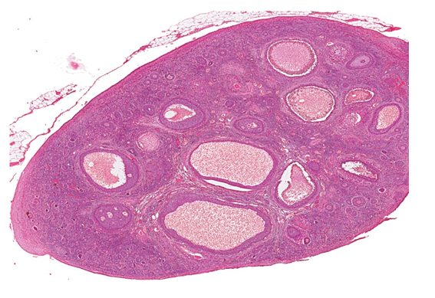
Follicles
Several stages of development
Primordial follicle
More mature follicles
_________________________ layers of granulosa cells
Primordial
follicles

Slide 64
Ovaries
Vesicular (antral or tertiary) follicle – fully mature follicle
_______________________ forms; follicle bulges from ovary surface
Ejection of oocyte from ripening follicle
Corpus luteum develops from ruptured follicle after ovulation
vesicular
follicles

Slide 65
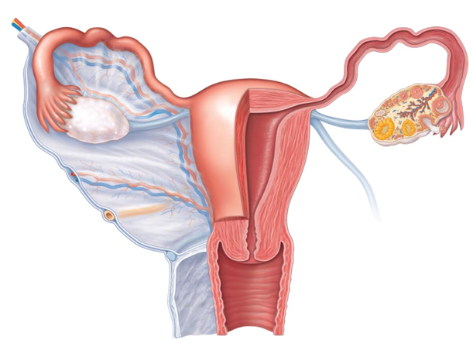
Female Duct System
Ducts have no contact with ovary
Uterine (fallopian) tubes or oviducts
Uterus
Fallopian
tubes
Uterus
Vagina

Slide 66
Uterine Tubes
Receive ovulated oocyte
_
constricted region where tube joins uterus
Distal expansion with infundibulum near ovary
Ciliated ___________________ of infundibulum create currents to move oocyte into uterine tube
Isthmus
Ampulla
Infundibulum

Slide 67
Uterine Tubes
Oocyte carried along by ________________________ and ciliary action
Nonciliated cells _
Covered externally by peritoneum

Slide 68
Homeostatic Imbalance
Oocyte fertilized in peritoneal cavity or distal uterine tube begins developing there
Normally abort naturally with substantial bleeding
Pelvic inflammatory disease (PID)
Spread of infection from reproductive tract to _
May cause scar tissue →

Slide 69
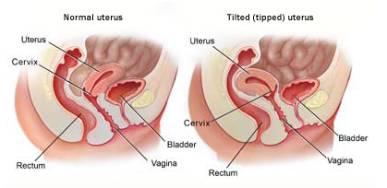
Uterus
Hollow, thick-walled, muscular organ
Function
Receive, retain, nourish fertilized ovum
inclined forward
retroverted
inclined backward
major portion
Fundus
rounded superior region
narrowed inferior region
Fundus
Body
Isthmus
Cervix

Slide 70
Uterus
narrow neck, or outlet; projects into vagina
Cervical canal communicates with
Vagina via _
Uterine body via _
Cervical glands __________________________ that blocks sperm entry except during midcycle
Cervix
Internal os
externalos

Slide 71
Homeostatic Imbalance
Cervical cancer
450,000 women worldwide each year
Most common between 30 – 50
Risks
frequent _
STIs
Papanicolaou (_______________ ) smear for detection
Every two years 21 – 30; every year > 30; discontinue at 65 if negative for 10 years

Slide 72
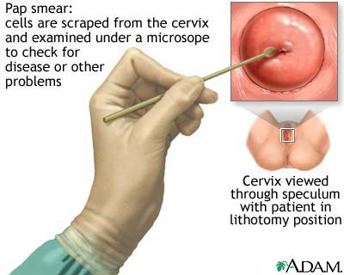
Homeostatic Imbalance
Pap smear results inconclusive
Test for _
cause of most cervical cancers
Gardasil
protects against HPV
Recommended for 11- and 12-year-old girls

Slide 73
Uterine Wall
Three layers
serous layer (visceral peritoneum)
interlacing layers of smooth muscle
mucosal lining
perimetrium
myometrium
endometrium

Slide 74
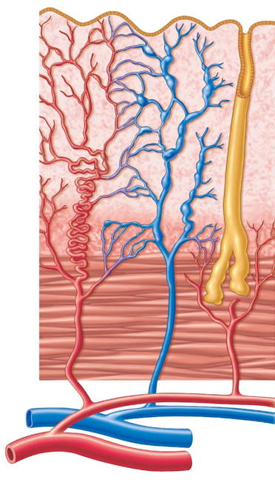
Endometrium
Stratum ______________ (functional layer)
Changes in response to ovarian hormone cycles
Stratum ______________ (basal layer)
Forms new functionalis after menstruation
Unresponsive to ovarian hormones
Stratum
Functonalis
Stratum
basalis

Slide 75
Uterine Vascular Supply
Uterine arteries →Arcuate arteries →Radial arteries in endometrium
branch into
________________________ → stratum basalis
________________________ → stratum functionalis
Degenerate and regenerate; spasms → shedding of functionalis layer during menstruation
Straight arteries
Spiral arteries

Slide 76
Vagina
Thin-walled tube 8-10 cm in length
organ of copulation
Extends between bladder and rectum from cervix to exterior
____________________________________________; embedded in anterior wall

Slide 77
Vagina
Layers of wall
Fibroelastic adventitia
Stratified squamous mucosa with _
Dendritic cells in mucosa may provide route for HIV transmission
Mucosa near vaginal orifice forms _
ruptures with intercourse
Vaginal _
upper end of vagina surrounding cervix

Slide 78
External Genitalia (Vulva or Pudendum)
fatty area overlying pubic symphysis
________________________, fatty skin folds
Counterpart of male scrotum
skin folds lying within labia majora
Join at posterior end of vestibule → _
_________________________ - recess within labia minora
Mons Pubis
Labia Majora
Labia Minora
Fourchette

Slide 79
External Genitalia
Greater _
Flank vaginal opening
Homologous to _
Release ___________________ into vestibule for lubrication
Vestibular glands

Slide 80
External Genitalia
______________________– anterior to vestibule
Glans of the clitoris
Prepuce of the clitoris
Counterpart of penis
Diamond-shaped region between pubic arch and coccyx
Bordered by ischial tuberosities laterally
Prepuce of clitoris
Glans clitoris
Perineum

Slide 81
Mammary Glands
Modified ___________________________________ consisting of 15–25 lobes
Function in _
pigmented skin surrounding _
attach breast to underlying muscle
Lobules within lobes contain glandular alveoli that produce milk

Slide 82
Mammary Glands
Milk → ________________________________ → lactiferous sinuses → open to outside at nipple
Breast size due to amount of _

Slide 83
Breast Cancer
___________________________________________ most common malignancy, second most common cause of cancer death in U.S. women
13% will develop condition

Slide 84
Breast Cancer
Usually arises from epithelial cells of smallest ducts; eventually _
Risk factors include
No pregnancies or first pregnancy late in life
No or short periods of breast feeding
Family history of breast cancer
70% of women with breast cancer have _

Slide 85
Breast Cancer
10% due to hereditary defects, including mutations to genes BRCA1 and BRCA2
50 – 80% develop breast cancer
Greater risk of _

Slide 86
Breast Cancer: Diagnosis
Early detection via self-examination and mammography
X-ray examination
American Cancer Society recommends screening every year for women _
U.S. Prevention Services Task Force on Breast Cancer Screening recommends _

Slide 87
Breast Cancer: Treatment
removes breast, all underlying muscles, fascia, associated lymph nodes
excises only cancerous lump
Simple mastectomy
removes only breast tissue
sometimes some axillary lymph nodes
Some have breast reconstruction

Slide 88
Physiology of the Female Reproductive System
Always assumed females total supply of eggs _
New evidence stem cells can arise from epithelial cells at ovary surface
May overturn previous assumption

Slide 89
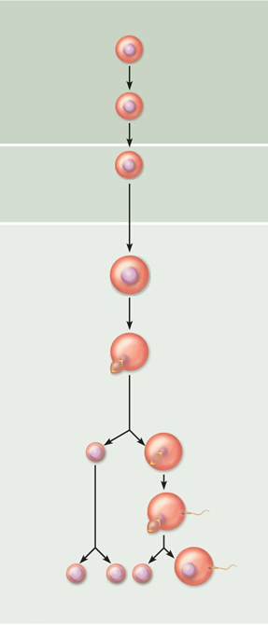
Oogenesis
Oogonia
Mitosis
Production of female gametes
Takes __________________ to complete
Begins in fetal period
________________________ (2n ovarian stem cells) multiply by ______________________ and store nutrients
__________________________ develop in primordial follicles
Primary oocytes begin meiosis; stall in prophase I
Primary
Oocyte
incomplete meiosis
Meiosis I completed
Secondary
Oocyte
Ovulation
Ovum

Slide 90
Oogenesis
At birth female presumed to have lifetime supply of primary oocytes
Each month after puberty, a few _______________________________________ activated
One "selected" each month to _
Result is two haploid cells of different sizes
large cell with most cytoplasm and organelles of original cell
First polar body
small cell

Slide 91
Oogenesis
Secondary oocyte arrests in metaphase II
If not penetrated by sperm _
If penetrated by sperm second oocyte completes meiosis II, yielding
_______________________________ (functional gamete)
Second polar body

Slide 92
Ovarian Cycle
Monthly series of events associated with maturation of egg
Two consecutive phases (in 28-day cycle)
__________________________________________- period of follicle growth (days 1–14)
Ovulation occurs midcycle
__________________________________________- period of corpus luteum activity (days 14–28)

Slide 93
Ovarian Cycle
Only ___________________________ women have 28-day cycle
Follicular phase _
Luteal phase _
always 14 days from ovulation to end of cycle

Slide 94
Follicular Phase
Primordial follicle
____________________ follicle becomes ____________________ follicle
Squamouslike cells become cuboidal; oocyte enlarges
Primary follicle becomes secondary follicle
Primary follicle
Secondary Follicle

Slide 95
Follicular Phase
Secondary follicle becomes late secondary follicle
Connective tissue (theca folliculi) and granulosa cells cooperate to _
Inner thecal cells produce _____________________________ in response to LH
________________________________________________ forms around oocyte
Fluid accumulates between granulosa cells

Slide 96
Follicular Phase
Late secondary follicle becomes _
____________________________________ forms
expands to isolate oocyte with corona radiata on stalk
Vesicular follicle bulges from external surface of ovary
Primary oocyte completes meiosis I → secondary oocyte and first polar body

Slide 97
Ovulation
Ovary wall ruptures, expels secondary oocyte with its corona radiata to peritoneal cavity
twinge of pain sometimes felt at ovulation
1–2% of ovulations release more than one secondary oocyte,
if fertilized, results in _
_________________________________________ result from fertilization of one oocyte, then separation of daughter cells

Slide 98
Luteal Phase of the Ovarian Cycle
Ruptured follicle collapses
antrum fills with clotted blood
corpus hemorrhagicum
Granulosa cells and internal thecal cells form _
Corpus luteum secretes progesterone and some estrogen

Slide 99
Luteal Phase
If no pregnancy, corpus luteum degenerates into ________________________________________ (scar) in 10 days
If pregnancy occurs, corpus luteum ___________________________________ that sustain pregnancy until ___________________________________________ at about 3 months

Slide 100
Establishing the Ovarian Cycle
During childhood, ovaries grow and secrete small amounts of estrogens that _______________________ hypothalamic release of GnRH
As puberty nears, GnRH released; FSH and LH released by pituitary, and act on _
These events continue until an adult cyclic pattern achieved and ________________________________ occurs

Slide 101
Hormonal Regulation of the Ovarian Cycle
Hormone interaction produces cyclic events in ovaries
Gonadotropin-releasing hormone (GnRH)
Ovarian _
Ovarian progesterone
Onset of puberty linked to amount of adipose tissue via hormone leptin

Slide 102
Establishing the Ovarian Cycle
During childhood, until puberty
Ovaries secrete __________________________of estrogens
Estrogen inhibits release of GnRH
If leptin levels adequate hypothalamus less sensitive to estrogen as puberty nears; releases GnRH in rhythmic pulse-like manner → FSH and LH release → ovarian hormone release

Slide 103
Establishing the Ovarian Cycle
Gonadotropin levels increase over _
no _
no _
Then adult cyclic pattern achieved and ____________________________________occurs
First menstrual period

Slide 104
Hormonal Interactions During a 28-Day Ovarian Cycle
1. GnRH → release of _
2. FSH and LH → ____________________________________________, and hormone release
3. ↑plasma estrogen levels inhibit release of FSH and LH
↑estrogen levels enhance further estrogen output
Inhibin from granulosa cells also inhibits FSH release

Slide 105
Hormonal Interactions During a 28-Day Ovarian Cycle
4. When estrogen levels high → brief positive feedback on brain and anterior pituitary
5. Stored ___________________________________, suddenly released by anterior pituitary at midcycle → _
→ primary oocyte to complete meiosis I → secondary oocyte
Secondary oocyte → _

Slide 106
Hormonal Interactions During a 28-Day Ovarian Cycle
LH effects at midcycle
Increases local vascular permeability
Triggers inflammatory response
→ Blood flow stops through protruding follicle wall _______________________________________________→ hole (stigma)
→ Oocyte with ____________________________________ exits (ovulation)

Slide 107
Hormonal Interactions During a 28-Day Ovarian Cycle
After ovulation
____________________________ levels decline
LH transforms ruptured follicle → _
LH stimulates corpus luteum →
progesterone and some estrogen almost immediately
Progesterone helps _
Maintains pregnancy, if occurs

Slide 108
Hormonal Interactions During a 28-Day Ovarian Cycle
6. Negative feedback (from rising plasma progesterone and estrogen levels) _
Inhibin, from corpus luteum and granulosa cells, enhances effect
Declining LH _____________________________________, inhibits follicle development

Slide 109
Hormonal Interactions During a 28-Day Ovarian Cycle
If no fertilization
Corpus luteum degenerates when LH levels fall →
sharp decrease in estrogen and progesterone →
→ Cycle starts anew
Oocyte actually activated ___________________________ prior to ovulation, not 14 days

Slide 110
The Uterine (Menstrual) Cycle
Cyclic changes in endometrium in response to fluctuating ovarian hormone levels
Three phases
Days 1–5 -
Days 6–14 - proliferative (___________________________) phase
Days 15–28 - secretory (____________________________) phase (constant 14-day length)

Slide 111
Uterine Cycle
Menstrual phase (Days 1 - 5)
________________________________________ at lowest levels
Gonadotropins beginning to rise
menstrual flow (blood and tissue) 3 - 5 days
By day 5 growing ovarian follicles produce more estrogen

Slide 112
Uterine Cycle
Proliferative phase (__________________________)
Rising estrogen levels prompt generation of _
glands enlarge and _
Normally thick, sticky cervical mucus thins in response to rising estrogen (allows sperm passage)
Ovulation occurs at end of proliferative phase

Slide 113
Uterine Cycle
Secretory phase (__________________________)
Most constant timewise
Endometrium propares for embryo
Rising progesterone levels prompt
Functional layer → _
Endometrial glands secrete nutrients

Slide 114
Uterine Cycle
If fertilization does not occur
Corpus luteum ______________________________________ toward end of secretory phase
Spiral arteries kink and spasm
Endometrial cells begin to die; glands regress
Spiral arteries constrict again, then relax and open wide
Rush of blood fragments weakened capillary beds and _

Slide 115
Effects of Estrogens
Promote __________________________________ and follicle growth in ovary
Exert _______________________________________ on female reproductive tract
Support rapid but short-lived growth spurt at puberty

Slide 116
Effects of Estrogens
Induce secondary sex characteristics
Increased deposit of ________________________________ (hips and breasts)
Widening and lightening of pelvis

Slide 117
Effects of Estrogens
Metabolic effects (not true secondary sex characteristics)
Maintain _________________________________________ and high HDL levels
Facilitate _

Slide 118
Effects of Progesterone
Progesterone works with estrogen to establish and _
Promotes changes in _
Effects of placental progesterone during pregnancy
Inhibits uterine _
Helps prepare breasts for lactation

Slide 119
Female Sexual Response
Initiated by _
Clitoris, vaginal mucosa, bulbs of vestibule, and breasts engorge with blood; nipples erect
Vestibular gland secretions _
Orgasm accompanied by muscle tension, increase in pulse rate and blood pressure, and _

Slide 120
Female Sexual Response
Females have _______________________________ after orgasm
can experience multiple orgasms in single sexual experience
Orgasm not essential for conception
Female libido prompted by _
Testosterone-like hormones

Slide 121
Sexually Transmitted Infections (STIs)
Also called sexually transmitted diseases (STDs) or venereal diseases (VDs)
U.S. – ______________________________________ among developed countries
Latex condoms help prevent spread
Single most important cause of reproductive disorders

Slide 122
Gonorrhea
Commonly called “________________________"
Bacterial infection of mucosae of ________________________ and _
Spread by contact with genital, anal, and pharyngeal mucosae
Number of cases in U.S. declining

Slide 123
Gonorrhea
Signs and symptoms
Males
____________________________________________, painful urination, _
Females
Abdominal discomfort, vaginal discharge, or abnormal uterine bleeding
Can result in pelvic inflammatory disease and sterility
Treatment
but resistant strains becoming prevalent

Slide 124
Syphilis
Bacterial infection transmitted sexually or contracted congenitally
Infected fetuses _
Infection asymptomatic for _
Painless ____________________________ appears at site of infection; disappears in few weeks

Slide 125
Syphilis
If untreated, ________________________________ appear several weeks later for 3–12 weeks, then disappear
Pink skin rash, _
Latent period may or may not progress to ___________________________________, characterized by gummas (lesions of CNS, blood vessels, bones, and skin)
Treatment
penicillin

Slide 126
Chlamydia
________________________________ bacterial STI in United States
Responsible for 25–50% of all diagnosed cases of _
Symptoms
______________________________; penile and vaginal discharges; abdominal, rectal, or testicular pain; painful intercourse; irregular menses
Can cause arthritis and urinary tract infections in men; ______________________________________________; newborns contract in birth canal → trachoma (painful eye infection), respiratory tract inflammation
Treatment - tetracycline

Slide 127
Trichomoniasis
Most common curable STI in active young women in U.S.
easily, inexpensively treated
___________________________________________ with strong odor
some symptomless

Slide 128
Viral Infections
Caused by human papillomavirus (HPV)
Second most common STI in United States
Increased risk of cancers in infected body regions
________________________________________________________; most strains do not cause cancer
Treatment difficult; controversial

Slide 129
Viral Infections
Genital herpes
Caused by _
Characterized by latent periods and flare-ups
Congenital herpes can cause malformations of fetus
Treatment - acyclovir and other antiviral drugs

Slide 130
Developmental Aspects: Determination of Genetic Sex
Of 46 chromosomes in fertilized egg, two (one pair) are sex chromosomes
Two sex chromosomes
Females are XX; each ovum always has an X chromosome
Males are XY, so ~50% of sperm contain X, ~50% contain Y

Slide 131
Developmental Aspects: Determination of Genetic Sex
X egg + X sperm → ____________ (female offspring)
X egg + Y sperm → _____________ (male offspring)
The _______________________________ on Y chromosome initiates testes development and maleness

Slide 132
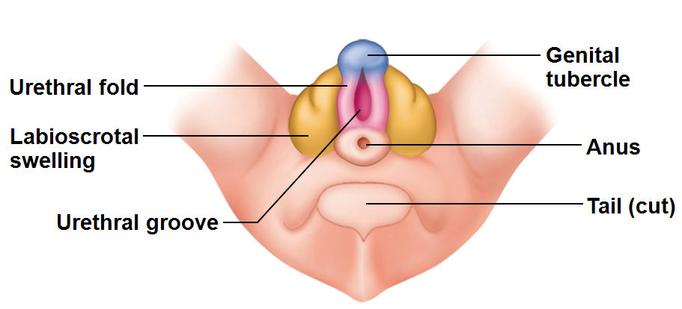
Developmental Aspects: Sexual Differentiation
Sexually _
Gonads begin development in ______________________ week as gonadal ridges
Primordial germ cells migrate to gonadal ridges to provide germ cells destined to become spermatogonia or oogonia
Gonads begin development in seventh week in males, eighth week in females

Slide 133
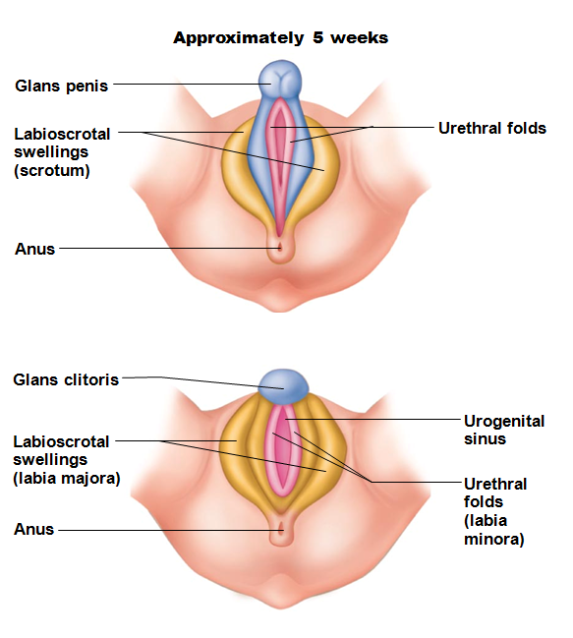
Development of External Genitalia
________________of male
clitoris of female
Urethral fold →
spongy urethra of male
labia minora of female
Labioscrotal swellings →
If testosterone absent, all embryos develop into females

Slide 134
Development Aspects: Descent of the Gonads
About two months before birth
Testosterone stimulates _
fibrous cord from each testis to scrotum or from ovary to labium majus; guides descent
Ovaries also descend, but stopped by __________________________________ at pelvic brim

Slide 135
Development Aspects: Puberty
FSH and LH elevated at birth but drop and remain low during prepubertal years
Reproductive organs grow to adult size and become functional
Occurs in response to rising levels of _
Earliest time that reproduction is possible

Slide 136
Menopause
Has occurred when _
No equivalent to menopause in males
Males continue to produce sperm well into eighth decade of life, though numbers and motility decrease

Slide 137
Menopause
Declining estrogen levels →
________________________________________ of reproductive organs and breasts
___________________________________________ in some
_________________________________________ as skin blood vessels undergo intense vasodilation
Gradual thinning of skin and bone loss
Increased total blood cholesterol levels and falling HDL

Slide 138
Menopause
Treatment with _______________________________ preparations given for years
Women's Health Initiative research reported increased risk of heart disease (51%), invasive breast cancer (24%), stroke (31%), dementia (risk doubled)
Smallest does for shortest time alright to reduce symptoms if no breast cancer or mutated BRCA gene

Slide 139
Pregnancy
_________________________________________ must enter uterine tube and be exposed to the male sperm cells.
Secondary oocyte lives _
Male sperm may exist for ________________________ in reproductive tract.

Slide 140
Fertilization
Sperm reaches secondary oocyte and the _________________________________ and its enzymes helps the sperm to penetrate
oocyte cell membrane _______________________________________________ after one sperm cell gains access

Slide 141
Fertilization
Once sperm within oocyte
forms large cell and polar body.
Female meiosis completes only after the sperm enters the egg.
Nuclei unite,
chromosomes mingle
____________________________________ is oocyte and sperm, has 46 chromosomes.

Slide 142
Cleavage
Zygote undergoes __
Gives rise to two cells
Two cells divide, turn to four cells, eight cells, etc.
Phase of development called _

Slide 143
Morula
Travel time to uterus:
solid ball of about 16 cells called the _
Remains unattached in the uterine cavity for _

Slide 144
Blastocyst
Structure becomes a ball of cells, __
Implants in the uterus by _

Slide 145
Organization
Blastocysts organizes into
gives rise to the _
Outer cells
become embryonic portion of _
_________________________________ until 8th week
_________________________________ until time of birth.

Slide 146
Placenta
Placenta develops
attaches the embryo to uterine wall
Gasses
wastes
between maternal blood and embryonic blood.
Placenta also _

Slide 147
Hormone changes
In non pregnant female,
the _
estrogen and progesterone levels _
uterine lining sloughs off
In pregnant female, need to _

Slide 148
HCG
______________ : human chorionic gonadotropin.
prevents spontaneous abortion (___________________________________)
HCG and some of the embryonic cells
maintain the corpus luteum
continues to secrete _
inhibits FSH and LH.

Slide 149
HCG
HCG secretion is high for about ____________________________________ and then declines.
Corpus luteum exists throughout pregnancy
most important in the first few months before the placenta takes over the estrogen and progesterone production.

Slide 150
More hormones
stimulates ________________________________________ and prepares the mammary glands for milk secretion.
Relaxin:
hormone from corpus luteum.
_________________________________________________ in the myometrium, suppresses uterine contractions until birth.
_________________________________________________ of the symphysis pubis and SI joints
aids passage of fetus through birth canal.

Slide 151
More hormones
Increased secretion of __________________________ and of parathyroid hormone
Aldosterone from adrenal cortex
promotes renal absorption of _
PTH helps to maintain high concentrations of _

Slide 152
Parturition
Pregnancy continues for about ____________________ and ends with ________________________________ or birth.

Slide 153
Hormonal changes with birth
Decreased progesterone
no longer preventing uterine contractions
___________________________________ stimulates uterus to contract.

Slide 154
Labor
Contractions start at the ____________________________________ and travel downward, forcing the _
Labor contractions _
stretches the cervix
elicits a reflex that stimulates contractions.

Slide 155
Dilation of cervix
_________________________________ of cervix stimulates increased release of oxytocin→ more contractions.

Slide 156
Involution
After the birth, the placenta _________________________________ from the uterine wall
expelled by the remaining uterine contractions,
stimulated by oxytocin.

Slide 157
Involution
For several weeks the uterus undergoes involution,
which is the _
For several weeks
will pass a _
then a ____________________________________ discharge
until the uterine lining heals and returns to a non-pregnant state.

Slide 158
More hormones (breast)
During pregnancy, placental estrogen and progesterone stimulate mammary development.
____________________________________________: causes ductile system to grow and branch.
_____________________________________________ stimulates the development of alveolar glands at the end of the ducts.

Slide 159
More hormones (breast)
____________________________________, released in week 5 and present throughout pregnancy.
Prolactin causes _
Placental lactogen _____________________________ prolactin _

Slide 160
Milk production and secretion
The placental hormones drop after birth. No longer will inhibit prolactin.
Prolactin stimulates the mammary glands to secrete large quantities of milk
not until _
Until then, there is _
rich in proteins
low in carbohydrates and fats

Slide 161
Milk ejection
Milk must be actively ejected by _
When the breast is suckled or stimulated
release of _
causes the muscles to contract and eject the milk.

Slide 162
Milk production
Prolactin is released as long as _
If milk not removed regularly,
prolactin is inhibited
mammary glands lose their ability to produce milk.

Slide 163
Embryonic Stage
Extends from week _
Internal organs develop
Major external body structures appear

Slide 164
Week Two
Amniotic cavity forms
Inner cell mass changes to _

Slide 165
Week Three
Layers from
Outer layer: _
Nervous system, epidermis
Inner layer: _
Linings of digestive respiratory, urinary and reproductive tracts
Middle layer: _
Muscle, bone, blood
These are the primary germ layers. All organs come from these germ layers

Slide 166
Week Four
Chorionic villi form
Embryonic disk changes into a cylindrical structure
Limb buds form

Slide 167
Weeks Five through Seven
Head grows rapidly
Eyes, nose, mouth
By end of week __________________________, all main internal organs are established

Slide 168
Umbilical Cord
Begins at umbilicus of embryo
Inserts into _
Three vessels
Two umbilical _
One umbilical vein

Slide 169
Amniotic Fluid
Provides a _
Provides _

Slide 170
Amniocentesis
Performed after _
Needle inserted into amniotic sac
Can determine _

Slide 171
Week Eight
Embryo is usually 30 mm long and weighs _
Looks human
Disturbances to development in embryonic stage can cause _

Slide 172
Fetal Stage
From end of week eight until birth
Month Three:
Body proportions change
___________________________________________ appear
By week 12, male and female organs distinguishable

Slide 173
Month Four
Skeleton continues to ossify
Fetus has _
Still has rapid growth

Slide 174
Month Five
Growth slows
______________________________________ muscles become active
_________________________________________: fine downy hair that covers skin
Vernix caseosa: cheesy mix of _____________________ and _____________________________________ covers the skin

Slide 175
Month Six
More weight gain
Month Seven

Slide 176
Final trimester
_________________________________________ formed
___________________________ deposited
Digestive and respiratory tracts mature

Slide 177
Neonatal period
Begins at _
Ends at _
Breathing (first breath)
Stimulated by _
Low oxygen
Decrease in _
Mechanical stimulation

Slide 178
Neonatal period
Energy
Fetus:
Neonate: _
Rich in nutrients and antibodies
Newborns will use _______________________________________________________ for energy as well

Slide 179
Neonatal
Used to allow blood from ______________________________________________ , skipping lungs
Closes due to blood pressure changes after birth

Slide 180
Ductus arteriosus
In fetus:
Allows blood in _________________________________________________, bypassing the lungs
Neotanal:

Slide 181
Infancy
From week four through _
Rapid growth: may _______________________ birth weight
Eruption of _
Increased coordination
First _

Slide 182
Infant nutrition requirements
Needs _
new tissues
Calcium/Vit D
bones and skeletal structures
Iron:
Vit C

Slide 183
Childhood
From end of first year through puberty
High rate of growth
Speech

Slide 184
Adolescence
Between _
Anatomical and physiological changes that result in _
Female puberty begins earlier than male
Girls will be taller, stronger than male peers
until male puberty

Slide 185
Adulthood
Maturity
From adolescence to old age
Male, age 18
Producing _________________________________________ for his lifetime
20’s:

Slide 186
Adulthood
30’s:
Hearing _
Heart muscle thickens
Loss of _
40’s:
Metabolism slows
Hair grays
Immune system _

Slide 187
Adulthood
50’s
Decreased pancreatic activity may lead to diabetes

Slide 188
Adulthood
60’s
Memory changes (___________________________)
70’s
Skin loses integrity
Cartilage continues to grow: _

Slide 189
Senescence
Senescence is the _
Result of _____________________________________________ over years
Decline of sensory functions more evident

Slide 190
Death
Following senescence, death usually results _

