Slide 1
Reproductive System
Primary sex organs
_______________________________in males
_______________________________in females
Gonads
produce sex cells called _
secrete

Slide 2
Reproductive System
Accessory reproductive organs
ducts, glands, and external genitalia
Sex hormones
estrogens and progesterone:

Slide 3
Male Reproductive System
male gonads ________________________________ and lie within the scrotum
Sperm are delivered through a system of ducts:
Accessory sex glands:
Empty secretions into ducts during ejaculation
Include the seminal vesicles, prostate gland, and bulbourethral glands

Slide 4
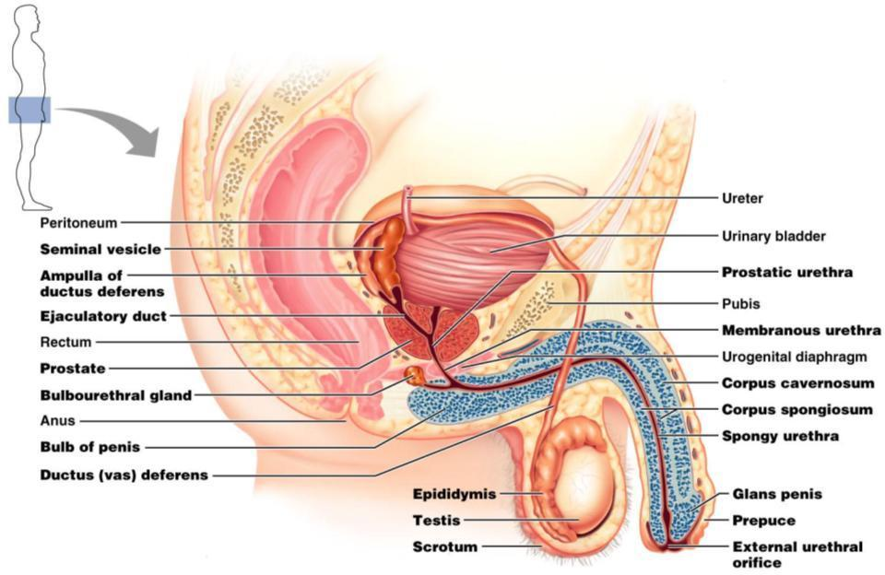
Figure 27.1

Slide 5
The Scrotum
Sac of skin and _
hangs outside the body at the _
Contains paired testicles separated by a midline septum
keeps the testes ________________________ than core body temperature

Slide 6
The Scrotum
Intrascrotal temperature is kept constant by two sets of muscles:
_______________________________________ that wrinkles scrotal skin
bands of ____________________________________ that elevate the testes

Slide 7
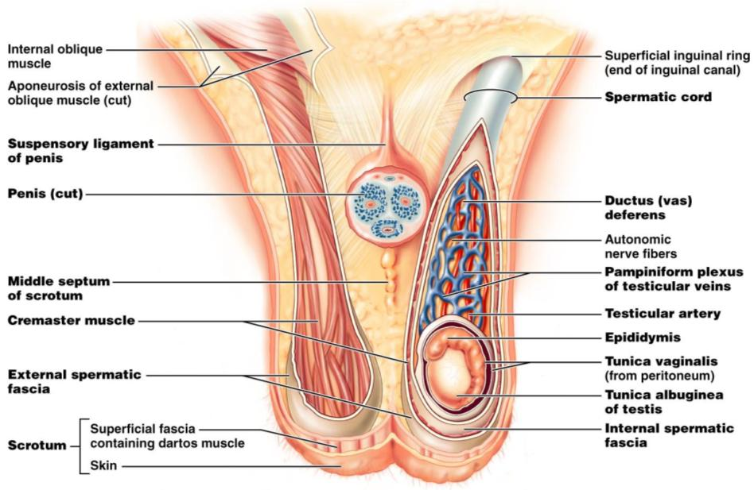
Figure 27.2

Slide 8
The Testes
Each testis is surrounded by two tunics:
derived from peritoneum
fibrous capsule of the testis
Septa divide the testis into 250-300 lobules, each containing 1-4 seminiferous tubules

Slide 9
The Testes
Produce the sperm
Converge to form the _
The straight tubulus rectus conveys sperm to the _

Slide 10
The Testes
From the rete testis, the sperm:
Leave the testis _
Enter the _
Surrounding the seminiferous tubules are interstitial cells

Slide 11
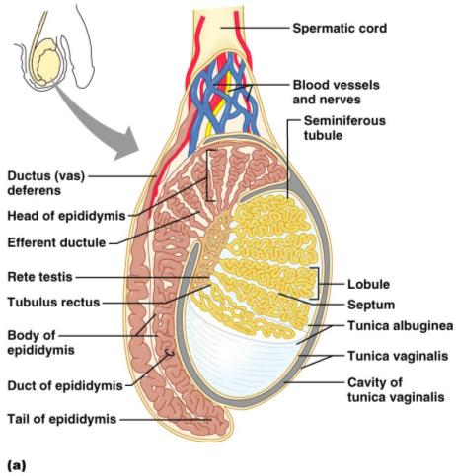
The Testes
Spermatic cord
encloses nerve fibers from ______________________________________
blood vessels,
__________________ that supply the testes

Slide 12
The Penis
A ________________________________ organ designed to deliver sperm into the female reproductive tract
Consists of
an attached root
a free shaft that ends in the _
or _
skin covering the distal end of the penis
Circumcision
surgical removal of the foreskin after birth

Slide 13
The Penis
the urethra and three cylindrical bodies of erectile tissue
spongy network of connective tissue and smooth muscle riddled with vascular spaces
during sexual excitement, the erectile tissue fills with blood causing the penis to enlarge and become rigid

Slide 14
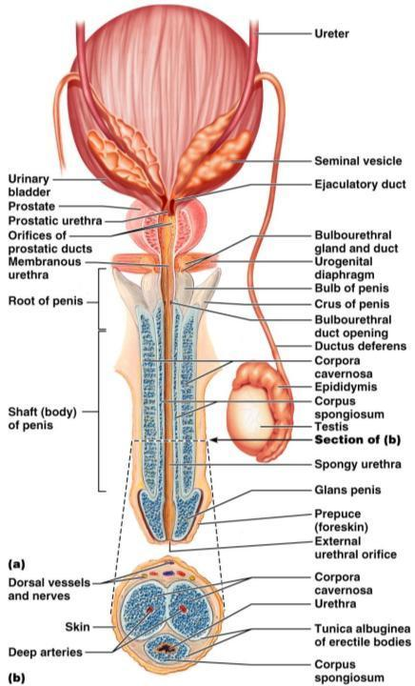
The Penis
Corpus spongiosum
expands to form the glans and bulb of the penis
Corpora _
_______________________ dorsal erectile bodies bound by fibrous tunica albuginea
Crura
_______________________ end of the penis surrounded by the ischiocavernosus muscle; _

Slide 15
Epididymis
Its head joins the efferent ductules and caps the superior aspect of the testis
The duct of the epididymis has __________________________________ that:
Absorb testicular fluid
Pass nutrients to the sperm
____________________________________ enter, pass through its tubes and become motile
Upon ejaculation the __________________________________ , expelling sperm into the _

Slide 16
Ductus Deferens and Ejaculatory Duct
Runs from the epididymis through the ______________________________________ into the pelvic cavity
expands to form the _
then joins the ___________________________________ to form the ejaculatory duct
Propels sperm from the epididymis to the _

Slide 17
Urethra
Consists of three regions
portion surrounded by the prostate
lies in the urogenital diaphragm
runs through the penis and opens to the outside at the external urethral orifice

Slide 18
Seminal Vesicles
Located at ___________________________ wall of the bladder
secrete 60% of the volume of semen
Semen
viscous ______________________________ fluid containing fructose, ascorbic acid, coagulating enzyme (vesiculase), and _

Slide 19
Seminal vesicles
Join the ductus deferens to form _
Sperm and seminal fluid mix in the ejaculatory duct and enter the _____________________________________during ejaculation

Slide 20
Prostate Gland
Doughnut-shaped gland
surrounds part of the urethra _
Plays a role in the _
Secretions enter the prostatic urethra during ejaculation

Slide 21
Prostate Gland
It is milky, _____________________________ fluid,
contains citrate,
accounts for one-third of the semen volume

Slide 22
Bulbourethral Glands
Pea-sized glands _
Produce _______________________________________prior to ejaculation
neutralizes traces of ____________________________________ in the urethra

Slide 23
Semen
Milky mixture of sperm and accessory gland secretions
Provides a ______________________________ and _______________________________ (fructose)
protects and _
facilitates movement of sperm

Slide 24
Semen
Prostaglandins in semen:
Decrease the viscosity of _
Stimulate _
Facilitate the movement of sperm through the female reproductive tract

Slide 25
Semen
The hormone _________________________________ enhances sperm motility
Semen is a_
Neutralizes _
Female _
Seminalplasmin
antibiotic chemical that _
_____________________________________________ coagulate semen _
then fibrinolysin liquefies the mass

