Slide 1
Male Sexual Response: Erection
Enlargement and stiffening of the penis from engorgement of __________________________________ with blood
During arousal, a ____________________________________ promotes the release _
Nitric oxide causes erectile tissue to fill with blood

Slide 2
Male Sexual Response: Erection
Expansion of the _
________________________________________ their drainage veins
_________________________________________and maintains engorgement
The corpus spongiosum functions in _____________________________________ during ejaculation

Slide 3
Male Sexual Response
Erection is initiated by sexual stimuli including:
Erotic sights, sounds, and smells
Erection can be _____________________________________ solely by emotional or _

Slide 4
Ejaculation
The propulsion of semen from the male duct system
At ejaculation, ____________________________________nerves cause:
Reproductive ducts and accessory organs to contract and _

Slide 5
Ejaculation
At ejaculation, sympathetic nerves cause: (continued)
______________________________________________________________________________, preventing the expulsion of urine
Bulbospongiosus muscles to undergo a rapid series of contractions

Slide 6
Spermatogenesis
The sequence of events that produces sperm in the seminiferous tubules of the testes
Each cell has ____________________________________ (one maternal, one paternal) and is said to be ___________________________________ (2n chromosomal number)

Slide 7
Spermatogenesis
Humans have 23 pairs of homologous chromosomes
________________________________________ and are said to be __________________________ (n chromosomal number)
Gamete formation is by _______________________________, in which the number of chromosomes is halved (from 2n to n)

Slide 8
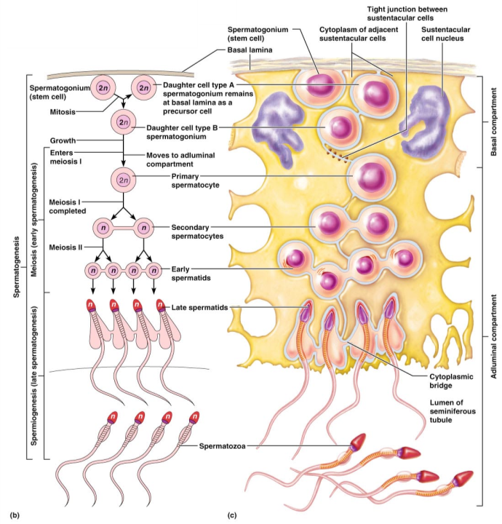
Figure 27.8b, c

Slide 9
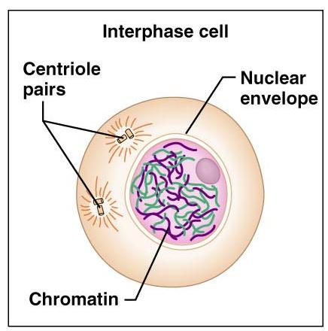
Meiosis – Interphase
Two _______________ divisions halve the number of chromosomes
Chromosomes _
Figure 27.7.1

Slide 10
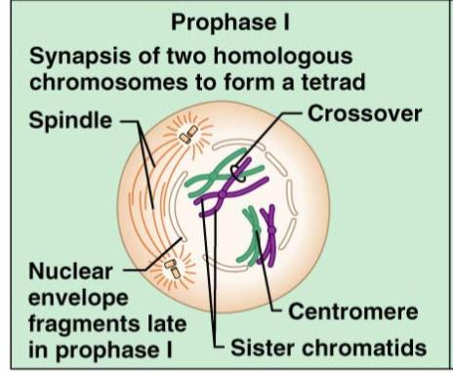
Meiosis – Prophase I
Homologous chromosomes undergo _
Tetrads are formed with _
____________________________________ takes place during prophase I
Figure 27.7.2.1

Slide 11
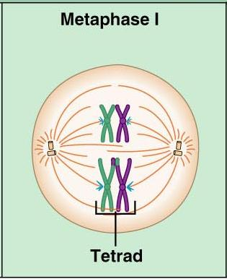
Meiosis – Metaphase I
__________________________________ at the spindle equator during_
Figure 27.7.2.2

Slide 12
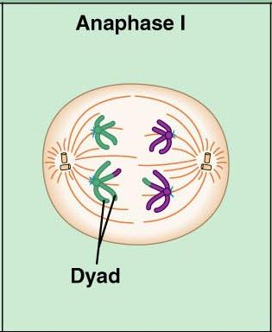
Meiosis – Anaphase I
Homologous chromosomes composed of __________________________________ are distributed to opposite ends of the cell
Figure 27.7.2.3

Slide 13
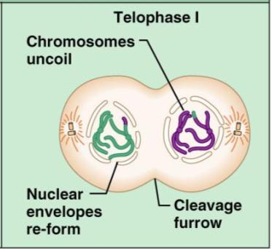
Meiosis – Telophase I
Nuclear membrane forms around chromosomal masses
With telophase and cytokinesis completed, two haploid daughter cells are formed (with 2n amount of DNA)
Figure 27.7.2.4

Slide 14
Meiosis II
Mirrors mitosis except that chromosomes are not replicated before it begins
Meiosis accomplishes two tasks:
It ____________________________________________ by half (2n to n)
It introduces _

Slide 15
Brain-Testicular Axis
Hormonal regulation of sperm production and testicular hormones involving the

Slide 16
Brain-Testicular Axis
Testicular regulation: three sets of hormones:
GnRH:
_____________________________________ stimulates the testes through:
Follicle stimulating hormone (FSH)
Luteinizing hormone (LH)
_______________________________________, which __________________________________ stimulate the testes
Testicular hormones
exert negative feedback controls

Slide 17
Hormonal Regulation
The hypothalamus releases gonadotropin-releasing hormone (GnRH)
GnRH stimulates the _________________________________________ to secrete FSH and LH
causes ______________________________________________ cells to release androgen-binding protein (ABP)
stimulates ________________________________________________ to release testosterone
ABP binding of testosterone enhances _

Slide 18
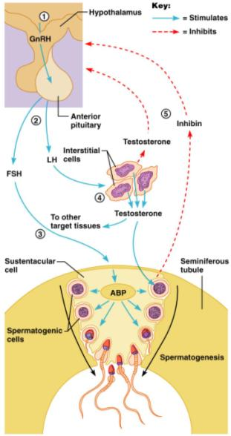
Hormonal Regulation
Feedback inhibition on the hypothalamus and pituitary results from:
Rising levels of _
Increased _
Figure 27.10

Slide 19
Testosterone Activity
Testosterone
Steroid hormone: synthesized from _
It must be transformed to exert its effects on some target cells
Prostate
it is converted into dihydrotestosterone (________) before it can bind within the nucleus
Neurons
it is ____________________________________________ to bring about stimulatory effects

Slide 20
Testosterone
Testosterone targets _
its _________________________________ causes these organs to _

Slide 21
Male Secondary Sex Characteristics
Male hormones make their appearance at puberty and induce changes in _
Appearance of _
Enhanced growth of the chest and deepening of the voice
Skin thickens and becomes oily
______________________________________ and increase in density
Skeletal muscles increase _

Slide 22
Male Secondary Sex Characteristics
Testosterone is the basis of _________________________________ in both males and females

Slide 23
Female Reproductive Anatomy
_______________________________: primary female reproductive organs
Make female gametes
Secrete female sex hormones
Accessory ducts include _

Slide 24
Female Reproductive Anatomy
Internal genitalia
external sex organs

Slide 25
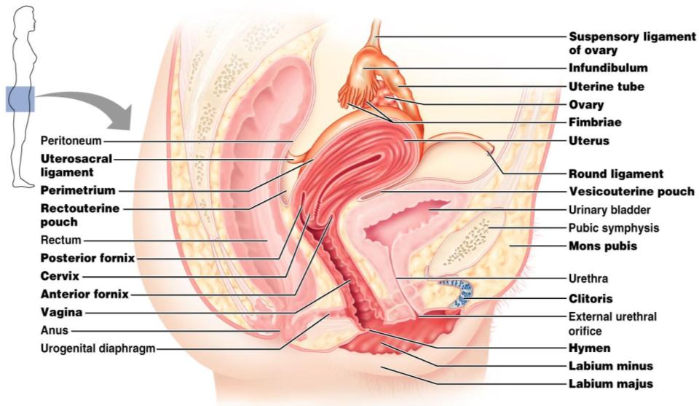
Female Reproductive Anatomy
Figure 27.11

Slide 26
The Ovaries
__________________________ organs on each side of the uterus held in place by several ligaments
Suspensory
Mesovarium
contains the suspensory ligament and the mesovarium

Slide 27
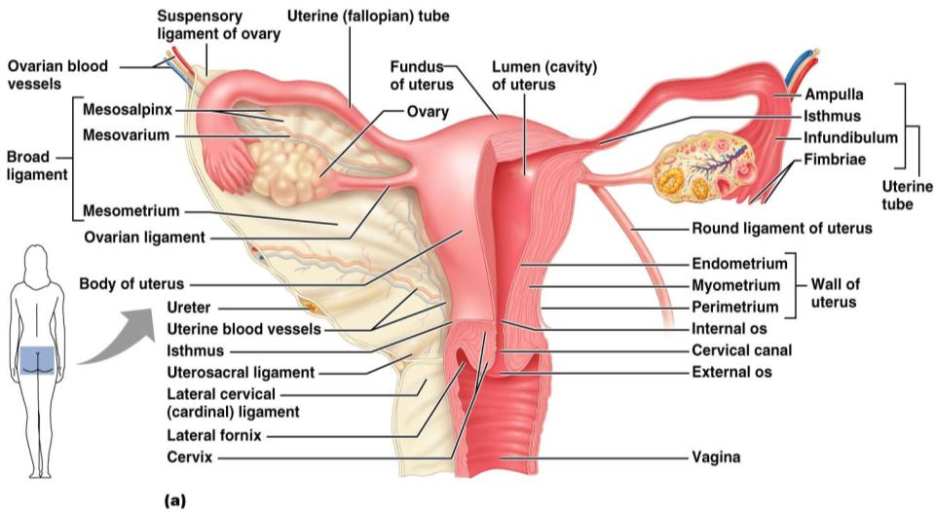
The Ovaries
Figure 27.14a

Slide 28
Ovaries
Blood supply
______________________________________ and the ovarian branch of _
They are surrounded by a fibrous tunica albuginea,
covered by a layer of epithelial cells called the _
Embedded in the __________________________ are ovarian follicles

Slide 29
Ovaries
Each follicle consists of an _
Cells around the oocyte are called:
one cell layer thick
when ______________________________________ is present

Slide 30
Ovaries
one layer of squamous-like follicle cells surrounds the oocyte
two or more layers of ___________________________________________ cells enclose the oocyte
has a _________________________________________ between granulosa cells that coalesces to form a central _

Slide 31
Ovaries
secondary follicle at its _____________________________________ that bulges from the surface of the ovary
Ovulation
_________________________________________from the ripening follicle
ruptured follicle _

