Slide 1
Ovulation
Ovulation occurs when the _
Mittelschmerz
a twinge of ___________________________ sometimes felt at _
1-2% of ovulations release more than one secondary oocyte, which if fertilized, results in fraternal twins

Slide 2
Luteal Phase
After ovulation,
the ruptured _
forms the _
The corpus luteum secretes _

Slide 3
Luteal Phase
If pregnancy does not occur:
the corpus luteum degenerates in 10 days, leaving a scar
If pregnancy does occur
the corpus luteum produces hormones _
at about 3 months

Slide 4
Establishing the Ovarian Cycle
During childhood,
ovaries grow
secrete small amounts of _
inhibit the hypothalamic release of GnRH
As puberty nears,
GnRH is released
These events continue until an adult cyclic pattern is achieved and menarche occurs

Slide 5
Hormonal Interactions During the Ovarian Cycle
Day 1
GnRH from ______________________________ stimulates the release of _____________________________________ from anterior pituitary
Over the next several days, FSH and LH _
As the follicle matures, it begins to produce and release estrogen
Rising estrogen levels:

Slide 6
Hormonal Interactions During the Ovarian Cycle
Estrogen levels increase
high estrogen levels have a ___________________________________________________________________________, causing a sudden surge of _

Slide 7
Hormonal Interactions During the Ovarian Cycle
The LH spike stimulates the primary oocyte to complete meiosis I, and the secondary oocyte continues on to metaphase II
Day 14 –

Slide 8
Hormonal Interactions & the Ovarian Cycle
LH transforms the ruptured follicle into a _
produces inhibin, progesterone, and estrogen
These hormones shut off ______________________________________ release and declining LH ends luteal activity
Days 26-28 – decline of the ovarian hormones
Ends the blockade of FSH and LH
The cycle starts anew

Slide 9
Uterine (Menstrual) Cycle
Series of cyclic changes that the uterine endometrium goes through each month in response to ovarian hormones in the blood
__________________________________________________– uterus sheds all but the deepest part of the endometrium
Days 6-14:
_________________________________________________ (preovulatory) phase – endometrium rebuilds itself
Days 15-28:
__________________________________________________ (postovulatory) phase – endometrium prepares for implantation of the embryo

Slide 10
Menses
If fertilization does __________________ occur
deprives the endometrium of hormonal support
_________________________________________ spasms and endometrial cells begin to die as blood flow is interupted
The functional layer begins to _
Spiral arteries constrict one final time then suddenly relax and open wide
The rush of blood fragments weakened capillary beds and _

Slide 11
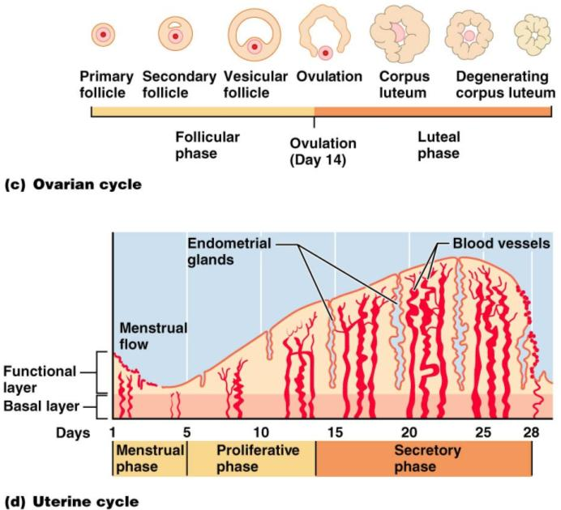

Slide 12
Extrauterine Effects of Estrogens and Progesterone
Estrogen levels _
Promote oogenesis and follicle growth in the ovary
Exert _________________________________ on the female reproductive tract
Uterine tubes, uterus, and vagina grow larger and become functional
Uterine tubes and uterus exhibit _
Vaginal mucosa thickens and _

Slide 13
Estrogen-Induced Secondary Sex Characteristics
Growth of the _
Increased deposition of _____________________________________, especially in the hips and breasts
Widening and lightening of the pelvis
Growth of _

Slide 14
Female Sexual response
_________________________________ nerve impulses cause arteries of erectile tissues to dilate
Blood flow _
erectile tissues swell
Vagina begins to _

Slide 15
Female Sexual Response
parasympathetic impulses stimulate
________________________________________ to secrete _______________________________ into the vestibule.
serves to moisten and lubricate the tissues,
prevent irritation of tissues and _

Slide 16
Female orgasm
The culmination of stimulation is _
the ____________________________________________________________________________________________ resulting in an increased friction.
Orgasm initiates a series of reflexes in which the
muscles of the perineum
walls of the uterus and fallopian tubes _
The contractions help to _____________________________________________ towards the uterine tubes.

Slide 17
Female Sexual Response
Females do not have a ____________________________________ after orgasm and can experience multiple orgasms in a single sexual experience
Orgasm is _____________________________ for conception

Slide 18
Sexually Transmitted Diseases: Gonorrhea
Bacterial infection caused by Neisseria gonorrhoeae,
spread by contact with _
Signs and symptoms
In males
___________________________________________, discharge of pus from the penis
In females
abdominal discomfort, vaginal discharge, abnormal uterine bleeding
Often mild symptoms are _________________________________________ or vaginosis

Slide 19
STD: Gonorrhea
Left untreated, can result in
pelvic inflammatory disease in women
May damage fallopian tubes and result in ectopic pregnancies or infertility
According to the CDC:
In the United States, the highest reported rates of infection are among _

Slide 20
STD: Gonorrhea
Prevention
Abstinence
_________________________________________ reduces transmission
Treatment:
antibiotics, but resistant strains are becoming more prevalent

Slide 21
STD: Syphilis
Bacterial infection from Treponema pallidum
transmitted sexually or _
“_____________________________” because signs and symptoms coincide with other disorders
Primary stage:
A ________________________________ appears at the site of infection and disappears in a few weeks

Slide 22
STD: Syphilis
time between infection and the start of the first symptom
from ____________________________________ (average 21 days).
The chancre is usually ___________________________________________, and painless.
It appears at the spot where syphilis entered the body.
The chancre _______________________________________, and it _______________________________________________. However, if adequate treatment is not administered, the infection progresses to the secondary stage.

Slide 23
STD: Syphilis
__________________________________________ shows signs of pink skin rash, fever, and joint pain
Other symptoms include swollen lymph glands, sore throat, patchy hair loss, headaches, weight loss, muscle aches, and fatigue.
A ______________________________ period follows, which may progress to tertiary syphilis characterized by gummas (lesions of the CNS, blood vessels, bones, and skin)
difficulty coordinating muscle movements, paralysis, numbness, gradual blindness, and dementia.
Treatment:

Slide 24
STD: Chlamydia
Most common STD in the U.S.
Bacteria: Chlamydia trachomatis
Symptoms include
penile and vaginal discharges;
abdominal, rectal, or testicular pain;
irregular menses
Can cause _____________________________________________ and urinary tract infections in men, and sterility in women
“___________________________________________" disease because about three quarters of infected women and about half of infected men have no symptoms
Prevention: abstinence, latex condoms reduce risk
Treatment is with tetracycline

Slide 25
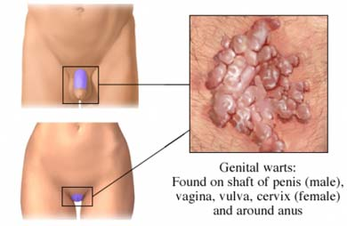
STD: Viral Infections
human papillomaviruses (HPV)
Low risk varieties can cause ________________________________________ and abnormal Pap smears
High risk varieties can increase the risk of _
Transmitted through _
Condoms do not prevent transmission of HPV, but have been show to reduce rates of cervical cancer

Slide 26
Sexually Transmitted Diseases: Viral Infections
Genital herpes
caused by Herpes Simplex Virus (HSV)
Herpetic lesions appear as _
characterized _
Can be passed to partner when sores are present OR absent
Congenital herpes can cause malformations of a fetus
Has been implicated with _
Treatment: acyclovir and other antiviral drugs

Slide 27
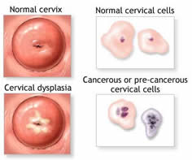
Pap Smears
Named for Dr. Papanicolaou
_____________________________________________________taken from external os and surrounding tissues for evaluation
Samples taken from the Squamo-columnar Junction.
circular area right at the opening of the cervix where the pink, smooth skin of the cervix meets the fiery-red, fragile, mucous-producing lining of the cervical canal.
If there is a problem with cancer or precancerous changes, it is this area that is most likely to be effected. This area of _______________________________________________ is also known as the _

Slide 28
Pelvic Inflammatory Disease
General term for infection of _
Often stemming from sexually transmitted diseases
Can damage uterus, fallopian tubes, and ovaries resulting in ________________________________________, abscesses, and chronic pain

Slide 29
Pelvic Inflammatory Disease
Risk factors
alters vaginal environment and allows bacteria to thrive
Forces bacteria through cervical canal
Symptoms: most commonly include _.
fever, unusual vaginal discharge that may have a foul odor,
painful intercourse, painful urination, irregular menstrual bleeding, and pain in the right upper abdomen (rare).

Slide 30
Endometriosis
Endometrial tissue normally found within the uterus is located within the pelvic cavity, commonly on ovaries
Fallopian tubes, uterine ligaments, intestines, bladder, vagina, cervix
Symtpoms:
pain during or after sexual activity
Infertility
Other symptoms may include fatigue; painful bowel movements with periods; _______________________________________; diarrhea and/or constipation and other intestinal upset with some periods.
Some women with endometriosis have no symptoms. Infertility affects about 30-40% of women with endometriosis and is a common result with progression of the disease.

