Slide 1
PMS: pre Menstrual syndrome
symptoms usually _
Symptoms usually stop when menstruation begins, or shortly thereafter.
exact cause of PMS has not been identified
estimated to affect up _____________________________ during their childbearing years
Symptoms:
headache, ankle swelling, back ache, abdominal cramps, abdominal pain, breast tenderness, weight gain, cold sores, acne flare-ups, nausea, constipation/diarrhea, food cravings, irritable, clumsy

Slide 2
Dysmenorrhea
Begins a day or so before menstruation and ends when the bleeding stops
May be related to _
Primary dysmenorrhea:
occurs in “healthy” women.
not related to any specific problems with the uterus or other pelvic organs.
Secondary dysmenorrhea:
caused by _______________________________________ or structural abnormality either within or outside the uterus

Slide 3
Genetic Sex Determination
Genetic sex is determined by the sex chromosomes each gamete contains
There are two types of sex chromosomes_
Females have two X chromosomes; males have one X and one Y
Hence, all eggs have an X chromosome; half the sperm have an X, and the other half a Y
A single gene on the Y chromosome, the _________________________, initiates testes development and determines maleness

Slide 4
Development of External Genitalia: Male
Under the influence of testosterone
_________________________________ enlarges forming the penis
___________________________________ elongates and closes completely
Urethral folds give rise to the _
____________________________________ swellings develop into the scrotum

Slide 5
Development of External Genitalia: Female
In the _
Genital tubercle gives rise to the _
The ________________________________ as the vestibule
The urethral folds become _
The labioscrotal swellings _

Slide 6
Descent of the Gonads
About 2 months before birth and stimulated by testosterone, the _________________________________________ and enter the scrotum
fibrous cord that extends from the testes to the scrotum
Spermatic cord
blood vessels, nerves, and fascial layers that help suspend the testes
Ovaries also descend, but are _______________________________________________ at the pelvic brim

Slide 7
Development Aspects: Puberty
Reproductive organs grow to adult size and become functional
Secondary sex characteristics appear
Characteristics of puberty
Males
__________________________________________ and scrotum, appearance of axillary and facial hair, _
Females
enlarging of the breasts, ____________________________________ , and dependable ovulation

Slide 8
Menopause
Ovulation and menses _
Without sufficient _________________________ , reproductive organs and breasts atrophy
Skin blood vessels undergo intense vasodilation (hot flashes occur)
Gradual thinning of the skin and bone loss
Males have no equivalent to menopause

Slide 9
From Egg to Embryo
Pregnancy
events that occur from _
the developing offspring
from the last menstrual period until birth

Slide 10
From Egg to Embryo
Preembryo
conceptus from _
Embryo
conceptus during the _
Fetus
conceptus from the _

Slide 11
Accomplishing Fertilization
The oocyte is viable for _
Sperm is viable _
For fertilization to occur, coitus must occur no more than:
Three days before ovulation
24 hours after ovulation
Fertilization
when a sperm fuses with an egg to _

Slide 12
Sperm Transport and Capacitation
Fates of ejaculated sperm:
Leak out of the vagina immediately after deposition
Fail to make it through the cervix
Dispersed in the uterine cavity or destroyed by _
Reach the uterine tubes
Sperm must undergo ________________________________ before they can penetrate the oocyte

Slide 13
Acrosomal Reaction and Sperm Penetration
An ovulated oocyte is encapsulated by:
The _
Extracellular matrix
Sperm binds to the zona pellucida and undergoes the _
_____________________________________ are released near the oocyte
Hundreds of acrosomes release their enzymes _

Slide 14
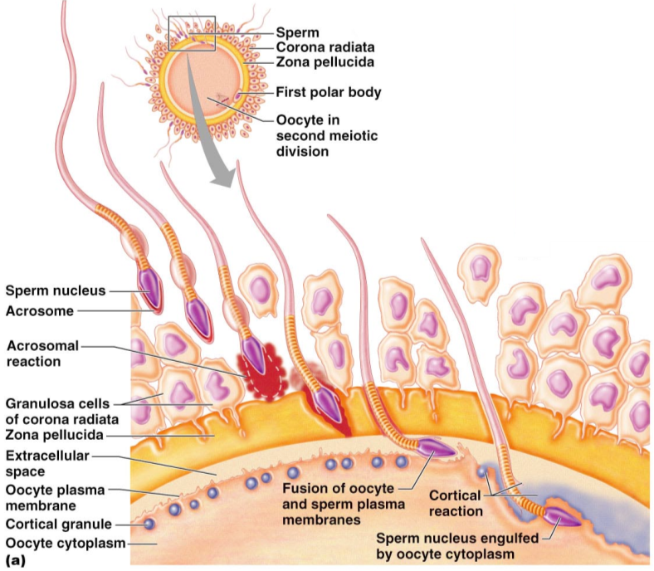

Slide 15
Completion of Meiosis II and Fertilization
Upon entry of sperm, the secondary oocyte:
Casts out the second polar body
The ovum nucleus swells, and the two nuclei approach each other
When fully swollen, the two nuclei are called _
Fertilization
when the _

Slide 16
Preembryonic Development
The first cleavage produces _
the 16 or more cell stage (72 hours old)
By the fourth or fifth day the preembryo consists of 100 or so cells (blastocyst)

Slide 17
Preembryonic Development
a fluid-filled hollow sphere composed of:
A single layer of _
An _
Trophoblasts take part in _
The inner cell mass becomes the _

Slide 18
Implantation
Begins ______________________________________ when the trophoblasts adhere to a properly prepared endometrium
The trophoblasts then proliferate and form _
Cytotrophoblast
cells of the inner layer that retain their cell boundaries
Syncytiotrophoblast
cells in the outer layer that lose their plasma membranes _

Slide 19
Implantation
The implanted blastocyst is covered over by endometrial cells
Implantation is completed by the _

Slide 20
Implantation
Viability of the corpus luteum is maintained by human chorionic gonadotropin (_______________) secreted by the _
hCG prompts the corpus luteum to continue to secrete progesterone and estrogen
Chorion
developed from trophoblasts after implantation, continues this hormonal stimulus
Between the second and third month, the placenta:
Assumes the role of progesterone and estrogen production
Is providing _

Slide 21
Placentation
Formation of the placenta from:
______________________________________ endometrial tissues
The placenta is fully formed and functional by the _

Slide 22
Placentation
Embryonic placental barriers include:
The _
The endothelium of embryonic capillaries
The _____________________________ also secretes other hormones
human placental lactogen, human chorionic thyrotropin, and relaxin

Slide 23
Embryonic Membranes
Amnion
Provides a ______________________________________ that protects the embryo
Helps maintain _
Amniotic fluid comes from maternal blood, and later, fetal urine

Slide 24
Embryonic Membranes
Forms part of the _
Produces earliest __________________________ and vessels
Is the source of primordial germ cells

Slide 25
Embryonic Membranes
a small outpocketing at the caudal end of the yolk sac
Structural base for the _
Becomes part of the _
helps form the _
Encloses the embryonic body and all other membranes

Slide 26
Gastrulation
During the 3rd week, the _____________________________________becomes a _
The primary germ layers are ectoderm, mesoderm, and endoderm

Slide 27
Primary Germ Layers
Serve as primitive tissues from which all body organs will derive
forms structures of the nervous system and skin epidermis
forms epithelial linings of the digestive, respiratory, and urogenital systems
forms all other tissues
Endoderm and ectoderm are securely joined and are considered epithelia

Slide 28
Effects of Pregnancy
________________________________________ develops a purplish hue
Breasts enlarge and their _
The uterus expands, occupying most of the abdominal cavity

Slide 29
Effects of Pregnancy
______________________________ is common due to the change of the body’s center of gravity
______________________________ causes pelvic ligaments and the pubic symphysis to relax
Typical weight gain is about 29 pounds

