Slide 1
Effects of Pregnancy: Metabolic Changes
The placenta secretes human placental lactogen (hPL),
stimulates the _
promotes growth of the fetus and exerts a maternal glucose-sparing effect
Human chorionic thyrotropin (hCT) _
Parathyroid hormone levels are high, ensuring a _

Slide 2
Effects of Pregnancy: Physiological Changes
GI tract
morning sickness occurs due _
Urinary system
_______________________________________________ to handle the additional fetal wastes
Respiratory system
Dyspnea (difficult breathing) may develop late in pregnancy

Slide 3
Effects of Pregnancy: Physiological Changes
Cardiovascular system
25-40%
Venous pressure from lower limbs is impaired, resulting in _

Slide 4
Parturition: Initiation of Labor
Estrogen reaches a peak during the last weeks of pregnancy causing _
Weak Braxton Hicks contractions may take place
As birth nears, _______________________________________ cause uterine contractions
Emotional and physical stress:
Activates the hypothalamus
Sets up a ________________________________________ mechanism, releasing more oxytocin

Slide 5
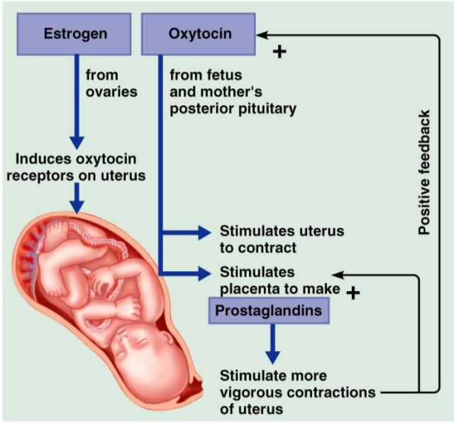
Parturition: Initiation of Labor

Slide 6
Stages of Labor: Dilation Stage
From the onset of labor ________________________________________(10 cm)
Initial contractions are 15–30 minutes apart and 10–30 seconds in duration
The cervix _
The __________________________________________, releasing amniotic fluid (breaking of the water)
____________________________________________ occurs as the infant’s head enters the true pelvis

Slide 7
Stages of Labor: Expulsion Stage
From full dilation to _
Strong contractions occur every _
The _________________________________ increases in labor without local anesthesia
_____________________________________ occurs when the largest dimension of the head is distending the vulva

Slide 8
Stages of Labor: Expulsion Stage
The delivery of the placenta is accomplished _
Afterbirth
the placenta and its attached fetal membranes
All placenta fragments must be removed to prevent _

Slide 9
Extrauterine Life
At 1-5 minutes after birth, the infant’s physical status is assessed based on five signs:
Each observation is given a score of _
Apgar score
the total score of the above assessments
Lower scores reveal problems

Slide 10
Occlusion of Fetal Blood Vessels
______________________________________________ constrict and become _
Fates of fetal vessels
Proximal umbilical arteries become _____________________________________________ and distal parts become the _
The umbilical vein becomes the _
The ductus venosus becomes the _
The __________________________________________ becomes the fossa ovalis
The ductus arteriosus becomes the ligamentum arteriosum

Slide 11
Transitional Period
Unstable period lasting 6-8 hours after birth
The __________________________________ the baby is alert and active
Heart rate increases (120-160 beats/min.)
Temperature _

Slide 12
Transitional Period
Activity then __________________________ and the infant sleeps about _
A second active stage follows in which the baby _
After this, the infant sleeps, with waking periods occurring every 3-4 hours

Slide 13
Lactation
The production of milk by the _
Estrogens, progesterone, and lactogen stimulate the hypothalamus to release _
The _________________________________ responds by releasing _

Slide 14
Lactation
Solution rich in vitamin A, protein, minerals, and IgA antibodies
Is released the _
Is followed by _____________________________ production

Slide 15
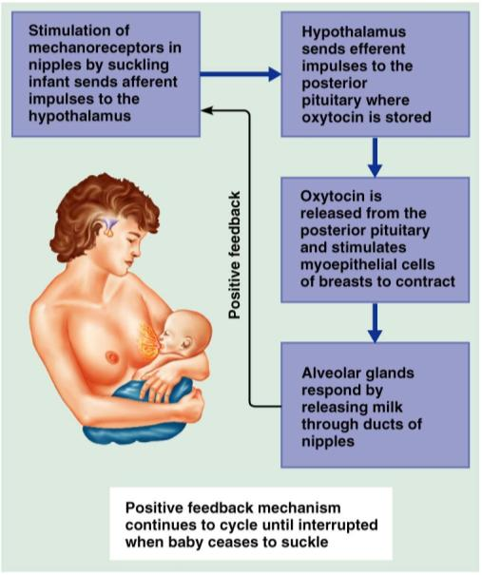
Lactation and Milk Let-down Reflex
After birth, milk production is _
Figure 28.18

Slide 16
Breast Milk
Advantages of breast milk for the infant
Fats and iron are _
Its amino acids are metabolized _______________________________________________ than those of cow’s milk
Beneficial chemicals are present – __________________, other immunoglobulins, complement, lysozyme, ___________________________________________, and lactoperoxidase
Interleukins and prostaglandins are present, which prevent overzealous inflammatory responses
Its ______________________________________________ help cleanse the bowels of meconium

