Slide 1
Establishing the Ovarian Cycle
During childhood,
ovaries grow
secrete small amounts of _
inhibit the hypothalamic release of GnRH
As puberty nears,
GnRH is released
These events continue until an adult cyclic pattern is achieved and menarche occurs

Slide 2
Hormonal Interactions During the Ovarian Cycle
Day 1
GnRH from ______________________________ stimulates the release of _____________________________________ from anterior pituitary
Over the next several days, FSH and LH _
As the follicle matures, it begins to produce and release estrogen
Rising estrogen levels:

Slide 3
Hormonal Interactions During the Ovarian Cycle
Estrogen levels increase
high estrogen levels have a ___________________________________________________________________________, causing a sudden surge of _

Slide 4
Hormonal Interactions During the Ovarian Cycle
The LH spike stimulates the primary oocyte to complete meiosis I, and the secondary oocyte continues on to metaphase II
Day 14 –

Slide 5
Hormonal Interactions & the Ovarian Cycle
LH transforms the ruptured follicle into a _
produces inhibin, progesterone, and estrogen
These hormones shut off ______________________________________ release and declining LH ends luteal activity
Days 26-28 – decline of the ovarian hormones
Ends the blockade of FSH and LH
The cycle starts anew

Slide 6
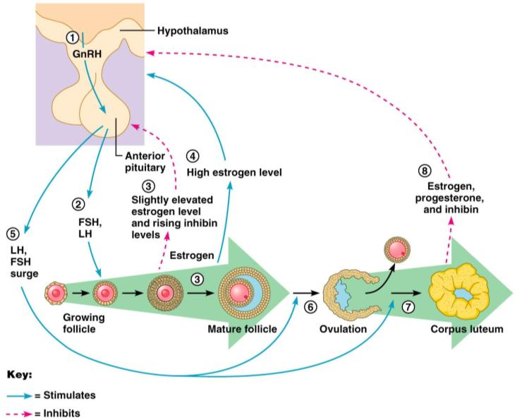
Feedback Mechanisms in Ovarian Function

Slide 7
Uterine (Menstrual) Cycle
Series of cyclic changes that the uterine endometrium goes through each month in response to ovarian hormones in the blood
__________________________________________________– uterus sheds all but the deepest part of the endometrium
Days 6-14:
_________________________________________________ (preovulatory) phase – endometrium rebuilds itself
Days 15-28:
__________________________________________________ (postovulatory) phase – endometrium prepares for implantation of the embryo

Slide 8
Menses
If fertilization does __________________ occur
deprives the endometrium of hormonal support
_________________________________________ spasms and endometrial cells begin to die as blood flow is interupted
The functional layer begins to _
Spiral arteries constrict one final time then suddenly relax and open wide
The rush of blood fragments weakened capillary beds and _

Slide 9
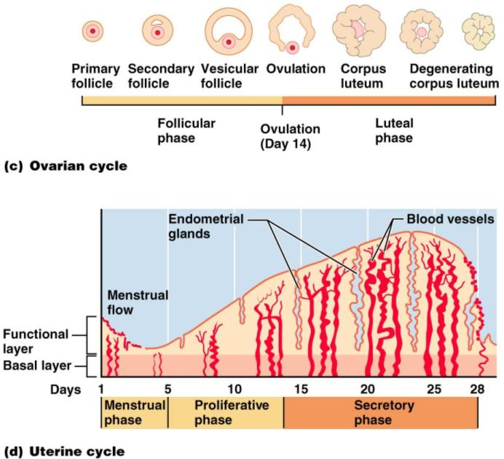

Slide 10
Extrauterine Effects of Estrogens and Progesterone
Estrogen levels _
Promote oogenesis and follicle growth in the ovary
Exert _________________________________ on the female reproductive tract
Uterine tubes, uterus, and vagina grow larger and become functional
Uterine tubes and uterus exhibit _
Vaginal mucosa thickens and _

Slide 11
Estrogen-Induced Secondary Sex Characteristics
Growth of the _
Increased deposition of _____________________________________, especially in the hips and breasts
Widening and lightening of the pelvis
Growth of _

Slide 12
Female Sexual response
_________________________________ nerve impulses cause arteries of erectile tissues to dilate
Blood flow _
erectile tissues swell
Vagina begins to _

Slide 13
Female Sexual Response
parasympathetic impulses stimulate
________________________________________ to secrete _______________________________ into the vestibule.
serves to moisten and lubricate the tissues,
prevent irritation of tissues and _

Slide 14
Female orgasm
The culmination of stimulation is _
the ____________________________________________________________________________________________ resulting in an increased friction.
Orgasm initiates a series of reflexes in which the
muscles of the perineum
walls of the uterus and fallopian tubes _
The contractions help to _____________________________________________ towards the uterine tubes.

Slide 15
Female Sexual Response
Females do not have a ____________________________________ after orgasm and can experience multiple orgasms in a single sexual experience
Orgasm is _____________________________ for conception

Slide 16
Sexually Transmitted Diseases: Gonorrhea
Bacterial infection caused by Neisseria gonorrhoeae,
spread by contact with _
Signs and symptoms
In males
___________________________________________, discharge of pus from the penis
In females
abdominal discomfort, vaginal discharge, abnormal uterine bleeding
Often mild symptoms are _________________________________________ or vaginosis

Slide 17
STD: Gonorrhea
Left untreated, can result in
pelvic inflammatory disease in women
May damage fallopian tubes and result in ectopic pregnancies or infertility
According to the CDC:
In the United States, the highest reported rates of infection are among _

Slide 18
STD: Gonorrhea
Prevention
Abstinence
_________________________________________ reduces transmission
Treatment:
antibiotics, but resistant strains are becoming more prevalent

Slide 19
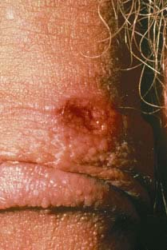
STD: Syphilis
Bacterial infection from Treponema pallidum
transmitted sexually or _
“_____________________________” because signs and symptoms coincide with other disorders
Primary stage:
A ________________________________ appears at the site of infection and disappears in a few weeks

Slide 20
sTD: Syphilis
time between infection and the start of the first symptom
from ____________________________________ (average 21 days).
The chancre is usually ___________________________________________, and painless.
It appears at the spot where syphilis entered the body.
The chancre _______________________________________, and it _______________________________________________. However, if adequate treatment is not administered, the infection progresses to the secondary stage.

Slide 21
STD: Syphilis
__________________________________________ shows signs of pink skin rash, fever, and joint pain
Other symptoms include swollen lymph glands, sore throat, patchy hair loss, headaches, weight loss, muscle aches, and fatigue.
A ______________________________ period follows, which may progress to tertiary syphilis characterized by gummas (lesions of the CNS, blood vessels, bones, and skin)
difficulty coordinating muscle movements, paralysis, numbness, gradual blindness, and dementia.
Treatment:

Slide 22
STD: Chlamydia
Most common STD in the U.S.
Bacteria: Chlamydia trachomatis
Symptoms include
penile and vaginal discharges;
abdominal, rectal, or testicular pain;
irregular menses
Can cause _____________________________________________ and urinary tract infections in men, and sterility in women
“___________________________________________" disease because about three quarters of infected women and about half of infected men have no symptoms
Prevention: abstinence, latex condoms reduce risk
Treatment is with tetracycline

Slide 23
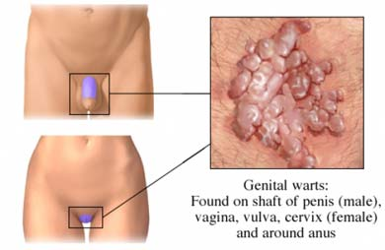
STD: Viral Infections
human papillomaviruses (HPV)
Low risk varieties can cause ________________________________________ and abnormal Pap smears
High risk varieties can increase the risk of _
Transmitted through _
Condoms do not prevent transmission of HPV, but have been show to reduce rates of cervical cancer

Slide 24
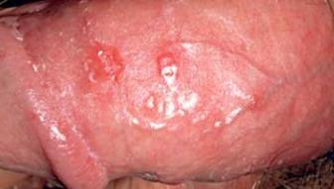
Sexually Transmitted Diseases: Viral Infections
Genital herpes
caused by Herpes Simplex Virus (HSV)
Herpetic lesions appear as _
characterized _
Can be passed to partner when sores are present OR absent
Congenital herpes can cause malformations of a fetus
Has been implicated with _
Treatment: acyclovir and other antiviral drugs

Slide 25
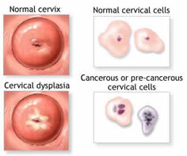
Pap Smears
Named for Dr. Papanicolaou
_____________________________________________________taken from external os and surrounding tissues for evaluation
Samples taken from the Squamo-columnar Junction.
circular area right at the opening of the cervix where the pink, smooth skin of the cervix meets the fiery-red, fragile, mucous-producing lining of the cervical canal.
If there is a problem with cancer or precancerous changes, it is this area that is most likely to be effected. This area of _______________________________________________ is also known as the _

Slide 26
Pelvic Inflammatory Disease
General term for infection of _
Often stemming from sexually transmitted diseases
Can damage uterus, fallopian tubes, and ovaries resulting in ________________________________________, abscesses, and chronic pain

Slide 27
Pelvic Inflammatory Disease
Risk factors
alters vaginal environment and allows bacteria to thrive
Forces bacteria through cervical canal
Symptoms: most commonly include _.
fever, unusual vaginal discharge that may have a foul odor,
painful intercourse, painful urination, irregular menstrual bleeding, and pain in the right upper abdomen (rare).

Slide 28
Endometriosis
Endometrial tissue normally found within the uterus is located within the pelvic cavity, commonly on ovaries
Fallopian tubes, uterine ligaments, intestines, bladder, vagina, cervix
Sympoms:
pain during or after sexual activity
Infertility
Other symptoms may include fatigue; painful bowel movements with periods; _______________________________________; diarrhea and/or constipation and other intestinal upset with some periods.
Some women with endometriosis have no symptoms. Infertility affects about 30-40% of women with endometriosis and is a common result with progression of the disease.

Slide 29
PMS: pre Menstrual syndrome
symptoms usually _
Symptoms usually stop when menstruation begins, or shortly thereafter.
exact cause of PMS has not been identified
estimated to affect up _____________________________ during their childbearing years
Symptoms:
headache, ankle swelling, back ache, abdominal cramps, abdominal pain, breast tenderness, weight gain, cold sores, acne flare-ups, nausea, constipation/diarrhea, food cravings, irritable, clumsy

Slide 30
Dysmenorrhea
Begins a day or so before menstruation and ends when the bleeding stops
May be related to _
Primary dysmenorrhea:
occurs in “healthy” women.
not related to any specific problems with the uterus or other pelvic organs.
Secondary dysmenorrhea:
caused by _______________________________________ or structural abnormality either within or outside the uterus

Slide 31
Genetic Sex Determination
Genetic sex is determined by the sex chromosomes each gamete contains
There are two types of sex chromosomes_
Females have two X chromosomes; males have one X and one Y
Hence, all eggs have an X chromosome; half the sperm have an X, and the other half a Y
A single gene on the Y chromosome, the _________________________, initiates testes development and determines maleness

Slide 32
Development of External Genitalia: Male
Under the influence of testosterone
_________________________________ enlarges forming the penis
___________________________________ elongates and closes completely
Urethral folds give rise to the _
____________________________________ swellings develop into the scrotum

Slide 33
Development of External Genitalia: Female
In the _
Genital tubercle gives rise to the _
The ________________________________ as the vestibule
The urethral folds become _
The labioscrotal swellings _

Slide 34
Descent of the Gonads
About 2 months before birth and stimulated by testosterone, the _________________________________________ and enter the scrotum
fibrous cord that extends from the testes to the scrotum
Spermatic cord
blood vessels, nerves, and fascial layers that help suspend the testes
Ovaries also descend, but are _______________________________________________ at the pelvic brim

Slide 35
Development Aspects: Puberty
Reproductive organs grow to adult size and become functional
Secondary sex characteristics appear
Characteristics of puberty
Males
__________________________________________ and scrotum, appearance of axillary and facial hair, _
Females
enlarging of the breasts, ____________________________________ , and dependable ovulation

Slide 36
Menopause
Ovulation and menses _
Without sufficient _________________________ , reproductive organs and breasts atrophy
Skin blood vessels undergo intense vasodilation (hot flashes occur)
Gradual thinning of the skin and bone loss
Males have no equivalent to menopause

Slide 37
From Egg to Embryo
Pregnancy
events that occur from _
the developing offspring
from the last menstrual period until birth

Slide 38
From Egg to Embryo
Preembryo
conceptus from _
Embryo
conceptus during the _
Fetus
conceptus from the _

Slide 39
Accomplishing Fertilization
The oocyte is viable for _
Sperm is viable _
For fertilization to occur, coitus must occur no more than:
Three days before ovulation
24 hours after ovulation
Fertilization
when a sperm fuses with an egg to _

Slide 40
Sperm Transport and Capacitation
Fates of ejaculated sperm:
Leak out of the vagina immediately after deposition
Fail to make it through the cervix
Dispersed in the uterine cavity or destroyed by _
Reach the uterine tubes
Sperm must undergo ________________________________ before they can penetrate the oocyte

Slide 41
Acrosomal Reaction and Sperm Penetration
An ovulated oocyte is encapsulated by:
The _
Extracellular matrix
Sperm binds to the zona pellucida and undergoes the _
_____________________________________ are released near the oocyte
Hundreds of acrosomes release their enzymes _

Slide 42
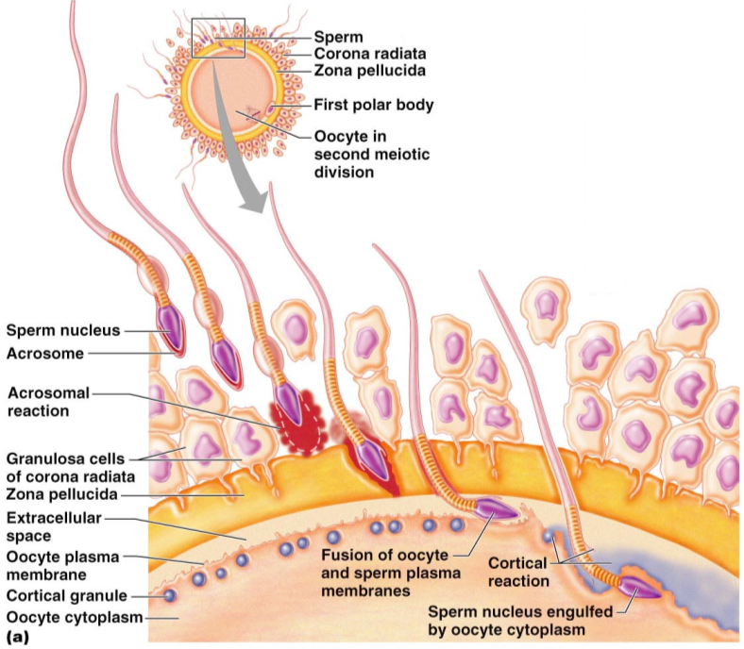

Slide 43
Completion of Meiosis II and Fertilization
Upon entry of sperm, the secondary oocyte:
Casts out the second polar body
The ovum nucleus swells, and the two nuclei approach each other
When fully swollen, the two nuclei are called _
Fertilization
when the _

Slide 44
Preembryonic Development
The first cleavage produces _
the 16 or more cell stage (72 hours old)
By the fourth or fifth day the preembryo consists of 100 or so cells (blastocyst)

Slide 45
Preembryonic Development
a fluid-filled hollow sphere composed of:
A single layer of _
An _
Trophoblasts take part in _
The inner cell mass becomes the _

Slide 46
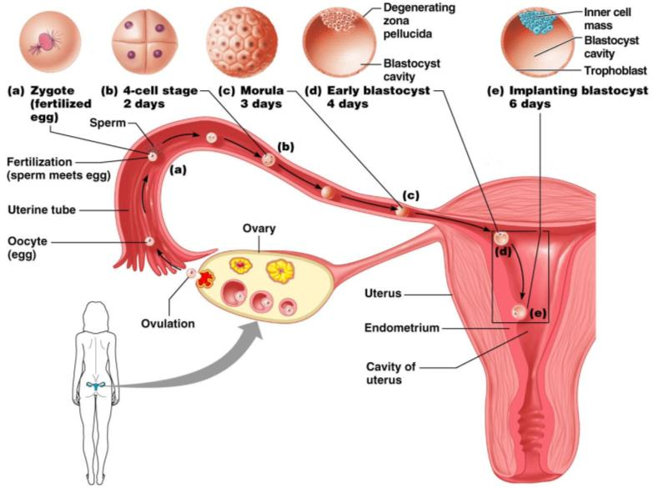
Cleavage: From Zygote to Blastocyst

Slide 47
Implantation
Begins ______________________________________ when the trophoblasts adhere to a properly prepared endometrium
The trophoblasts then proliferate and form _
Cytotrophoblast
cells of the inner layer that retain their cell boundaries
Syncytiotrophoblast
cells in the outer layer that lose their plasma membranes _

Slide 48
Implantation
The implanted blastocyst is covered over by endometrial cells
Implantation is completed by the _

Slide 49
Implantation
Viability of the corpus luteum is maintained by human chorionic gonadotropin (_______________) secreted by the _
hCG prompts the corpus luteum to continue to secrete progesterone and estrogen
Chorion
developed from trophoblasts after implantation, continues this hormonal stimulus
Between the second and third month, the placenta:
Assumes the role of progesterone and estrogen production
Is providing _

Slide 50
Placentation
Formation of the placenta from:
______________________________________ endometrial tissues
The placenta is fully formed and functional by the _

Slide 51
Placentation
Embryonic placental barriers include:
The _
The endothelium of embryonic capillaries
The _____________________________ also secretes other hormones
human placental lactogen, human chorionic thyrotropin, and relaxin

Slide 52
Embryonic Membranes
Amnion
Provides a ______________________________________ that protects the embryo
Helps maintain _
Amniotic fluid comes from maternal blood, and later, fetal urine

Slide 53
Embryonic Membranes
Forms part of the _
Produces earliest __________________________ and vessels
Is the source of primordial germ cells

Slide 54
Embryonic Membranes
a small outpocketing at the caudal end of the yolk sac
Structural base for the _
Becomes part of the _
helps form the _
Encloses the embryonic body and all other membranes

