Slide 1
Gastrulation
During the 3rd week, the _____________________________________becomes a _
The primary germ layers are ectoderm, mesoderm, and endoderm

Slide 2
Primary Germ Layers
Serve as primitive tissues from which all body organs will derive
forms structures of the nervous system and skin epidermis
forms epithelial linings of the digestive, respiratory, and urogenital systems
forms all other tissues
Endoderm and ectoderm are securely joined and are considered epithelia

Slide 3
Effects of Pregnancy
________________________________________ develops a purplish hue
Breasts enlarge and their _
The uterus expands, occupying most of the abdominal cavity

Slide 4
Effects of Pregnancy
______________________________ is common due to the change of the body’s center of gravity
______________________________ causes pelvic ligaments and the pubic symphysis to relax
Typical weight gain is about 29 pounds

Slide 5
Effects of Pregnancy: Metabolic Changes
The placenta secretes human placental lactogen (hPL),
stimulates the _
promotes growth of the fetus and exerts a maternal glucose-sparing effect
Human chorionic thyrotropin (hCT) _
Parathyroid hormone levels are high, ensuring a _

Slide 6
Effects of Pregnancy: Physiological Changes
GI tract
morning sickness occurs due _
Urinary system
_______________________________________________ to handle the additional fetal wastes
Respiratory system
Dyspnea (difficult breathing) may develop late in pregnancy

Slide 7
Effects of Pregnancy: Physiological Changes
Cardiovascular system
25-40%
Venous pressure from lower limbs is impaired, resulting in _

Slide 8
Parturition: Initiation of Labor
Estrogen reaches a peak during the last weeks of pregnancy causing _
Weak Braxton Hicks contractions may take place
As birth nears, _______________________________________ cause uterine contractions
Emotional and physical stress:
Activates the hypothalamus
Sets up a ________________________________________ mechanism, releasing more oxytocin

Slide 9
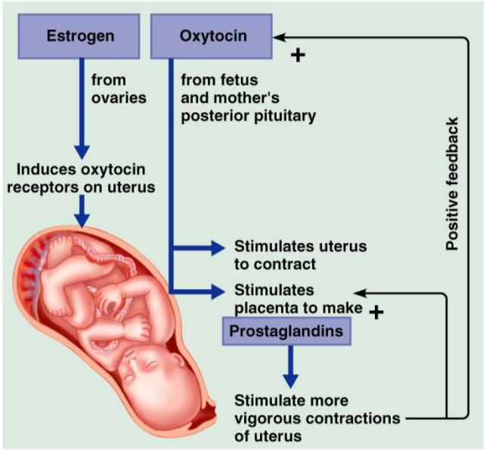
Parturition: Initiation of Labor

Slide 10
Stages of Labor: Dilation Stage
From the onset of labor ________________________________________(10 cm)
Initial contractions are 15–30 minutes apart and 10–30 seconds in duration
The cervix _
The __________________________________________, releasing amniotic fluid (breaking of the water)
____________________________________________ occurs as the infant’s head enters the true pelvis

Slide 11
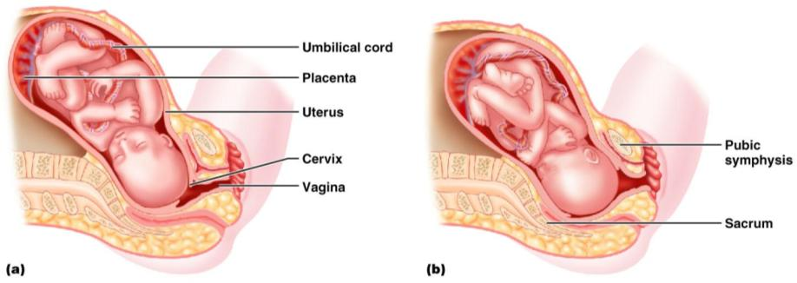
Stages of Labor: Dilation Stage

Slide 12
Stages of Labor: Expulsion Stage
From full dilation to _
Strong contractions occur every _
The _________________________________ increases in labor without local anesthesia
_____________________________________ occurs when the largest dimension of the head is distending the vulva

Slide 13
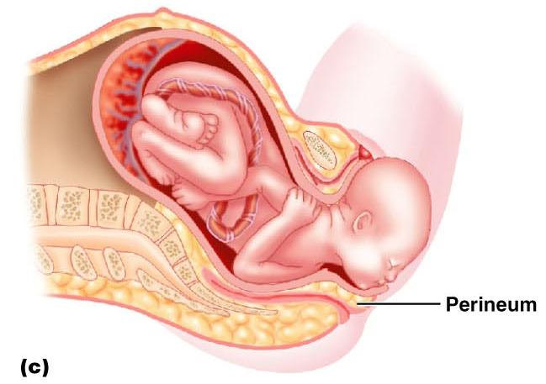
Stages of Labor: Expulsion Stage

Slide 14
Stages of Labor: Expulsion Stage
The delivery of the placenta is accomplished _
Afterbirth
the placenta and its attached fetal membranes
All placenta fragments must be removed to prevent _

Slide 15
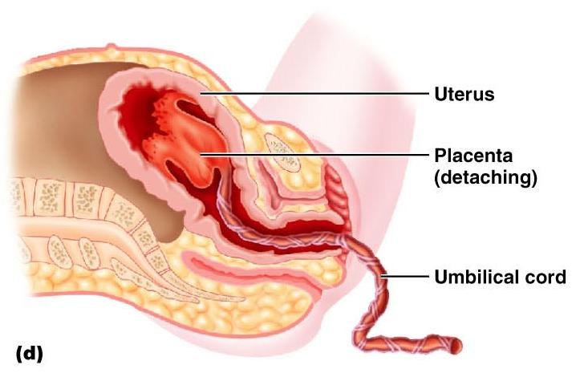
Stages of Labor: Expulsion Stage

Slide 16
Extrauterine Life
At 1-5 minutes after birth, the infant’s physical status is assessed based on five signs:
Each observation is given a score of _
Apgar score
the total score of the above assessments
Lower scores reveal problems

Slide 17
Occlusion of Fetal Blood Vessels
______________________________________________ constrict and become _
Fates of fetal vessels
Proximal umbilical arteries become _____________________________________________ and distal parts become the _
The umbilical vein becomes the _
The ductus venosus becomes the _
The __________________________________________ becomes the fossa ovalis
The ductus arteriosus becomes the ligamentum arteriosum

Slide 18
Transitional Period
Unstable period lasting 6-8 hours after birth
The __________________________________ the baby is alert and active
Heart rate increases (120-160 beats/min.)
Temperature _

Slide 19
Transitional Period
Activity then __________________________ and the infant sleeps about _
A second active stage follows in which the baby _
After this, the infant sleeps, with waking periods occurring every 3-4 hours

Slide 20
Lactation
The production of milk by the _
Estrogens, progesterone, and lactogen stimulate the hypothalamus to release _
The _________________________________ responds by releasing _

Slide 21
Lactation
Solution rich in vitamin A, protein, minerals, and IgA antibodies
Is released the _
Is followed by _____________________________ production

Slide 22
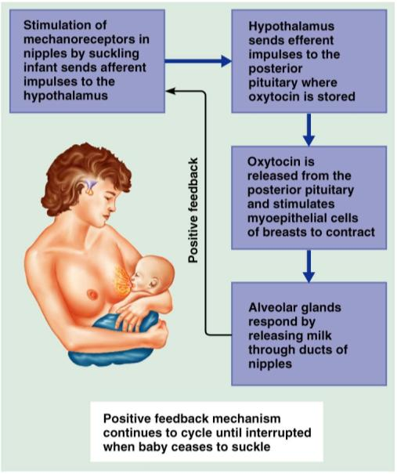
Lactation and Milk Let-down Reflex
After birth, milk production is _
Figure 28.18

Slide 23
Breast Milk
Advantages of breast milk for the infant
Fats and iron are _
Its amino acids are metabolized _______________________________________________ than those of cow’s milk
Beneficial chemicals are present – __________________, other immunoglobulins, complement, lysozyme, ___________________________________________, and lactoperoxidase
Interleukins and prostaglandins are present, which prevent overzealous inflammatory responses
Its ______________________________________________ help cleanse the bowels of meconium

