Slide 1
Reproductive System
Primary sex organs
_______________________________in males
_______________________________in females
Gonads
produce sex cells called _
secrete

Slide 2
Reproductive System
Accessory reproductive organs
ducts, glands, and external genitalia
Sex hormones
estrogens and progesterone:

Slide 3
Male Reproductive System
male gonads ________________________________ and lie within the scrotum
Sperm are delivered through a system of ducts:
Accessory sex glands:
Empty secretions into ducts during ejaculation
Include the seminal vesicles, prostate gland, and bulbourethral glands

Slide 4
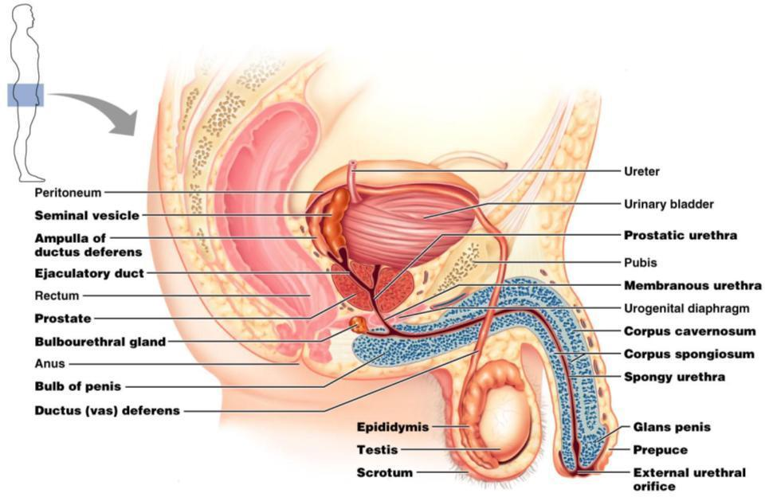
Figure 27.1

Slide 5
The Scrotum
Sac of skin and _
hangs outside the body at the _
Contains paired testicles separated by a midline septum
keeps the testes ________________________ than core body temperature

Slide 6
The Scrotum
Intrascrotal temperature is kept constant by two sets of muscles:
_______________________________________ that wrinkles scrotal skin
bands of ____________________________________ that elevate the testes

Slide 7
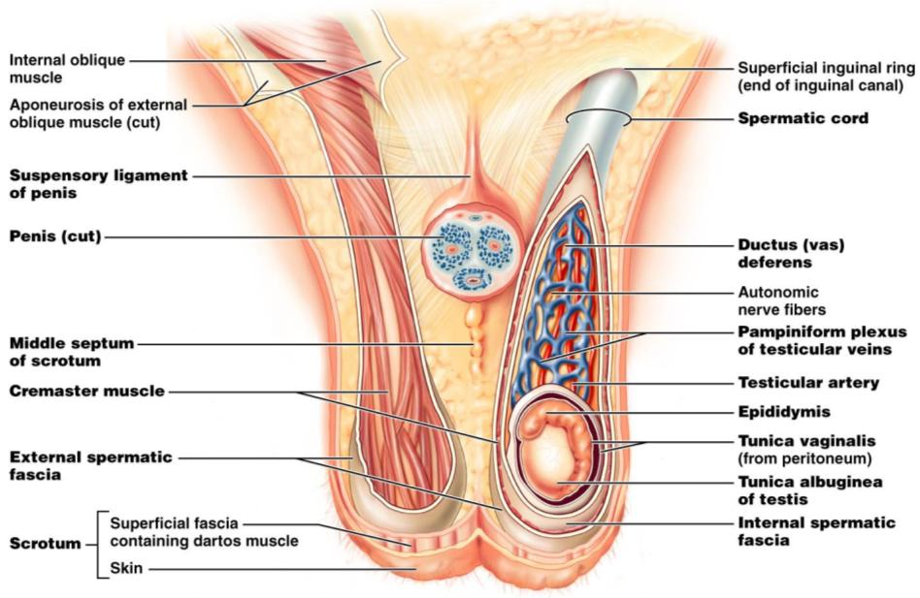
Figure 27.2

Slide 8
The Testes
Each testis is surrounded by two tunics:
derived from peritoneum
fibrous capsule of the testis
Septa divide the testis into 250-300 lobules, each containing 1-4 seminiferous tubules

Slide 9
The Testes
Produce the sperm
Converge to form the _
The straight tubulus rectus conveys sperm to the _

Slide 10
The Testes
From the rete testis, the sperm:
Leave the testis _
Enter the _
Surrounding the seminiferous tubules are interstitial cells

Slide 11
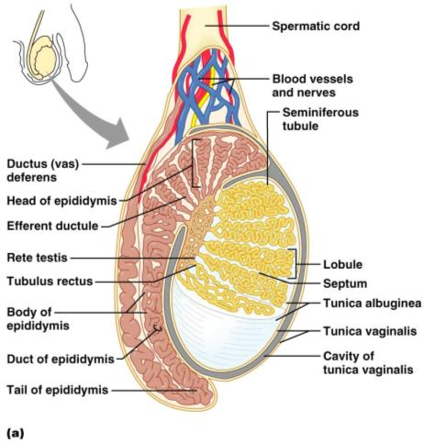
The Testes
Spermatic cord
encloses nerve fibers from ______________________________________
blood vessels,
__________________ that supply the testes

Slide 12
The Penis
A ________________________________ organ designed to deliver sperm into the female reproductive tract
Consists of
an attached root
a free shaft that ends in the _
or _
skin covering the distal end of the penis
Circumcision
surgical removal of the foreskin after birth

Slide 13
The Penis
the urethra and three cylindrical bodies of erectile tissue
spongy network of connective tissue and smooth muscle riddled with vascular spaces
during sexual excitement, the erectile tissue fills with blood causing the penis to enlarge and become rigid

Slide 14
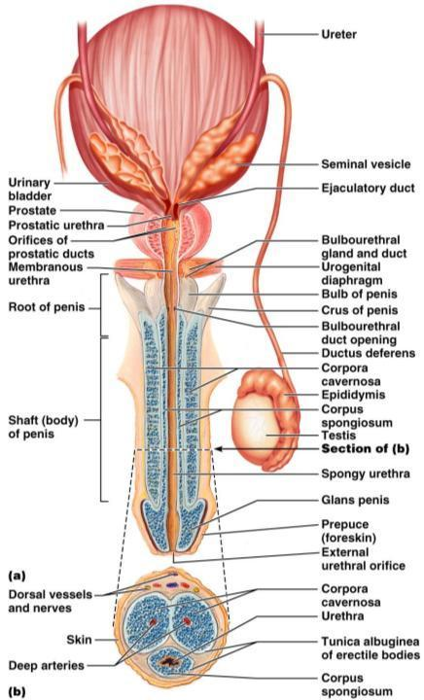
The Penis
Corpus spongiosum
expands to form the glans and bulb of the penis
Corpora _
_______________________ dorsal erectile bodies bound by fibrous tunica albuginea
Crura
_______________________ end of the penis surrounded by the ischiocavernosus muscle; _

Slide 15
Epididymis
Its head joins the efferent ductules and caps the superior aspect of the testis
The duct of the epididymis has __________________________________ that:
Absorb testicular fluid
Pass nutrients to the sperm
____________________________________ enter, pass through its tubes and become motile
Upon ejaculation the __________________________________ , expelling sperm into the _

Slide 16
Ductus Deferens and Ejaculatory Duct
Runs from the epididymis through the ______________________________________ into the pelvic cavity
expands to form the _
then joins the ___________________________________ to form the ejaculatory duct
Propels sperm from the epididymis to the _

Slide 17
Urethra
Consists of three regions
portion surrounded by the prostate
lies in the urogenital diaphragm
runs through the penis and opens to the outside at the external urethral orifice

Slide 18
Seminal Vesicles
Located at ___________________________ wall of the bladder
secrete 60% of the volume of semen
Semen
viscous ______________________________ fluid containing fructose, ascorbic acid, coagulating enzyme (vesiculase), and _

Slide 19
Seminal vesicles
Join the ductus deferens to form _
Sperm and seminal fluid mix in the ejaculatory duct and enter the _____________________________________during ejaculation

Slide 20
Prostate Gland
Doughnut-shaped gland
surrounds part of the urethra _
Plays a role in the _
Secretions enter the prostatic urethra during ejaculation

Slide 21
Prostate Gland
It is milky, _____________________________ fluid,
contains citrate,
accounts for one-third of the semen volume

Slide 22
Bulbourethral Glands
Pea-sized glands _
Produce _______________________________________prior to ejaculation
neutralizes traces of ____________________________________ in the urethra

Slide 23
Semen
Milky mixture of sperm and accessory gland secretions
Provides a ______________________________ and _______________________________ (fructose)
protects and _
facilitates movement of sperm

Slide 24
Semen
Prostaglandins in semen:
Decrease the viscosity of _
Stimulate _
Facilitate the movement of sperm through the female reproductive tract

Slide 25
Semen
The hormone _________________________________ enhances sperm motility
Semen is a_
Neutralizes _
Female _
Seminalplasmin
antibiotic chemical that _
_____________________________________________ coagulate semen _
then fibrinolysin liquefies the mass

Slide 26
Male Sexual Response: Erection
Enlargement and stiffening of the penis from engorgement of __________________________________ with blood
During arousal, a ____________________________________ promotes the release _
Nitric oxide causes erectile tissue to fill with blood

Slide 27
Male Sexual Response: Erection
Expansion of the _
________________________________________ their drainage veins
_________________________________________and maintains engorgement
The corpus spongiosum functions in _____________________________________ during ejaculation

Slide 28
Male Sexual Response
Erection is initiated by sexual stimuli including:
Erotic sights, sounds, and smells
Erection can be _____________________________________ solely by emotional or _

Slide 29
Ejaculation
The propulsion of semen from the male duct system
At ejaculation, ____________________________________nerves cause:
Reproductive ducts and accessory organs to contract and _

Slide 30
Ejaculation
At ejaculation, sympathetic nerves cause: (continued)
______________________________________________________________________________, preventing the expulsion of urine
Bulbospongiosus muscles to undergo a rapid series of contractions

Slide 31
Spermatogenesis
The sequence of events that produces sperm in the seminiferous tubules of the testes
Each cell has ____________________________________ (one maternal, one paternal) and is said to be ___________________________________ (2n chromosomal number)

Slide 32
Spermatogenesis
Humans have 23 pairs of homologous chromosomes
________________________________________ and are said to be __________________________ (n chromosomal number)
Gamete formation is by _______________________________, in which the number of chromosomes is halved (from 2n to n)

Slide 33
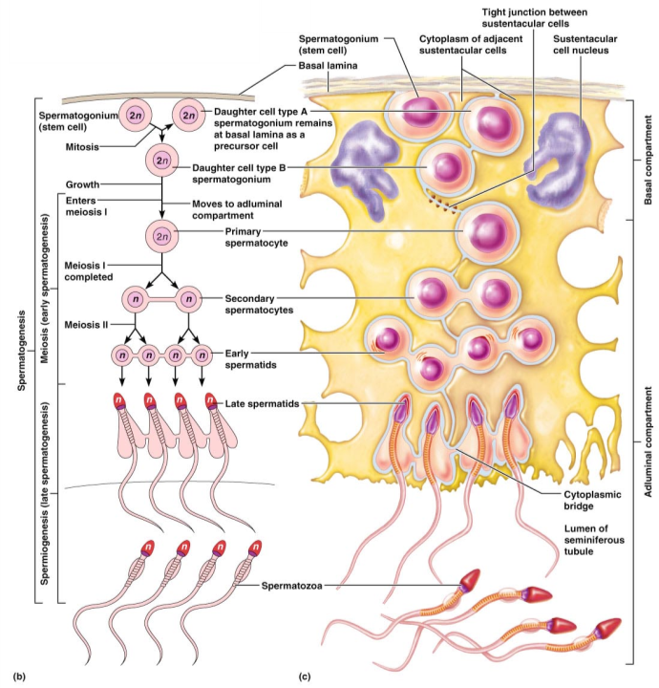
Figure 27.8b, c

Slide 34
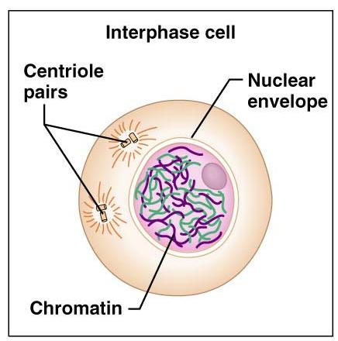
Meiosis – Interphase
Two _______________ divisions halve the number of chromosomes
Chromosomes _
Figure 27.7.1

Slide 35
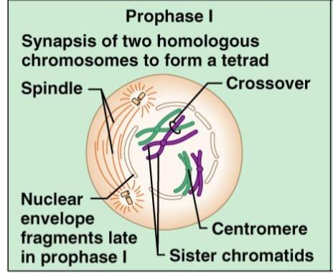
Meiosis – Prophase I
Homologous chromosomes undergo _
Tetrads are formed with _
____________________________________ takes place during prophase I
Figure 27.7.2.1

Slide 36
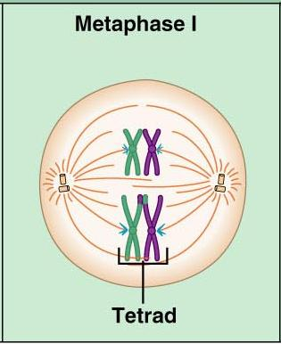
Meiosis – Metaphase I
__________________________________ at the spindle equator during_
Figure 27.7.2.2

Slide 37
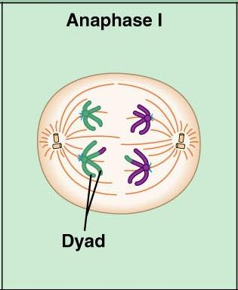
Meiosis – Anaphase I
Homologous chromosomes composed of __________________________________ are distributed to opposite ends of the cell
Figure 27.7.2.3

Slide 38
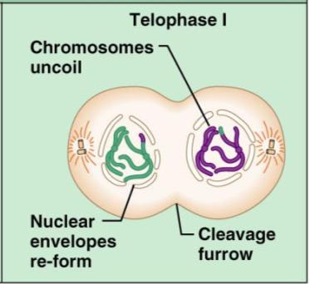
Meiosis – Telophase I
Nuclear membrane forms around chromosomal masses
With telophase and cytokinesis completed, two haploid daughter cells are formed (with 2n amount of DNA)
Figure 27.7.2.4

Slide 39
Meiosis II
Mirrors mitosis except that chromosomes are not replicated before it begins
Meiosis accomplishes two tasks:
It ____________________________________________ by half (2n to n)
It introduces _

Slide 40
Brain-Testicular Axis
Hormonal regulation of sperm production and testicular hormones involving the

Slide 41
Brain-Testicular Axis
Testicular regulation: three sets of hormones:
GnRH:
_____________________________________ stimulates the testes through:
Follicle stimulating hormone (FSH)
Luteinizing hormone (LH)
_______________________________________, which __________________________________ stimulate the testes
Testicular hormones
exert negative feedback controls

Slide 42
Hormonal Regulation
The hypothalamus releases gonadotropin-releasing hormone (GnRH)
GnRH stimulates the _________________________________________ to secrete FSH and LH
causes ______________________________________________ cells to release androgen-binding protein (ABP)
stimulates ________________________________________________ to release testosterone
ABP binding of testosterone enhances _

Slide 43
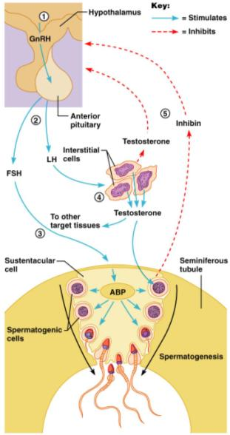
Hormonal Regulation
Feedback inhibition on the hypothalamus and pituitary results from:
Rising levels of _
Increased _
Figure 27.10

Slide 44
Testosterone Activity
Testosterone
Steroid hormone: synthesized from _
It must be transformed to exert its effects on some target cells
Prostate
it is converted into dihydrotestosterone (________) before it can bind within the nucleus
Neurons
it is ____________________________________________ to bring about stimulatory effects

Slide 45
Testosterone
Testosterone targets _
its _________________________________ causes these organs to _

Slide 46
Male Secondary Sex Characteristics
Male hormones make their appearance at puberty and induce changes in _
Appearance of _
Enhanced growth of the chest and deepening of the voice
Skin thickens and becomes oily
______________________________________ and increase in density
Skeletal muscles increase _

Slide 47
Male Secondary Sex Characteristics
Testosterone is the basis of _________________________________ in both males and females

Slide 48
Female Reproductive Anatomy
_______________________________: primary female reproductive organs
Make female gametes
Secrete female sex hormones
Accessory ducts include _

Slide 49
Female Reproductive Anatomy
Internal genitalia
external sex organs

Slide 50
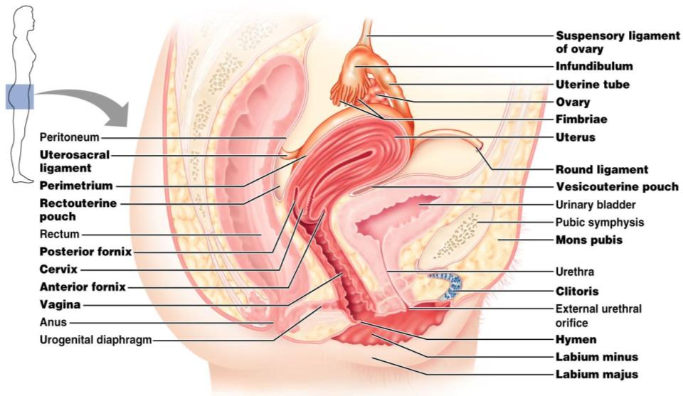
Female Reproductive Anatomy
Figure 27.11

Slide 51
The Ovaries
__________________________ organs on each side of the uterus held in place by several ligaments
Suspensory
Mesovarium
contains the suspensory ligament and the mesovarium

Slide 52
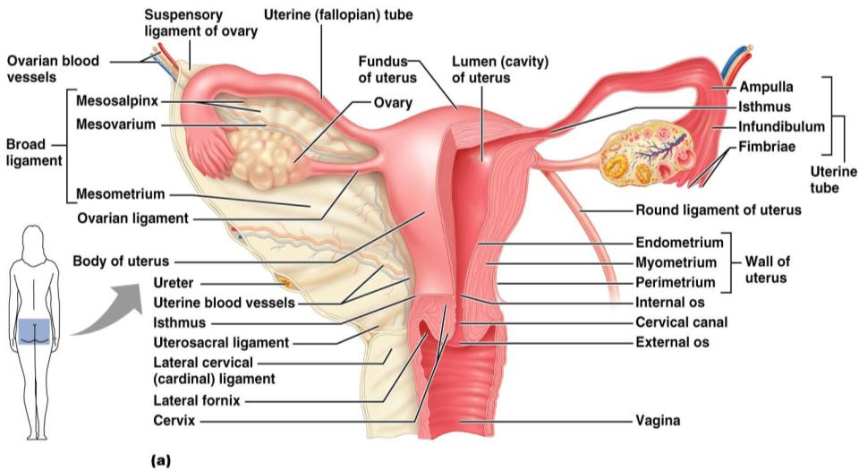
The Ovaries
Figure 27.14a

Slide 53
Ovaries
Blood supply
______________________________________ and the ovarian branch of _
They are surrounded by a fibrous tunica albuginea,
covered by a layer of epithelial cells called the _
Embedded in the __________________________ are ovarian follicles

Slide 54
Ovaries
Each follicle consists of an _
Cells around the oocyte are called:
one cell layer thick
when ______________________________________ is present

Slide 55
Ovaries
one layer of squamous-like follicle cells surrounds the oocyte
two or more layers of ___________________________________________ cells enclose the oocyte
has a _________________________________________ between granulosa cells that coalesces to form a central _

Slide 56
Ovaries
secondary follicle at its _____________________________________ that bulges from the surface of the ovary
Ovulation
_________________________________________from the ripening follicle
ruptured follicle _

Slide 57
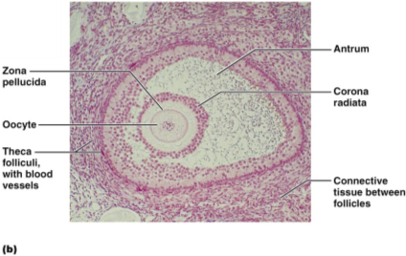
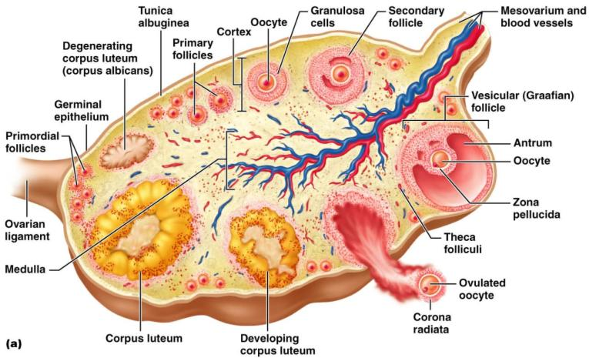
Ovaries

Slide 58
Fallopian Tubes
Receive the _
provide a _
Empty into the uterus via the isthmus
Expand distally around the ovary forming the _
The ampulla ends in the funnel-shaped, ciliated infundibulum containing fingerlike projections called fimbriae

Slide 59
Uterine Tubes
The uterine tubes have __________________________________ with the ovaries and the ovulated oocyte is cast into the _
Beating __________________________ on the fimbriae create currents to carry the oocyte into the uterine tube

Slide 60
Uterine Tubes
The oocyte is carried toward the uterus by _
Nonciliated cells keep the oocyte and the _

Slide 61
Uterus
Hollow, thick-walled organ
located in the pelvis ___________________________________________ and posterosuperior to the bladder
major portion of the uterus
rounded region superior to the entrance of the uterine tubes
narrowed region between the body and cervix

Slide 62
Uterus
narrow _______________________________ which projects into the vagina inferiorly
Cervical canal
cavity of the cervix that communicates with:
The vagina via the _
The uterine body via the _
Cervical glands ________________________________________ that covers the external os and ______________________________________________ except during midcycle

Slide 63
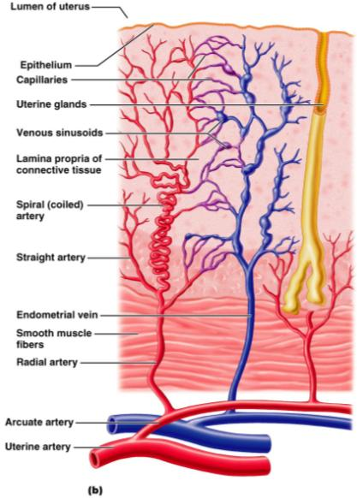
Uterine Wall
three layers
outermost serous layer
the visceral peritoneum
middle layer
smooth muscle
mucosal lining of the uterine cavity

Slide 64
Endometrium
Has numerous uterine glands that change in length as the endometrial thickness changes
Undergoes cyclic changes in response to ovarian hormones
Is shed during _
Forms a new functionalis after menstruation ends
Does not respond to ovarian hormones

Slide 65
Uterine Vascular Supply
Uterine arteries
arise from _
ascend the sides of the uterus and send branches into the uterine wall
branches of the uterine arteries in the myometrium that give rise to radial branches

Slide 66
Uterine Vascular Supply
Radial branches
descend into the endometrium and give off:
______________________________________ to the stratum functionalis
______________________________________ to the stratum basalis

Slide 67
Uterine Vascular Supply
__________________________________________________________________________ causes the functionalis to shed during menstruation

Slide 68
Vagina
Thin-walled tube
between the _
The urethra is embedded in the anterior wall
Provides a passageway for birth, menstrual flow, and is the organ of copulation

Slide 69
Vagina
Wall consists of three coats:
fibroelastic adventitia
smooth muscle muscularis,
stratified squamous mucosa
______________________________ near the _______________________________________ forms an incomplete partition called the _
Vaginal _
upper end of the vagina surrounding the cervix

Slide 70
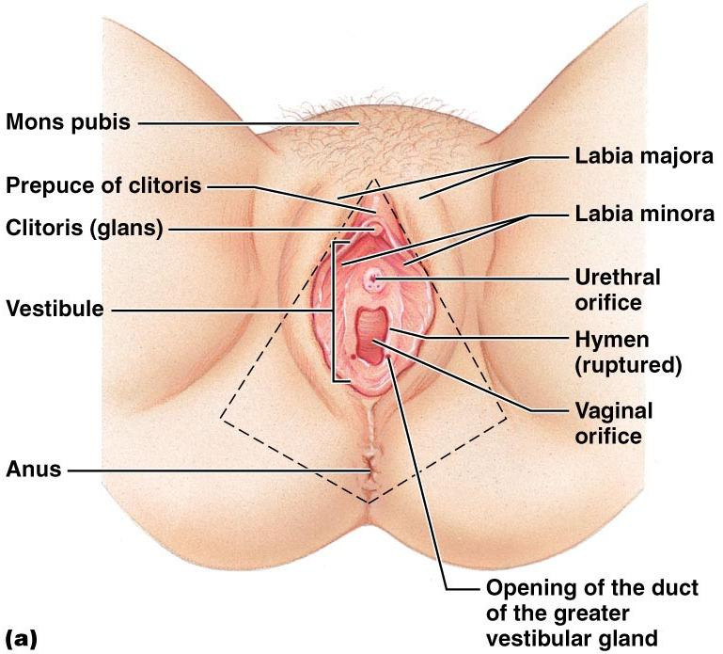
Vagina

Slide 71
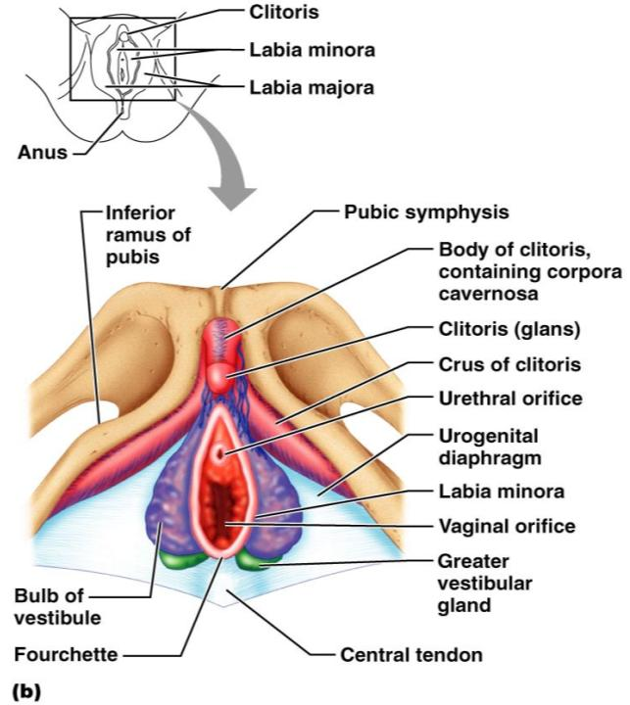
Female External Genitalia: Deep
Figure 27.16b

Slide 72
External Genitalia: Vulva
_______________________________: Lies external to the vagina and includes
Labia
Vestibular structures

Slide 73
External Genitalia: Vulva
Mons pubis
round, __________________________________ overlying the _
Labia _
elongated, hair-covered, _
homologous to the _

Slide 74
External Genitalia: Vulva
Labia _
__________________________________ skin folds lying within the labia majora
homologous to the _
Greater _
Pea-size glands flanking the vagina
Homologous to _
Keep the vestibule _

Slide 75
External Genitalia: Vulva (Pudendum)
Clitoris (______________________________)
exposed portion is the _
Diamond-shaped region between the pubic arch and coccyx
Bordered by the _______________________________________ laterally

Slide 76
Mammary Glands
Modified _____________________________ consisting of 15-25 lobes that radiate around and open at the nipple
pigmented skin surrounding the nipple
____________________________________ attach the breast to underlying muscle fascia

Slide 77
Mammary Glands
Lobes contain ____________________________________ that _________________________________ in lactating women
Compound alveolar glands pass milk to _____________________________________, which open to the outside

Slide 78
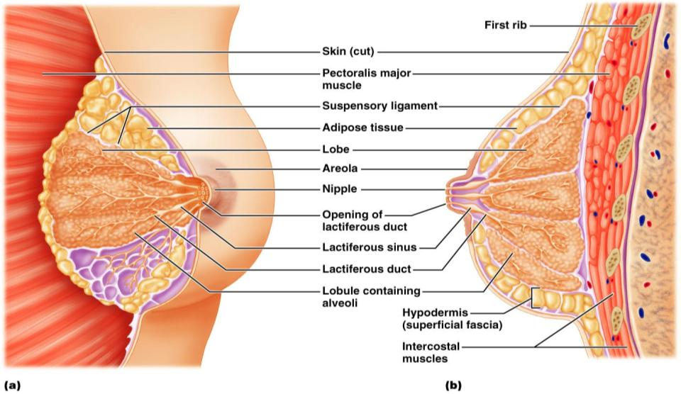
Structure of Lactating Mammary Glands
Figure 27.17

Slide 79
Breast Cancer
Usually arises from the epithelial cells of the ducts
Risk factors include:
______________________________________________ or late menopause
No pregnancies or the _
Previous history of breast cancer or family history of breast cancer
Hereditary factors including mutations to the genes BRCA1 and BRCA2
___________________ of women with breast cancer have _

Slide 80
Detection and Treatment
Early detection is by _________________________________________ and mammography
Treatment depends upon the characteristics of the lesion
Radiation, chemotherapy, and surgery followed by irradiation and chemotherapy
Today, _______________________________________ is the surgery used rather than radical mastectomy

Slide 81
Oogenesis
Production of _
In the fetal period, oogonia (2n ovarian stem cells) multiply by mitosis and store nutrients
___________________________________ appear as oogonia are transformed into _

Slide 82
Oogenesis: Puberty
Primary oocytes begin meiosis but _
At puberty, one activated primary oocyte produces two haploid cells
The first _
The secondary _
The secondary oocyte arrests in ______________________________________ and is ovulated

Slide 83
Oogenesis: Puberty
_____________________________________ the second oocyte completes meiosis II, yielding:
One large ovum (the functional gamete)
A tiny second _

Slide 84
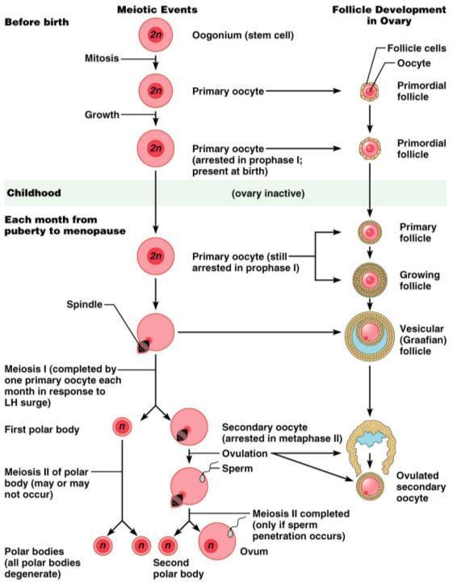

Slide 85
Ovarian Cycle
Monthly series of events associated with the maturation of an egg
period of ________________________________________ (days 1–14)
period of corpus luteum activity (days 14–28)
Ovulation occurs _

Slide 86
Follicular Phase
The primordial follicle, directed by the oocyte, becomes a _
Primary follicle becomes a _
The theca folliculi and granulosa cells cooperate to produce estrogens
The ___________________________________ forms around the oocyte
The antrum is formed

Slide 87
Follicular Phase
The secondary follicle becomes a vesicular follicle
The ____________________________________ and isolates the oocyte and the corona radiata
The full size follicle (vesicular follicle) _________________________________ from the external surface of the ovary
The primary oocyte completes meiosis I, and the stage is set for ovulation

Slide 88
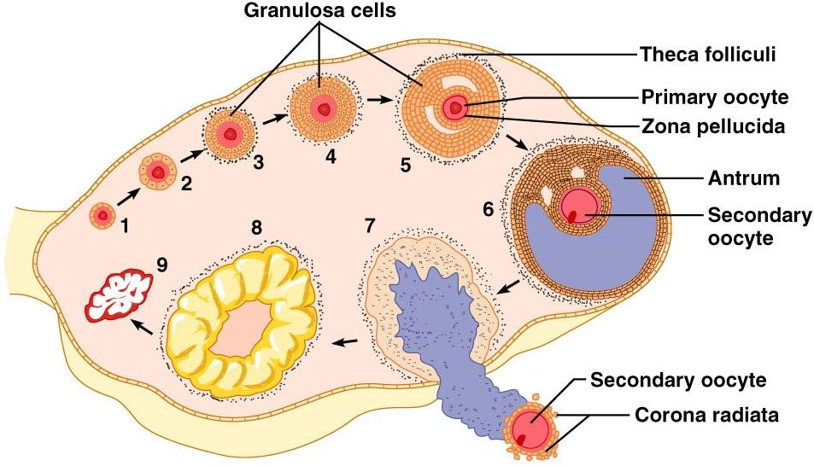
Ovarian Cycle
Figure 27.20

Slide 89
Ovulation
Ovulation occurs when the _
Mittelschmerz
a twinge of ___________________________ sometimes felt at _
1-2% of ovulations release more than one secondary oocyte, which if fertilized, results in fraternal twins

Slide 90
Luteal Phase
After ovulation,
the ruptured _
forms the _
The corpus luteum secretes _

Slide 91
Luteal Phase
If pregnancy does not occur:
the corpus luteum degenerates in 10 days, leaving a scar
If pregnancy does occur
the corpus luteum produces hormones _
at about 3 months

Slide 92
Establishing the Ovarian Cycle
During childhood,
ovaries grow
secrete small amounts of _
inhibit the hypothalamic release of GnRH
As puberty nears,
GnRH is released
These events continue until an adult cyclic pattern is achieved and menarche occurs

Slide 93
Hormonal Interactions During the Ovarian Cycle
Day 1
GnRH from ______________________________ stimulates the release of _____________________________________ from anterior pituitary
Over the next several days, FSH and LH _
As the follicle matures, it begins to produce and release estrogen
Rising estrogen levels:

Slide 94
Hormonal Interactions During the Ovarian Cycle
Estrogen levels increase
high estrogen levels have a ___________________________________________________________________________, causing a sudden surge of _

Slide 95
Hormonal Interactions During the Ovarian Cycle
The LH spike stimulates the primary oocyte to complete meiosis I, and the secondary oocyte continues on to metaphase II
Day 14 –

Slide 96
Hormonal Interactions & the Ovarian Cycle
LH transforms the ruptured follicle into a _
produces inhibin, progesterone, and estrogen
These hormones shut off ______________________________________ release and declining LH ends luteal activity
Days 26-28 – decline of the ovarian hormones
Ends the blockade of FSH and LH
The cycle starts anew

Slide 97
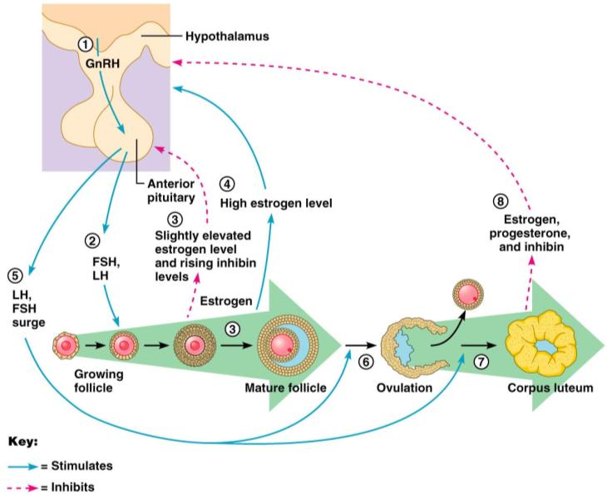
Feedback Mechanisms in Ovarian Function

Slide 98
Uterine (Menstrual) Cycle
Series of cyclic changes that the uterine endometrium goes through each month in response to ovarian hormones in the blood
__________________________________________________– uterus sheds all but the deepest part of the endometrium
Days 6-14:
_________________________________________________ (preovulatory) phase – endometrium rebuilds itself
Days 15-28:
__________________________________________________ (postovulatory) phase – endometrium prepares for implantation of the embryo

Slide 99
Menses
If fertilization does __________________ occur
deprives the endometrium of hormonal support
_________________________________________ spasms and endometrial cells begin to die as blood flow is interupted
The functional layer begins to _
Spiral arteries constrict one final time then suddenly relax and open wide
The rush of blood fragments weakened capillary beds and _

Slide 100
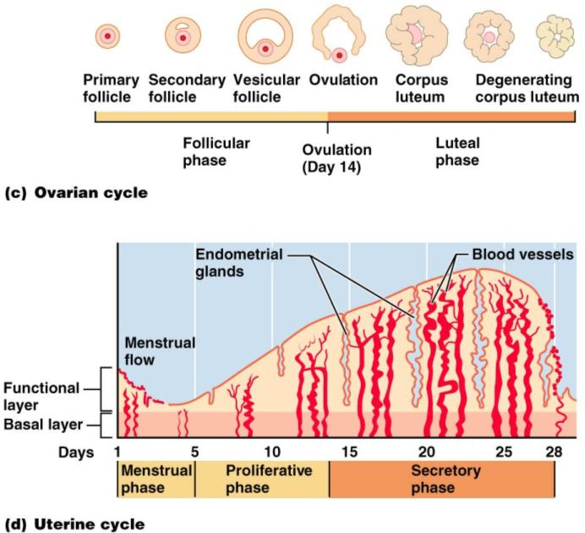

Slide 101
Extrauterine Effects of Estrogens and Progesterone
Estrogen levels _
Promote oogenesis and follicle growth in the ovary
Exert _________________________________ on the female reproductive tract
Uterine tubes, uterus, and vagina grow larger and become functional
Uterine tubes and uterus exhibit _
Vaginal mucosa thickens and _

Slide 102
Estrogen-Induced Secondary Sex Characteristics
Growth of the _
Increased deposition of _____________________________________, especially in the hips and breasts
Widening and lightening of the pelvis
Growth of _

Slide 103
Female Sexual response
_________________________________ nerve impulses cause arteries of erectile tissues to dilate
Blood flow _
erectile tissues swell
Vagina begins to _

Slide 104
Female Sexual Response
parasympathetic impulses stimulate
________________________________________ to secrete _______________________________ into the vestibule.
serves to moisten and lubricate the tissues,
prevent irritation of tissues and _

Slide 105
Female orgasm
The culmination of stimulation is _
the ____________________________________________________________________________________________ resulting in an increased friction.
Orgasm initiates a series of reflexes in which the
muscles of the perineum
walls of the uterus and fallopian tubes _
The contractions help to _____________________________________________ towards the uterine tubes.

Slide 106
Female Sexual Response
Females do not have a ____________________________________ after orgasm and can experience multiple orgasms in a single sexual experience
Orgasm is _____________________________ for conception

Slide 107
Sexually Transmitted Diseases: Gonorrhea
Bacterial infection caused by Neisseria gonorrhoeae,
spread by contact with _
Signs and symptoms
In males
___________________________________________, discharge of pus from the penis
In females
abdominal discomfort, vaginal discharge, abnormal uterine bleeding
Often mild symptoms are _________________________________________ or vaginosis

Slide 108
STD: Gonorrhea
Left untreated, can result in
pelvic inflammatory disease in women
May damage fallopian tubes and result in ectopic pregnancies or infertility
According to the CDC:
In the United States, the highest reported rates of infection are among _

Slide 109
STD: Gonorrhea
Prevention
Abstinence
_________________________________________ reduces transmission
Treatment:
antibiotics, but resistant strains are becoming more prevalent

Slide 110
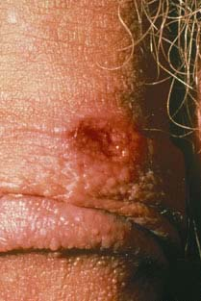
STD: Syphilis
Bacterial infection from Treponema pallidum
transmitted sexually or _
“_____________________________” because signs and symptoms coincide with other disorders
Primary stage:
A ________________________________ appears at the site of infection and disappears in a few weeks

Slide 111
sTD: Syphilis
time between infection and the start of the first symptom
from ____________________________________ (average 21 days).
The chancre is usually ___________________________________________, and painless.
It appears at the spot where syphilis entered the body.
The chancre _______________________________________, and it _______________________________________________. However, if adequate treatment is not administered, the infection progresses to the secondary stage.

Slide 112
STD: Syphilis
__________________________________________ shows signs of pink skin rash, fever, and joint pain
Other symptoms include swollen lymph glands, sore throat, patchy hair loss, headaches, weight loss, muscle aches, and fatigue.
A ______________________________ period follows, which may progress to tertiary syphilis characterized by gummas (lesions of the CNS, blood vessels, bones, and skin)
difficulty coordinating muscle movements, paralysis, numbness, gradual blindness, and dementia.
Treatment:

Slide 113
STD: Chlamydia
Most common STD in the U.S.
Bacteria: Chlamydia trachomatis
Symptoms include
penile and vaginal discharges;
abdominal, rectal, or testicular pain;
irregular menses
Can cause _____________________________________________ and urinary tract infections in men, and sterility in women
“___________________________________________" disease because about three quarters of infected women and about half of infected men have no symptoms
Prevention: abstinence, latex condoms reduce risk
Treatment is with tetracycline

Slide 114
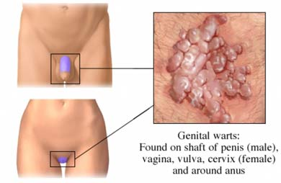
STD: Viral Infections
human papillomaviruses (HPV)
Low risk varieties can cause ________________________________________ and abnormal Pap smears
High risk varieties can increase the risk of _
Transmitted through _
Condoms do not prevent transmission of HPV, but have been show to reduce rates of cervical cancer

Slide 115
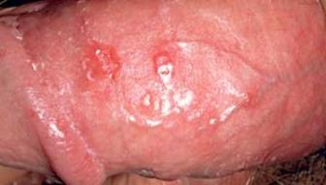
Sexually Transmitted Diseases: Viral Infections
Genital herpes
caused by Herpes Simplex Virus (HSV)
Herpetic lesions appear as _
characterized _
Can be passed to partner when sores are present OR absent
Congenital herpes can cause malformations of a fetus
Has been implicated with _
Treatment: acyclovir and other antiviral drugs

Slide 116
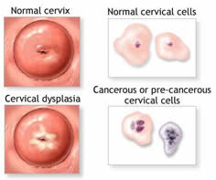
Pap Smears
Named for Dr. Papanicolaou
_____________________________________________________taken from external os and surrounding tissues for evaluation
Samples taken from the Squamo-columnar Junction.
circular area right at the opening of the cervix where the pink, smooth skin of the cervix meets the fiery-red, fragile, mucous-producing lining of the cervical canal.
If there is a problem with cancer or precancerous changes, it is this area that is most likely to be effected. This area of _______________________________________________ is also known as the _

Slide 117
Pelvic Inflammatory Disease
General term for infection of _
Often stemming from sexually transmitted diseases
Can damage uterus, fallopian tubes, and ovaries resulting in ________________________________________, abscesses, and chronic pain

Slide 118
Pelvic Inflammatory Disease
Risk factors
alters vaginal environment and allows bacteria to thrive
Forces bacteria through cervical canal
Symptoms: most commonly include _.
fever, unusual vaginal discharge that may have a foul odor,
painful intercourse, painful urination, irregular menstrual bleeding, and pain in the right upper abdomen (rare).

Slide 119
Endometriosis
Endometrial tissue normally found within the uterus is located within the pelvic cavity, commonly on ovaries
Fallopian tubes, uterine ligaments, intestines, bladder, vagina, cervix
Sympoms:
pain during or after sexual activity
Infertility
Other symptoms may include fatigue; painful bowel movements with periods; _______________________________________; diarrhea and/or constipation and other intestinal upset with some periods.
Some women with endometriosis have no symptoms. Infertility affects about 30-40% of women with endometriosis and is a common result with progression of the disease.

Slide 120
PMS: pre Menstrual syndrome
symptoms usually _
Symptoms usually stop when menstruation begins, or shortly thereafter.
exact cause of PMS has not been identified
estimated to affect up _____________________________ during their childbearing years
Symptoms:
headache, ankle swelling, back ache, abdominal cramps, abdominal pain, breast tenderness, weight gain, cold sores, acne flare-ups, nausea, constipation/diarrhea, food cravings, irritable, clumsy

Slide 121
Dysmenorrhea
Begins a day or so before menstruation and ends when the bleeding stops
May be related to _
Primary dysmenorrhea:
occurs in “healthy” women.
not related to any specific problems with the uterus or other pelvic organs.
Secondary dysmenorrhea:
caused by _______________________________________ or structural abnormality either within or outside the uterus

Slide 122
Genetic Sex Determination
Genetic sex is determined by the sex chromosomes each gamete contains
There are two types of sex chromosomes_
Females have two X chromosomes; males have one X and one Y
Hence, all eggs have an X chromosome; half the sperm have an X, and the other half a Y
A single gene on the Y chromosome, the _________________________, initiates testes development and determines maleness

Slide 123
Development of External Genitalia: Male
Under the influence of testosterone
_________________________________ enlarges forming the penis
___________________________________ elongates and closes completely
Urethral folds give rise to the _
____________________________________ swellings develop into the scrotum

Slide 124
Development of External Genitalia: Female
In the _
Genital tubercle gives rise to the _
The ________________________________ as the vestibule
The urethral folds become _
The labioscrotal swellings _

Slide 125
Descent of the Gonads
About 2 months before birth and stimulated by testosterone, the _________________________________________ and enter the scrotum
fibrous cord that extends from the testes to the scrotum
Spermatic cord
blood vessels, nerves, and fascial layers that help suspend the testes
Ovaries also descend, but are _______________________________________________ at the pelvic brim

Slide 126
Development Aspects: Puberty
Reproductive organs grow to adult size and become functional
Secondary sex characteristics appear
Characteristics of puberty
Males
__________________________________________ and scrotum, appearance of axillary and facial hair, _
Females
enlarging of the breasts, ____________________________________ , and dependable ovulation

Slide 127
Menopause
Ovulation and menses _
Without sufficient _________________________ , reproductive organs and breasts atrophy
Skin blood vessels undergo intense vasodilation (hot flashes occur)
Gradual thinning of the skin and bone loss
Males have no equivalent to menopause

Slide 128
From Egg to Embryo
Pregnancy
events that occur from _
the developing offspring
from the last menstrual period until birth

Slide 129
From Egg to Embryo
Preembryo
conceptus from _
Embryo
conceptus during the _
Fetus
conceptus from the _

Slide 130
Accomplishing Fertilization
The oocyte is viable for _
Sperm is viable _
For fertilization to occur, coitus must occur no more than:
Three days before ovulation
24 hours after ovulation
Fertilization
when a sperm fuses with an egg to _

Slide 131
Sperm Transport and Capacitation
Fates of ejaculated sperm:
Leak out of the vagina immediately after deposition
Fail to make it through the cervix
Dispersed in the uterine cavity or destroyed by _
Reach the uterine tubes
Sperm must undergo ________________________________ before they can penetrate the oocyte

Slide 132
Acrosomal Reaction and Sperm Penetration
An ovulated oocyte is encapsulated by:
The _
Extracellular matrix
Sperm binds to the zona pellucida and undergoes the _
_____________________________________ are released near the oocyte
Hundreds of acrosomes release their enzymes _

Slide 133
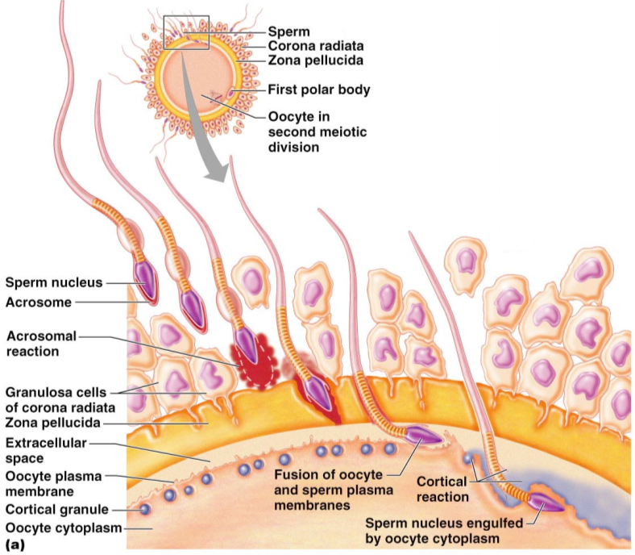

Slide 134
Completion of Meiosis II and Fertilization
Upon entry of sperm, the secondary oocyte:
Casts out the second polar body
The ovum nucleus swells, and the two nuclei approach each other
When fully swollen, the two nuclei are called _
Fertilization
when the _

Slide 135
Preembryonic Development
The first cleavage produces _
the 16 or more cell stage (72 hours old)
By the fourth or fifth day the preembryo consists of 100 or so cells (blastocyst)

Slide 136
Preembryonic Development
a fluid-filled hollow sphere composed of:
A single layer of _
An _
Trophoblasts take part in _
The inner cell mass becomes the _

Slide 137
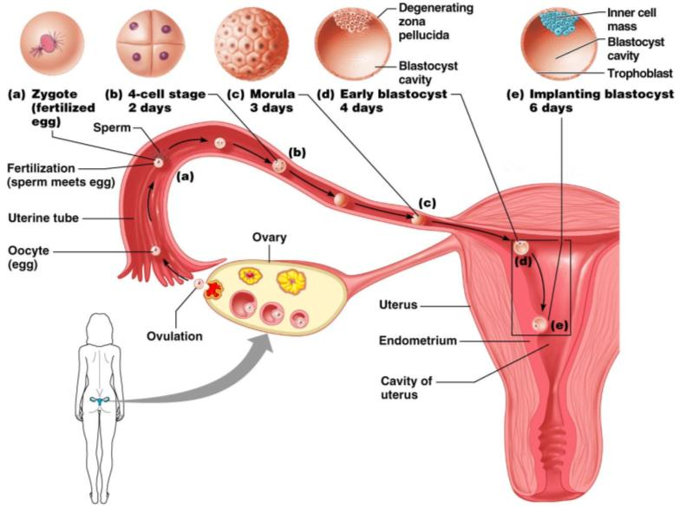
Cleavage: From Zygote to Blastocyst

Slide 138
Implantation
Begins ______________________________________ when the trophoblasts adhere to a properly prepared endometrium
The trophoblasts then proliferate and form _
Cytotrophoblast
cells of the inner layer that retain their cell boundaries
Syncytiotrophoblast
cells in the outer layer that lose their plasma membranes _

Slide 139
Implantation
The implanted blastocyst is covered over by endometrial cells
Implantation is completed by the _

Slide 140
Implantation
Viability of the corpus luteum is maintained by human chorionic gonadotropin (_______________) secreted by the _
hCG prompts the corpus luteum to continue to secrete progesterone and estrogen
Chorion
developed from trophoblasts after implantation, continues this hormonal stimulus
Between the second and third month, the placenta:
Assumes the role of progesterone and estrogen production
Is providing _

Slide 141
Placentation
Formation of the placenta from:
______________________________________ endometrial tissues
The placenta is fully formed and functional by the _

Slide 142
Placentation
Embryonic placental barriers include:
The _
The endothelium of embryonic capillaries
The _____________________________ also secretes other hormones
human placental lactogen, human chorionic thyrotropin, and relaxin

Slide 143
Embryonic Membranes
Amnion
Provides a ______________________________________ that protects the embryo
Helps maintain _
Amniotic fluid comes from maternal blood, and later, fetal urine

Slide 144
Embryonic Membranes
Forms part of the _
Produces earliest __________________________ and vessels
Is the source of primordial germ cells

Slide 145
Embryonic Membranes
a small outpocketing at the caudal end of the yolk sac
Structural base for the _
Becomes part of the _
helps form the _
Encloses the embryonic body and all other membranes

Slide 146
Gastrulation
During the 3rd week, the _____________________________________becomes a _
The primary germ layers are ectoderm, mesoderm, and endoderm

Slide 147
Primary Germ Layers
Serve as primitive tissues from which all body organs will derive
forms structures of the nervous system and skin epidermis
forms epithelial linings of the digestive, respiratory, and urogenital systems
forms all other tissues
Endoderm and ectoderm are securely joined and are considered epithelia

Slide 148
Effects of Pregnancy
________________________________________ develops a purplish hue
Breasts enlarge and their _
The uterus expands, occupying most of the abdominal cavity

Slide 149
Effects of Pregnancy
______________________________ is common due to the change of the body’s center of gravity
______________________________ causes pelvic ligaments and the pubic symphysis to relax
Typical weight gain is about 29 pounds

Slide 150
Effects of Pregnancy: Metabolic Changes
The placenta secretes human placental lactogen (hPL),
stimulates the _
promotes growth of the fetus and exerts a maternal glucose-sparing effect
Human chorionic thyrotropin (hCT) _
Parathyroid hormone levels are high, ensuring a _

Slide 151
Effects of Pregnancy: Physiological Changes
GI tract
morning sickness occurs due _
Urinary system
_______________________________________________ to handle the additional fetal wastes
Respiratory system
Dyspnea (difficult breathing) may develop late in pregnancy

Slide 152
Effects of Pregnancy: Physiological Changes
Cardiovascular system
25-40%
Venous pressure from lower limbs is impaired, resulting in _

Slide 153
Parturition: Initiation of Labor
Estrogen reaches a peak during the last weeks of pregnancy causing _
Weak Braxton Hicks contractions may take place
As birth nears, _______________________________________ cause uterine contractions
Emotional and physical stress:
Activates the hypothalamus
Sets up a ________________________________________ mechanism, releasing more oxytocin

Slide 154
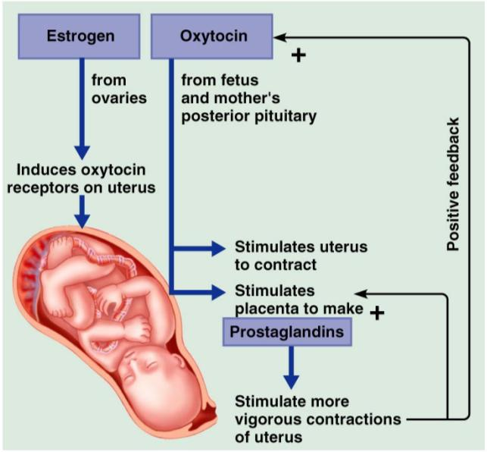
Parturition: Initiation of Labor

Slide 155
Stages of Labor: Dilation Stage
From the onset of labor ________________________________________(10 cm)
Initial contractions are 15–30 minutes apart and 10–30 seconds in duration
The cervix _
The __________________________________________, releasing amniotic fluid (breaking of the water)
____________________________________________ occurs as the infant’s head enters the true pelvis

Slide 156
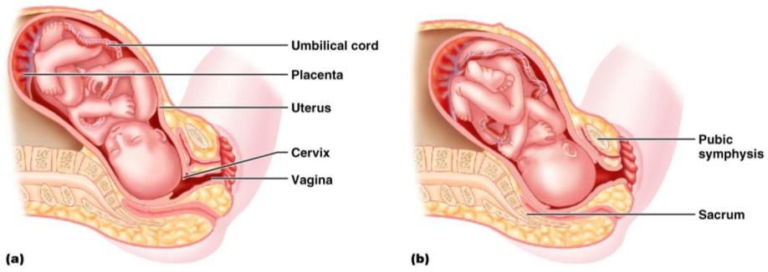
Stages of Labor: Dilation Stage

Slide 157
Stages of Labor: Expulsion Stage
From full dilation to _
Strong contractions occur every _
The _________________________________ increases in labor without local anesthesia
_____________________________________ occurs when the largest dimension of the head is distending the vulva

Slide 158
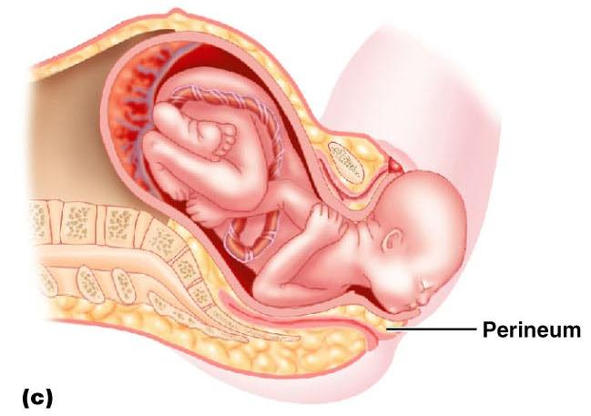
Stages of Labor: Expulsion Stage

Slide 159
Stages of Labor: Expulsion Stage
The delivery of the placenta is accomplished _
Afterbirth
the placenta and its attached fetal membranes
All placenta fragments must be removed to prevent _

Slide 160
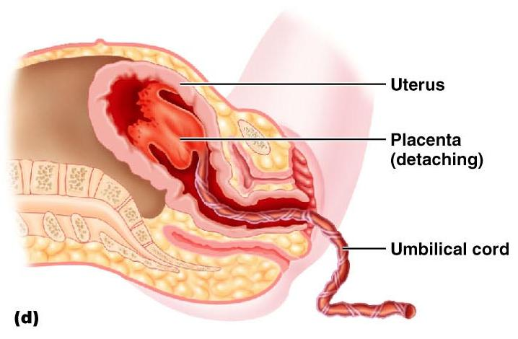
Stages of Labor: Expulsion Stage

Slide 161
Extrauterine Life
At 1-5 minutes after birth, the infant’s physical status is assessed based on five signs:
Each observation is given a score of _
Apgar score
the total score of the above assessments
Lower scores reveal problems

Slide 162
Occlusion of Fetal Blood Vessels
______________________________________________ constrict and become _
Fates of fetal vessels
Proximal umbilical arteries become _____________________________________________ and distal parts become the _
The umbilical vein becomes the _
The ductus venosus becomes the _
The __________________________________________ becomes the fossa ovalis
The ductus arteriosus becomes the ligamentum arteriosum

Slide 163
Transitional Period
Unstable period lasting 6-8 hours after birth
The __________________________________ the baby is alert and active
Heart rate increases (120-160 beats/min.)
Temperature _

Slide 164
Transitional Period
Activity then __________________________ and the infant sleeps about _
A second active stage follows in which the baby _
After this, the infant sleeps, with waking periods occurring every 3-4 hours

Slide 165
Lactation
The production of milk by the _
Estrogens, progesterone, and lactogen stimulate the hypothalamus to release _
The _________________________________ responds by releasing _

Slide 166
Lactation
Solution rich in vitamin A, protein, minerals, and IgA antibodies
Is released the _
Is followed by _____________________________ production

Slide 167
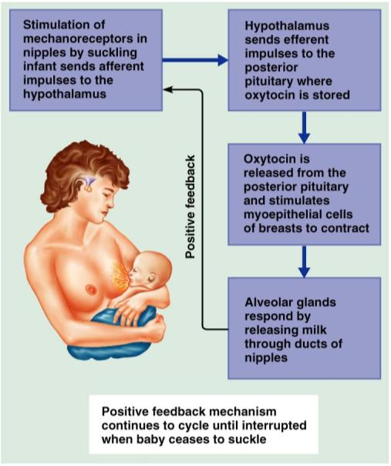
Lactation and Milk Let-down Reflex
After birth, milk production is _
Figure 28.18

Slide 168
Breast Milk
Advantages of breast milk for the infant
Fats and iron are _
Its amino acids are metabolized _______________________________________________ than those of cow’s milk
Beneficial chemicals are present – __________________, other immunoglobulins, complement, lysozyme, ___________________________________________, and lactoperoxidase
Interleukins and prostaglandins are present, which prevent overzealous inflammatory responses
Its ______________________________________________ help cleanse the bowels of meconium

