Slide 1


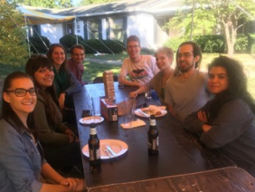
Join Phi Sigma
Members can network with faculty, students, and speakers. They can also apply for our internal and travel grants to support research. Phi Sigma provides an excellent presentation opportunity at our annual research symposium and holds social events for its members. Phi Sigma also prioritizes community involvement to provide opportunities to give back to the local community.
Who can Join?
Graduate Students
Must have attended ISU for 1 semester
Admitted into a biology sequence
GPA of 3.0 or above
Undergraduate Students
Students studying biology, biochemistry, biology education, molecular and cellular biology, or clinical laboratory science
Must be at least of junior status (60 or more credit hours)
GPA of 3.0 or above
If you are interested in joining please contact our Vice President, Elyse McCormick, at ecmcco1@ilstu.edu

