Slide 1
Social insects
Ch. 11
Eusocial: co-operate in reproduction and have division of reproductive effort
division of labor, with a caste system involving sterile or non-reproductive individuals assisting those that reproduce;
co-operation among colony members in tending the
young;
overlap of generations capable of contributing to colony functioning.
  Daughters help mom raise daughters

Slide 2
Subsocial insects
Heterogeneous behavioral traits that include some but not all of the elements of eusociality
  Nonbreeding aggregations
  Parental care
  Division of labor, particularly defense
Quasisocial: Cooperative nesting, all females reproducing
Semisocial: Cooperative nesting, division of reproductive labor, but only one generation
  All sisters

Slide 3
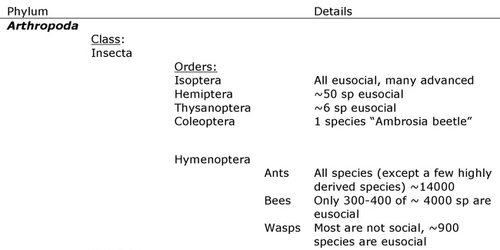
Eusocial insects
http://www.nature.com/scitable/knowledge/library/an-introduction-to-eusociality-15788128

Slide 4
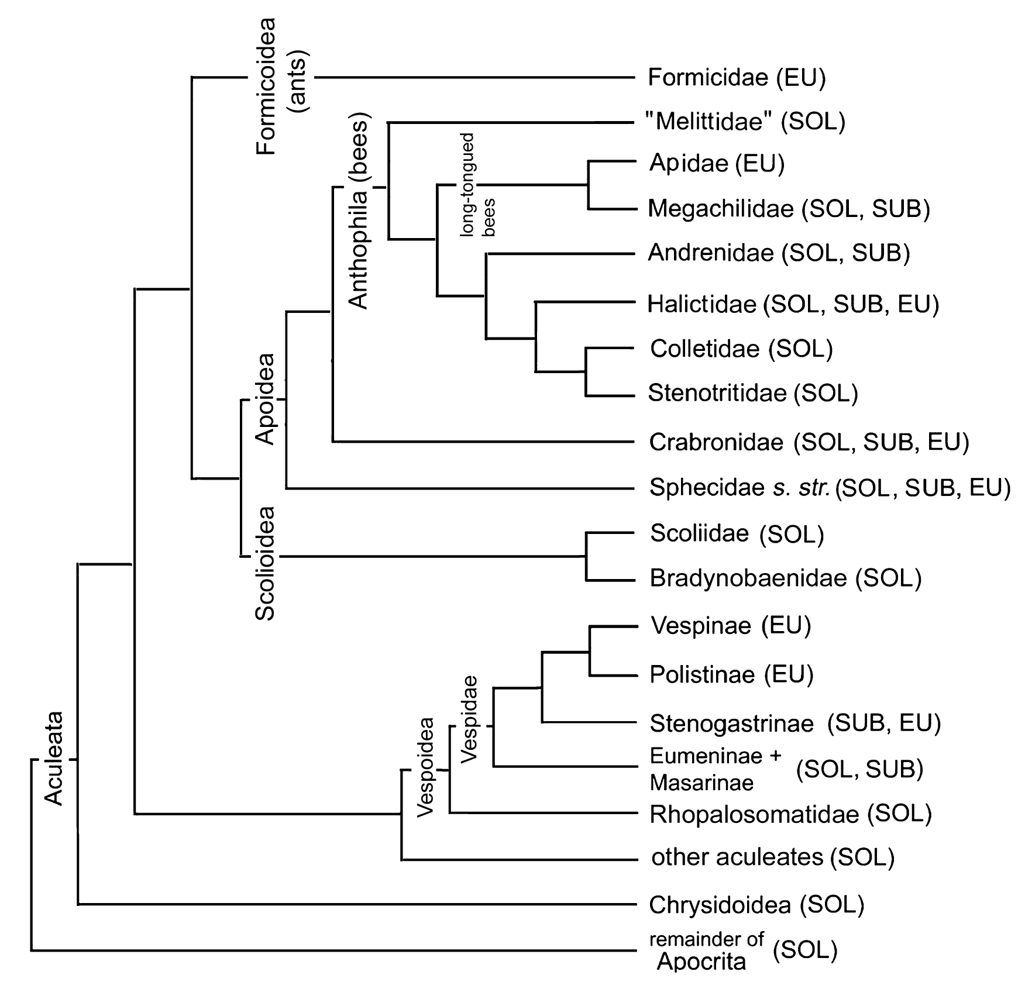
Eusociality
Hymenoptera – evolved (probably) 10 separate times
  All ants (Formicidae)
  Several lineages of Bees
    Apidae (three times)
    Halictidae (three times)
  Several lineages of Wasps
    Vespidae (twice)
    Sphecidae (once)
All termites (Isoptera within Blattodea)
Hemiptera (Aphids)
Coleoptera (Cuculionidae)

Slide 5
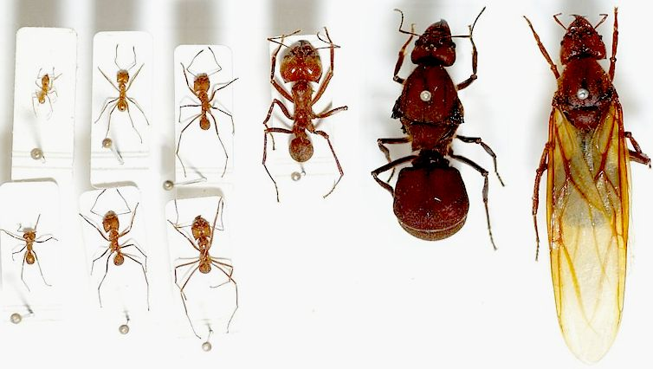
Eusociality
Castes
  Morphologically and behaviorally different individuals within a colony
    Queen (reproductive)
    Workers
    Soldiers
    Drone/King

Slide 6
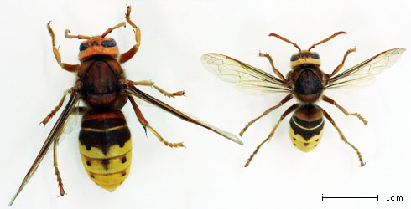
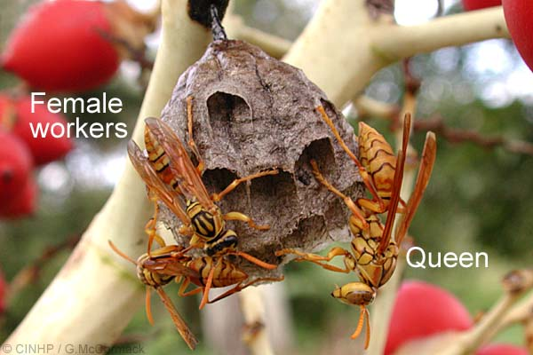
Vespidae castes

Slide 7
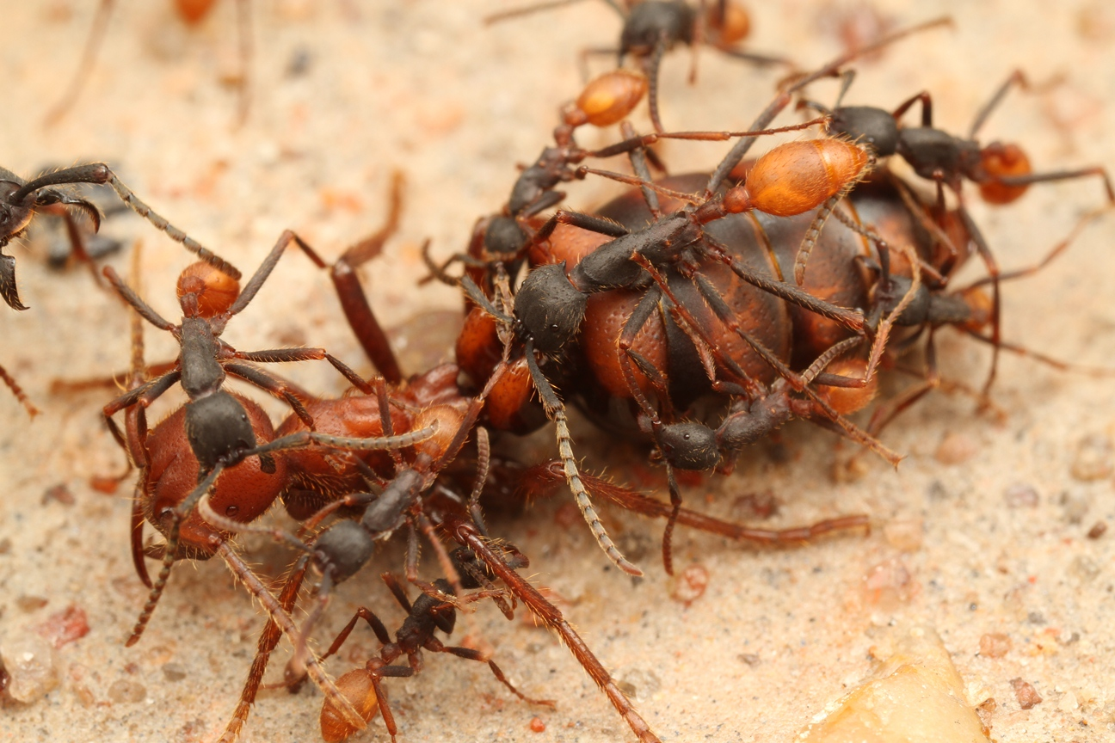
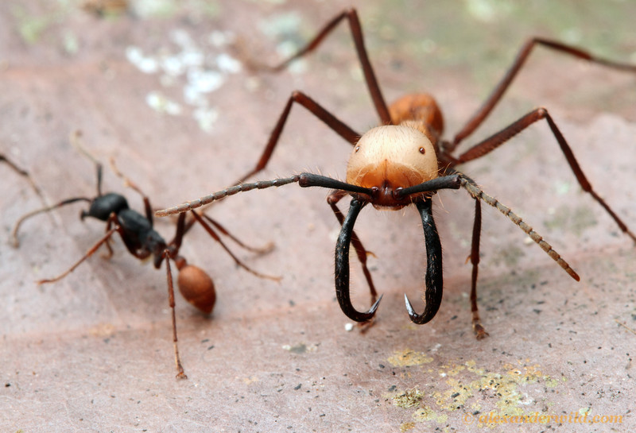
Eciton

Slide 8
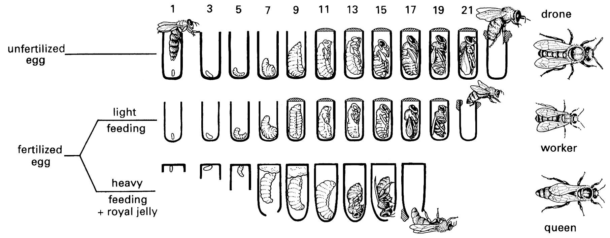
How do castes form?
Caste is trophigenic: Determined by food quantity & quality during immature stages

Slide 9
Apis mellifera
Queens compared to workers
  Larger
  Lack wax glands
  Sting is NOT barbed
Fed on Royal Jelly
  Food supply differs in quantity and quality
  Royal jelly rich in Pantothenic acid, Biopterin, sugar
Queen maintains control of workers via pheromone
  Inhibits worker ovarian development
  Queen+pheromone more effective than pheromone only

Slide 10
Honey bee workers
Monomorphic
Polyethic
  Young: hive bees
    Feed brood
    Clean cells
  Old: Foragers
  Change determined by Juvenile hormone III
    Low in young bees (Hive)
    Higher in field bees (Foragers)

Slide 11
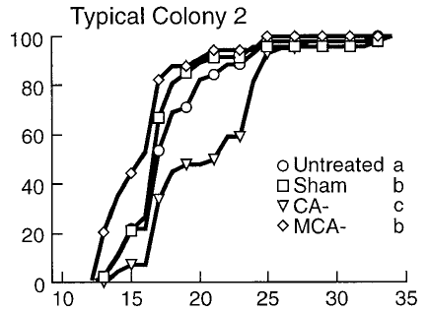
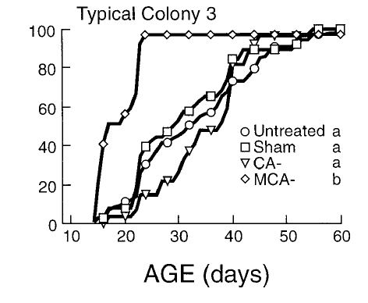
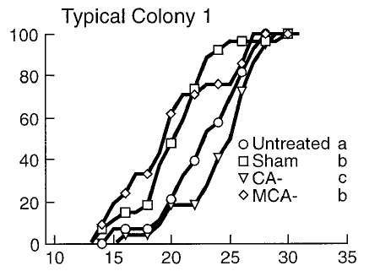
Experiment: Role of JH?
Sullivan et al. 2000 Hormones & Behavior 37:1-14
Corpora allata (CA) secrete JH
Allatectomy: remove CA; remove JH
JH replacement therapy
What does this do to behavior?
  CA- (sugically remove CA)
  Sham (surgery, no removal)
  CA- with Methoprene (Synthetic JH)
  Untreated
% Foragers

Slide 12
JH not necessary for foraging
JH regulates timing of transition
Remove JH, Timing of transition delayed
Even CA- bees eventually become foragers
Replace JH, return unmanipulated timing
Colonies varied in their responses to allatectomy and to JH analog

Slide 13
Colony founding
Newly mated queen
Produces brood of daughters
Reproduction suppressed in daughers
  Help mother raise more daughters
Reproductive offspring (queens, males) produced later in season

Slide 14

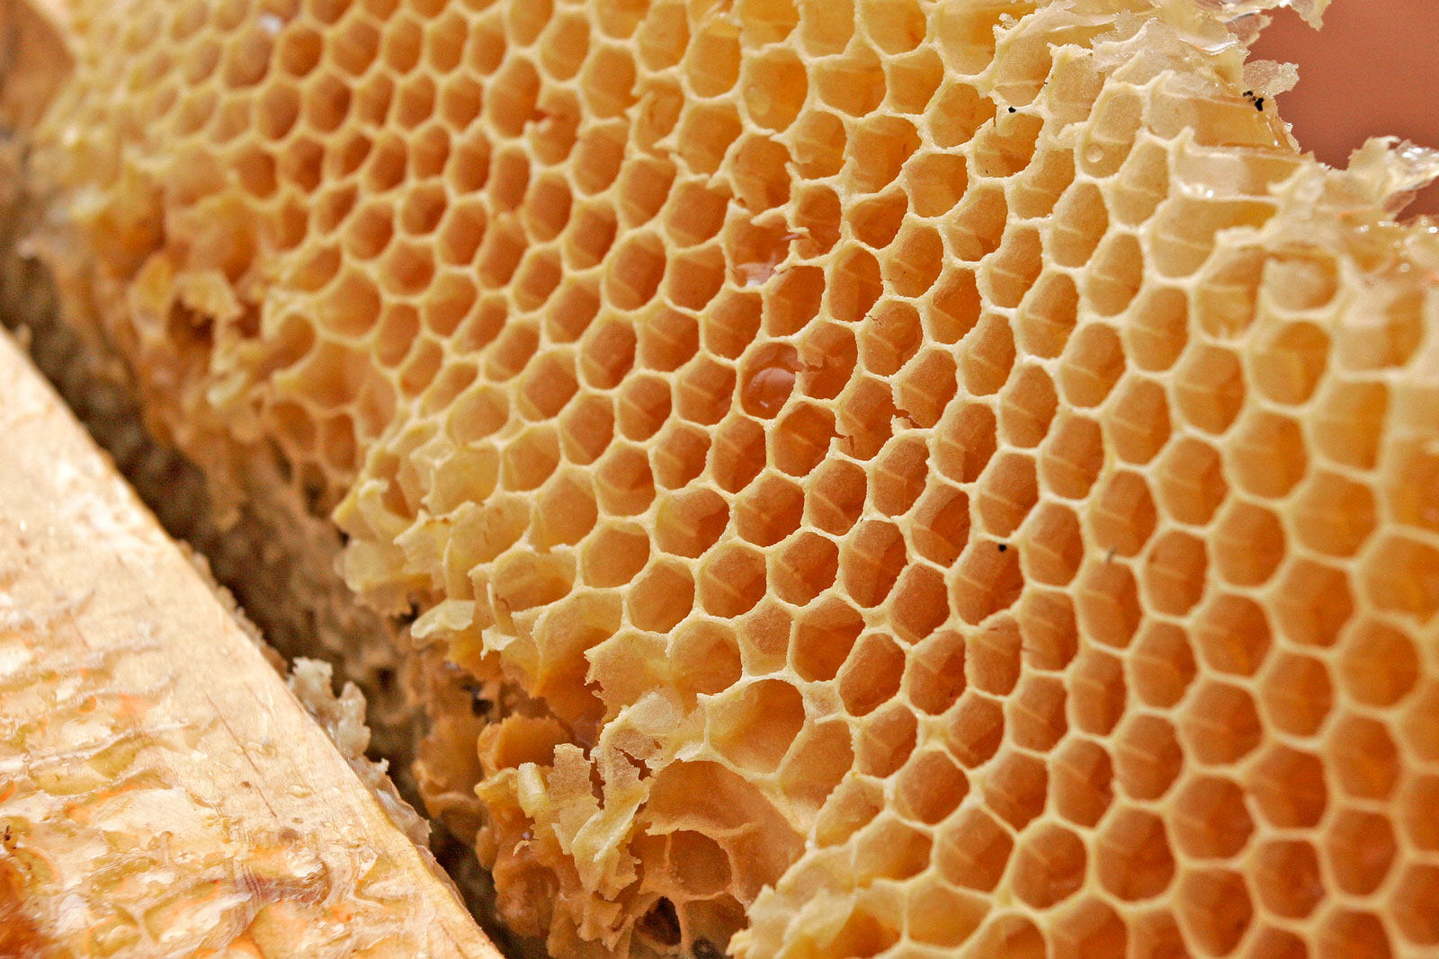
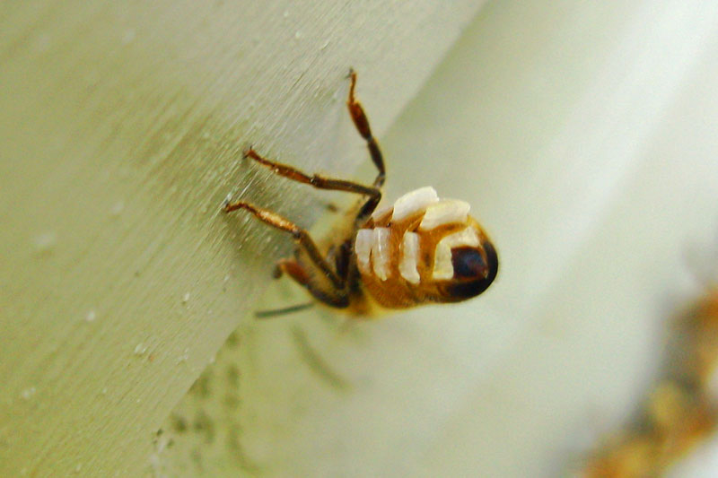
Nest construction in Hymenoptera
Wasps (Vespidae) – “paper”
  Plant fibers chewed and modified into papery substance
  Cellulose
Bees (Apidae, Halictidae) – Wax
  Produced by glands on abdomen

Slide 15
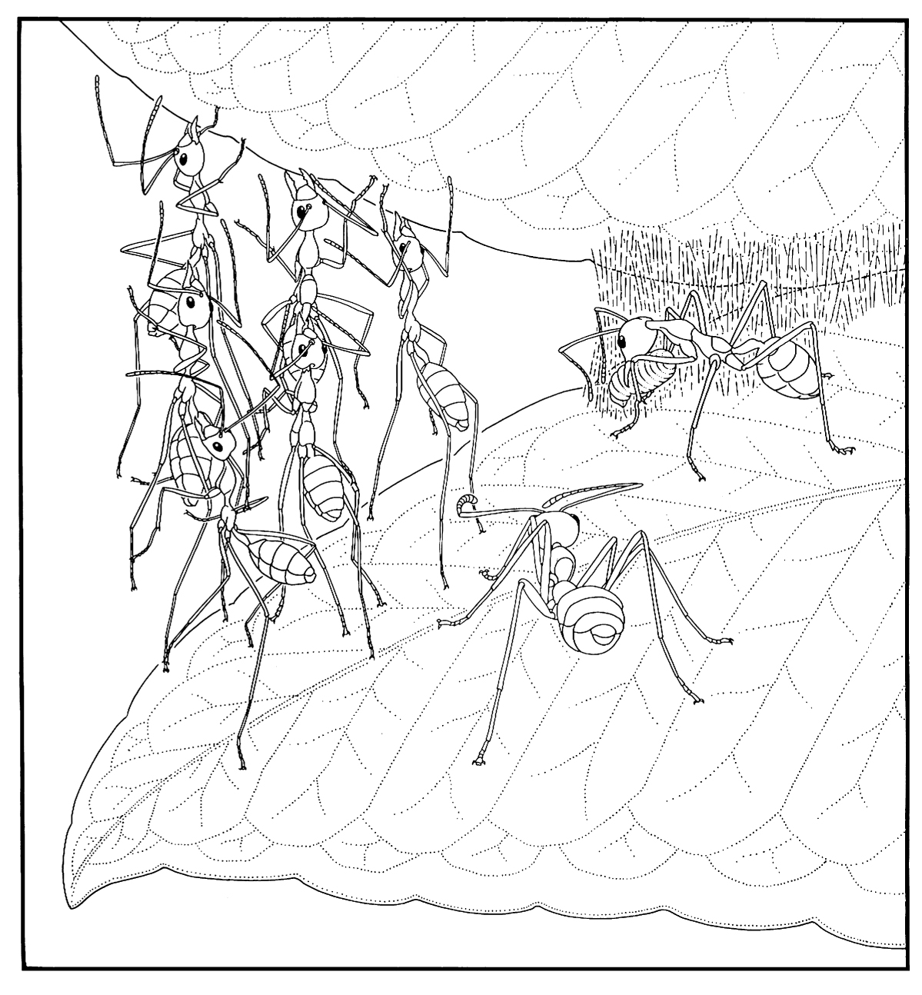
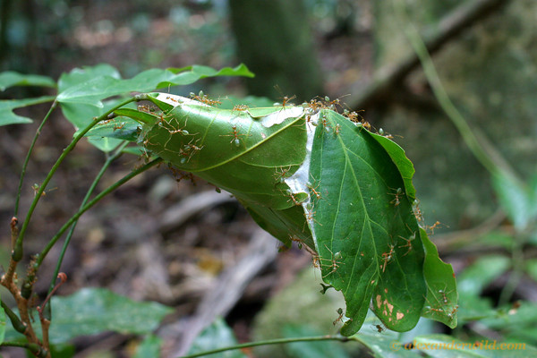
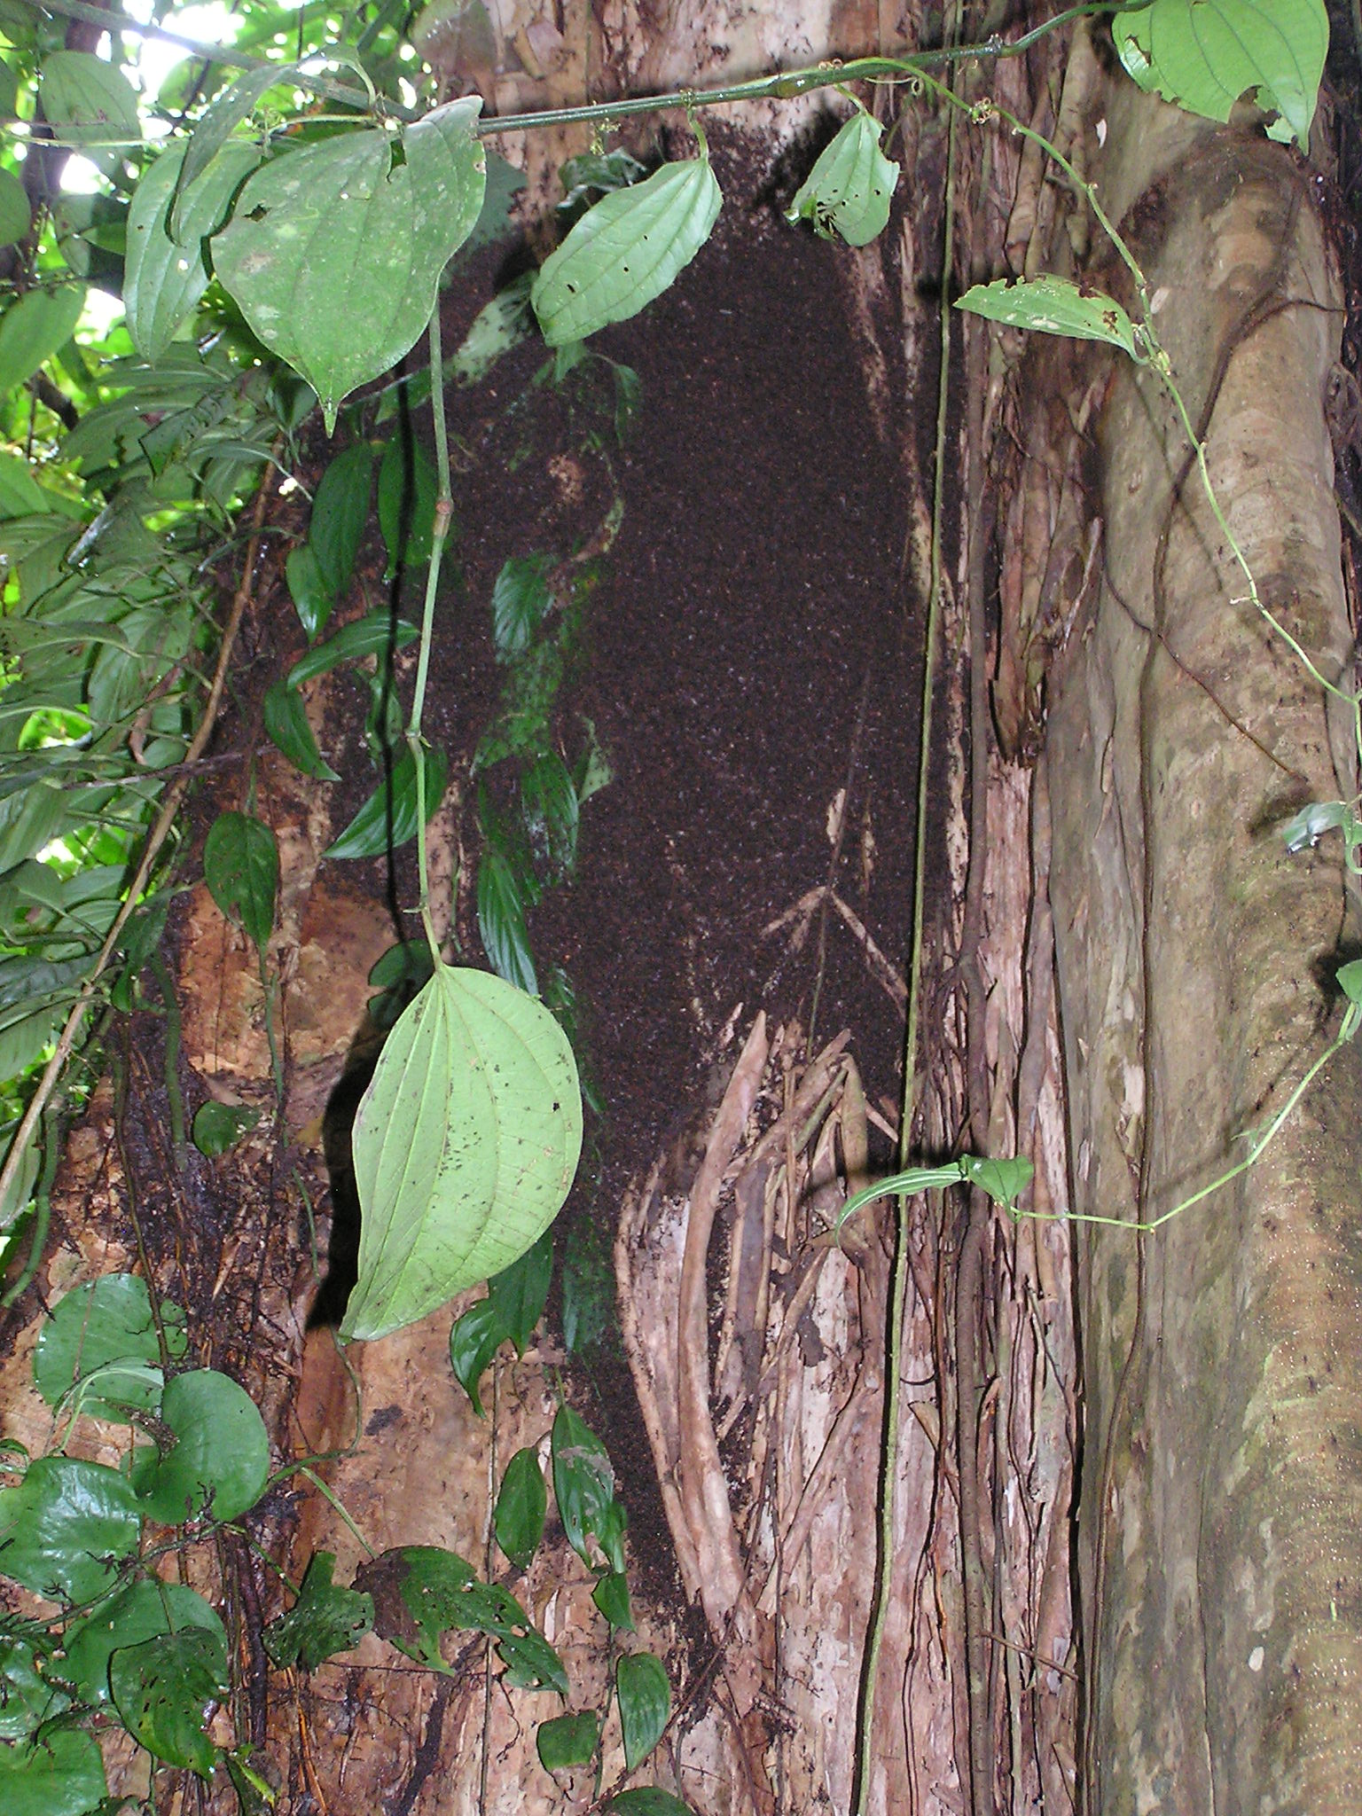
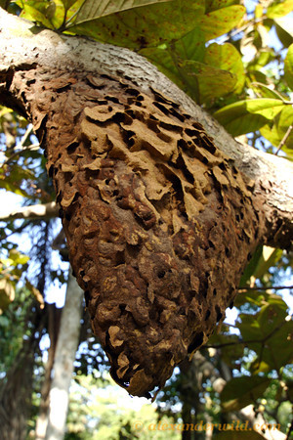
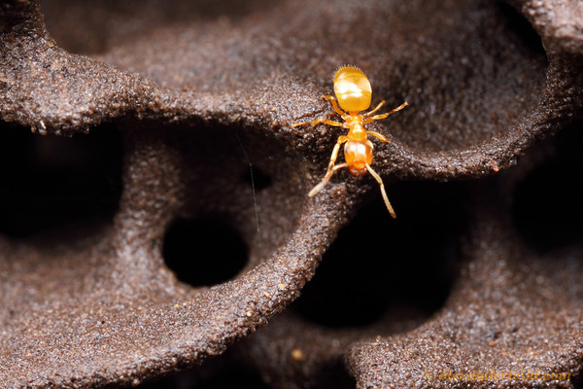
Nest construction in Hymenoptera
Ants (Formicidae)
  Subterranean
  “carton”; Fungus galleries
  Living plants
    Weaver ants use silk
    Domatia-dwelling ants
  None (army ants)

Slide 16
New colonies
Reproduction in social insects = new colonies
Founding new colonies varies among social insect taxa
Wasps (Vespidae) – Mostly annual
Bees (Apidae – particularly Apis) - >Annual
Ants (Formicidae) – Variable
Termites (Isoptera) - variable

Slide 17
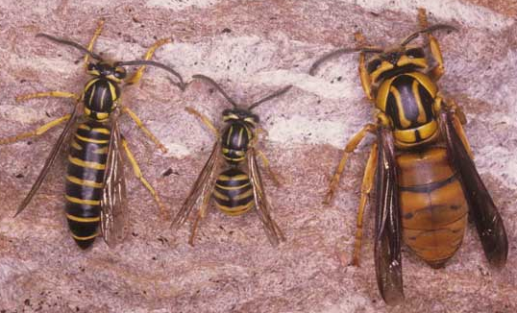
Vespidae
Queens and males produced in fall
Existing colonies break down and die
Females mate; reproductive diapause
Locate overwintering site
Spring
  Queens feed
  Locate nest site
  Constructs first cells
  Produces workers

Slide 18
Apidae (Apis mellifera)
Colonies overwinter; queens live multiple years
Spring: Queen leaves with majority of workers
  Swarming; often in 2nd year of colony life
Locates new nest site; founds “new” colony
Existing site retained by a daughter queen
  Daughter queens fight; one survivor
  Daughter queens go on mating flights (possibly >1)

Slide 19
Ants (Formicidae)
Typically seasonal production of alates (male, female)
Mating flights
Single-queen colonies
Multi-queen colonies
  Primary [found colony together]
  Secondary [daughter queens join mom as reproductives]
  Facultative or obligate
Budding: Founding new colonies by splitting of existing multi-queen colony

Slide 20
Reproduction by workers
Across hymenoptera
Highly variable
Unmated produce males
In some species workers may mate and produce females
Workers may “move up” if queens die

Slide 21
Legionary or Army ants
Traits
  Obligate collective foraging
  Nomadism
  Robust wingless queens
  Abdominal distension during egg production
Three well defined subfamilies
  Dorylinae ~150 spp. (E. Africa, Asia)
  Aenictinae ~100 spp. (Africa, Asia, Australia)
  Ecitoninae ~70 spp. (N., C., S. America)

Slide 22
Traditional Hypothesis
  Two lineages (old world, new world)
  Evolved Army ant habit independently (Homoplasy)
New information:
  Brady, S. 2003. Proc. Natl. Acad. Sci. USA 100:6575-79
  Molecular, Morphological, Fossil evidence
  Nuclear genes (18S rDNA, 28S rDNA, and wingless)
  mtDNA (Cytochrome Oxidase I)

Slide 23
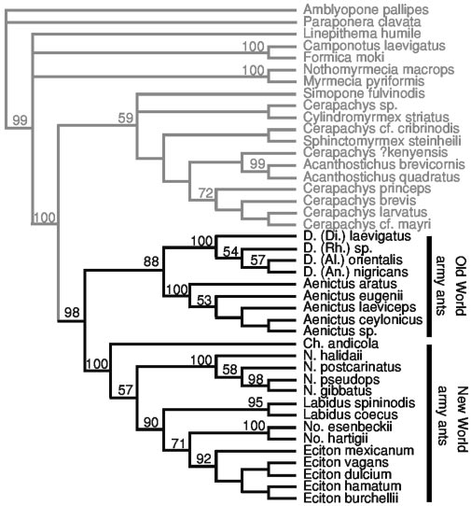
Consensus tree

Slide 24
Fig. 2. Bayesian divergence dating analysis. NW, New World; OW, Old World. Divergence dates were estimated on the ML phylogeny derived from COI, 18S rDNA, 28S rDNA, and wingless genes (-ln L = 26603.88301). Clades marked with asterisks had a posterior probability of >95% after independent Bayesian phylogenetic analysis. Lowercase letters at nodes indicate minimum age constraints obtained from the fossil record: a– c, 20 Mya (34, 35); d, 25 Mya (36, 37); e–f,
42 Mya (38); g, 50 Mya (39); h, 65 Mya (40); i, 92 Mya (32). Army ant taxa are shown in thick type.
Branch lengths are drawn scaled to estimated mean values of absolute time. The origin of army ants is estimated at 105 Mya (±11 SD).
Separation of Africa from S. America ~100 mya

Slide 25
Evolution of Eusociality
Remember: independently evolved in Hymenoptera (multiple times), Isoptera, Hemiptera, Thysanoptera, Coleoptera
Hymenoptera: What selective advantages favor eusociality?
Solitary -> subsocial/semisocial -> eusocial
  Advantages from:
    shared cost of nest construction
    Shared cost of offspring defense

Slide 26
Evolution or eusociality in Hymenoptera
Increased longevity of female
  Remains in association with offspring (subsocial)
Unrelated females of the same generation associate
  Cooperative rearing (Quasisociality)
  Division of reproductive labor evolves
Related females of the same generation associate
  Cooperative rearing; mulitple queens (Quasisociality)

Slide 27
But what selects for reproductive division of labor?
What would select for altruistic abandonment of reproduction?
  Group selection
  Kin selection
  Maternal manipulation
  Mutualism

Slide 28
Group selection
Selection favors colonies that produce most offspring, and that happens with nonreproductive workers
  Problem: presumes nonreproductive caste already exists
  Problem: what could select for loss of reproduction?
May contribute to maintenance of eusociality after it arises, but likely cannot account for origin of eusociality

Slide 29

Kin selection
Historically favored, now deemed inadequate
Fitness of an individual depends on its reproductive success and on reprodutive success of relatives
  Relatives success discounted by degree of relatedness
  Inclusive fitness
Haplodiploidy makes kin selection of altruism toward relatives very likely

Slide 30
Kin selection
Hamilton’s rule
Altruism toward a relative can be favored by selection if:
  rB > C
  Where r = relatedness coefficient (see previous) of relative
  B = benefit to the relative
  C = cost to the altruist
What’s the problem?

Slide 31
Kin selection and inclusive fitness
Nowak, Tarnita, Wilson 2010. Nature 466:1057-62
Eusociality and altruism rare even in animals that reproduce clonally (r even greater)
Haplodiploidy universal in Hymenoptera; eusociality is rare.
Termites: Haplodiploidy is not necessary
For inclusive fitness and kin selection to favor altruism, interactions of altruists and recipients must be Additive and pairwise.
  If not, inclusive fitness irrelevant or uncalculable

Slide 32
Nowak, Tarnita, Wilson
Model for evolution of eusociality via natural selection
Constructed expensive nests
Sequential provisioning of young
Eusocial allele (recessive; remain in nest)
Individual simple natural selection can favor eusocial allele over noneusocial allele
Once colonies form, kin selection maintains it and contributes to division of labor

Slide 33
Maternal manipulation
It isn’t altruism, it is forced by mother
Manipulation of feeding -> reproductive development
Selfish maternal behavior is the primary agent selecting for eusociality

Slide 34
Mutualism
Mutual defense of brood creates individual selective advantage to cooperation
Reproductive competition within the nest
Inclusive fitness and kin selection can maintain cooperation and push toward altruism

Slide 35
Eusociality in termites
XX/XY sex determination
Endosymbiotic protozoa for digestion of cellulose predispose offspring remaining with parents
  Requires overlapping generations
  longevity

Slide 36
Keep in mind…
Biomass of ants:
  ½ of all insect biomass
  Exceeds that of non-human terrestrial vertebrates
Social insects are the other dominant group on planet earth
Nowak, Tarnita, Wilson 2010. Nature 466:1057-62

