Slide 1
Ch. 3 Internal anatomy and physiology
Muscles, locomotion, flight
Nervous system
Endocrine system, hormones
Circulatory system
Tracheal system
Digestive system
Excretory system
Reproductive system

Slide 2
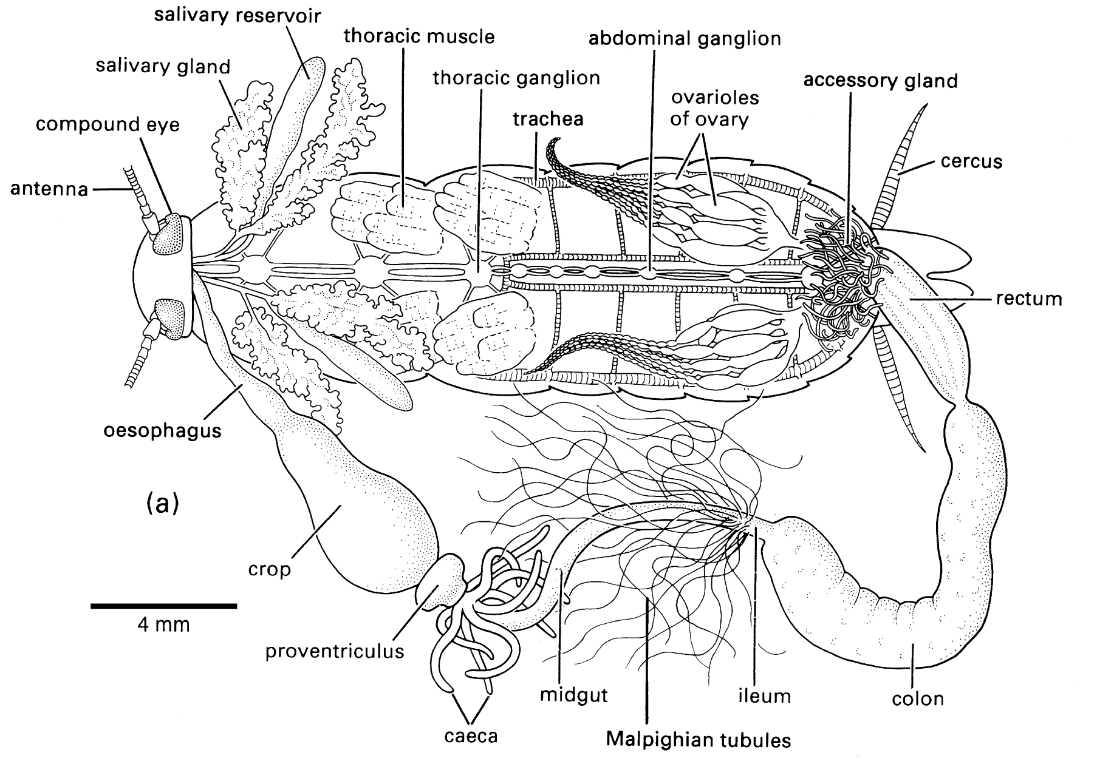
Internal anatomy

Slide 3
Muscles
Only Striated
Actin, myosin fibrils
Synchronous vs. asynchronous
Synchronous
One contraction per nerve impulse
Legs, mandibles
Asynchronous (Fibrillar)
Multiple contractions per nerve impulse
Flight muscles, Cicada tymbal muscle

Slide 4
Muscle attachment
Problems
Muscles mesoderm; Exoskeleton ectoderm
Exoskeleton shed at molt; Muscles are not
Specialized fibrils (tonofibrillae)
Grow from muscle to exoskeleton
Lost with molt
Regrow every molt
Soft body (e.g., caterpillar); No rigid attachment
Hydrostatic skeleton

Slide 5
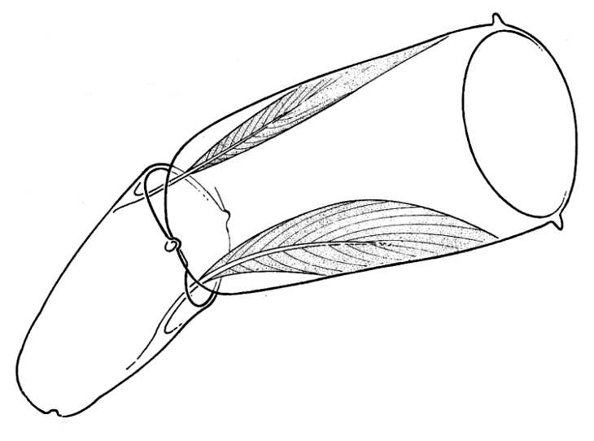
Leg musculature
© Copyright D G Mackean

Slide 6
Insect flight
http://www.youtube.com/watch?v=3gLEuxGo6tI
http://www.youtube.com/watch?v=8JUP7aMDUO4
http://www.youtube.com/watch?v=2z9F6pVhR5o

Slide 7
Wing motion
Figure 1 from A novel mechanism for emulating insect wing kinematics
Pranay Seshadri et al 2012 Bioinspir. Biomim. 7 036017 doi:10.1088/1748-3182/7/3/036017

Slide 8
Wing beat
Forward-downward stroke
Upward-backward stroke
Rotation of the wing around its base
Anterior edge leads in both directions
Wing flexion

Slide 9
Wing use
Odonata, others
Meso-, meta-thoracic wings controlled and move independently
Hymenoptera, Lepidoptera, others
Meso-, meta-thoracic wings linked and work as a unit
Diptera
Mesothoracic wings only
Metathoracic wings modified as halteres
Balancing organs
Orthoptera, Hemiptera, Coleoptera
Metathoracic wings only
Mesothoracic wings modified as protective covers

Slide 10
Two forms of flight muscle activity Direct flight muscles Indirect flight muscles
Odonata
Ephemeroptera
Blattodea
Diptera
Hymenoptera
Coleoptera
And most others

Slide 11
Muscle contractions
Slow wing beat [Odonata, Ephemeroptera, some Lepidoptera]
<100 Hz
Synchronous muscles
Single nerve impulse induces contraction & wing beat
Rapid wing beat [Hymenoptera, Diptera, some Lepidoptera, others]
100 to >1000 Hz
Asynchronous muscles
Faster than nerve impulses
Thorax snaps back and forth between wings up/wings down
Asynchronous muscles (fibrillar muscles) respond to release of muscle tension with an autonomous muscle contraction
Muscles oscillate faster than nerve impulses.

Slide 12
Nervous system
Neurons organized more or less as in other animals
Central Nervous System organization
Different from vertebrates
Ventral paired nerve cords
Bilobed ganglia
Ancestral: 2 paired ganglia per metamer
Usually fused into one paired ganglion
Further aggregated into major ganglia in the tagmata

Slide 13
Central Nervous System
Brain
3 pairs of fused ganglia from first 3 head metamers
Protocerebrum [eyes]
Deutocerebrum [Antennae]
Tritocerebrum [input from remainder of body]
Subesophogeal ganglion
3 pairs of fused ganglia
Mandibular, Maxillary, Labial metamers
Control mouthparts

Slide 14
Visceral/Peripheral Nervous system
Visceral
Stomatogastric [Frontal ganglion, Anterior gut]
Ventral visceral [Endocrine organs]
Caudal visceral [Reproductive organs]
Peripheral
Motor and sensory neurons

Slide 15
Decentralization (Fig. 3.6)

Slide 16
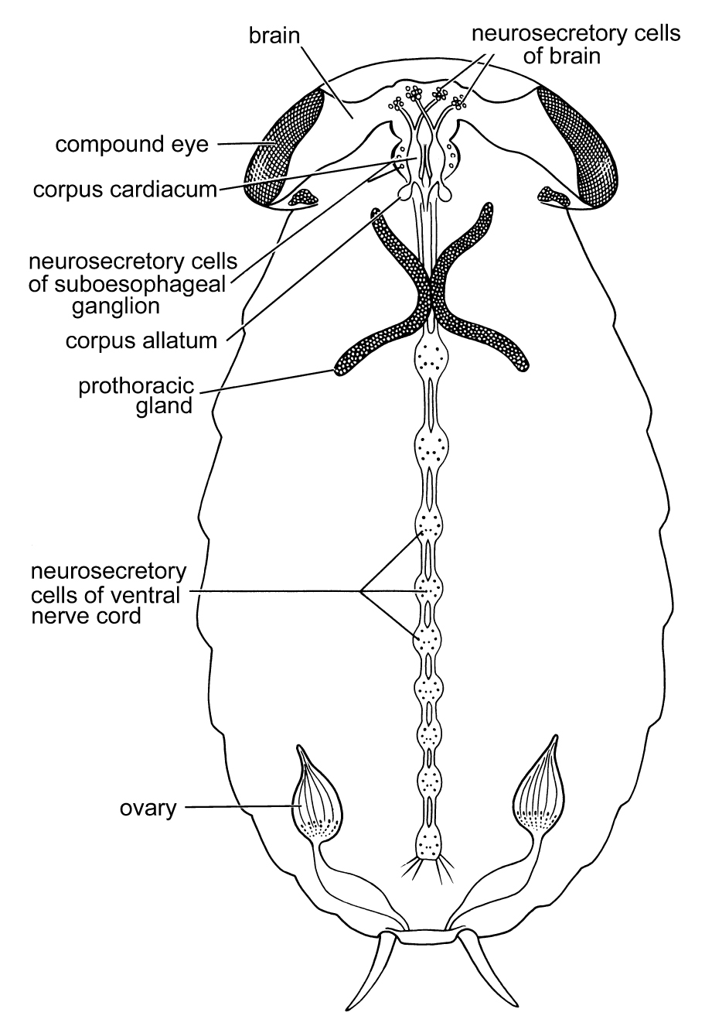
Endocrine system
Hormones
Chemical signals
Transported in body fluids
Regulate
Development
Behavior
Reproduction
Dormancy

Slide 17
Endocrine system
Neurosecretory cells
Sources of many peptide hormones
Corpora cardiaca
Neuroglandular
Behind brain
Secrete PTTH – prothoracicotropin
Stimulates prothoracic gland
Prothoracic gland
Secretes ecdysterone
Corpora allata
Secretes juvenile hormone

Slide 18
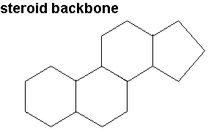
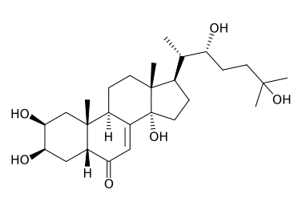
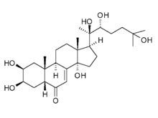
Major insect hormones
Ecdysteroids
Steroids induce molting activity
Sterols must be in diet
Ecdysone
Released from prothoracic glands
Reponse to Prothoracicotrophic Hormone (PTTH)
Neuropeptide
Converted to 20-Hydroxyedysone
Active form for inducing molt

Slide 19
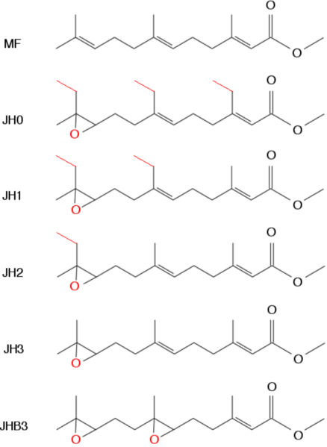
Major insect hormones
Juvenile hormones
Sesquiterpenoids
16 C linear chains
JH0, 1, 2 in Lepidoptera
JH3 in Ants,
JHB3 in Diptera
MF in Crustaceans
High JH + Ecdysteroids
Molt to larva
Low JH + Ecdysteroids
Molt to Pupa
No JH + Ecdysteroids
Molt to adult

Slide 20
Other activities of JH and Ecdysteroids
Vitellogenesis
Stimulated by JH in Orthoptera, Lepidoptera, Hemiptera
Stimulated by JH + Ecdysteroids in Diptera
Eggs
Provisioned with Ecdysteroids
Effects?
Males
JH stimulates accessory gland activity
Social insects
JH controls development of castes in ants (worker, soldier)
Regulates temporal change in behavior in bees

Slide 21
Major insect hormones
Neuropeptides
Small proteins
Many kinds; Many functions (Table)
Produced by neurosecretory cells in many parts of the insect
May reach targets via hemolymph or via movement along axons
Particularly important ones:
Prothoracicotropic hormone (PTTH)
Stimulates production of ecdysterone by prothoracic gland
Allatostatin & Alltotropin
Inhibits or stimpulates JH production by the corpora allata
Metabolic peptides [AKH/RPCH family]
Regulate storage, mobilization, use of lipids, proteins, carbohydrates
Critical for growth and development

Slide 22
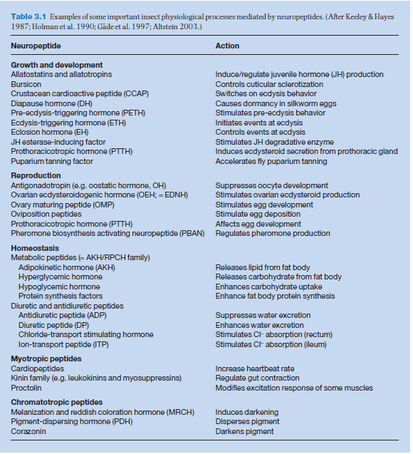

Slide 23
Hormone modes of action
Hormones bind to receptors
Action of lipophilic hormones (JH, Ecdysteroids) differs from that of hydrophilic hormones (peptides)
Lipophilic pass through cell or Nuclear membrane
Bind to cytosolic and nuclear receptors
Interact directly with DNA to stimulate or block transcription
Hydrophilic hormones
Bind to receptor on cell membrane
Initiate synthesis of secondary intracellular messenger molecule
Stimulates phosphorylation, enzyme activation, etc.

Slide 24
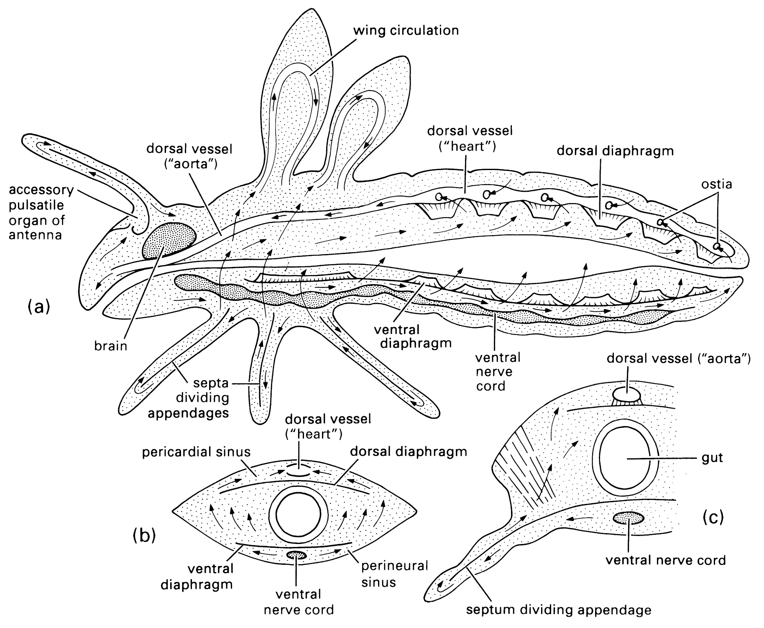
Circulatory system
Convey chemical components and mobile cells around the body
Open
Does not convey O₂ & CO₂ [usually]
Dorsal vessel
peristalsis

Slide 25
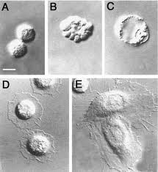
Hemolymph
Sugars (trehalose)
Lipids
Amino acids
Proteins
Storage proteins (hexamerins)
Carrier proteins
Enzymes
Inorganic ions
Hormones
Cryoprotectants
Hemocytes
Phagocytosis
Encapsulation, melanization
Coagulation
Storage and distribution
prohemocyte
plasmocyte
granulocyte

Slide 26
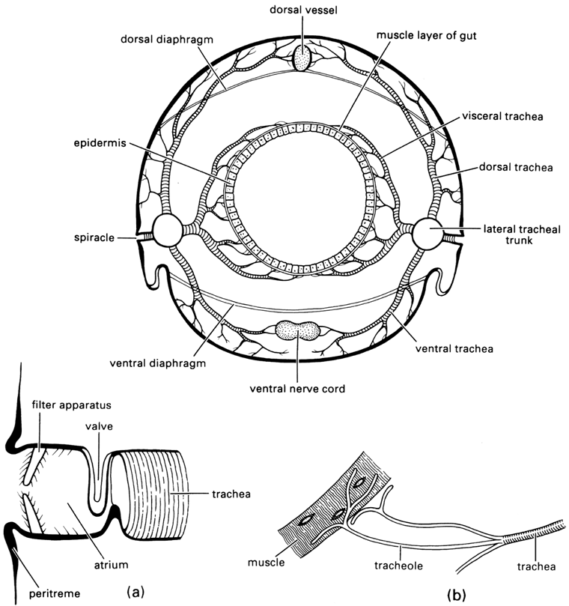
Respiratory system: Trachea
External openings: Spiracles
valved
Trachea are branched
Every cell is in contact with a tracheole (<1μm)
Epidermal; lined with exoskeleton [and shed at molt]
Ridges or rings (Taenidia)
sclerotized exoskeleton
Flexible
Resistant to compression

Slide 27
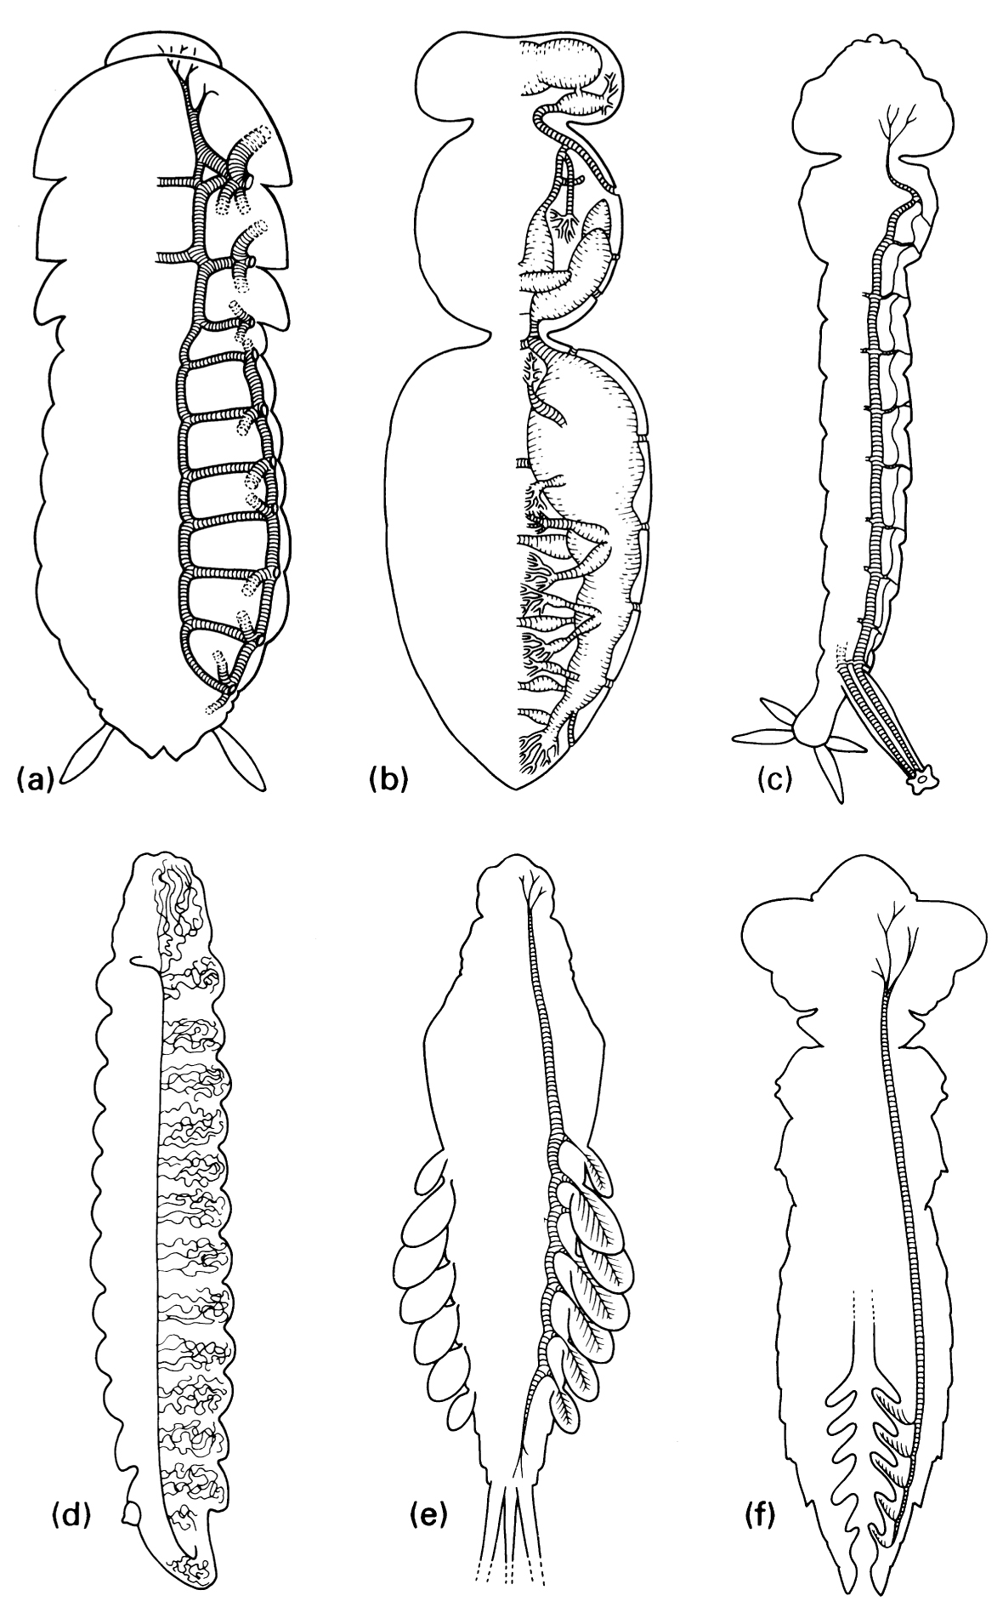
Respiratory system: Trachea
Modifications
Some aquatic insects & endoparasites have closed spiracles
Trachea divide toward the epidermis; form gills
Very Active insects have air sacs that can be contracted and dilated for ventillation

Slide 28
Exchange
Gas exchange vs. water loss
Valve
Discontinuous gas exchange
Air sac ventilation
Active pumping of abdomen, thorax
Anterior spiracles open on inpiration
Posterior spiracles open on expiration
http://www.youtube.com/watch?v=FdQ3d3w6-_o

Slide 29
Digestive system

Slide 30
Gut segments
Foregut
Lined with exoskeleton
Crop [storage]
Proventriculus [grinding]
Midgut
Food wrapped in peritrophic membrane [chitin, protein]
Enzymatic digestion & absorption
Gastric cecae [digestion, symbiotic microorganisms]
Hindgut
Lined with exoskeleton
Absorption of minerals, water
Addition of excretory products from Malpighian tubules

Slide 31
Gut specializations
Carnivore vs. Herbivore
Shorter vs. longer midgut
Solid vs. liquid feeder
More vs. less protection from abrasion (peritrophic membrane)
Liquid feeders: specialized to removing excess water
Hemiptera
Aphids: honey dew (excreted sugars)
Spittle bugs (Cercopidae): foam (excreted water)
Gut symbionts
Digest cellulose, etc.
Provide essential nutrients (sterols, vitamins, pigments)
Bacteria, protozoa, fungi

Slide 32
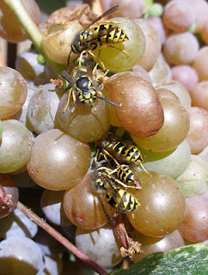
Wasps, yeast, & the real value of biodiversity
Yeast
Saccharomyces cerevisiae
Dispersal?
Overwintering?
S. cerevisiae in social wasps
Queens
Mother-offspring
PNAS paper – Reggienet
http://inkfish.fieldofscience.com/2012/07/enjoy-wine-thank-wasp.html

Slide 33
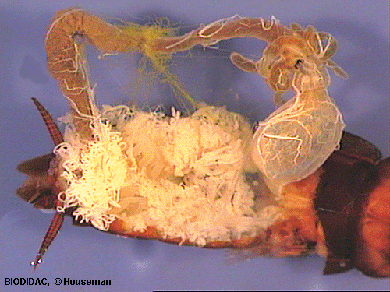
Fat body
Not digestive
Diffuse
Unconnected
Variable
Synthesis, storage, release of lipids, proteins, carbohydrates

Slide 34
Excretory system
Excess N from protein metabolism
Removed by excretory system
Osmoregulation: Management of water balance and ionic (Na, K, Cl) balance
Insects: Malpighian tubules
0 (aphids) to >200 (grasshoppers)
Excretory product
Terrestrial: mostly Uric Acid
Aquatic, some blood feeding: Mostly Ammonia

Slide 35
Malpighian tubules (schematic)

Slide 36
Feces (Frass)
Typically low water content
Malpighian tubules produce fluid isoosmotic to hemolymph
K⁺ actively pumped into tubule
Water follows by osmosis
Amino acids, Nitrogen compounds actively pumped into tubule
Rectum: resorbs water, Cl⁻
concentrates solid material
Undigested food + Excretory products

Slide 37
Reproductive system
Most insects have two sexes
Sexes separate
Exceptions: some Phasmatodea, others are only females

Slide 38
Reproductive systems Female Male

Slide 39
Female reproductive system
Ovaries organized into ovarioles
Linear arrangement of eggs
Spermatheca: stores sperm
May be >1
Eggs fertilized as they are laid
Nurse cells in the ovariole conduct material (Protein, lipid) into egg
Panoistic [no specialized nurse cells]
Telotropic [nurse cells only at anterior (germarium)]
Polytrophic [multiple nurse cells follow egg down ovariole]

Slide 40
Male reproductive system
Most interesting component: accessory gland
Form spermatophore (package holding sperm)
Form spermatophylax (edible part of spermatophore)
Seminal fluids nourish sperm during storage
Induce motility in sperm
Secretes compounds that may manipulate female behavior
Reduce mating receptivity
Nourish female
Stimulate oviposition

