Slide 1
Kairomones
Basically scent of another species
Advantageous for recipient to detect and to respond
Disadvantageous to sender
Prey, host cues
Predator, parasite cues
Pheromones (within species communication) may also be kairomones (e.g., pheromone is cue for a predator)
Tapping into communication channels of prey.

Slide 2
Synomones
Plant chemicals that are produced by herbivore damage
Serve as cues to parasitoids of herbivore
Selection on parasitoid for better host finding
Selection on plant?
Beneficial to plant
Adaptation? Or Exaptation.
Adaptation: selected for its current function
Exaptation: character exists and was selected for some other function, and incidentally as a beneficial function

Slide 3
CO₂ receptors
Biting Diptera cue in on CO₂ and skin chemicals to locate blood meal hosts
Fruit flies (Tephritidae) lay eggs in damaged fruit – cue in on CO₂
Even plant feeding insects use CO₂ as a cue as many parts of plants produce CO₂
Sensed via sensilla on maxillae, palps, antennae

Slide 4
Vision
Three kinds of eyes
Photoreceptor: Rhabdom cell
Nerve cells: Retinula cells
Lenses
Stemmata: simple eyes of larvae
Simple light / dark sensors; detect movement, but probably don’t give an image in the usual sense
Low acuity

Slide 5
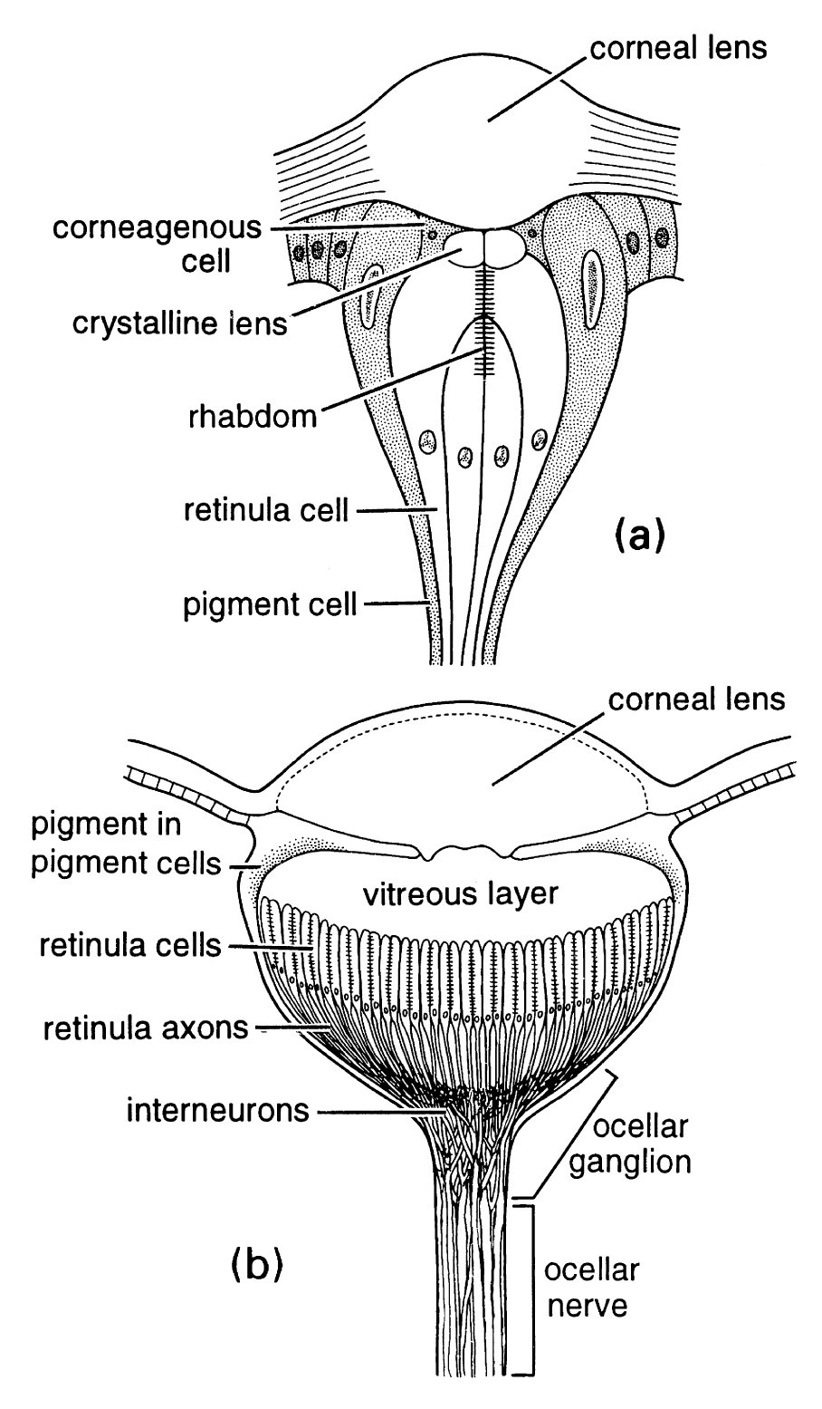
Simple eyes
Stemmata: simple eyes of larvae
Simple light / dark sensors; movement; probably no image
Low acuity
Ocelli: simple eyes of adults, nymphs
Simple light / dark sensors
Not homologous with stemmata
More retinula cells
Operate in low light
Horizon detectors; position

Slide 6
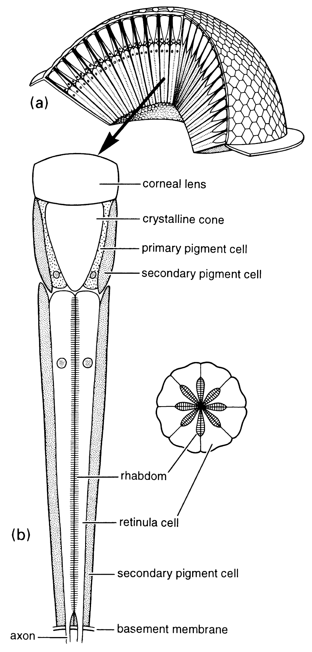
Compound eyes
Present in crustacea
Rival vertebrate, cephalopod eye for sophistication
Unit: Ommatidia
Many ommatidia together provide excellent motion detection
Apposition eye: ommatidia isolated by pigment cells
Best resolution
Superposition eye: light crosses ommatidia
Best sensitivity

Slide 7
Color vision
Up to pentachromatic (contrast with trichromatic vision of the most color sensitive vertebrates)
Insects see ultraviolet, and many plants provide ultraviolet cues to pollinators
Insects often see polarized light
Light organized into wavelengths that have a particular angle
Used by bees to navigate relative to polarized sky light

Slide 8
Systematics: Taxonomy & Phylogeny chapter 7
Systematics: Broadly, the study of organismal diversity and evolutionary relationships
Taxonomy: Classification
Describing, naming, classification of species
Organizing species into larger groups
Kingdom, Phylum, Class, Order, Family, Genus, Species
Phylogenetics: posing and testing hypotheses about evolutionary relationships among organisms
Investigating important characters
Determining distribution of important characters among different taxa

Slide 9
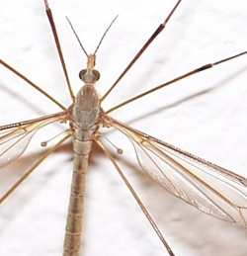
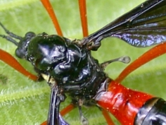
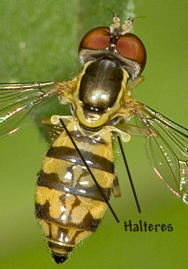
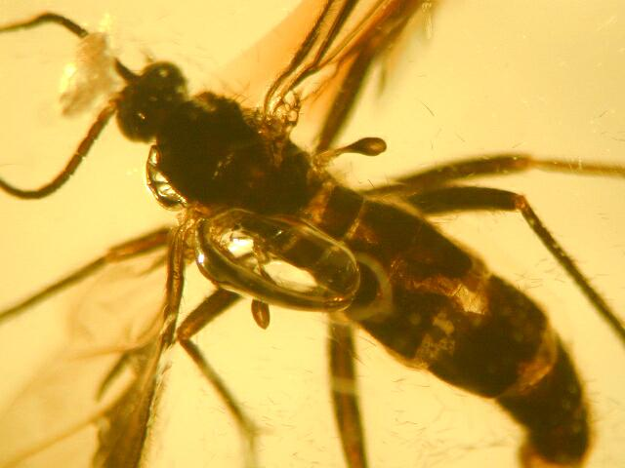
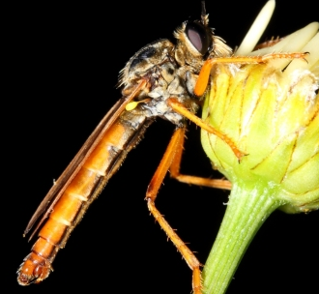
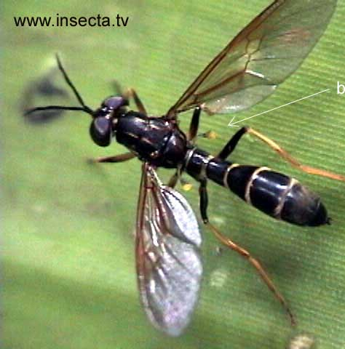
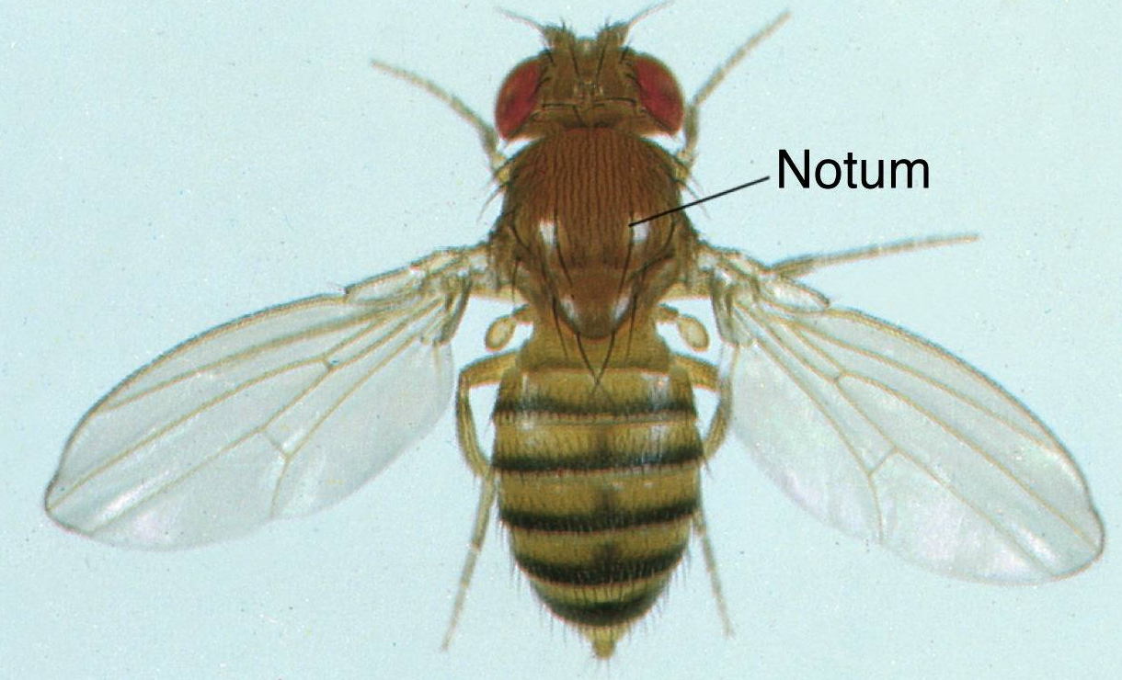
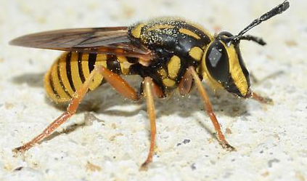
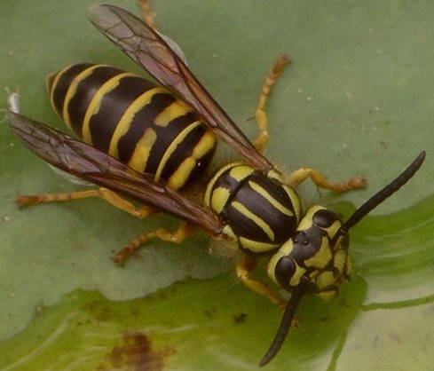
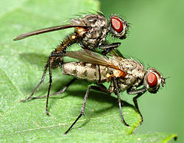
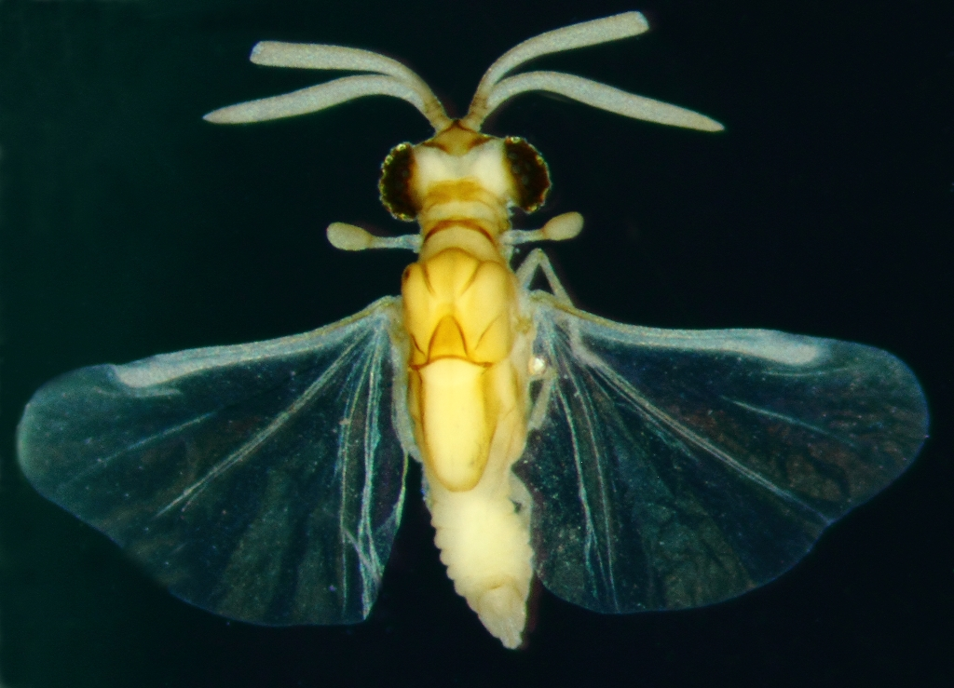
Systematics
Both aspects deal with characters
Features of the taxon
Morphological
Behavioral
Biochemical
Genetic
etc.
Character state: Conditions
Hind wing: Haltere (Y, N)

Slide 10
Characters
Number of states (2, >2)
Qualitative or attribute characters
Quantitative characters
Meristic (integer)
Continuous
Diagnostic

Slide 11
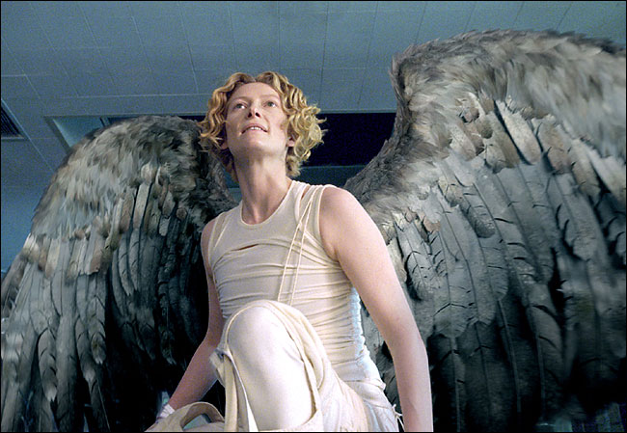
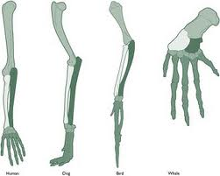
Identifying important characters
Homology: same character through common ancestry
Homoplasy: Similar characters that evolved independently (Convergent, Parallel)
Tests of homology
Similarity [morphology, development, etc.]
Non – conjunction: Two character states in the same organism cannot be homologous
Congruence with other homologies

Slide 12
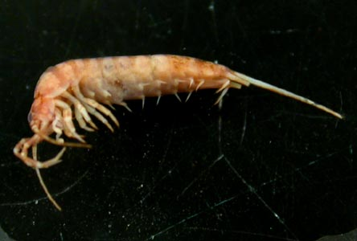
Serial Homology
Metameric organisms
Structures on different segments may be repeated modifications of a character, identically derived
Insect limbs
Myriopod limbs
Vertebrae

Slide 13
Characters
Morphological
Developmental
Molecular characters
Chromosomes (banding)
Electrophoretic mobility of proteins
Sequence of DNA
Mitochondrial
Nuclear
Symbionts
ALL characters subject to homoplasy

Slide 14
Phylogenetic Systematics
Ideally, classification reflects evolutionary history
Systematic methods: Entire course (BSC 488)
Phylogenetic trees
Cladogram – shows branching pattern
Phylogram – shows branching pattern and number of characters
Chronograms – show time via branch length

Slide 15
Cladistics
Resolve branching pattern via shared derived traits
synapomorphies
Semantics:
Primitive vs. Derivative
Ancestral vs. Derivative
Shared ancestral traits:
Sympleisiomorphies
Trees not ladders
Sister groups: Taxa that are closest relatives and arise from the same node

Slide 16
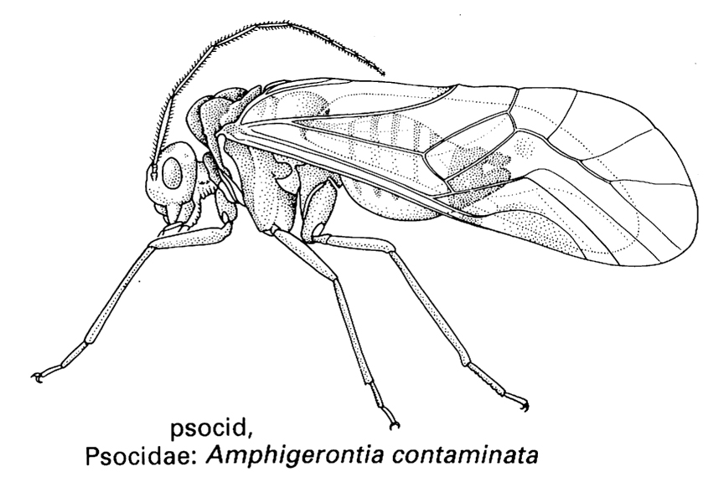
Example: Inferring evolutionary relationships
Yes
No

Slide 17
Cladistic method
Monophyletic groups: All descendants of a single ancestor
Clade
Polyphyletic: group formed from two or more clades
Paraphyletic: Not a clade; Does not include all members of a clade.

Slide 18
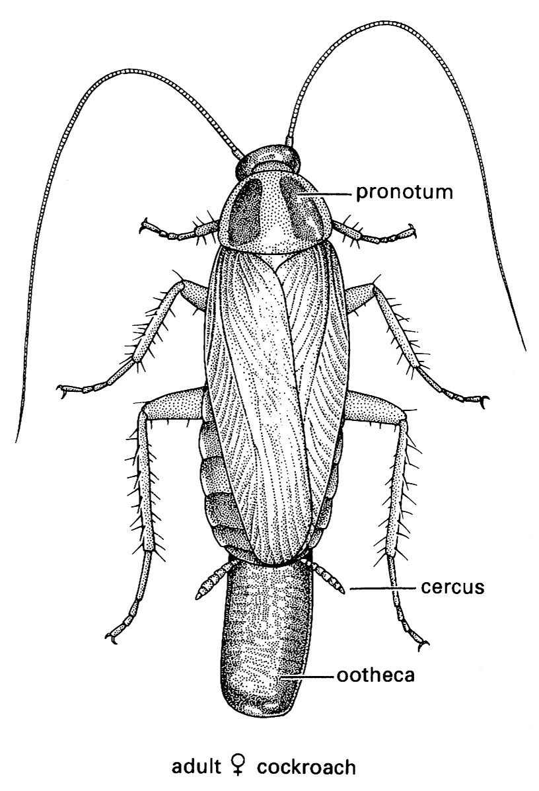
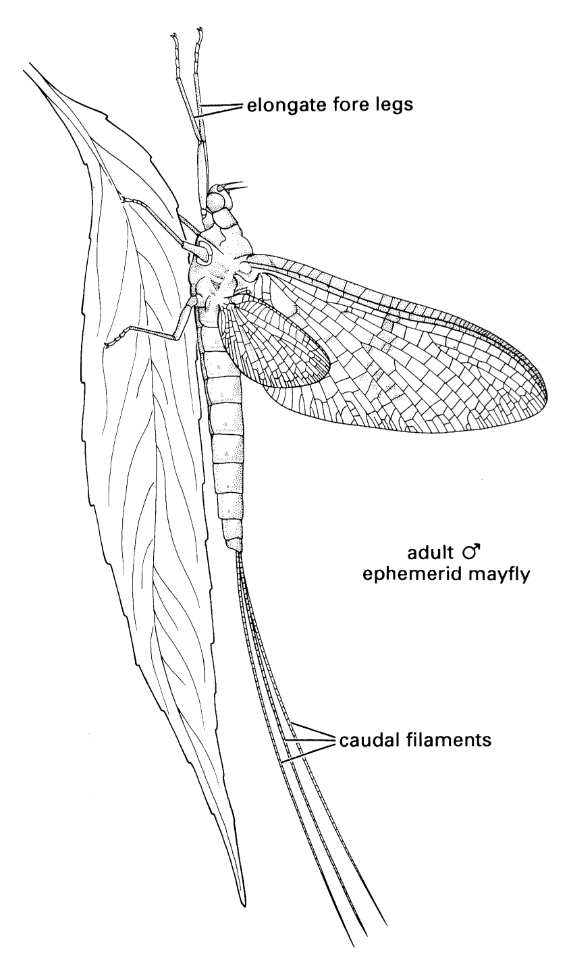
Paleoptera
Neoptera
Pterygota

Slide 19
Molecular phylogenetics
DNA and RNA sequences of 300 – 1000 bp
Compared for substitutions and insertions and deletions
Multiple time scales
More rapid mutation/evolution for recent divergence
Populations within species
Highly conserved genes for more distant divergence
Orders, Phyla, etc.
Aligned base pairs are Characters
Different bases are character states

Slide 20
Species-Base pair matrix
BP→ Species↓ | #1 | #2 | #3 | #4
Species A | A | T | T | T
Species B | A | T | T | T
Species C | A | T | C | T
Species D | A | C | C | T
Outgroup | C | C | C | T
out
C
A & B
D
C3
T3
T2
C2
C1
A1

Slide 21
The problems with molecular data
Obtaining DNA
Preservation of DNA in specimens
Aligning sequences difficult when there are deletions/insertions
Repeat substitutions obscure information
All segments not phylogenetically informative
Gene duplication; analysis of one gene may yield information on phylogeny of that gene only
Failure to amplify DNA

Slide 22
Current classification of insects
Based on combinations of morphology, physiology, molecular characters, others
Uncertainty and continual change
Phylogenetic classification represents a hypothesis
Conjecture about how nature works, and that is testable
Changing classification in response to testing hypothesis
Rules of nomenclature
Unique binomial (Genus species)
Description published, with sufficient detail
Type specimen(s)

Slide 23
Classification of Arthropoda [Box 7.2]
Major changes in classification, postulated phylogeny
Chelicerata, [Insecta, Crustacea, Myriopods]=mandibulata
1960-70’s Polyphyletic Arthropod Hypothesis
Sindie Manton
Recent morphological, fossil, embryological, and molecular data largely refute this hypothesis

Slide 24
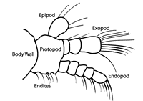
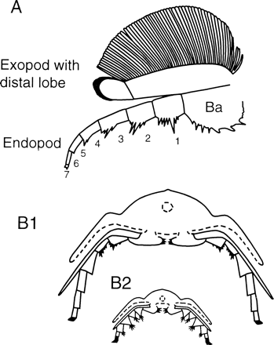
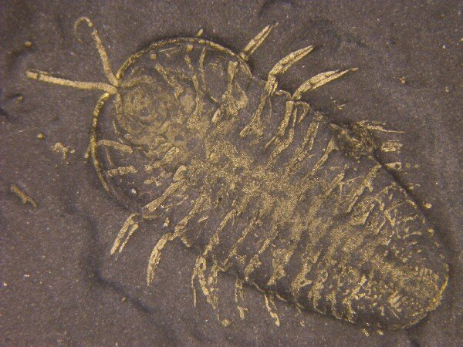
The biramous limb

Slide 25
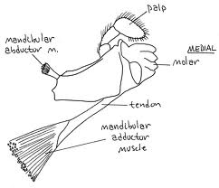
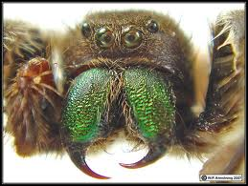
Traditional hypothesis
Mandibulata
Chelicerata
Trilobitomorpha
Crustacea
Myriopoda
Hexapoda
Onycophora

Slide 26
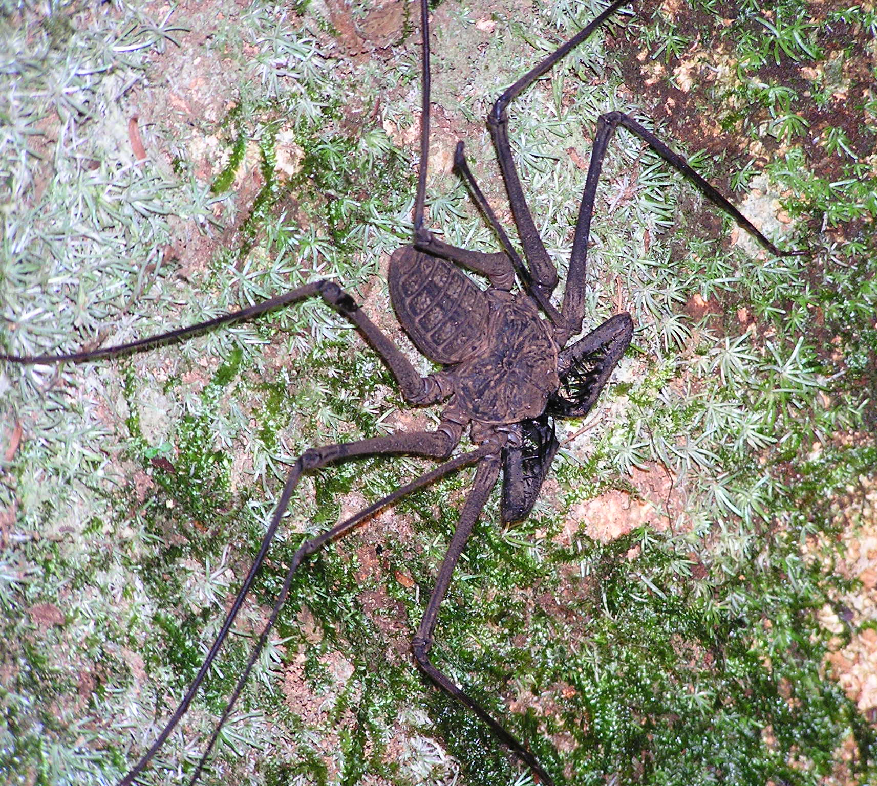
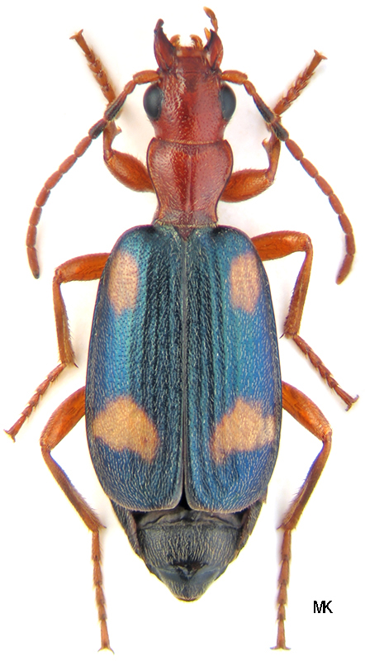
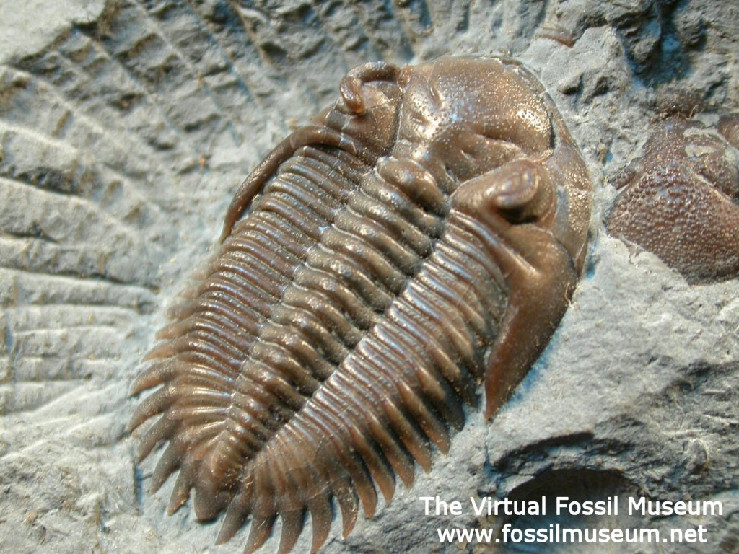
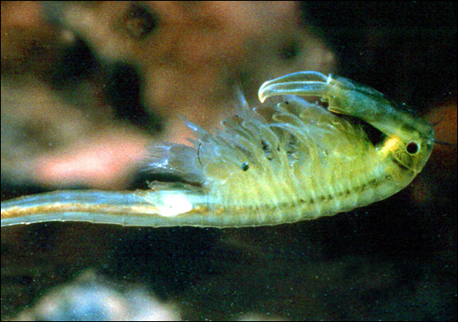
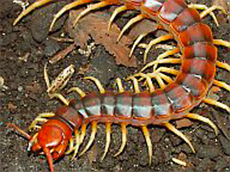
Manton’s polyphyletic hypothesis
Chelicerata
Trilobitomorpha
Crustacea
Myriopoda
Hexapoda
Onycophora
?
Uniramia

Slide 27
Monophyletic hypothesis with Uniramia
Schizoramia
Uniramia
Chelicerata
Trilobitomorpha
Crustacea
Myriopoda
Hexapoda
Onycophora

Slide 28
Monophyletic hypothesis with Atelocerata #1
Schizoramia
Atelocerata
Chelicerata
Crustacea
Myriopoda
Hexapoda
Onycophora

Slide 29
Monophyletic hypothesis with Pancrustacea #1
Mandibulata
Pancrustacea
Chelicerata
Myriopoda
Crustacea
Hexapoda
Onycophora

Slide 30
Monophyletic hypothesis with Pancrustacea #2
Pancrustacea
Chelicerata
Myriopoda
Crustacea
Hexapoda
Onycophora

Slide 31
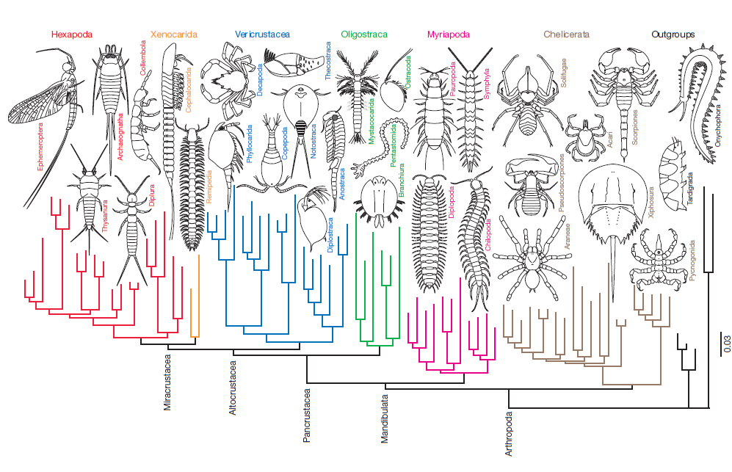
Recent molecular (nuclear coding) phylogeny Regier et al. Nature 2010

Slide 32
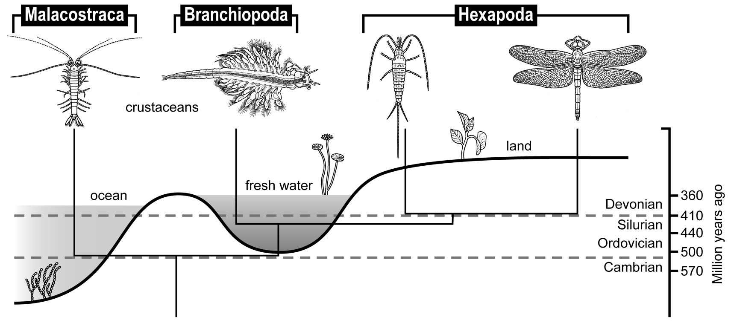
Freshwater origin of insects

Slide 33
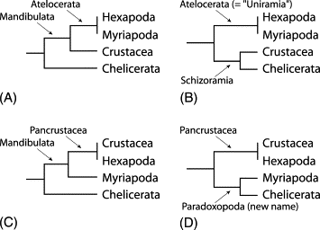
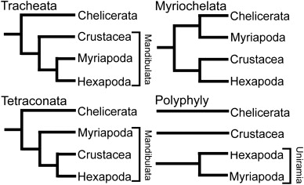

Slide 34
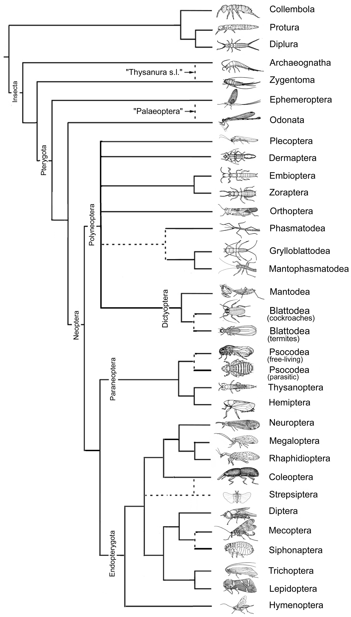
Hexapoda 1

Slide 35
Hexapoda 2

