Slide 1
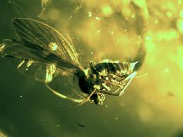
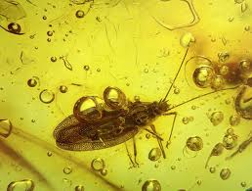
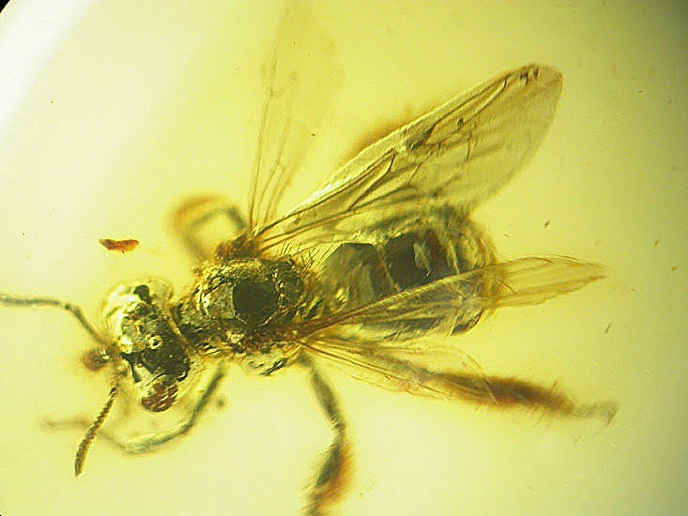
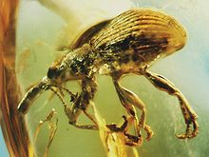
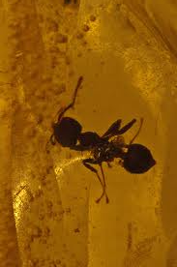
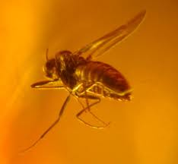
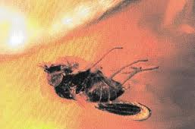
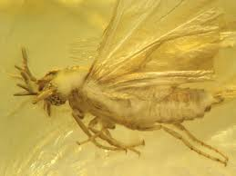
Tertiary Amber
Miocene [17-20 mya]
Ecocene [44 mya]
DNA has been claimed from amber preserved insects
Complete sequences not available
Contamination
Families, genera 10’s of millions of years old
Many species may be ~million years old

Slide 2
Freshwater or Terrestrial origin
Many basal Pterygote groups have freshwater larvae
Entognatha, Apterygote insects strictly terrestrial
Insect origins in freshwater?
Older orders
Ephemeroptera, Odonata, Plecoptera, extinct orders
Adults strictly aerial/terrestrial
Evolution of gills from trachea vs. evolution of trachea from gills

Slide 3
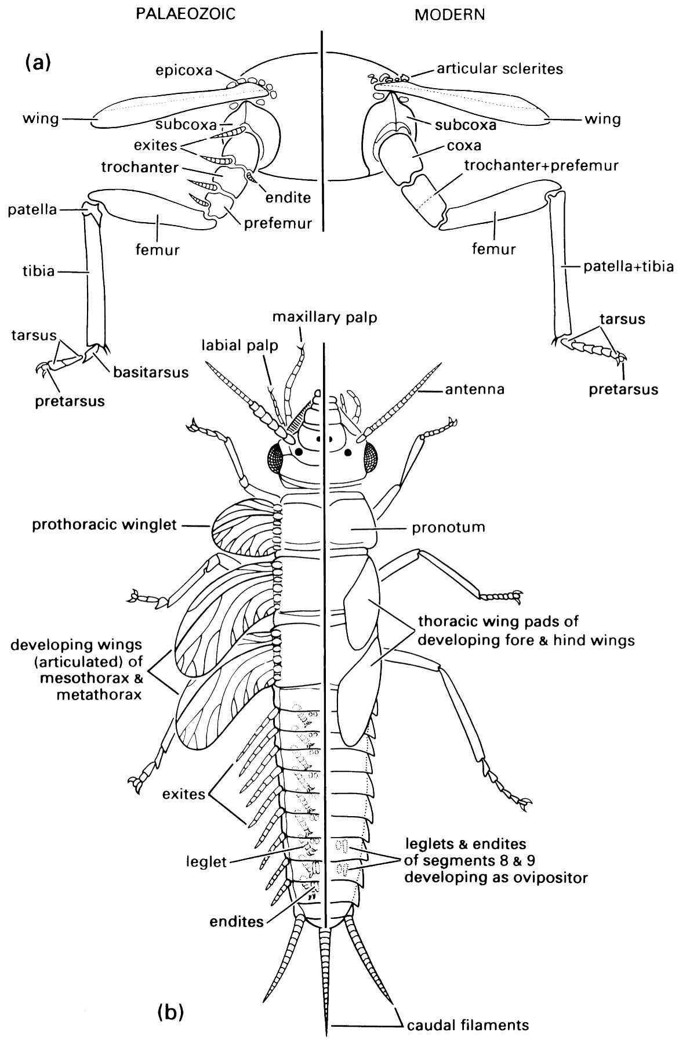
Evolution of wings
Hypotheses for morphological origin
Paranotal lobes
Epicoxa (basal limb segment)
Exite, or exite+endite
Molecular developmental evidence
Gill homolog
Serial homology with abdominal gills
Both wings and gills may have evolved from limb exites
Implies multiple invasions of terrestrial environment
Entognatha
Apterygotes
Pterygotes

Slide 4
Function of proto-wings?
What is selective advantage of protowing?
Hypotheses
Floating
akin to ballooning in spiders
Paragliding
dropping from high point; as in gliding vertebrates
Better leaping
Same hypothesis applied to birds
Surface sailing
Wing as a sail for adults of aquatic insects
Can see this work now

Slide 5
http://www.youtube.com/watch?v=xZ1qrkRfHXY

Slide 6
Evolution of metamorphosis
Evolved in the Permian; adaptive radiation in Mesozoic
Two hypotheses
1. Larvae homologous to nymphal stages of hemimetabolous insects
Pupa represents a new stage
2. Larvae homologous to pronymphal stage
Pronymph: prehatchling or hatchling stage
Morphologically distinct from nymphs
Within egg
Hatches from egg, mobile, membrane encased, feeds on yolk
Unsclerotized; reduced limbs
Molts to first instar nymph
Nymphal stages compressed into the pupa

Slide 7
Mantis pronymph

Slide 8
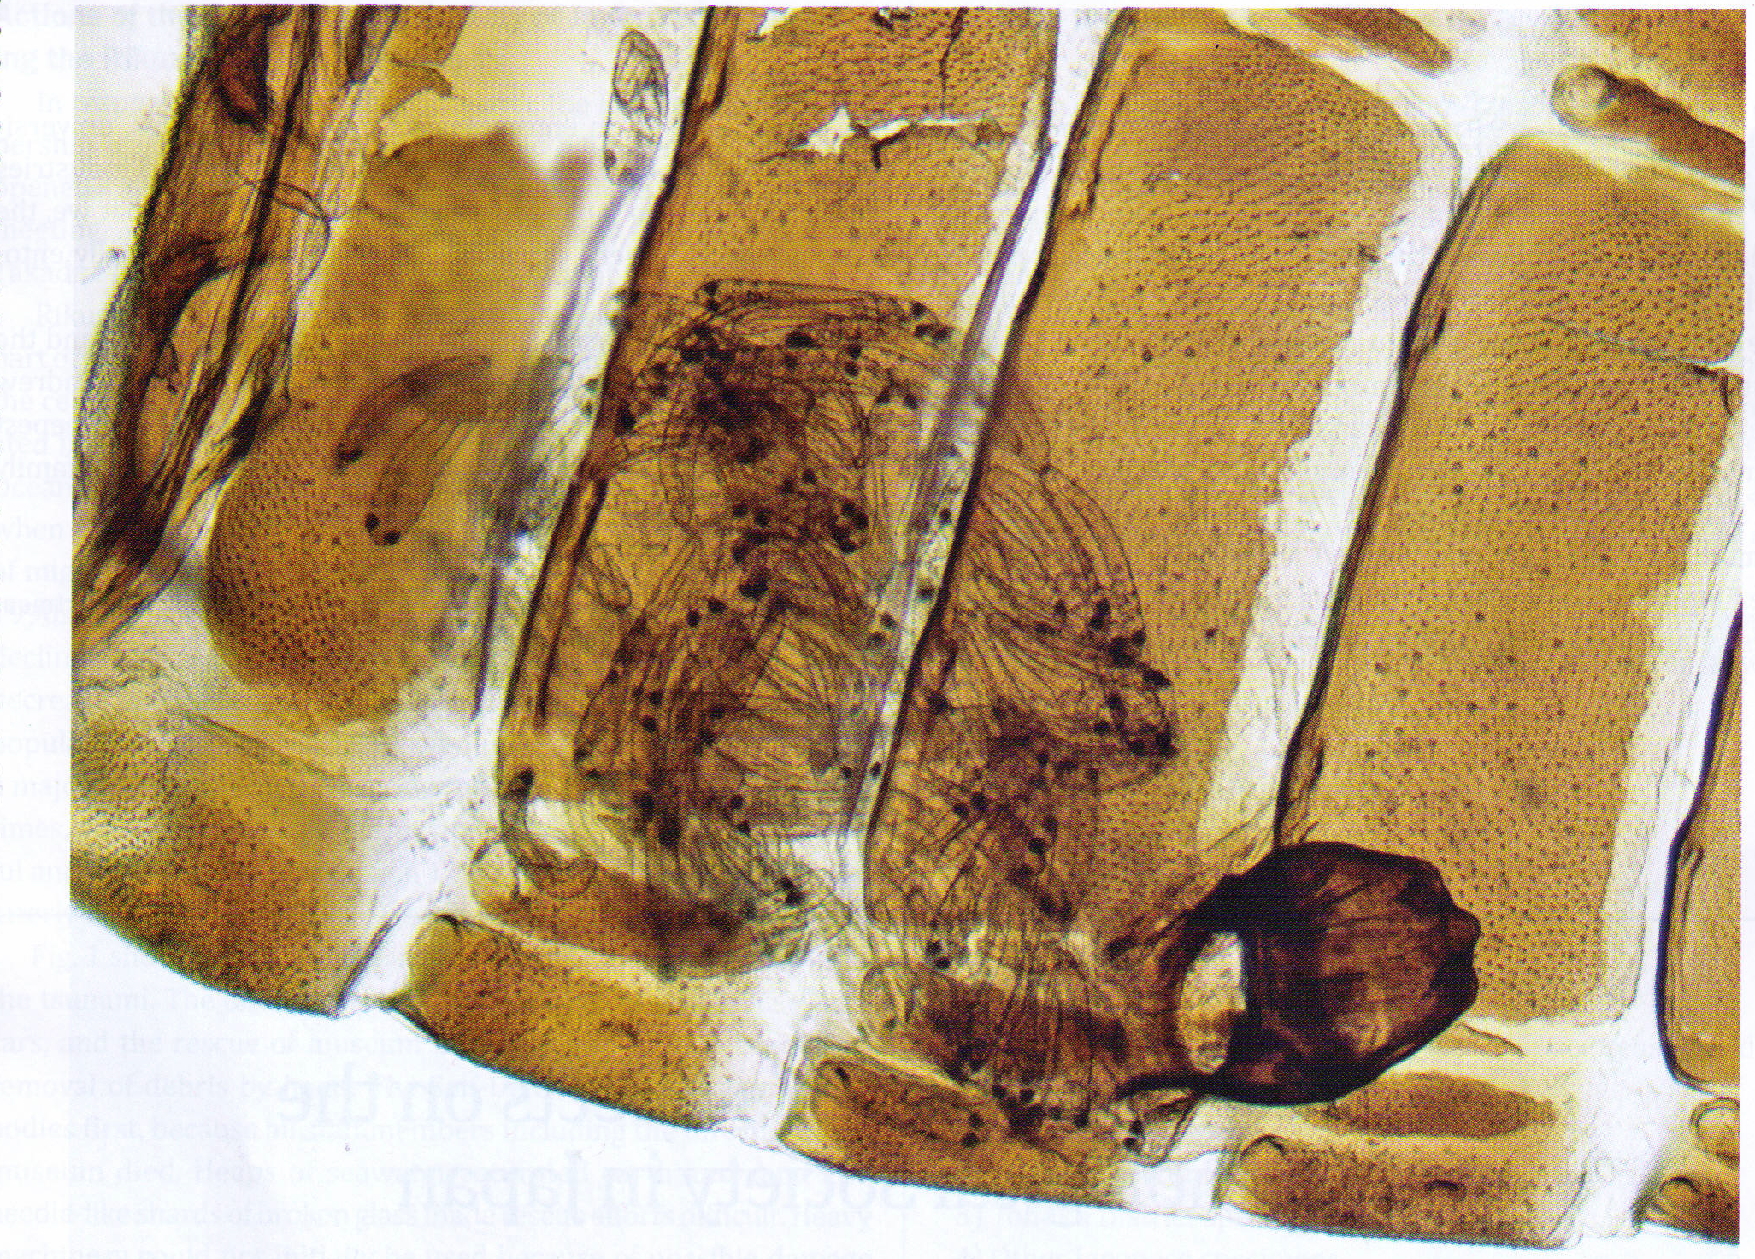
What is it?

Slide 9
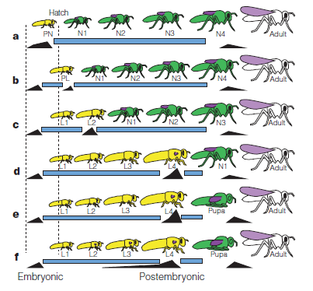
Pronymph hypothesis

Slide 10
Pronymph hypothesis
Evidence
Morphological change from one larval or nymphal stage to another is smooth, linear
Morphological change from pronymph to 1st instar nymph is usually much more pronounced and not continuous with nymphal changes
Pronymphs and larvae lack wing buds
Pronymphs and 1st instar larvae are unsclerotized
Pronymphs and larvae have initially high JH levels that decline toward the next molt; nymphal stages have high JH throughout

Slide 11
How do such changes evolve?
Heterochrony
Evolutionary change in the relative timing of activation or suppression of different developmental pathways; Changes due to changed timing of gene expression
Thought to involve shifting timing of expression of Juvenile hormones and perhaps ecdysteroids.

Slide 12
Insects and Plants _{[Ch. 11]}
Insect association with terrestrial plants dates back to carboniferous
Extinct orders
Seed fern, Gymnosperms, Cycads
Radiation and dominance of flowering plants (Angiosperms) and modern major orders dates to the Cretaceous.
Most primitive flowering plants probably beetle pollinated.
Endopterygotes are both major pollinators and major herbivores

Slide 13
Coevolution of insects and plants
Coevolution:
Reciprocal natural selection between to interacting species; each causing adaptation by the other, and each being selected for counter adaptation
Text distinguishes 2 sub types

Slide 14
Coevolution of insects and plants
Specific / pairwise coevolution: two species
Example: plant defense chemicals and insect ability to detoxify them
Guild / diffuse coevolution: groups of similar species
Example: plant-pollinator morphological evolution
In both cases the implication is that one species or group is the primary agent of selection favoring the traits in question in the other species or group, and vice versa

Slide 15
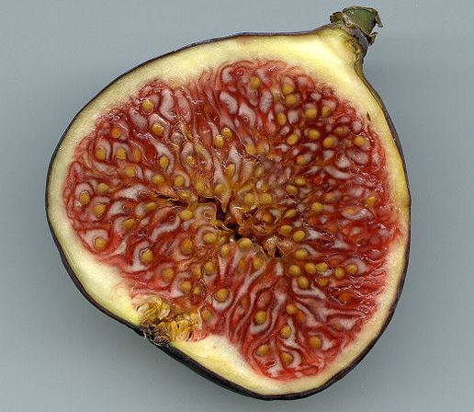
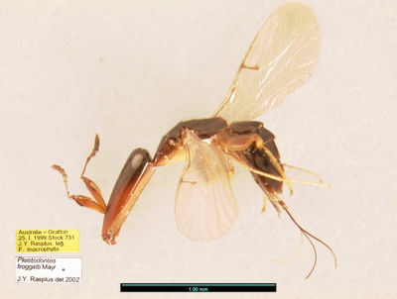
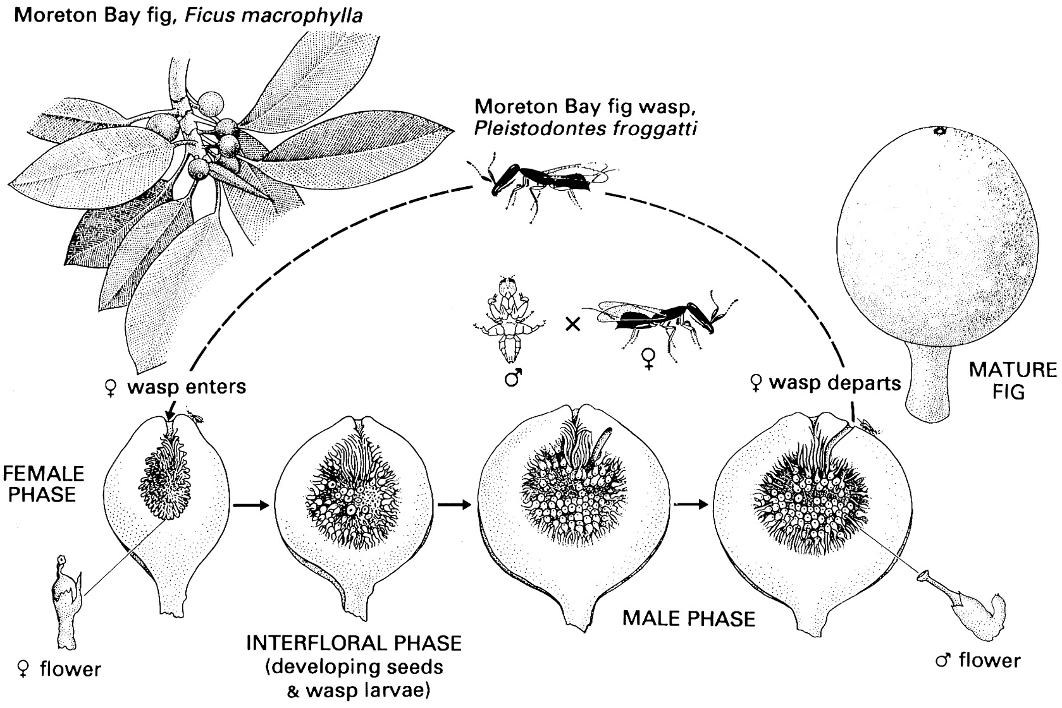
Coevolution: Figs and Fig wasps [box 11.4]

Slide 16
Plant-insect interactions
Herbivory
Pollination
Domatia
Seed dispersal
Concepts
Defenses
Chemical
Structural
Constitutive/Inducible
Mutualistic

Slide 17
Herbivory (Phytophagy)
Plants are (mostly) not a good animal food
Protein
Herbivores may be
Specialized on particular taxa
Monophagous
Oligophagous
Polyphagous
Specialized on particular plant parts
Leaves, shoots
Roots
Seeds
Fruits
Flowers

Slide 18
Why specialize?
Overcoming defenses is costly
Overcoming multiple defenses is more costly
No defense is 100% effective
Defenses that deter a large fraction of potential herbivores yield plant a benefit
Antagonistic coevolution as an arms race
The race isn’t between the plant and the insect

Slide 19
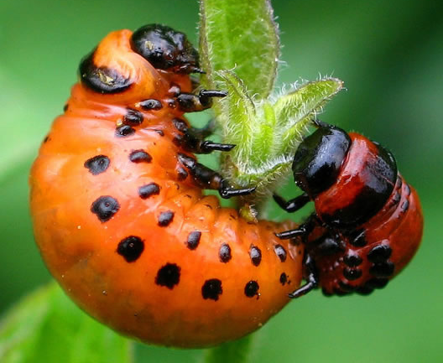
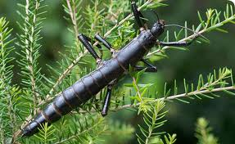
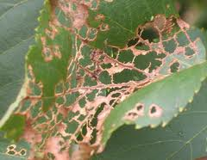
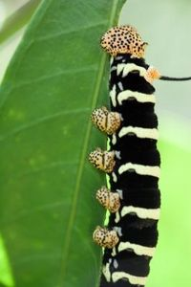
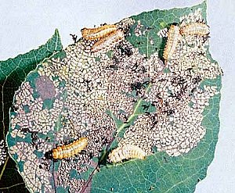
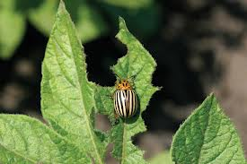
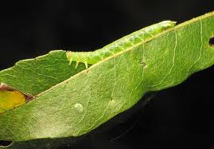
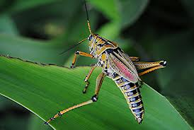
Leaf/shoot chewing

Slide 20
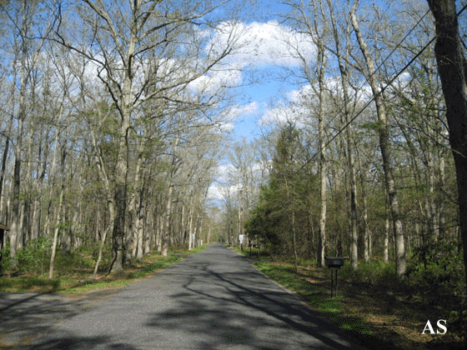
Leaf / shoot chewing
Loss of photosynthetic tissue
Accentuated if young leaves are targets
Defoliation and insect outbreaks
Caterpillars [gypsy moth Lymantria dispar]

Slide 21
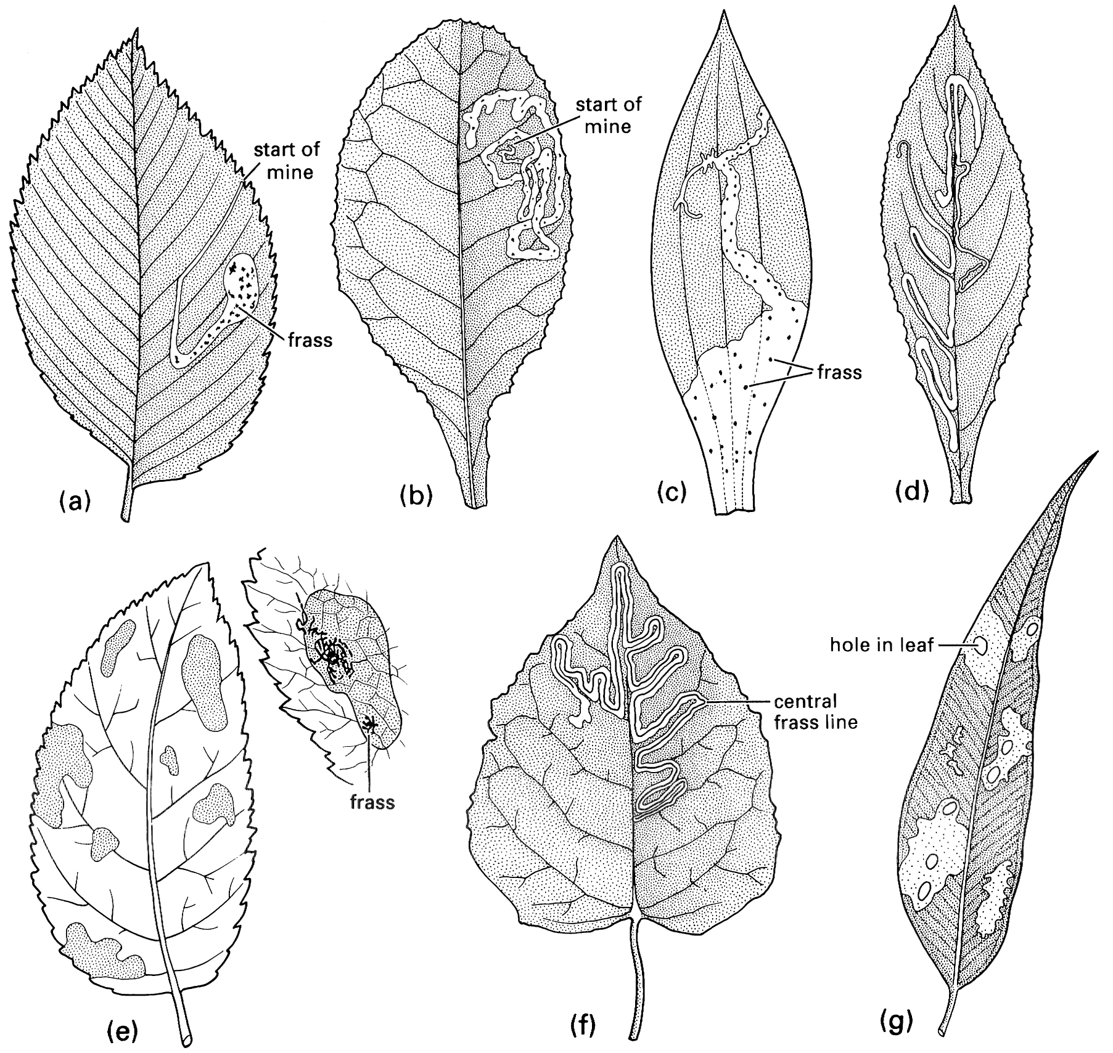
Leaf / Stem / Root mining
Chewing, but from inside the plant
Diptera, Lepidoptera, Coleoptera, Hymenoptera
Larvae do the mining
Advantages for the insect
Evades epidermis of plant
Larva less exposed to desiccation
Larva less exposed to enemies (however...)
May feed on most digestible / nutritious tissue

Slide 22
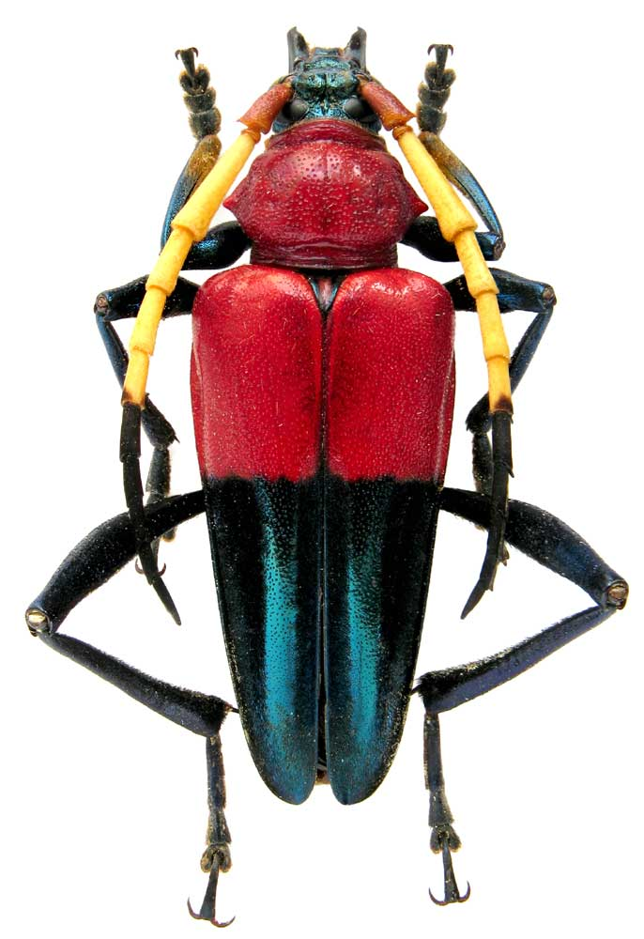
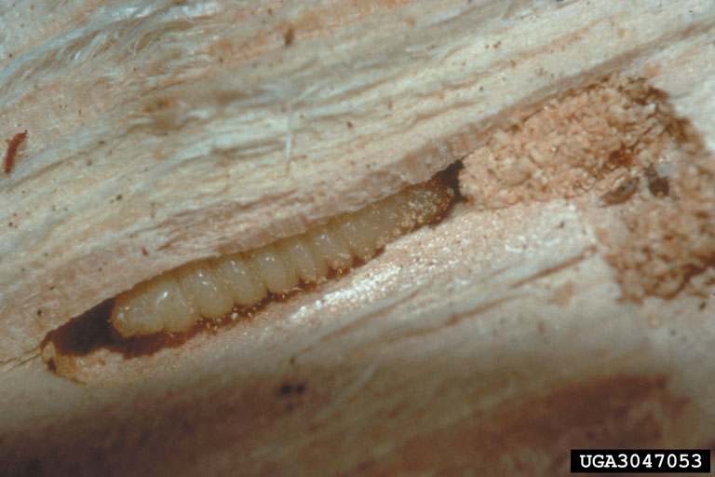
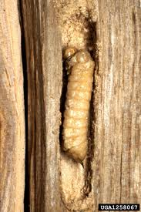
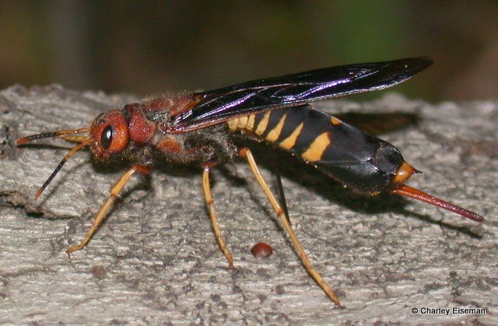
Wood boring
Coleoptera
Cerambycidae, Curculionidae, Buprestidae, Curculionidae
Box 11.2
Lepidoptera
Hepialidae, Cossidae
Hymenoptera
Siricidae
May feed on Phloem, Xylem, bark, Heartwood
May require mutualistic fungus

Slide 23
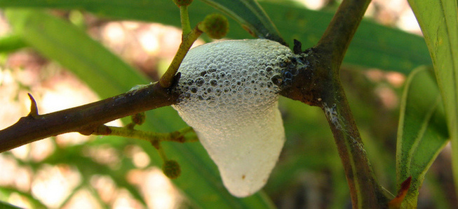
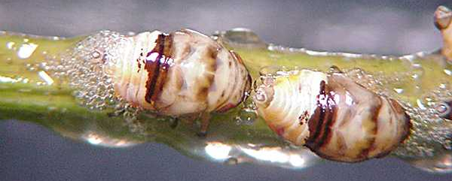
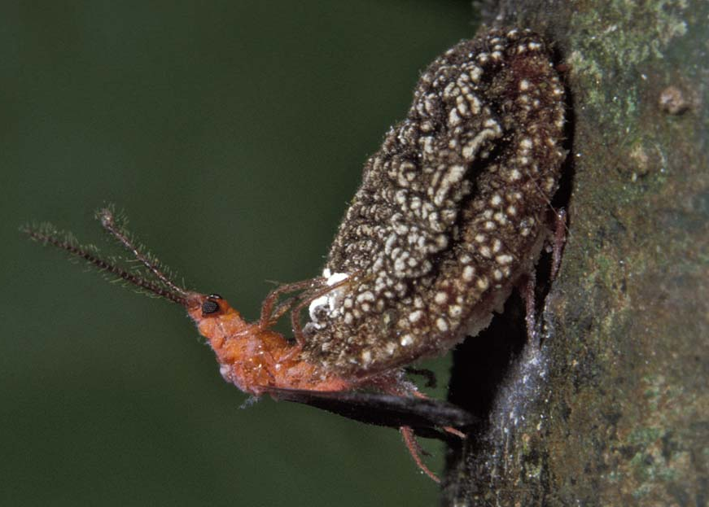
Plant sucking insects
Hemiptera
Mainly Phloem feeding (Aphids, Scale insects, Membracidae, Cicadellidae)
Some Xylem feeding (Cecopidae, Cicadidae)
Parenchyma
Many Heteroptera (Miridae, Pentatomidae, Coreidae)
Lytic saliva
Aphids, Membracids, others produce honeydew
Thysanoptera
Vectors of plant viruses

Slide 24
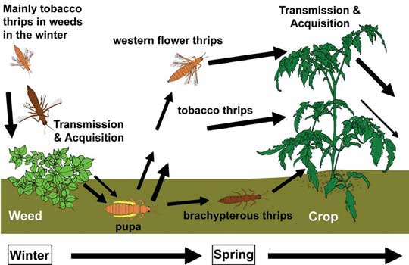
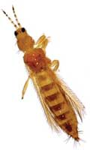
Tospovirus transmission by Thysanoptera
Western Flower Thrips
Frankliniella occidentalis

Slide 25
Gall makers
Galls: proliferation of tissue of the plant caused by invading parasite
Insect gall makers attack leaves, buds, stems
May cause cell enlargement or cell proliferation
Insect usually feeds on gall
Proliferating parenchyma tissue may be more nutritious than normal tissue
Affords some protection for the insect (however...)
Diptera, Hymenoptera, Hemiptera
Also some Thysanoptera, Coleoptera, Lepidoptera

Slide 26
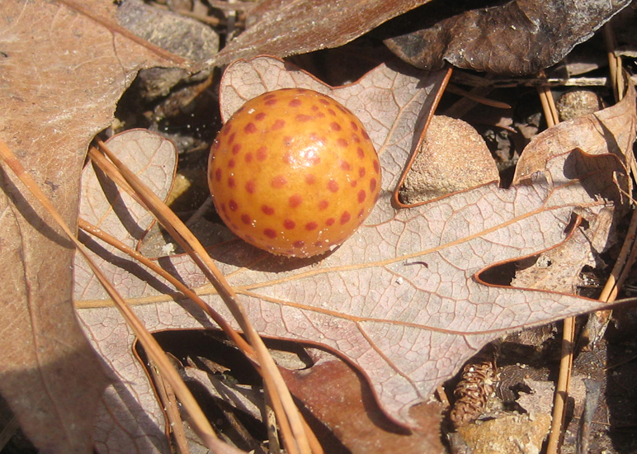
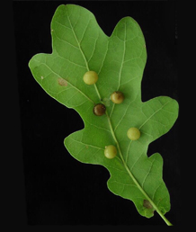
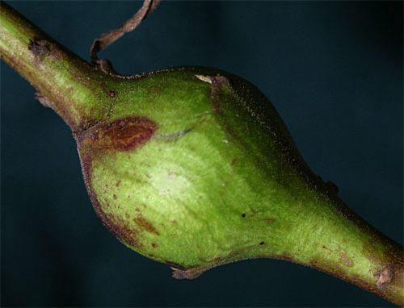
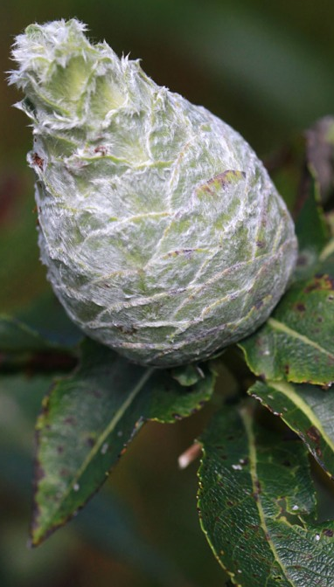
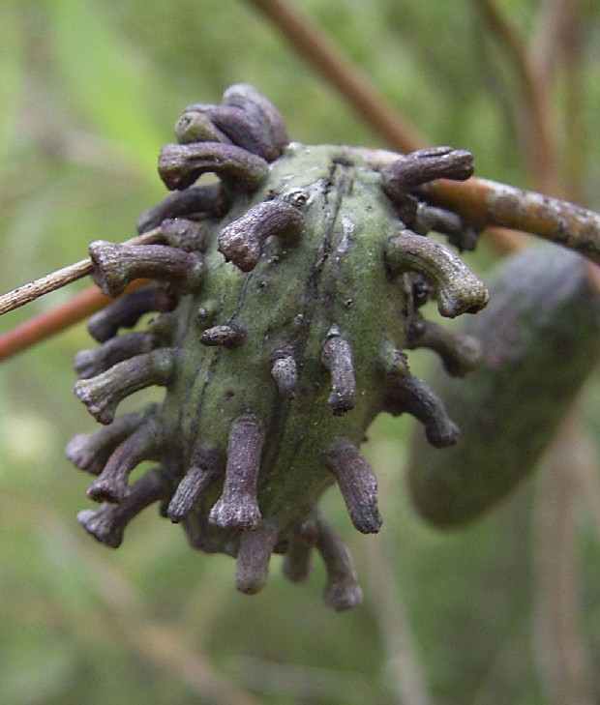
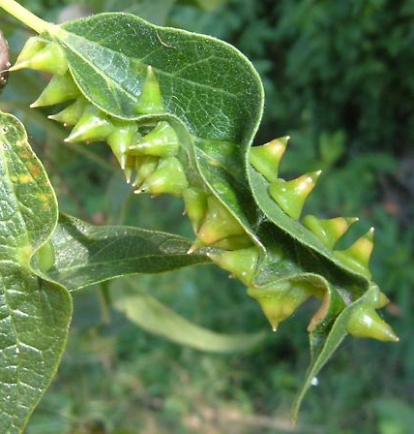
Hymenoptera
Diptera
Hemiptera (Scale)

Slide 27
Evolution of gall making
Probably evolved from mining / boring habit
Gall induction
Mechanical – gall is a response to damage
Chemical/hormonal – plant hormones, amino acids, secondary compounds (or mimics) in insect saliva
Genetic elements – viruses, plasmids, transposons may be transferred from insect to plant, and induce gall

Slide 28
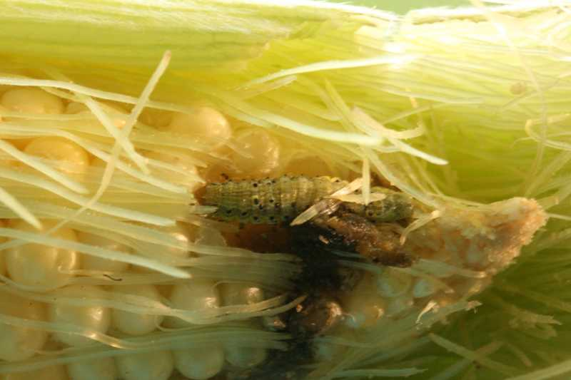
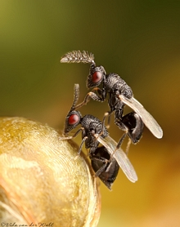
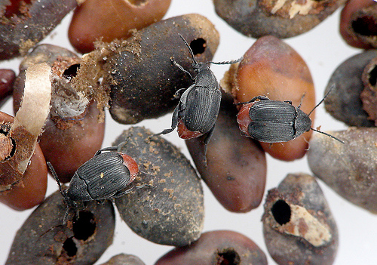
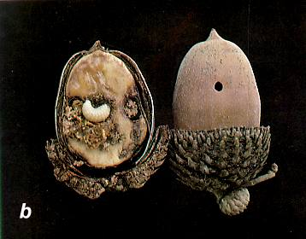
Seed predation
Insects are a major source of mortality for seeds
Hymenoptera (ants)
Hemiptera (Coreidae, Pyrrhocoridae, Lygaeidae)
Coleoptera (Curculionidae, Chrysomelidae – Bruchid group)
Lepidoptera (Gelechiidae, Oecophoridae, Noctuidae)
Hymenoptera (Eurytomidae)
Parasitoid or Predatory habit
Ants may also be dispersers of seeds

Slide 29
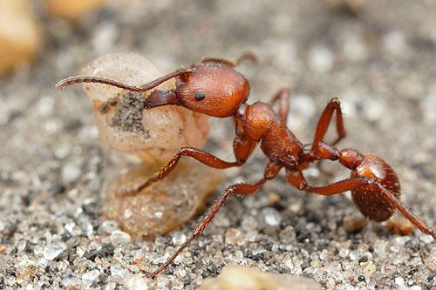
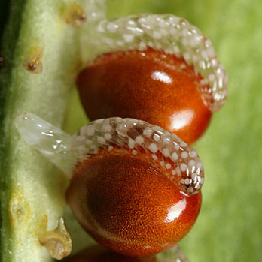
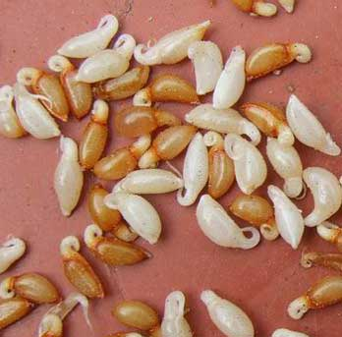
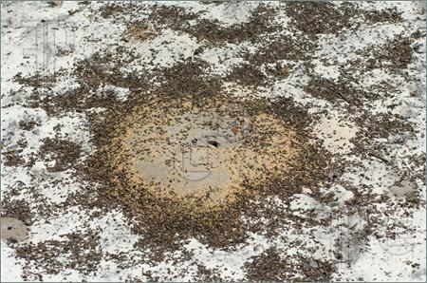
Ants and seeds (Myrmecochory)
Harvester ants
Pogonomyrmex, Veromessor
Specialists on seeds
Violets (Violaceae)
Formica
Seeds of ant plants typically have elaiosomes
Evolved from seed predation
Coevolution? Very non-specific

Slide 30
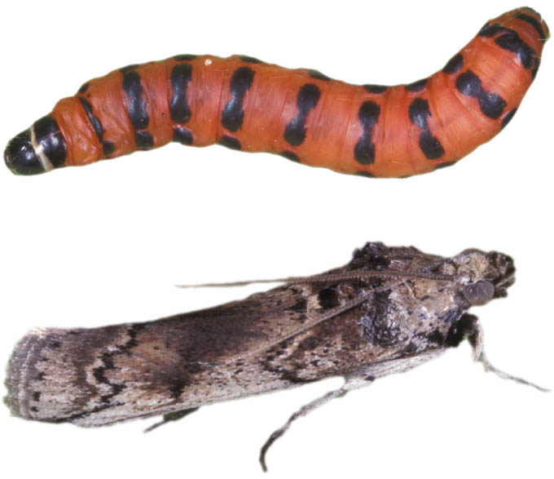
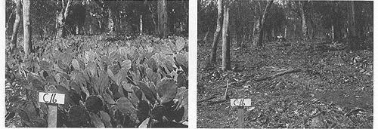
Plant feeding insects and biological control
Opuntia and Cactoblastis cactorum
Australia, South Africa, S. Florida
C. cactorum from S. America
Success in Australia, S. Africa
Introduced to Caribbean; threatening native cacti

Slide 31
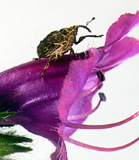
Plant feeding insects and biological control
Patterson’s curse (Echium plantaginium)
Mediterranean, introduced to Australia, North America
Toxic to grazing animals (but good for bees)
CSIRO began introductions of 6 biological control agents in 1970s
5 beetles, 1 moth
Curculionidae:
Mogulones larvatus [shoot]
Mogulones geographicus [root]

Slide 32
Other examples
Salvinia & Cyrtobagous [box 11.3]
Purple loostrife
Galerucella pusilla -- a leaf-feeding beetle
Galerucella calmariensis -- a leaf-feeding beetle
Hylobius transversovittatus -- a root-mining weevil
Vermont: 90% reduction
North Dakota: Nontarget effects of urban mosquito control

Slide 33
Biological control theory
Classical
introduce natural enemies that become established
create lower equilibrium population size (K) for the target species
Usually nonnative species
Populations of target and enemy both persist
Clewley, et al. 2012.The effectiveness of classical biological control of invasive plants. J. Applied Ecol. http://onlinelibrary.wiley.com/doi/10.1111/j.1365-2664.2012.02209.x/pdf
Augmentative
Introduce large numbers of natural enemies
Devastate target population over the short term
May be nonnative
Persistence of enemies not critical
Conservation
create environments that foster natural enemy populations
Vegetation management, tillage, buffer strips
Emphasis on native enemies

